Slide 1
An Introduction to the JPL Flight Software Product Line
Dr. Kathryn Anne Weiss
FSW Core Cognizant Engineer
December 11, 2013

Slide 2
JPL FSW Product Line
Product Line Motivation and Objectives
What is the JPL Flight Software Product Line?
Product Line Development and Evolution
Software Architecture Overview
Summary

Slide 3
The Team
Benjamin Cichy
Dr. Dan Gaines
Dr. Ed Gamble
Dee Leang
Jeff Levison
Dr. Rajeev Joshi
Lloyd Manglapus
Steve Scandore
Igor Uchenik

Slide 4
Background
Our heritage flight software is comprised of tightly coupled modules integrated into a monolithic delivery for a specific mission and flight system with limited reuse across projects
Since Pathfinder, in-house flight projects have followed a “clone and own” model of flight software reuse, inheriting a code base from a previous project and adapting the code to suit the project’s specific needs
More recently, the Reference Bus was established to develop implementation templates for in-house or mixed mode mission implementation at competitive prices
The different Reference Bus configurations that arose let to a desire for a coherent approach for associated FSW implementations, with built-in flexibility for future configurations

Slide 5
Project Objectives
Reference Bus commissioned the development of a JPL FSW Product Line by Section 349 in FY13
Project Objectives:
Facilitate the delivery of an integrated avionics and FSW product to projects
Significantly improve reuse potential of flight software while leveraging existing flight-proven implementation approaches and assets
Reduce start-up time and costs for flight software infrastructure development on a project or task
Facilitate software technology infusion that enhances applicability and/or reliability of flight software assets and maintains viability of the Product Line
Facilitate a collaborative FSW development environment, where Line and Project can be organized around distributed development and delivery of FSW capabilities

Slide 6
What is the JPL Flight Software Product Line?
The Product Line is…
A collection of reusable FSW assets available for deployment on a wide range of flight projects
e.g. Discovery, New Frontiers, flagship, small scale satellites
A FSW product development strategy that includes architectural guidelines and well-defined interfaces so that projects can integrate mission-specific FSW into existing assets to create a complete FSW system
A management approach whereby the Line Organization owns the Product Line assets and oversees proposed use, deployment, maintenance, and evolution
Provides configuration control of Product Line assets and reviews/approves changes
Defines the processes for asset deployment and overall FSW system integration

Slide 7
Benefits of the FSW Product Line
Proposal teams leverage assets to meet a FSW system specification and cost
FSW costs decrease as asset base grows over time
The FSW line manages asset base
Minimizes differentiation by projects and reducing overall implementation costs
Coherent approach to supporting different Reference Bus configurations
The architecture standardizes interfaces and patterns for subsystem organizations (ex. G&C, Navigation, Mobility) to deliver FSW
Enables distributed FSW development
An iterative approach to asset development
Supports technology infusion and the evolving strategic vision of the line
Aligns with the Reference Bus product delivery paradigm

Slide 8
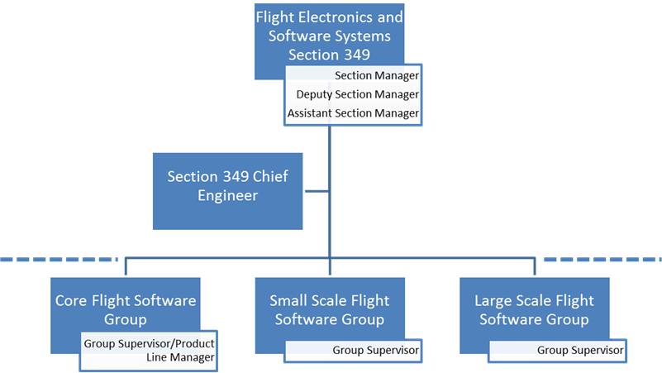
Section 349 Organization
Core FSW Group maintains the Product Line and hosts the development team
Large and Small Scale FSW groups leverage reusable assets deployed by the Core Group
Core group strengthens its asset base with contributions and feedback from the Large and Small Scale groups
Section 349 responsibilities
Utilize FSW Product Line assets in applicable JPL proposals
Deploy Product Line assets to project customers
Manage all updates required by projects using direct funds
Solicit funds via proposals to support strategic multi-mission capabilities outlined in technology roadmap
Establish process for continuous product improvement

Slide 9
Architecture Objectives
Reduce Complexity
Reusability
Significantly improve reuse potential of the standard portions of FSW
Leverage existing flight-proven implementation approaches and assets
Reduce the FSW start-up time and costs on a project or task
Reliability & Predictability
Deterministic execution → A property of a FSW System such that given a set of inputs to a starting system state, the resulting output and ending system state will be predictably the same
Robust execution of critical software functions in the presence of faults in non-critical and non-interacting-critical software
Testability
Reduce the V&V burden of projects
Availability
Reconfiguration of the system to load and execute only the minimum set of critical software functions
Maintainability, in particular Extensibility and Modifiability
Support for phased development, delivery, and integration of spacecraft system functionality, e.g. EDL software for a Mars mission does not need to be on-board the spacecraft at launch and can therefore be phased into the FSW System at a later time
Distributed development of FSW, i.e. delivery of portions of the FSW system by different organizations and / or institutions
Facilitate software technology infusion that enhances applicability and/or reliability of flight software assets and maintains viability of the Product Line
Portability
Portability of FSW to multiple different platforms, e.g. Reference Bus, Broadreach, etc.
Support for software executing in different partitions, CPU cores, or processors

Slide 10
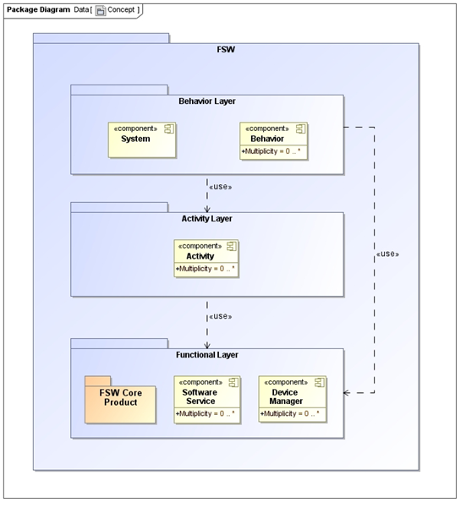
Context – The JPL FSW Product Line
A FSW System consists of a FSW Core + Apps
Component-Based Architecture provides architectural separation of fundamentally different concerns, e.g. mission-critical vs. non-critical functions
Improved reliability
Increased development flexibility
Improved reusability
The types of Apps are Functions (Software Services and Device Managers), Activities, and Behaviors
Function → A discrete action required to achieve spacecraft objectives
Activity → A collection of functions required to execute in a particular order to achieve spacecraft objectives; started by the Ground or by a Behavior and have a defined duration
Behavior → A collection of activities scheduled autonomously to achieve mission goals

Slide 11
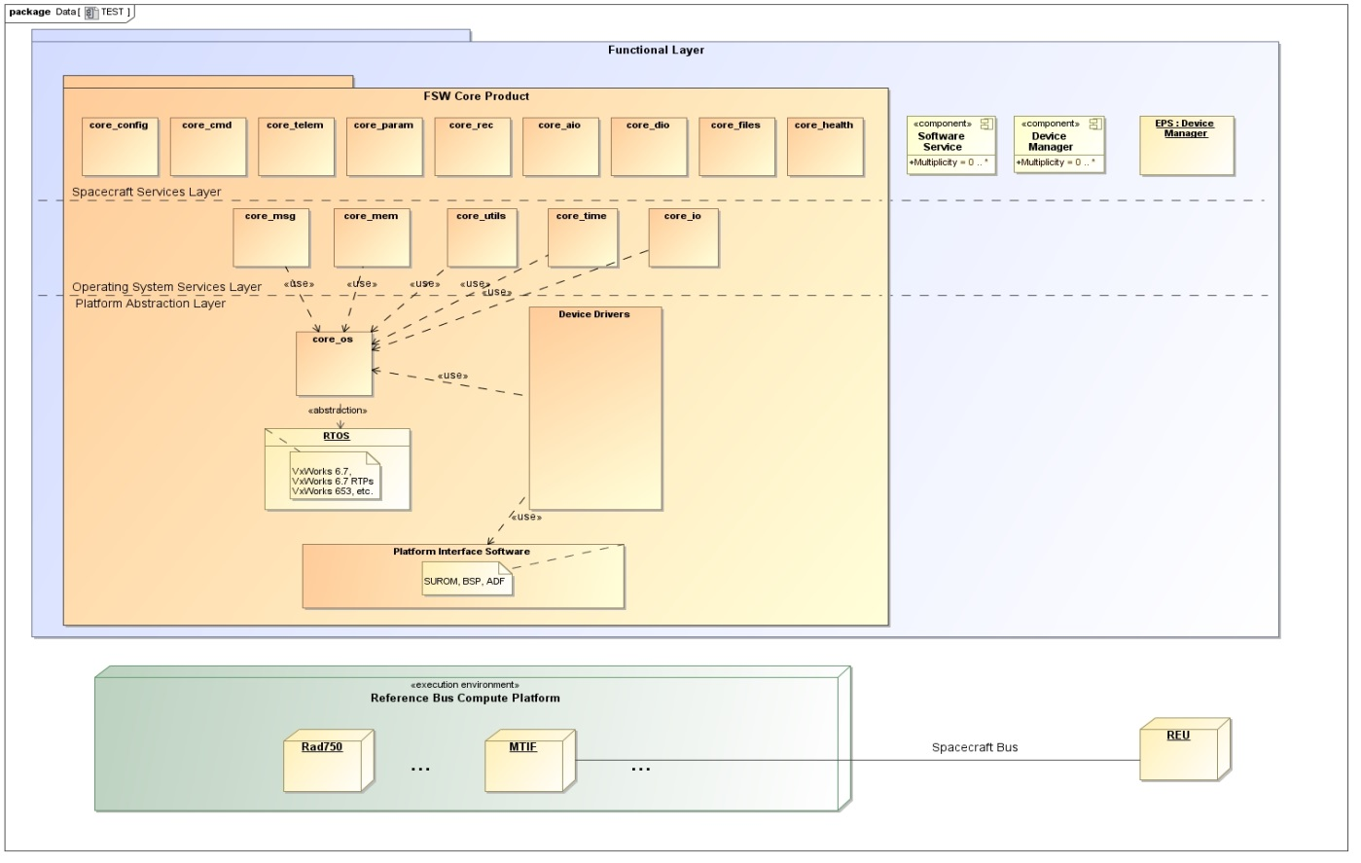
Conceptual Architecture: The Core Component
DEFINITIONS:
Core → The component that interfaces directly with the underlying computer platform; it provides an execution interface to other components.
The Core Component provides (1) the functionality necessary to support the execution of a component on the target compute element as well as (2) the interfaces to key spacecraft capabilities including command, telemetry, timekeeping, reliable data storage, and basic input / output.
The Core Component abstracts the underlying compute platform from the remaining apps
Core Component Functional Domains:
Configuration Management
Command
Telemetry – EHA, EVR, Data Products
File System
Parameters
Intra- and Inter-Component Messaging
Operating System and Computer Hardware Abstraction
Timekeeping
Utilities (i.e. math, compression, bit/byte ops, etc.)
Health
IO

Slide 12
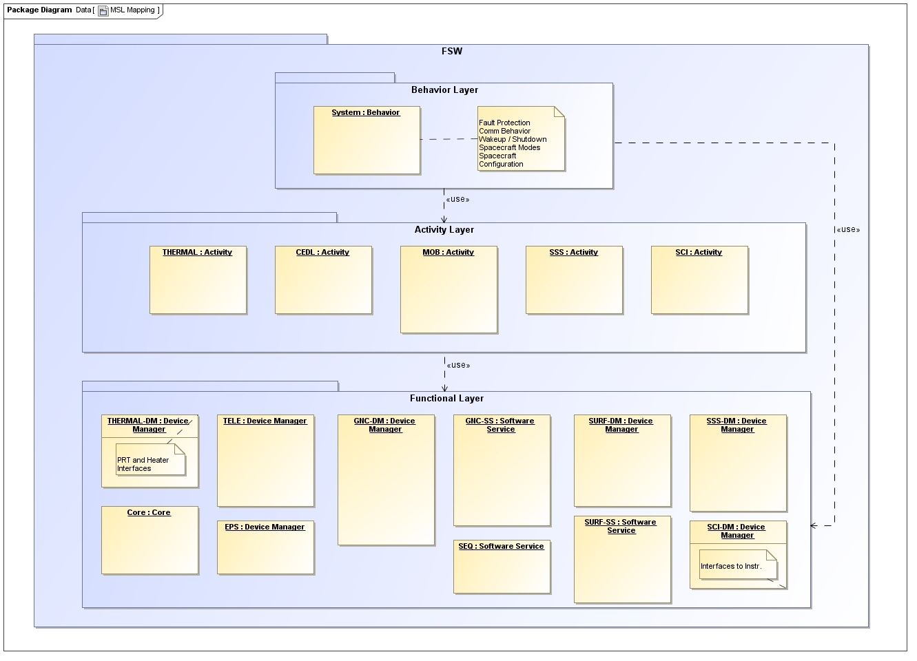
Conceptual Architecture: MSL

Slide 13
Structural View: Components

Slide 14
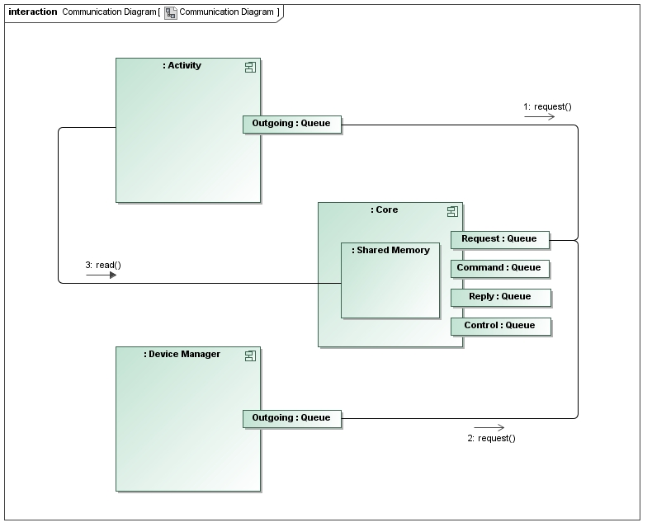
Structural View: Connectors
ID
Destination
Payload
Reply
ID
Destination
Payload
Reply
Components only communicate via (1) asynchronous non-blocking messages from a single sender to a single receiver or (2) synchronous access to single-writer shared memory
Notes:
Rationale: Communication between a single sender and a single receiver enables guarantees about message receipt and status replies indicating the success or failure of that message. In the systems we build, closed loop commanding and ordered operations are necessities, and this type messaging supports these requirements. Synchronous access to single-writer shared memory regions is the only type of synchronous communication allowed. Since synchronous data access can lead to inconsistencies between components, especially during state transitions, this type of communication should be limited. Furthermore, synchronous data access between partitions is not allowed in strict space-partitioned architectures and would require special handling if allowed.

Slide 15
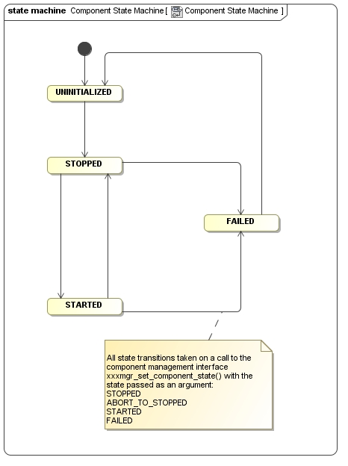
Structural View: Component State Machine
All components implement a standard component state machine.
Enables predictable behavior
Supports reasoning about system state
Component State Characteristics
 | UNINITIALIZED | STOPPED | STARTED | FAILED
Non-volatile state | uninitialized | restored | diverged (ie same as restored state or updated) | diverged (ie same as restored state or updated)
Volatile state | uninitialized | initialized to known boot state | diverged (ie same as boot state or updated) | diverged (ie same as boot state or updated)
Threads | not running | running | running | not running
Queues | not established | established; incoming requests are discarded* | established; incoming requests processed | established; incoming requests queued
Sending Messages | no | no | yes | no
* does not apply to messages in the CONTROL queue
Notes:
Rationale: Enables predictable software behavior and reasoning about the current state of a component and overall system, because the states and transitions between those states are clearly defined and standardized.

Slide 16
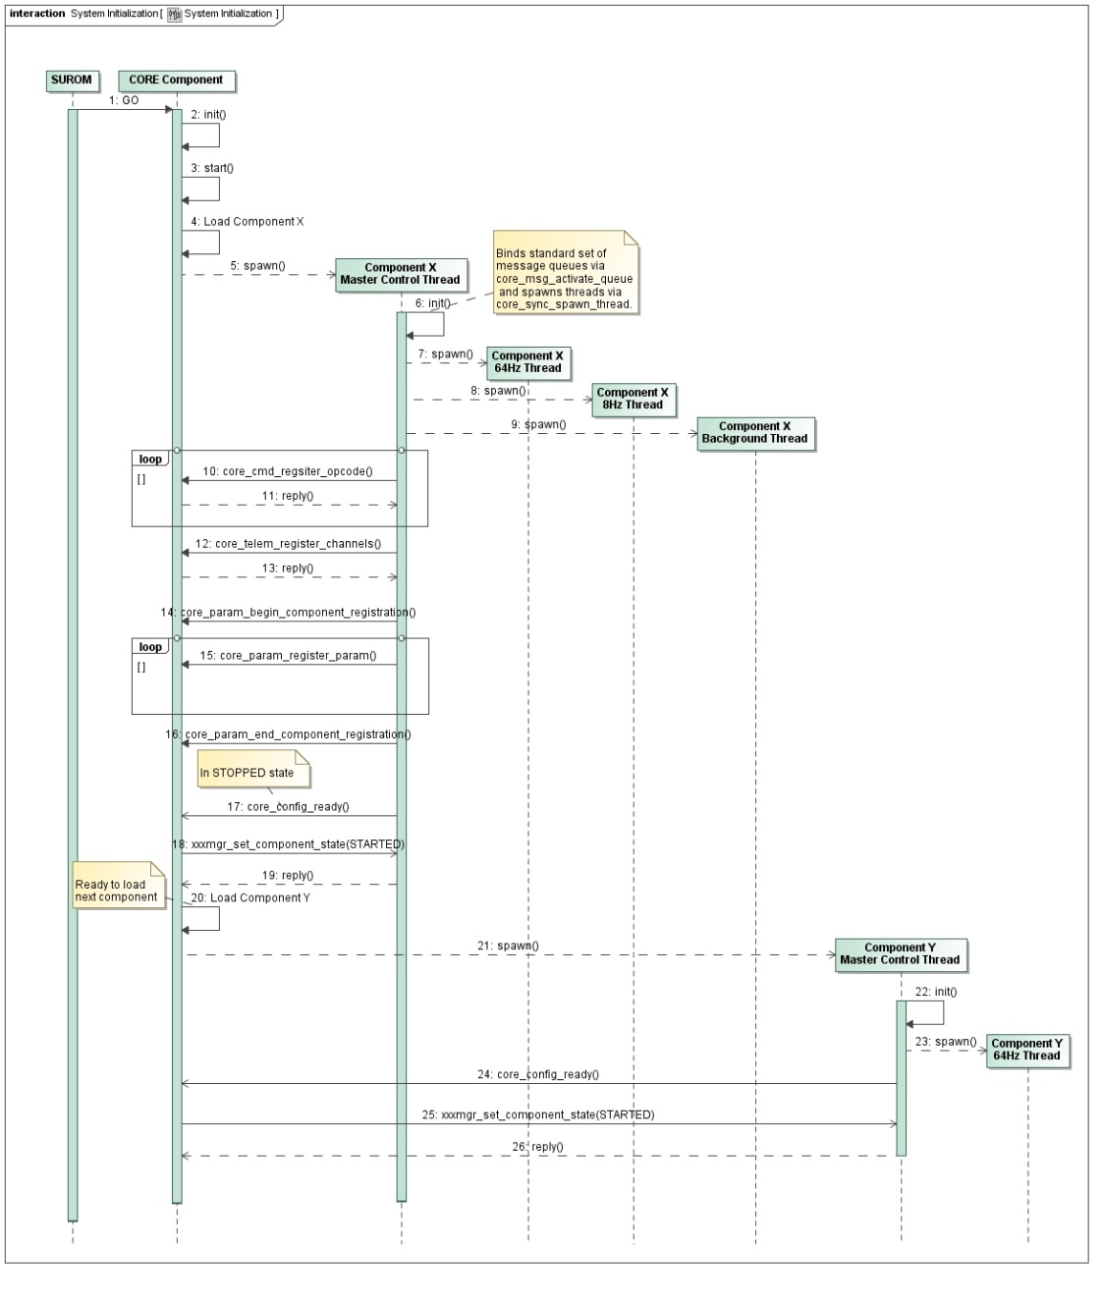
Component Registration
There are no compile-time dependencies; associations between components and the Core are established via registration.
The software allows Components to be integrated into the FSW system without any changes to the Core or unrelated components.
Independent Development and Delivery
The configuration of the software – including allocation of all resources (e.g. memory), runtime schedules, and component selection – is fixed at system initialization.
Increases Testability
Notes:
Rationale: Enables independent development and delivery of components by separate organizations.
Rationale: Limiting the number of configurations of the software to a known finite site minimizes the number of test cases that must be run.

Slide 17
Dynamic View: Execution Architecture
Components segment their real-time processing by rate and create separate threads for each rate group.
The real-time processing execution schedule (time slice ordering and duration) shall be fixed at system initialization.
Supports Deterministic Execution
Components segregate non-real-time processing to separate dynamically scheduled threads.
All critical processing is done on real-time threads.
DEFINITIONS:
Critical → A set of functions required to maintain vehicle health and safety, including hardware safety and minimum communication (command and telemetry) with the ground.
Notes:
Rationale: A rate-group execution architecture provides for deterministic execution.
Rationale: A fixed schedule for real-time processing increases determinism.
Rationale: Non-critical processing can be scheduled to utilize the processor if there is time after all real-time processing has been completed. Therefore, these threads are scheduled at runtime to utilize spare cycles.
Rationale: Processing done on real-time threads has a fixed scheduled with hard real-time deadlines.

Slide 18
Rate Group Flexibility
Not all applications need to implement the full set of rate groups
Part of the configuration of a component is to identify which rate groups it requires
An application that doesn’t require a particular rate group wouldn’t expend any system resources on that rate group
The architecture does support non-critical event-driven processing
Not all processing must be done in rate groups
Non-critical processing (e.g. image compression) may be done on aperiodic threads within the component
These threads request time slices from the CORE for execution
CORE adjusts schedule to allocate time to these threads
Note that this allows a non-critical application to not use rate-groups at all

Slide 19
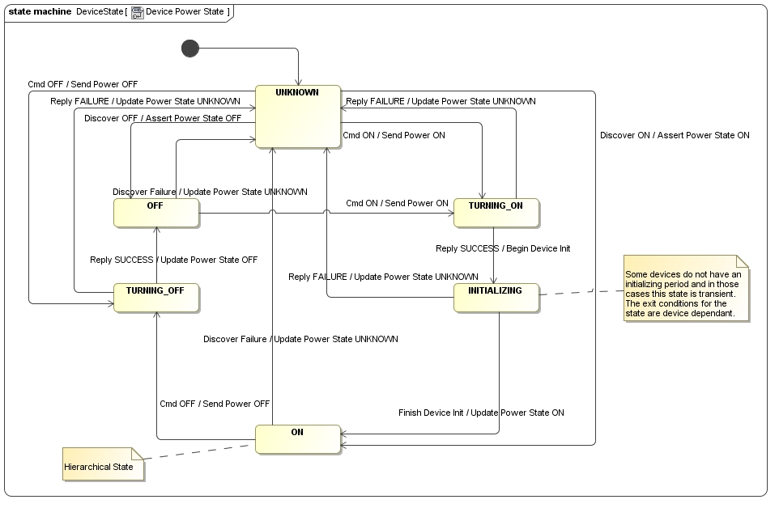
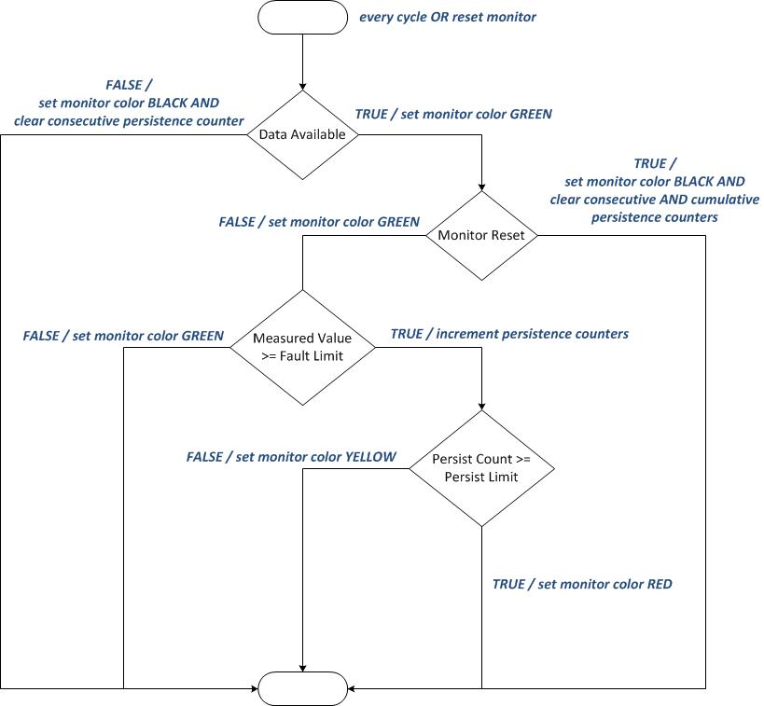
Supporting Patterns
Components follow a set of key supporting design patterns such as device power and health, and fault monitor behavior
Supports Behavioral Predictability

Slide 20
Architecture Objectives – Revisited
Reduce Complexity
Reusability
Significantly improve reuse potential of the standard portions of FSW
Leverage existing flight-proven implementation approaches and assets
Reduce the FSW start-up time and costs on a project or task
Reliability & Predictability
Deterministic execution → A property of a FSW System such that given a set of inputs to a starting system state, the resulting output and ending system state will be predictably the same
Robust execution of critical software functions in the presence of faults in non-critical and non-interacting-critical software
Testability
Reduce the V&V burden of projects
Availability
Reconfiguration of the system to load and execute only the minimum set of critical software functions
Maintainability, in particular Extensibility and Modifiability
Support for phased development, delivery, and integration of spacecraft system functionality, e.g. EDL software for a Mars mission does not need to be on-board the spacecraft at launch and can therefore be phased into the FSW System at a later time
Distributed development of FSW, i.e. delivery of portions of the FSW system by different organizations and / or institutions
Facilitate software technology infusion that enhances applicability and/or reliability of flight software assets and maintains viability of the Product Line
Portability
Portability of FSW to multiple different platforms, e.g. Reference Bus, Broadreach, etc.
Support for software executing in different partitions, CPU cores, or processors

Slide 21
Summary
The JPL FSW Product Line helps address key issues:
Provides a means of consolidating FSW infrastructure development typically handed down from one project to the next, minimizing rework
Allows FSW components to be tightly coupled to the subsystems and associated organizations they represent, while minimizing coupling to each other
Offers a consistent approach for costing FSW on future missions
Provides a more direct path for FSW tech infusion into flight projects

