Slide 1
Overview on CCSDS SOIS and Electronic Data Sheets
Flight Software Workshop, 16/12/2014
Felice Torelli⁽¹⁾, Stephan Jahnke⁽²⁾, Chris Taylor⁽³⁾, Stuart Fowell⁽⁴⁾
(1) felice.torelli@esa.int, ESA ESTEC, Noordwijk, The Netherlands
(2) stephanjahnke@gmx.de, ESA ESTEC, Noordwijk, The Netherlands
(3) chris.taylor@esa.int, ESA ESTEC, Noordwijk, The Netherlands
(4) stuart.fowell@scisys.co.uk, SCISYS Ltd, Bristol, UK

Slide 2
Outline
SOIS as On-board Communication Architecture
SOIS Electronic Data Sheets Use Cases
SOIS Electronic Data Sheets Schema
SOIS Electronic Data Sheets Tool Chain
Conclusions and Future Work
Acknowledgments and References

Slide 3
SOIS as On-board Communication Architecture

Slide 4
Spacecraft On-board Interface Services
CCSDS standard for Spacecraft On-board Interface Services (SOIS)
Objectives:
Improve development process of flight segment data systems
Harmonize software interaction by a defined set of services
Benefits:
Reusable standard building blocks
Support Plug-and-Play avionics
Notes:
First some BRIEF general information on SOIS: Spacecraft On-Board Interface Services (see reference docs)
Objectives:
Benefits:

Slide 5
The SOIS and ECSS Standards
The communication architecture relies on CCSDS and ECSS standards.
This type of services and protocols are present in any spacecraft avionics.
SOIS Application Support Services
SOIS Subnetwork Services
ECSS-E-ST-50-XX Protocols

Slide 6
Command & Data Acquisition Services - Attributes
Device Access Service (DAS)
abstracts from the protocol required
to access the device
abstracts from the type of communication
service (i.e. memory access, packet-base)
required to access the device
abstracts from time constrains strictly
related to the device specific access protocol
Device Virtualisation Service (DVS)
adds ontology to the raw command and data information related to devices
can provide a uniform interface for each class of devices, independent from their actual implementation
Device Data Pooling Service (DDPS)
decouples device physical access from device data consumption by the applications

Slide 7
Time, Files, Packet Stores and Message Transfer - Attributes
Time Access Service (TAS)
abstracts from the mechanisms required
to access the on-board reference time and
to handle time alarms.
Message Transfer Service (MTS)
provides a high level and uniform
mechanism to communicate between software applications within the spacecraft.
File & Packet Store Service (FPSS)
provides a standardised interface to mass memory file and packet stores
abstracts from the implementation details related to the mass memory file systems.

Slide 8
Device Enumeration and Discovery Services - Attributes
Device Discovery Service (DDS)
provides mechanisms to discover and
configure devices connected
to a subnetwork
Device Enumeration Service (DES)
provides mechanisms to handle
units redundancy
provides the means to configure the Command & Data Acquisition Services

Slide 9
Subnetwork Services - Attributes
Packet Service (PS)
Memory Access Service (MAS)
Synchronisation Service (SS)
abstract from the physical location
(within the spacecraft) of the unit to
be accessed
abstract from the datalink protocol
required by a specific communication media to access a unit
abstract from time constrains strictly related to the specific communication media used to access a unit
abstract from the addressing scheme required by a specific communication media to identify a unit.

Slide 10
SOIS Electronic Data Sheets Use Cases

Slide 11
SOIS Electronic Data Sheets
CCSDS standard for machine-readable Electronic Data Sheets (SEDS)
Objectives:
Describe on-board equipment data interfaces
Streamline flight software design process
Standardization of functional interfaces
Benefits:
Replace paper ICD, interface specifications and data sheet documents
Automatic code generation for SOIS services
Automatic generation of documentation
Notes:
SOIS EDS: SOIS Electronic Data Sheets: current study of SOIS WG on machine-readable ICDs
Objectives:
Benefits: farewell of paper documents?, auto-code generation: relief for software development process

Slide 12
EDS Extended Use Cases

Slide 13
SOIS Command & Data Acquisition
Use case focuses on Command & Data Acquisition Services
  Device Virtualisation Service (DVS), Device Access Service (DAS)
  Subnetwork Layer Services as final access point to device
Notes:
General structure of SOIS communication architecture
Focus on CMD & Data Acquisition service: DVS, DAS and (Device data pooling => mainly data buffering, not part of study)
Worked mainly on three parts: DVS, DAS and Subnetwork services

Slide 14
SOIS EDS and Command & Data Acquisition
DVS
Functional Interface (FI)
Device Abstraction Control Procedure (DACP)
DAS
Device Raw Data Interface
Device-specific Access Protocol (DAP)
Sections of the EDS reflect the elements of DVS, DAS and Subnetwork
Subnetwork
Notes:
Typical flow of device access during this study
DVS: user isolation from manufacture differences
DAS: interface between software and hardware, access specific devices via
Subnetwork data link

Slide 15
SOIS Electronic Data Sheets Schema

Slide 16
SOIS EDS Overview
Schema
Based on Red Book CCSDS 876.0-R-0
~237 requirements on SEDS schema elements
XML schema file provided
3 main elements: Parameter Type, Interface Type, Component Type
Organised and grouped inside Namespace elements
Dictionary of Terms
Based on Red Book CCSDS 876.1-R-0
It is a model-based vocabulary
It contains the ontology of the types used in the EDS
Notes:
YGT study by Piotr: recommended SEDS schema, not much in common
Baseline of this current study: EDS schema defined by SCISYS UK and the SOIS WG
3 main elements:

Slide 17
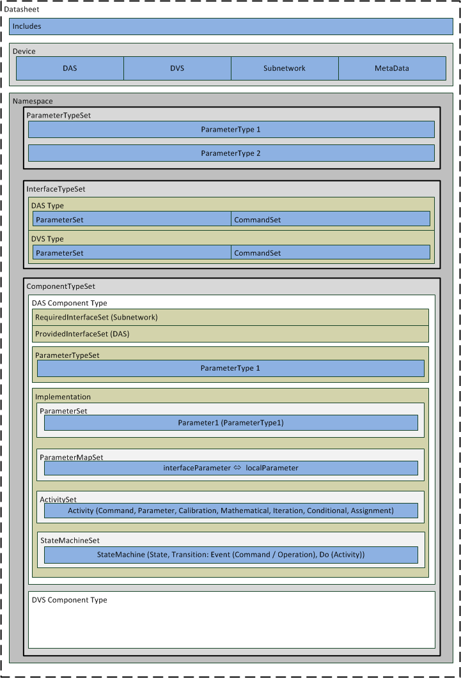
SOIS EDS Schema
Datasheet:
XML root element
May include other SEDS XML files
2 allowed child elements:
  Device
  Namespace
Notes:
Basic, simplified structure of SEDS XML file
Root element: Datasheet
XML schema validation via XSD file inclusion
Import of other SEDS XML files

Slide 18
SEDS Schema - Device
Device:
Instances of ComponentType linked to DAS / DVS
Subnetwork interface configuration
MetaData
Notes:
Assign component types to SOIS stack services (DAS/DVS), configure Subnetwork (SpaceWire: Transceive rate, protocol…)
MetaData: hierarchical set of constant data values, each of which can be associated with machine-understandable semantics

Slide 19
SEDS Schema - Namespace
Namespace:
Parent element for every type definition
Encapsulation and grouping of information
Can be used as library for e.g. standard data and interface types
3 allowed child elements:
  ParameterTypeSet
  InterfaceTypeSet
  ComponentTypeSet
Notes:
Namespace: contains every following information
Can be used as libraries: imported and used afterwards

Slide 20
SEDS Schema – Parameter Types
Parameter Types:
8 basic data types:
  Boolean, Binary, Integer, Float, String, Enumerated, Array, Container
Refined by adding attributes and encoding
4 encodings
  Binary, Integer, Float, String
Type inheritance allowed
Container type for building data structures
Notes:
8 basic data type from bool to complex structures
Attributes: encoding, ranges, contraints…
4 encoding types: define the way the data type is actually encoded and transferred/handled

Slide 21
SEDS Schema – Interface Type
Interface Types:
Define interface parameters and commands
Type inheritance takes all features of the parent
Child Elements:
  ParameterSet
  CommandSet
  GenericTypeSet
Generic types have to be mapped for interface instantiation
Notes:
Interface Types group parameter and commands with arguments of predefined parameter types
Also generic types possible → have to be mapped

Slide 22
SEDS Schema – Component Types
Component Types:
Core part of the SEDS
Defines provided and required interface instances to link to other components
May define local sets of type definitions
Actual behaviour described in Implementation element
Notes:
Biggest part of SEDS: implementation
Interface instantiation → linkage of component types
Local type definition (private inside component type)
Implementation: behaviour!

Slide 23
SEDS Schema - Implementation
Implementation:
Defines protocols and procedures
Child elements:
  ParameterSet
  DelegateSet
  ComponentSet
  ParameterMapSet
  ParameterMapActivitySet
  ActivitySet
  StateMachineSet
Notes:
Implementation: functionality
The DAS implementation represent e.g. the Device specific access protocol, for DVS device abstraction control procedure
A lot of features for access process

Slide 24
Electronic Data Sheets Tool Chain

Slide 25
SOIS EDS Tool Chain Prototype
INPUT:
Set of valid SEDS XML files
SEDS schema
SEDS Translator Tool
TASTE Model
  Data View: Parameter / Interface Types
  Interface View: System structure model
  OpenGeode: Implementation
  Deployment View: Hardware mapping
TASTE generation
  Build System in Ada/C
  Create Data Type ICD
OUTPUT:
Ada/C source code
Executable Binaries
Data Type ICD (HTML)
Notes:
Complete Tool chain, find the SEDS translator and intermediate files
Files are imported into TASTE tools
Describe different steps and outputs
DeploymentView: also distributed systems and partitions possible

Slide 26
SOIS EDS Translator
ParameterTypes
ASN.1/ACN
InterfaceTypes
ASN.1/ACN
ComponentTypes
Local Types:
ASN.1/ACN
System Structure:
AADL
Implementation:
SDL
Notes:
Recall SEDS schema
Translator parses different parts and creates output
ASN.1: Abstract Syntax Notation One
AADL: Architecture Analysis and Design Language
SDL: Specification and Description Language

Slide 27
SEDS Translator – Parameter Types
SEDS → ParameterTypes
Output → DataView (ASN.1/ACN)
<ParameterTypeSet> <!--Scalar types--> <IntegerParameterType sizeInBits="12" signed="false" name="UInt12"/> <!--Enumerated types--> <EnumeratedParameterType name="Team_Type"> <IntegerDataEncoding encoding="unsigned" sizeInBits="2"/> <EnumerationList> <Enumeration value="0" label="homeTeam"></Enumeration> <Enumeration value="1" label="awayTeam"></Enumeration> </EnumerationList> </EnumeratedParameterType> <!–-Container types types--> <ContainerParameterType name="Score_Type"> <EntryList> <Entry type="UInt12" name="ScoreTeamHome"></Entry> <Entry type="UInt12" name="ScoreTeamAway"></Entry> </EntryList> </ContainerParameterType> <ContainerParameterType name="Game_Info_Type"> <EntryList> <Entry type="/SEDS/SecondsSinceTAI" name="Time"></Entry> <Entry type="Score_Type" name="Score" ></Entry> </EntryList> </ContainerParameterType> </ParameterTypeSet>
-- ParameterTypeSet IMPORTS DEFSEDSSecondsSinceTAI FROM SEDS; ssDEFDEMOUInt12 INTEGER ::= 12 dsDEFDEMOUInt12 INTEGER ::= 0 DEFDEMOUInt12 ::= INTEGER((0..4095)) ssDEFDEMOTeamType INTEGER ::= 2 dsDEFDEMOTeamType INTEGER ::= 0 DEFDEMOTeamType ::= ENUMERATED { optionhomeTeam(0),optionawayTeam(1) } ssDEFDEMOScoreType INTEGER ::= 24 dsDEFDEMOScoreType INTEGER ::= 0 DEFDEMOScoreType ::= SEQUENCE { fieldScoreTeamHome DEFDEMOUInt12, fieldScoreTeamAway DEFDEMOUInt12 } ssDEFDEMOGameInfoType INTEGER ::= 56 dsDEFDEMOGameInfoType INTEGER ::= 0 DEFDEMOGameInfoType ::= SEQUENCE { fieldTime DEFSEDSSecondsSinceTAI, fieldScore DEFDEMOScoreType } ---------ACN File----- DEFDEMOUInt12 [] DEFDEMOTeamType [size 2, encoding pos-int] DEFDEMOScoreType [] { fieldScoreTeamHome [], fieldScoreTeamAway [] } DEFDEMOGameInfoType [] { fieldTime [], fieldScore [] }
ssDEFDEMOGameInfoType INTEGER ::= 56
dsDEFDEMOGameInfoType INTEGER ::= 0
DEFDEMOGameInfoType ::= SEQUENCE {
fieldTime DEFSEDSSecondsSinceTAI,
fieldScore DEFDEMOScoreType
}
DEFDEMOGameInfoType [] { fieldTime [], fieldScore [] }
<ContainerParameterType name="Game_Info_Type">
<EntryList>
<Entry type="/SEDS/SecondsSinceTAI" name="Time"></Entry>
<Entry type="Score_Type" name="Score" ></Entry>
</EntryList>
</ContainerParameterType>
Notes:
SEDS input on the left, output from Translator on the right
ParameterType: Container one imported type one local defined, no additional encoding defined

Slide 28
SEDS Translator – Interface Types
SEDS → InterfaceTypes
Output → DataView (ASN.1/ACN)
-- Parameters
PARDEMODVSTYPEGameInfo ::= DEFDEMOGameInfoType
-- Commands
COMDEMODVSTYPEGoal ::= CHOICE {
argIn SEQUENCE {
argTeam DEFDEMOTeamType }
}
-- Interface
INTDEMODVSTYPE ::= CHOICE {
intGameInfo CHOICE {
getParam PARDEMODVSTYPEGameInfo },
intGoal COMDEMODVSTYPEGoal
}
<InterfaceTypeSet> <InterfaceType name="DVS_TYPE"> <ParameterSet> <Parameter name="Game_Info" type="Game_Info_Type" mode="sync" readOnly="true"/> </ParameterSet> <CommandSet> <Command name="Goal"> <Argument name="Team" type="Team_Type" mode="in"/> </Command> </CommandSet> </InterfaceType> <InterfaceType name="DAS_TYPE"> <ParameterSet> <Parameter name="Score" type="Score_Type" mode="sync" readOnly="true"/> </ParameterSet> <CommandSet> <Command name="Goal"> <Argument name="Team" type="Team_Type" mode="in"/> </Command> </CommandSet> </InterfaceType> <InterfaceType name="CLOCK_TYPE"> <ParameterSet> <Parameter name="Time" type="/SEDS/SecondsSinceTAI" mode="sync" readOnly="false"/> </ParameterSet> </InterfaceType> </InterfaceTypeSet>
-- Parameters PARDEMODVSTYPEGameInfo ::= DEFDEMOGameInfoType -- Commands COMDEMODVSTYPEGoal ::= CHOICE { argIn SEQUENCE { argTeam DEFDEMOTeamType } } -- Interface INTDEMODVSTYPE ::= CHOICE { intGameInfo CHOICE { getParam PARDEMODVSTYPEGameInfo }, intGoal COMDEMODVSTYPEGoal } -- Parameters PARDEMODASTYPEScore ::= DEFDEMOScoreType -- Commands COMDEMODASTYPEGoal ::= CHOICE { argIn SEQUENCE { argTeam DEFDEMOTeamType } } -- Interface INTDEMODASTYPE ::= CHOICE { intScore CHOICE { getParam PARDEMODASTYPEScore }, intGoal COMDEMODASTYPEGoal } -- Parameters PARDEMOCLOCKTYPETime ::= DEFSEDSSecondsSinceTAI -- Interface INTDEMOCLOCKTYPE ::= CHOICE { intTime CHOICE { getParam PARDEMOCLOCKTYPETime, setParam PARDEMOCLOCKTYPETime } }
<InterfaceTypeSet>
<InterfaceType name="DVS_TYPE">
<ParameterSet>
<Parameter name="Game_Info" type="Game_Info_Type"
mode="sync” readOnly="true"/>
</ParameterSet>
<CommandSet>
<Command name="Goal">
<Argument name="Team" type="Team_Type" mode="in"/>
</Command>
</CommandSet>
</InterfaceType>
<InterfaceType name="DAS_TYPE">
Notes:
InterfaceType: DVS example: one Parameter (of the previous described container), one command with one argument
Translation: Parameter is read only → only getParam

Slide 29
SEDS Translator – Component Types
SEDS → ComponentType
Output → InterfaceView (AADL)
<ComponentType name="DVS_COMP" shortDescription="DVS component"> <ProvidedInterfaceSet> <Interface type="/DEMO/DVS_TYPE" name="DVS"></Interface> </ProvidedInterfaceSet> <RequiredInterfaceSet> <Interface type="/DEMO/DAS_TYPE" name="DAS"></Interface> <Interface type="/DEMO/CLOCK_TYPE" name="CLOCK"></Interface> </RequiredInterfaceSet> <Implementation> … </Implementation> </ComponentType>
SYSTEM DVSCOMP FEATURES PI_DVS_IN : PROVIDES SUBPROGRAM ACCESS interfaceview::FV::DVSCOMP::PI_DVS_IN.others{ TASTE::InterfaceName => "DVS_IN"; TASTE::RCMoperationKind => sporadic; }; RI_DVS_OUT : REQUIRES SUBPROGRAM ACCESS interfaceview::FV::DVSCOMP::RI_DVS_OUT.others{ TASTE::InterfaceName => "DVS_OUT"; TASTE::LabelInheritance => "false"; }; PI_DAS_IN : PROVIDES SUBPROGRAM ACCESS interfaceview::FV::DVSCOMP::PI_DAS_IN.others{ TASTE::InterfaceName => "DAS_IN"; TASTE::RCMoperationKind => sporadic; }; RI_DAS_OUT : REQUIRES SUBPROGRAM ACCESS interfaceview::FV::DVSCOMP::RI_DAS_OUT.others{ TASTE::InterfaceName => "DAS_OUT"; TASTE::LabelInheritance => "false"; }; PI_CLOCK_IN : PROVIDES SUBPROGRAM ACCESS interfaceview::FV::DVSCOMP::PI_CLOCK_IN.others{ TASTE::InterfaceName => "CLOCK_IN"; TASTE::RCMoperationKind => sporadic; }; RI_CLOCK_OUT : REQUIRES SUBPROGRAM ACCESS interfaceview::FV::DVSCOMP::RI_CLOCK_OUT.others{ TASTE::InterfaceName => "CLOCK_OUT"; TASTE::LabelInheritance => "false"; }; PROPERTIES Source_Language => (SDL); END DVSCOMP; SYSTEM IMPLEMENTATION DVSCOMP.others END DVSCOMP.others;
<Interface type="/DEMO/DAS_TYPE" name="DAS"></Interface>
PI_DAS_IN : PROVIDES SUBPROGRAM ACCESS interfaceview::FV::DVSCOMP::PI_DAS_IN.others{
TASTE::InterfaceName => "DAS_IN";
TASTE::RCMoperationKind => sporadic;
};
RI_DAS_OUT : REQUIRES SUBPROGRAM ACCESS interfaceview::FV::DVSCOMP::RI_DAS_OUT.others{
TASTE::InterfaceName => "DAS_OUT";
TASTE::LabelInheritance => "false";
};
Notes:
ComponentType , System Structure
Complete example would be too big → snippet
Two interface elements needed to support input and output messages with the same interface type

Slide 30
SEDS Translator – Component Types
SEDS → ComponentType Implementation
Output → SDL
<ActivitySet>
<Activity name="send_goal_command">
<Implementation>
<Command command="DAS/Goal" transaction="1">
<ArgumentValue name="Team">
<ParameterRef parameterRef="working_Team"/>
</ArgumentValue>
</Command>
</Implementation>
</Activity>
</ActivitySet>
… <ParameterMapSet> <ParameterMap internalParameterRef="working_Time" interfaceParameterRef="CLOCK/Time"/> </ParameterMapSet> <ParameterMapActivitySet> <ParameterActivityMap> <Provided name="DVSGameInfo" interfaceParameterRef="DVS/Game_Info"/> <Required name="DASScore" interfaceParameterRef="DAS/Score"/> <GetActivity> <Assignment outputParameterRef="DVSGameInfo.Score"> <ParameterRef parameterRef="DASScore"/> </Assignment> <Assignment outputParameterRef="DVSGameInfo.Time"> <ParameterRef parameterRef="working_Time"/> </Assignment> </GetActivity> </ParameterActivityMap> </ParameterMapActivitySet> <ActivitySet> <Activity name="send_goal_command"> <Implementation> <Command command="DAS/Goal" transaction="1"> <ArgumentValue name="Team"> <ParameterRef parameterRef="working_Team"/> </ArgumentValue> </Command> </Implementation> </Activity> </ActivitySet> …
PROCESS dvscomp; /* CIF TEXT (0, 0), (100, 100) */ -- Interface declaration DCL DVS_VAR INTDEMODVSTYPE; DCL DAS_VAR INTDEMODASTYPE; DCL CLOCK_VAR INTDEMOCLOCKTYPE; /* CIF ENDTEXT */ -- ParameterSet Types /* CIF TEXT (0, 0), (100, 100) */ DCL WorkingScore DEFDEMOScoreType; DCL WorkingTime DEFSEDSSecondsSinceTAI; DCL WorkingTeam DEFDEMOTeamType; /* CIF ENDTEXT */ -- ParameterMapActivity Types /* CIF TEXT (0, 0), (100, 100) */ DCL DVSGameInfo PARDEMODVSTYPEGameInfo; DCL DASScore PARDEMODASTYPEScore; /* CIF ENDTEXT */ -- Activity Set -- Activity SendGoalCommand PROCEDURE SendGoalCommand; /* CIF TEXT (0, 0), (100, 100) */ DCL argument COMDEMODASTYPEGoal; /* CIF ENDTEXT */ START; TASK argument := argIn:{argTeam WorkingTeam}; OUTPUT DAS_OUT(intGoal:argument); STOP; ENDPROCEDURE; …
-- Activity Set
-- Activity SendGoalCommand
PROCEDURE SendGoalCommand;
/* CIF TEXT (0, 0), (100, 100) */
DCL argument COMDEMODASTYPEGoal;
/* CIF ENDTEXT */
START;
TASK argument := argIn:{argTeam WorkingTeam};
OUTPUT DAS_OUT(intGoal:argument);
STOP;
ENDPROCEDURE;
Notes:
Implementation part, again full example too big
Focus on one activity to forward the goal command to the DAS level, argument is set to local parameter, then send via interface

Slide 31
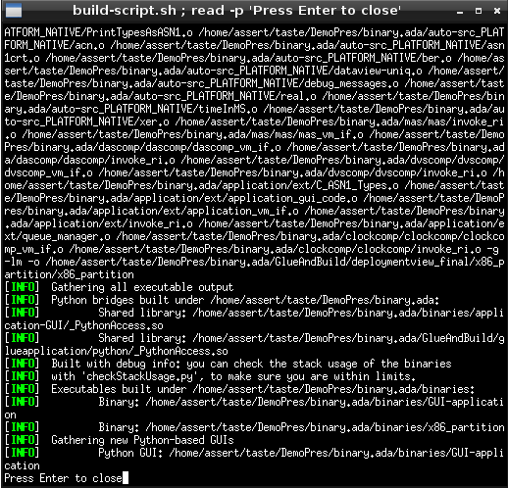
Translator Tool Tests
Input:
Artificial Device SEDS
SEDS snippets for specific test cases
  ParameterTypes.xml
  InterfaceTypes.xml
  ComponentTypes.xml
Special Testing of Subnetwork library
  SubnetworkTest.xml
Testing methods:
Parsing Process:
  Monitored by debug messages of different level
  Exceptions and ERROR messages as indications for failed test
Output files / TASTE compatibility:
  Tested by import of intermediate files to TASTE editors and modelling tools
  Error message or unexpected content marked as indications for failed test
  Building errors as indications for failed test
Notes:
Translator tool tests:
Input: different SEDS instances (artifical device, specific tests for main elements)
Testing method:
parsing process monitored by debug messages and unforeseen exceptions → failed!
Output files: import to taste and complete system, build it, run it → error messages or uncomplete build → failed!

Slide 32
Generated Code Tests
Automatic Testing
Preparation:
Configure Translator Tool to complete system automatically
  Unconnected interfaces are linked to test class
Generate code skeletons with TASTE
Fill code skeletons with specific test source code for User Applications and Subnetwork/Device behaviour
Result:
Comparison of expected and actual output
Outlook into the future:
SEDS Translator for automatic test case definition
Import of Input and expected Output vectors
Auto validation of Answer
Notes:
Automatic testing
Translator tool is configurable to complete system structure, code skeletons can be filled with specific test code
Comparison between input, expected output and actual system answer → not as expected? Failed!
Outlook: create specific test case with SEDS Translator or similar tool including auto validation

Slide 33
Conclusions and Future Work

Slide 34
Conclusions
Summary
Overview of published SOIS standards
Use cases and structure of the SOIS EDS
Overview of the code generation tool-chain prototype
Parallel work
Alternative code generation tool-chain designed by SCISYS Ltd, UK
Other SW tools implemented by GFSC and JSC
Future work
EDS schema and Dictionary of Terms Red Books submitted to Agency review.
Interoperability tests between independent EDS users planned before the Blue Books publication.

Slide 35
Acknowledgments and References

Slide 36
Acknowledgments
This presentation summarizes the work of the CCSDS SOIS working group, whose members beyond the paper authors include:
Ray Krosley (DesignNet representing AFRL, USA),
Richard Melvin (SCISYS Ltd, UK),
Peter Mendham (Bright Ascension Ltd, UK),
Elizabeth Nguyen (Aerospace Corp, USA),
Sam Price (NASA/GSFC, USA),
Glenn Rakow (NASA/GSFC, USA),
Kevin Rice (ASRC Research & Technology Solutions representing NASA/GSFC, USA),
Jonathan Wilmot (NASA/GSFC, USA),
Piotr Skrzypek (ESA, Poland)

Slide 37
References
[1] CCSDS 850.0-G-2 December 2013, Green Book - Spacecraft Onboard Interface Services
[2] CCSDS 851.0-M-1 December 2009, Magenta Book – SOIS Subnetwork Packet Services
[3] CCSDS 852.0-M-1 December 2009, Magenta Book – SOIS Subnetwork Memory Access Services
[4] CCSDS 853.0-M-1 December 2009, Magenta Book – SOIS Subnetwork Synchronisation Services
[5] CCSDS 854.0-M-1 December 2009, Magenta Book – SOIS subnetwork Device Discovery Services
[6] CCSDS 855.0-M-1 December 2009, Magenta Book – SOIS Subnetwork Test Services
[7] CCSDS 871.0-M-1 March 2013, Magenta Book – SOIS Device Access Service
[8] CCSDS 871.1-M-1 November 2012, Magenta Book – SOIS Device Data Pooling Service
[9] CCSDS 871.2-M-1 March 2014, Magenta Book – SOIS Device Virtualization Service
[10] CCSDS 871.3-M-1 October 2014, Magenta Book – SOIS Device Enumeration Service
[11] CCSDS 872.0-M-1 January 2011, Magenta Book – SOIS Time Access Service
[12] CCSDS 873.0-M-1 September 2012, Magenta Book – SOIS File and Packet Store Service
[13] CCSDS 875.0-M-1 November 2012, Magenta Book – SOIS Message Transfer Service
[14] CCSDS 876.0-R-0 August 2014, Red Book – Spacecraft Onboard Interface Services XML Specification For Electronic Data Sheets For Onboard Devices
[15] CCSDS 876.1-R-0 August 2014, Red Book - Spacecraft Onboard Interface Services—specification For Dictionary Of Terms For Electronic Data Sheets For Onboard Components
[16] Adoption of Electronic Data Sheets & Device Virtualization Final Report, SSL/08816/REP/FIN-REP-001 Issue 1.1, 24/01/2014
[17] SOIS EDS YGT Study Final Report, issue 1.0, 31/7/2013
[18] SOIS EDS Follow-Up Study Final Report, issue 1.0, 30/7/2014
[19] TASTE Documentation, http://taste.tuxfamily.org/wiki/
CCSDS publications are available at: www.ccsds.org
ECSS publications are available at: www.ecss.nl

