Slide 1
Klocwork
Source Code Analysis for Quality, Safety and Security
Igor Gvero
igor.gvero@roguewave.com

Slide 2
The faster you find a defect, the less costly to fix
Cost to Fix
Time Detected
Release
UAT
System Test
Cost to Fix
Cost to Fix
Unit Test
Code
Design
Specification
Development
Unit Tests
QA Testing
Production
Lifecycle Stage
Time

Slide 3
Benefits: security, safety & quality
Significantly reduces the cost of reliable, secure software
Complements existing testing approaches
Automated and repeatable analysis
Enforces key industry standards
DISA STIG, CWE, MISRA
CERT, SAMATE
OWASP, DO-178B, FDA validation
...and more
Notes:
Source code analysis reduces costs, saves time, improves quality and helps detect security flaws.
Klocwork has enabled numerous customers in this regard.

Slide 4
Analysis done after compile/build
Development Cycle
Edit
Save
Compile
Test
Check In
Build
Analyze & Fix
Takeaways:
Late stage “rework” reduces tool adoption
Timelines compromised
Issues are more expensive to fix
Notes:
Traditional source code analysis tools wait until after the code has been submitted and built to analyze.
This is helpful, but it is still not soon enough.

Slide 5
Klocwork: analysis earlier in the cycle
Development Cycle
Edit
Save
Analyze & Fix
Compile
Test
Check In
Build
Eliminates new defects from being checked back into the team level build
No extra work for developers
In-context checking and fixes
Continuity of development flow
Notes:
Klocwork pushes the analysis point even earlier than unit test. This is done with a fast incremental analysis that takes a matter of <1 minute, even on a large code base.
This saves time in unit test by giving the developer the benefit of fixing things as he/she types them.
Klocwork is the only source code analysis tool capable of doing this.

Slide 6
Straight forward results
Increases development productivity
No test cases, stubs or complex set-up
Runs on your code “as is”
Lawrence Livermore: $200K savings on 360K LOC project
Harris: $60K in 6 months on 10-person pilot project
LMCO: 1 critical defect per developer per year gives ROI

Slide 7
Klocwork Static Analysis Engine
Hundreds of checkers for C, C++, Java and C#
Numerous standards supported
Customizable interface:
Enabling/disabling checkers
Changing the severity of defect categories
Developing custom checkers
Security
Reliability
Coding Standards & Maintainability
Buffer overflow
Un-validated user input
SQL injection
Path injection
File injection
Cross-site scripting
Information leakage
Vulnerable coding practices
…
Memory and resource leaks
Concurrency violations
Infinite loops
Dereferencing NULL pointers
Usage of uninitialized data
Resource management
Memory allocation errors
…
MISRA, DISA, CWE, CERT, etc.
Dead code
Unreachable code Calculated values that are never used
Unused function parameters
…

Slide 8
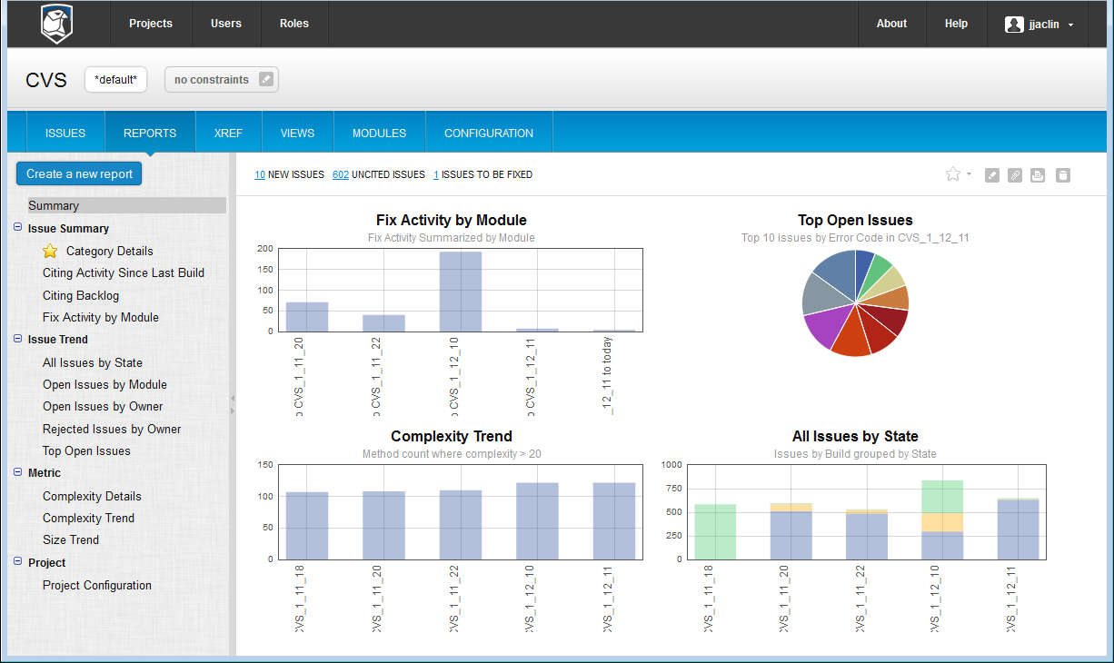
Reporting, metrics and filtering to fit your needs
Modules
Views
Owners
Severity
Status
We never delete a defect, we file it where you request
Notes:
We have powerful filtering, metrics and reporting capabilities.

Slide 9
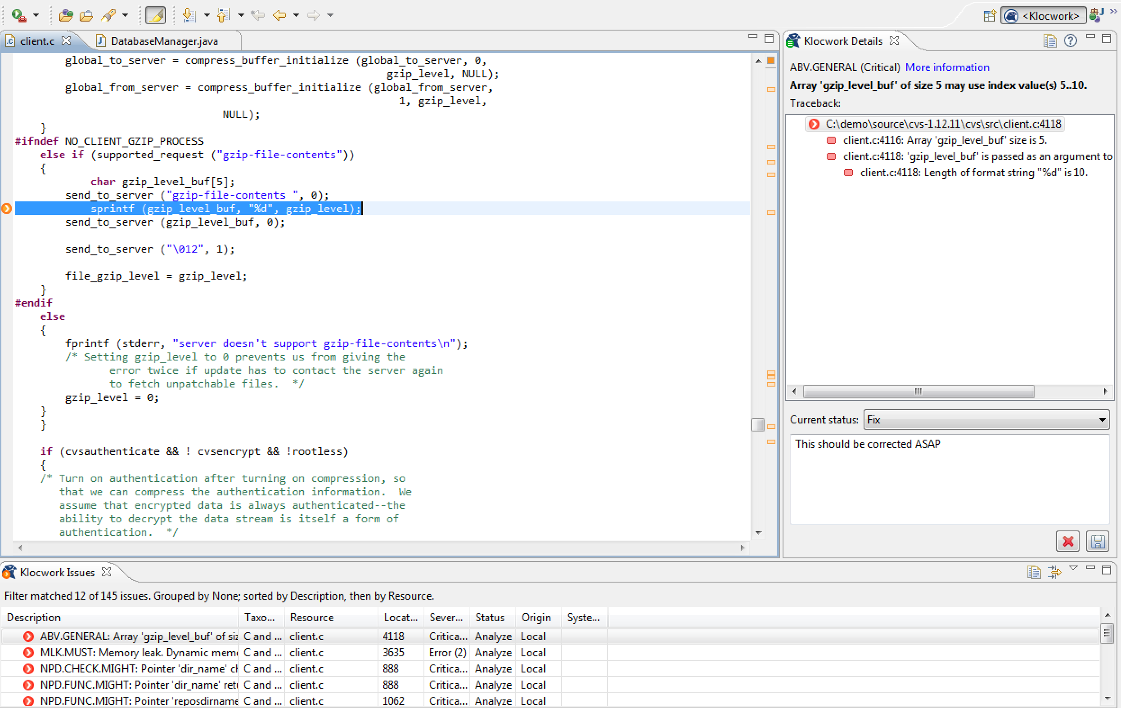
Desktop analysis with ANY editor or IDE
Eclipse
Visual Studio
IntelliJ IDEA
Klocwork Desktop
Notes:
We have powerful filtering, metrics and reporting capabilities.

Slide 10
Continuous Integration Roadmap
Plug in for Hudson / Jenkins available today
Enhance interface into multiple CI systems
Provide visibility into your development workflow
Save time resolving and triaging integration issues with revision based system build results.
Easy install and set up
automatic CI agent deployment
enhanced analysis performance with minimal footprint
flexible CI framework
pre or post check in, integrated code review
Notes:
Demo flow (5 mins)
Make a code change
Initiate a pre checkin CI build
Show results in cahoots
Cite issues
Integration testing
Issue triage and management on system issues before having to wait for the main integration build
Increased visibility – developers are now able to share desktop results on the server
Revision based results, not just the build but what does the code difference look like
Build code confidence
Prevent integration problems - avoid one developer's work in progress breaking another developer's copy

Slide 11
DEMONSTRATION

Slide 12
Summary
Modern Source Code Analysis
Point of greatest time savings for your developers
Point of lowest cost for your company
Prevent Quality and Security Issues with Coding Standards
Show that you are following those standards
Detect Issues at the Developer Desktop
Ensures issues are found and fixed early in the SDLC
Use Reporting Capabilities
Gages health of the project and provides historical trending
Mitigate Issues
Focus, Fix and Repeat
Continuous use as part of developer workflow
Adapt SCA into your CI process

