Slide 1
The MiRaTA CubeSat FSW Architecture
&
Scaling CubeSat FSW to Cooperative Constellations
Andrew “Kit” Kennedy
MIT AeroAstro, S.M. 2015
Advisor: Prof. Kerri Cahoy
12/18/2014

Slide 2
Outline
Purpose and Motivation
MiRaTA Flight Software Architecture
Scaling up to a CubeSat Constellation
Conclusions

Slide 3
Purpose and Motivation
Purpose is two fold
Introduce MiRaTA CubeSat FSW Design
  Small satellite, but complex mission
  Identify benefits and limitations of CubeSat-oriented FSW
Discuss initial work in scaling FSW to a distributed constellation architecture
  Enabling cooperative operations
  Maximizing autonomy in activity planning

Slide 4
Outline
Purpose and Motivation
MiRaTA Flight Software Architecture
  MiRaTA Mission
  FSW Architecture Overview
Scaling up to a CubeSat Constellation
Conclusions
Part 1

Slide 5
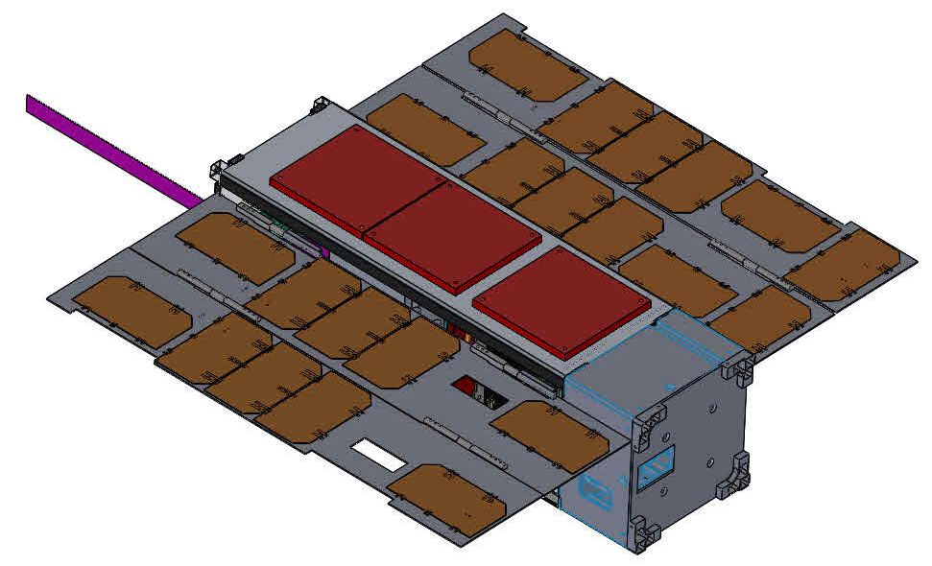
MiRaTA Mission
Microwave Radiometer Technology Acceleration CubeSat
Funding sources: NASA ESTO – InVEST and NOAA
  Launch early 2016
Follow-on mission to MicroMAS CubeSat
  Microsized Microwave Atmospheric Satellite
  Launched July 2014
Developers:
  MIT Campus (bus)
  MIT Lincoln Lab (radiometer payload)
  Aerospace Corporation (GPSRO payload)
  UMass Amherst, Space Dynamics Laboratory
3U CubeSat
Tri-band radiometer
  50-58, 175-191, and 203-206 GHz bands
Modified GPS receiver
  Radio occultation measurements
Image courtesy MiRaTA structures team
Part 1

Slide 6
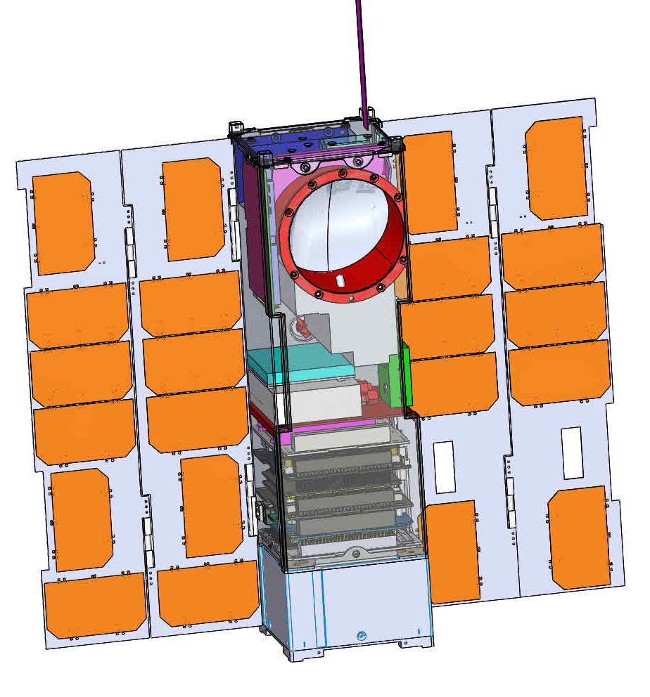
MiRaTA Space Vehicle
Payload
  Tri-band microwave radiometer
  Patch antenna array (on back)
  GPS receiver
Bus
  Avionics
    L-3 Cadet UHF Radio
    Spring tape antenna
    Pumpkin PIC24F motherboard
    Clyde Space EPS and battery
    Custom interface boards
  Deployable solar panels
  MAI-400 ADCS
    Reaction Wheels, Torque Rods
    Gyros, Earth Horizon Sensors, Sun Sensors
Image courtesy MiRaTA structures team
Part 1
Notes:
4 mins to here

Slide 7
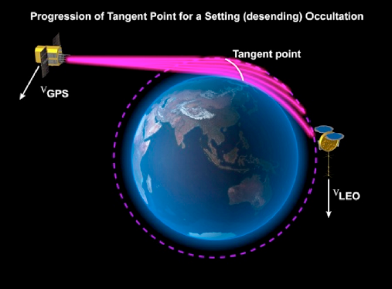
GPS Radio Occultation
Image credit: Lidia Cucurull
Part 1
Notes:
JPSS 14-075

Slide 8
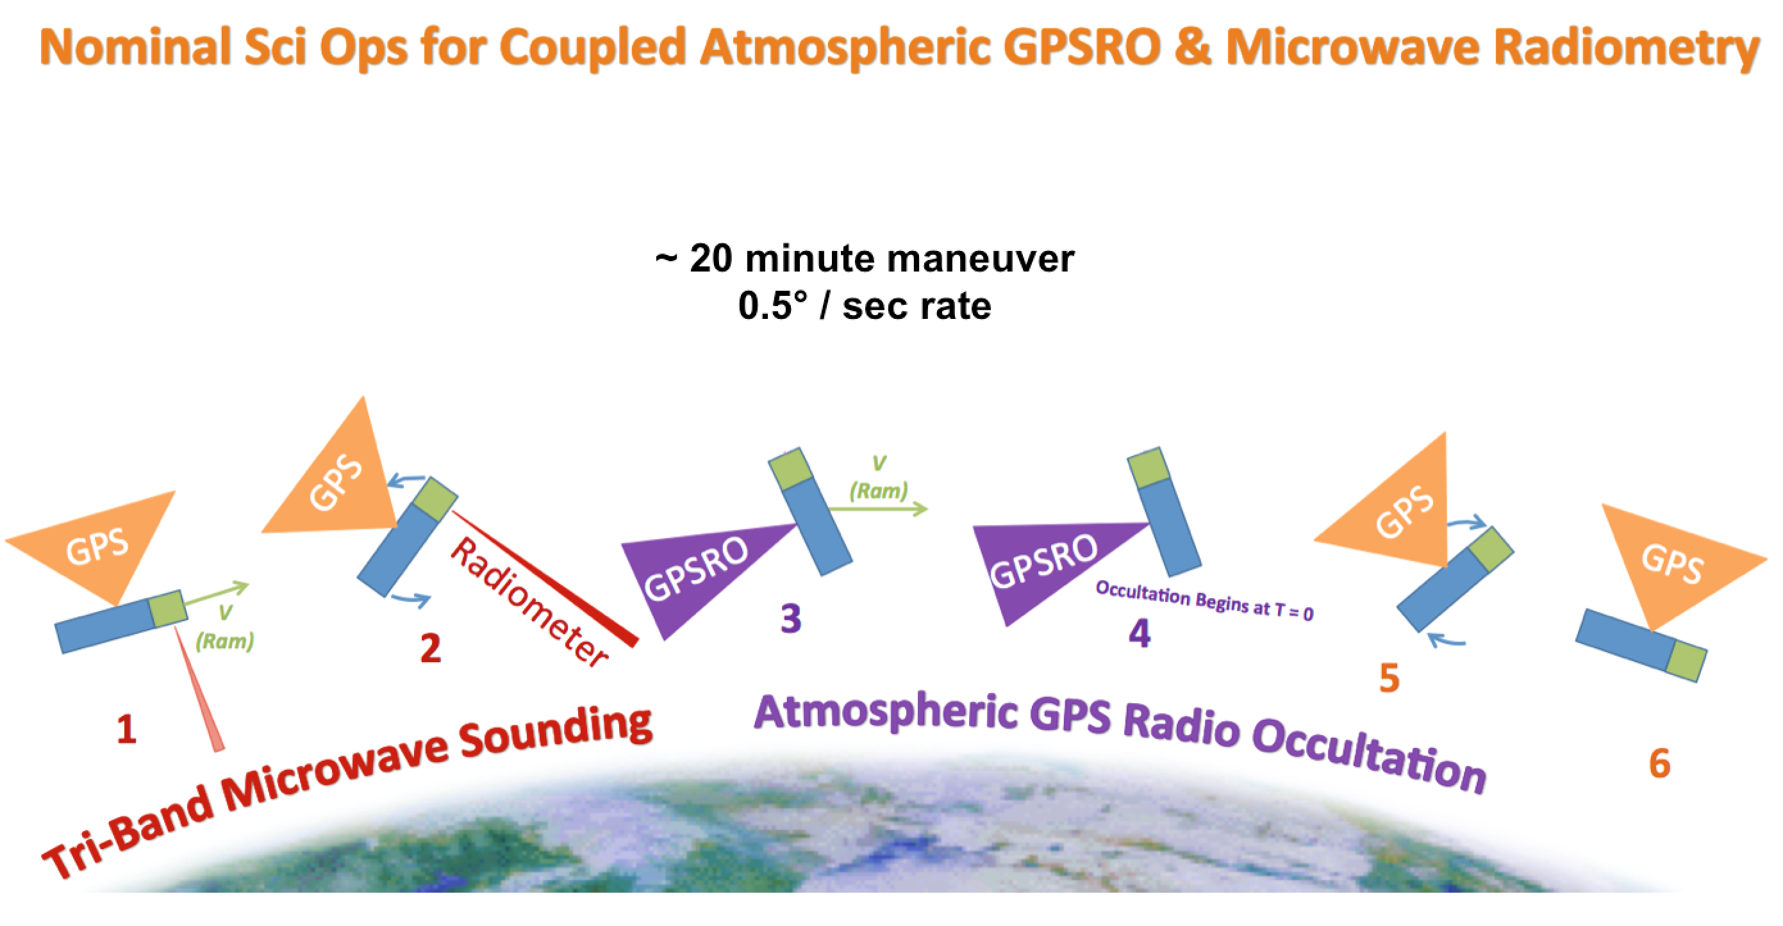
MiRaTA Calibration Maneuver
Blackwell, Cahoy, Bishop, et al [1]
Part 1
Notes:
5 mins to here

Slide 9
Concept of Operations
Launch
Release
EOA
Science Ops
Decommission
ELaNa launch
  To be confirmed, early 2016
  600 km altitude
  Sun-synchronous orbit (13:30 LTDN)
Early Orbit Activation
  Prepare spacecraft for science ops
Science Operations
  Goal: execute one maneuver per orbit
  90 day mission
Primary Downlink (Cadet ) | Secondary Beacon (EyeStar )
Ground Station: NASA Wallops Downlink: 468 MHz, 1.5 Mbps Uplink: 450 MHz, 9.6 kbps | Globalstar constellation Low data rate health TLM
Part 1
Notes:
6 mins to here

Slide 10
Modes: Early Orbit Activation
After initial release from Poly-PicoSatellite Orbital Deployer (PPOD)
High level tasks:
  Inhibit communications
  Deploy solar panels
  Bring to safe mode
Part 1

Slide 11
Modes: Science Operations
Part 1
Notes:
9 mins to here

Slide 12
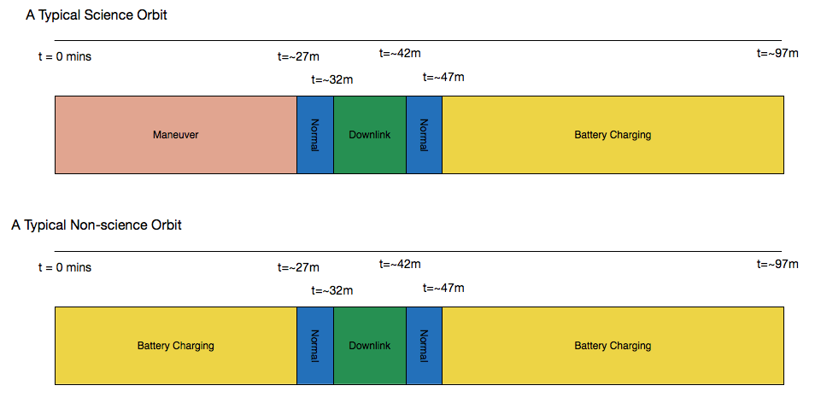
Notional Mode Commanding
Part 1

Slide 13


Implementation
Bus processor:
  PIC24 Microprocessor (PIC24FJ256GB210)
  Processor and motherboard from
  Pumpkin, Inc
  16-bit processor running at 16 MIPS
  256 kB flash program memory
  96 kB data memory
  Numerous peripherals
Salvo RTOS (Pumpkin Inc )
  Minimal memory use RTOS
  Event-driven cooperative multitasking
  Task intercommunication & resource
  management
  Software timers (delays, timeouts)
FSW written in C, Microchip XC16 Compiler
Microchip Website
Pumpkin Inc Website
Part 1

Slide 14
FSW Architecture
Part 1

Slide 15
Current State
Just passed PDR!
  but lots of coding to do…
SW heritage from MicroMAS CubeSat
  8 of 9 drivers
  Templates for
    mission manager
    command handler
    housekeeping task
    ADCS task
FSW benefits
  Simplicity!
FSW limitations
  Little processing power
  Unable to do complex activities
Part 1

Slide 16
Outline
Purpose and Motivation
MiRaTA Flight Software Architecture
Scaling up to a CubeSat Constellation
  Benefits and Difficulties
  Enabling cooperative operations through FSW
Conclusions
Part 1
Part 2

Slide 17

Coordinated Constellations
Remote sensing science applications:
  Cross-validation, diverse geometry (a)
  Calibration (b)
  Multiple sensing modalities (c)
Spontaneous observation opportunities
  Scouting and low-latency follow-up
  New Requests
More effective downlink to ground stations
  Re-planning downlink times
  Routing data through constellation
(a)
(b)
MiRaTA-like
Goal: exploit simplicity of MiRaTA architecture by scaling up to a distributed constellation of simple sats with heterogenous payloads
(c)
Part 1
Part 2
Notes:
Mention how this applies small satellites (cheaper, smaller, enable constellations)
small sats enable big constellation missions
Applications: GPSRO tomography, Bidirectional Reflection Distribution Function Measurement
use of term operational/resource “flexibility”

Slide 18
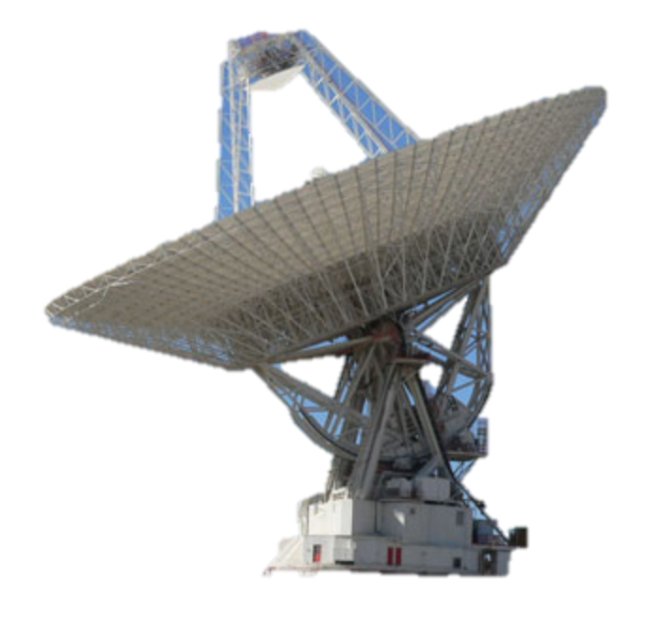
Challenges for Coordination
Limited communications access to spacecraft
  Comm black-out periods
  Bandwidth limitations
Spacecraft on-orbit activities tightly coupled
  Operational problems cascade
  Full constellation state knowledge limited
Limits on ground control interaction
  Pre-sequenced ground plans may diverge
  Budgetary limits on human operator time
Spontaneous events
  New observation opportunities
  Faults onboard spacecraft
?
v
On-orbit Plan Divergence
A need for onboard software to autonomously coordinate observations
Part 1
Part 2

Slide 19
Need to simplify the problem! so… first consider activity onboard only two spacecraft
Part 1
Part 2

Slide 20
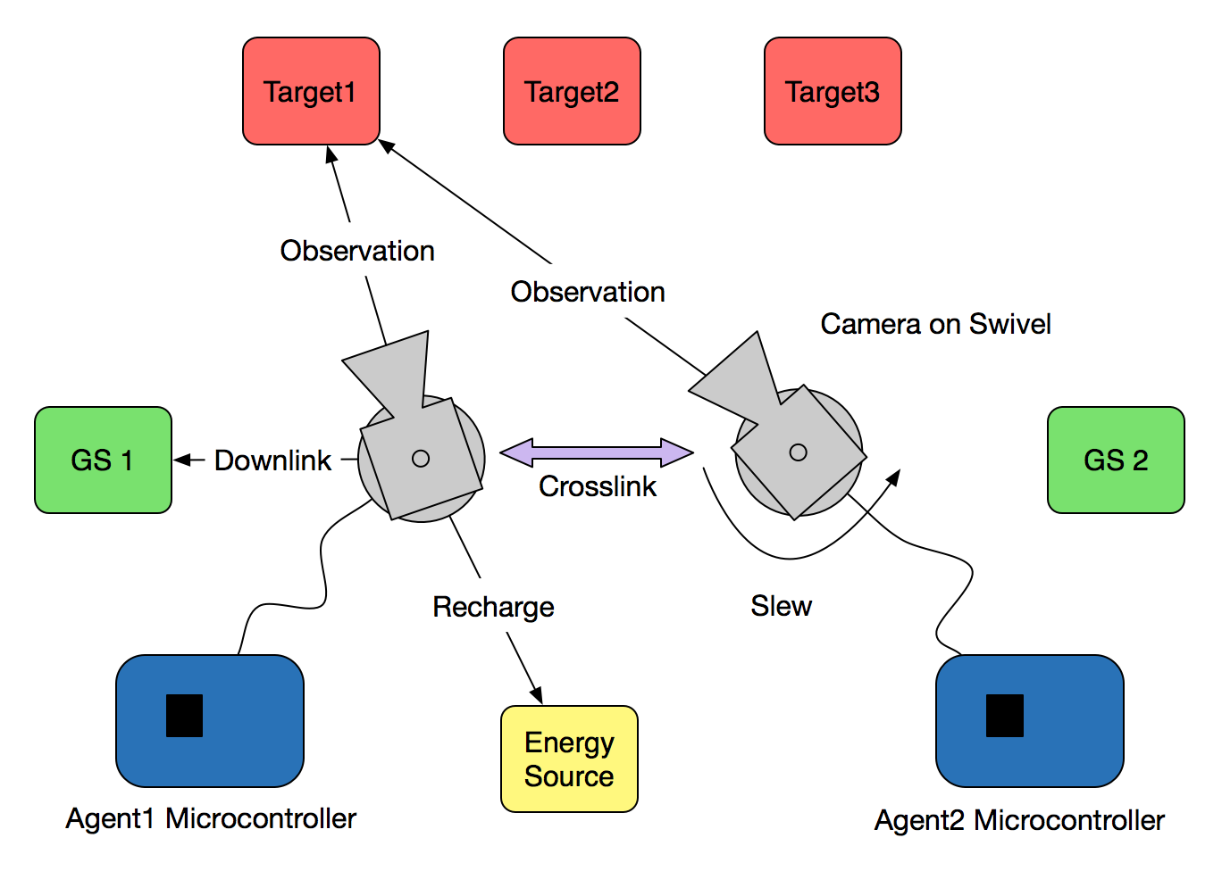
Two Agent Scenario
Concept
  Agents: cameras on
  motors for swiveling
  Reward for joint observation
  of targets
  Manage finite onboard resources
  Increasing penalty for
  stale state info
Onboard States
  Energy Storage
  Data Storage
  Momentum Storage
Crosslink
  State information
  sharing
  Sporadic availability
Agent software plans activities to maximize joint observation, minimize “staleness” of shared state information
Part 1
Part 2

Slide 21
Now consider planning onboard a single spacecraft agent
Part 1
Part 2

Slide 22
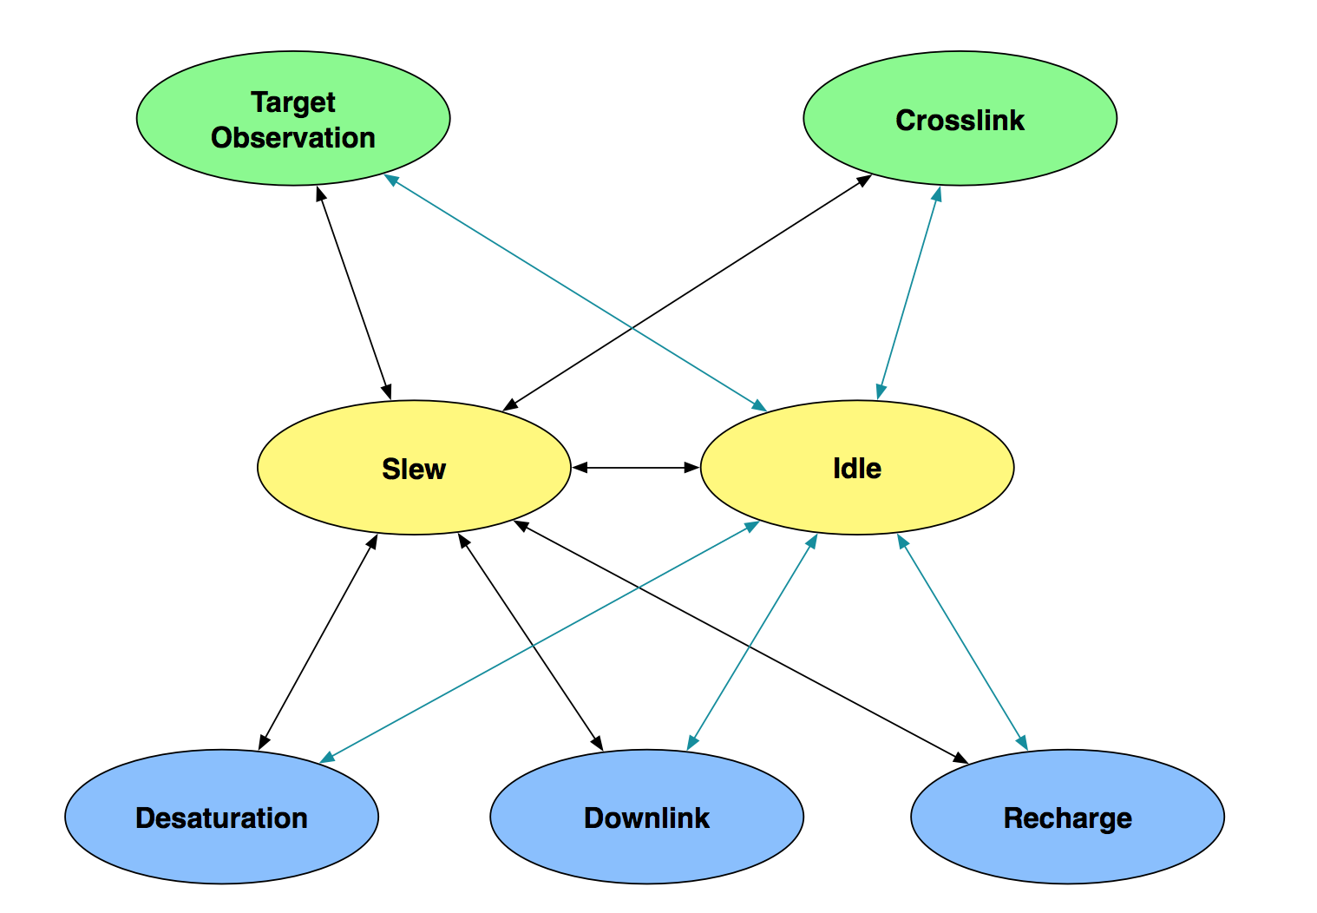
Spacecraft Agent Modes
 | Energy Storage | Data Storage | Momentum Storage
Increase | Recharge | Target Obs (high), other modes (low) | Slew (high), other modes (low)
Decrease | Other modes | Downlink | Desaturation
Part 1
Part 2

Slide 23
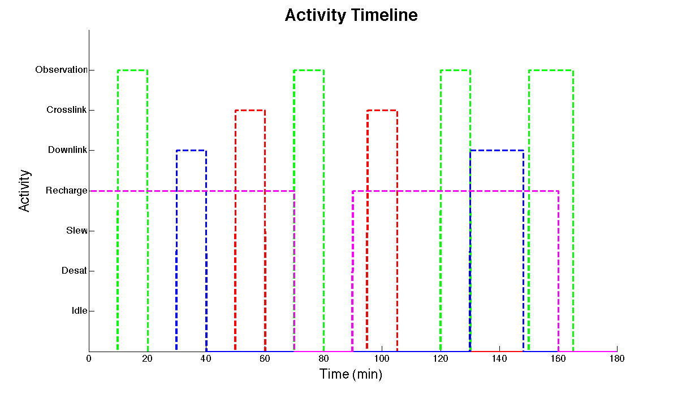
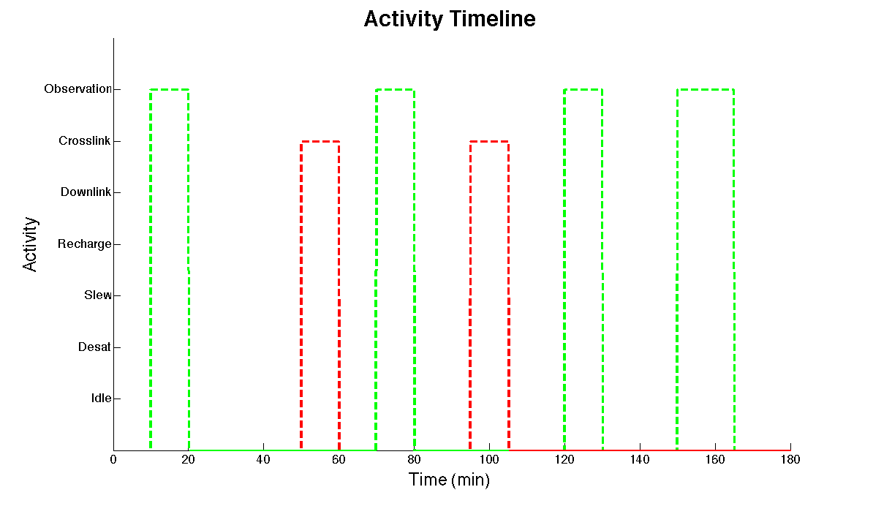
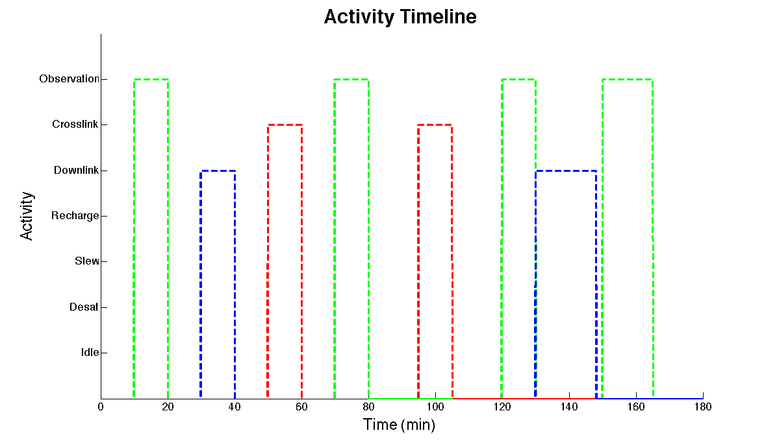
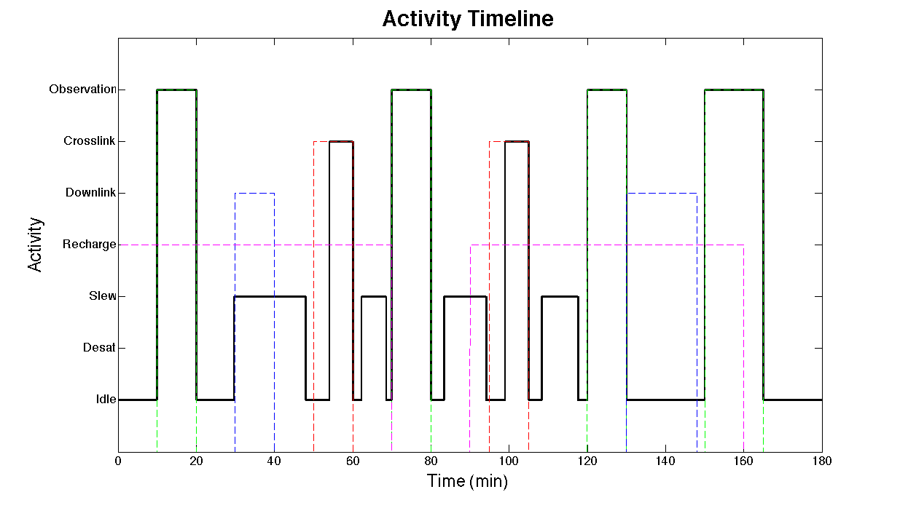
Notional Activity Timeline
Part 1
Part 2

Slide 24
Activity Planner MILP Formulation
Subject to constraints:
}
Resource
Upper
Bounds
Activity
Timing
Resource
Lower
Bounds
Observ.
Timing
** z values are 0 or 1
Similar for Data Storage, Momentum Storage
*Similar for Dlink, Xlink, Recharge, Slew
Part 1
Part 2

Slide 25
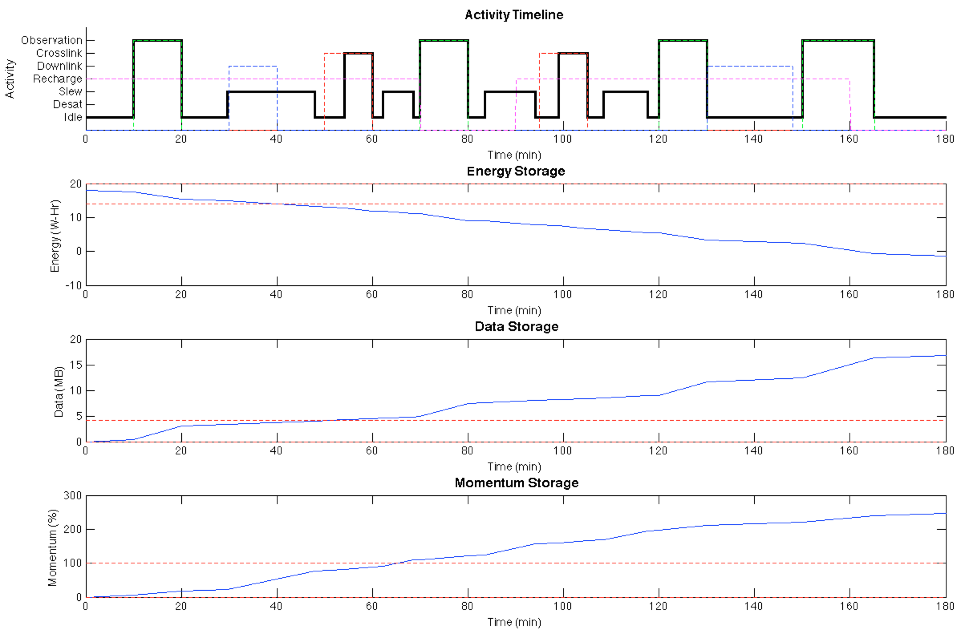
Planning – Initial Windows
Insert Downlink
Consistent Plan – with no resource constraints
Total Observ Time = 45 mins
Downlink Data Vol = 0 MB
Part 1
Part 2

Slide 26
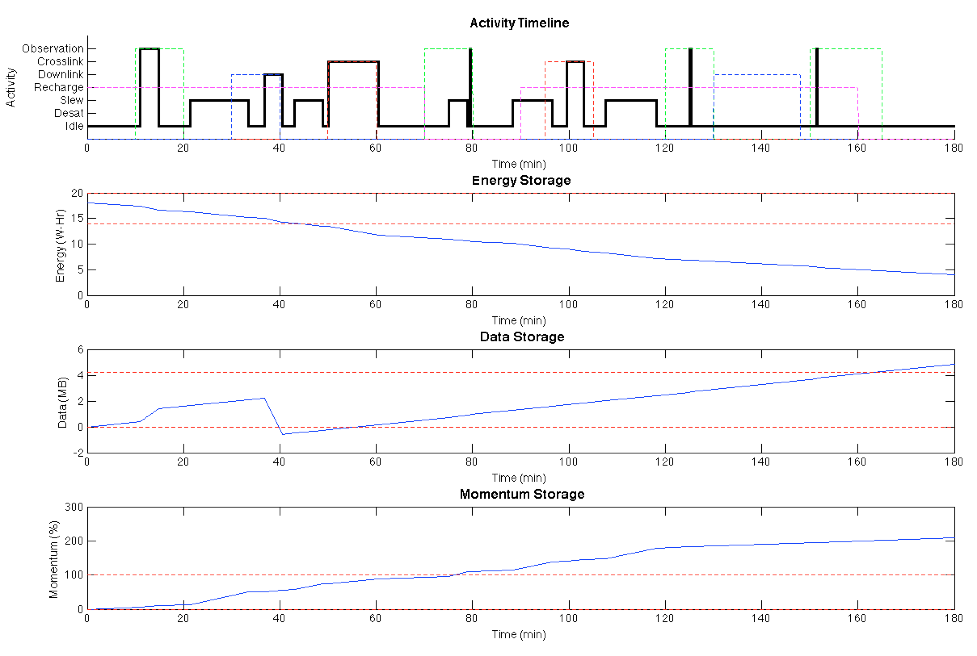
Planning – Plus 1 Downlink
Insert second Downlink
Inconsistent Plan – with DS constraints enforced
Total Observ Time = 4.70 mins
Downlink Data Vol = 2.81 MB
(*100 kbps downlink rate)
Part 1
Part 2

Slide 27
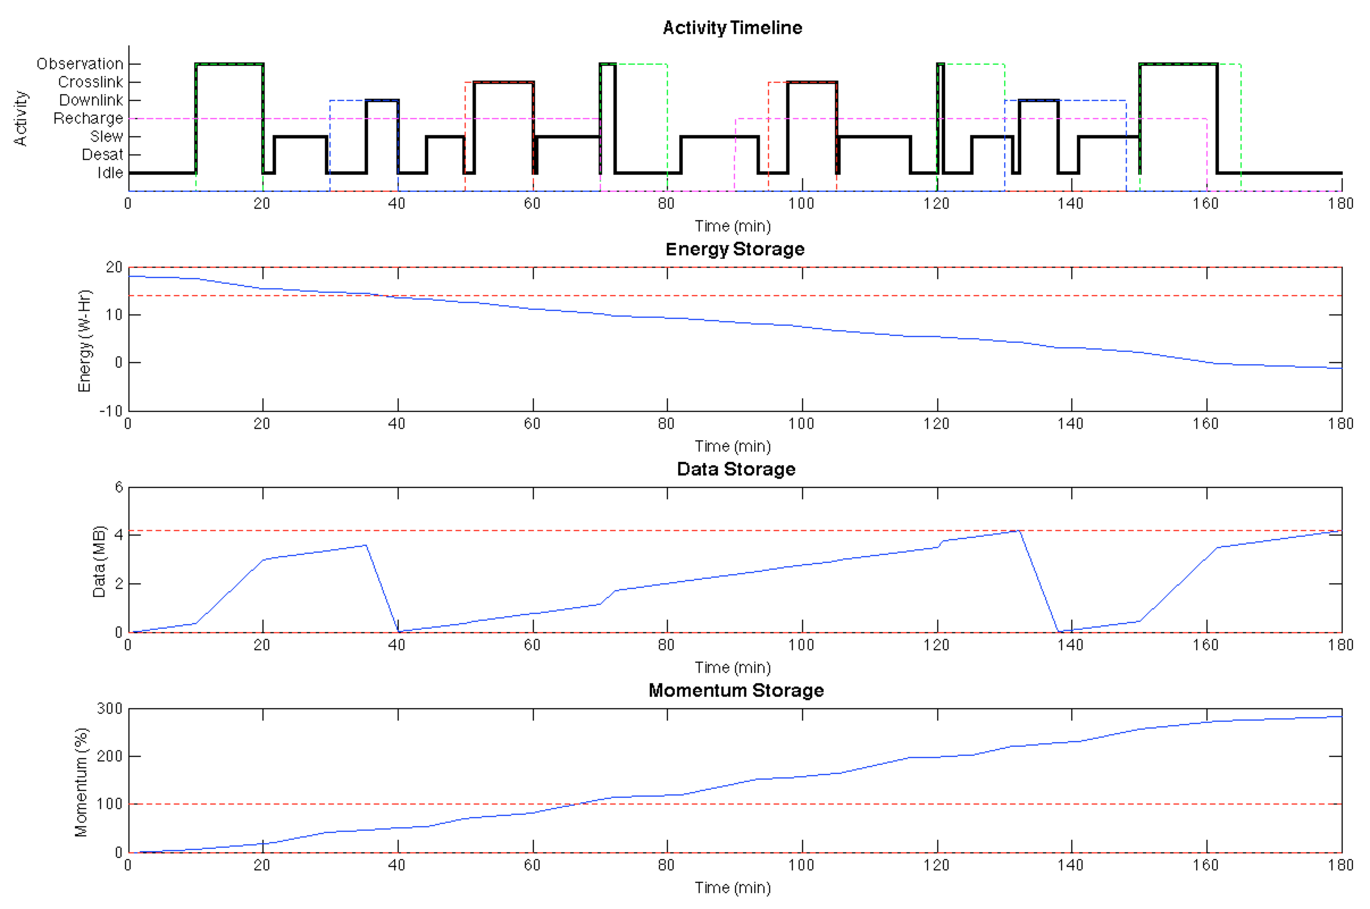
Planning – Plus 2 Downlinks
Next: add Recharges
Consistent Plan – with DS constraints enforced
Total Observ Time = 24.88 mins
Downlink Data Vol = 7.77 MB
Part 1
Part 2

Slide 28
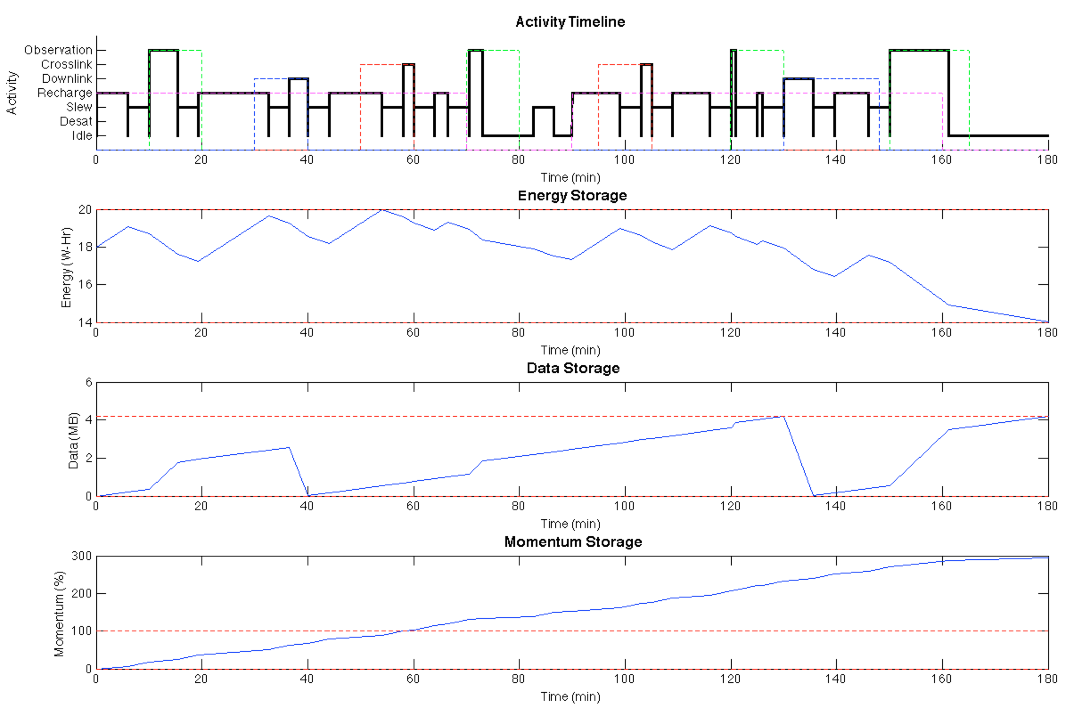
Planning – Plus Recharges
Next: add Desaturations
Consistent Plan – with ES,DS constraints enforced
Total Observ Time = 20.23 mins
Downlink Data Vol = 6.77 MB
Part 1
Part 2

Slide 29
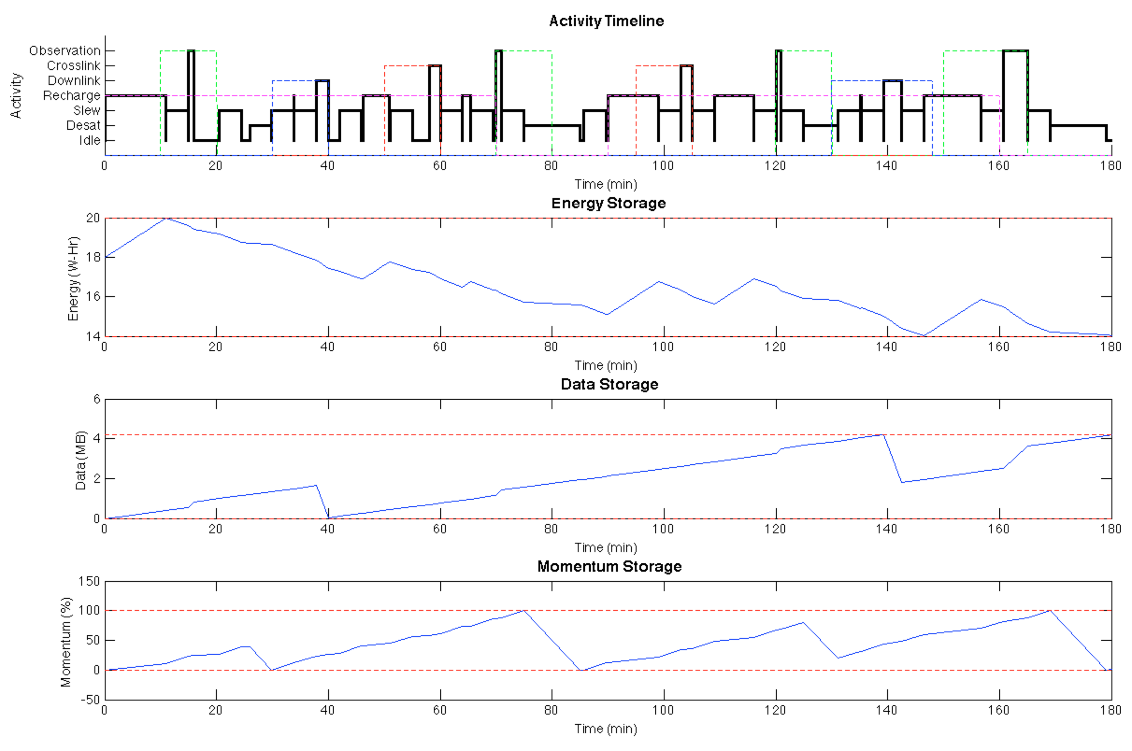
Planning – Plus Recharges
Done!
Consistent Plan – with ES,DS,MS constraints enforced
Total Observ Time = 7.32 mins
Downlink Data Vol = 4.00 MB
Part 1
Part 2

Slide 30
Outline
Purpose and Motivation
MiRaTA Flight Software Architecture
Scaling up to a CubeSat Constellation
Conclusions

Slide 31
Conclusions
Two distinct sections to presentation
  MiRaTA CubeSat Software architecture
  Planning algorithm for a single spacecraft in a coordinated constellation
A natural combination, however
  Simplicity of CubeSat FSW architecture
  Mode-based formulation of this planning algorithm
Future work involves bringing these together
  Implementing the planning algorithm in a CubeSat FSW context
  More precisely modeling resource usage onboard the CubeSat
  Figuring out how to plan coordinated activities between the spacecraft
  Testing in a multi-agent simulation
Meanwhile…
  Work on MiRaTA FSW continues
  Delivery end of 2015, for 2016 launch

Slide 32
Acknowledgements
Ryan Kingsbury, MIT StarLab
Dr. William Blackwell, MIT Lincoln Lab
MiRaTA MIT Campus and MIT Lincoln Lab teams
National Science Foundation Graduate Research Fellowship Program

Slide 33
References
[1] Blackwell, W., Bishop, R., Cahoy, K., Cohen, B., Crail, C., et al, “Radiometer Calibration Using Colocated GPS Radio Occultation Measurements”, IEEE Transactions On Geoscience And Remote Sensing, Vol. 52, No. 10, October 2014.

Slide 34
Backup

Slide 35
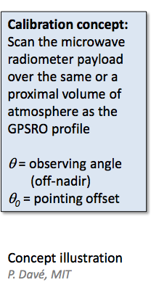
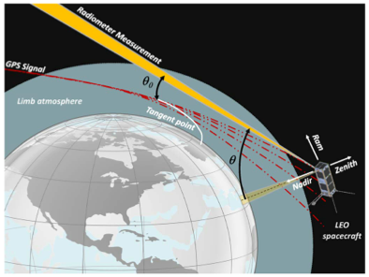
MiRaTA Calibration

Slide 36
Geograpical Locations of Profiles - MiRaTA
All profiles
Rejected profiles
CALCON14_MiRaTA_12Aug2014_RVL

Slide 37
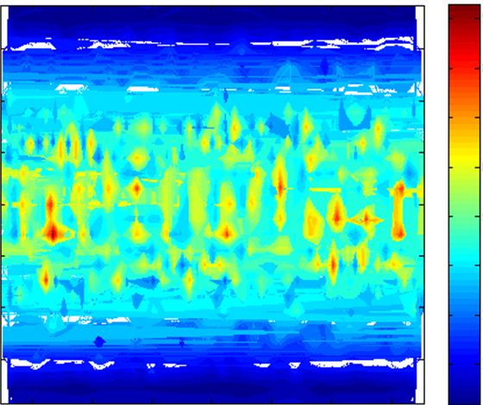
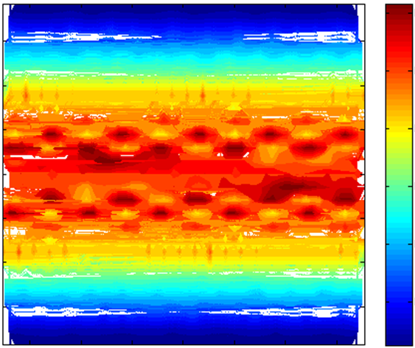
Architecture Studies Show Great Promise for Constellation Approaches
3 Satellites, one per plane
24 Satellites, eight per plane
9
.7
60
8
60
40
40
.6
7
20
6
20
.5
0
Latitude
Latitude
Mean revisit time (hours)
0
Mean revisit time (hours)
5
.4
-20
4
-20
.3
-40
3
-40
-60
2
-60
.2
-150
-100
-50
0
50
100
150
-150
-100
-50
0
50
100
Longitude
150
Longitude
2014-10-24-MiRaTA-ESTF-Cahoy-v2

Slide 38
ADCS Modes
Nominal Modes
Fault Modes
Notes:
ADCS activation
After first transition to SC Normal
Brings SC to Stable @ LVLH
Stable Mode
Holds at a given attitude relative to LVLH
Slew
Transitions from attitude A to B
Sun Tracking
Holds inertial attitude that maximizes solar power input
Safe Modes
Low Power: gracefully returns to LVLH, use magnetorquers only
Fault Safe: holds ADCS at current attitude

Slide 39
FSW Heritage
Much of the code is adapted from MicroMAS
Expect little change in driver tasks
More change in high level tasks
  More commanding intensive conops
  Need for delayed command execution
  Maneuver-centric science operations
  Beacon usage
Beacon driver entirely new
Driver Task Code
Gyro
PDU
TKD
MAI
EPS
RTD
Cadet (modem)
Payload
Beacon
High Level Task Code
Mission Manager
Housekeeping
Command Handler
ADCS Task
Legend
Little modification
Substantial modification
Completely new

Slide 40
Research Objective
To: design a software system for real-time coordination of observations from multiple spacecraft, with only limited knowledge of other agents in the constellation
By: comparing the performance of a coordination planning algorithm to an ideal baseline with a set of metrics
Using: a specially built hardware and software test bed to simulate coordinated operations
Metrics for comparison:
  Data downlink volume
  Number of successfully coordinated activities
  Onboard resource utilization
Ideal baseline
  Full observability and controllability of spacecraft
Notes:
Mention that I’m focusing on small sats, because I UNDERSTAND them. MicroMAS and MiRaTA give a good basis for understanding operational limitations for a real spacecraft

Slide 41
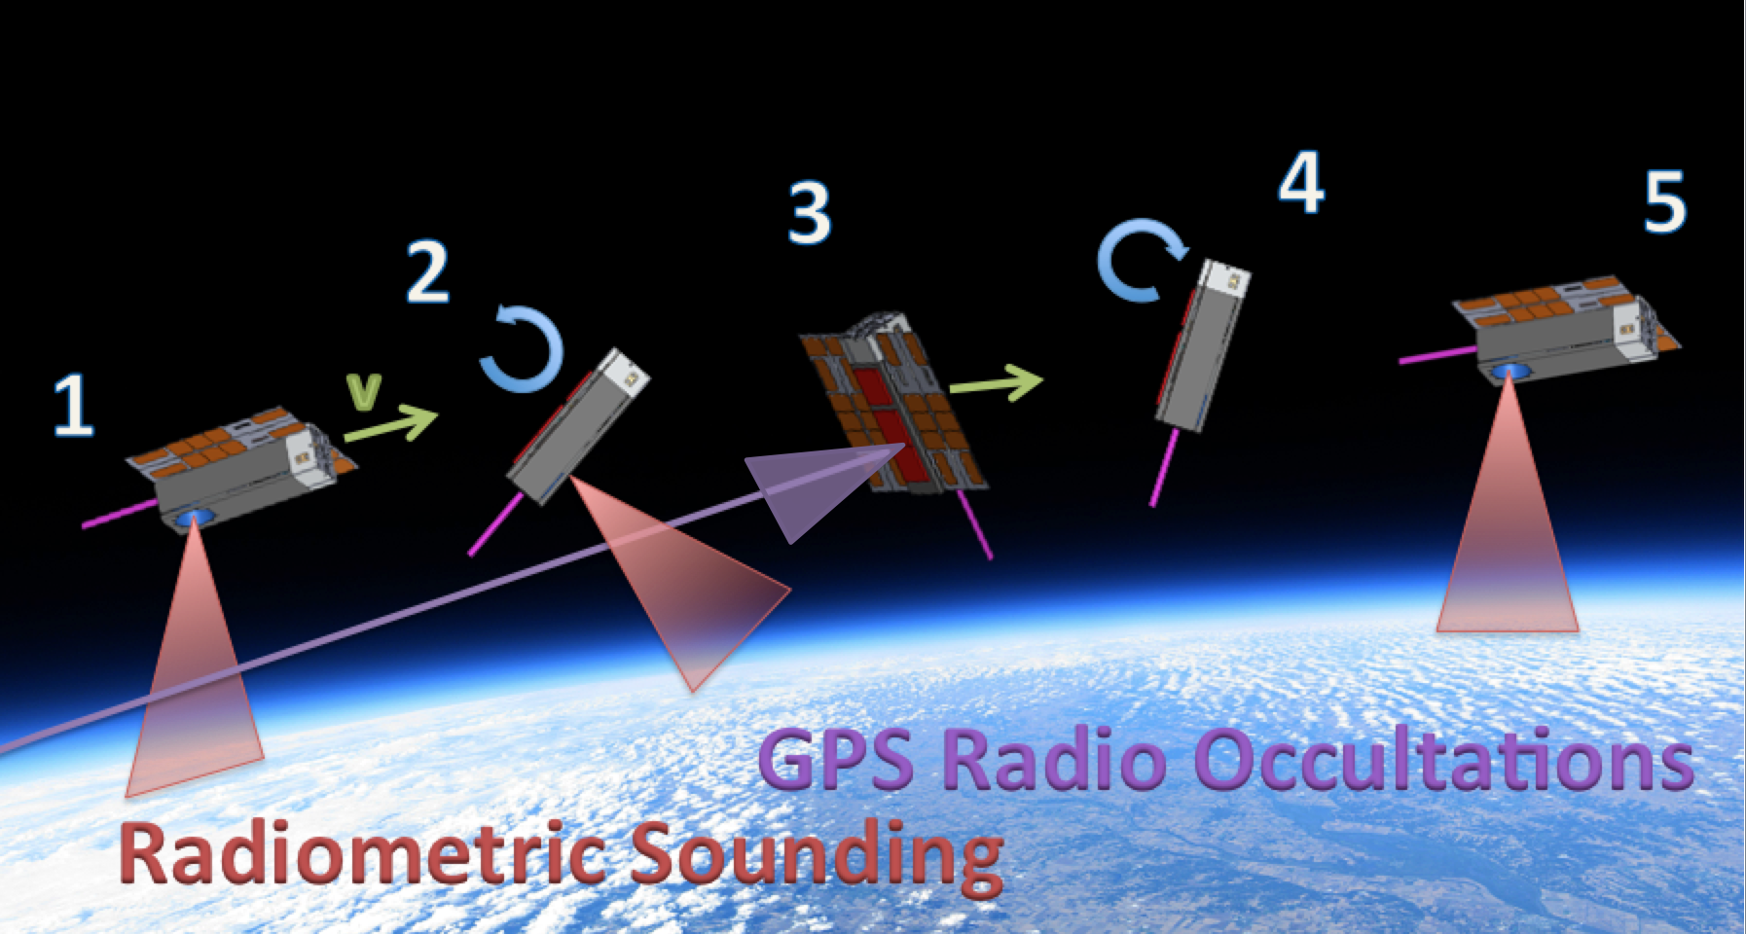
Coordinated Operations Example
Earth Weather Remote Sensing CubeSat Constellation
Heterogeneous payloads
  Radiometer sats
  GPS RO sats
Heritage from MicroMAS and MiRaTA CubeSats
MiRaTA Calibration Maneuver
Notes:
24 sats, 3 planes: < 1 Hr av. revisit
mention MicroMAS mission ops- “always-on”
mention MRO ops – perfectly presquenced
move bracketed numbers behind descrition lines

Slide 42
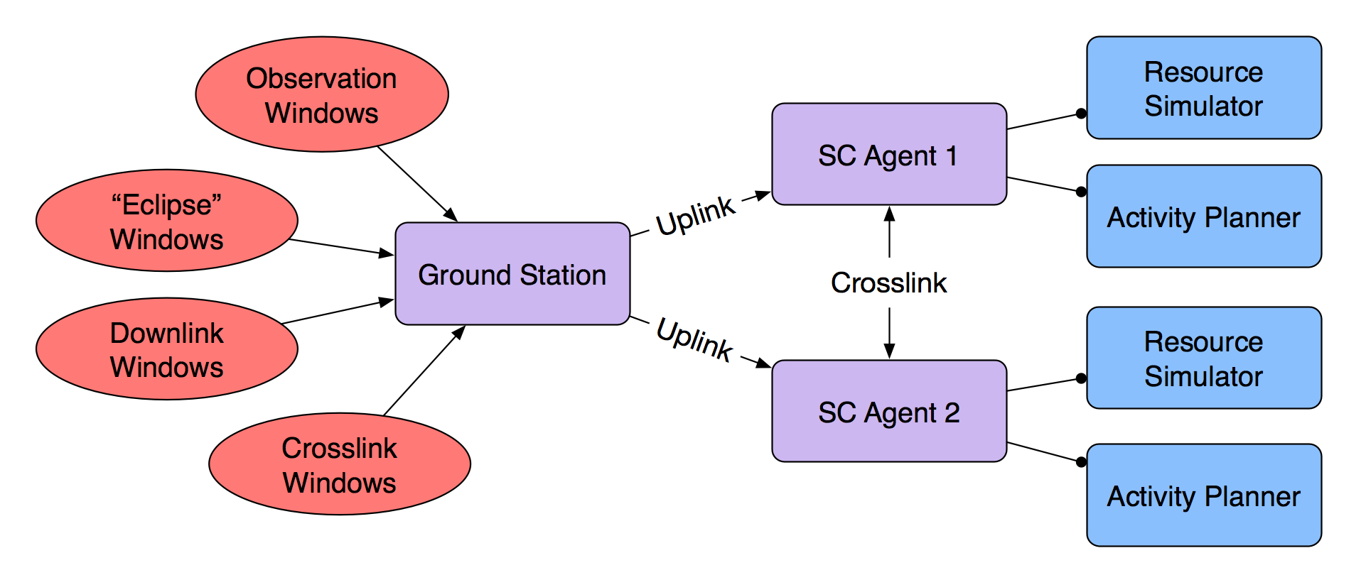
Testbed Operational Flow
“Ground” software analyzes orbital geometry
  Determines time windows for activities, uplinks to SC Agents
Agents plan activities based on shared state information
Agent SW implemented as C++ application on SSM middleware
Activity Planner formulated as Linear Program
Notes:
-need to think more about how to explain this

