Slide 1
FSW Workshop 2015
Rob Chambers
Lockheed Martin
“Orion FSW – Enabling the Future of Human Exploration of the Solar System”

Slide 2
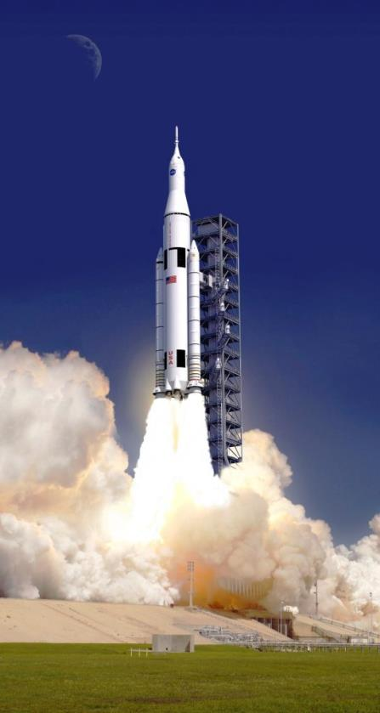
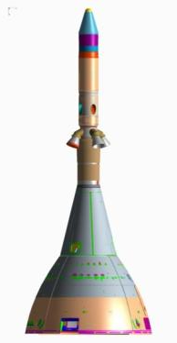
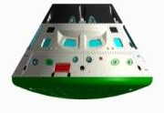
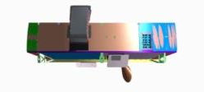
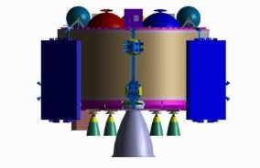
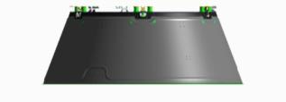
Orion Overview
Orion Top Level Functions & Configuration
The Orion Spacecraft will serve as the primary crew vehicle for NASA Exploration Systems Development (ESD) missions in Low Earth Orbit (LEO) and Beyond Earth Orbit (BEO). The vehicle will be capable of conducting regular in-space operations in conjunction with payloads delivered by the Space Launch System (SLS) Launch Vehicle.
Crew Module (CM) Functions
The CM provides a habitable pressurized volume to support crewmembers and cargo during all elements of a given mission - from Launch Operations to Earth Entry, Descent, Landing, and Recovery.
LAS
Service Module (SM) Functions
The SM, comprised of two subcomponents the Crew Module Adapter (CMA) and the European Service Module (ESM), provides services to the CM in the form of propulsion, consumables storage, heat rejection and power generation.
CM
Spacecraft Adapter (SA) Functions
Provide structural connection to the launch vehicle from ground operations through orbital injection
Provide protection for SM components from atmospheric loads and heating during first stage flight
CMA
Launch Abort System (LAS) Functions
The LAS provides an abort capability to safely transport the CM away from the launch vehicle stack in the event of an emergency on the launch pad or during ascent.
SM
ESM
SA

Slide 3
Orion FSW Distribution
Flight Control Module
(FCM)
Communications Control Module (CCM)
Displays Control Module
(DCM)
Display Unit
(DU)
Guidance, Nav, Ctrl and
Propulsion
Environmental Control and Life Support (ECLS)
Power
Mission Automation
Communications and Tracking (C&T)
External / Internal Network Routing
Displays and Controls
Electronic Procedures (eProc)
System-Level Fault Management
Backup Software Engage
Display Formats
Bezel Key I/O
CM Power and Data Unit
(PDU)
SM Power and Data Unit
(PDU)
Camera Controller
(CC)
Vision Processing Unit (VPU)
Data Bus Management
D/A Conversion
Power Control
Camera Housekeeping
Wireless Bridge
Optical Navigation
Data Storage
Video Compression
Backup Software
Primary FSW Recon
Flew on EFT-1 (about ½ the total EM-2 code base)
All FSW is Scaled Agile Model-Based C++ Development Using Matlab/ Simulink or Rhapsody
Added for EM-1 or -2 (each flight adds about ¼ the total EM-2 code base)

Slide 4
Orion FSW CSCIs
Orion FSW has 22 CSCIs
Infrastructure, GN&C, and crew displays comprise nearly 60% of Orion FSW
CORE | Syncs applications with ARINC 653 O/S and exchanges data with onboard Ethernet
GNCP | Performs guidance, navigation, controls, and prop management
DACF | Provides interface between the crew and the other on-board CEV systems via display formats
NRC | Network Router Card manages the external network connectivity and IP related functionality
VPUD | VPU Drivers for backup and recording computer, interfaces with CFS
ECLS | Performs environmental control and life support
SMG | Systems-level fault management
TVM | Timeline and vehicle management performs mission automation
VID | Video support executing on camera control computer

Slide 5
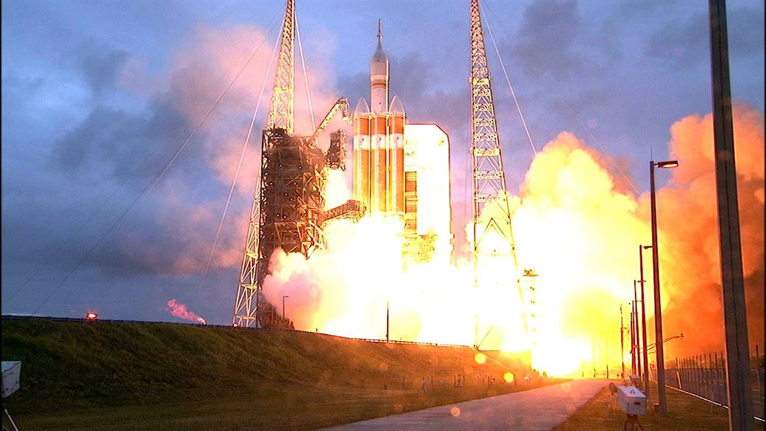
EFT-1 Ascent Video

Slide 6
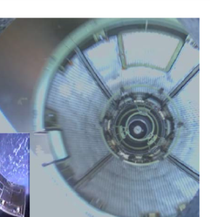
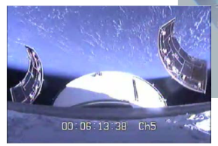
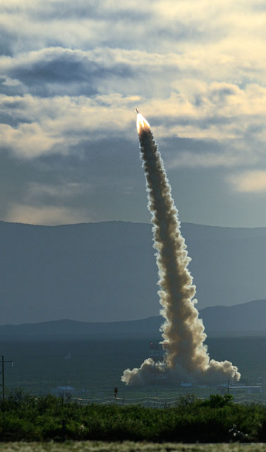
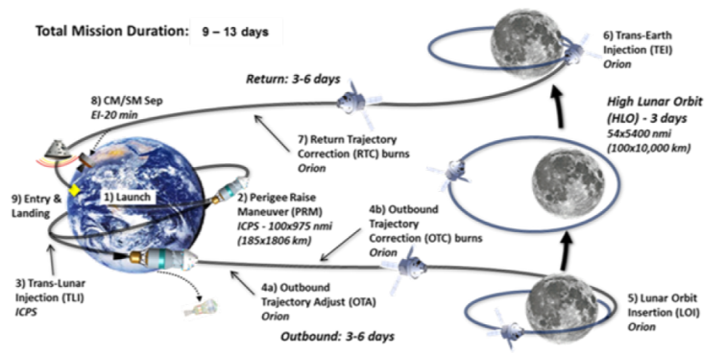
Orion Ascent FSW
The launch vehicle controls the stack, with limited crew manual steering on 1st stage
We’re a “payload”…
Inertial and GPS-based navigation
Communications through LV
Mission sequencing for Orion staging events
…unless something goes wrong
Launch Abort System (LAS)
Untargeted Abort Splashdown (UAS)
PA-1
Flight
Test
EM-2 Reference Mission

Slide 7
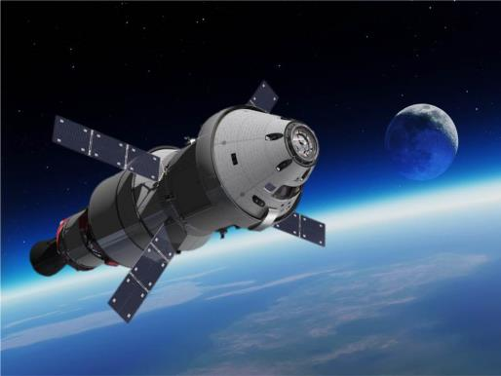
Orion Orbital FSW
“The Usual Stuff” for Earth Orbiters
Star tracker and GPS-based attitude and nav
Attitude control and maneuvers with RCS, aux thrusters, or main engine
Antenna and solar array pointing (TDRS, DSN)
Battery management
Data recording and playback
Fault management
More “Unique” Functionality
Environmental control and life support
Pressurization, humidity, CO2 rejection
Significant interaction between vehicle, ground, and crew
Full-mission coverage backup FSW
Extensive video ops (13 cameras)
EM-2 Reference Mission

Slide 8
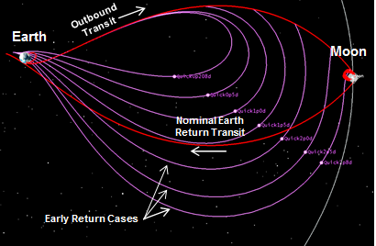
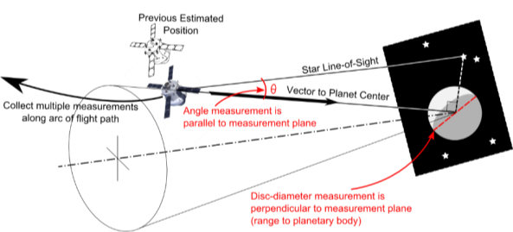
Orion Deep-Space FSW
“The Usual Stuff” for Deep Space Probes
Ground-based navigation
Extensive automated mission sequencing
More “Unique” Functionality
Optical navigation
Radiation monitoring
Time-critical powered flybys (EM-1)
Anytime abort / early return
On-board mission replanning
Multi-week duration life support
Flexible system configurations
EM-2 Reference Mission

Slide 9
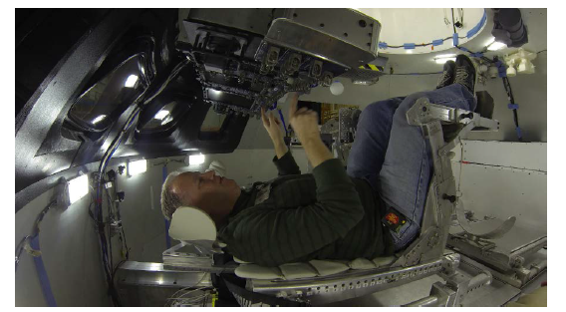
Orion Crewed Operations FSW
Two primary categories – manual piloting and supervised autonomy
Manual piloting
Stack steering during ascent
Large number of in-flight piloted modes
Entry steering, bank rates
Orion is fly-by-wire – manual piloting is really manual guidance into closed-loop controls
Supervised autonomy
Landing site selection
Mission sequencing pause, resume, authority to proceed
Over 80 display formats and various hand controllers
Key capability – electronic procedures (eProcs) which interact with formats to simplify crew operations
EM-2 Reference Mission

Slide 10
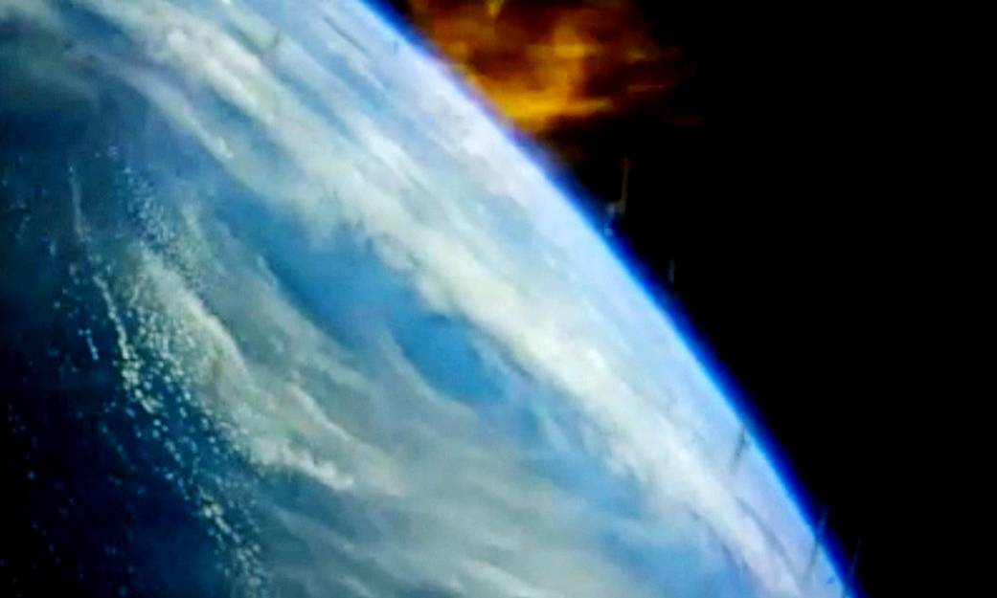
EFT-1 Entry Video

Slide 11
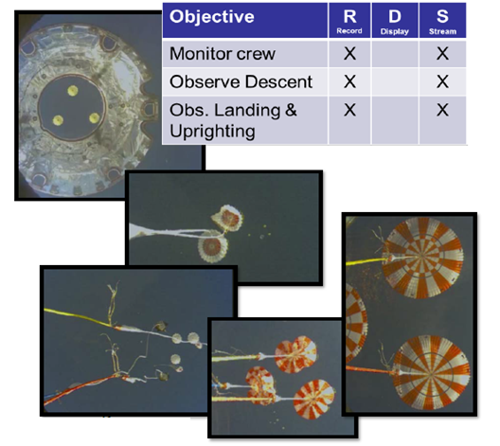
Orion Entry FSW
Orion lands off San Clemente instead of in mid-Pacific like Apollo
Tight landing accuracy and long entry-to-splashdown range – “skip” entry
Propagates to landing sites and calculates corrections
Developed for Apollo but insufficient computational throughput to execute
Multiple time-critical event-based triggers
Various primary and backup flight software downmodes
Precision guidance
Loads managed
Manual crossrange control
Ballistic (lift-cancelled)
EM-2 Reference Mission

Slide 12
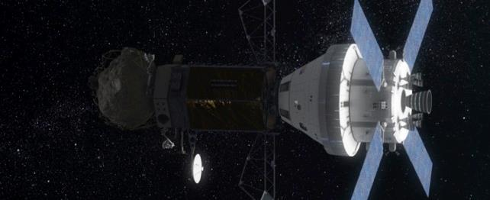
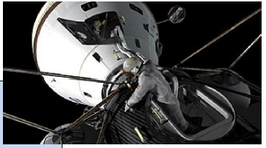
What’s Next?
Orion provides NASA’s access to human exploration beyond LEO
Cis-lunar “Proving Grounds”
Long-duration Martian exploration
Proving ground mission manifests in work using minor Orion upgrades (mostly flight software – less than 5% additional code)
Orion lunar sample return
Orion lunar habitat-based science support (e.g., far side telerobotics)
Orion exploration of lunar vicinity asteroid
Extra-Vehicular Activity (EVA)
Rendezvous, Proximity Operations, and Docking (RPOD)

