Slide 1

Mil Std 1553B Architecture for ISRO Spacecrafts
S Sudhakar-Group Head, CDEG,ISAC/ISRO
Email: sudhakar@isac.gov.in
FSW-2015
John Hopkins Applied Physics Lab, Maryland, USA
October- 2015

Slide 2
Agenda
Introduction - Subsystems
Requirements
Mil Std 1553B Architecture
Data Transfer Schemes
Fault Handling
Experiences

Slide 3
Mil Std 1553B Development Areas in ISRO – Spacecrafts
Control and Digital Area
Control & Digital Electronics
Control Hardware Development
Control Software Development
Space Astronomy
TC, TM systems
Development
Test System Development
ISAC
Sensors
Communications
Power
ISRO Inertial Systems
SAC
(Payloads)
Integration
Payload Data Handling
Control Dynamics and Simulation
Other Payload Systems Designers
AOCC – On Board Computer – Telecommand Processor Systems – BC/RT
Other Subsystems - RT
All Employ both Customised + Mil 1553B I/f
Mil Std 1553B Interface increasingly employed
Configuration evolved over past 15 years. First Spacecraft with Mil 1553 in 2005

Slide 4
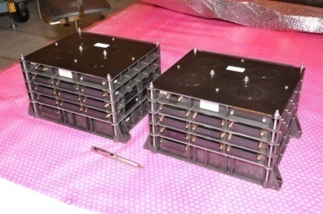
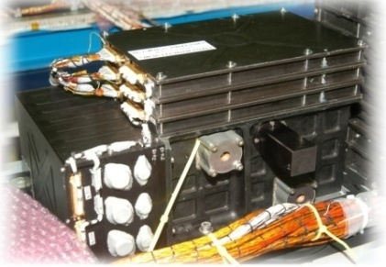
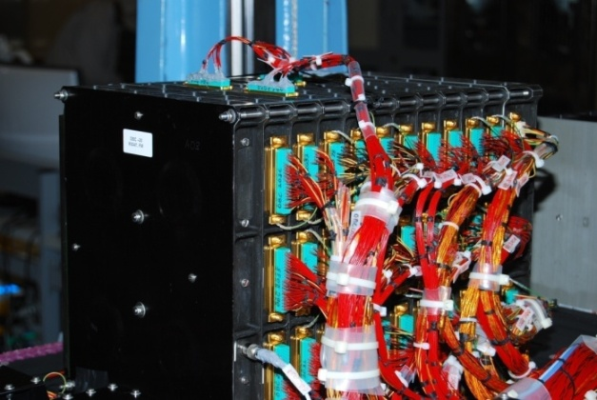
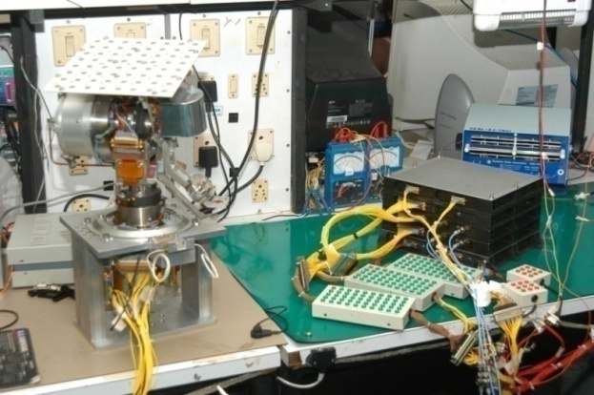
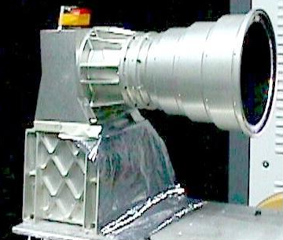
Usage of Mil Std 1553 B Bus
Functional Usage of Mil Std 1553B Bus
  AOCC / On Board Computer
  Sensors, Actuators
  TM, TC Bus
  GPS Receiver.
  Antenna Control
  Solar Array Drive
  Payload Interfaces HK and Payload Data
  Auxilliary Data Transfer for Payload Post Facto AD.

Slide 5
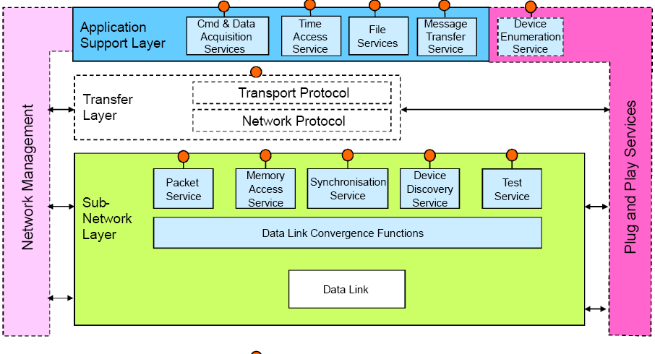
Interface Requirements
Discrete Interfaces
Serial Digital Interfaces + Analog Interfaces
Star Sensors, GPS Receivers
Analog Voltages
Digital Bits
Order of 32 words @32ms. 16kbps
Customised
Marginal increase in data rate
TM 1kbps
300 kbps
Remote Sensing Spacecrafts + Scientific Missions + Standardisation
Auxiiliary Data to Payload Processing
Scientific Payloads with minimum data rates
GEOSAT
High Data rate + CCD Interfaces
Star Sensor CCD etc. Spacewire
AOCS, TC, TM
AOCS
Navigation Payload commands
Antenna Control
Two Buses
200kbps AOCS
4kbps TM
TC, TM Reqmts
Mil 1553B Bus

Slide 6
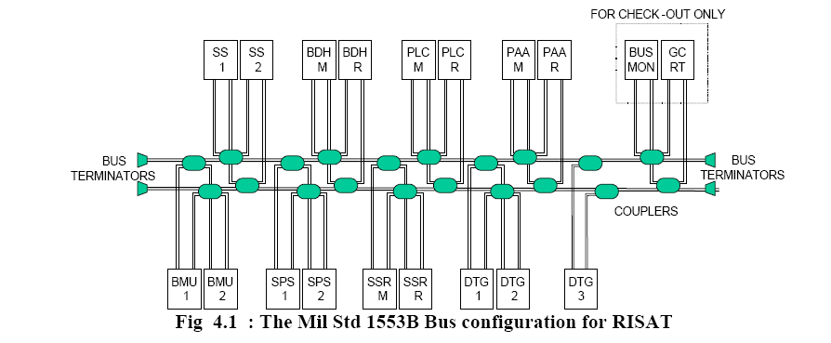
Mil Std 1553B Hardware Architecture
BMU (Bus Management Unit) – The On Board Computer (OBC) configuration uses dual redundant Bus topology with Bus A and B connected to all sub-systems.
Selected OBC will function as Bus controller and Non selected OBC will function as RT.
All other subsystems are RT
Bus Monitor only at GC.
Non Selected System – needs all data for Hot redundancy. Hence RT

Slide 7
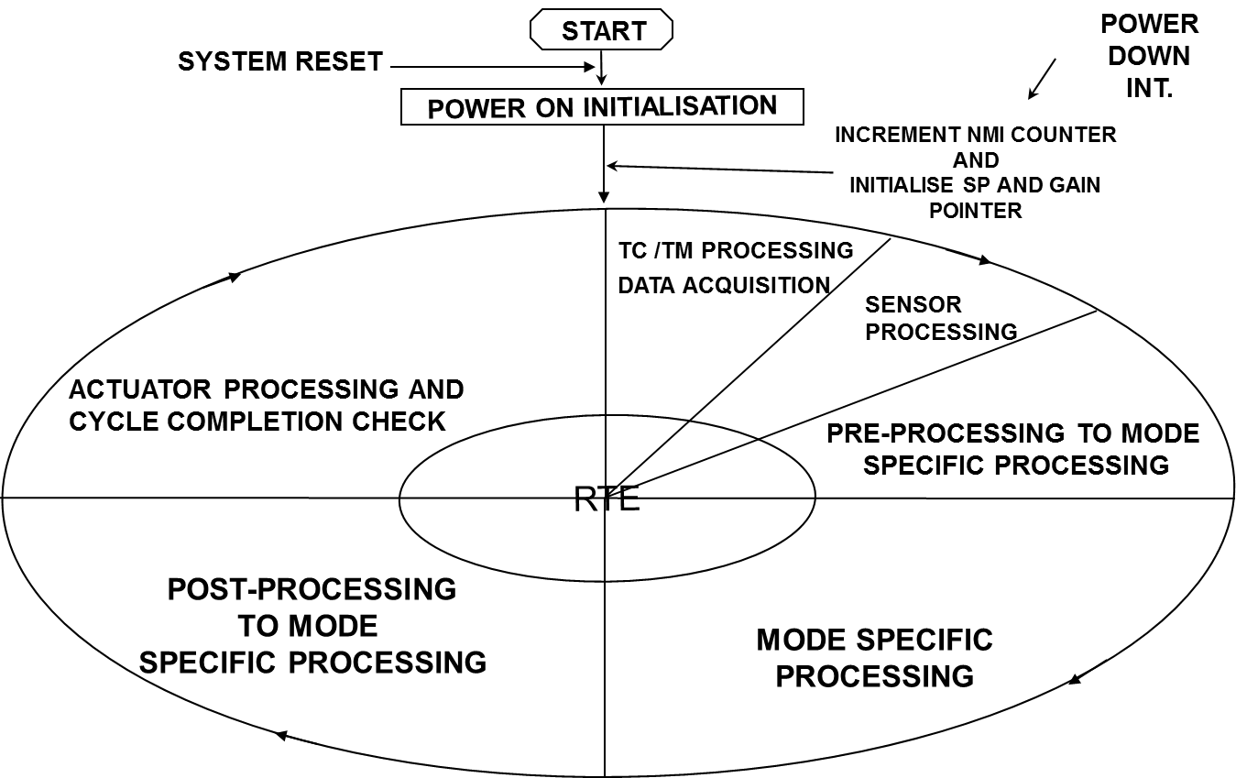
Software Architecture
Host Software
Round-robin
  Advantage
    Simplicity, Deterministic
  Short comings
    Scalability
    Fragile for code changes
    Manual partitioning
    Manual scheduling
    Multiple cycles –
    8ms/16ms/32ms/64ms
    /128ms/512ms
Mil 1553 Software
Should Match Host Software
architecture
No Asynchronous Interfaces
Deterministic
Fail Safe
Multiple cycles – 8 to 512ms.
Should have both BC, RT Functions.

Slide 8
Types of Data Transfer – Functional
Types of Data Transfer
Sensors Data
Actuators Data
House Keeping Telemetry
Telecommand
Payload Data
Payload Processing Telemetry
Calibration Data
Time Synchronisation
Protocol Handling
Fault Tolerance
Susbsystems
Sensors to AOCC
AOCC to Actuators
TM, TC to All subsystems
Payload Transfers
Non selected AOCC Data transfers

Slide 9
Data Transfer Types – 1553 Types
Message Transfer Types
  BC to RT : TC, Aux Data for Payload, Time Sync Data.
  RT to BC : TM, Sensor Data
  RT to RT : TM , Sensor Data to Non Sel OBC, Payload Data to BDH
  Broadcast : Attitude, Time Transfer to Payloads
  Modecodes :
    Synchronise Without Data : For Time correlation
    Mandatory Mode codes by standard to be enabled
    (Txshutdown, Override Tx Shutdown, Reset RT & Transmit Status word)
Function Types:
Attitude, Position Transfer :Star Sensors, SPS Data
Actuator Interface: Wheel Speed, Torque Cmd
TM,TC : Mil 1553B based TC & TM for all subsystems on the Bus
Time Correlation: For GPS Time, OBT Transfer
Aux Data for Payload : For Payload Data Processing
Payload Data : Science data from Payload
Antenna Control: Beam Angle for transferring Payload Data.

Slide 10
Types of Software Interfaces provided
Types of Interface Services Provided
TC Service
  Type 1,2,3
TM Service
  Function, Format Based
Periodic Data Service
  Critical, Delay Reqmt, Hardware synchronised
Polled Request Periodic Service
  Data Ready, Data Request I/F
Asynchronous Message Transfer Service
Time Sync Service
Bulk Data Transfer Service
Used by:
  Time Critical Data => Gyro Sync, Time Marker
  Periodic => Sensor Data ( like Star sensor) H/w Sync, Auxilliary Data
  Data Ready Driven => Data like GPS Position, Payload Data
  Delay Requirement => Data like Gyro Angle read after Sync
  Asynchronous Data => Telecommand Derived
  Bulk Data => Payload data ( Periodic)
  Bulk Data => asynchronous – Large volume – like Software Patch

Slide 11
House Keeping Data Transfer Schemes
Telecommand Transfer:
  Type 1: Simple, Single Transfer 32 Bit.
  Type 2: Single 1553 Subaddress Transfer. 32 Words
  Type 3: Bulk Transfer. More than 1 Transfer.
  ( Patch Upload, Payload Data Update)
  Data Transfer Completion Identifier– Part of Data.
Telemetry Acquisition:
  Functional Acquisition. ( Along with Sensor / Interface data)
  Separate Format Driven Acquisition
  Dwell / Super sampling Acquisition
Asynchronous Message Transfer:
  Provision in Scheduler to include message which can be uplinked and used for BC to RT or RT to BC data transfer.

Slide 12
Major System Requirements Considered.
Maximize Efficiency of Data transfer. - whenever bus is used for data transfer, the data should be utilized.
Data is grouped- Function wise – AOCS, HK, Handshaking
Schedule wise - Time critical, Periodic, Data which require delay
Delay times are effectively used – because of grouping
Low volume Handshake I/F ( on 1553) for High volume message Data
Maximize the usage of the bus for all Interface requirements to avoid other discrete interfaces.
  Schemes for All data transfer Reqmt, Time sync, 1553 Protocol, Minimum Latency I/F
Minimize the Dynamic Scheduling of data - To simplify design and employs a fixed, determinant, reliable scheduling scheme.
Minimize Host Processor interactions
Reliable data transfer
  Data Transfer verification – Protocol wise, Data wise with Checksum, Validation schemes
Provision of Fault tolerant features
  Bus and BC Changeover Logics

Slide 13
Mil 1553B Bus Profiling
Bus Profiling
  Architecture Design: Minor Frame (8ms), Major Frame (64ms), Super Frame (512ms)
  Allocation of Bandwidth / Slots for Each Subsystem
  Identify Slots – Critical / Delay / Periodic / Post Delay
  Scheduling – Periodic / Handshake Driven / Asynchronous
  Bulk Message Slots Provisions
  Syncing of Hardware Events with Mil 1553 Cycle
  Compute
    Margins in Each Minor Frame
    Execution Latency
    Minimum / Maximum Delays

Slide 14
Mil 1553B Bus Profiling contd..
Bus Profiling contd..
Data Ready and Data Request Messages
  Time Critical - Hence Sampling / handling is periodic
Data Transfer Messages
  Dictated by Consumption of Message
  Gyro usage before Controller
  Actuator after Controller
  Loop bandwidth requirements
Periodic Data messages
  Dictated by periodicity
  Source of data / Source Modules

Slide 15
Typical Scheduler Design
Selected AOCC is BC.
Non selected AOCC is RT
Message Table for Each Message
Grouping of Messages of Each RT.
Each RT is a component
Messages divided as
  Time Critical
  Periodic
  Asynchronous Messages
  Event Driven Messages
  Bulk Messages
Fixed Scheduling
Bulk messages dynamically
scheduled in fixed slots
Main Frame 1
Main Frame 2
Start Message
Start Timer
Wait For Timer End
End Message
Critical Slot
Post Delay Slot
Normally filled with
TM, Dwell TM Messages
Subsystem Interface Modules
Cycle Number
Request Flag
Scheduler
Main
Frame
Scheduled Flag
Protocol Chip
Subsystem Interface Modules
Request Flag
Scheduled Flag
TCP

Slide 16
Mil Std 1553B Scheduler + Host CPU Configuration
Slots
Slots Variable
Slots for allocation
Mil Bus Scheduler Update
MF-1
Mil Bus Scheduler Update
MF-2
Mil Bus Scheduler Update
MF-1
1553 Bus Activities
Post Delay Messages
Post Delay Messages
Post Delay Messages
Processor Activities
MIL Bus Reqmt Gen
MIL Bus Reqmt Gen
MIL Bus Reqmt Gen
MilBus Data Copy
Delay Fill
Messages
Delay Fill
Messages
Delay Fill
Messages
MilBus Data Copy
MilBus Data Copy
1553 Cycle
Completion
check + Init
Critical
Messages
Critical
Messages
Critical
Messages
1553 Cycle
Completion
check + Init
1553 Cycle
Completion
check + Init
Hardware
Events
MF1
MF2
MF2
<100us
Minor Frame 1
( 8 msec)
Minor Frame 1
1553
( 8 msec)
Minor Frame 2
( 8 msec)
Minor Frame 2
1553
( 8msec)
…
Minor Frame 64
(8 msec)
Minor Frame 64
1553
(8 msec)
t
Super Frame ( 512ms)

Slide 17
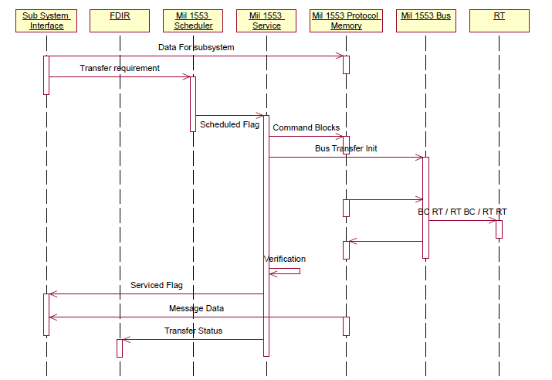
Mil 1553B Typical Interfaces
Interfaces Provided
Data
Message Transfer Requirement
Message Service Flag
Message Error Flag
Time of Message Information
Bus Used Flag
Transfer Status

Slide 18
Functions Implemented in OBC
Selected OBC Functions as Bus Controller
Bus Controller Functions
  Message Transfer Requirement Generation
  Message Scheduler
  Message Transfer Verification
  Data Copy to Respective interface data
  Bus Selection and Bus Changeover Logic for each RT
  TC,TM
  FDIR
Data Transfer is initiated every minor cycle by OBC Software
Messages to be initiated are decided by respective interface modules.
Non Selected OBC functions as RT
RT functions
  Message Transfer verification
  Bus Selection
  TC, TM
  Time of Message Transfer
  Bulk Message Handling
  Handling Asynchronous Sampling
  Double Buffering
Common Functions
  Refresh RAM operations
  Register Refresh Operations
  Initialisation
  System Changeover Logics

Slide 19
BC,RT Initialisation – OBC Changeover
OBC
OFF
OBC On
MIL STD 1553B
Modes of AOCE
OBC System or
Processor Reset
Power On
Init
Power On Init Over
Init Mode
States in OBC Major Cycle
BC Delay Not Over
OBC Changeover
OBC Not Selected
OBC Selected &
BC Delay
Over
OBC Changeover
BC
Mode
RT Mode
No OBC Changeover
No OBC Changeover

Slide 20
Time Sync Schemes
Time Sync Interfaces
1. Marker From Time Source / User
Hardware / Mil 1553 Marker ( PPS, Sync Mode Code)
2. Time at Marker from Time Source
Time Sync – By Marker followed by Onboard Time
Time sync – applicable for both - OBC to subsystem or GPS receiver to OBC
Marker – Discrete I/f like PPS / 1553 Message though Sync without data Mode command
Time sync message types – RT Based
Broadcast Based – single / alternate Bus
TT Register is kept track w.r.t On Board Time – For monitoring all messages and events.
Marker Syn c
Time Tag register
Time sync accuracies in the order of 100us.

Slide 21
Mil 1553B Bus Typical Implementations
Function | Implementation
Bus Configuration | Dual Redundant Transformer Coupled
Topology | Single & Two Level used
Bus Selection | Individual RTs can be selected for A or B
Bus Reconfiguration / Retry | Retry Not used ( to be deterministic) Changeover to Other Bus in case of 3 successive failures
Bus Load | Less than 60% ( Megha) Others normally < 50%
Subsystem | Function | % Load over 1024ms cycle
Between OBC 1 & 2 | Monitoring Data , Time Correlation | 5%
Star Sensor | TM,TC, Attitude, Aux Data | 6.5% 2 SS => 13%
GPS Receiver (IRS-P5) | TM,TC, State Vector, Aux Data, Time | < 1 %
DTG ( C-2) | TM,TC, Attitude, Aux Data | 1.5% 3 DTGs => 4.5%
SSR ( C-2) | TM,TC | <1%
Dual Gimbal Antenna | TM, TC, Beam Angles, Sensor Data | 1 %
Wheel Drive Electronics | TM, TC, Speed, TCS | 1.6% 3 WDE => 4.8%
Payload Controllers | TM, TC, Time | 1%
Baseband Data Handling | TM, TC, Aux Data, Time, Handshake I/F | 6 %
Broadcast Data Chandrayaan | Marker, Time of Marker, Attitude & Time | 1 %
MADRAS (MeghaTropiques) | TM, TC, Time, Payload Data | < 7 %

Slide 22
Typical Hardware Implementation
Local PROM, RAM,I/O
Processor or Eqvt Logic
Processor Based
Non Processor Based Systems
Protocol controller Memory
mapped
Two level Topology requires
two protocol controllers
Protocol Controller chip based
IP Core – based
External RAM to Controller
upto 8KW of Shared RAM
With Built in / External
Transceiver
Tansceiver, Transformer with
5V, 15V, 3.3 V options
Shared RAM
Reset
Clock
Memory Arbitration Logic
Mil Std 1553B Protocol Controller
BC/RT
RT Addr
1553 A/B
Transceiver +Transformer
Low Latency I/O Through 1553
Bus A, B

Slide 23
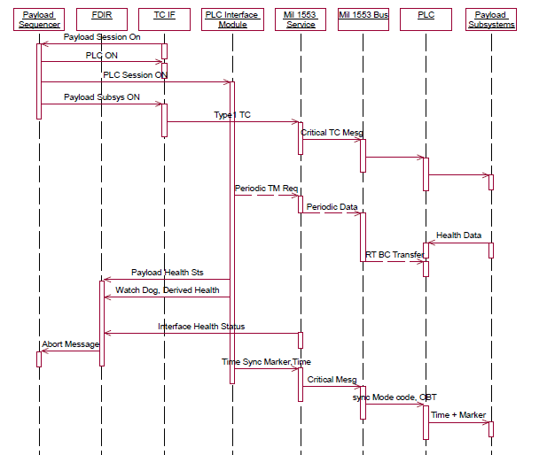
Typical Implementations – SAR Payload Controller Interface

Slide 24
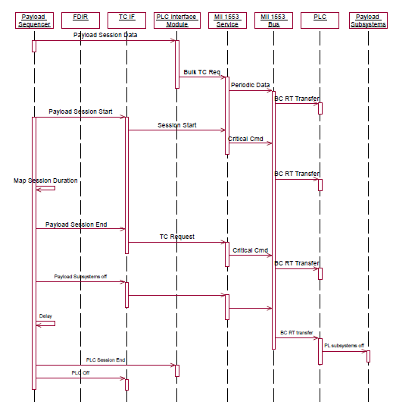
SAR Payload Controller Interface - Contd..

Slide 25
Interface Safety Features
Major Requirements:
  Data Transfer Consistency
  Functional Consistency
  Communication Verification
Means:
  Parity Bits in I/f
  Wild sample remover
  Validation of at least 3 consecutive samples for taking critical action
  Checksum in Packet Transfers
  Validation with Other sensors
  Valid / Invalid bit provision in I/f
  Communication Validation.
Consistency of Data ensured by
  Data Ready logic – Sampling + Delay requirements
  Checksum in all critical packets
  If synchronised with hardware, scheduler profile sync with hardware. Periodic Forced Sync.
  Double buffering if required

Slide 26
Fail Safe Logics
RAM Refresh
  Periodic refresh of Protocol logic pointers
Register Refresh
  Protocol registers are initiated every cycle.
Bus Fault Detection logics
  Bus Changeover Logics
  Successive 3 Fail cycles changes Bus for the RT
  RT FDIR : Further 3 successive Fail cycles declare RT failure after changeover.
  Detection of BC failure – for 2 selected RTs results in BC changeover - by declaring Safe Mode.
FDIR for subsystems / Payloads
  No Retry used. Auto Bus changeover logic is expected to Act
  Heart Beat timers are provided in periodic readout ( TM). Incase of freeze, shutdown actions are initiated.
  In addition, Payload can request shutdown, in case it finds wrong sequence or anomaly.
Onboard Diagnostics
  1553 Cycle Completion Error Checks and Diagnostic counters
  Interface Fail Error Counters
  Mil 1553 Bus Error checks and Fail counters
  Real Time Executive - Scheduler – Time overrun Indicators
  Message Status, Bus Status of Mil 1553B

Slide 27
Experiences
Mil Std 1553B Interface Architecture – Problems seen
Hardware Protocol is well established
  Problems due to Current / Powering /Grounding Configurations – Requirements
    Routing Txr Supply, Grounding
Most Software Problems are related to Data definitions
  Sub Address Mismatch – Normally resolved at ICD Level
  Response to Mode codes – Resolved at Interface Tests
  Asynchronous Interfaces
  Behaviour during System Changeover – RT to BC
BC RT Changeover Logic
Delay provided in BC RT changeover logic resulted in
  Wrong Saturation of Incremental angle at Gyro End
  Non transfer of Star sensor REFT signal – resulted
  in Hangup of Star sensor
Problems identified early – Solutions worked out.
Incremental angle accumulated
By gyro and transferred to AOCC
At Sync
Sync Loss due to changeover
Incremental Angle
Saturated Incr angle with
Wrong polarity

Slide 28
Experiences contd..
Scheduler Effects
Correlator was getting reset with Mil Std 1553B Interface in GPS Receiver.
  Flight Scheduler schedules all messages together once Data ready is received.
  Always the Receiver was tested with 1 msg at a time.
Early Interface Test with BC Scheduler identified the Issue and correction carried out at GPS
Database Driver Scheduler + Schemes are provided for BC simulators.
64ms
Data Rdy Sampling
Sync Command
1 min
Read State Vector
Measurements
SL, NS OBC
SPS State vector
Measurements Reading
< 1 sec
Time sync Reading
1 sec

Slide 29
Conclusion & Future.
  Mil Std 1553B Bus has been effectively used for various ISRO spacecraft Applications.
  Typical requirements of AOCS & other applications have been captured and used.
  Present Monolithic configuration with service functions needs to be migrated to more Layered architecture.
  Requirements with multiple 1553 Bus topologies for isolation reqmts are provided.
  Also other interface requirements are being increasingly envisaged at various levels, i.e Spacewire, CAN Bus, I2C at Lower level.
  CCSDS –SOIS is to be considered for the advantages of mixing multiple interface standards, multiple sources and including Multiple Processors in future.

Slide 30
Acknowledgements are Due to
Dr. A S Kiran Kumar, Chairman ISRO
Dr. M Annadurai, Director ISAC
Mr. Subramanya Udupa, DD, CDA, ISAC
Colleagues and Team members of
Control and Digital Electronics Group,
Sincere thanks to
Dr. Allen D Unell, Chairman FSW-2015
Mr. Subodh Harmalkar, FSW-2015, APL
Thank You
sudhakar@isac.gov.in

