Slide 1
Test-as-You Fly SpaceWire for Solar Probe Plus
Rich Conde, SPP Deputy Spacecraft System Engineer
Andrew Harris, SPP Testbed Software Lead
Alan Mick, SPP Data System Engineer
This presentation does not contain ITAR restricted information.

Slide 2
Summary
The Solar Probe Plus uses SpaceWire as the primary data interconnect between the Single Board Computers, the Avionics, and the Radios.
SpaceWire, specifically the SPP router, has capabilities that can greatly simplify spacecraft test configurations, simplify simulation of missing spacecraft components, and allow injection of data for testing fault conditions.
These capabilities are:
  Logical addressing
  Packet duplication
  Remote updating of the routing table

Slide 3
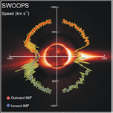

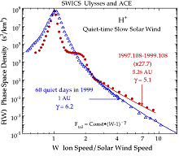
Solar Probe Plus Science Objectives
Primary Science Goal:
  Determine structure and dynamics of Sun’s coronal magnetic field, understand how the solar corona and wind are heated and accelerated, determine what mechanisms accelerate and transport energetic particles
The primary SPP mission science goal defines three overarching science objectives
  Trace the flow of energy that heats and accelerates the solar corona and solar wind
  Determine the structure and dynamics of the plasma and magnetic fields at the sources of the solar wind
  Explore mechanisms that accelerate and transport energetic particles
Notes:
Two major themes of Solar Probe science objectives:
Coronal heating and solar wind acceleration
Production, evolution and transport of Solar Energetic Particles

Slide 4
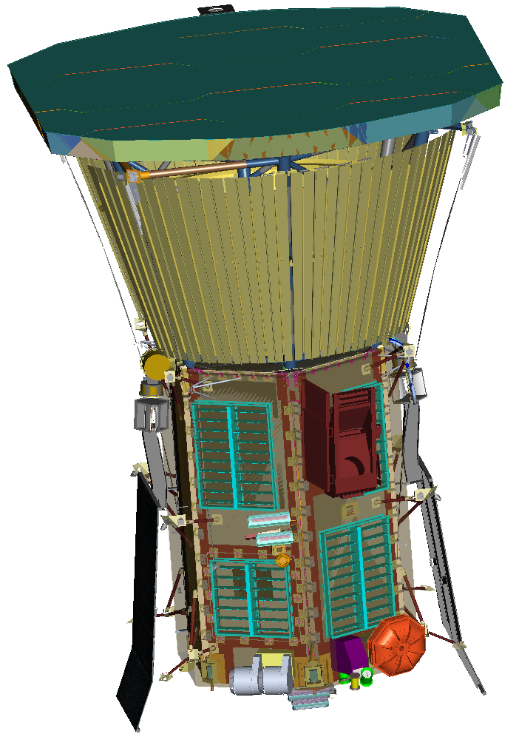
Spacecraft Overview
Three Axis Stabilized
  Wheels + Thrusters for Momentum Dumping.
Ceramic Coated Carbon-Carbon Thermal Protection Shield (TPS)
Actively Cooled Solar Power System
  Water Cooled Solar Array Substrates
  Mechanical Pump Loop
  Radiator area under TPS
Design Drivers:
  Solar Environment
  Mass
  Power

Slide 5
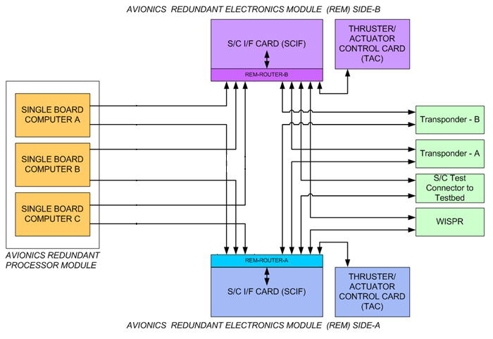
Solar Probe Avionics and SpaceWire Network
SpaceWire Selected over 1553:
  Greater Bandwidth
  Lower Emissions
Redundant Processor Module
  Prime, Hot Spare, Backup Spare
Redundant Electronics Modules
Two Cross Strapped Transponders
Cross Strapped Imager

Slide 6
Solar Probe Avionics and SpaceWire Network
NOTE: SpaceWire Router provides connection the Spacecraft testbed.

Slide 7
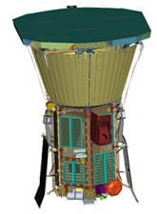
Testbed Functional Responsibilities
The testbed is responsible for the following capabilities:
  The testbed substitutes for components that are under development or that have been “swapped out” for various reasons during integration testing.
  The testbed maintains a “truth model” that simulates the dynamics of the spacecraft based on the history of reaction wheel / thruster actuation.
  The testbed updates avionics telemetry with the “truth” maintained by the truth model.
  The testbed allows injection of non-nominal data to simulate fault conditions for testing autonomy responses.
TRUTH MODEL

Slide 8
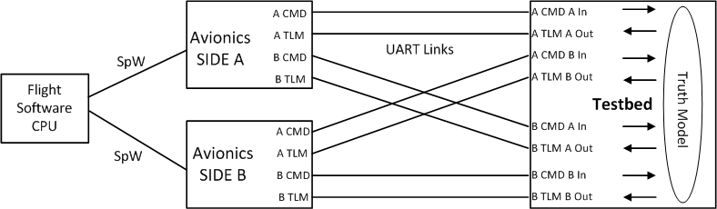
Tried and True Implementation (Notional)
TRUTH MODEL

Slide 9
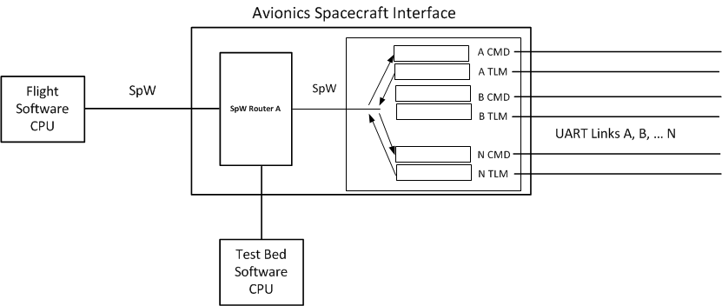
Spacecraft Interface Detail (Notional)

Slide 10
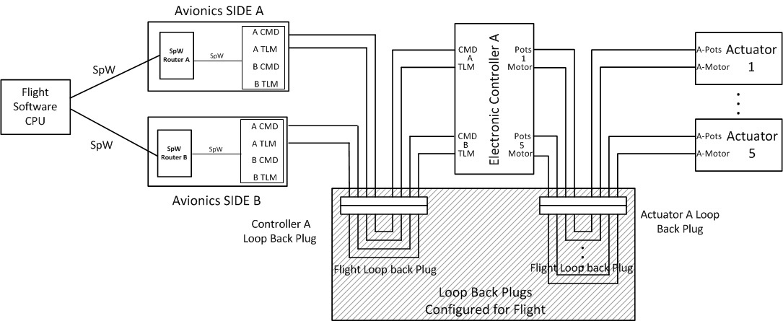
Tried and True Implementation (Notional)
Loop Back Plugs Provide Insertion Points for the Test Bed UARTS
Notes:
Mass Penalty About 800 g

Slide 11
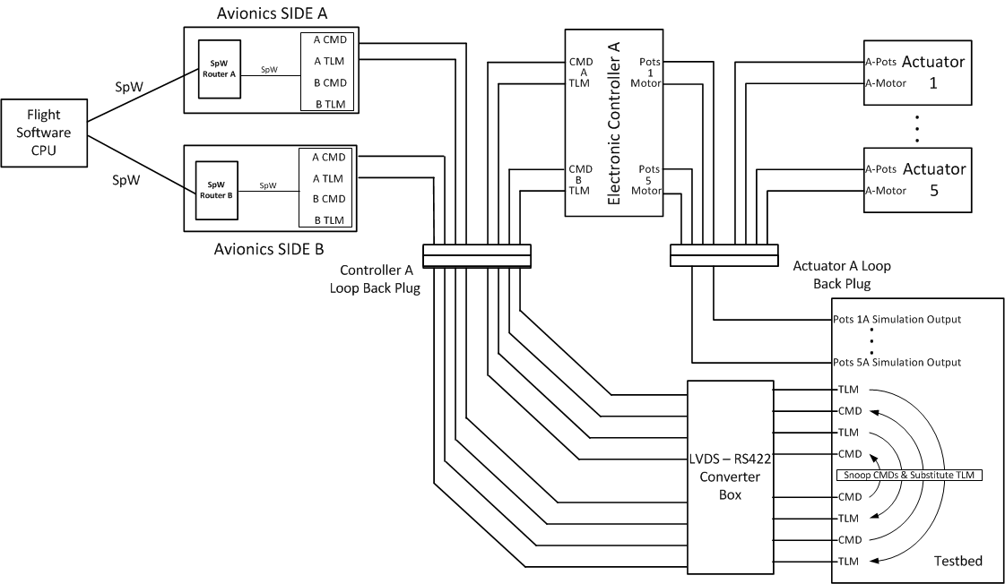
Tried and True Implementation (Notional)
Loop Back Plugs Provide Insertion Points for the Test Bed UARTS

Slide 12
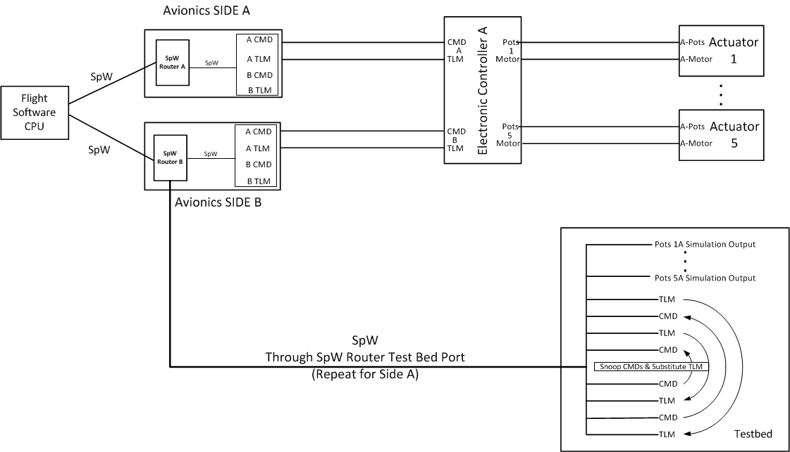
Simplification Utilizing SpW (Notional)
Use SpW Capabilities to Snoop and Substitute through SpW Router
Notes:
Note NO mass penalty, save 800g.

Slide 13
SpaceWire Capabilities Used
Remote Memory Access Protocol (RMAP)
  Allows reading and writing of avionics memory buffers from multiple sources.
    In flight only the flight software initiates RMAP transactions.
    During system level testing the testbed software may also initiate RMAP transactions, allowing it to snoop and substitute avionics data.
Logical Addressing
  Each separate component, regardless of physical node, has separate logical address.
  The testbed software can re-route transactions for specific components by updating the SpaceWire router logical address table for that component.
Packet Duplication
  Each logical address may be routed to TWO physical addresses. The packet is duplicated to the second physical address.
  The testbed software can set up the router to duplicate packets from specific logical addresses allowing it to snoop avionics data in parallel with the flight software.

Slide 14
Component Substitution –
Utilizes Logical Addressing
The testbed substitutes for components that are under development or that have been “swapped out” for various reasons during integration testing.
  The testbed software updates the SpW router to route the components logical address to the testbed, rather than the component’s port.
  The testbed software emulates the component’s functionality and responds appropriately.
  The flight software functions as it would in flight.

Slide 15
Truth Model Maintenance –
Utilizes Packet Duplication
The testbed software maintains a “truth model” that simulates the dynamics of the spacecraft based on the history of reaction wheel / thruster actuation.
  The testbed software updates the logical addresses of the components providing sensor data in the SpaceWire routing table.
  The update specifies the testbed SpaceWire port as a secondary destination for packets directed to that logical address.
  The router duplicates SpaceWire packets sent to that logical address to the testbed’s SpaceWire port, allowing the testbed software to “snoop” on commands and telemetry, updating the truth model.

Slide 16
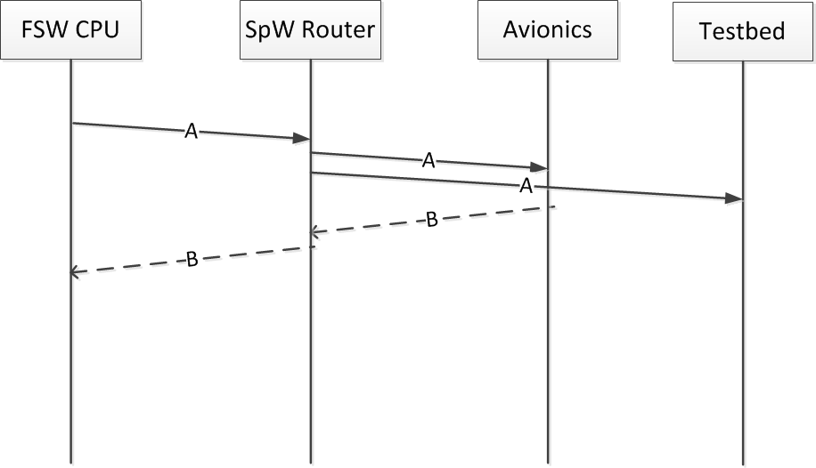
Truth Model –
Command Snooping
Commands = RMAP Write Transactions

Slide 17
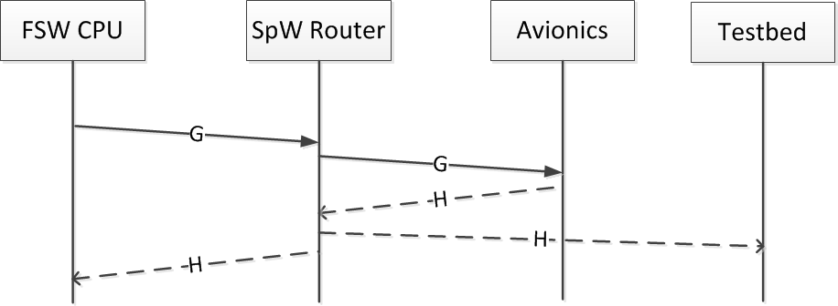
Truth Model –
Telemetry Snooping
Telemetry = RMAP Read

Slide 18
Truth / Fault Injection
The testbed updates avionics telemetry with the “truth” maintained by the truth model.
The testbed allows injection of non-nominal data to simulate fault conditions for testing autonomy responses.
  The testbed performs a “read – modify – write” sequence that substitutes the “truth” or the “fault” for the telemetry being returned by the avionics components.
    RMAP Read from the avionics telemetry buffer for the component.
    Testbed software uses truth model values or commanded fault value to modify the telemetry and update CRC accordingly.
    RMAP Write to the avionics telemetry buffer for the component.
    Flight software then reads the telemetry and reacts to the supplied dynamics or fault.

Slide 19
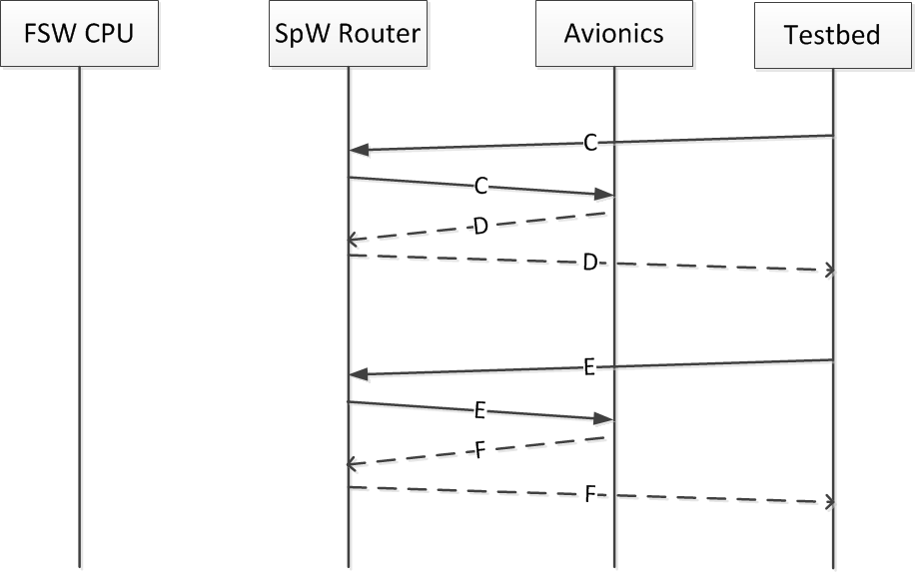
Truth Model / Fault Injection –
Telemetry Override
Testbed Software RMAP Read / Truth Modify / RMAP Write

Slide 20
Conclusion
By utilizing logical addressing and packet duplication the following advantages are realized:
  Allows greater fidelity to flight configuration during testing, improving “test as you fly”.
  Loop back connectors are not required at the UART interfaces and may be eliminated
    Eliminates a mass penalty,
    Simplifies design and fabrication,
    Simplifies configuration changes during integration and test,
  Hardware may be simulated in the test bed at the SpW level allowing temporary removals.

