Slide 1
Advanced Exploration Systems (AES)
Core Flight Software (CFS) Project
Summary of Products (FY13-FY15)
  Plans for FY16
Additional CFS Projects at JSC
Lorraine Prokop, Ph.D.
Software Manager, Advanced Exploration Systems Avionics & Software Project NASA – Johnson Space Center (JSC)
October 2015

Slide 2
CFS AES Project
Product Summary FY13 & FY14
FY13 Products
  CFS on Orion/B787 Platform – CFS on Partitioned Green Hills RTOS
  Quad-Voting CFS System – CFS on Partitioned VxWorks RTOS, synchronizing & voting 4 computers
  CFS within Trick Simulation
  Distributed CFS – network-based software bus additions
  Reusable Certification Test Suite (begin)
FY14 Products
  Class A CFS Certification on Integrity ARINC-653/Orion Primary Flight Platform
  Performance Monitoring Tool
  CFS Synch & Voting Software Development
  Product Line
  Command & Data Dictionary Ground Database Tool
  Education/Outreach

Slide 3
AES CFS FY15 Software Tasks & Status
Major Tasks for FY15
  CFS Class A Certification on VxWorks/LEON3 Complete
    Will be delivered to Orion program an GOTS after merge with main product line
    Full-coverage UT Assert unit test suite
    API unit tests
    Vertical Integration tests
  Other AES Projects: Ongoing, Much progress
    Integration of AES Habitat Apps with CFS Message Bus/SBN
    Migration of Autonomy Applications within CFS Framework
Additional Tasks for FY15
  Orion Backup Prototype/Analysis with CFS/LEON3 Complete (Demo Jan 2015)
  Generic Command & Telemetry Apps V1 Complete (Demo 9/2015)
    CFS Communication Interface with C3I Standard Complete (Demo 9/2015)
  CFS Synch & Voting Software Development Added TTGbE (Demo 9/2015)
  Command & Data Dictionary Tools 2 Tools (Demo 9/2015)
  Product Line Active and Evolving
  Education / Outreach Progress, Completion FY16
  Symmetric & Asymmetric Multicore Development Deferred FY16

Slide 4
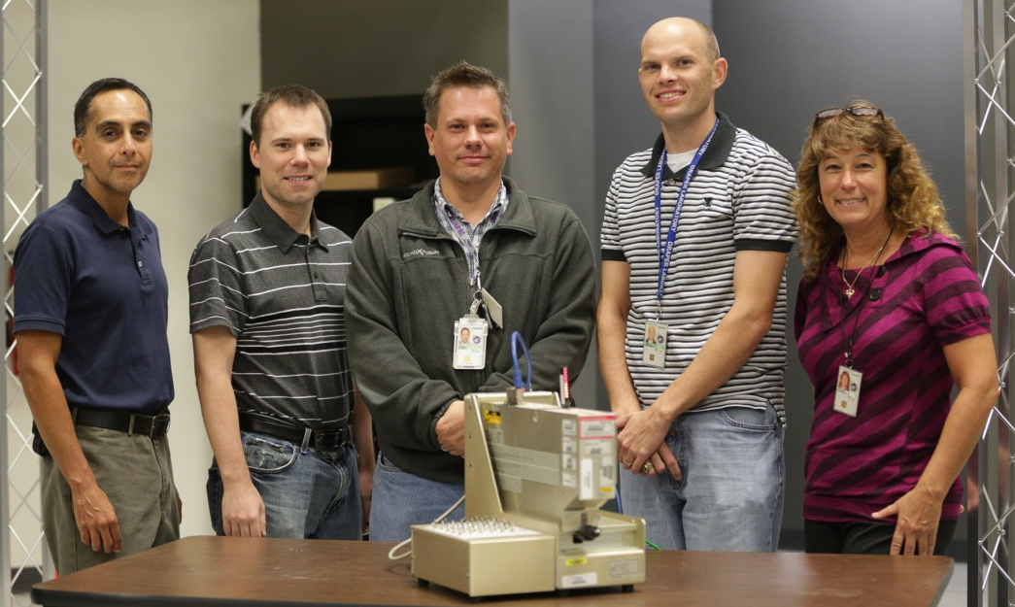
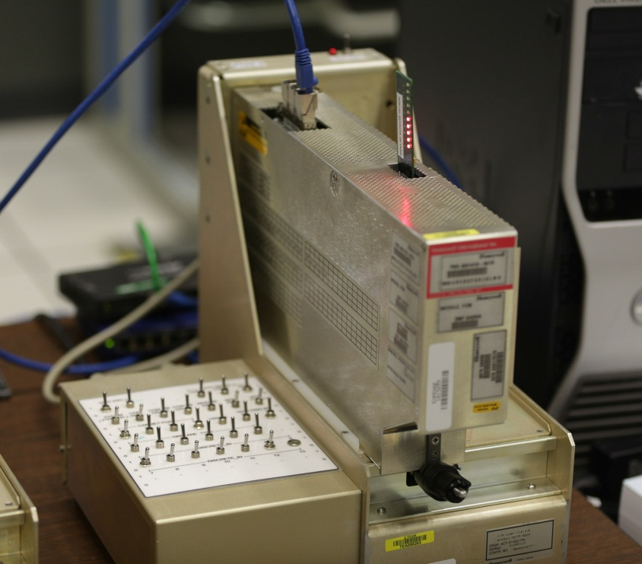
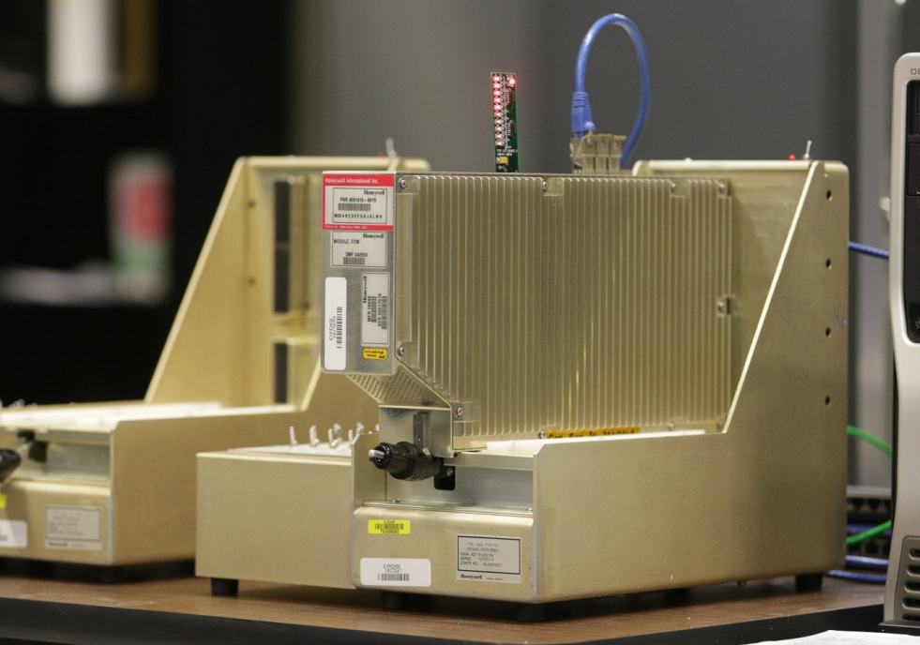
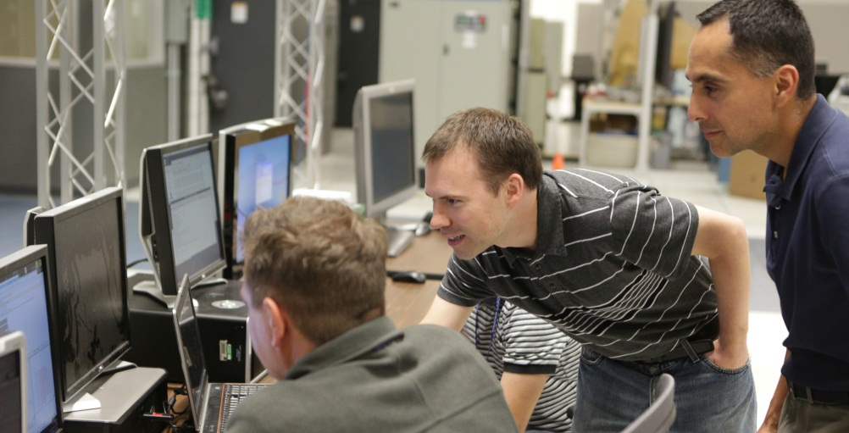
CFS on Partitioned ARINC-653 OS/B787
Class A Product Team

Slide 5
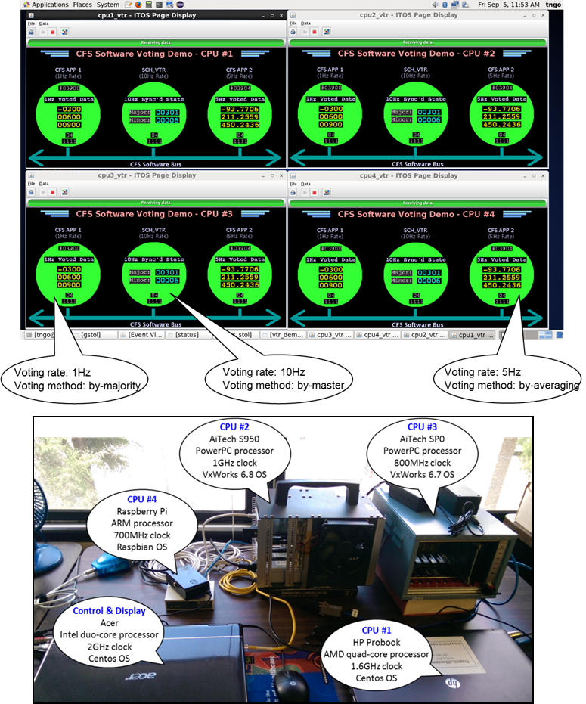
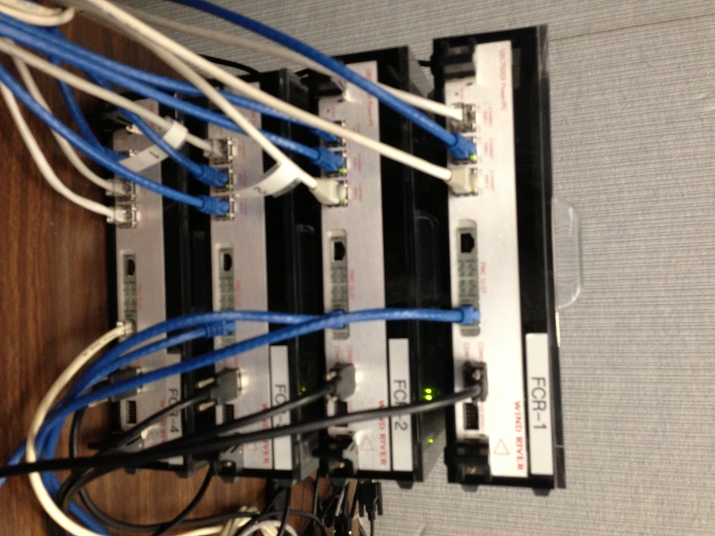
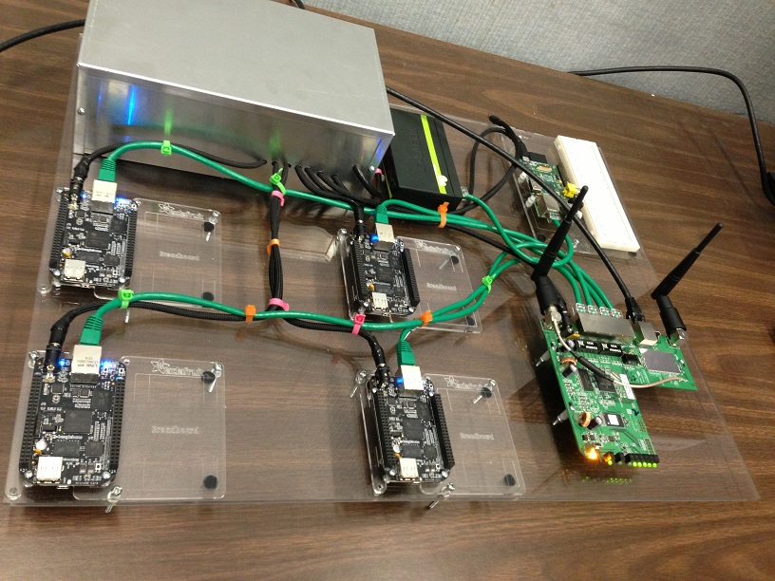
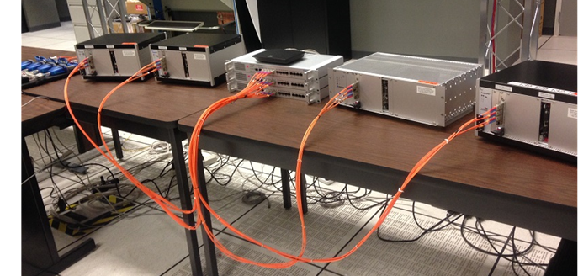
Synchronization & Voting
Homogeneous Voting:
Beagle Bone, Rad750, SP0
FY15 Sync & Voting over TTGbE
Heterogeneous Voting, Ethernet

Slide 6
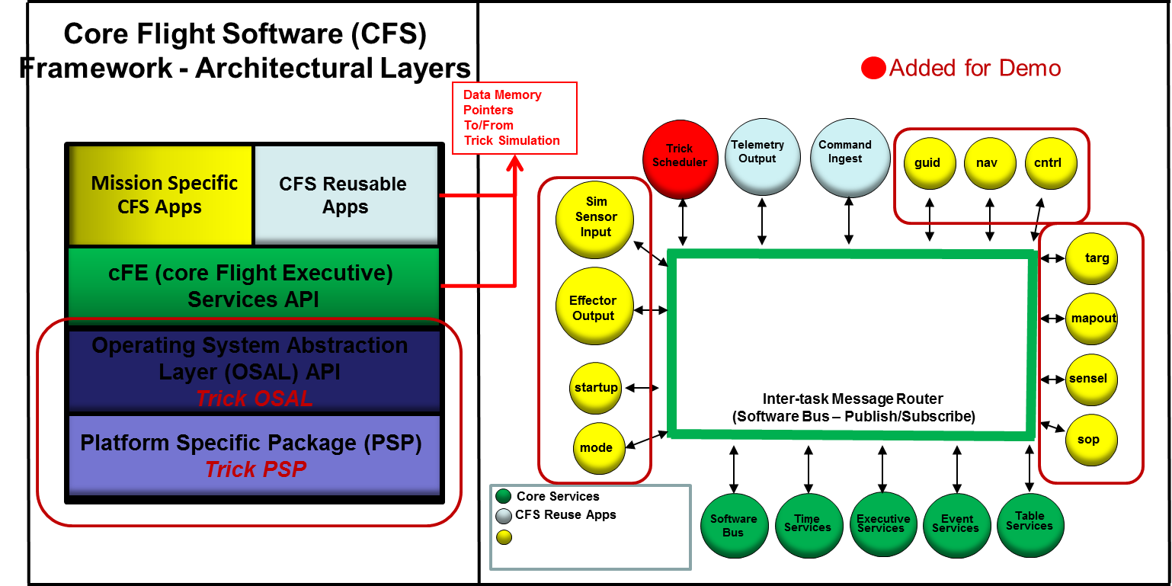
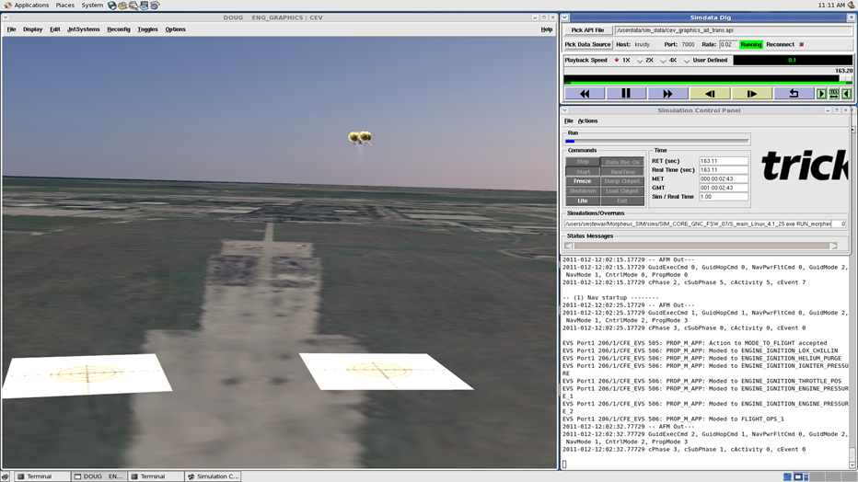
CFS Embedded in Trick Simulation
(single executable, Trick scheduler used)
Morpheus Simulation w/ Flight Software
Simulation Computer
Trick Simulation Framework
Dynamics Models
Sensor Input/
Effector Outputs
CFS Flight Software
Visualization Graphics Server
(EDGE) & Display

Slide 7
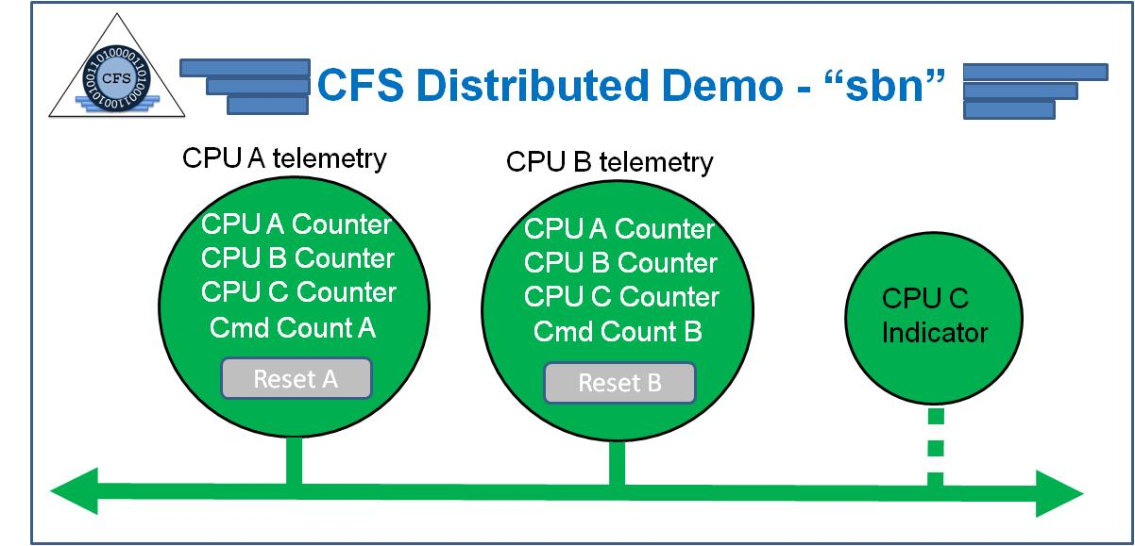
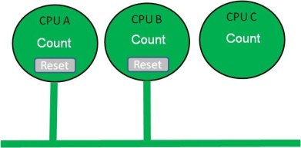
Distributed CFS Demo Configuration
Scheduler
Test
App 1
Software
Bus
Scheduler
Test
App 2
Software
Bus
40Hz
40Hz
40Hz
40Hz
CPU A
CPU B
80Hz
80Hz
Telemetry
Output
Command
Ingest
Network
Software
Bus
(sbn)
Telemetry
Output
Command
Ingest
Network
Software
Bus
(sbn)
5Hz
5Hz
5Hz
5Hz
sbn over IP comm
CCSDS over IP comm
Ethernet
Wireless
Ground Display Computer
(ITOS)
80Hz
Software
Bus
Network
Software
Bus
(sbn)
Local Display (Java)
CPU C
Test
App 3
Scheduler
20Hz
Wireless Ethernet
20Hz

Slide 8
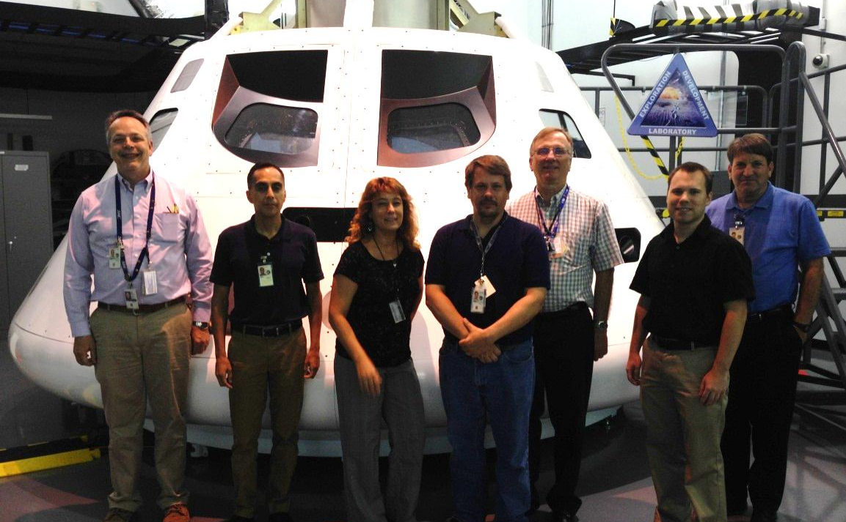
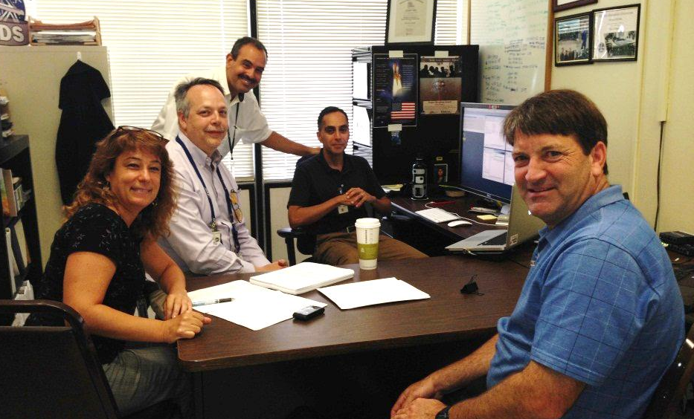
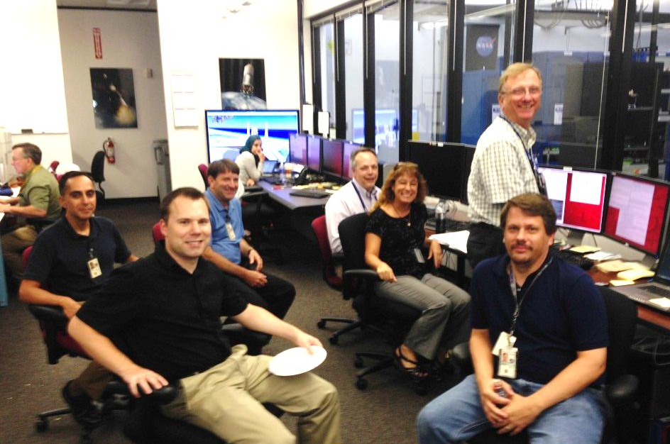
Integrity/Orion Certification Testing Pics
Verification testing on “SIMICS” hardware simulation platform
Kedalion Lab, Houston
Remote Login
Validation testing on Orion Self Checking Pair EFT-1 rig
HOTH Laboratory, Lockheed Facility, Houston

Slide 9
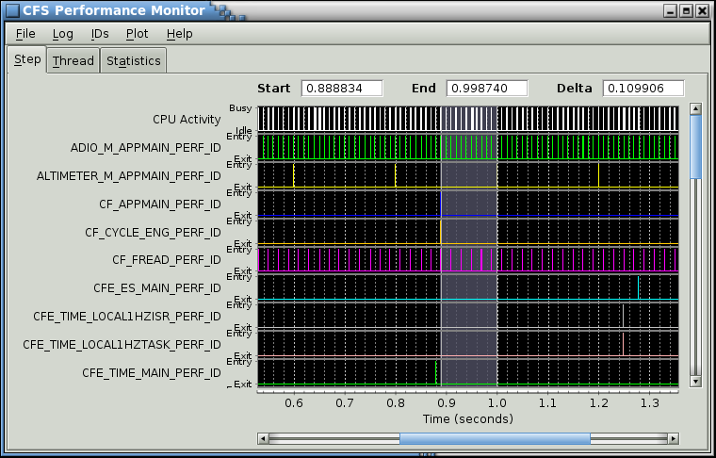
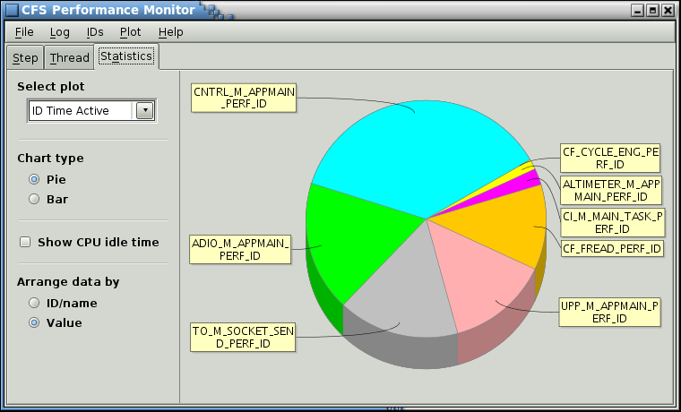
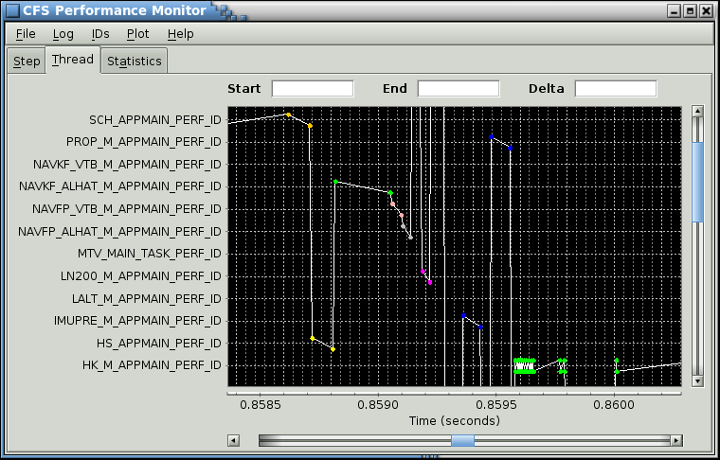
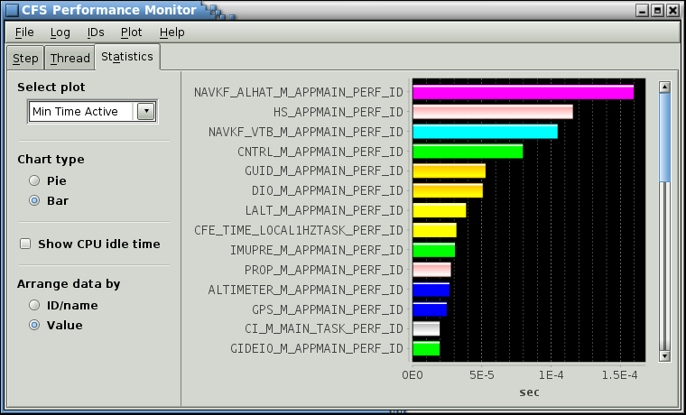
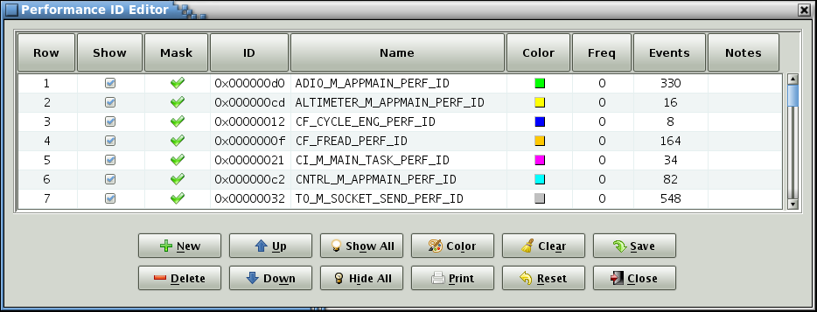
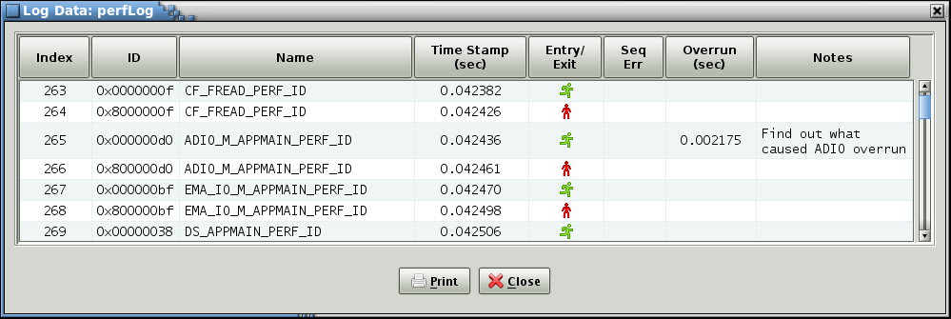
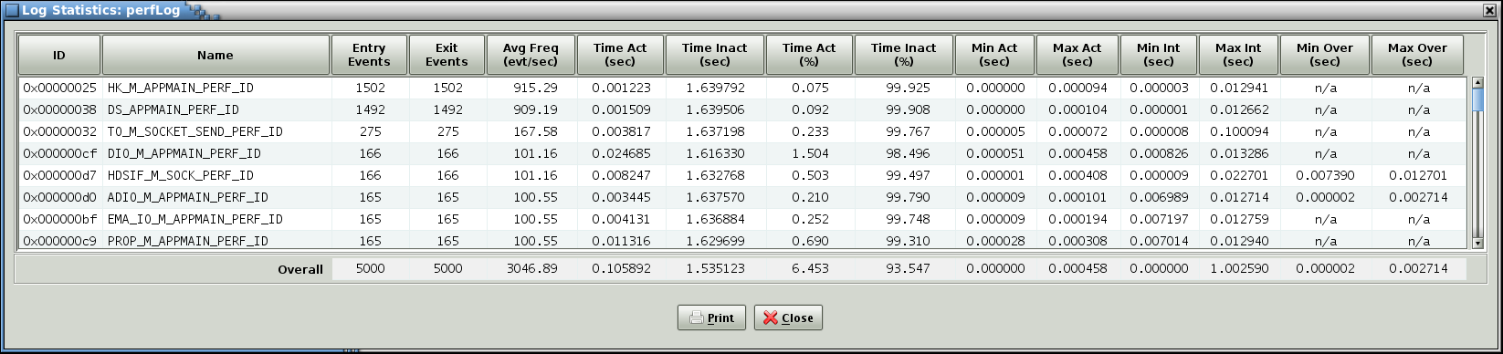
Performance Monitoring Tool Screenshots

Slide 10
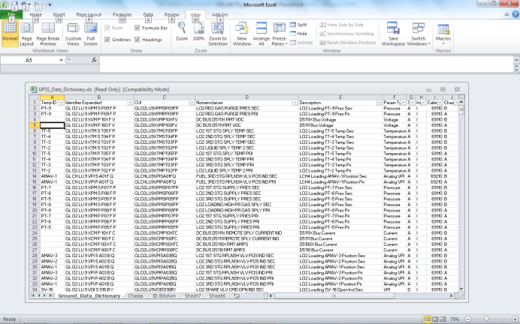
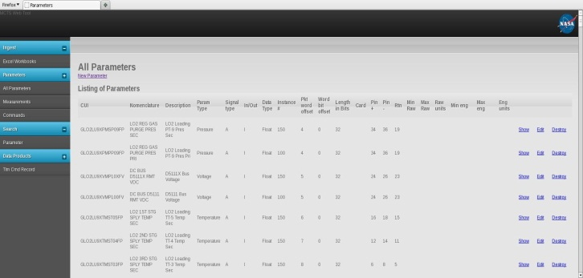
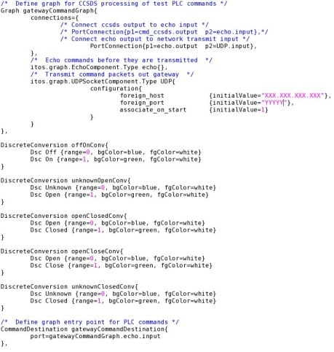
Mobile Command and Telemetry System
KSC developed general purpose data integration tool for managing command and telemetry metadata
Intended to be generic in nature and applicable to any project using CFS or ITOS
Web based interface built with Ruby on Rails
Data can be ingested from a variety of formats including flat text files or Excel spreadsheets
Imported into PostgreSQL relational database on which a wide variety of queries and reports can be run from MCTS provided GUI screens
Currently capable of exporting data directly into ITOS compatible data record format
Future enhancements include exporting data to XTCE format files as well as ‘C’ type data structure statements for compiling into CFS application code
Demonstration held August 2014

Slide 11
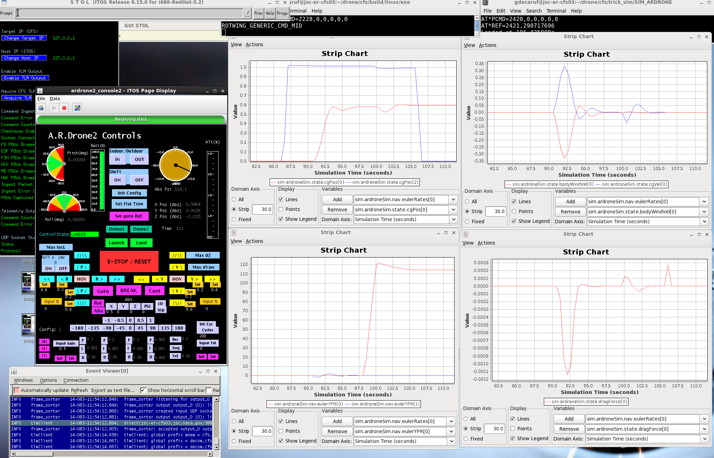

Education/Course Idea: CFS on AR Drone Embedded with Trick Controls & Simulation

Slide 12
Product Development & Test Process
The source code for cFE and OSAL layers was already developed to Class B pedigree by Goddard (CMMI Level 2) and was TRL-9
The goal of this effort was to gain confidence in elevating the use of this for Class A Safety-Critical applications, including the Orion backup flight system
To Achieve this, several forms of inspections, analysis, and tests will be/were performed against the source code as follows:
  Application Program Interface (API) Requirements Verification Testing on Target
  Code Coverage Analysis and Targeted Code Inspections for Code Not Covered
    Note the performance of Code Coverage analysis prompted development of full-coverage unit tests
  Static Code Analysis with Targeted Code Inspections to decide on incorporation of static analysis findings
    cppcheck tool, clang, Understand tool (MISRA)
  Full Coverage Unit Testing on Target Platform (white box unit tests)
  Vertical Validation Tests on Target
  Multiple Rounds of Team Code Inspections
    Code inspections were performed to inspect findings from static analysis, gaps in test coverage, as well as to inspect all code changed as a result of this effort
More details regarding these tests may be found in JSC-61999, Test Plan, Test Procedures, and Test Report for the CFS Instantiation Supporting the VxWorks OS and SPARC LEON3 Hardware Platform, and static analysis results matrix

Slide 13
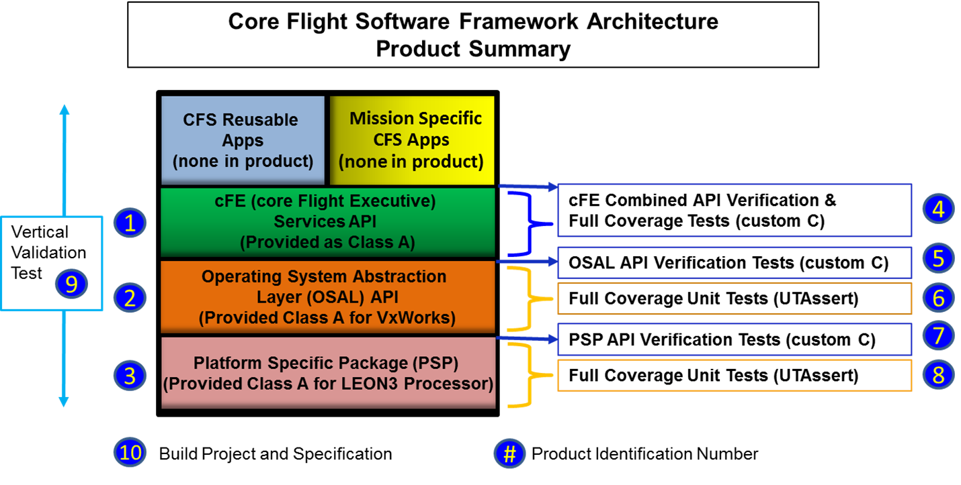
CFS VxWorks/LEON3 Class A Product/Test Suite Summary
Products Include Full Documentation
Test matrix
Test Plan, Procedures, Report
VDD, User’s Guide
Code inspections,
Static analysis results & actions
Coverage analysis results & actions

Slide 14
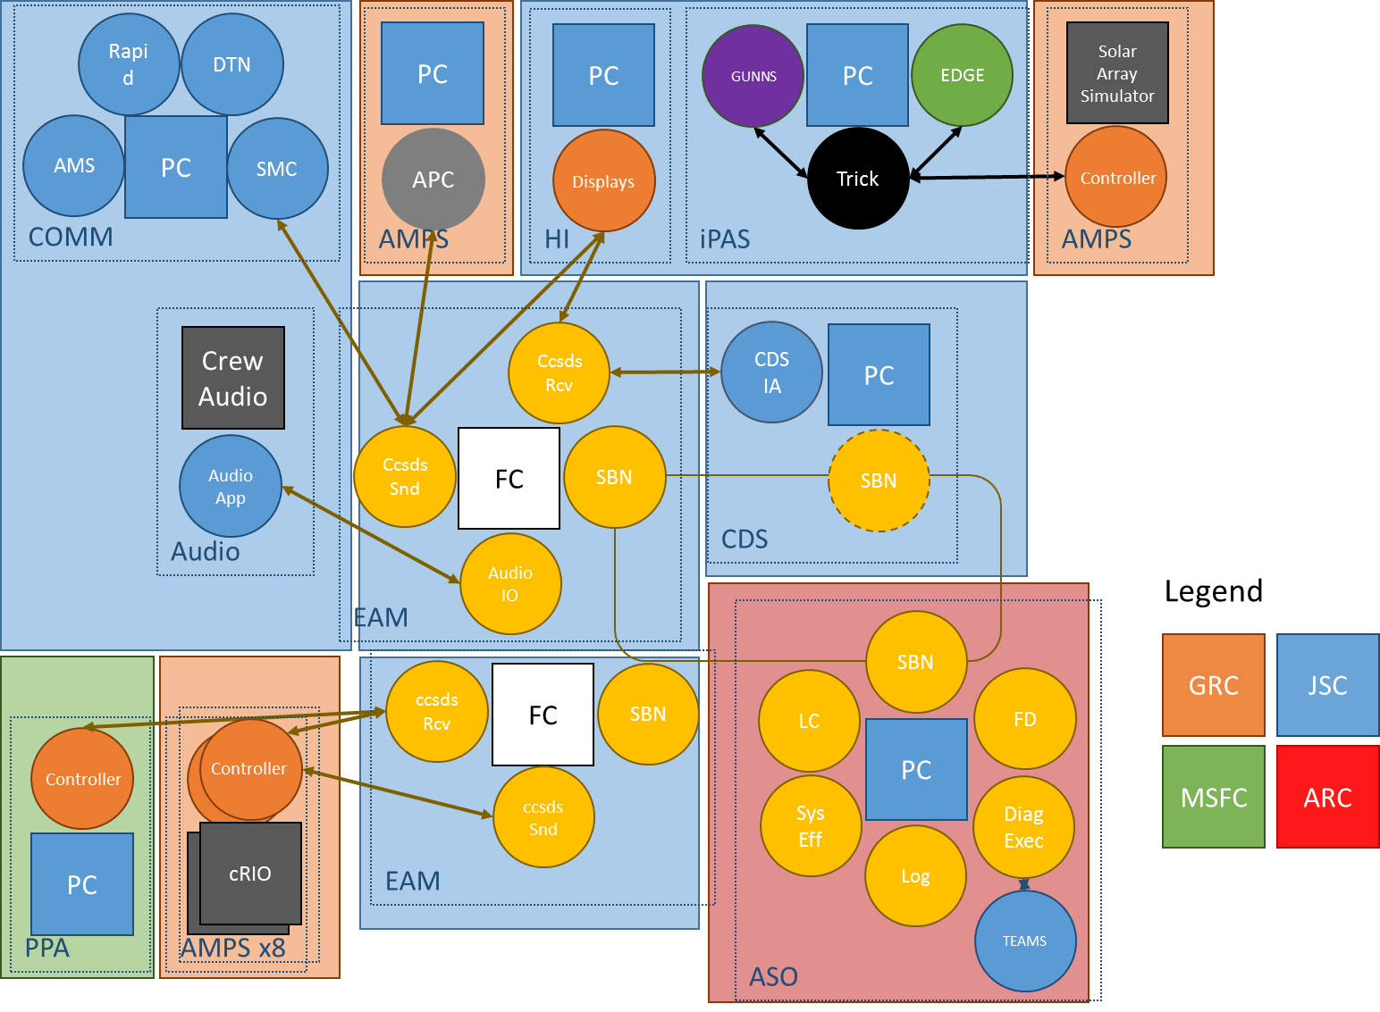
AES Project Integration with CFS/sbn (FY15)
(Habitat DRM)
AMPS – AES Modular Power System
AMS – Asynchronous Message Service
APC – Autonomous Power Controller
ARC – Ames Research Center
ASO – Autonomous System Operations
ccsdsRcv – CFS user app
ccsdsSnd – CFS user app
CDS – Cascade Distillation System
COMM – Communications System
cRIO – compact reconfigurable I/O
DiagExec – Diagnoser Executive app
DTN – Disruption Tolerant Networking
EAM – Exploration Augmentation Module
FC – flight computer
FD – Failure Detector app
GUNNS – General Use Nodal Network Solver
GRC – Glenn Research Center
HI – Human Interfaces
IA – interface app
iPAS – integrated Power, Avionics, &Software
JSC – Johnson Space Center
LC – Limit Checker app
MSFC – Marshall Space Flight Center
PC – personal computer
PPA – Plasma Pyrolysis Assembly
RAPID – Robotic control standard
SBN – Software Bus Network app
SM&C – Space Craft Monitoring and Control
SysEff – System Effects app
TEAMS – Real-time diagnostics and reasoner

Slide 15
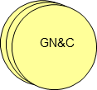

AES AMO Project:
Vehicle Systems Automation
Instruments
PPA
Mass
Storage
File System
Scheduler
Limit
Checker
Memory
Space
Wire
Instrument
Manager
CFDP File
Transfer
Orion
Battery
AMPS
AMPS
Manager
CDS
Data
Storage
Stored
Command
State
Estimation
Fault
Detection
System
Effects
Planning
Execution
File
Manager
Packet
Manager
Inter-task Message Router (Software Bus)
cFS Applications
Mission Applications
1553 Bus
Support
Telemetry
Output
Command
Ingest
Software
Bus
Time
Executive
Event
Table
Services
Services
Services
Services
Core Services/Applications
Commands
Communication
Interfaces
Autonomy Components
1553
Hardware
Real-time Telemetry
File downlink
Chart obtained form FY15 AES AMO End of Year Review / Jeremy Frank / ARC

Slide 16
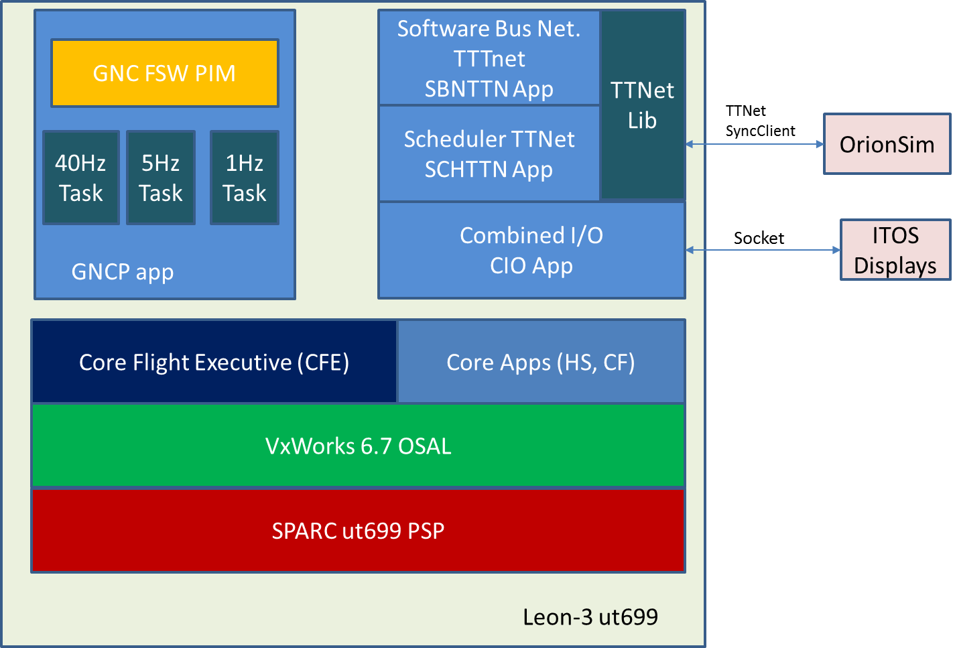
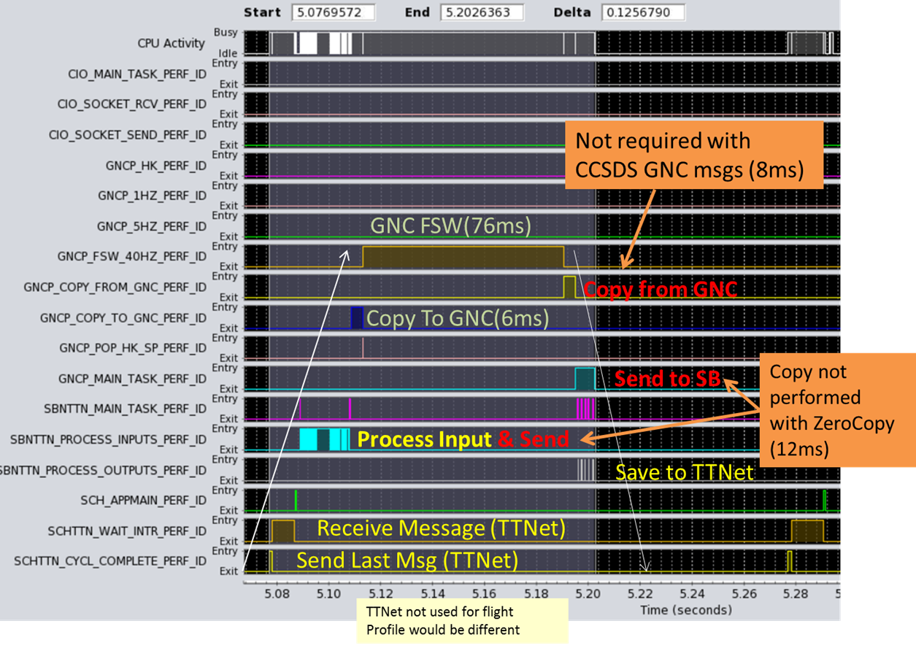
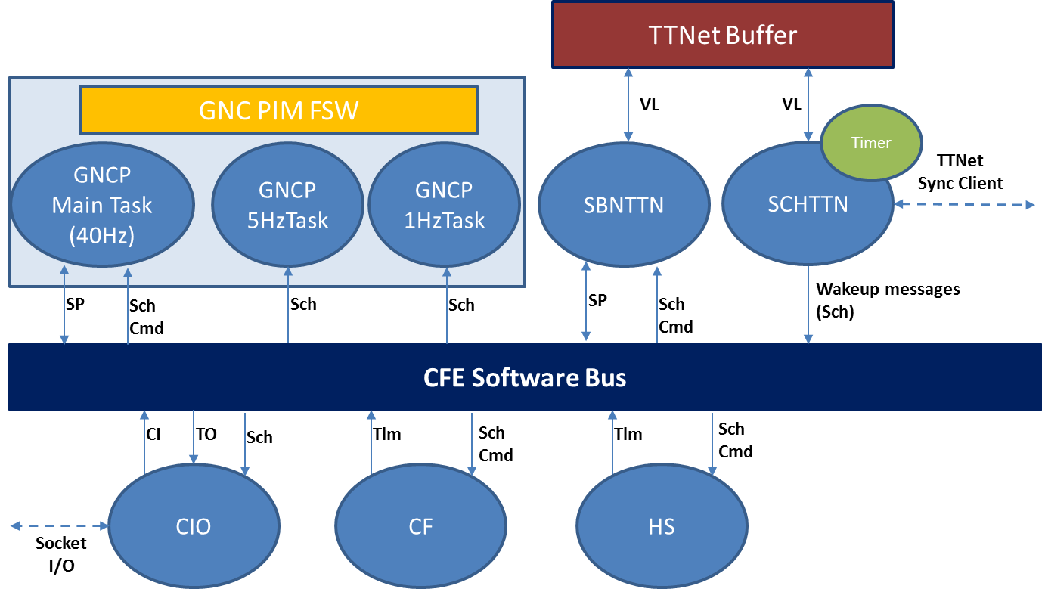
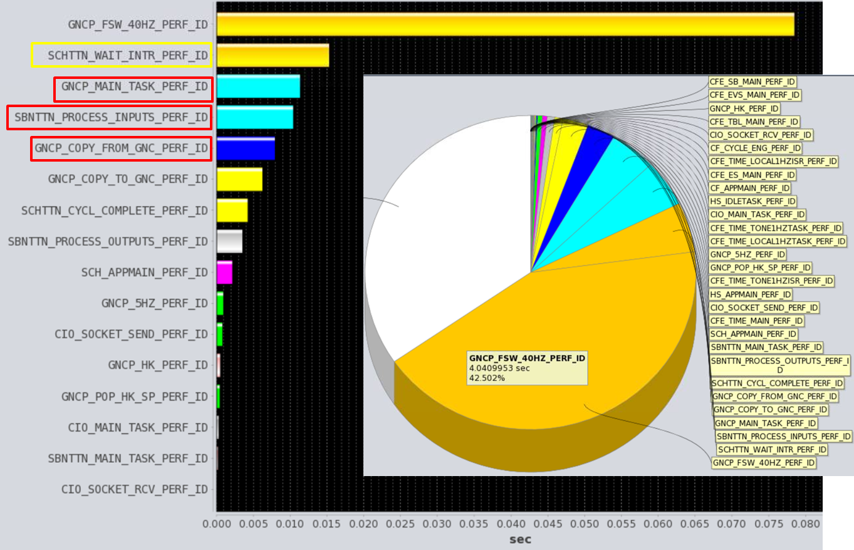
Orion Backup Computer Proof-of-Concept Architecture
(EFT-1 Flight Code under CFS on LEON3 Processor)

Slide 17
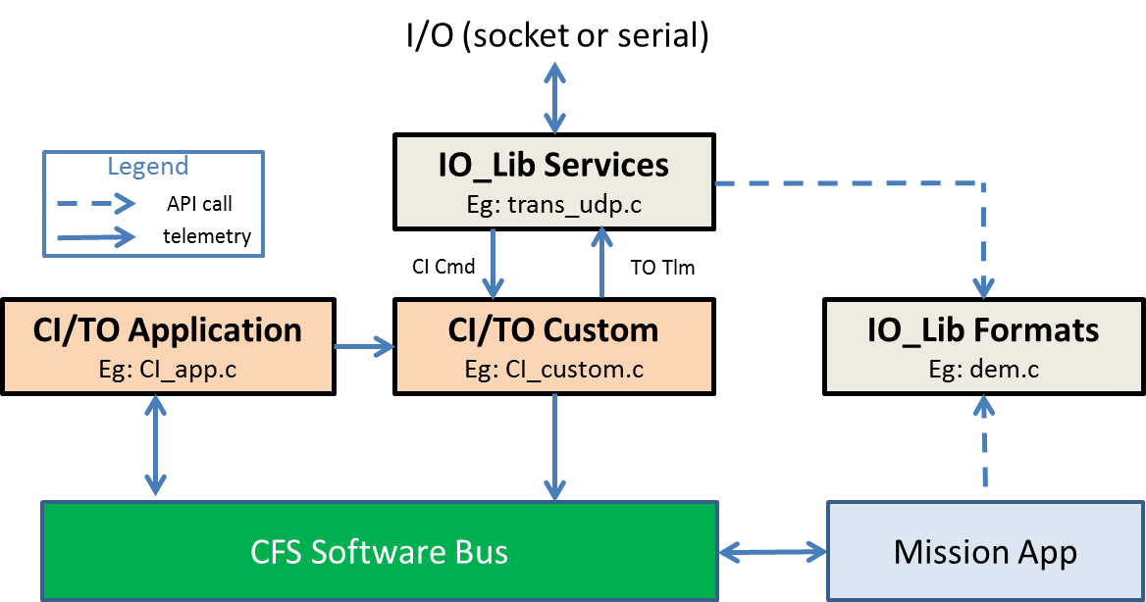
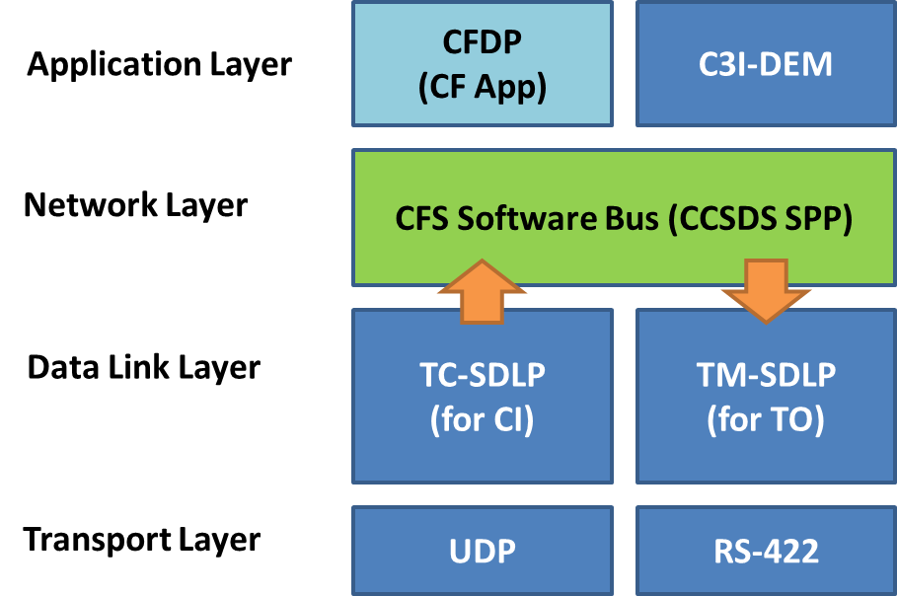
Generic TO/CI Apps with C3I Interface
Product Summary
  New applications to handle Command Inputs / Telemetry Outputs
  Designed such that it can be easily expanded and customized for specific mission needs through a library suite called IO_LIB.
  Multiple channels supported, reconfigurable through CFS tables
  Supports communication over UDP and RS-422
  CCSDS Space-Data Link Protocols: TM-SDLP, TC-SDLP, COP-1
  Integration with the File Transfer Application (CF) for CFDP file transfers

Slide 18
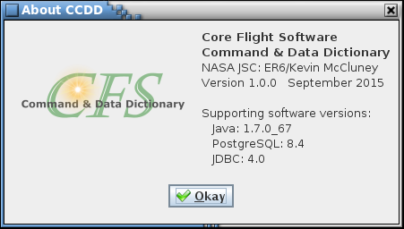
CFS Command & Data Dictionary Tool (CCDD)
Product Summary
  Provides a means for managing CFS and CFS application variable structure and command message information in a PostgreSQL database
  Data can be accessed by user-defined scripts using built-in access functions; e.g., to create output files (C headers, HK copy table, etc.)
Demo Description
  Basic application functionality
    Project creation
    Data entry
    Data customization
    Script access

Slide 19
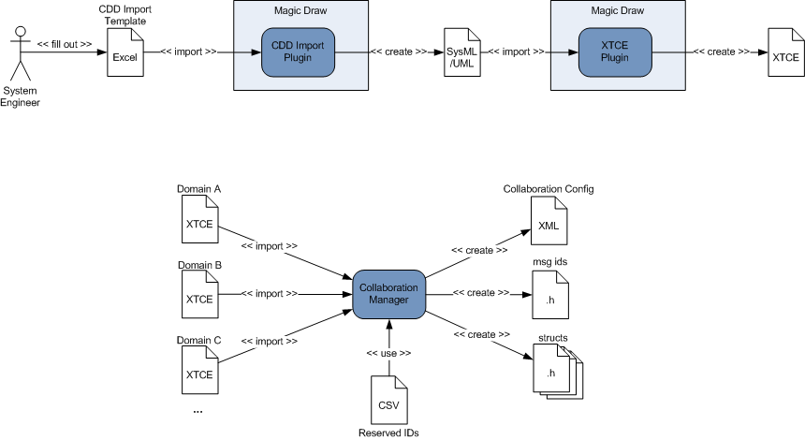
Collaboration Manager Tool
System representation SysML model is generated
System Engineer describes system command and telemetry lists
XTCE files describing system representation is generated
XTCE files used to create other product files
Message IDs pulled from available user app pool
Larry Garner/Tietronix

Slide 20
CFS Supported Platforms
(non-exhaustive)
Platform | OS | Project | Status / Notes
RAD750 | vxWorks 6.4 | LRO,RBSP, GPM | Project tested.
RAD750 | RTEMS 4.10 | ICESat-2/ATLAS | Early in instrument test program
Rad Hard Coldfire (5208) | RTEMS 4.10 | MMS | Project tested.
LEON3 | RTEMS 4.10 | Solar Probe Plus | In Development for SPP mission
MCP750 PPC | vxWorks 6.4 | cFE/CFS Project | Tested. Used as baseline CFS development platform.
PC / x86 | Linux | n/a | Not formally tested. Used by JSC.
Coldfire MCF5235 board | RTEMS 4.10 | n/a | Not formally tested. Used for RTEMS Development, and MMS board.
LEON3 – generic –(simulator, multiple COTS boards ) | RTEMS 4.10 | n/a | Not tested. Not in CFS CM. Used for LEON3 development. Can be used on LEON3 Simulator.
Coldfire Simulator (qemu 68k ) | RTEMS 4.10 | n/a | Not formally tested. Used for OSAL / cFE development
TILERA | Linux | Maestro IRAD (FY12) | Not formally tested. Compatible with Desktop PC linux version.
MCP750 PPC | vxWorks 6.x | Memory Protection IRAD (FY11) | Adds memory protection to standard cFE. Not formally tested. Not integrated with cFE repository.
PC x86 | Linux | Multi-Core IRAD (FY12) | Adds multi-core CPU capability to cFE. Not formally tested. Not integrated with cFE repository.
Leon3 | PikeOS | Virtualization IRAD (FY12) | Adds ability to run in partitioned OS. Prototype. Not integrated with cFE repository.
Platform | OS | Project | Status / Notes
Aitech S950 (PPC750FX) | vxWorks 6.7 | Morpheus | In JSC CM. Integration tested on real Morpheus Vehicle hardware. Flown on Morpheus test vehicle.
RTD pc386-IDAN, PC104, Pentium M | RTEMS 4.10 | ISS Downmass/Micro Capsule | In JSC CM. Integration tested on real Micro Capsule hardware.
RTD IDAN Core 2 Duo | SUSE Linux | DoD Payloads Office STPSat-4 | In development. Used only for C&DH, payload data handling, data recording(ds), file downlink (CFDP,) extensive onboard autonomy (sc)
Acro Virtex 5 | VxWorks 6.9 | AEMU | In development.
Space Micro Proton P400k | VxWorks SMP 6.8 | MMSEV, AAE | In JSC CM. MMSEV FY13.
Maxwell SCS750 | VxWorks 6.9 RTEMS 4.10 | EAM, AAE | In JSC CM. EAM/DSH
787FCM | Integrity ARINC | AES CFS | In JSC CM. Class A cert. ARINC653 cFE, OSAL.
OrionSCP | Integrity ARINC | AES CFS | In JSC CM ARINC653 cFE, OSAL.
750FCR | VxWorks ARINC 6.8 | AES CFS | In JSC CM FTSS SW fault containment with a voting quad architecture.
Trick (simulation environment) | Linux | AES CFS | In JSC CM RPM
LEON3 | VxWorks 6.7 | Orion BFS | In JSC CM. Class A cert. BFS prototype. Currently in ic-sgd-dev-trac-10-merge branch, release Dec 2015
AiTech SP0 | VxWorks 6.9 | AES Voting, RPM?, AA2? | Currently in ic-sgd-dev-trac-10-merge branch, release Dec 2015
BeagleBone, Raspberry Pi | Linux, Raspian Linux | Misc, voting, outreach/drone

Slide 21
AES CFS FY16 Tasks/Tentative
Task Name | Focus, activities, description
Product Line | Community Product Line: CCB, product evolution, changes, merges, open source releases
AES Project Deployment | Continue deployment of CFS products in “field” of other AES projects and/or users Continue migration of AES project apps to CFS
Multicore | Get Symmetric Multicore Processing (SMP) OSALs working on LEON4 & Tilera 36 Get Asymmetric Multicore Processing (AMP) environment set up on LEON4 & Tilera 36 Perform SMP Analysis load balancing with processor intensive apps & characterize performance - Perform AMP Analysis – Investigate multiple OS's/Hypervisor on different cores different applications on different cores, sbn between cores put synch/voting on selected cores Put autonomy apps on cores & measure performance
Generic TO/CI | - Enhancements to support outstanding requirements/design items approved for implementation - Enhancements in support of Orion DEM updates
Sync/Voting | - Apply to real-world application (AA-2 GNC) - Study, stress & characterize performance on TTGbE with real applications using data
Xenomai OSALs | - Get default-skin Xenomai version of CFS running on UEIPAC platform - study performance with sample apps & timing tests - modify OSAL if necessary, get new PSP working - Develop partitioned version of Xenomai for CFS - Utilize test applications on partitions & study performance
sbn | Acquire latest & stress test - Merge latest sbn into product line - Stress test performance with multiple deployments on multiple machines and higher speeds - Enhance as Needed supporting multiple AES distributed projects
CCDD | - Complete development, adding XML, XTCE & clean up - Possible add EDS - Deploy to uses & provide updates/maintenance/improvements as needed
Education/Outreach | - Complete deployment package for universities

Slide 22
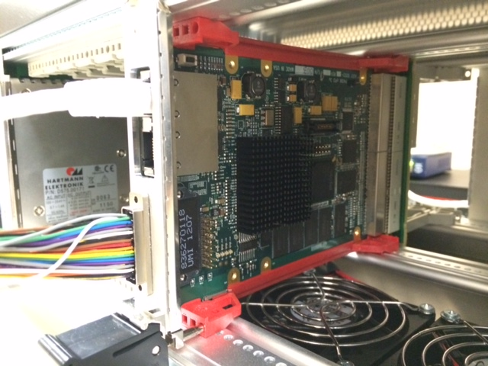
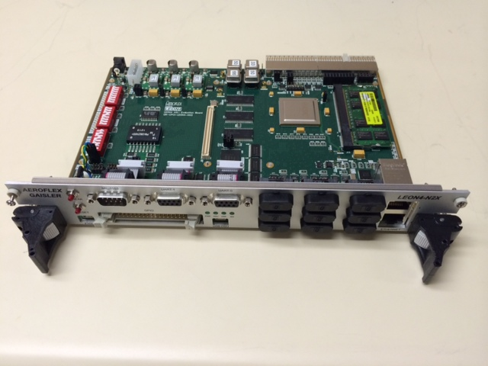
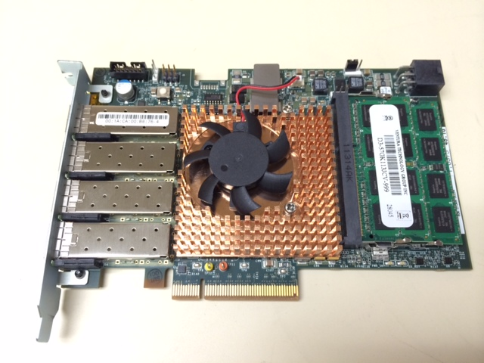
Symmetric Multiprocessing
CFS Development
Symmetric Multiprocessing (SMP) Support
  Description
    Provide a generic SMP Operating System Abstraction Layer (OSAL) supporting multi-core processor architectures
  Accomplishments
    Prototype implementation of CFS on dual core Space Micro Proton board and VxWorks SMP complete
      Apps can be allocated to specific cores to deterministically balance processing load or to improve performance of certain apps
  Remaining Work (FY15)
    Implement on SPARC LEON 4 quad-core, Tilera 36-core
    Merge SMP support modifications into mainline CFS
Proton
LEON4 quad-core
Tilera 36-core

Slide 23
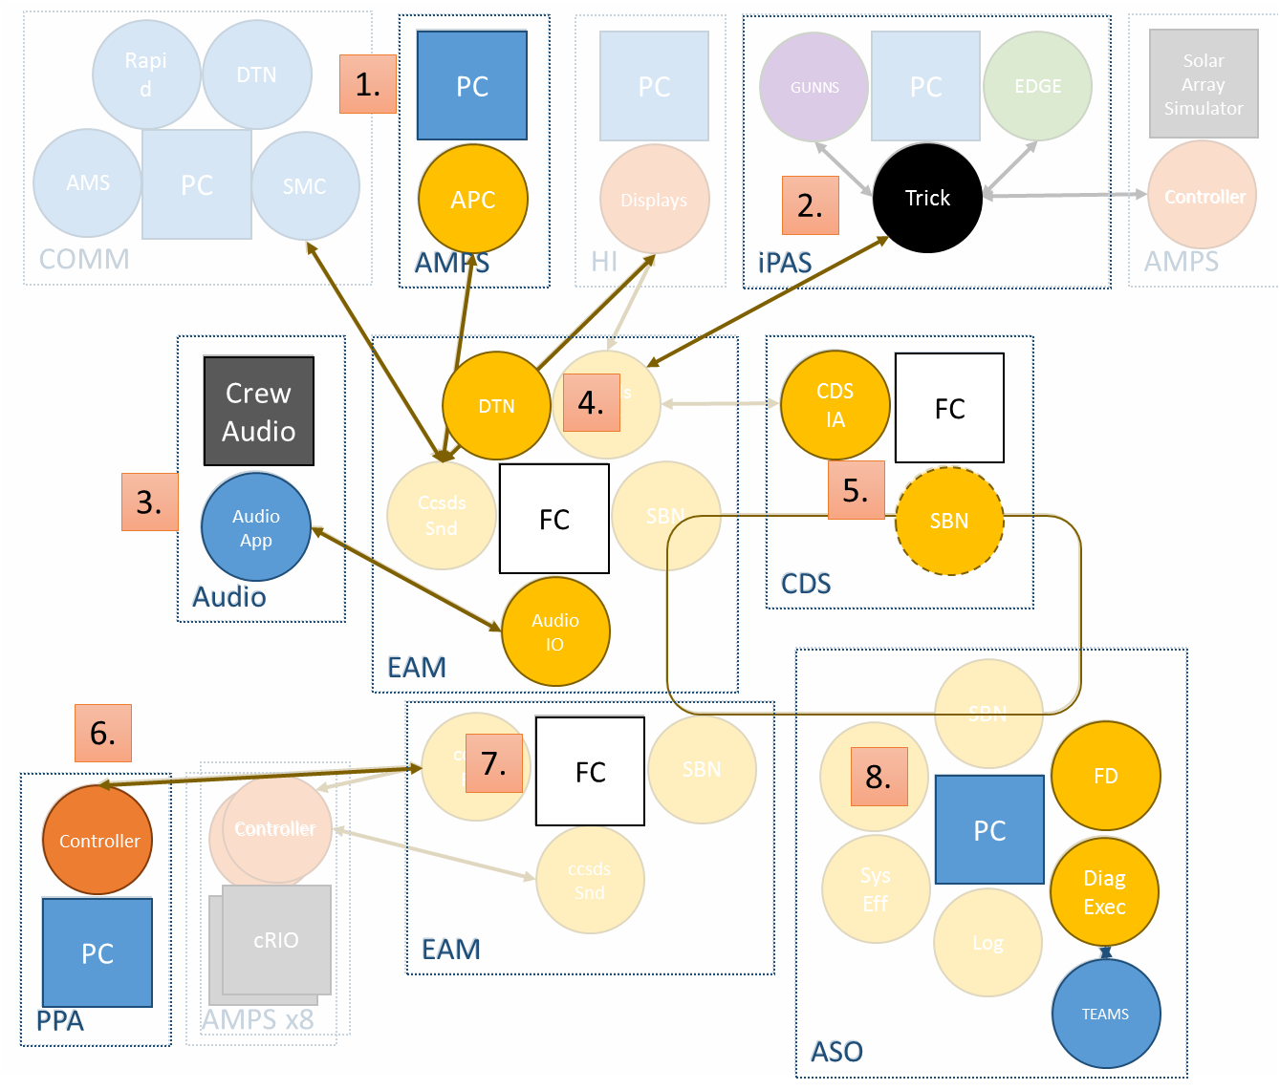
FY16 Software development plan
Planned maturity
for FY16
Mature AMPS Autonomous Power Controller (APC)
Enable telemetry from TRICK integrated vehicle systems simulation
Develop CFS controller app for onboard crew audio system
Deploy Disruption Tolerant Networking (DTN) capability onto flight computer platform
Mature embedded controller of Cascade Distiller System (CDS)
Expand CFS/LabVIEW interface of Plasma Pyrolysis Assembly (PPA)
Deploy CFS builds to path-to-flight model avionics
Expand fault detection models within Autonomous Systems Operations (ASO) suite

Slide 24
Projects Use of CFS at JSC
Morpheus Lander (VxWorks, Aitech S950)
AES CFS, Avionics & Software Projects (already discussed)
MMSEV (VxWorks, S950)
Downmass MicroCapsule (RTEMS, Pentium)
Other AES Projects:
  Advanced IMU Space Suit (Linux, Vertex 5 microblaze)
  ASO, DTN, CDS, AMPS…
DoD Payloads Office STPSat-4 Deployed Payload (SUSE Linux, RTD IDAN Core 2 Duo)*
Orion Vision Processing Unit (VPU)*
  Includes Backup Flight System (BFS) (VxWorks, LEON3)
Orion Video Processing Unit (Linux, I5)*
Orion AA-2 Flight Experiment (VxWorks, TBD)*
* Flight Projects in Development

Slide 25

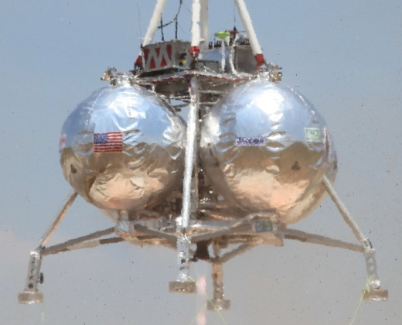
Morpheus Software Components
Flight Software
CFS Core
Apps
Morpheus
Specific
Applications
C
Custom
Sensor/
Effector
Apps
Tool Chain
Open Source
  VMWare (local PC/Mac)
  Eclipse (local IDE)
  CentOS/Linux (local VM OS)
  GNU C/C++, Java (compile/Xlate)
  Subversion (CM)
  Redmine (change tracker)
  Hudson (build checker)
  UCC (code count metrics)
  Windriver Workbench (target IDE/OS)
  Parasoft C++test (standards checker)
Software Reuse
New Software
CFS Infrastructure (Goddard)
VxWorks 6.7 Operating System
PPC 750GX Processor, cPCI (AiTech)
I/O Devices (Serial, 1553, A/D)
Simulation Software
Ground Software
Morpheus Specific System & I/O Models
C++
Displays & Controls
Java
scripts
Dynamics, Time, Environment Models
EDGE Visualization
JEOD
Command & Data Dictionary
Generic Systems
Models
Database
(postgreSQL)
Valkyrie
Trick Simulation Core (JSC)
25
ITOS Infrastructure (Goddard)
(Data Com/Decom, Recon, Distribution, Display, Scripting, Recording, Post processing)
Linux OS
Linux OS

Slide 26
Morpheus Flight Software Architecture
GNC Sensors
Prop EMAs, HW, Valves, Sensors
Wireless
Framed CCSDS
57.6Kbps / 100Mbps
C&T Hardware,
Serial Radio and/or
Hard-line Ethernet
4 video cameras
HDS/ALHAT Sensors
PWM FW
Doppler Lidar
Ethernet
Doppler
IO
Video Switch
5 Hz
232
Telemetry
Output
Command
Ingest
House-
keeping
Scheduler
CFDP
File
Manager
Laser Alt.
Ethernet
Lalt
IO
A I/O
D IO
MTV
10 Hz
10 Hz
10 Hz
100 Hz
5 Hz
100 Hz
100 Hz
HDS
Ethernet
HDS
IO
50 Hz
Mass
Storage
SSR
SIGI
SIGI,
1553
IO
50 Hz
1553
GNC-N Apps
PPS
Javad
GPS
5 Hz
Nav – KF (Kalman Filter)
(VTB & ALHAT)
Nav Fast
Propagate
(VTB & ALHAT)
Nav
UPP
232
GPS IO
Nav - IMU
Preprocessor
Data
50 Hz
5 Hz
50 Hz
50 Hz
Storage
Acuity Alt.
5 Hz
Bkground
232
Alt IO
Inter-task Message Router (SW Bus – Publish/Subscribe)
Health &
Safety
Manager
1 Hz
1 Hz
AHRS
AHRS
IO
1 Hz
232
50 Hz
Automated
Flight
Manager
(AFM)
GNC-G
Application
GNC-C
Application
Prop
Application
SDI500 IMU
Software
Bus
Time
Executive
Event
Table
SDIO
DFI
5Hz
Services
Services
Services
Services
232
5 Hz
25Hz
100 Hz
cFE Core Services
Mission Specific I/O Apps
CFS Configurable Applications
Mission Specific Apps
26

Slide 27
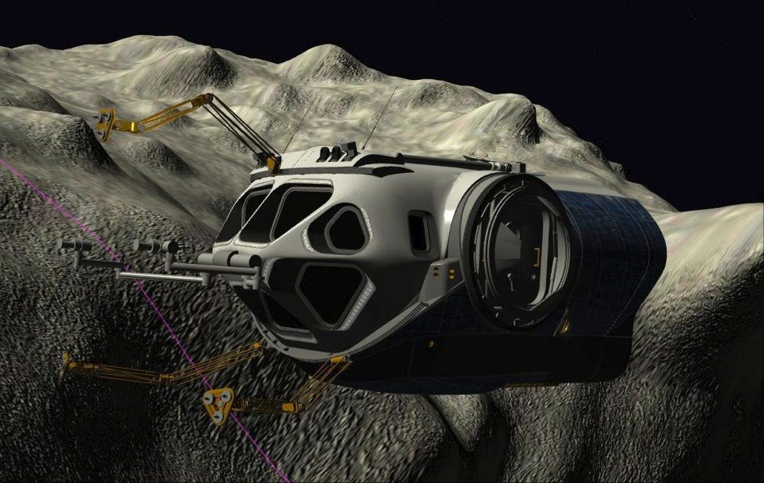
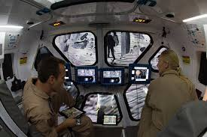
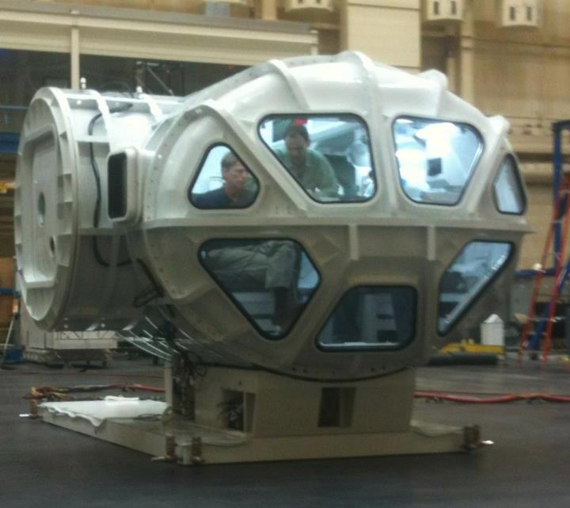
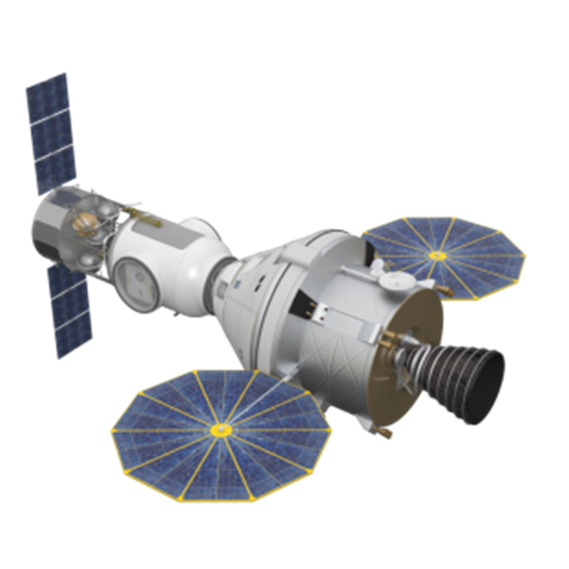
MMSEV
MMSEV – Orion Augmentation Module (OAM)

Slide 28
MMSEV CFS Architecture
UI Computers
CCSDS pkts/sockets (TCP or UDP??)
THCs/RHCs, Bezel buttons
Mass Storage
Fans, Lights, Power switches
UI Computer Interface
MMSEV Motion Control
Canbus
Interface
TBD Hz
Suit Port Control
Display Control
Lights and Fans
Webrelay Interface
Mlvds
Interface
1Hz
1Hz
20 Hz
1Hz
20Hz
Suitport, aft doors motors
10 Hz
TBD Hz
Thrusters
Data Storage
Bkground
EPS
Sequencer
TBD
Inter-task Message Router (SW Bus – Publish/Subscribe)
Health & Safety Manager
1 Hz
Limit
Checker
Telemetry
Output
Command
Ingest
House-
keeping
Scheduler
Software
Bus
Time
Executive
Event
Table
10 Hz
100 Hz
Services
Services
Services
Services
5 Hz
10 Hz
10 Hz
TO & CO Ground Sys (ITOS)
Wireless Ethernet
(CCSDS/UDP sockets 802.11 G)
CFS Core Services
Mission Specific I/O Apps
CFS Configurable Applications
Mission Specific Apps

Slide 29
Downmass Microcapsule Software
Flight Software Architecture
Prop HW Valves & Thrusters
B. Ly
Solid State
4 GB
Mass Storage
Multiio
Thruster IO
EPS
Application
Automated
Flight
Manager
(AFM)
GNC-G
Application
GNC-N
Application
GNC-C
Application
Prop
Application
Parachute
Application
TBD Hz
TBD Hz
TBD Hz
TBD Hz
TBD Hz
TBD Hz
TBD Hz
TBD Hz
TBD Hz
Horizon Sensor
TBD
Horizon Sensor IO
TBD
Data Storage
GPS
232
5 Hz
Bkground
GPS IO
Altimeter
232
5 Hz
Sequencer
Alt IO
TBD
50 Hz
IMU
TBD
IMU IO
Health & Safety Manager
Inter-task Message Router (SW Bus – Publish/Subscribe)
1 Hz
Limit
Checker
Telemetry
Output
Command
Ingest
House-
keeping
Scheduler
Software
Bus
Time
Executive
Event
Table
10 Hz
100 Hz
Services
Services
Services
Services
5 Hz
10 Hz
10 Hz
TO & CO Ground Hardware
Wireless Ethernet
(802.11 G)
CFS Core Services
Mission Specific I/O Apps
CFS Configurable Applications
Mission Specific Apps

Slide 30
Advanced Space Suite: CWA CFS Software Architecture
Ground
Support
(e.g. PLSS
LabView?)
Comm
Informatics
Out-Of-Range Limit Table
Diagnostic
Port
Calibration Table
New
Applications
Battery
Management
I/F
iLoad
Library
State/Mode
Manager
PMAD
(power/battery)
FLASH
Loader
Consumable
Monitoring
Command
Telemetry
Flash
Storage
Device
PLSS
I/F
SWME/BPV
RCA
Fan
Primary
O2
Secondary
O2
TCV
Pump
Gas Sensor
Sysmon
Misc
Begin to phase out Misc app
Data
Storage
Time
Manager
DCU
Fault
Manager
Alarm
Annunciator
BIT
Automated
Checkout
Stored
Command ^{2,3}
CF
Mem
Manager
Software
Scheduler
House
Keeping
Health &
Limit
Checker ¹
Software
Bus
Time
Executive
Event
Table
Safety
Services
Services
Services
Services
Manager ³
¹ Limit Checker provides AEMU C&W
² Stored Command provides Checkout & Configuration
³ Limit Checker, Stored Command, H&S Manager provide Recover & Restore
CFS Core Services
AEMU Custom Applications
CFS Configurable Applications
Application Specific Software
30

