Slide 1
cFS Use at Goddard
The Johns Hopkins University Applied Physics Laboratory
core Flight Software System Workshop
October 26, 2015
Alan Cudmore – NASA Goddard Space Flight Center

Slide 2
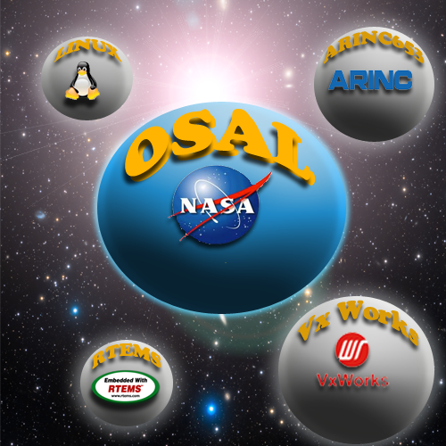
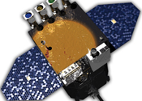
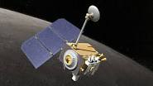
cFS at Goddard
Early use of cFS
OSAL
Developed for Solar Dynamics Observatory (SDO) – Launched in 2010
Used to share code between vxWorks on RAD750 and RTEMS on Coldfire CPUs
First public release in 2004
cFE - Development started in 2004
First cFE User – Lunar Reconnaissance Orbiter (LRO)
Launched June 2009
vxWorks 6 on RAD750
cFE was developed during LRO FSW development
LRO developed cFE applications, some of which became cFS apps
DISILCAS – Distributed System Integration Lab Communications Adapter Set
Connects Engineering Test Unit (ETU) boxes and flight-like interfaces to other ETUs and flight-like interfaces (Geographically distributed)

Slide 3
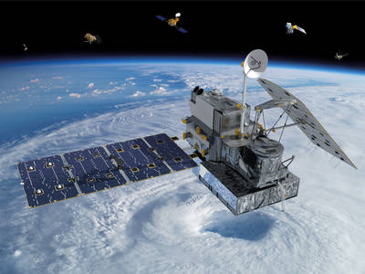
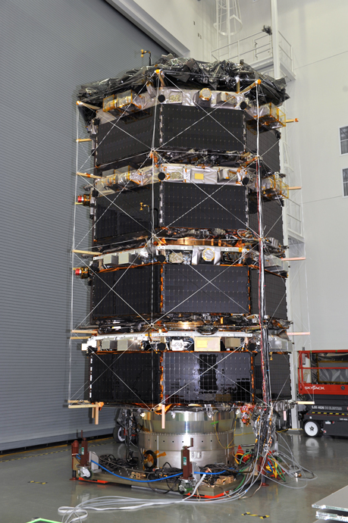
cFS at Goddard
Current cFS flagship Missions
GPM - Global Precipitation Measurement
Launched Feb 2014 -
Full complement of cFS applications
RAD750 – vxWorks 6.4
MMS - Magnetospheric Multiscale Mission
Launched March 2015
Four identical spacecraft –
Radiation Hardened Coldfire ( 40Mhz ) - RTEMS 4.10
NASA EEPROM File System ( github.com/nasa/eefs)
Full complement of cFS applications
Officially began science operations September 4, 2015

Slide 4
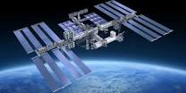
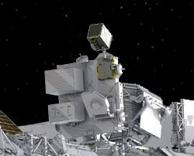
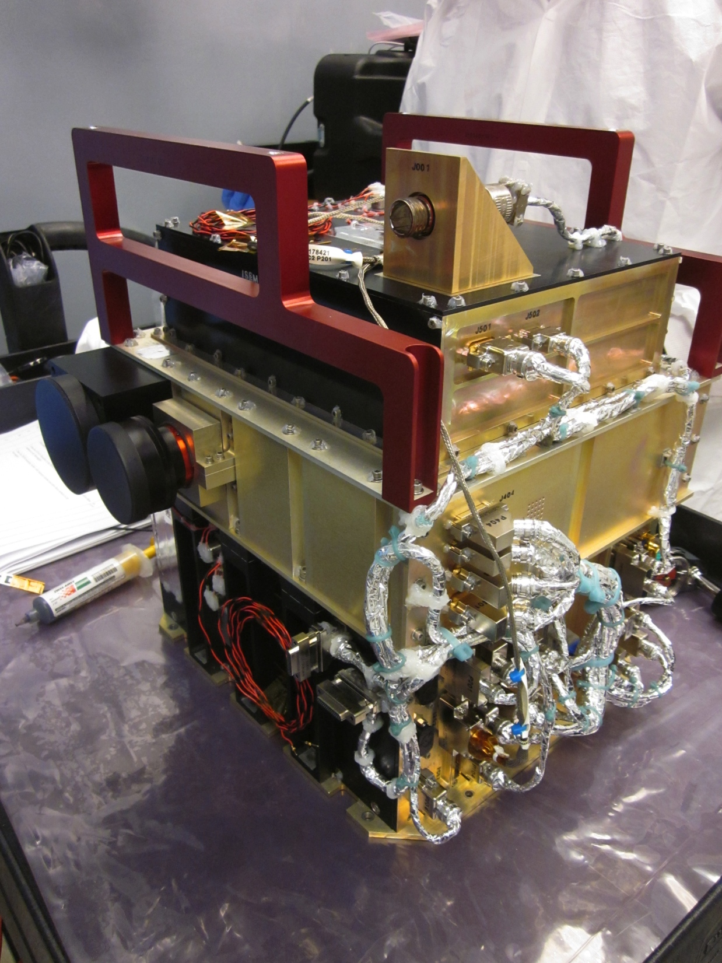
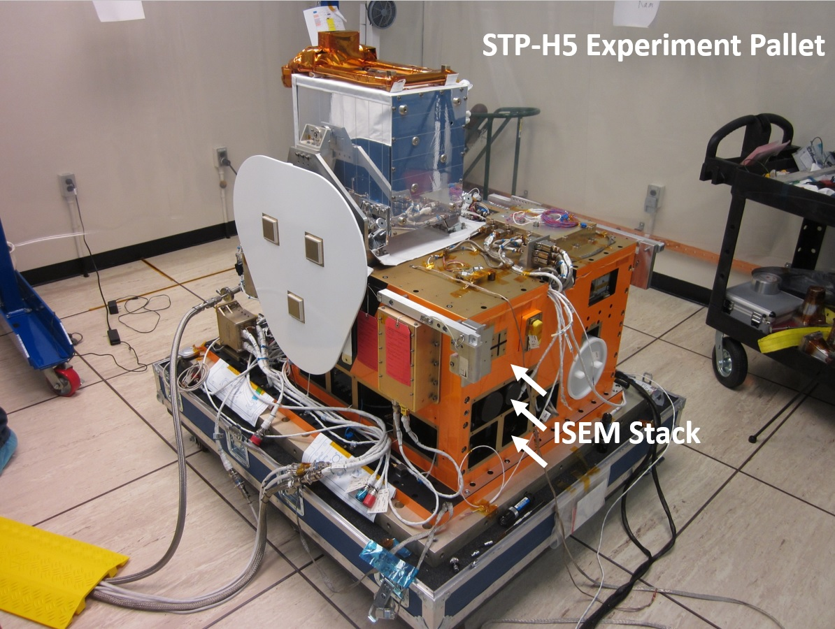
cFS at Goddard
Space Station Experiments
NICER - Neutron star Interior Composition ExploreR Mission
ISS Payload
Using cFS , vxWorks, Broadreach PPC board
GEDI - Global Ecosystem Dynamics Investigation Lidar
ISS Payload – Under study / early development
Using cFS, vxWorks, Broadreach PPC board
Space Cube / Space Station Experiments
STP-H4
STP-H5

Slide 5
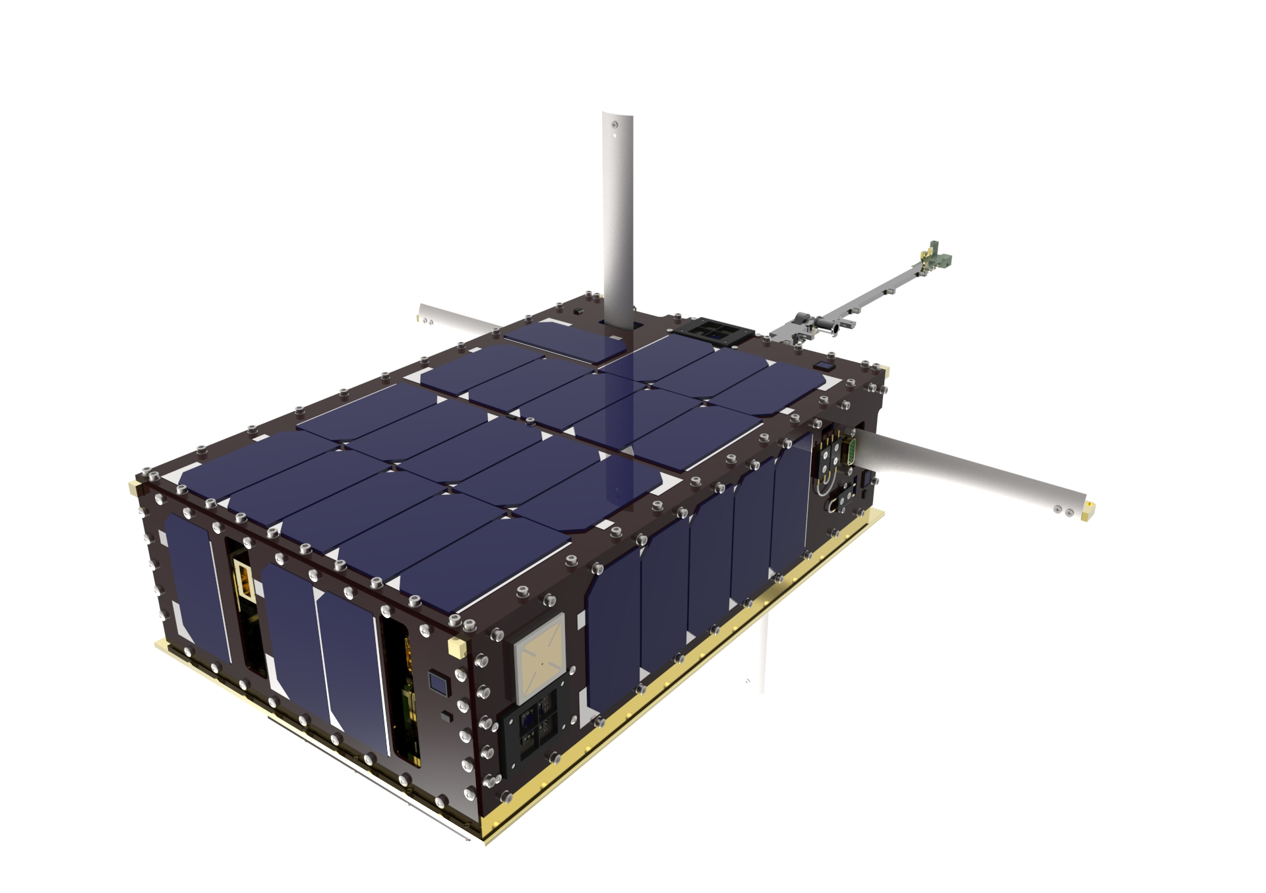
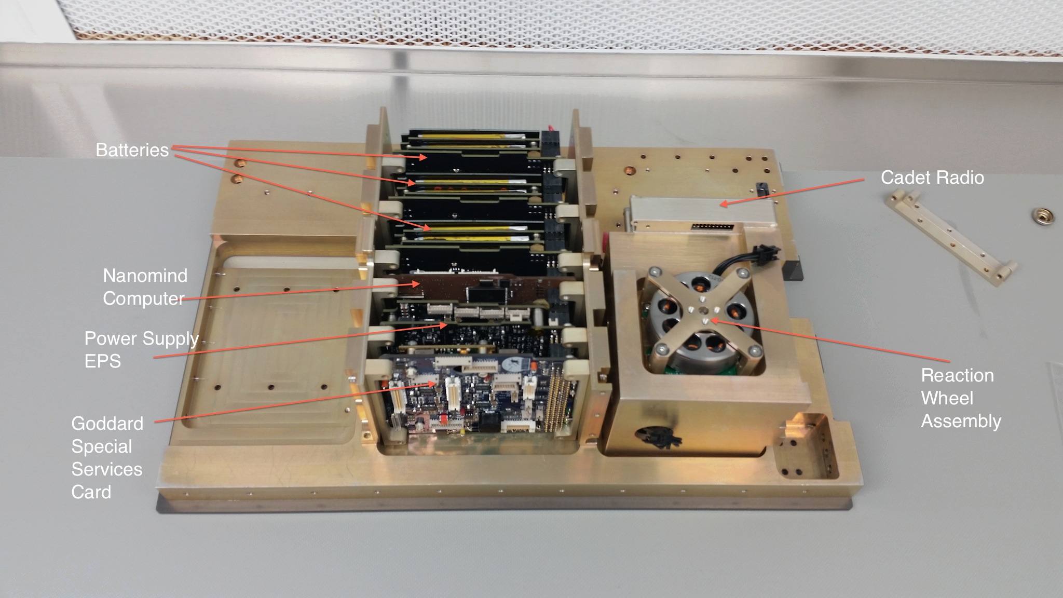
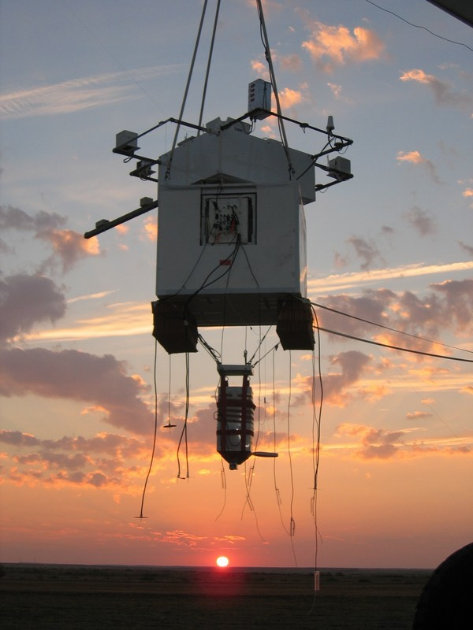
cFS at Goddard
Cubesats and Balloon Missions
Cubesats
Dellingr
Heliophysics “Skunkworks” Cubesat
Using COTS components
Nanomind A712 Processor Card
FreeRTOS , cFS
CeREs
cFS on the CHREC Space Processor (CSP)
Many more being proposed
Balloon Platforms
OPIS
GHAPS – Mission Gondola for High Altitude Planetary Science

Slide 6
cFS at Goddard
Testing the Dellingr Cubesat ACS FSW
Problem: Dellingr only has one copy of the flight hardware, and almost no way to test the ACS in a dynamic environment
The abstracted hardware interfaces allow the cFS based FSW to run on the flight computer or a Linux based PC
ACS cFS App
Actuator Cmds
Hardware Calls
(serial,I2C, SPI)
DHL
Dellingr
Hardware Lib
Sensor Data
Serial protocol
PC Running the 42
Simulator
Common Theme – Abstracting Flight Hardware

Slide 7
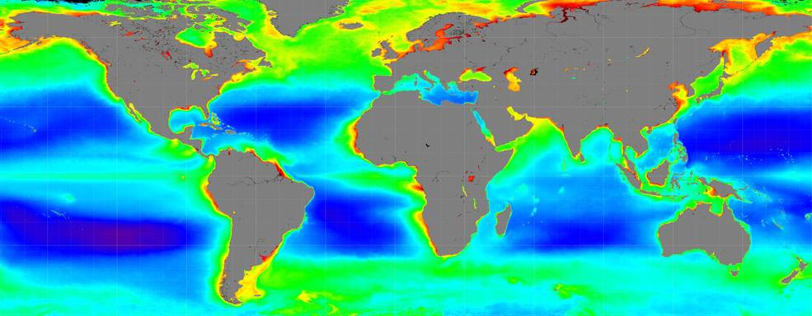
cFS at Goddard
Upcoming work
MUSTANG / PACE / Ocean Color Instrument
Custom C&DH / Instrument computer
Dual Core LEON3 architecture
FPGA based LEON3FT I/O processor
RTEMS 4.11
Multi-Core support
Dynamic Loader for cFE and cFS applications
Flash file system
Possibly Multi-processor communication between LEON3 CPUs

Slide 8
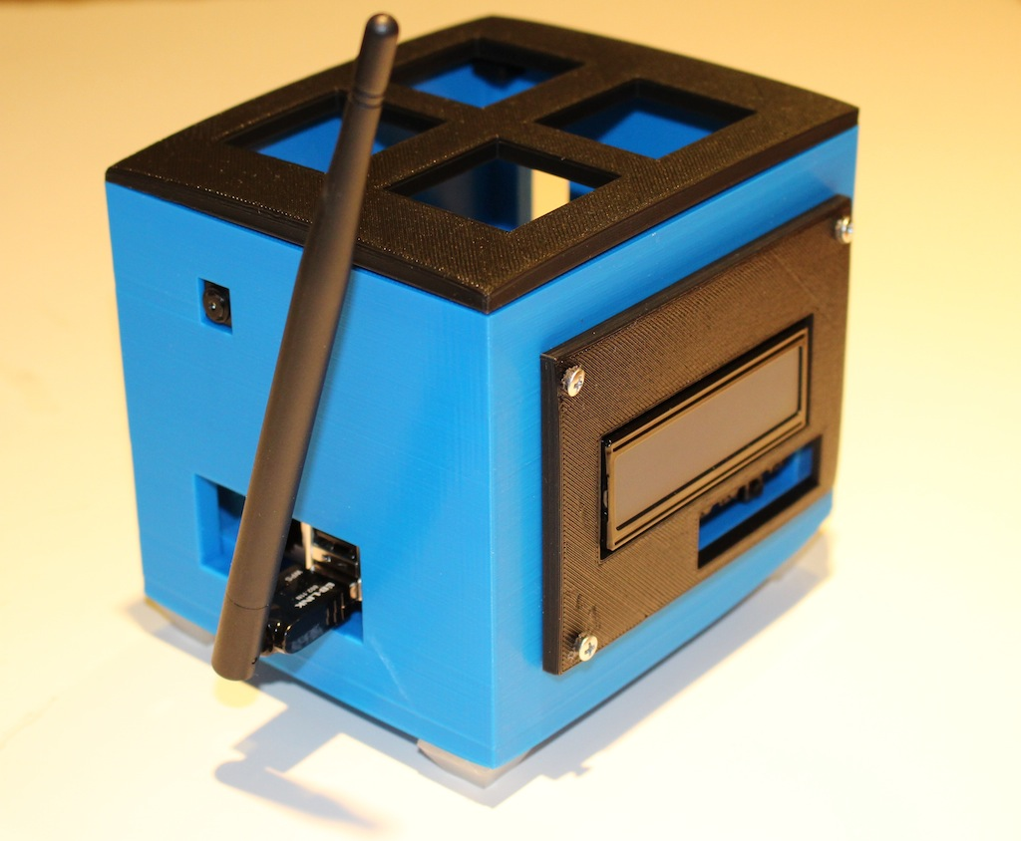
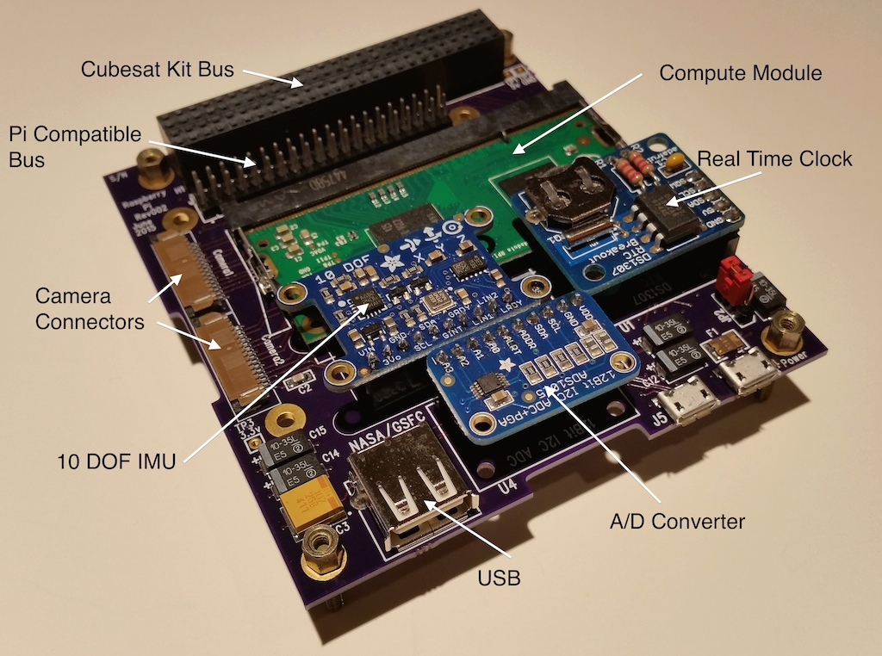
cFS at Goddard
Technology and Training
Technology Initiatives
Multi-core Support co-developed with JHU/APL
Memory Protection Process Model cFS co-developed with JHU/APL
Partitioned system – cFS ported to PikeOS on LEON3
Xenomai Linux – for future Balloon missions
Software Bus Network updates
Development Environment (IDE)
Training –
cFS Training course
AKA – ”The Jonathan and Susie show”
Pi-Sat
Cubesat Prototype based on Raspberry Pi
Developed and used by Summer Interns/Co-op students
Common Theme – Training kits

Slide 9
Goddard as a cFS Customer
Flagship Missions (GPM, MMS, etc)
Want to have the tested, heritage cFS
Instrument Subsystems
In the absence of big missions, instruments may play a larger role
Cubesats
This is a growing trend at GSFC, and the cFS has a large role.
Heritage/testing plays a role to increase reliability
Cost is a major factor
ISS/Balloon missions
More willing to use leading edge technology
Technology development

