Slide 1
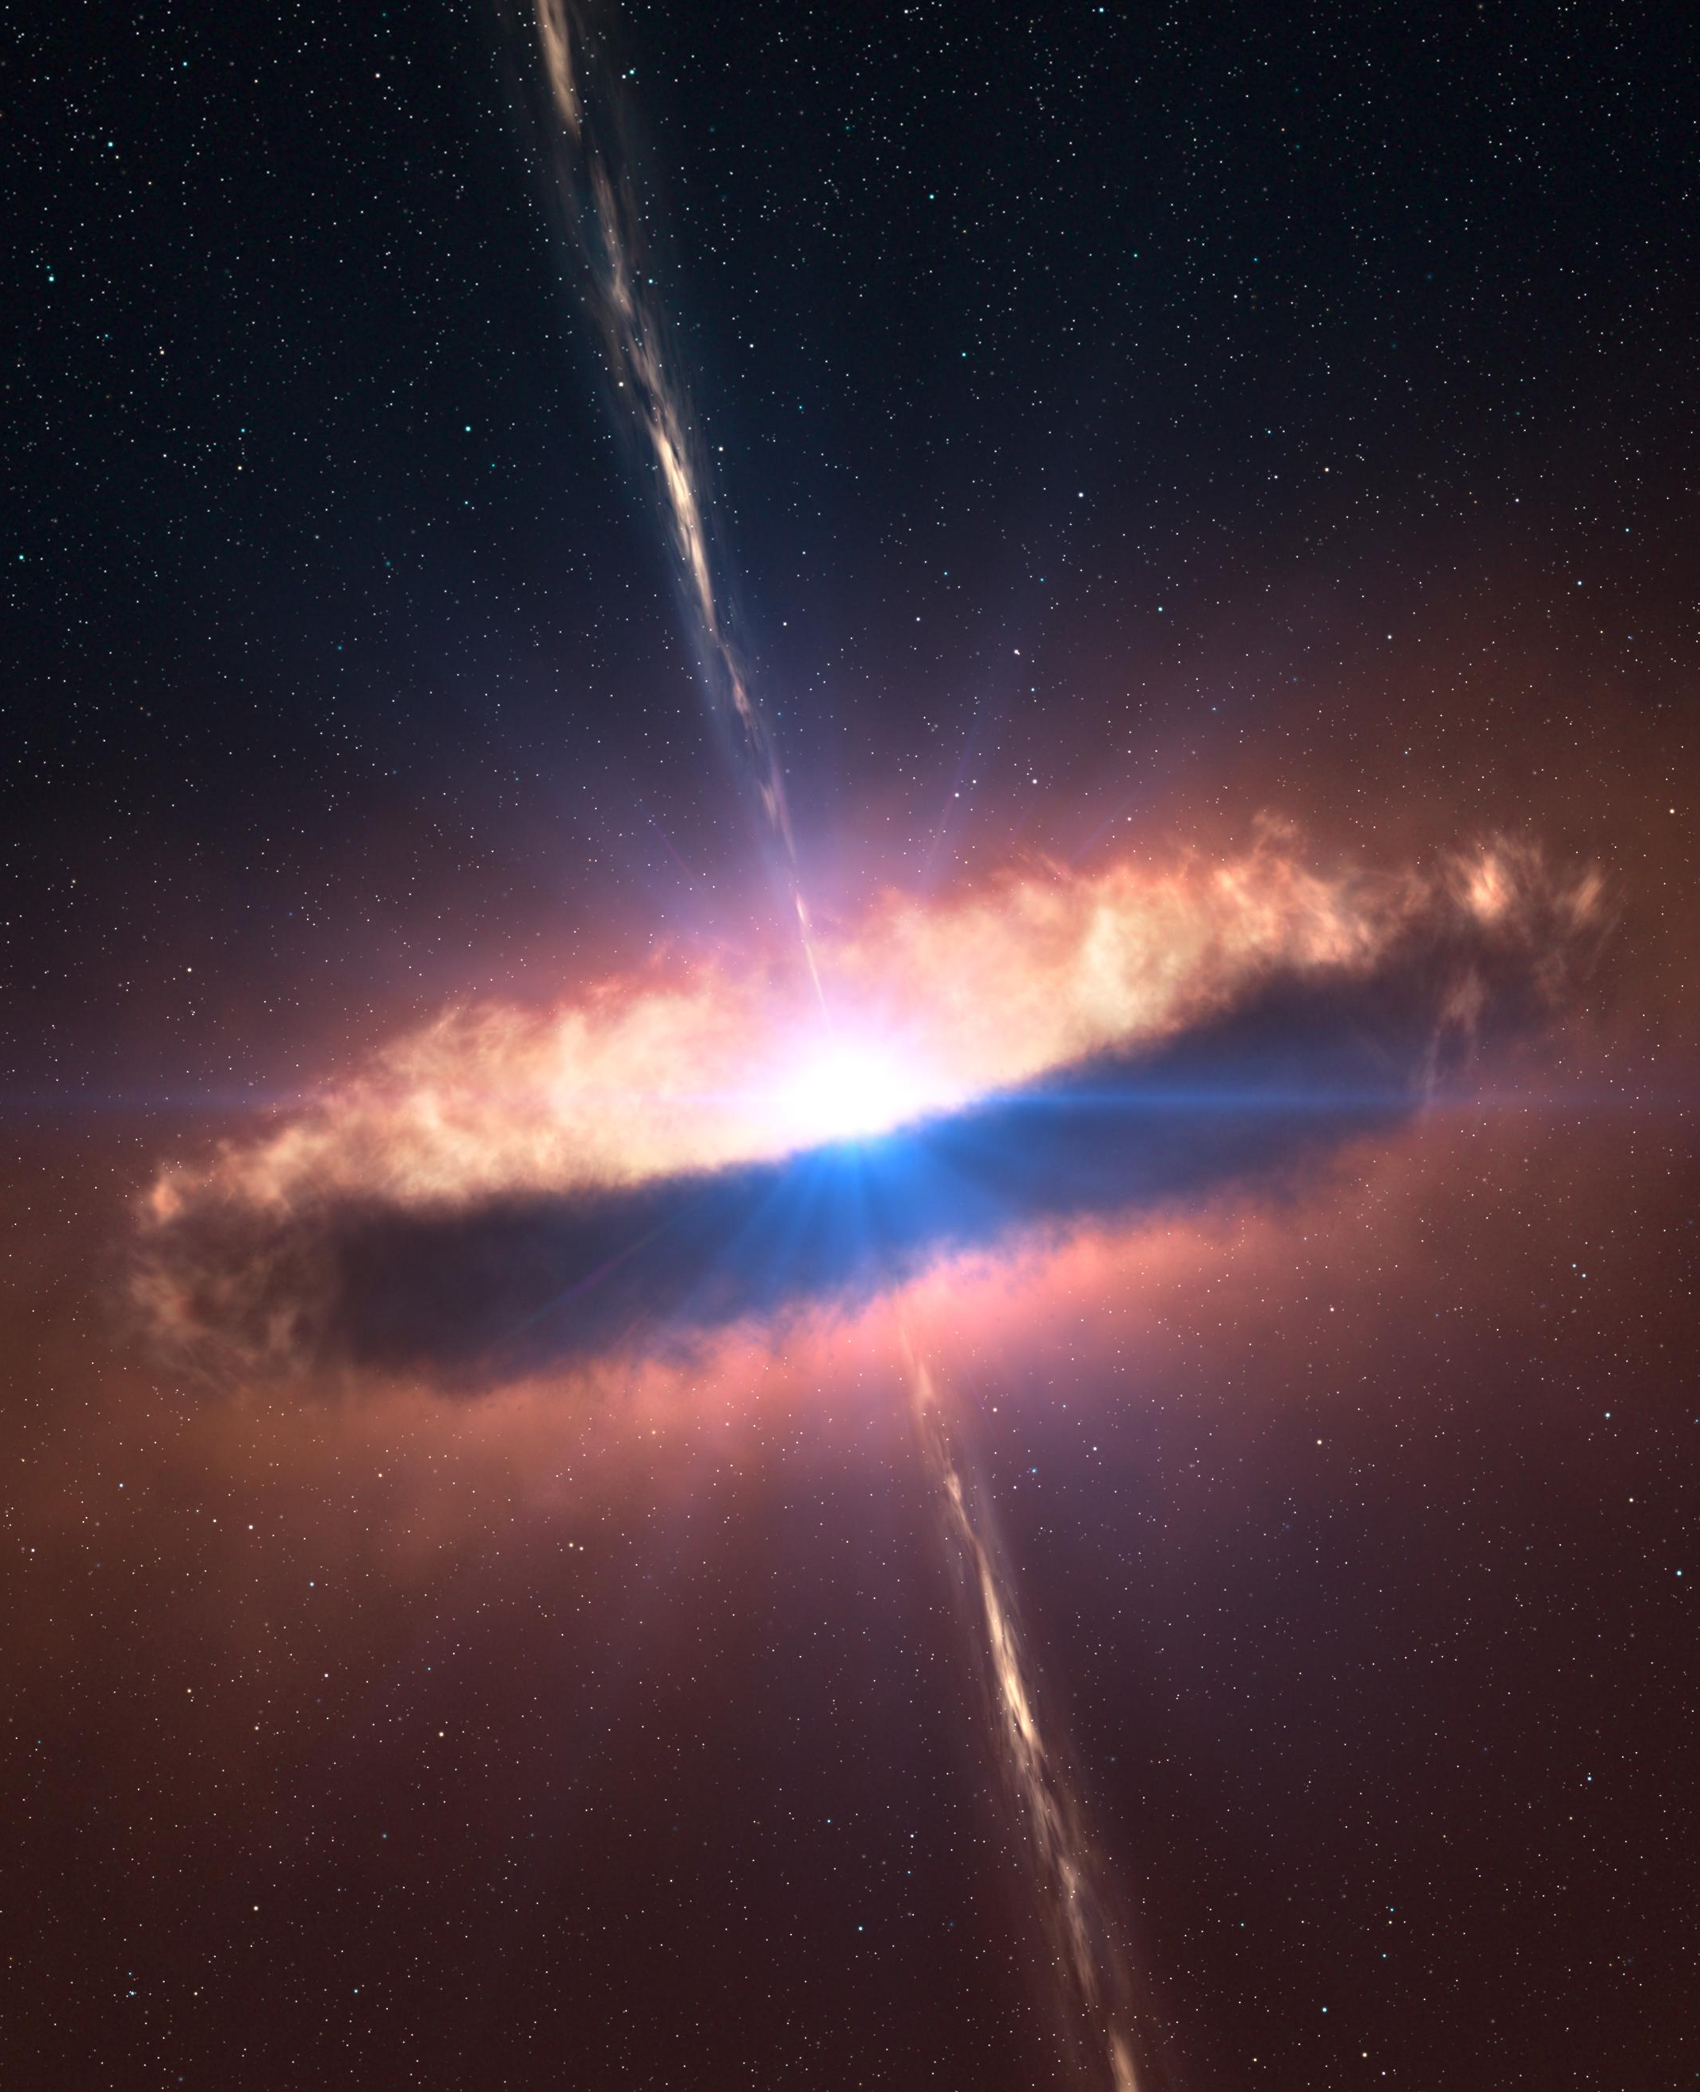
Cyber Defense Lessons for
Flight Software
DJ Byrne

Slide 2
Overview
How attackers look at your system
Key take-aways
  It's worth your time
  It's not that difficult
    80/20 rule
  It's not that expensive
Lessons by Lifecycle
  Mission Planning
  Software Management
  System Engineering
  Architecture & Design
  Implementation
  Testing
  Operations
Notes:
Finish by: 02 minutes

Slide 3
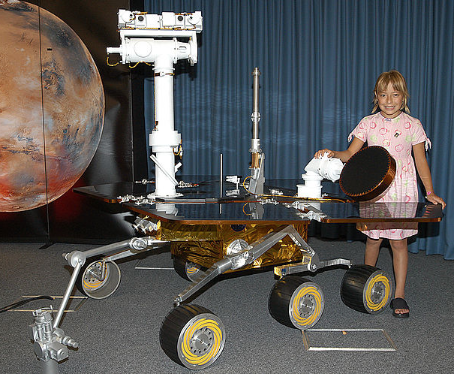
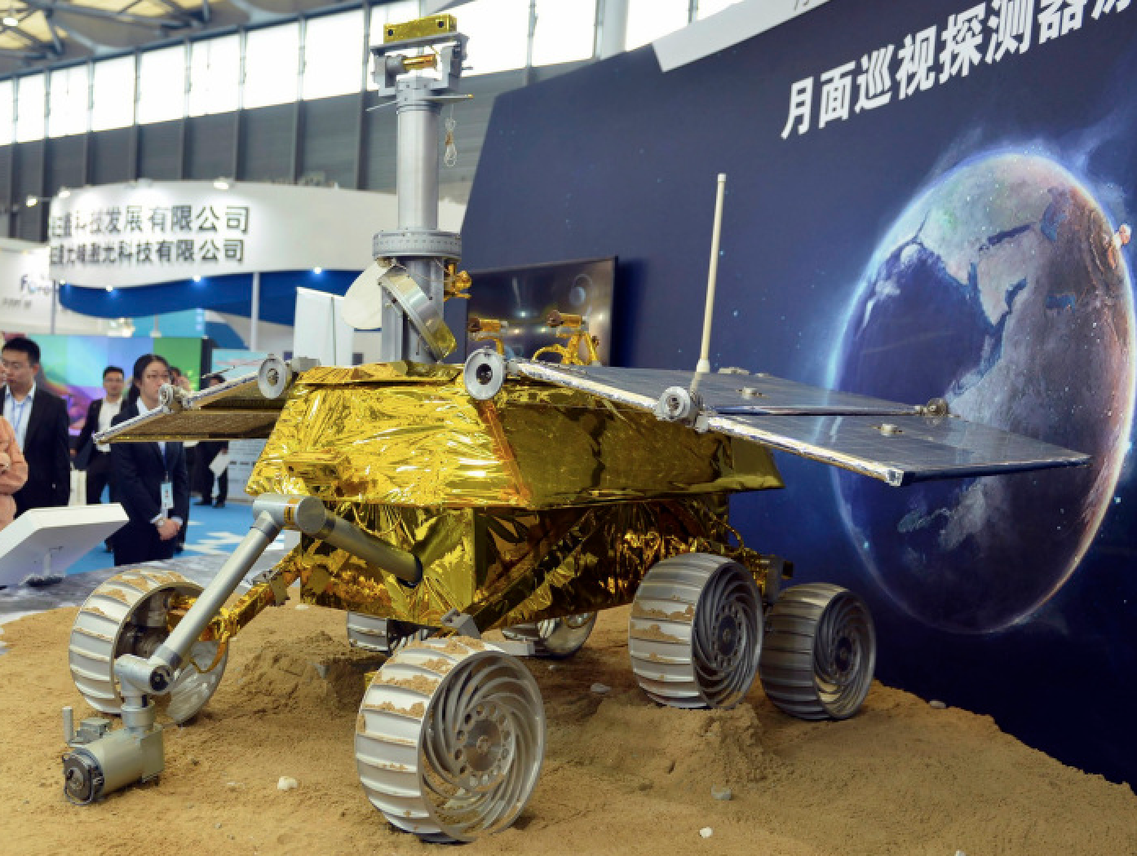
How Closely Are You Being Watched?
Spirit/Opportunity Mars
  2004-01, USA
  Yutu (Jade Rabbit) Luna
  2013-11, China
Notes:
15 seconds
Chang'e 3 lander and its Yutu rover on the Moon
https://en.wikipedia.org/wiki/Mars_Exploration_Rover
http://www.reuters.com/article/2013/11/26/us-china-space-idUSBRE9AP04W20131126
Visitors take pictures of a prototype model of a lunar rover at the 15th China International Industry Fair in Shanghai, November 5, 2013.
Credit: Reuters/Stringer

Slide 4
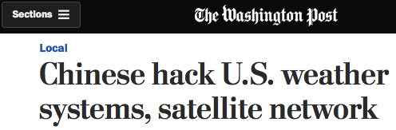

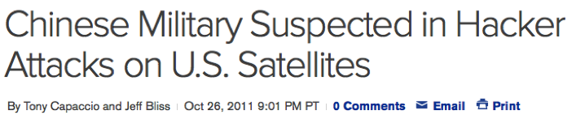
Yesterday's Headlines
Notes:
15 seconds

Slide 5
Tomorrow's Headlines?
Cyber Attack Turns ‘Curiosity’ into Martian Boulder
Hackivists fry Spitzer Telescope by Pointing at Sun
‘Juno’ Jupiter Explorer hijacked by Al Qaeda, transmitting anti-U.S. Slurs
Notes:
15 seconds

Slide 6
Attackers Do Not "Fly As You Test"
Can I come at you through the weeds?
  Breadth of attack surface
  Depth of defenses
"Test as you fly, fly as you test"
  Creates coverage gaps by permitting us to avoid, rather than patch, dangerous behavior.
  If a Bad Thing can happen by chance, it can also happen by intention (e.g. maliciously)
V'ger 6 was totally pwned...
  Stardate 7412.6
Notes:
Finish by: 04 minutes
Pwn is a leetspeak slang term derived from the verb own, as meaning to appropriate or to conquer to gain ownership.

Slide 7
Mission Planning
Fortune Favors the Prepared
Can I attack you unopposed?
Acknowledge the need, define it, track it
  Good starting reference: CCSDS Green Book "Security Threats Against Space Missions"
Threat Agents, Motivations:
  Nation state – Design Info, Financial Plans
  Criminals – Money (e.g. RansomWare)
  Terrorists/activists – Publicity (destruction OK)
  "Kids" – Thrills, Attention, Experimentation
Notes:
Finish by: 05

Slide 8
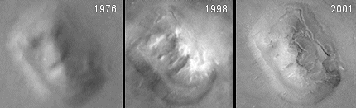
Mission Planning, cont
C-I-A "Security triad"
  Confidentiality
  Integrity
  Availability
Consequences to Avoid Include
  Scientific scooping (who publishes first?)
  Bogus science results (injected)
  Loss of mission or schedule
  Loss of reputation, i.e. loss of future business
Notes:
Finish by: 06
Pranksters stir up enough trouble with un-modified data.
Face on Mars images from https://science.nasa.gov/science-news/science-at-nasa/2001/ast24may_1

Slide 9
Mission Planning, cont
Some threats FSW could be resilient to
  Data corruption
  Ground facility physical attack
  Interception
  Jamming
  Denial-of-Service
  Masquerade
  Replay
  Software threats
  Unauthorized Access
  Tainted Hardware Components
Notes:
30 seconds
Taken from CCSDS Green Book "Security Threats Against Space Missions"
https://public.ccsds.org/Pubs/350x1g2.pdf

Slide 10
Software Management
Don't start from scratch
How disciplined are your defenses?
Governance, controlling authorities you need a story for - starting with:
  FISMA (Federal Information Security Management Act of 2002)
  FIPS requirements
    Federal Information Processing Standard Publication 199, "Standards for Security Categorization of Federal Information and Information Systems"
  Implementation guidance
    CNSSI 1253 "Security Categorization and Control Selection for National Security Systems"
      Attachment 2, Appendix F "Space Platform Overlay"
    NIST Special Publication 800-53, "Security and Privacy Controls for Federal Information Systems and Organizations"
Notes:
Finish by: 07
FISMA: "Thou shalt meet FIPS-199"
FIPS-199: Inventory of Low/Med/High for C-I-A
NIST SP 800-53: Definitions for OMB M-04-04. Controls for Low/Med/High
OMB M-04-04 "E-Authentication Guidance for Federal Agencie": Levels of Assurance, with tie to FIPS-199
OMB A-130 "Management of Federal Information Resources"

Slide 11
Software Management, cont
Make defenses work for you
Budgeting for cyber-defense
  Return on investment from dual-use benefits
    Screen out accidental behaviors
    Monitor behavior against expected baseline
    Fewer subtle dangers available to users
  Include wedge for sunset, or sustaining fixes
Notes:
Finish by: 08

Slide 12
Software Management, cont
Training
  Experience and knowledge matter
  Defensive coding materials freely available
  Schedule time for training
Lifecycle
  Threats and attacks evolve
  Include sunset, or sustaining fixes
  Waterfall vs iterative, agile
Notes:
15 seconds

Slide 13
System Engineering
"I can't do that, Dave."
Is there one command that would kill your spacecraft, end the mission?
  How about a pair of cmds? A sequence?
Reliability analyses vs Threat Models
  "It hurts when I do that!" "Then don't do it."
  Model your environment, including threats
  Be resilient to ground-system flaws
Notes:
Finish by: 10

Slide 14
System Engineering, cont
Can I achieve my goal with your system?
Risk drivers: adversary capability and motivation
  If it can happen accidentally, it can happen maliciously. But worse than that...
  Intentional faults have different characteristics than accidental, or random faults
  Risks adapt to defeat your counter-measures
  Think strategic campaign, not single-fault analysis
Notes:
Finish by: 11

Slide 15
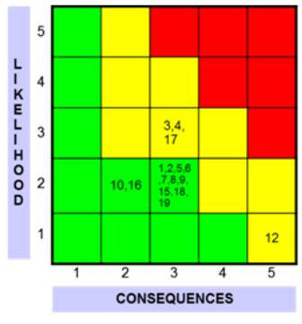
System Engineering, cont
Capability
Risk Likelihood
  Linked with attacker capability
  Can be driven up from "epsilon / negligible" toward "almost certain"
  Multiple, coordinated, simultaneous faults
Risk Consequences
  Alignment with motives affects the likelihood
Motivation
Notes:
30 seconds
5x5 matrix from http://rules.jpl.nasa.gov/cgi/doc-gw.pl?docid=78158

Slide 16
System Engineering, cont
Can I process your data before you do?
Can I modify your cmds or telemetry?
Can I deny your service?
Requirements for security (C-I-A views)
  C: Encryption, key mgt,...
  I: Signatures / hashes, key mgt...
  A: What is safety-critical?
    Power, thermal, telecom
Notes:
Finish by: 12

Slide 17
Architecture and Design
Bake it in
Diagram both use cases and abuse cases
How many users do you design for?
  Six? Six million?
  Should it matter?
  Prevent, Detect, Mitigate, Recover
Notes:
30 seconds

Slide 18
Architecture and Design - Prevent
Can I impersonate a trusted component?
Distrust users, instruments, other modules
  Isolate inputs
    Validate against unforgiving spec
  Isolate outputs
  Digital signatures on code, config, files, data
When inheriting, can details be modified?
  Like re-using a combination lock while changing the code (e.g. opcodes)
Notes:
Finish by: 14

Slide 19
Architecture and Design – Prevent, cont
Can I taint a trusted component?
Chart the full supply chain
  Compiler, libraries, chips
  Can these be vetted / analyzed?
    ...or isolated?
  Is there malware inside already?
Notes:
30 seconds

Slide 20
Architecture and Design - Detect
Can I jam an interface? Replay cmds?
Build in visibility
  Avoid "no news is good news"
    Does silence mean all is well, or alarm's been cut?
    "...A 16-inch pipeline ruptures under Whatcom Falls Park and releases about 237,000 gallons of unleaded gasoline into Whatcom Creek, unknown to anyone."
  Hashes / signatures / checksums on data
  Heartbeats with timetags
  Invalid data marked and returned, not dropped
Notes:
Finish by: 16
http://www.bellinghamherald.com/news/local/article22200432.html

Slide 21
Architecture and Design - Mitigate
Can I gain unauthorized access?
  And do untraceable things?
Survive the attack
Notice the attack, characterize it
Call for help
Shed complexity
  Strip down to minimal critical functions
Notes:
30 seconds

Slide 22
Architecture and Design - Recover
Can I persist after being noticed?
Fail-safe fallback of minimum complexity
Checkpoint and restore to last-known-good state
Redundant but non-identical components
Notes:
Finish by: 18

Slide 23
Implementation
Bugs == Exploits
Can I inject my code to a running image?
Use everything your mother taught you about maintainable design
  Few if any globals, etc
  Anticipate buffer overflow attempts
  Memory segmentation
Code analysis is an unalloyed win
  Dev process should have analysis baked-in
Notes:
Finish by: 19

Slide 24
Implementation, cont
Can I modify artifacts in your CM (Configuration Management) System?
  Circumventing your reviews
How often does this happen?
  PROM image sent by email
  Firmware image salvaged from old laptop
  Parameter files from USB drive
  "As-run" test data mis-labeled when retrieved
Archive checksums separate from artifact they protect; compare them out-of-band
Notes:
Finish by: 20

Slide 25
Testing
More reliable too!
Can I make the unexpected work for me?
Seeing goat paths as highways
  "It can be made to work"
  ...vs "Can it be made to fail?"
Independent testers who use software in unintended ways, configs, and combinations
  Fuzzing inputs
Code coverage (looking for trojans)
Notes:
Finish by: 21

Slide 26
Operations
Can I upload my own software patch?
Can I re-normalize your baseline?
Flight rules and restrictions vs code fixes
Constant patch vs fly-as-you-test
Continuous Monitoring
  Establish a baseline and track against it
  Command counter?
  Time-powered-on counter?
Notes:
Finish by: 22
By "re-normalize the baseline", I mean making small changes over time, so the new (adversarial) behavior becomes expected.

Slide 27
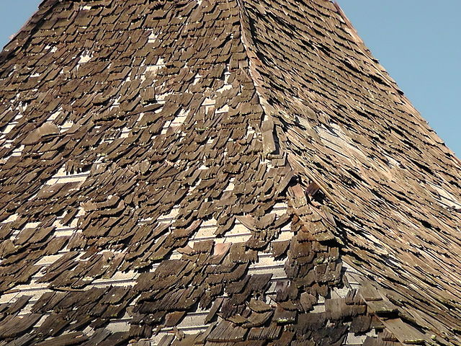
Summary: Necessary But Not Sufficient
Look for gaps in coverage
Current cyber-security designs
  Single-layer; blind to multi-layer actions
  Fault Containment intended along Dev/Test/Ops lifecycle boundaries, but not strictly maintained
  Gaps in coverage between layers
Notes:
Finish by: 23
Roof damage image from https://commons.wikimedia.org/wiki/File:Roof_Damage_3.JPG
licensed under the Creative Commons Attribution-Share Alike 3.0 Unported license.
The Hogan Fountain Pavilion is a unique mid-20th century modern architectural structure located within Cherokee Park, Louisville, Kentucky built in 1965.

Slide 28
Questions?
"I can't do that, Dave."
Fortune Favors the Prepared
Look for gaps in coverage
Key take-aways
  It's worth your time
  It's not that difficult
    80/20 rule
  It's not that expensive
Bake it in
More reliable too!
Make defenses work for you
Don't start from scratch
Capability
Bugs == Exploits
Motivation
Notes:
5x5 matrix from http://rules.jpl.nasa.gov/cgi/doc-gw.pl?docid=78158

Slide 29
References
CCSDS Green Book "Security Threats Against Space Missions"
  https://public.ccsds.org/Pubs/350x1g2.pdf
NASA IV&V Secure Coding portal
  https://nen.nasa.gov/web/coding
Build Security In - best practice articles
  https://www.us-cert.gov/bsi
Common Weakness Enumeration
  https://cwe.mitre.org/

Slide 30
References, cont
Satellites interfered with
  2011 Report to Congress of the U.S.-China Economic and Security Review Commission (page 216)
  http://origin.www.uscc.gov/sites/default/files/annual_reports/annual_report_full_11.pdf
"Hacking Curiosity" article
  http://www.pcmag.com/article2/0,2817,2408295,00.asp

Slide 31
References, cont
2012-02-29, NASA OIG to Congress
  http://oig.nasa.gov/congressional/FINAL_written_statement_for_%20IT_%20hearing_February_26_edit_v2.pdf
NASA OIG Semiannual report, April 1 – Sept 30, 2012
  http://oig.nasa.gov/SAR/sar0912.pdf
  http://oig.nasa.gov/press/pr2012-E.pdf
"Exposing One of China's Cyber Espionage Units"
  https://www.fireeye.com/content/dam/fireeye-www/services/pdfs/mandiant-apt1-report.pdf

Slide 32
References, cont
"Chinese hack U.S. weather systems, satellite network"
  https://www.washingtonpost.com/local/chinese-hack-us-weather-systems-satellite-network/2014/11/12/bef1206a-68e9-11e4-b053-65cea7903f2e_story.html
"Chinese hackers took over NASA's Jet Propulsion Lab, Inspector General reveals"
  http://www.foxnews.com/tech/2012/03/01/chinese-hackers-nasa-jpl-lab.html

