Slide 1
cFS Workshop Ground Systems & Kits
core Flight System Workshop
Caltech
December 12, 2016
David McComas – NASA Goddard Space Flight Center

Slide 2
Agenda
Inventory ground systems used with cFS
Kit General Concepts
Databases
Ground Tools & Features
Technology Strategic Roadmap
Closing Remarks

Slide 3
Ground System Inventory
ASIST, Advanced System for Integration and Spacecraft Test, http://www.assist-dai.com/
Design America
Government and commercial versions available
COSMOS, http://cosmosrb.com/
Ball Aerospace
Open Source
ITOS, Integrated Test and Operations System, http://www.hammers.com/
The Hammers Company
Government and commercial (GALAXY) versions available
YAMCS, Yet Another Ground System, http://www.yamcs.org/
Sponsored by Space Applications Services, http://www.spaceapplications.com

Slide 4
What is a Kit?
Out-of-the-box complete solution that is easy to access, install, configure, and run.
Configurable and expandable
Example below similar to Goddard’s and uses a connection-based architecture
Ground System
cFS
Dynamic
Simulator
Embedded
Target

Slide 5
Why Kits?
Common platform easily accessible to the cFS community provides many benefits
Education and training
Ongoing discussions for making academic courses with a cFS kit-based lab
Easier to port from working system to your target
Capitalize on cFS regression test suite
Missions can maintain and utilize delivered cFS test suites (once translated into the kit scripting language)
Serve as a mission integration test platform for new mission applications
Common certification platform
Platform abstraction and device plug certification test suites
Lower the bar for adopting the cFS which helps the community expand

Slide 6
Kit Inventory
NASA’s Independent V&V Facility - NASA Operational Simulator for Small Satellites (NOS³)
Ground System: Ball Aerospace’s COSMOS
Dynamic Simulator: NASA Goddard’s 42
NASA Goddard
Ground System: Ball Aerospace’s COSMOS
Dynamic Simulator: NASA Goddard’s 42 (planned for version 2)
The Hammers Company
Ground System: Hammer’s Integrated Test and Operations System (ITOS)
Dynamic Simulator: Hammer’s VirtualSat®
NASA Johnson Space Center
cFS Training: Python Ground System (others optional) and no simulator
Education Outreach: YAMCS, NASA JSC Trick

Slide 7
NOS³ Overview

Slide 8
NOS³ Architecture

Slide 9
NOS³ Components

Slide 10
HammersSat

Slide 11
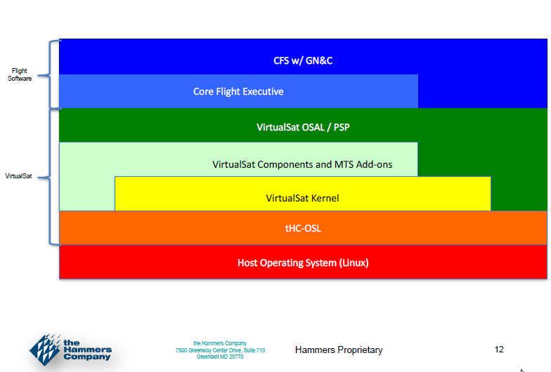
HammersSat Architecture

Slide 12
VirtualSat

Slide 13
VirtualSat (cont.)

Slide 14
File Transport
CCSDS File Delivery Protocol
Goddard released an open source cFS app
ASIST and ITOS provide ground engines
Trivial File Transport Protocol (TFTP)
Prototype app at Goddard with open source Ruby ground client
Dellingr custom protocol

Slide 15
Databases

Slide 16
Tools
cFS Command and Data Dictionary Tool, JSC
PostgreSQL database front end
Generates header files, copy table, schedules telemetry, scheduler table, ITOS command & rec files
Inputs types include, CSV, Text, XML, XTCE, Electronic Data Sheets

Slide 17
Kit Technology Strategic Roadmap
Technology Focus: Kits
Ground-cFS
Ground-cFS-Simulator
Goals
Mission cFS Regression Test
Platform Certification
Device Certification
File Transport
Electronic
Datasheets
Device Plug-in Model
Related
Technologies
Direct dependency that drives
next activity
Indirect dependency. Receiving activity
can still occur without it.

Slide 18
Closing Remarks
Minimize duplicate work
Can a modular approach be taken so kits can build upon one another
Kits are not mutually exclusive
One version could be
Technology focused
Quick to respond and adapt to new technologies
Another version
Formal controls and slower to respond to change
Used as certification platform
Lifecycle support
Proposals
Mission planning
FSW maintenance
Operations

