Slide 1
Robotic Servicing of Geosynchronous Satellites:
Adaptability, Affordability, Resilience
Gordon Roesler
U.S. Defense Advanced Research Projects Agency
Arlington, Virginia, USA
International Communications Satellite Systems Conference
Trieste, Italy
October, 2017

Slide 2
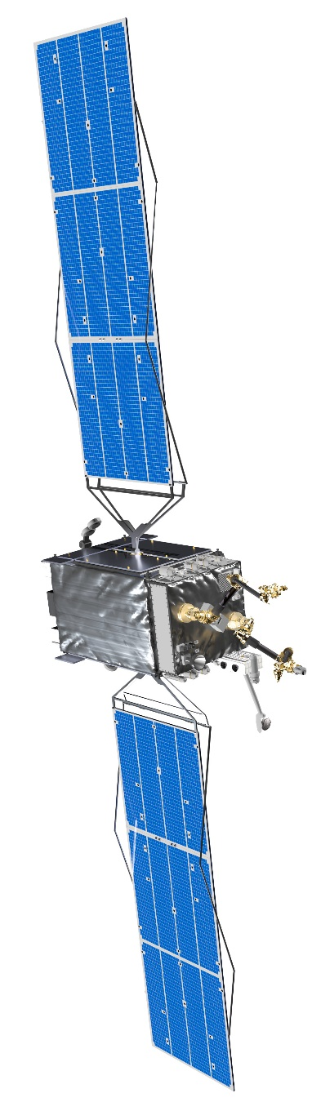
Robotic servicing in GEO: improved reliability, new capabilities
Same benefits for GEO satellites that maintenance, repair and upgrade provide to valuable terrestrial assets
Improved reliability and affordability:
  Refueling: increased fleet flexibility
  Capability to repair some anomalies
  Inspection: data on on-orbit condition of mechanical systems
New capabilities:
  Cooperatively attach modules to on-orbit spacecraft
  Communications, scientific and entrepreneurial applications
  Reduced CAPEX for small GEO payloads
Approach:
  Overcome the technical barriers
  Sustain the capability to execute servicing missions
  Develop years of operational experience and data
  Transparent operations in GEO

Slide 3
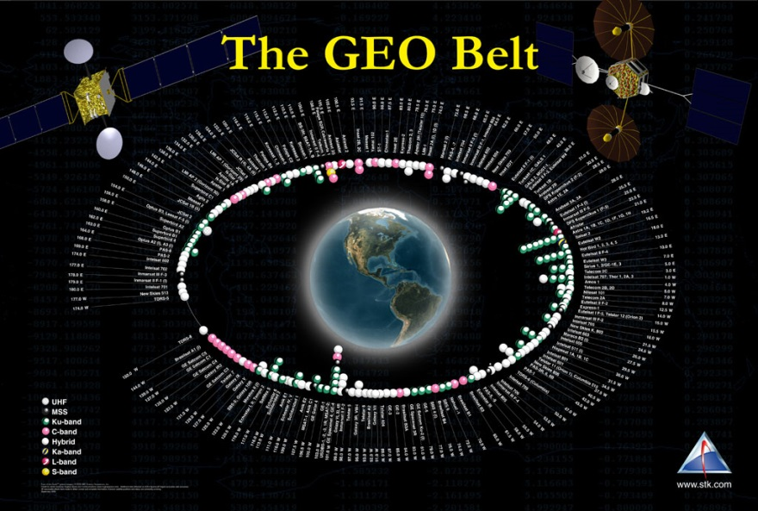
Why DARPA chose GEO: large concentration of serviceable, accessible assets
~5:1 commercial
to government
More data
Reduced cost
Available for government when needed
$B’s
National security from robust revenue stream

Slide 4
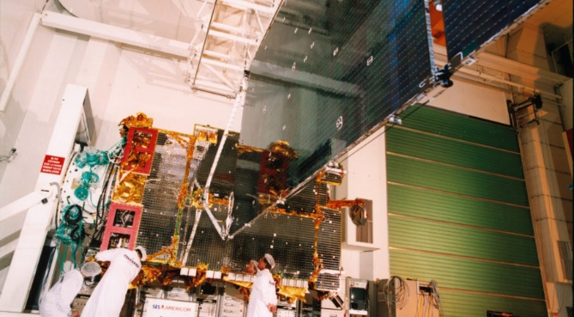
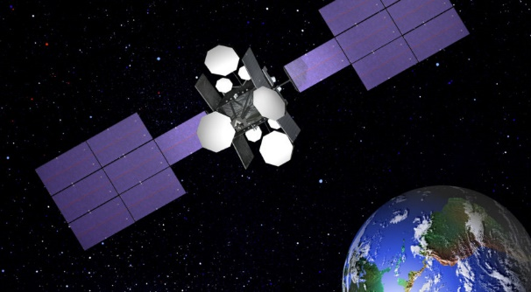
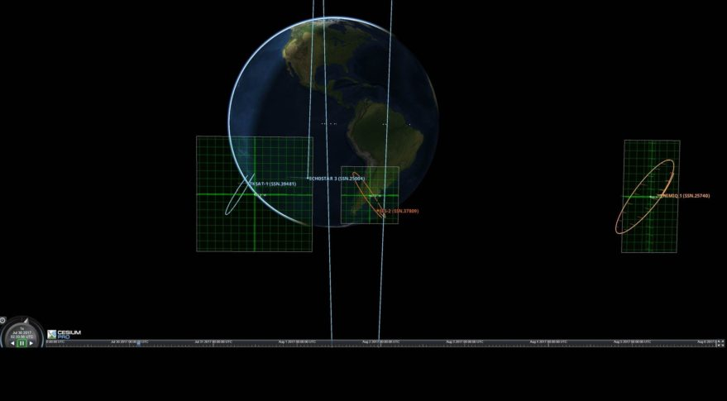
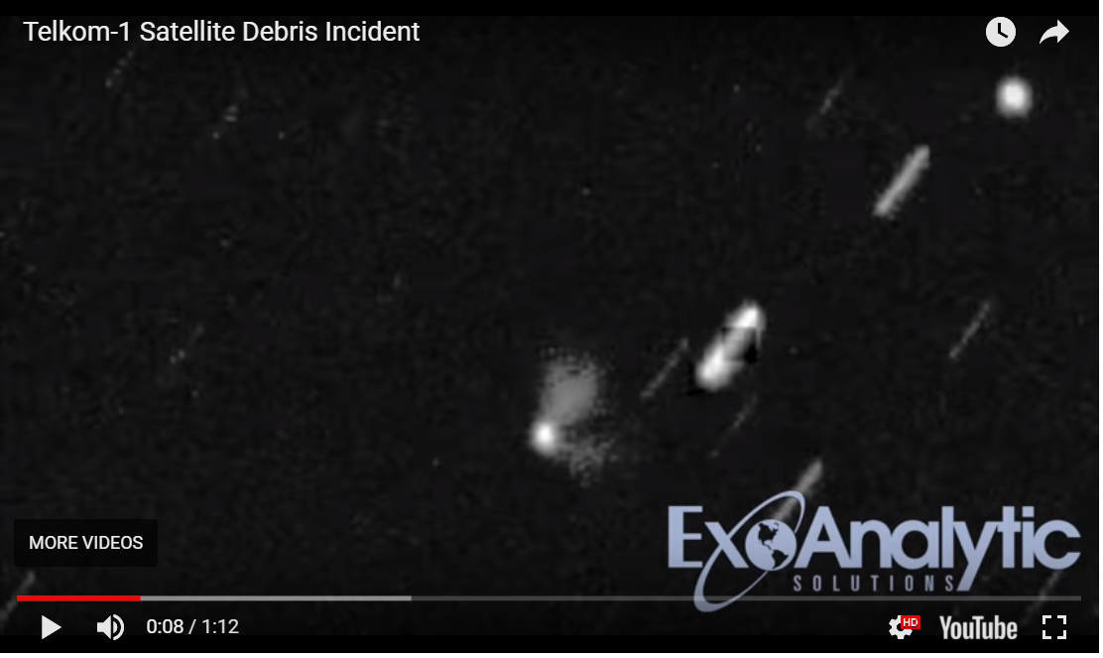
GEO satellites in the news, 2017
June 18, 2017, AMC-9
“SES says its 14-year-old satellite that malfunctioned and strayed from its orbit poses no collision or interference danger to other satellites in the vicinity.”
July 28, 2017, NSS-806 (SES)
“A 19-year old SES satellite lost nearly a third of its transponders in an anomaly - 12 transponders ceased functioning.”
August 2, 2017, Echostar-3
“A 20-year old satellite is drifting after an anomaly of unknown origin during a relocation maneuver - caused communications to become intermittent. “
August 30, 2017, Telkom-1
“Ground-based observations of PT Telkom’s 18-year old Telkom-1 satellite show a large cloud of debris generated the night the satellite lost contact.”
SpaceNews.com Images

Slide 5
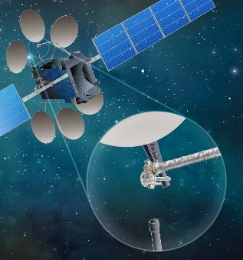
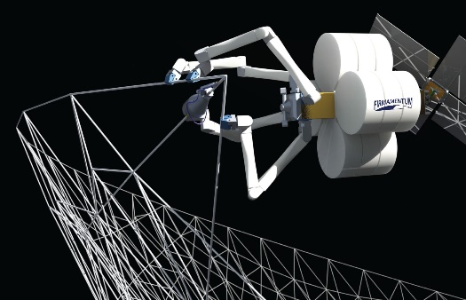
The potential of space robotics
GEO today
Single fairing constraint
No response to failures
Fixed capabilities
GEO future
On-orbit assembly
On-orbit servicing
On-orbit upgrades
Tethers Unlimited
SSL
Robotics enables a transformation of space

Slide 6
The GEO opportunity space
Opportunities per year
Replace
(legacy box)
Replenish
(legacy cryogen)
Today’s Market
Refuel
(legacy chemical)
10s / yr
Technical
Complexity
Repair
< 10 / yr
Replace
(by design)
Replenish
(cryogen by design)
< 1 / yr
Assemble
Refuel
(by design)
Gen2 Services
Attach Upgrade
Deployment Assistance
Many
Relocate
Inspection
Some
Value
SATS LLC chart

Slide 7
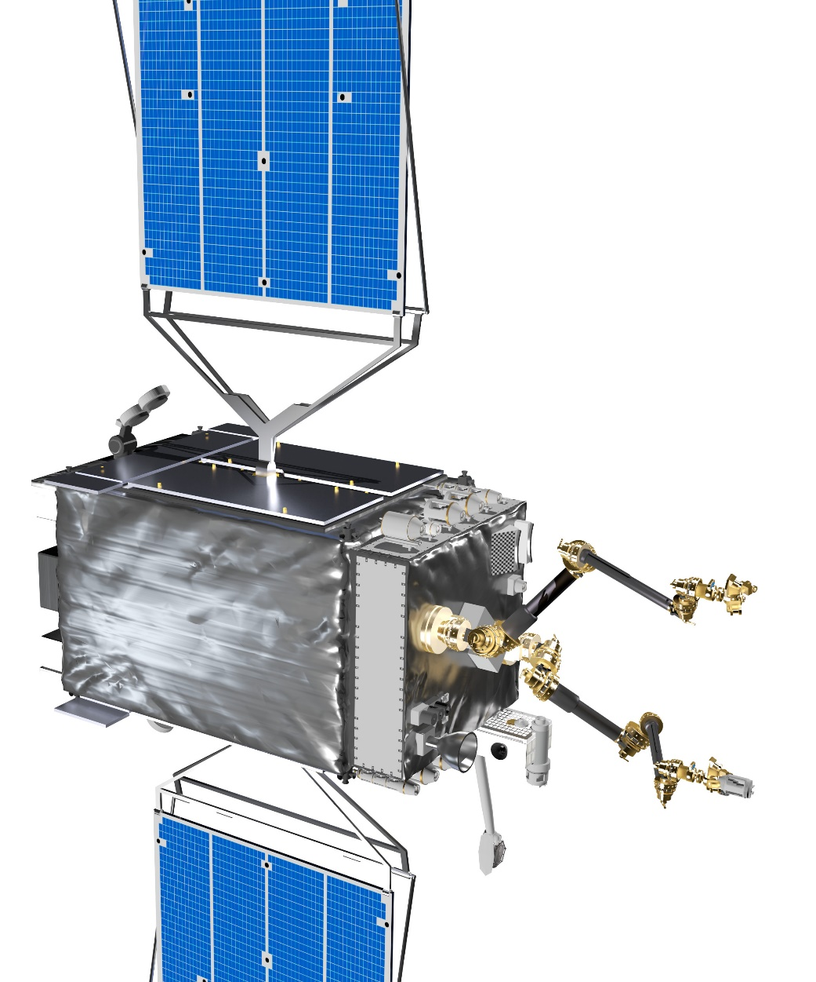
RSGS: Resilience and transformation
Goals:
dexterous robotic capability in GEO
increased resilience for current infrastructure
transformed space architecture, revolutionary capabilities
Approach:
Public-private-partnership
Major investments by both the US government and private industry
Partner: SSL and its JV partner Space Infrastructure Services (SIS)
Artist’s Concept

Slide 8
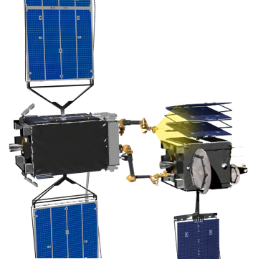
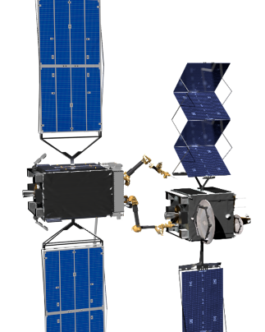
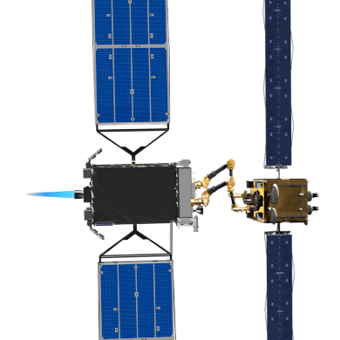
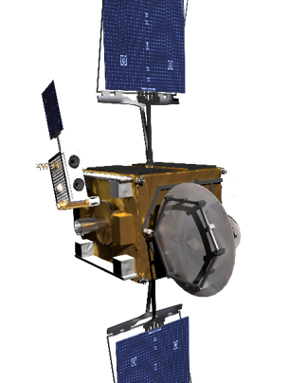
The RSGS baseline mission set
Artist’s Concept
Artist’s Concept
High-Resolution Inspection
Anomaly Correction
Artist’s Concept
Artist’s Concept
Cooperative Relocation
Install Upgrade Modules

Slide 9
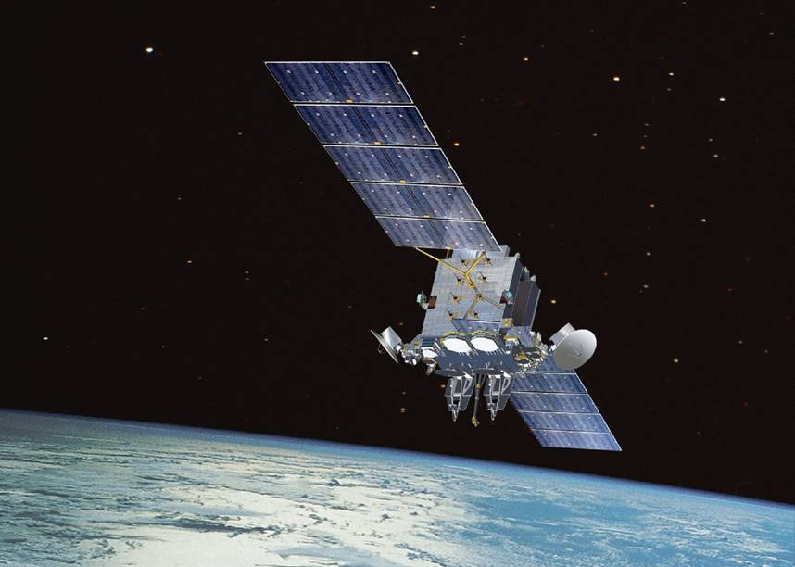
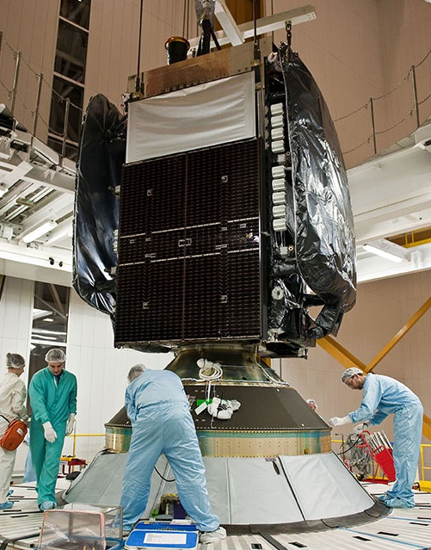
No end in sight for GEO satellite anomalies
New Dawn
AEHF-1
©arianespace.com

Slide 10
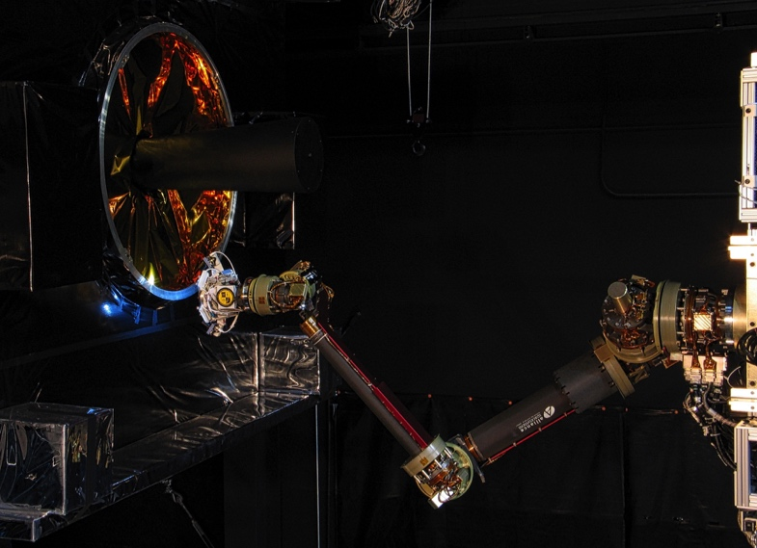
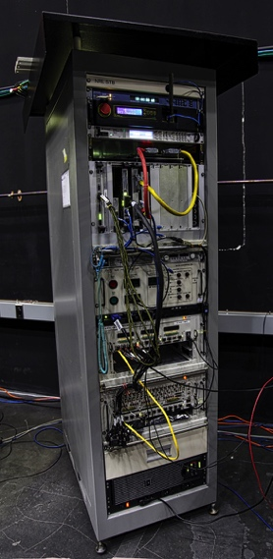
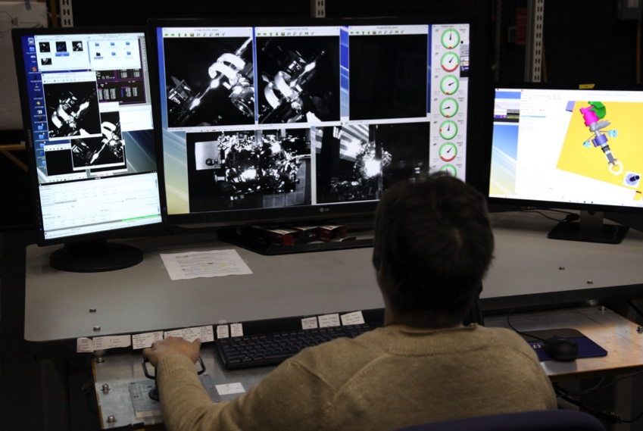
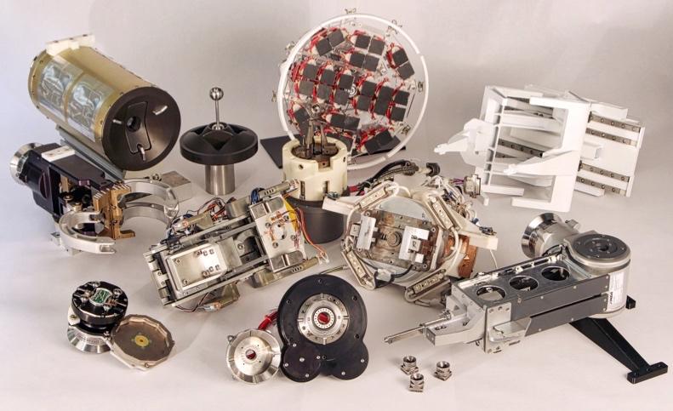
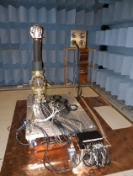
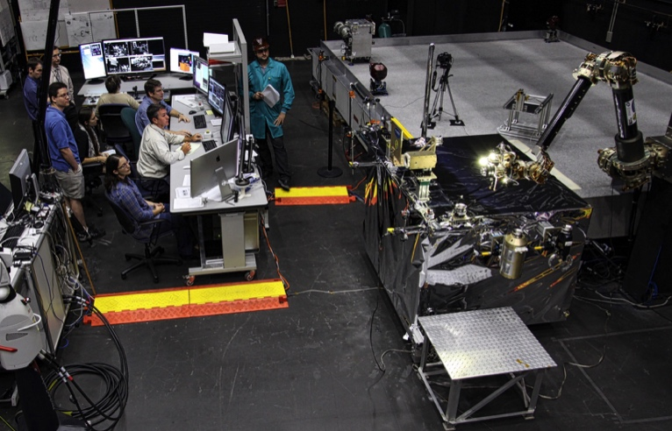
Technology: 15-year foundation for flight program
Full scale HWIL testing
Flight SW Testing
Robotics Control Workstation
Flight Prototype Tools
Flight Prototype Robotics
Demonstration Testbeds
All photos: U.S. Naval Research Lab

Slide 11
Software: key to safety and efficiency
Automated docking
  “Robot reflexes”-–unique space capability
  Screen for unanticipated interactions
  Automate some fault responses
Rendezvous and proximity operations
  Cooperative on-orbit inspection and docking operations
Bus software (retain heritage)
  Bus-robotic payload controls integration
  Add RPO module
Coordinated operations
  Payload-to-bus
  Servicer-to-client
ROBOTIC ARM CONTROL SYSTEM
Teleoperator
commanding
Pre-generated
script
Feature Tracking
Marmon
Feature Tracking
Bolt Hole
or
Feature Tracking
Fiducial
Inverse Kinematics
and Obstacle
Avoidance
Joint space
compliance control
Cartesian
compliance control
Servo
Control
Robot Arm
F/T Sensor
EE Cameras

Slide 12
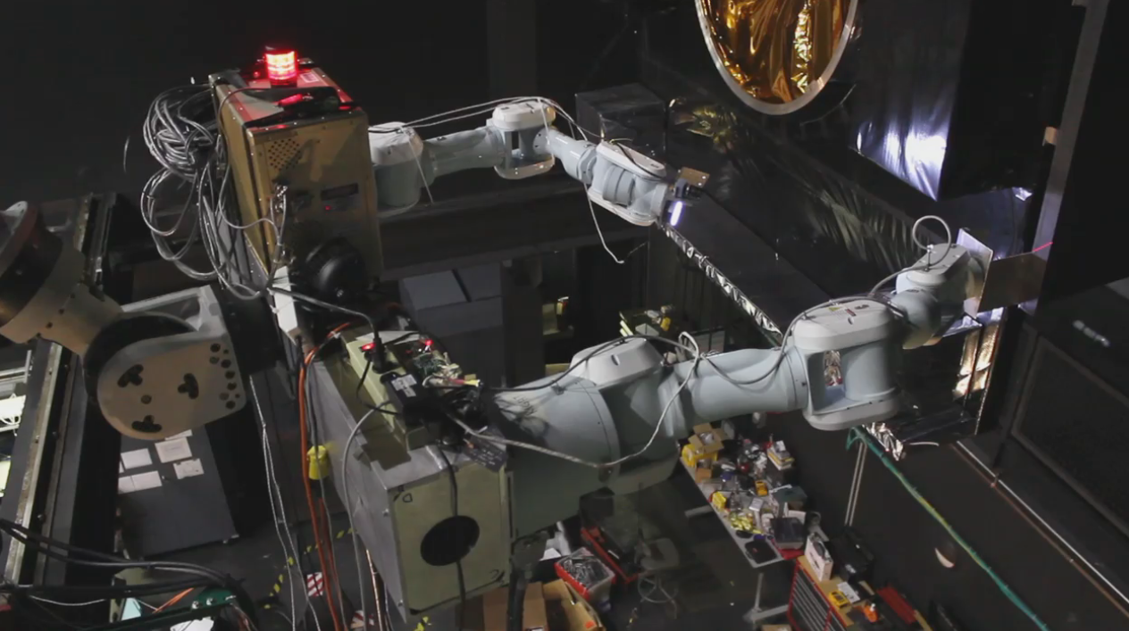
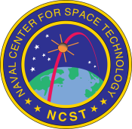
Automated repair demonstration
Photo: U.S. Naval Research Lab

Slide 13
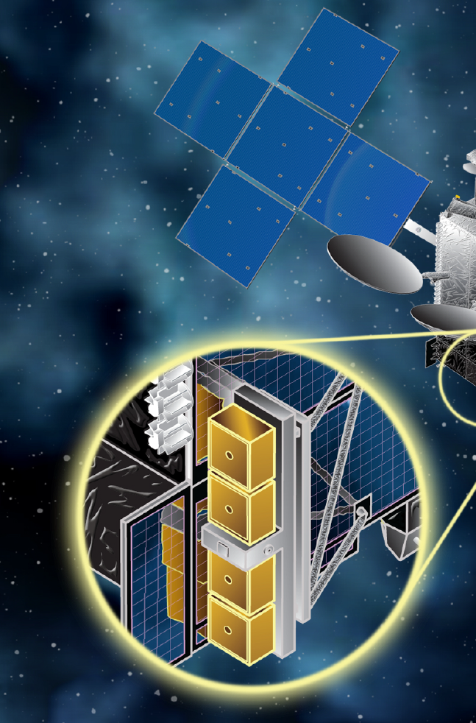
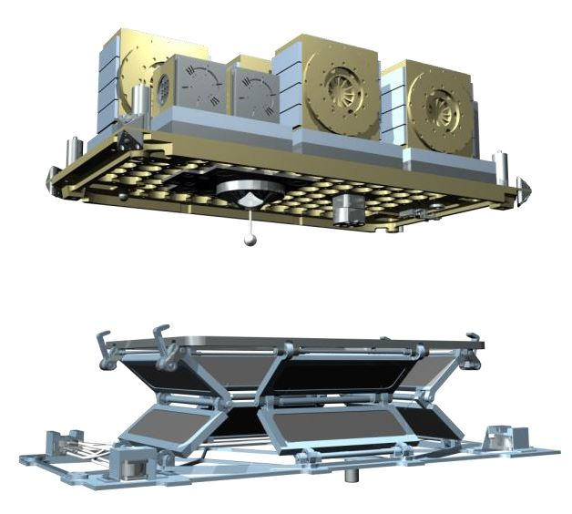
Delivery: the other half of Space Logistics
Artist’s conception: MDA
DARPA Payload Orbital Delivery (POD) System
Artist’s conception: MDA
Artist’s conception: MDA

Slide 14
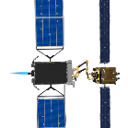
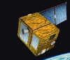
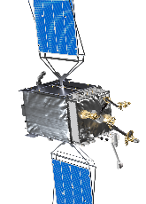

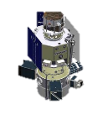

RSGS + delivery = space logistics infrastructure
Rendezvous, Dock
Present-day GEO asset
Future small satellite
Restore orbit
Future GEO asset
Spacecraft maneuver
Future GEO asset
Capture, transport, unpack
Install
Capture, transport
Replenish
Delivery:
PODS
Delivery: ESPA, secondary, dedicated
14

Slide 15
SSL’s Dragonfly: robots on board!
Enables larger and more powerful satellites that cannot be launched fully assembled
packaged in pieces within a standard launch vehicle fairing
DARPA Seedling/NASA Tipping Point Project
The first step in changing the GEO infrastructure paradigm
On-orbit robotic assembly from efficiently stowed state
Lower satellite mass while enabling higher satellite performance
Commercial and government applications
Artist’s conception: SSL
Robotic arm replaces traditional deployment mechanism
Less cost, less weight, more reflectors
Future applications:
  On-orbit upgrade
  Assembly
  Repair

Slide 16
Dragonfly demo
https://sslmda.com/downloads/videos/dragonfly.mp4

Slide 17
Payoffs
Fielding the capability rapidly
  Commercial partner, existing bus design
  Targeting launch in 2021
Sustained capability, not just demonstration
  Revenues from servicing operations
On-orbit upgrade could lower cost of access to GEO
  Payloads that do not require propulsion or attitude control
  → Quicker, lower cost payload integration
  Variety of means of delivering to orbit
  More rapid response to tech development, terrestrial changes
Validate assembly concepts
  Send assembly demo kits to GEO

Slide 18

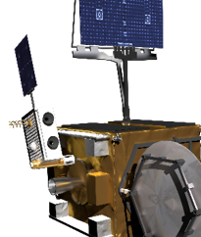
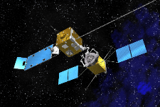
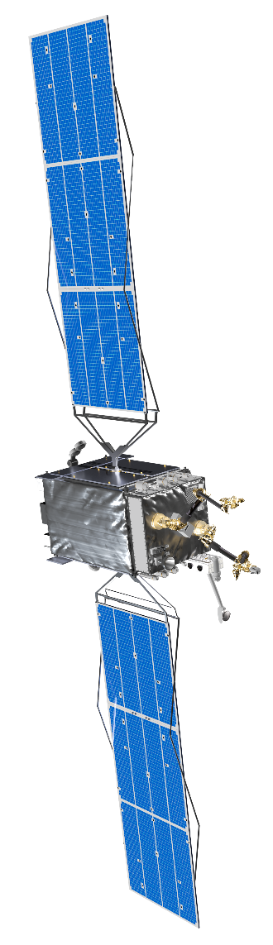

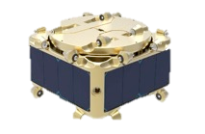
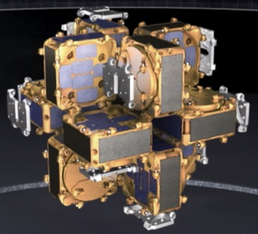
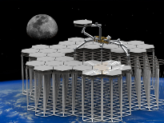
Evolution: expanded capabilities, lower costs
LOGISTICS
First robotic capability in GEO
Artist’s Concept
NASA
Artist’s Concept
Fully automated space logistics
POD
OAC Capability
First steps in GEO logistics
REPAIR w REPOSITION w INSPECT w AUGMENT
Technology development and investment
CONSTRUCTION
Expanded coverage, new tools, experiments
Modular spacecraft with on-orbit replaceable units
Large apertures, structures, and bases
Artist’s Concept
NASA

Slide 19
Preparing for the future
This is a nascent capability
  Like a newborn, it needs love and attention
We all need to work together
  Information sharing
  Opportunity sharing
New ideas are needed
  Entrepreneurs
  Scientific missions
  Corporate IR&D

Slide 21
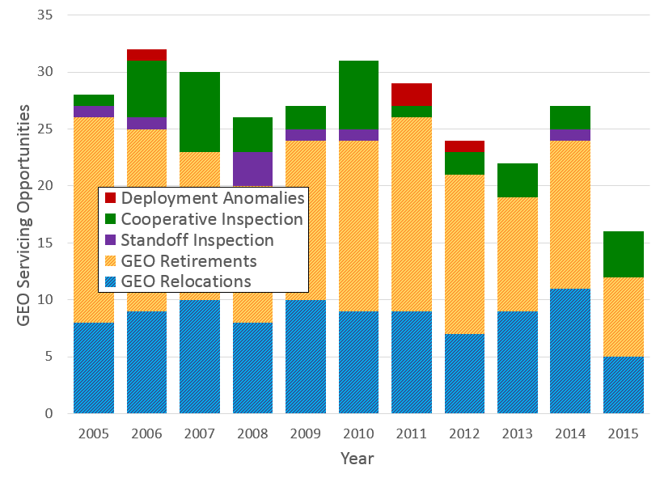
Servicing opportunities
Episodic:
OPPORTUNITY HISTORY
Deployment Anomalies
Jun. ’12 – IS-19: Solar array deploy fails
Cooperative Inspection
May ‘13 – GOES 13 Unknown anomaly (possibly hit by micrometeorite)
Standoff Inspection
Apr. ‘10 – Galaxy 15: Contact lost, transponders outputting at full power
Predictable:
GEO Retirements
10-15 retirements per year
GEO Relocations
8-12 relocations per year
Once RSGS is in operation:
Servicing provides revenue stream for RSGS operator → persistence
Observe ops, collect data, assess reliability

Slide 22
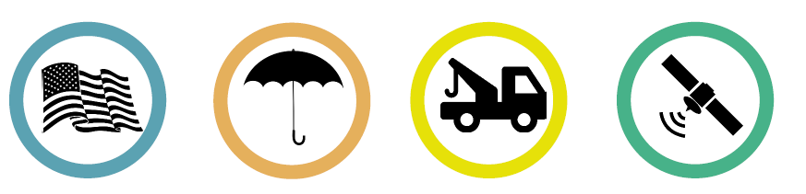

Consortium For Execution of Rendezvous and Servicing Operations (CONFERS)
On-orbit servicing lacks common safety standards
  needed for governments, insurers, and investors to evaluate commercial operations
U.S.
GOVERNMENT
INSURANCE INDUSTRY
SERVICING ENTITIES
COMMUNICATIONS OPERATORS
CONFERS is a government / industry consortium:
  Non-binding industry consensus safety standards
  Forum for industry to engage the US Government in “one-stop shopping”
  Future international participation
  Discuss on-orbit servicing-related plans and issues
  Share data and experience among government and industry participants
  Protect commercial participants’ financial and/or strategic advantages
  Produce technical basis for licensing commercial servicing missions

