Slide 1
G&C, Glue, and 42 Independent Dynamics for Independent Testing
Mark Suder
Systems Engineer
TMC Technologies
NASA’s IV&V Program
Image Credit: NASA/JHU APL

Slide 2
BLUF – Why?
NASA’s Independent Verification and Validation Program
Key: Independence
Managerially, financially, technically
Software within the system focus
NASA IV&V Engineer opportunity:
Single truth/FSW G&C Matlab/Simulink model developed by the PSP project
Can IV&V have an independent truth source?

Slide 3
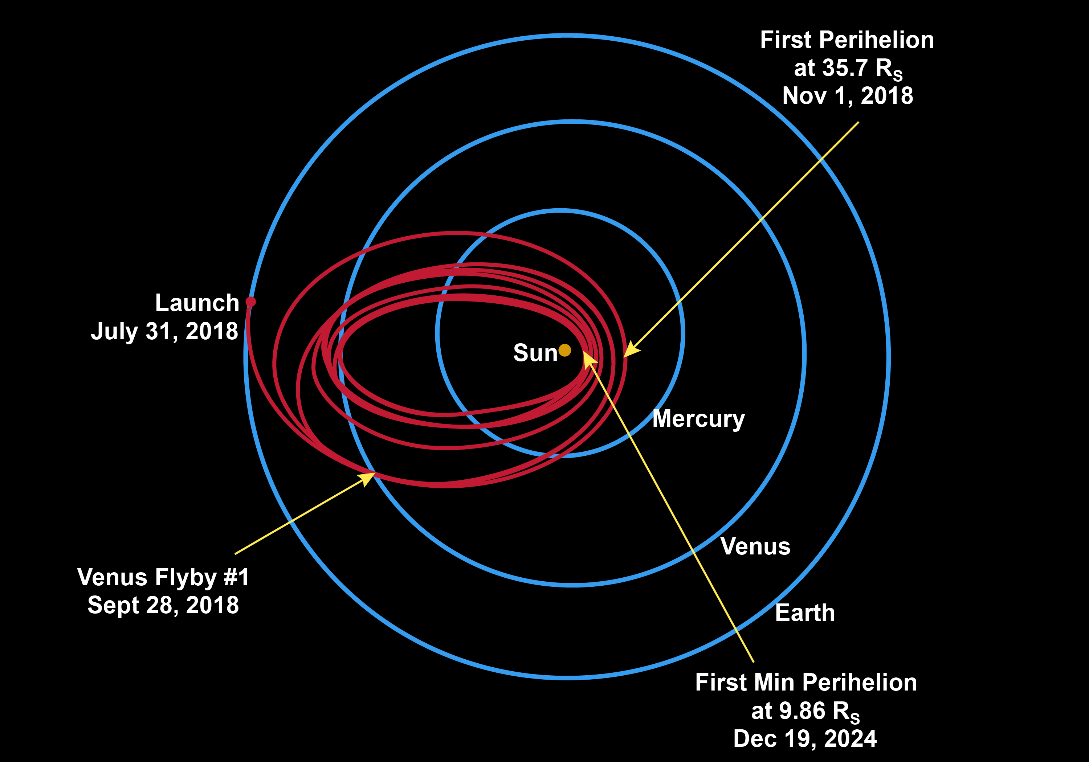
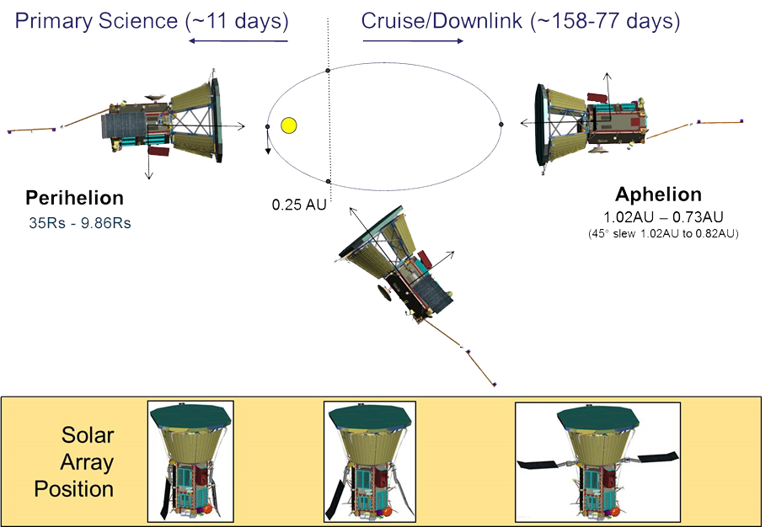
Parker Solar Probe (PSP)
Swoop closer to the Sun’s surface than any spacecraft before it
Face brutal heat and radiation conditions
Protected by a 4.5-inch-thick carbon-composite shield
Withstand temperatures that reach nearly 2,500 degrees Fahrenheit
G&C pointing is incredibly important!

Slide 4
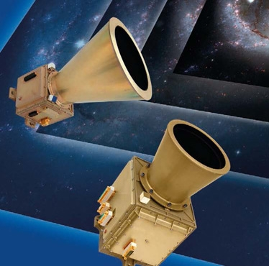
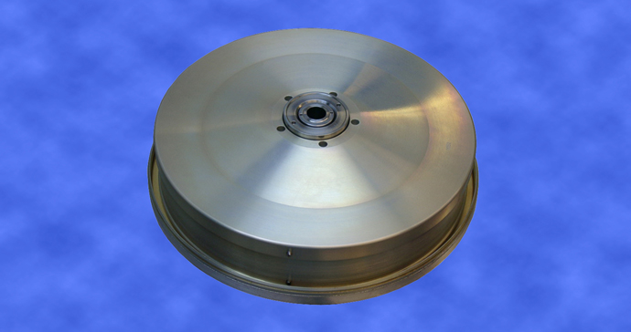
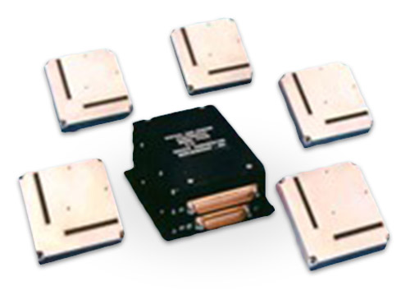
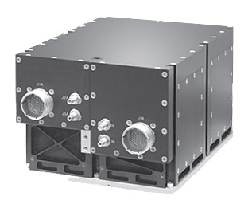
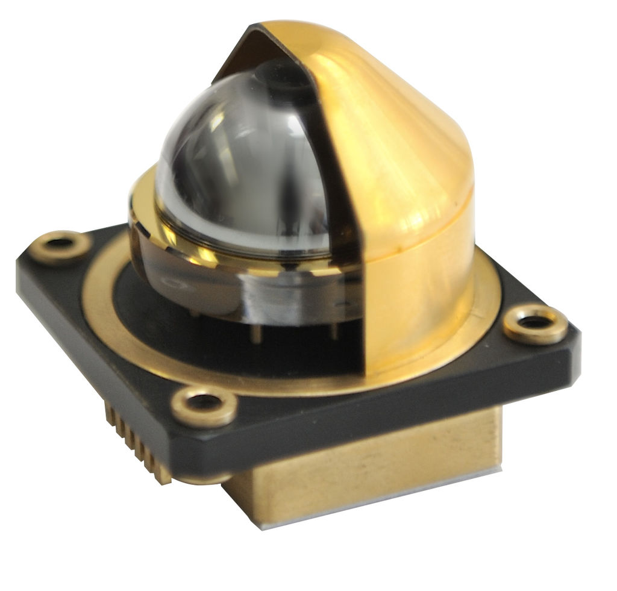
Sensors/Actuators
Star Trackers
Reaction Wheel Motors/Tachometers
Solar Limb Sensors
Digital Sun Sensors
IMU/Gyroscopes/Accelerometers
Thrusters
Solar Array Motors/Potentiometers
High Gain Antenna Motor/Potentiometers

Slide 5
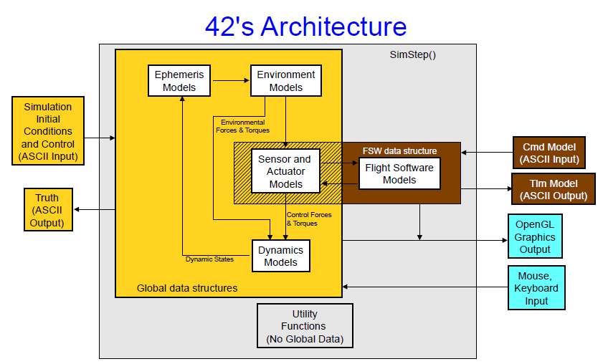
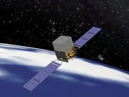
42 – An Independent Dynamics Source
Developed by Eric Stoneking, GSFC
A simulation of spacecraft attitude and orbital dynamics and control
Intended for use from concept studies through ops
Architecture Source: 42 Overview.pdf, “42, A General-Purpose Multi-body, Multi-spacecraft Simulation, Eric Stoneking, 2014”

Slide 6
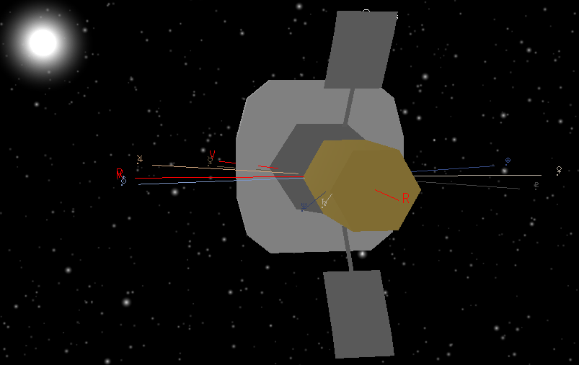
IV&V and JSTAR
IV&V
Perform analysis of software artifacts for a project
Requirements, Design, Code, Test, etc.
JSTAR developers
Experts in simulations
Build tools used by IV&V analysts to do their job
Sam Brown, IV&V Analyst, started the PSP Testbed
JSTAR developers:
Re-architected and modularized environment
Minimized PSP G&C FSW changes
Easier to upgrade PSP G&C FSW
Added sensor and actuator models

Slide 7
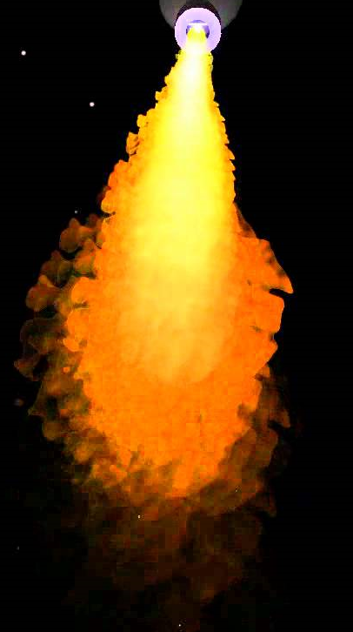
Glue
PSP G&C – cFS style application developed by PSP project that uses cFS software bus messages
Sensor data in
Actuator data out
42 architecture:
Allows call out to flight S/W each integration step
JSTAR wrote the Glue Code
42 dynamics data – position, velocity, acceleration, attitude, sun vector, wheel speeds, joint positions
Convert to body/sensor frame and then to sensor signals
Pass in to PSP G&C as the software bus message data structures
PSP G&C actuator control messages
Received by glue code and converted to 42 actuator commands
Thruster firing, reaction wheel torques, motor movements
cFS Software Bus
Sensor Data
Actuator Data
PSP G&C

Slide 8
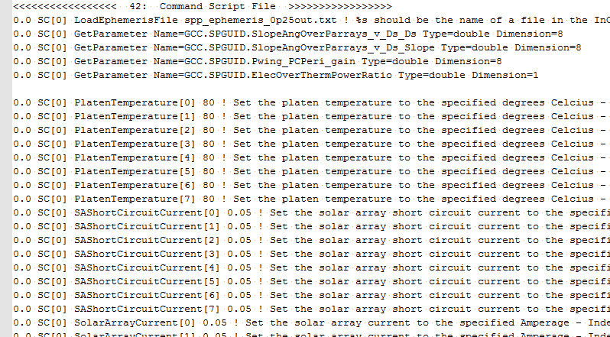
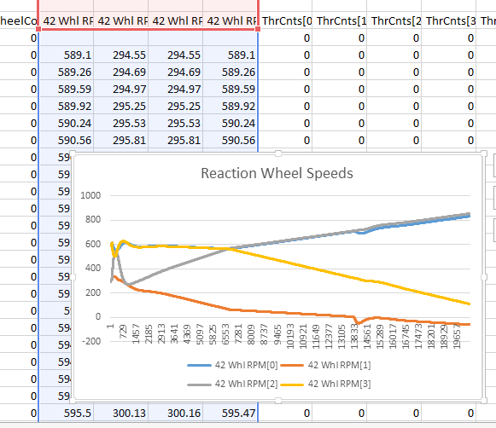
Inputs and Outputs
Parameter Files
Ephemeris, mass props, etc.
Data from PSP G&C parameters data and documents
Command Files
Load ephemeris, report parameters, set control parameters
CSV Reports
Easily plot inputs/outputs

Slide 9
Video
Visualization can allow the analyst to “see” what the code is causing to happen. Resulting output files can be analyzed to understand behavior.

Slide 10
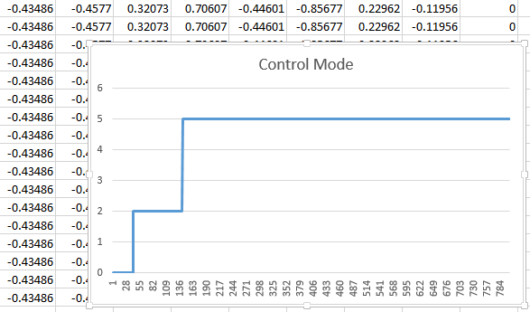
Advantages/Disadvantages
Advantages
Using PSP auto generated & hand generated code
42 makes it easy to call external flight software… just set/get data at appropriate rates for PSP G&C
Extensive CSV reporting of G&C inputs, outputs, intermediate results, 42 truth data
Independent truth model
Disadvantages
Took time / G&C expertise to develop

Slide 11
IV&V Uses
Testing
Ability to independently test how the software will behave under adverse conditions
Learning how the sensors/actuators really work and interact
A huge benefit not necessarily thought of at the beginning

Slide 12
Bottom Line
Bottom line – why this is important
Provides independent testing capability based on IV&V identified need
Glue
PSP
G&C
42 –
Independent
Dynamics
Glue

Slide 13
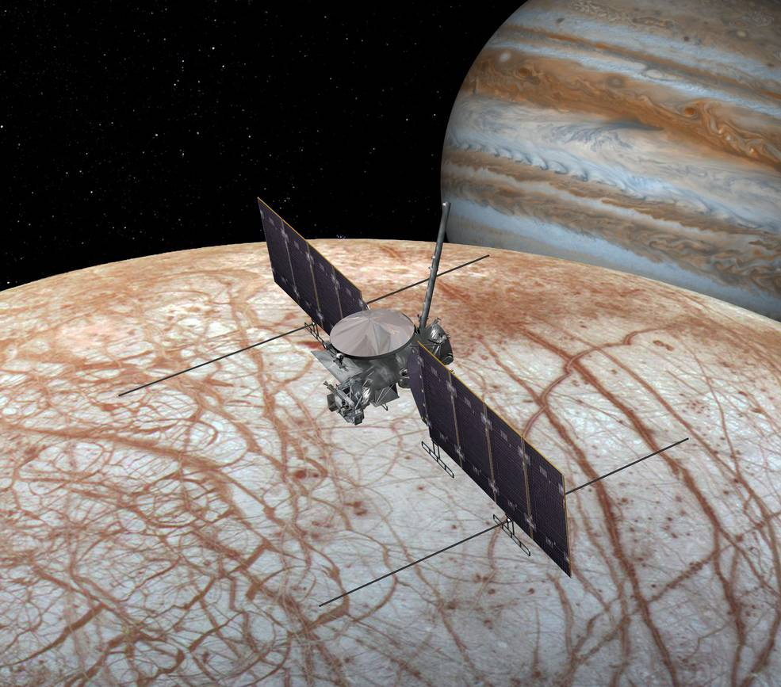
Future
Future on PSP
IV&V analyst testing
Future on other missions
Pathfinder, shows it is possible
We went closed loop!

Slide 14
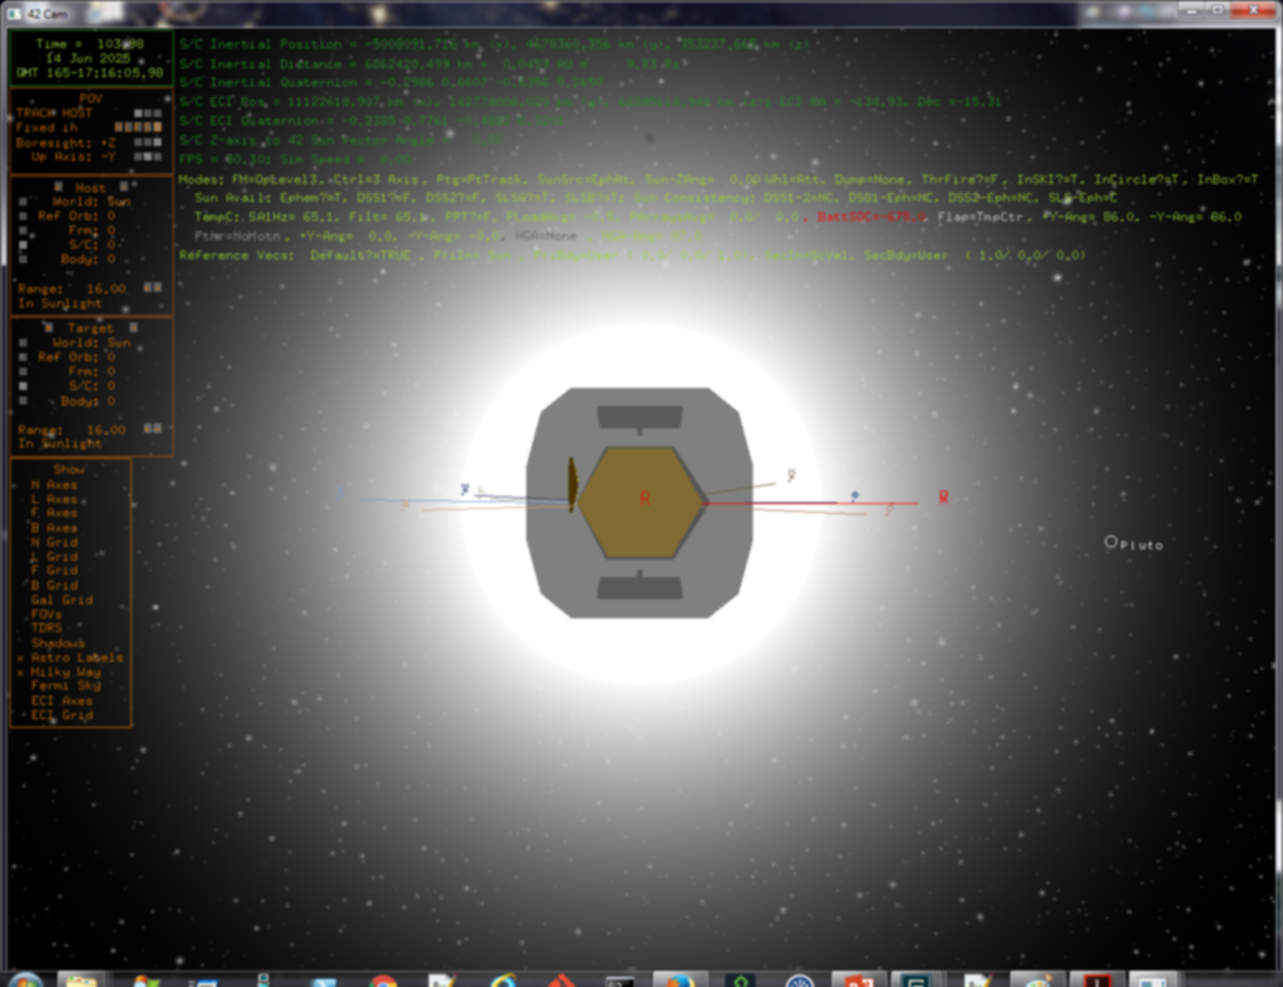
The End!
Questions?

