Slide 1
cFS Workshop Introduction
core Flight System Workshop
Johns Hopkins APL
December 4, 2017
David McComas – NASA Goddard Space Flight Center

Slide 2
Thanks to Host and Sponsors
Hosts
Jet Propulsion Laboratory, Aerospace Corporation, Johns Hopkins University Applied Physics Laboratory
Sponsors

Slide 3
Logistics
Consent & Release forms
Restrooms
Meeting Areas: Cafeteria & Lobby
Lunch
Points of Contact Sheets
Demos & Posters
Shuttle Bus
Dinner
Looney’s Pub reserved for 5:30/6:00pm dinner

Slide 4
cFS Historical Context
< 2007: Birth of core Flight Executive (cFE)
NASA Goddard Space Flight Center performed an assessment of FSW reuse to date, heritage analysis, architectural trades
Project independent funding kick started the effort
Operating System Abstraction Layer (OSAL) released as open source
2007: cFE goes to the Moon
Lunar Reconnaissance Orbiter (LRO) first to use OSAL & cFE
2008 – 2014: Birth of core Flight System (cFS)
Developed 12 cFS applications
Leveraged project funding
JSC certified Class A pedigree of cFS targeted to the ARINC-653

Slide 5
cFS Historical Context (cont.)
2014: Birth of a Community
cFS NASA Workshop (12/14 at GRC) established a NASA-wide repository managed by an inter-center Configuration Control Board (CCB)
2015: Community Youth
12 Goddard applications released as open source
CCB successfully released cFE 6.4.2
cFE functional Application Programmer Interface (API) is unchanged since LRO
Held first cFS Workshop at Johns Hopkins Applied Physics Lab
2016-2017: Community Adolescence
CCB successfully released cFE 6.5.* and cFE 6.6
NASA Johnson contributes tools and apps
Second & third cFS Workshops

Slide 6
Where is the cFS?
Neutron star Interior Composition Explorer (NICER)
cFE 6.4, VxWorks 6.7, Broad Reach Eng. Rad Hardened BRE440 PowerPC
Simulink Interface Layer (SIL) used to generate Pointing Control App
Robotic Installation on the International Space Station, June 12-14, 2017

Slide 7
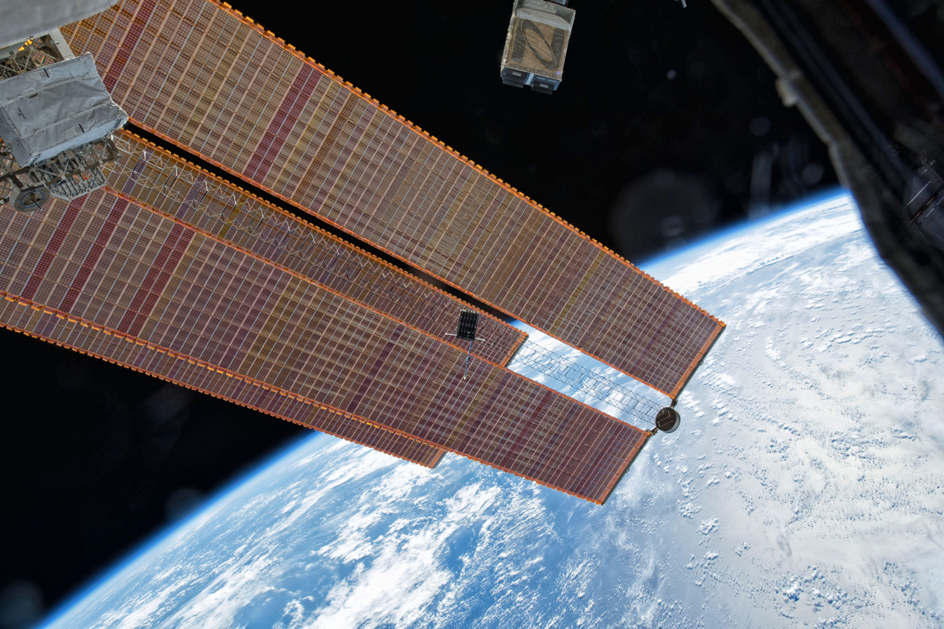
Where is the cFS?
Dellinger CubeSat deployed from ISS on 11/20/17
cFE 6.4, FreeRTOS 8.x, Gomspace Nanomind A712

Slide 8
Where is the cFS going?
CubeSats
BioSentinel (Ames), CeRes (Goddard), Lunar IceCube (Morehead State), Cactus-1 (Capitol Tech), …
Laboratory for Atmospheric and Space Physics (LASP) at Colorado University using the CFS for a deep space mission
Lunar Cargo Transportation and Landing by Soft Touchdown (Lunar CATALYST) initiative
Spur commercial cargo transportation capabilities to the surface of the Moon.
All three NASA commercial partners using the cFS
The Wide Field Infrared Survey Telescope (WFIRST)
Next NASA Goddard flagship mission
Orion backup computer

Slide 9
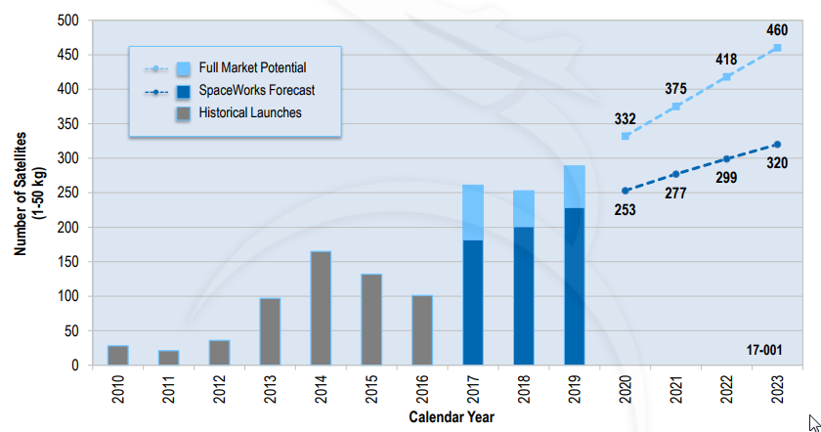
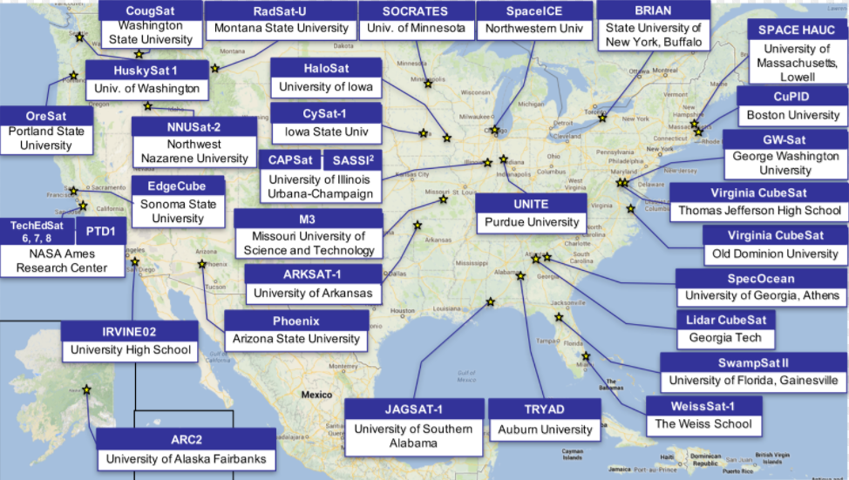
Where Could the cFS Go?
Nano/MicroSatellite
Launch Projections
2017 NASA CubeSat
Selections

Slide 10
Workshop Goals
Bring cFS user’s together
Communicate the current state of the community organization, products, and technologies
Get feedback to understand people’s perspectives, needs, and goals
Connect people with ideas and organize strategic paths

Slide 11
Workshop Agenda
START | TITLE | SPEAKER | ORGANIZATION | Length
8:30 AM | Welcome & Introduction | David McComas | NASA Goddard | 0:15:00
 | Session: cFS Program
8:45 AM | Product Management | David McComas | NASA Goddard | 0:30:00
9:15 AM | cFE Release 6.6 | Joe Hickey | NASA Glenn | 0:15:00
9:30 AM | cFS Systems Technology Roadmap | Jonathan Wilmot Joe Hickey | NASA Goddard NASA Glenn | 0:45:00
10:15 AM | Advanced Exploration Systems cFS Summary | Lorraine Prokop | NASA Johnson | 0:15:00
10:30 AM | BREAK |  |  | 0:15:00
 | Session: Platforms
10:45 AM | Platform Technology Roadmap | Alan Cudmore Joe Hickey | NASA Goddard NASA Glenn | 0:30:00
11:15 AM | A New OS for a Reliable, Secure cFS: Cubesats - Reliability & Securty for cubesats, Composite micro-kernel | Gabriel Parmer | George Washington U. | 0:20:00
11:35 AM | A Flight RTEMS OSAL With Runtime Module Support and Other Enhancements | Allen Brown | Odyssey Space Research | 0:20:00
11:55 AM | CSP/RTEMS/CFS in preparation for upload to ISS experiment | David Akre | Lockheed Martin | 0:15:00
12:10 PM | LUNCH |  |  | 1:05:00

Slide 12
Workshop Agenda
START | TITLE | SPEAKER | ORGANIZATION | Length
 | Session: Tools
1:15 PM | A Study of Management tools for Command and Telemetry Dictionaries [CFS-oriented] | Craig Pires | NASA Ames | 0:20:00
1:35 PM | cFS Command Data Dictionary | Kevin McCluney | NASA Johnson | 0:20:00
1:55 PM | cMAKE | Joe Hickey | NASA Glenn | 0:20:00
2:15 PM | Tool Summary & Session Conclusion | David McComas | NASA Goddard | 0:10:00
 | Session: Applications
2:25 PM | COSMOS CFDP Engine | Edipo Crispim | Visiona Tecnolgia Espacial | 0:20:00
2:45 PM | Software Bus Network | Chris Knight | NASA Ames Research Center | 0:30:00
3:15 PM | Simulink Interface Layer | Pat Castle Steve Lentine | NASA Ames NASA Goddard | 0:20:00
3:35 PM | Application Summary & Session Conclusion | David McComas | NASA Goddard | 0:10:00
 | Session: Community
3:45 PM | Session Introduction | David McComas | NASA Goddard | 0:10:00
3:55 PM | Posters, Demos, and Splinter Meetings | Everyone |  | 1:30:00

Slide 13
Demos & Posters
Name | Organization | Title
Alan Cudmore | NASA Goddard | PiSat
Jeff D'Agostino | Hammers Co. | Running cFS with VirtualSat and Galaxy in a Multi-Satellite Configuration
Matt Grubb John Lucas | NASA IVV | NASA Operational Simulation for Small Satellites (NOS3)
Joe Hickey | NASA Glenn | cFS Electronic Data Sheet Tools
Chris Knight | NASA Ames | Software Bus Network
David McComas | NASA Goddard | OpenSatKit
Danilo Miranda | Viiona Tecnologia Espacial | COSMOS CFDP
Brendan O'Connor | Emergent | Cluster Ingest
Gary Smith | NASA Goddard | cFS Website

Slide 14
FSW Workshop Presentations with cFS
Autonomy Requirements Tester (ART): Deploying a cFS App on a Robotic Operating System Architecture, Ayman (Alex) Quaddumi, S&K Global Solutions, LLC
Integrating Support for Microkernel Security for CubeSats into cFS, Jeff Brandon, MIT LL
Porting the cFS to the Dellingr CubeSat, Alan Cudmore, Goddard Space Flight Center
LM Planetary FSW Product Line and cFS for a Human Safe System at the Deep Space Gateway, Matt Goman, LMSCO
Porting the cFE to spacecraft onboard with Spacewire engine and RTOS based on ITRON specification, Takada Mitsutaka, Nagoya University
Application of the cFS to a Lander Rover, Howard Cannon, NASA Ames Research Center

