Slide 1
cFS Community Day Core Flight System Command and Data Dictionary Utility December 4, 2017
NASA JSC/Kevin McCluney
December 4, 2017

Slide 2
CCDD Overview
The cFS Command and Data Dictionary utility, CCDD, is a generic utility for creating, storing, maintaining, and manipulating the command and telemetry data for a cFS project
Designed to be the authoritative source for a project's command and telemetry data
Written in Java™, with data stored in a PostgreSQL database
Provides cross-platform operation
Released as open source
Available on GitHub: https://github.com/nasa/CCDD
Extensive documentation
User’s guide
Tutorial

Slide 3
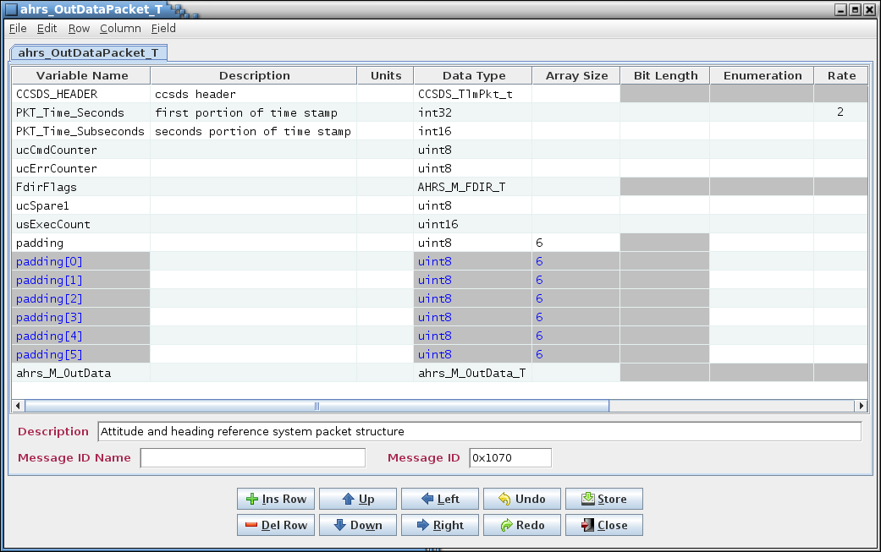
Interface
Information is handled via tables (similar to spreadsheet worksheets)
Each table represents telemetry, command, or other user-definable data
Table content is user-definable (i.e., columns may be added as needed)
Tables can be grouped to represent spacecraft systems, or in any organization scheme defined by the user
Features
Inconsistencies and errors are automatically prevented where possible
Configurable data types
Macro values
Message ID assignment

Slide 4
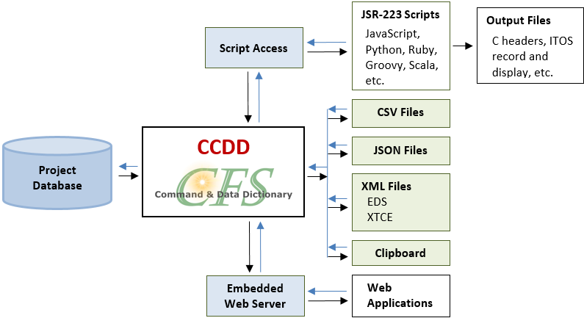
Data Access
Data is accessible to external applications directly from the application via:
Scripting languages: Products such as C header files, cFS tables, displays, etc. can be built from the stored data
Web-based applications: Access to stored data in JSON format

Slide 5
Data Import & Export
Data can be imported into and exported in CSV (comma-separated values, such as spreadsheet) files, operating system clipboard (“cut & paste”), XTCE (XML Telemetric and Command Exchange), and EDS (Electronic Data Sheet) XML (Extensible Markup Language)

Slide 6
Use Cases
Stand-alone
CCDD is used to enter, access, and output the command and telemetry information
CCDD → scripts → products
Data Supplier
CCDD supplies the command and telemetry information to another tool
CCDD → tool(s) → products
Example: Export and incorporate the data into an existing EDS, which can then be used with other tools to generate the output products
Data Interface
CCDD ingests the command and telemetry information from another source in order to build a database, then uses the scripting interface to generate output products from the database
Other source → CCDD → scripts → products
Example: Import the data from an existing EDS, then generate the output products via the scripting interface
In this instance CCDD is essentially just a conversion tool that makes the command and telemetry data readily available to scripts

