Slide 1
Autonomous Operations in Space
11th Annual FSW Conference
December 2018

Slide 2
Advanced Space exists to support the sustainable exploration, development, and settlement of space.
Projects
Mission systems and enabling technology (Moon)
Robust and resilient orbital transfers (Security)
Interplanetary mission design (Mars)
Earth orbit and highly challenging spacecraft navigation
Trajectory optimization (chemical & electric)
Satellite constellation planning, design, and engineering
Spacecraft guidance and avionics
Spacecraft autonomy
Notes:
Moon, Mars, satellite

Slide 3
Outline
Cislunar Autonomous Position System (CAPS)
Linearized Lambert Solver (LLS) for Distributed Spacecraft Missions (DSM)
Sustained Low Altitude Lunar Orbital Missions (SLALOM)
Implementation

Slide 4
CAPS - Overview
CAPS is a peer-to-peer, autonomous navigation system
Generates onboard navigation solutions independent of Earth-based tracking systems
Potential to provide navigation solutions for orbiting spacecraft, landers, and rovers
Will be integrated as an application into existing cFS FSW architectures.
Easily integrated into other FSW architectures
Objectives:
Create a self-sustaining, scalable constellation able to maintain navigation solutions of all participants
Implement over a decade of algorithmic research in a flight system environment
Providing an innovation to:
A new way of performing cislunar navigation.
Vastly reducing ground network congestion
Redefined mission operations in cislunar space

Slide 6
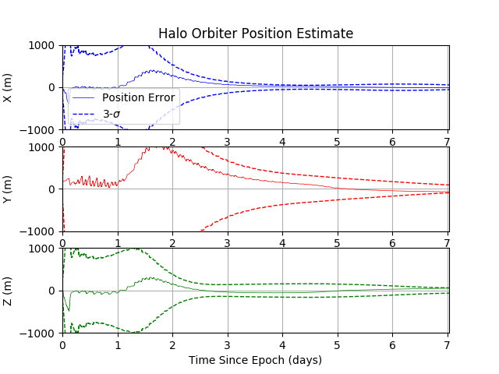
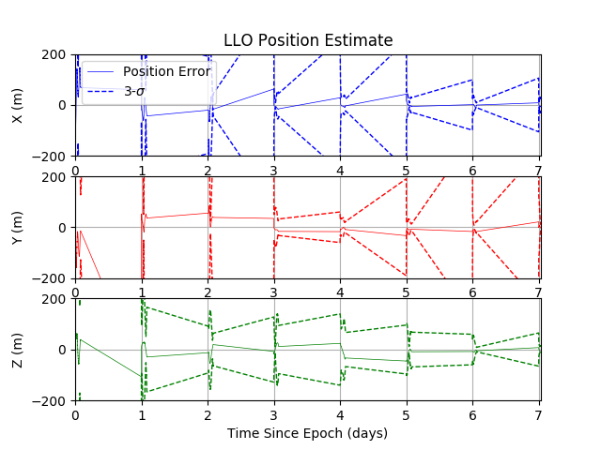
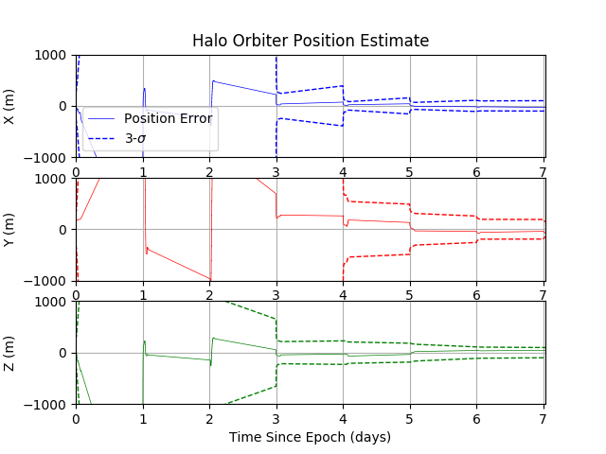
CAPS – Preliminary Results
Continuous Tracking
2hr/day Tracking
6
Notes:
Continuous: < 10 m for LLO, < 100 m for halo
2hr/day: <20 m for LLO, <100 m for halo

Slide 7
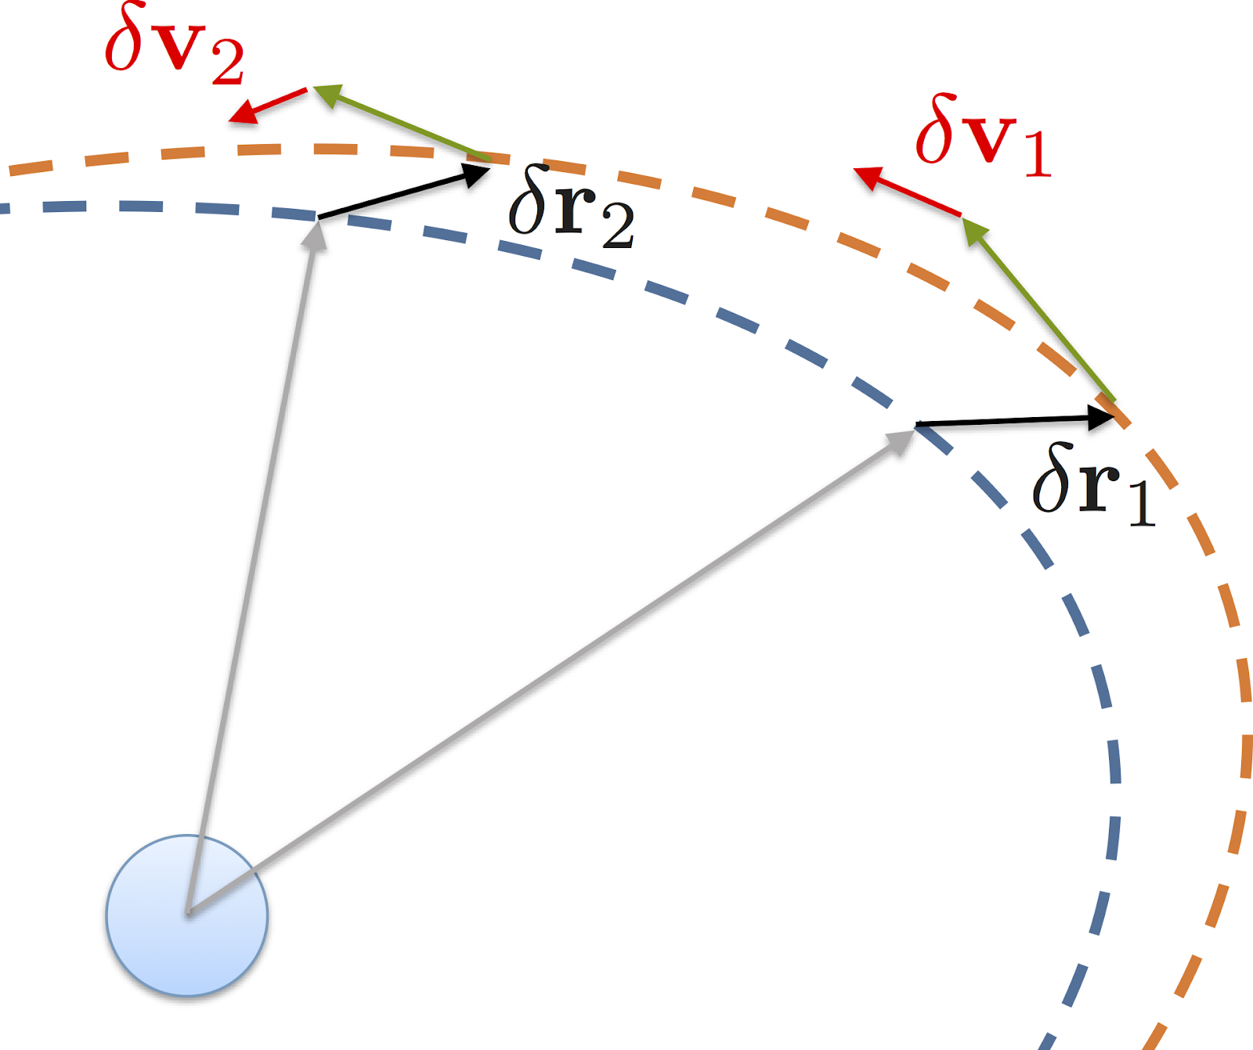
DSM - Overview
Leveraging a novel solution to Lambert’s Problem
Determine an initial Lambert solution
7
Notes:
Demonstrated in LEO for >300 km with less than 1% accuracy

Slide 8
DSM - Overview
Leveraging a novel solution to Lambert’s Problem
Determine an initial Lambert solution
Compute relative position between manager spacecraft and all others in mission
N linearized solutions can be determined at 0.1% of usual onboard computational cost
Developed as a cFS application
8

Slide 9
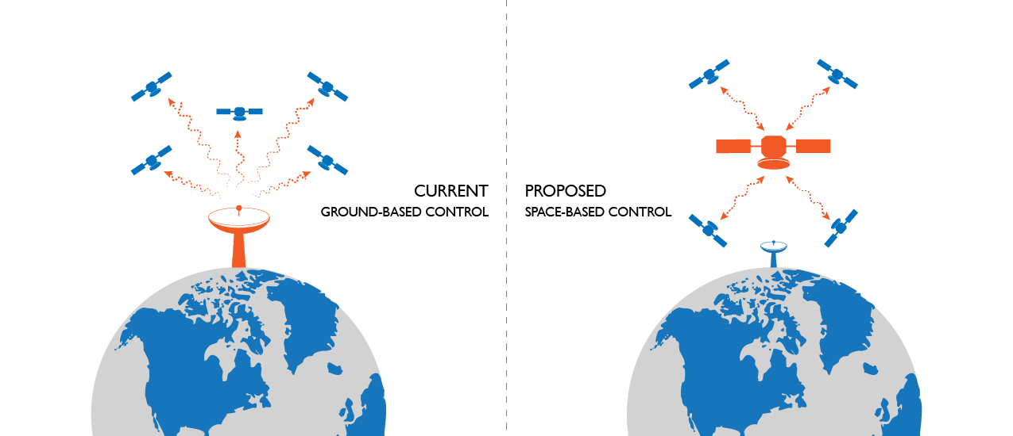
DSM - Overview
Leveraging a novel solution to Lambert’s Problem
Determine an initial Lambert solution
Compute relative position between manager spacecraft and all others in mission
N linearized solutions can be determined at 0.1% of usual onboard computational cost
Developed as a CFS application
Providing a solution for:
Simplified constellation management
Automated maneuver planning
Onboard orbit determination
Expansion of scientific and programmatic DSM benefits
9

Slide 10
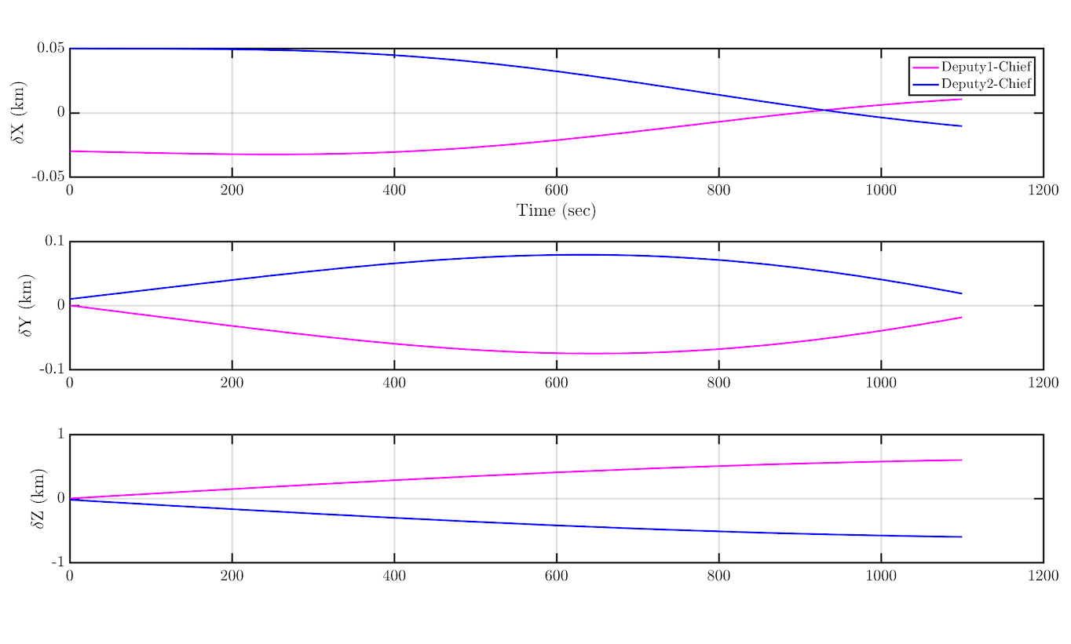
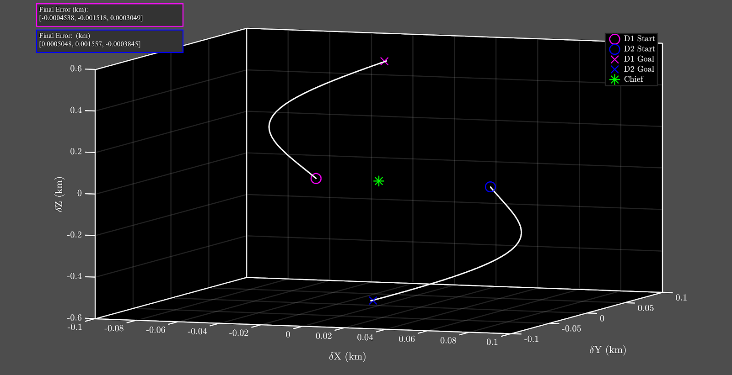
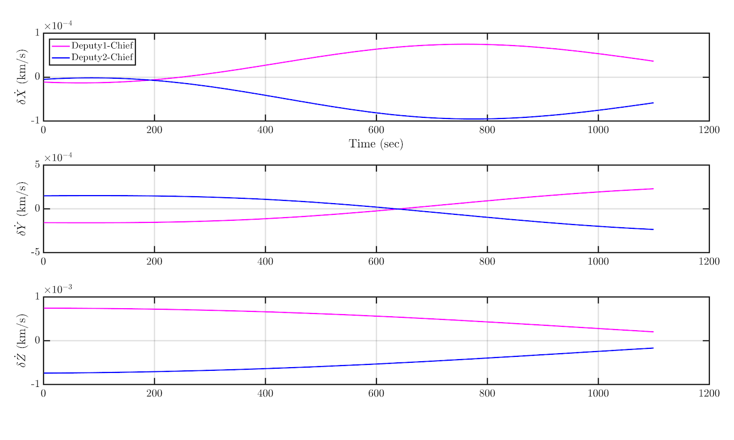
DSM – Preliminary Results
Demonstration of algorithm as a cFS application
Implementation of a cFS linear algebra library
Successfully demonstrated using more than 1400 automated test cases
10

Slide 11
SLALOM
Develop a new orbit management system that combines several autonomous capabilities to push the envelope of current GNC limitations
System must be enable the spacecraft to detect and avoid surface features on the Moon
Provide the spacecraft with navigation data where Earth based tracking stations cannot
Objective
Create a system that can sustain a low lunar orbit of ~10km
Develop algorithms to fuse several navigation sources
Create heuristics for efficient and effective maneuver planning and execution
Providing an innovation for:
Close proximity navigation solutions
Fundamental change to deep-space mission planning
Enabling new realms of science data
11

Slide 12
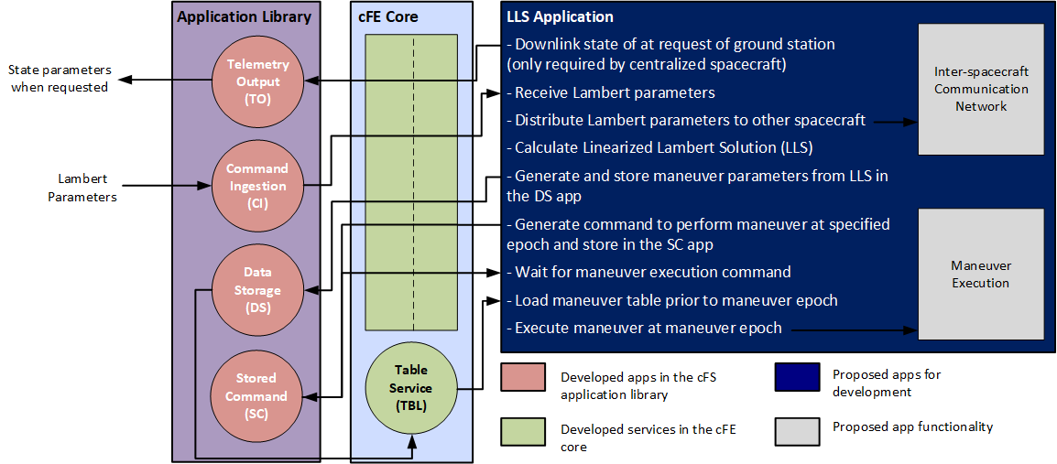
Standardized FSW Approach
CAPS and DSM would deploy same FSW algorithms across many different spacecraft
Need to ensure the integrity of the products across many different environments
Recognize the need/value for standardized, customizable software → Core Flight
Currently developing CAPS and DSM in cFS and planned development for SLALOM in cFS
Isolate our software from the core spacecraft software
12
Notes:
Performance on one flight computer is comparable to performance on another

Slide 13
Standardized Testbed
Advanced Space is using its astrodynamics expertise to integrate a system of tools for full spacecraft simulation
Johnson’s Copernicus, Goddard’s GMAT, JPL’s Monte, CU’s Basilisk
In addition to internally specialized tools
Scheduling optimization, inter-spacecraft communication, cloud deployment, etc.
Centralized around cFS such that any custom spacecraft application can be fully tested on any platform
Demonstrated use of:
Redefined cFS ground system to allow for facilitated integration and use with cFS and developed applications
Google’s Protobufs for inter-processor communication between simulated spacecraft and cFS instances
Interfacing of Rust with cFS applications
13

Slide 14
Alec Forsman 612-581-2860 alec.forsman@advancedspace.com
Questions?

