Slide 1
Bringing Core Flight Software to the Drone Universe
Author(s)
Casey Nalley
Mathew Benson

Slide 2
Mission
Windhover builds reliable, open, extensible software for the safe operation of drones
We leverage spaceflight software capabilities and concepts to enable more complex use cases
Notes:
Founded in 2015 to develop software that could be FAA­ certified to enable safety critical drone operations beyond visual line of sight.

Slide 3
NASA SBIR
Phase I
Phase II
June – December 2016
June 2017 – June 2018
Goal: Develop foundational components of Windhover Ecosystem
Goal: Build full drone software ecosystem that is safe and open with industry leading processes.
Created proof-of-concept flight software and ground software
Demonstrated commercial potential
Created a tool chain to support Phase 2 development
Positioned to be first or early to market with a system that will meet required safety standards for reliability
Released first version of the Windhover Ecosystem including flight and ground software
Multiple successful flight tests and demonstrations building to full autonomy
Scriptable flight control for rapid prototyping and mission planning
Launched development portal

Slide 4
Windhover Ecosystem
Integrated flight software stack, ground control software, and tool chain

Slide 5
Windhover Ecosystem Overview
Airliner
Commander
Pyliner
Trainer
Flight Software
Operations Console
User Applications
Simulation
Workshop
Hangar
Checkride
Development Platform
Online Portal
Software Certification
Notes:
Airliner - Flight Software, Commander - Ground System, Pyliner - Scripting Engine, Trainer - Simulator, Workshop - Development Environment, Hangar - Online Portal, Checkride - Software Certification

Slide 6
Airliner Flight Software
Airliner flight software is built upon improved NASA Core Flight Software 6.5.0a (CFS)
High rate between 250-500 Hz
Multi-core
Faster than real time
Chosen for its extensibility & widespread use for mission critical applications in space
Notes:
Airliner is built upon CFS developed at Goddard and tested at JSC for human rating evaluation. Significant code refactoring required to create cFS applications. Implemented new math libraries for coding standard compliance. Running high rate threads (at 250 Hz) on Linux for sensor processing and closed loop control had not been previously completed and was a significant technical risk.

Slide 7
Airliner Sensors Architecture
Vehicle Manager
Navigator
Position Controller
Attitude Controller
Attitude Estimator
Position Estimator
Sensors
Core Drivers
Accel
Gyro
Baro
Mag
GPS
RC
CFE/OSAL/PSP
Notes:
All CFS applications. The driver layer contains the minimum number of applications for flight. Additional applications to improve and augment the core sensor applications are a distance sensors (radar, sonar, etc), optical flow. The sensors application combines various sensor data and can be used to implement voting if multiple IMUs or sensors are present. Estimators (complementary and kalman filter) consume sensor data, estimate attitude and position for the navigator, multi-coptor position controller, vehicle manager state machine applications.

Slide 8
Airliner Effectors Architecture
Vehicle Manager
Navigator
Attitude Controller
Position Controller
Motor Control
Landing Gear Control
LED Control
CFE/OSAL/PSP
Notes:
Vehicle manager mode switching. Navigator autonomous modes (RTL, waypoints, etc). Sensors and effectors are divided into platform independent components (PIC) and custom platform specific components.

Slide 9
Airliner Additional Applications
Video Control (VC)
External Application control (EA)
CFS product line applications
PX4 Software Bus Bridge
CI with two-step commanding
TO with prioritized queuing
Auto-generated Protobuf serialization for CI and TO
Notes:
Video Control - streaming video application built on Video for Linux V4L
External application - executes, monitors, and limits resources of external applications
All standard CFS product line applications
PX4 software bus bridge - serialized software bus bridge between Airliner (32-bit) and PX4 (64-bit).
Serialized CI channel for off-board/on-board scripted commands
TO has a serialized protobuf channel as well for off-board /on-board serialized telemetry

Slide 10
Commander Ground System
Commander was built for scalability to multiple users and multiple vehicles
Vehicle data server is built on open source YAMCS with the front end served by Node.js
Operator displays are created with HTML and JavaScript
Commander displays proved instrumental for sensor integration and checkout during Airliner development
Notes:
Backend (Yet Another Mission Control System)

Slide 11
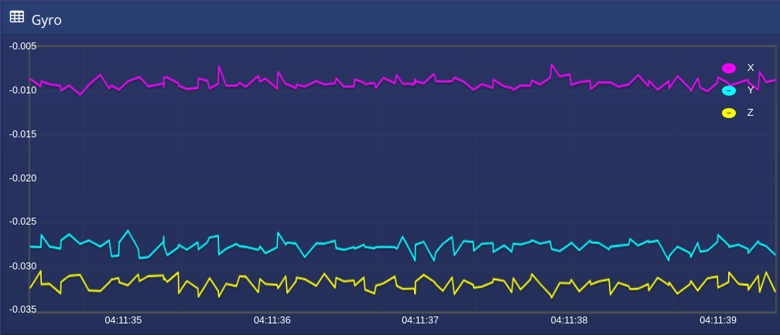
Commander Screen Captures

Slide 12
Pyliner Scripting Engine
The Windhover Ecosystem embraces the idea of extensibility through a Python scripting engine
The Pyliner API is available on the ground system as well as onboard the vehicle
Pyliner provides the script writer with access to real-time vehicle telemetry, commanding, and flight control
Abstraction for mission planning, closed loop position control, and intelligent flight modes
Notes:
Allows for rapid prototyping of closed-loop flight control algorithms. Traditional waypoints are included.

Slide 13
Pyliner Waypoints
with ScriptingWrapper(vehicle) as rocky: # Takeoff rocky.ctrl.arm() rocky.ctrl.takeoff() current_alt = rocky.nav.position.altitude
# Generate waypoints: Lat, Lon, Altitude (meters), Heading waypoints = [] waypoints.append(Waypoint(47.3977271, 8.5455870, current_alt+10, 90))
# Goto waypoints with specified position accuracy rocky.nav.goto(tolerance=0.75)(waypoints)

Slide 14
Pyliner Position Control
with ScriptingWrapper(vehicle) as rocky:
# Get user authorization to start mission
rocky.ctrl.atp('Begin Mission')
rocky.ctrl.arm()
rocky.ctrl.takeoff()
rocky.ctrl.flight_mode(FlightMode.PosCtl)
# Closed loop vertical movement
vertical_ctl = rocky.nav.vnav(method=proportional(0.25), tolerance=0.5)
vertical_ctl.up(10)
# Closed loop lateral movement
lnav = rocky.nav.lnav(method=proportional(0.20), tolerance=0.5)
lnav.forward(15)

Slide 15
Trainer Simulation
Simulation environment built around Gazebo open source 3D dynamics simulator
Each Airliner target includes a corresponding Software In the Loop (SITL) build
For regression testing ARTE (Airliner Regression Test Environment) was developed
ARTE combined with Pyliner makes faster than real-time regression testing possible
Notes:
Note: simulation exercises platform independent code.

Slide 16
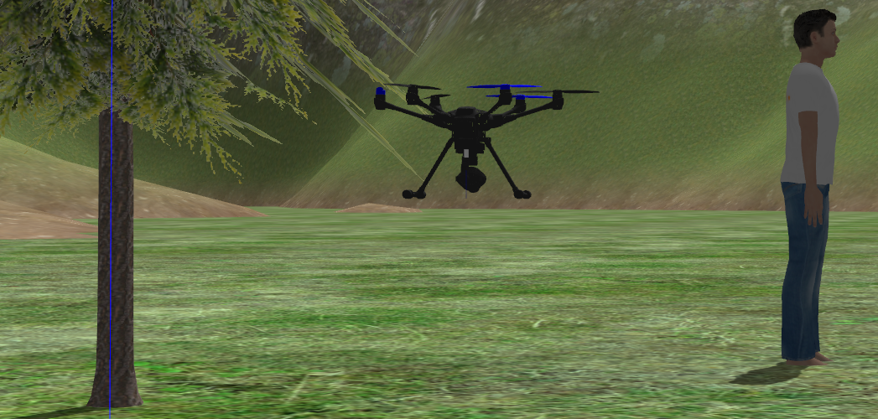
Trainer Screen Captures

Slide 17
Workshop SDK
Vagrant virtual machine with the Windhover development environment and associated tools pre-installed
Airliner uses the CMake build system and Eclipse as an IDE and integrated debugger
Setup scripts are available for native Linux installations

Slide 18
Hangar Online Portal
https://hangar.windhoverlabs.com/
Wiki - documentation
Code - source code exchange
Tickets - issue and feature tracking
Factory - continuous integration
Review - peer reviews
Scorecard - software status
Questions - support forum
Notes:
Using Atlassian open source tools.

Slide 19
Checkride Scorecard
Software development process based on best practices from RTCA DO178C and NASA NPR-7150
Process workflow and component pedigree tracked using Jira with a scorecard for colorized visualization
Requirements, Architecture, Design, Implementation, and Test are linked for traceability analysis
Checklists govern the workflow transitions through Open, In Work, In Review, Baselined

Slide 20
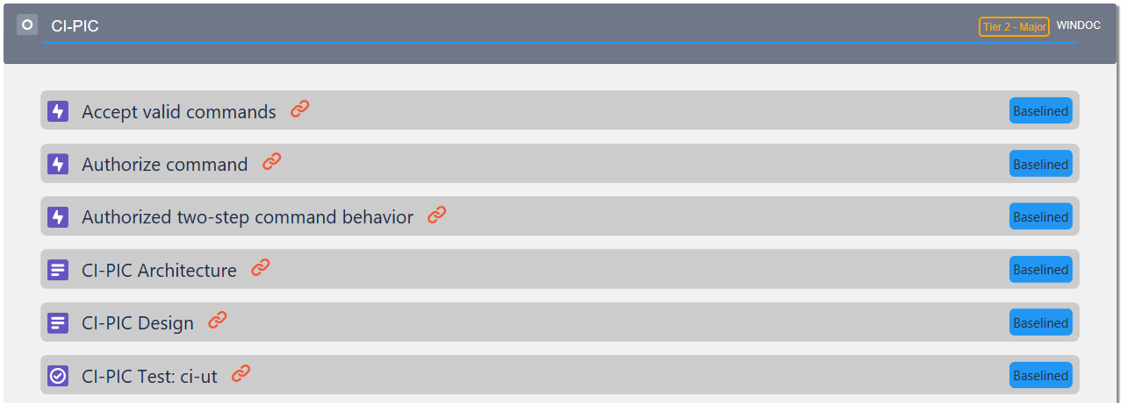
Scorecard Screen Capture

Slide 21
Current Status
Supported Platforms:
Parrot Bebop 2
Aerotenna OcPoC
Typhoon H480
Beaglebone Blue (in progress)
Commander V2 nearing completion
Notes:
Bebop - educational outreach, beaglebone blue - cost effective, OcPoC - mission specific.

Slide 22
Future Plans
Systems Engineering for fail down, recovery, and redundancy
RTOS support RTEMS, Xenomai, or FreeRTOS
Web based build system and configuration tool
Sensor integration for Intel RealSense and Aerotenna 360 Sense & Avoid Radar
Standards compliant mission planner (ARINC 424)
More platforms

Slide 23
Questions?
https://hangar.windhoverlabs.com/
https://www.windhoverlabs.com/
https://youtu.be/lWrRRqeMWQw

