Slide 1

Deep Neural Networks for Onboard Intelligence
Daniel Davila
daniel.davila@swri.org
Southwest Research Institute
This is a non-ITAR presentation, for public release
and reproduction from FSW website.

Slide 2
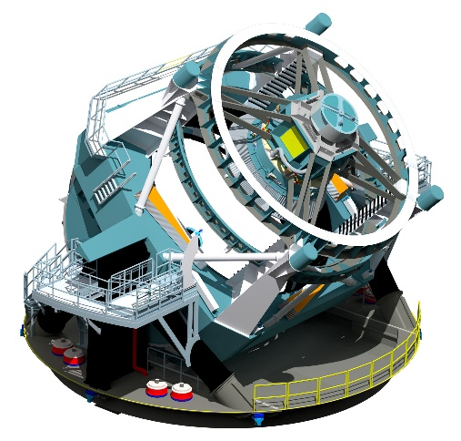
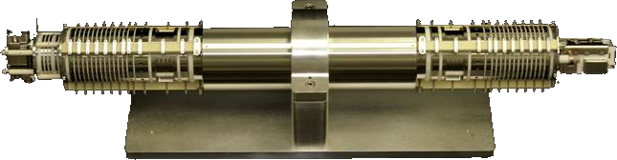
How Do We Handle All This data?
Modern hardware capable of pushing out very high volume, high veracity data
Need to prioritize observation opportunities before they are lost
LSST – 20 TB / day
MASPEX – 2.5 GB / hr

Slide 3
Convolutional Neural Network SparkNotes
A deep learning architecture
Come in many shapes and sizes
Applications include image recognition, object detection, and signal processing
Primary operation is convolution on matrices

Slide 4
Why Machine Learning on FPGA?
Massive parallel computing power = Faster processing of data
Low power
Onboard processing
FPGAs commonly used in space

Slide 5
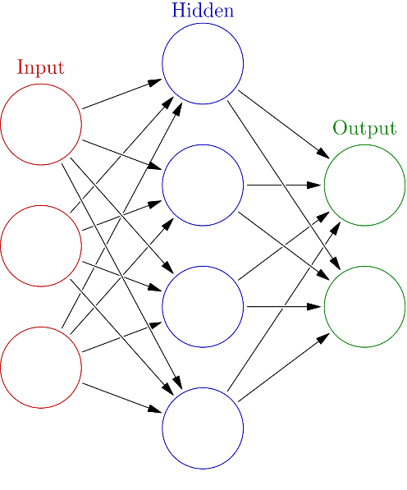
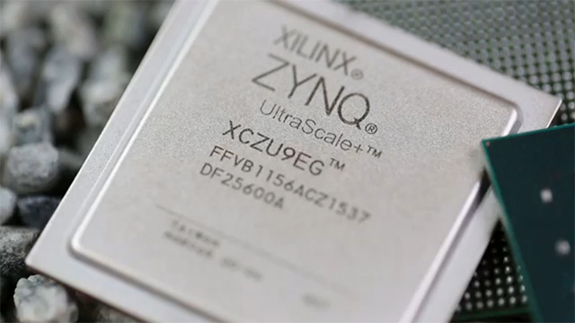
Insitu Intelligence
Combines:
  Best practices in compact AI algorithm design
  Modern flight FPGA densities
  Access to ample ground data for training

Slide 6
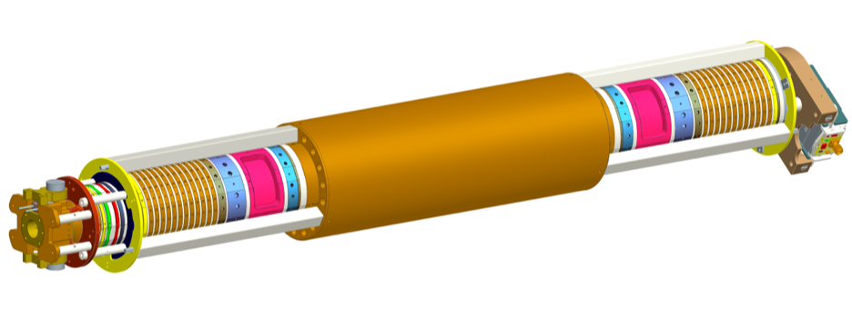
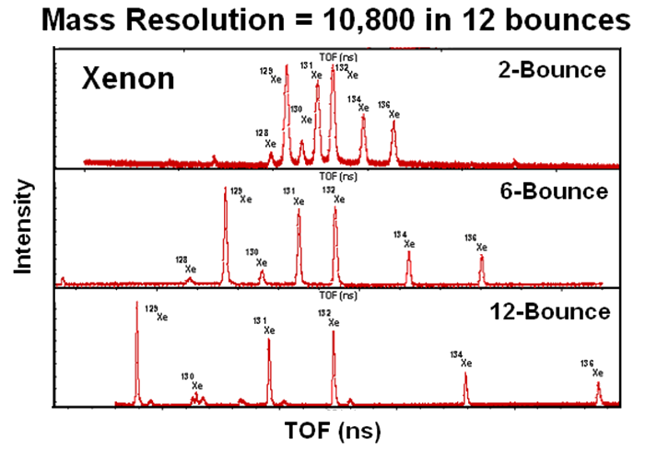
Model: Mass Spectrometer for Planetary Exploration
Targeted at planetary science missions
Majority of data collected by instrument is noise
Can neural network be used to automatically select relevant signal for transmission?

Slide 7
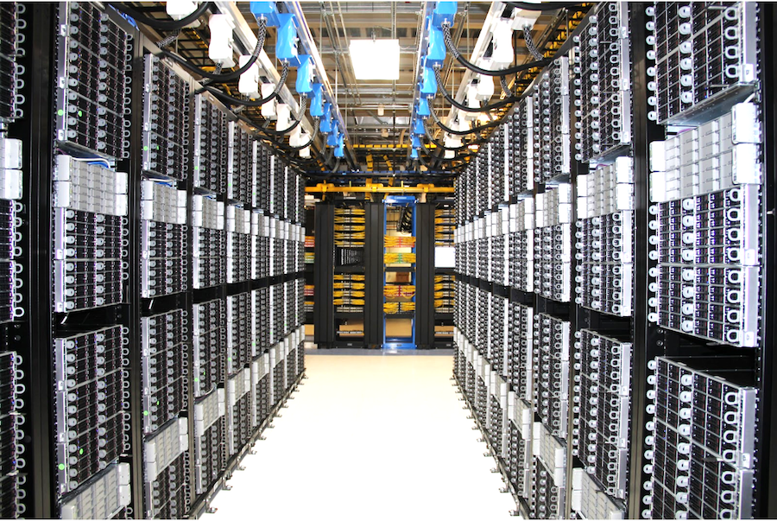
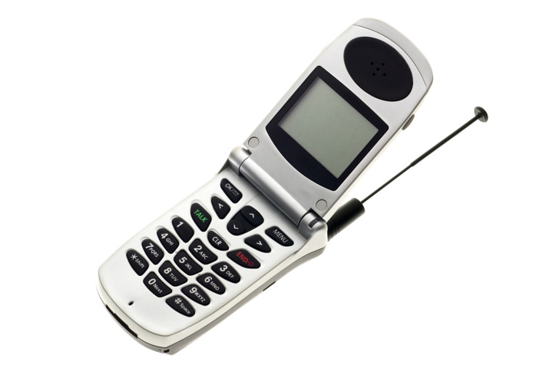
Challenge: Spaceflight Hardware
Typical ground hardware:
Typical space hardware:

Slide 8
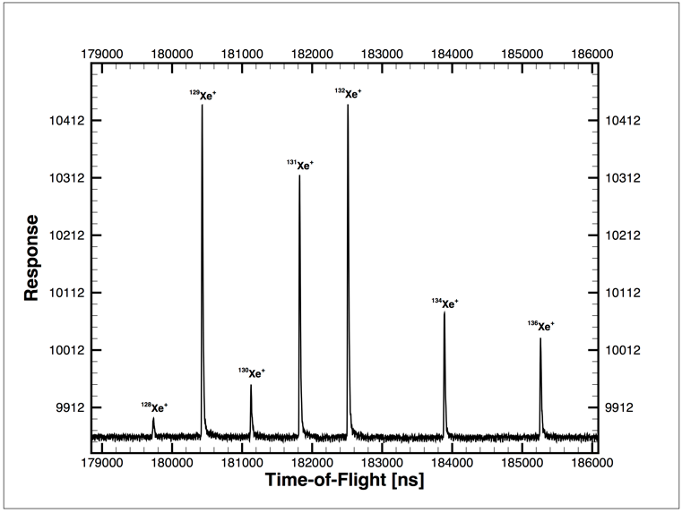
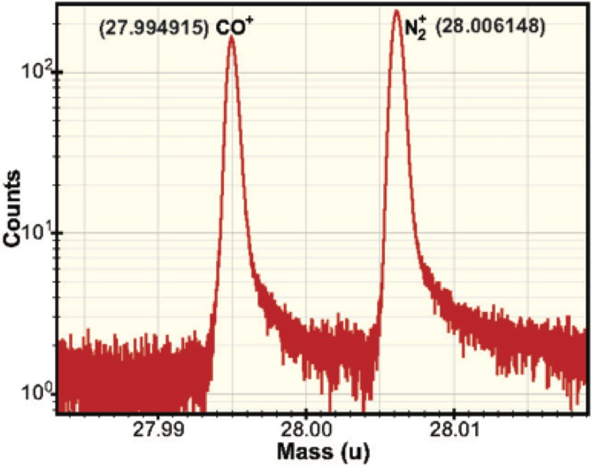
Dataset Description
Information sparsity
Shifting baselines, noisy peaks, low SNR peaks

Slide 9
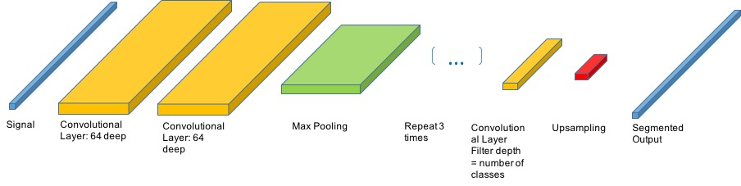
Model Architecture
1D Conv Net Architecture
Ingests segments of length 120 as input
Iterates continuously over time series signal

Slide 10
Network Compression
Goal: Minimize memory usage
  Determined by size of weights and intermediate layer outputs
Goal: Minimize hardware footprint
  Determined by width and depth of network

Slide 11
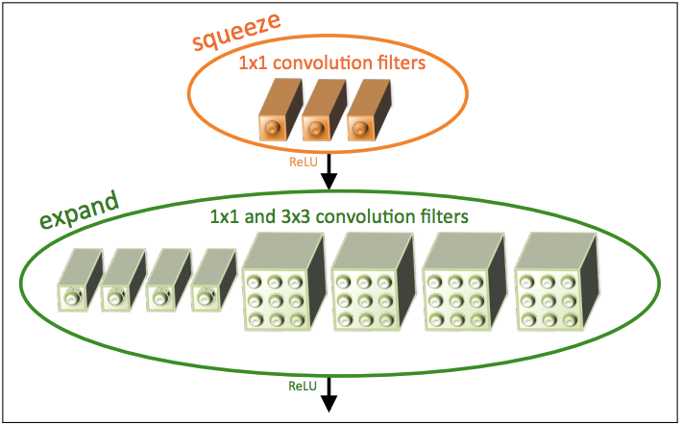
Introduction of Fire Modules
Reduces footprint of conv layers by implementing squeeze mechanism
7x reduction in model size with same performance
Model Architecture | Number of Weight Parameters | Model File Size
Fully Convolutional Network | 616,386 | 1.5 Mb
Fully Convolutional Squeeze-net | 264,786 | 236 Kb

Slide 12
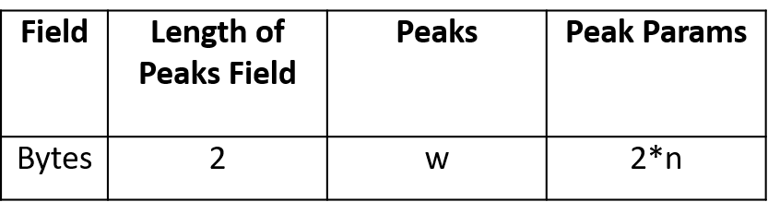
Peak Compression Strategy
Need to define data field that can store information required to reconstruct peak locations
size = 2+ [extracted peak data] + [2 * n_peaks]

Slide 13
Results: 10x Reduction in Data with 95% Information Retention

Slide 14
What’s Next?
Explore anomaly detection for new observations
Explore higher dimensional data, such as 2D EO/IR imaging and video
Compare speed and scalability vs GPU
Improve parallelization
Technique | Ratio | Science Information Preserved
Rice Compression | 2.1 | 100%
FLAC | 1.9 | 100%
Neural Net | 10 | 90%
Co-addition | n | (100/n) %

