Slide 1
Advantages of Deterministic Ethernet for Space Applications
Space Flight Software Workshop 2013
Christian Fidi, Product Manager Space Products
Christian.Fidi@TTTech.com
December 11th, 2013

Slide 2
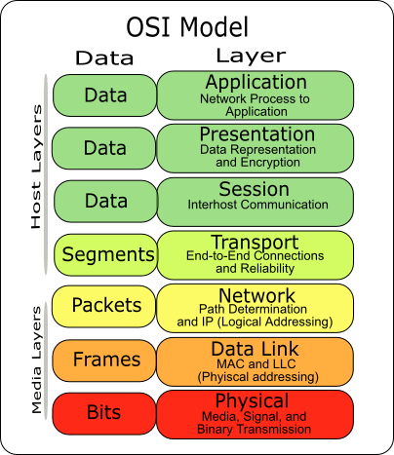
Ethernet a Worldwide Standard
  Worldwide used, cross industry with a strong growth in embedded systems
  IEEE802 is an open and well defined standard
  Supports different speeds and topologies
  Well defined network stack ISO/OSI
  Low cost COTS Ethernet equipment available
  Robust physical layer with future enhancements e.g. BroadR-Reach (100Mbps with 2-wire twisted-pair)
  Standardized interface to the physical layer
  Engineers learn about Ethernet in schools

Slide 3
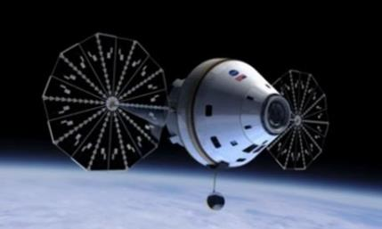

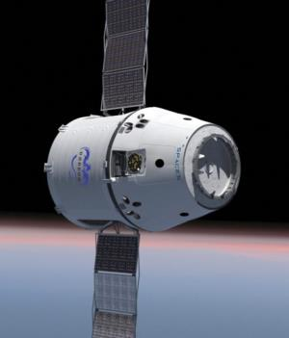
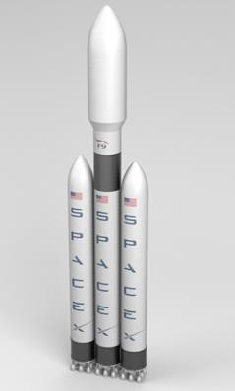
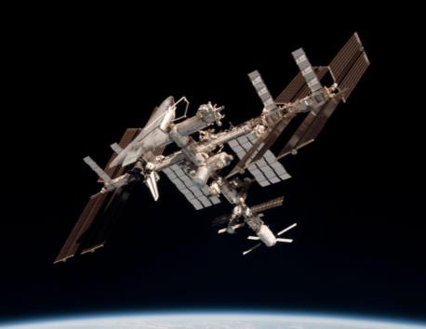

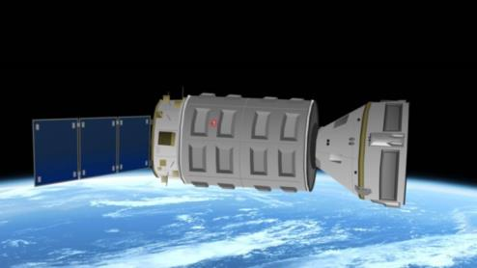
Space Programs Using Ethernet

Slide 4
Ethernet = Unsynchronized Communication
Asynchronous Communication
Transmission points in time are not predictable
→ Transmission latency and jitter accumulate
→ Number of hops has a significant impact

Slide 5
Motivation for Time-Triggered Ethernet
Statically Configured Communication
Free-Form Communication
Performance guarantees:
real-time, dependability, safety
No performance guarantees:
“best effort” plus some QoS
  Standards:
  ARINC 664, ARINC 429, TTP,
  MOST, FlexRay, CAN, LIN, …
  Applications:
  Flight control, powertrain, chassis,
  passive and active safety, ..
  Validation & verification:
  Certification, formal analysis, ...
  Standards:
  Ethernet, TCP/IP, UDP, FTP,
  Telnet, SSH, ...
  Applications:
  Multi-media, audio, video, phones,
  PDAs, internet, web, …
  Validation & verification:
  No certification, test, simulation, ...
High cost
Low cost
Integration of functions from both worlds requires
a communication platform supporting both worlds

Slide 6
TTEthernet – Big Picture
TTEthernet = combination on the same network of
IEEE802.3
best effort Ethernet
no performance
guarantee
ARINC664p7
asynchronous
jitter < 500 μs
latency typical 1-10 ms
TTTech AFDX licensee
SAE AS6802
synchronous
jitter < 1 μs
latency < 12.5 μs/switch
(1 GBit/s Ethernet)
very tight control loops

Slide 7
TTEthernet Clock Synchronization
Time Master
Time Master
Time Master
Fault-tolerant synchronization services are needed for establishing a robust global time base

Slide 8
Term: Permanence
Frames in a switched network can have different transmission delays. It is possible that receive order is different to the transmit order.
Example:
  frame F1 is transmitted by node A at 10:00
  frame F2 is transmitted by node B at 10:05
  frame F1 has a transmission delay A → C of 0:20
  frame F2 has a transmission delay B → C of 0:05
  receiver C sees: frame F2 arrives at 10:10, then F1 arrives at 10:20
In a TTEthernet network, frame F2 is said to become “permanent” when it is certain that no frame F1, which was transmitted at an earlier point in time than F2, will be received anymore. TTEthernet needs to know when certain frames become permanent to run synchronization algorithms.
B
F2
F1
10:05
10:10
A
C
10:00
10:20
Comp

Slide 9
Permanence of PCFs
Using the transparent_clock value, a receiver can determine the “earliest safe” point in time when a PCF becomes permanent:
  permanence_delay = max_transmission_delay – transparent_clock
  permanence_point_in_time = receive_point_in_time + permanence_delay
Example:
  max_transmission_delay in this network is 0:30
  frame F1 is transmitted by node A at 10:00
  frame F2 is transmitted by node B at 10:05
  frame F1 has a transmission delay A → C of 0:20. This is visible in F1’s transparent_clock
  frame F2 has a transmission delay B → C of 0:05. This is visible in F2’s transparent_clock
  receiver C sees: F2 arrives at 10:10, becomes permanent at 10:10 + (0:30 - 0:05) = 10:35
  receiver C sees: F1 arrives at 10:20, F1 becomes permanent at 10:20 + (0:30 - 0:20) = 10:30
  ➔ F1 becomes permanent before F2
B
F2
F1
10:05
10:10
A
C
10:00
10:20
Comp

Slide 10
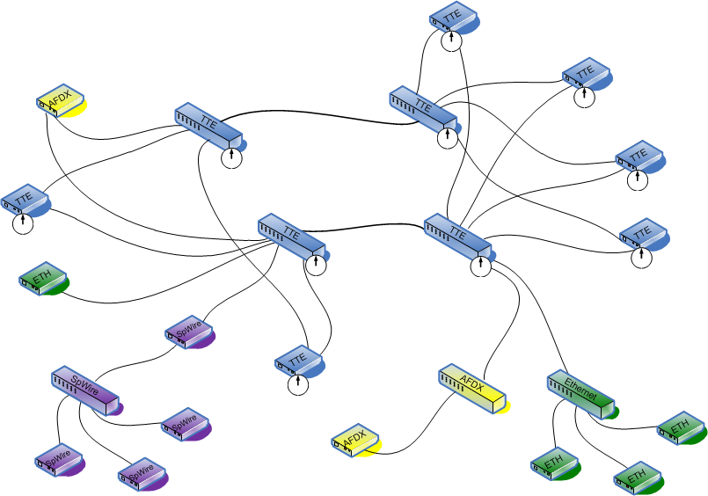
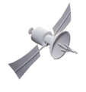
Mixed-Criticality Architecture
Gateway
GPS
IEEE1588
Standard Ethernet
SpaceWire / SpaceFiber

Slide 11

Time-triggered Traffic Timing
Full control of timings in the system.
Defined latency and sub-microsecond jitter
I’ll accept M only between 10:40 and 10:50
I’ll expect M between 11:05 and 11:15
I’ll accept M only between 10:55 and 11:05
M
M
M
I’ll forward M at 11:00
M
I’ll transmit M at 10:45
I’ll forward M at 11:10
Let’s see if I can receive M
…a switch
Notes:
…but sender and receiver still only do “I’ll transmit M at…” and “I’ll expect M at…” – the added complexity is in the network, not in the nodes

Slide 12
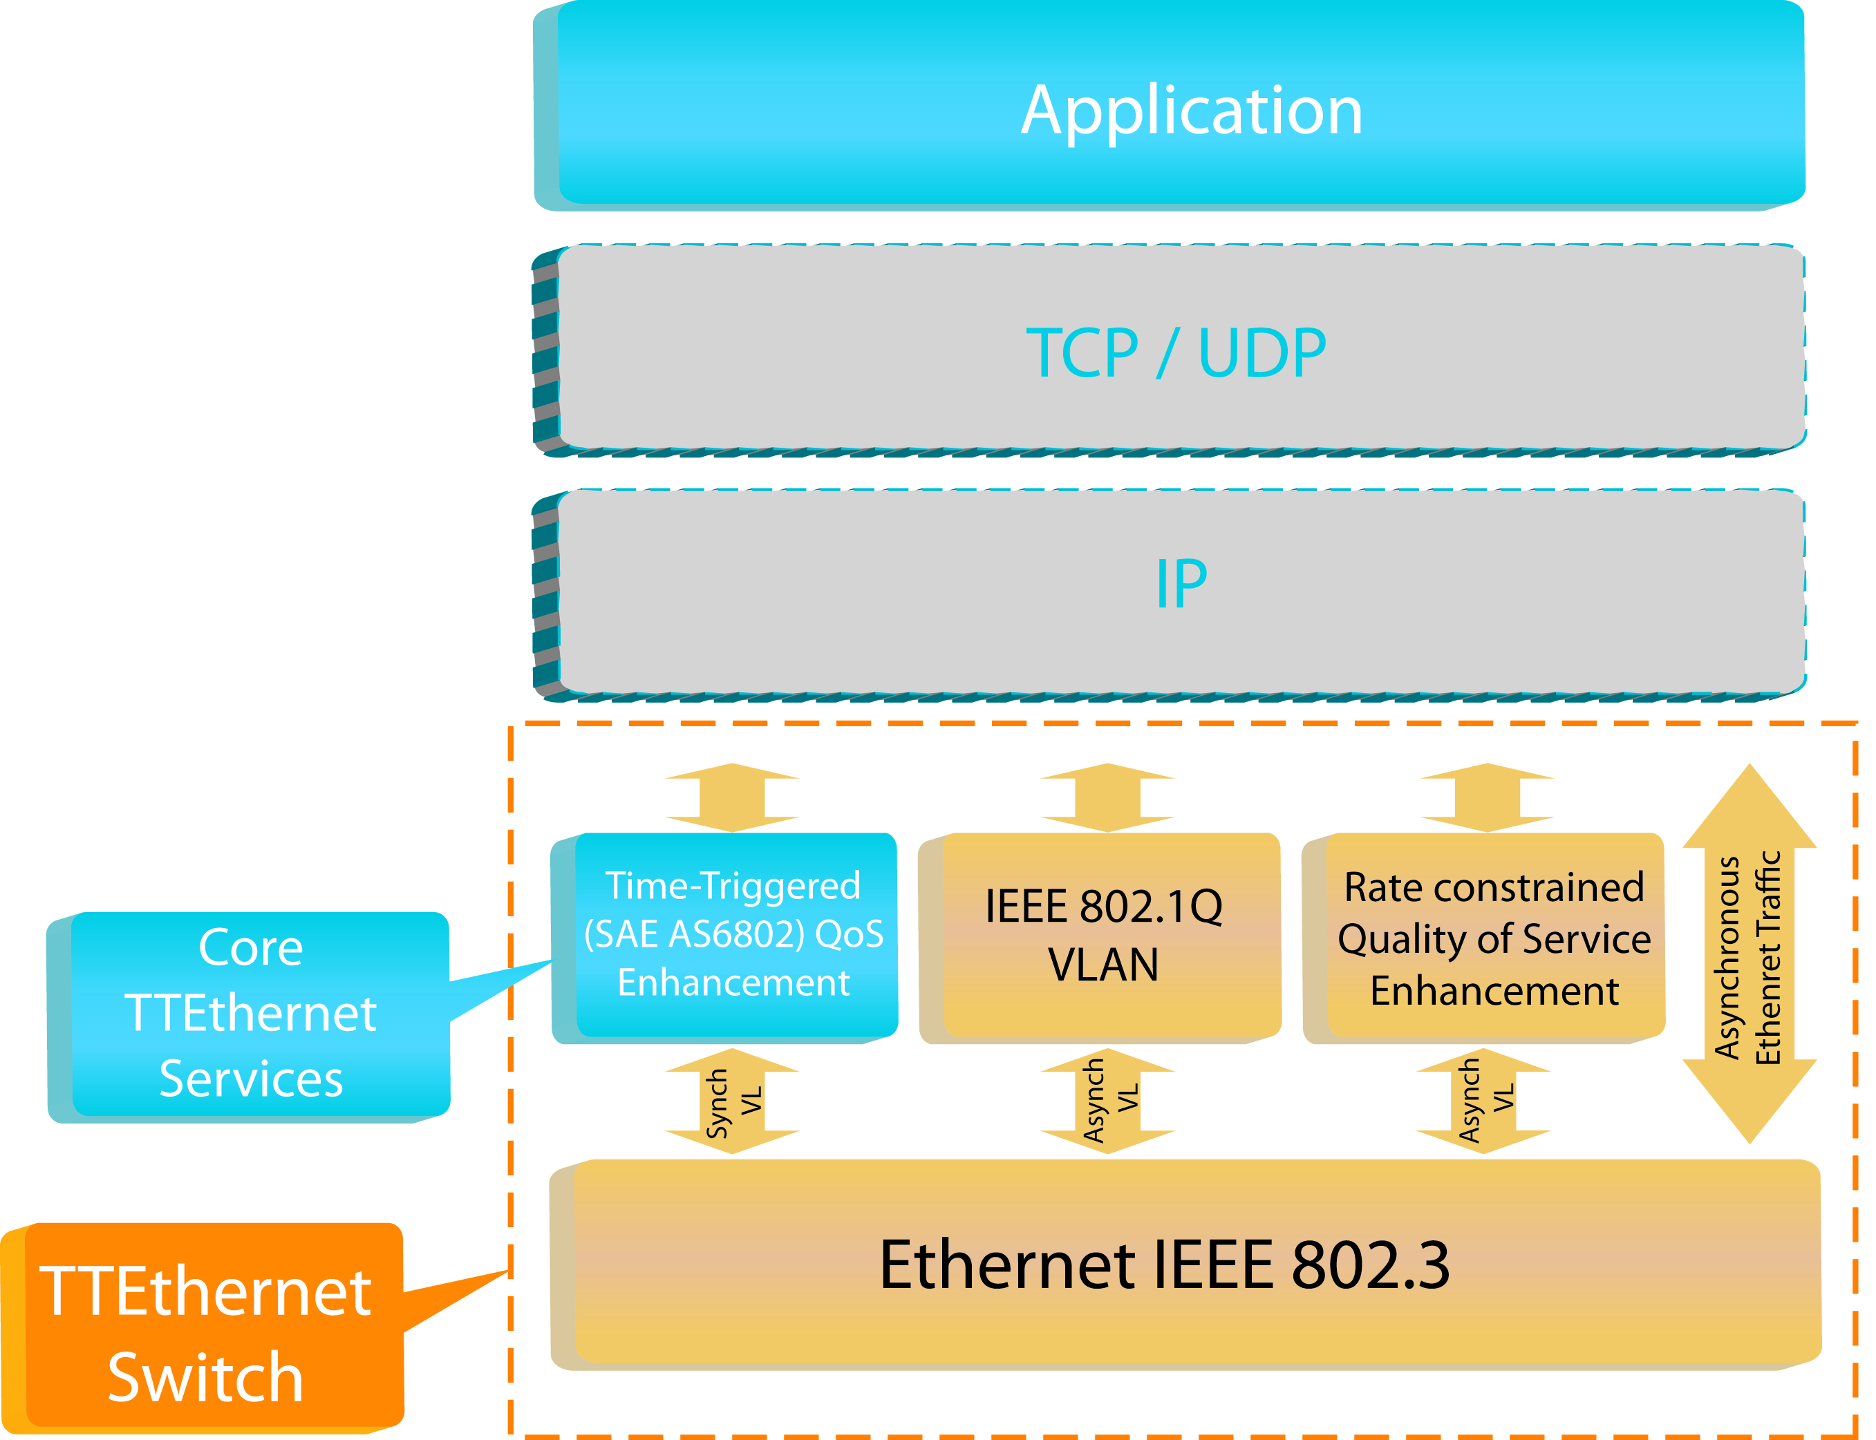
Extensions & Standard Ethernet
Time-triggered extensions for standard switched Gigabit-Ethernet
  Startup
  Recovery
  Robust fault-tolerant distributed clock
Makes Ethernet viable for safety-critical distributed applications!

Slide 13
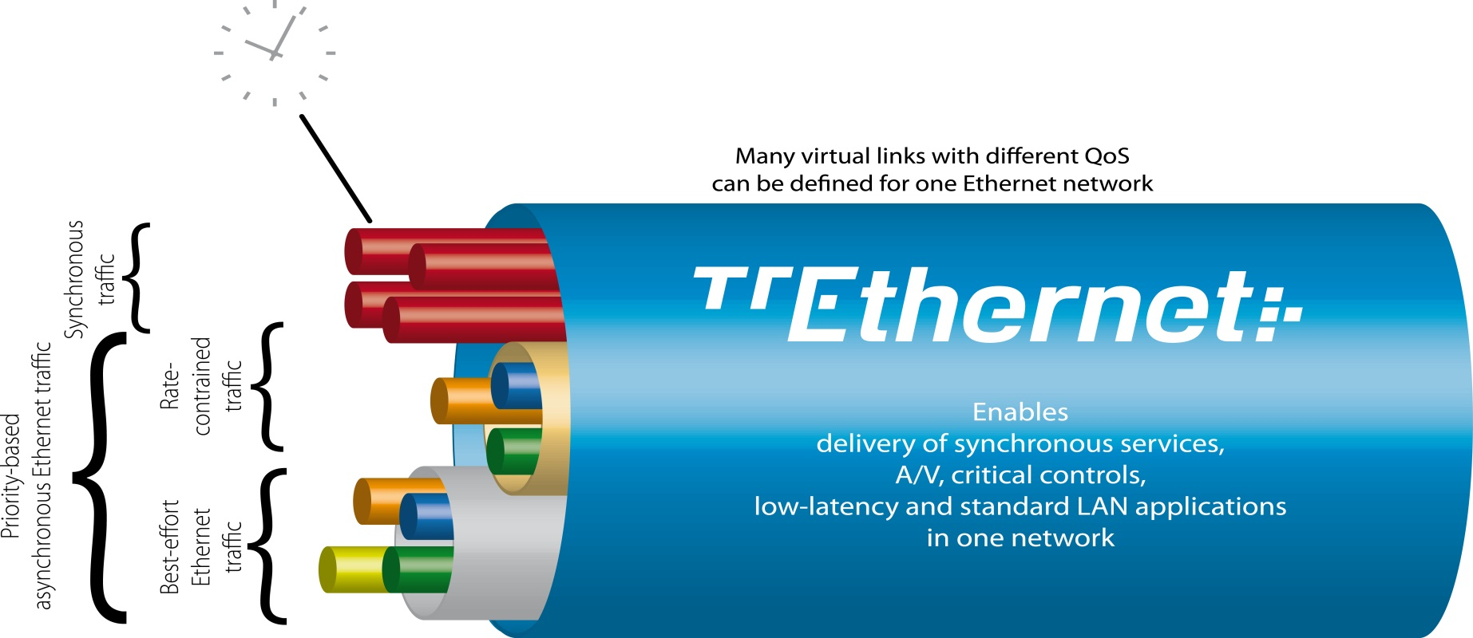
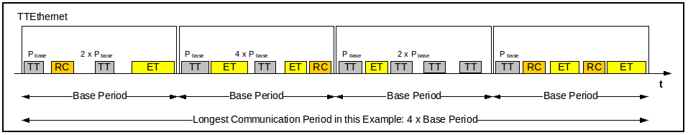
TTEthernet Traffic Partitioning
Page 13
Notes:
TTEthernet provides a set of time-triggered services implemented on top of standard IEEE 802.3 Ethernet. These services are designed to enable design of synchronous, highly dependable embedded computing and networking systems, capable of tolerating multiple faults.
With TTEthernet, robustly partitioned multimedia data streams, critical control data and standard LAN messages can operate in one network without congestion or unintended interactions.
On this slide, four synchronous time-triggered Ethernet streams are shown in red. They are robustly separated from other asynchronous priority-based or rate-constrained datastreams such as IEEE DCB or AVB, and other lower-priority standard Ethernet traffic.

Slide 14

“System of Systems” Fusion
Priority 1
time-triggered
Priority 2
SoS architecture with TTEthernet supports reconfiguration
  Several separate vehicles or elements fuse into a new combined network configuration
Notes:
14
architecture is coupled together through Virtual Backplane™
The Integrated Systems ideal for system of systems
individual systems come together > coupled through fusion of Virtual Backplane™
predetermined, yet dynamic, re-configuration of the individual computing element’s configuration tables
enables the several free-flying elements
start a mission with individual state vectors, to fuse into a combined configuration that share a new, common set of state vectors.

Slide 15
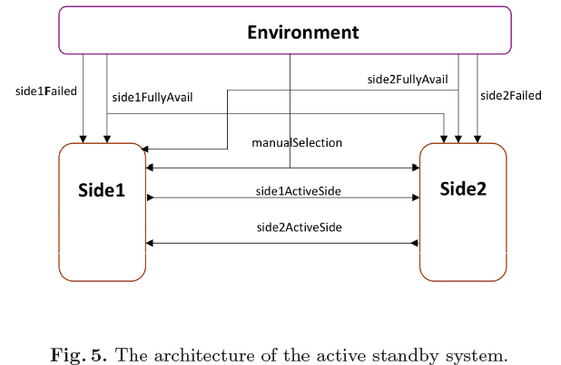
Complexity Example:
Synchronous vs. Asynchronous
Active standby avionics system model with three components…
  Synchronous model: 185 reachable states (~2x10²)
  Asynchronous model & communication with no latency: >3x10⁶ states
  Asynchronous model with varying communication
  latency: The number of
  reachable states could not
  be calculated with 8Gb RAM…
https://www.ideals.illinois.edu/bitstream/handle/2142/17089/pals-formalization.pdf?sequence=2
>10⁸⁻10¹⁰
???
The number of system states in an integrated systems can be very high…
And this is still a relatively simple system…

Slide 16


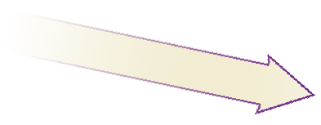
Distributed IMA: 653 OS + TTEthernet
Expanding "time/space partitioning" into "time/space/bandwidth partitioning"
Enabler:
Networking
Technology
  IMA (Module-level time/space partitioning)
  = Mixed-Criticality Systems
  Critical Functions
  (DO-254/DO-178B Level A-C)
  Non-Critical Functions
  Distributed IMA (System-level partitioning)
  = Distributed Mixed-Criticality Systems
  Critical Systems
  (DO-254/DO-178B Level A-C)
  Audio/Video/Voice/Multimedia
  Payload Data w. Distributed processing
  Internet, LAN, Non-Critical Systems
Time & Space Partitioning
for each Module (653 OS)
Time, Space and Network Partitioning
for each Module (653 OS) & TTEthernet
Notes:
VxWorks653 is partitioned OS designed for hosting function of different criticality levels on one processor. So this is useful for saving weigth and space in A&D systems and represents the basic technology behind IMA paradigm.
On the left side we see two computing modules relying on time/space partitioning OS. All partitions on one module are synchronized to local time with scheduled start and end point. It is natural that the common notion of time is available on one processor, so the scheduling is easy.
However different computing modules with partitioned OS are not synchronized to each other, so the timing of their operation drifts.
This drift adds latency and jitter and imposes constraints for middleware and application software design. Basically this requires additional activity at higher layers, requires more computing resources and reduces hard RT capabilities of a distributed systems.
On the right side we see the time/space partitioning concept extended by TDMA network bandwidth partitioning. With TTEthernet synchronization capability, all partitions in the systems can be synchronized to the communication schedule of the most critical data streams in the system.
When integrated, both technologies support efficent time/space/bandwidth partitioning in a distributed system. The networked system, in this case, works as a large distributed computer with a number of aligned (or synchronized) partitions.
This allows hosting of distributed functions of different criticality in one networked systems. Distributed mixed criticality systems equals to Distributed IMA architecture.
RTCA DO-297 outlines guidance for building IMA systems based around standards such as DO-254, DO-178B and ARINC 653, and it is used for key commercial aviation programs. DO-297 provides examples of architectures such as Centralize d and Distributed IMA. Distributed IMA relies on TDMA network partitioning.
VxWorks653 and TTEthenret integration create a Distributed IMA platform based on COTS technology.

Slide 17
Synchronous Alignment:
Resource Use & Complexity Reduction
Maximize use of network bandwidth and computing resources for critical embedded functions
  Ensure unambiguous design of key system interfaces
  Reduce uncertainity, jitter and unintended system states (prevents system state explosion)
Improve functional alignment (and separation!)
  Simplified sensor fusion and distributed processing
  Simplified redundancy management
  Minimize software complexity / simplify functional alignment

Slide 18
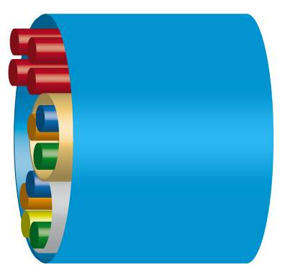


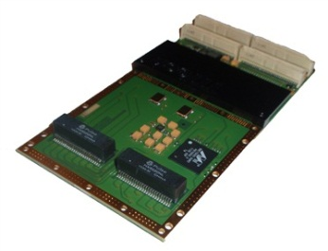
Architecture Level Approach
APP
APP
APP
Bandwith to Memory Partitioning mapping at E/S based on VLs
Redundancy management
Bandwith Partitioning at Switch Level
RTEMS
Linux
OS
TSP OS
Mem
Mem
Mem
Strong Partitioning (TSP + TTEthernet)
  Bandwidth partitioning at the network level
  Bandwidth partitioning supported at the switch and E/S level
  Memory partitioning at the E/S Level
  Bandwidth to memory mapping at the E/S based on virtual links

Slide 19





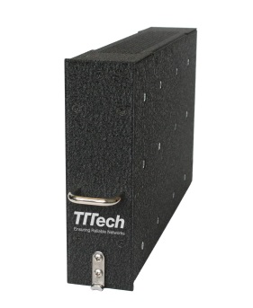
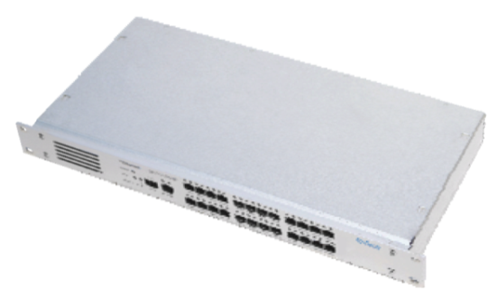
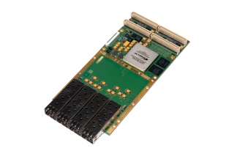

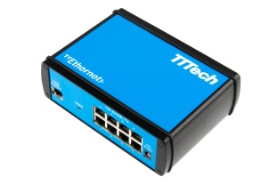
TTEthernet COTS Products
Rugged Hardware
  ^{TTE}Switch 3U VPX Rugged
  ^{TTE}PMC Card Rugged
Development Equipment
Switches • ^{TTE}Dev Switch 1 Gbit/s 12 Ports
• ^{TTE}Dev Switch 100 Mbit/s A664
• ^{TTE}Switch 1 Gbit/s Lab 24 Ports
E/S • ^{TTE}PMC Card, ^{TTE}PCI Card
• ^{TTE}XMC Card, ^{TTE}PCIe Card
Test and Simulation Equipment
  ^{TTE}Monitoring Switch 1 Gbit/s 12+1 Ports
  ^{TTE}End System A664 Dev & Test
Development Systems
  ^{TTE}Dev System 1 Gbit/s v2.0
  ^{TTE}Dev System 1 Gbit/s for VxWorks 653
Configuration & Verification Tooling
  ^{TTE}Build
  ^{TTE}Load
  ^{TTE}View
  ^{TTE}Verify (certification RTCA DO 178B)
Embedded Software
  ^{TTE}Driver and ^{TTE}API Library
  ^{TTE}COM Layer ARINC 653
  ^{TTE}Sync Library

Slide 20
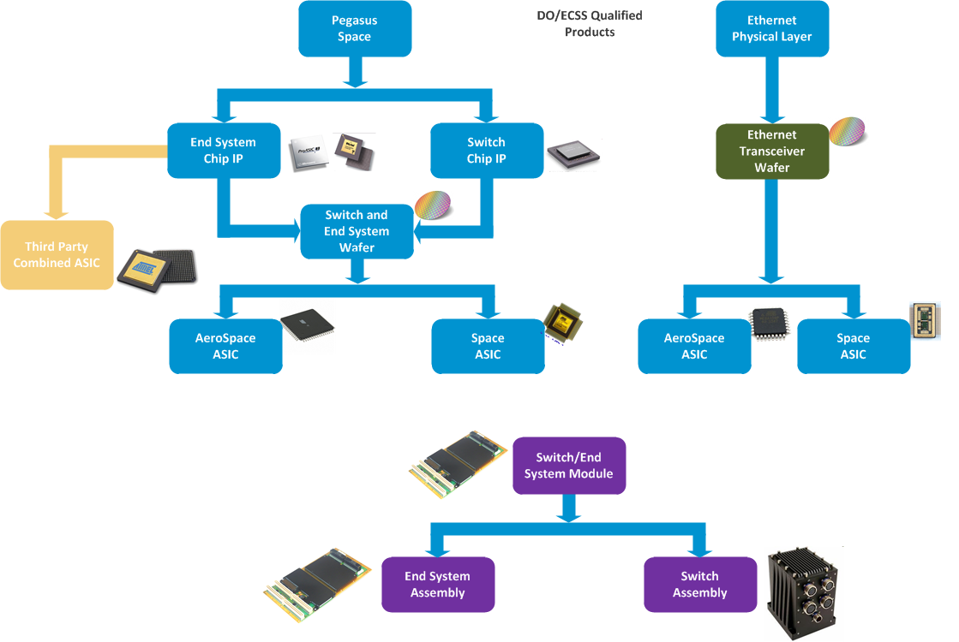
Space Product

Slide 21
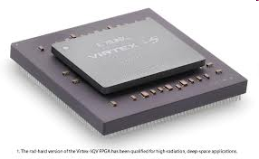
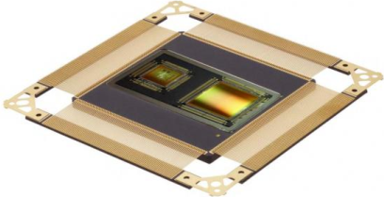
Chip Product Roadmap
TTEthernet Space IP Variants
For rad-tolerant/hard FPGA
“Pluto” Space IP
2x 10/100 Mbps (small footprint IP)
SR
PT
NIC Space IP
Switch/End System ASIC
3x 10/100/1000 Mbps MAC
SR
Rad-hard ASIC
3x 10/100/1000Mbps End System
10x 10/100Mbps + 6x 10/100/1000Mbps
Management CPU
RGMII Interface
PT
Switch Space IP
12x 10/100/1000 Mbps
SR
SR
PT
SR
PT
PT
2012 2013 2014 2015 2016
Time
AVAILABLE
UNDER DEVELOPMENT
ENVISAGED
PT
Prototype
PS
Preseries
SR
Series
EOL
End of Life

Slide 22
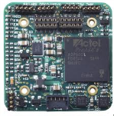
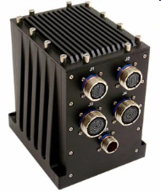
Flight Hardware Products
TTEthernet RTU
Rad-tolerant
COTS HW using Pluto IP
PT
TTEthernet PMC Card
Space Qualified TTEthernet PMC Card
FPGA based (designed for ASIC)
TTE-PMC/XMC Card Space
PT
PS
SR
TTEthernet Switch Assembly
Space Qualified TTEthernet Switch
FPGA based (designed for ASIC)
TTE-Switch 12 Port 10/100/1000 Mbps Space
PT
PS
SR
2012 2013 2014 2015 2016
Time
AVAILABLE
UNDER DEVELOPMENT
ENVISAGED
PT
Prototype
PS
Preseries
SR
Series
EOL
End of Life

Slide 23
System States and Complexity

Slide 24
Complexity
System integration technology can reduce complexity

Slide 25
Robust TDMA Partitioning
Robust TDM network bandwidth partitioning
  Distributed fault-tolerant timebase
  Enforcement of prescribed communiciation schedule
  Defined low latency and minimal jitter enable precise "slicing" of network bandwidth and communication resources
Notes:
This simplifes interaction among functions.
We know about behavior of all data exchange in the system
Jitter, delay and order of messages through different paths well defined
Strictly deterministic communication for selected critical functions
System behavior is well-understood
No impact by less critical or non-critical functions

Slide 26
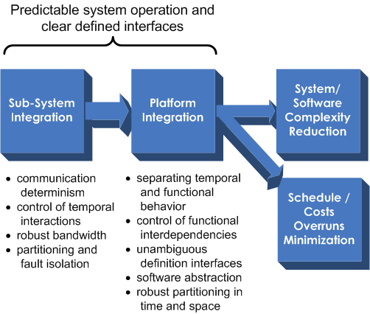
System Integration
Impacts module and sub-system design
in all lifecycle phases:
  Software design
  Testing
  Certification
  Maintenance
  Upgrades/extensions
  Reuse/redesign

Slide 27
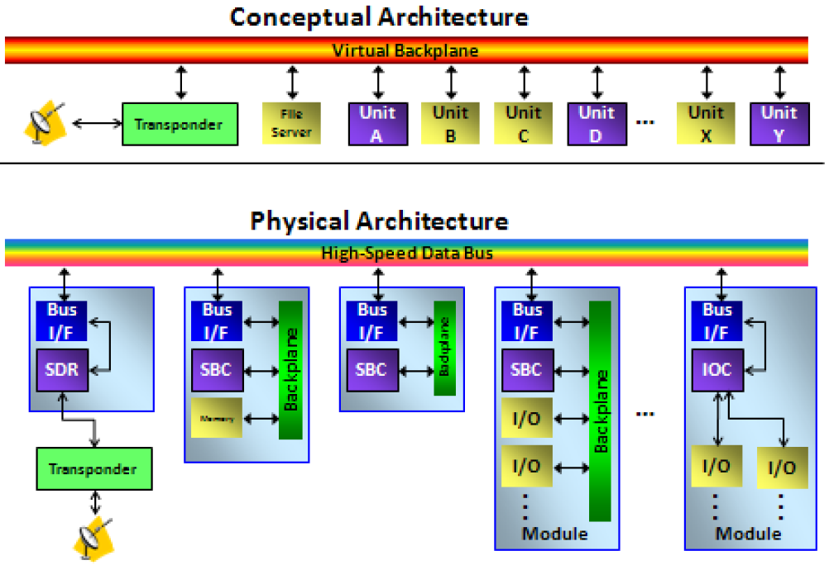

Orion‘s Virtual Backplane
  "We look forward to realizing the potential of TTEthernet technology development, which provides a high bandwidth avionics databus capability supporting future technology insertion.“
  NASA statement
Page 27

Slide 28
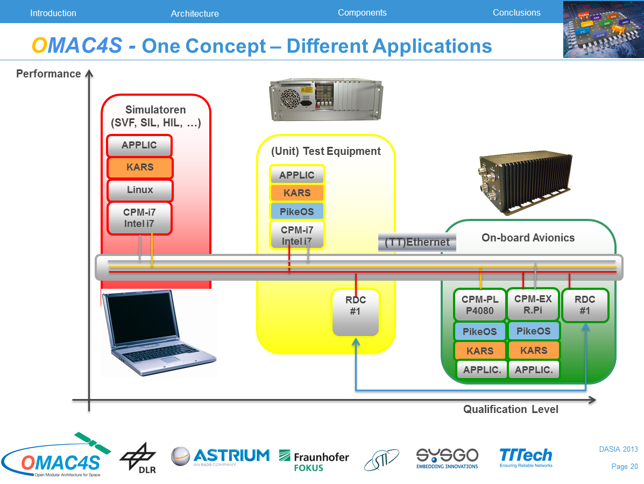
Avionic-X Demonstrator
Page 28

Slide 29

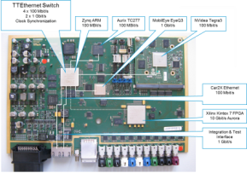
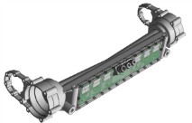
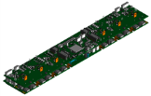
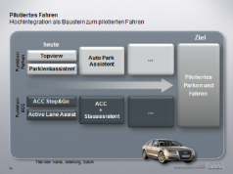
Strategic ECU Programs with AUDI since 2011
Advanced Chassis Control
(integrated in front axle) and
Advanced Driver Assistance
Computing Platform

Slide 30






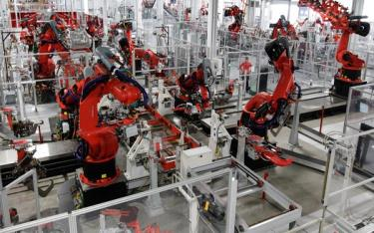


Standardization: TTTech working with partners to drive Deterministic Ethernet standard across industries
  Working with Audi/Volks-wagen and other European, American and Asian OEMs on Automotive Ethernet (Deterministic Ethernet)
  Working with Honeywell, NASA
  and other aerospace partners on SAE standardization of Deterministic Ethernet for Aerospace
  (SAE AS6802)
Aerospace
SAE Standardization
Cross- industry standard
Automotive Ethernet
IEEE Standardization
  Working with Cisco and IEEE com-munity on 802.1 TSN standard
Industrial
Automotive

