Slide 1
Code Awareness Assistant
Automatically Collecting and Checking Detailed Design Decisions
Presented by:
Dr. Michael McDougall, mcdougall@grammatech.com
This material is based upon work supported by the United States Navy under Contract No. N00014-12-M-0240. Any opinions, findings and conclusions or recommendations expressed in this material are those of the author(s) and do not necessarily reflect the views of the United States Navy.

Slide 2
GrammaTech
Focus:
Software analysis and manipulation
Founders:
Tim Teitelbaum, CEO (Professor Emeritus at Cornell U.)
Thomas Reps, President (Professor at U. Wisconsin)
Research:
Sponsored by NASA, DoD, NSF and commercial companies
Static and dynamic software analysis
Source code and machine code
Applications
Safety/Reliability
Security
Producibility
Products:
CodeSurfer®, CodeSonar®
CodeSonar used to check MSL flight code for
Bugs and risky code
Compliance with JPL coding standard
Page 2
Copyright © GrammaTech, Inc. 2013
Notes:
2

Slide 3
Some GrammaTech Customers
Mil/Aero
Medical
Industrial Control / Electronics
Telecom/Datacom
Page 3
Copyright © GrammaTech, Inc. 2013

Slide 4
Outline
swap() Example
Detailed Design Decisions
Goals of the Code Awareness Assistant
Time/Changes
How the Code Awareness Assistant Works
Looking for Participation

Slide 5
What’s wrong with this code?
Is it safe?
void swap(int *x,
int *y) {
int tmp;
tmp = *x;
*x = *y;
*y = tmp;
}
Null Pointer Dereference if x is NULL.
.. but (sort of) ok (and fast) if you know x is never NULL.
Accident waiting to happen? Or prudent optimization?

Slide 6
Recent change?
Accident waiting to happen? Or prudent optimization?
Last week
Today
void swap(int *x,
int *y) {
int tmp;
if (!x || !y)
return;
tmp = *x;
*x = *y;
*y = tmp;
}
void swap(int *x,
int *y) {
int tmp;
tmp = *x;
*x = *y;
*y = tmp;
}

Slide 7
Fixes
void swap(int *x,
int *y) {
int tmp;
if (!x || !y)
return;
tmp = *x;
*x = *y;
*y = tmp;
}
// crashes if x or
// y is NULL
void swap(int *x,
int *y) {
int tmp;
tmp = *x;
*x = *y;
*y = tmp;
}
void swap(int *x,
int *y) {
int tmp;
assert(x);
assert(y);
tmp = *x;
*x = *y;
*y = tmp;
}
Handle error
Documentation
Assertion

Slide 8
Code Awarness Assistant
Code is unsafe when
x or y is NULL
void swap(int *x,
int *y) {
int tmp;
tmp = *x;
*x = *y;
*y = tmp;
}
Code recently handled NULL
x and y
Suggested fixes:
Assertion
Documentation
Handle the error

Slide 9
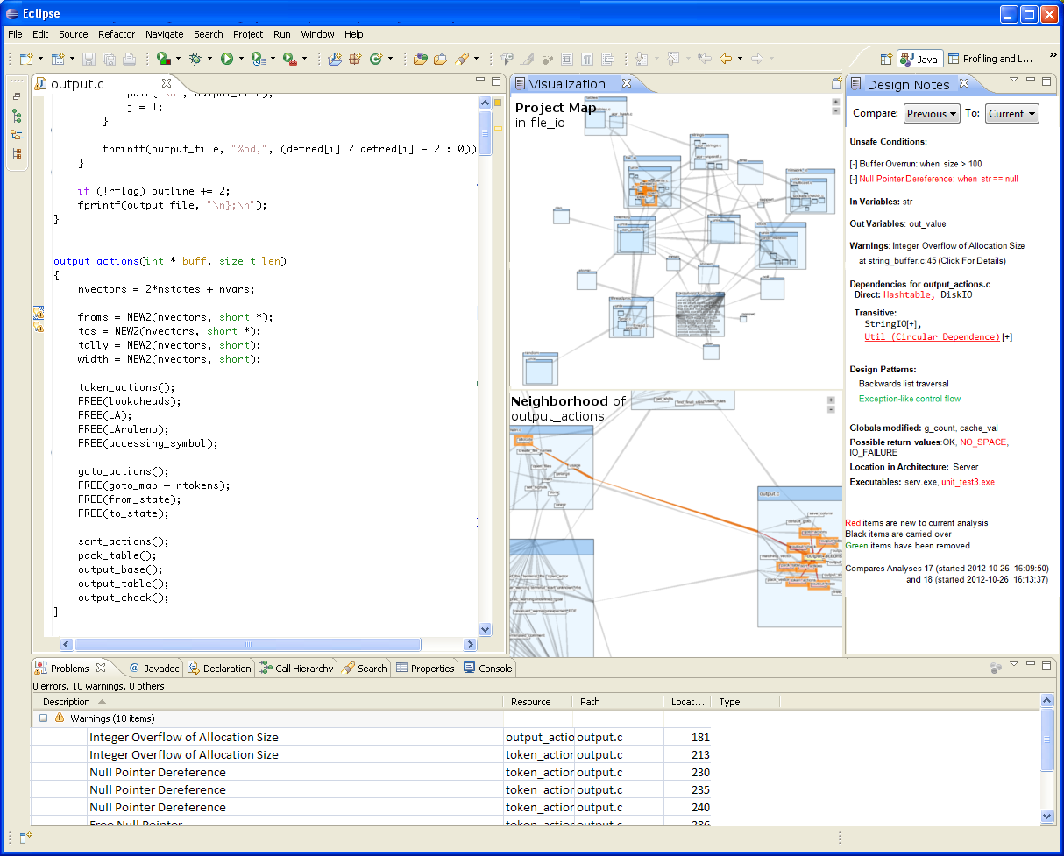
User Interface

Slide 10
Code Consistency with Design Decisions
foo(x,y) reads from x[y]
Procedure assumes globals initialized
Procedure assumes pointers point to heap
Procedure allocates memory
Procedure writes through pointer (‘out variable’)
Procedure uses <1000 cycles
Procedure avoids calling library X
Procedure can call printf
Procedure returns ERR_IO
g_length = length of g_array

Slide 11
Prototype: Design Notes Panels

Slide 12
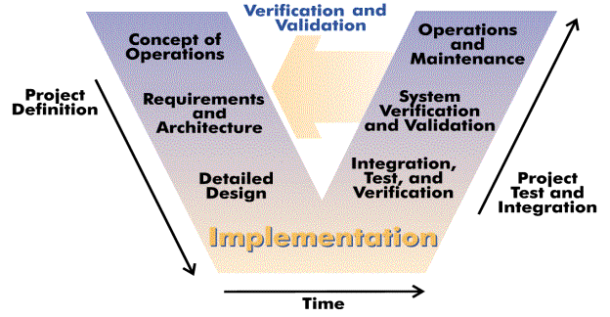
Detailed Design Decisions
Lots of decisions.
Not enough documentation.
Easily forgotten.
Hints in source code.

Slide 13
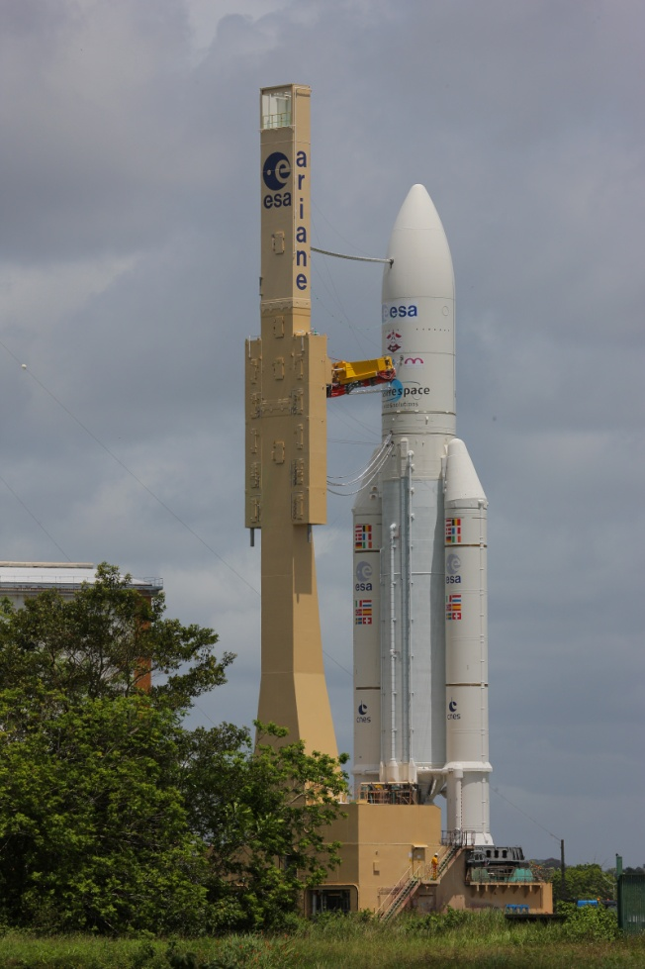
When Design Decisions are Forgotten
Code modified by unaware programmer
Violates built-in assumptions and constraints
“Stepping stones”
Consequences:
System fails after deployment
System fails in testing
Forces changes to documentation, packaging, test plans, etc.
System architect makes you rewrite code after review
http://flickr.com/photos/48213136@N06/8958839420

Slide 14
Goals
Infer design characteristics automatically
Additional documentation, useful to new (or forgetful) programmer
Alert when design characteristics change
Example
Change in procedure interface
Change in performance characteristics
Chance to re-assess: intentional or accidental?
Inform peer review / code inspections
One-click documentation
Make it easy for programmers to record important properties
Tool will compare documentation with code
Enable formal methods/ design by contract
Feed characteristics to other analysis tools

Slide 15
Time/Change
History gives us more hints about program characteristics
Sometimes the fact something changed is what matters
time
Unsafe when x == NULL
time
Alert
Safe when x == NULL

Slide 16
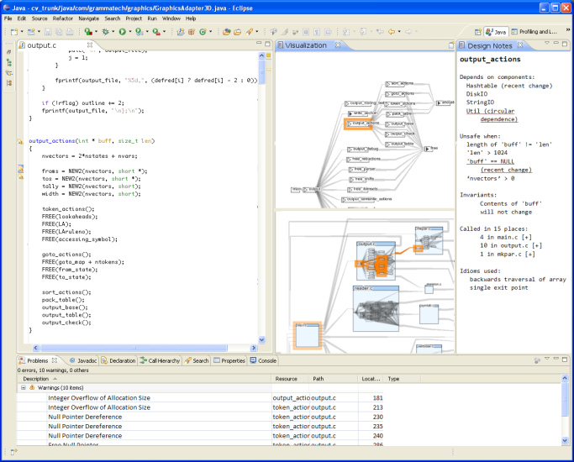
How we (will) do it
Eclipse IDE:
Analyzers:
Code and build steps
Static analysis A
Static analysis B
Specification discovery
Text analysis
User supplied scanner
Version Control
Repository
Notes and
Warnings
Project database
Filtering/
Transformation
Observations
User
History
Design input
(e.g. UML)

Slide 17
Analysis flow
Abstract
Syntax Tree
Intermediate
Representation
Code
Machine
Code
Syntax
Coloring
Semantics
(Scenarios+)
Compilers
Editors
Warnings
(Bugs)
Design
Observations
Static
Analysis
Code Awareness
Assistant

Slide 18
Showing Information that Programmers Need
Limited screen real estate
Drop info that is clear from code
Summarize, report in plain English
Drop info about obscure corner cases
Memory corruption if
x points to a char
void swap(int *x, int *y) {
int tmp;
tmp = *x;
*x = *y;
*y = tmp;
}
Memory corruption if x points outside an array.
Example:
int a[5];
int i = 3;
swap(&a[5], i);

Slide 19
Looking for Engagement
Requirements / Needs
What program characteristics not covered by existing process/tools?
Spacecraft flight software domain
Early Adopters
Plan to deploy prototype in 9-12 months to early adopter organizations
Use tool while working on real projects
Give feedback

Slide 20
Retaining Detailed Design Decisions: Other Approaches
Make design decisions part of the code
Use assertions
Leverage compile-time checks: types, enums, structures, etc.
Macros instead of boilerplate
Tables
Autocoding: generate code from design
Does not have to be heavyweight
Scan code for design violations
Enable compiler warnings
Simple grep/awk tools
Static analysis tools with customization facilities
Apply automation and re-engineering to SDLC

Slide 21
Conclusion
Code Awareness Assistant
Infer design decisions from code, document them
Warn when changes violate decisions
Looking for engagement
Needs of the community
Early-adopters
Leverage automation to enforce your designs
Questions?

