Slide 1
LADEE FSW Utilization of Lunar Laser Communication Bandwidth
Douglas Forman
Millennium Engineering and Integration Company (MEI)
LADEE FSW Payload I/F Developer
NASA-Ames Research Center
Moffett Field, CA
Craig Pires – LADEE C&DH Lead
Scott Christa – AerospaceComputing, Inc. (ACI)

Slide 2
Overview
Lasercom Channel for FSW Telemetry Only
More information on the LADEE lasercom
Boroson, D.M. et al. “The Lunar Laser Communications Demonstration (LLCD).”
LADEE FSW Approach
cFE / Payload Interfaces / Integration Testing
LLST (Lunar Laser Space Terminal) Interface
Control Electronics
High Speed FSW LLST Interface
LADEE FSW LLST I/F Implementation
Constraints and Design Decisions
Operational Utilization
Test, FSW SOH and Science Data
Future Implications

Slide 3
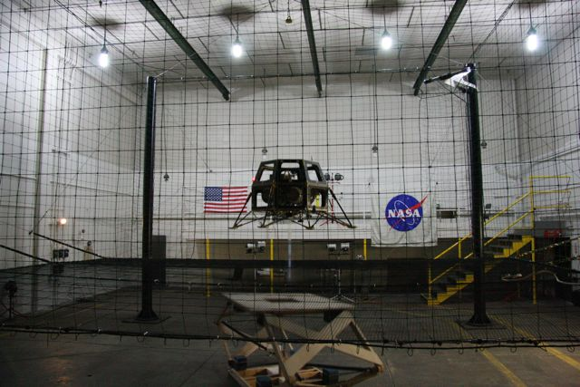
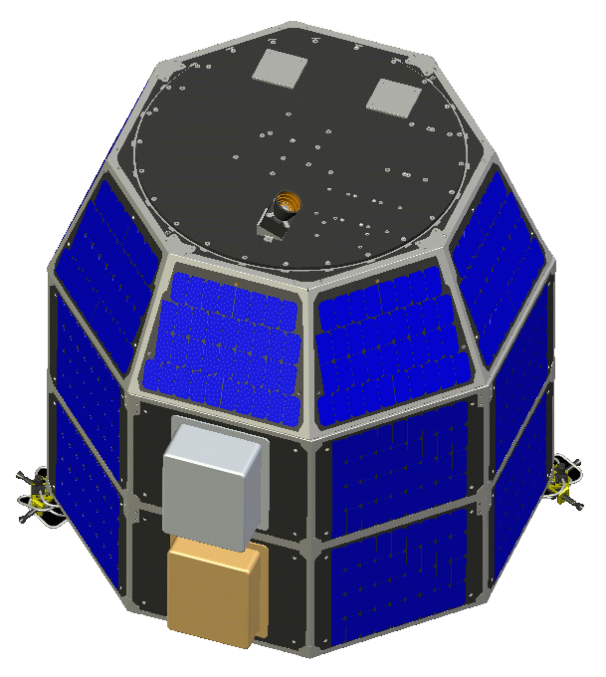
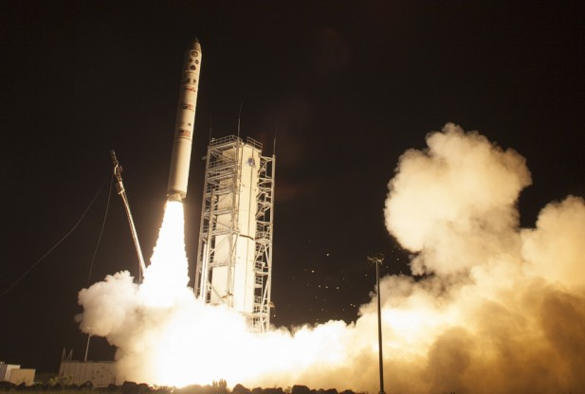
LADEE FSW
CFE Software Bus
Goddard Re-usable framework
Model Based Evolution
Simulink/Autocode
Closed Loop Simulation
Auto-coded to Multiple Targets
CCSDS Cmd/Tlm
ITOS Ground S/W

Slide 4
“Loosely-Coupled” FSW Architecture
OFSW
Command
& Mode
Processor
Actuator
Manager
State
Estimator
Safe Mode
Controller
Attitude
Control
System
Thermal
Control
System
Power
Control
System
Battery
Charge
System
Software Bus
Scheduler
Stored
Commands
Memory
Manager
Memory
Dwell
Limit
Checker
House-
keeping
Memory
Scrub
Hardware
I/O
Health &
Safety
File
Manager
CCSDS File
Delivery
Checksum
Data
Storage
Telemetry
Output
Command
Ingest
System Support, O/S Services and Device Drivers
Telemetry
KEY
Gnd Cmds
FSW Internal
Simulink
Task
cFS
Task
Hand
Written
Task
Sensor Data
FSW External

Slide 5
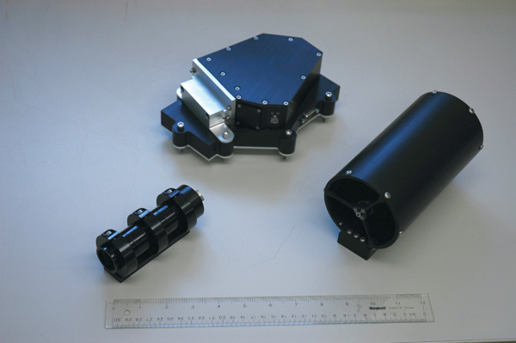
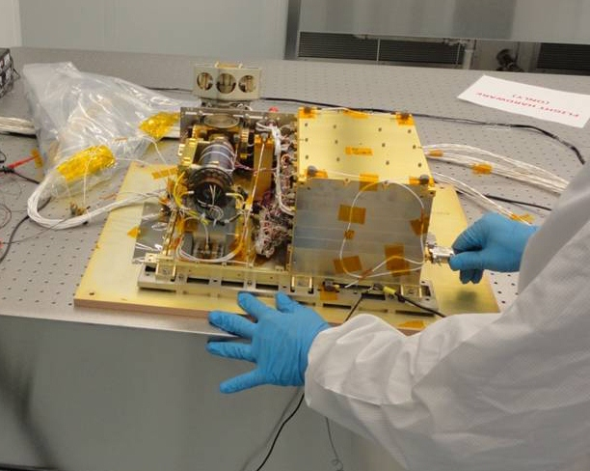
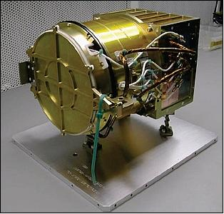
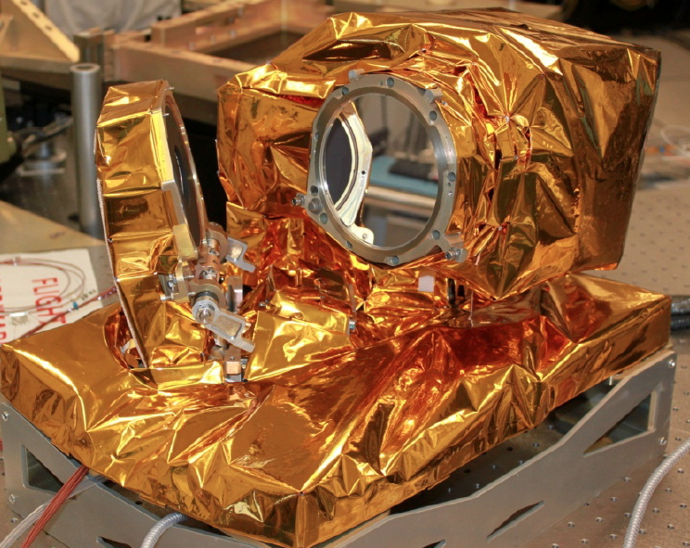
LADEE Payload Interfaces
UVS (Ultra-violet Spectrometer)
NASA Ames
NMS (Neutral mass Spectrometer)
Goddard Spaceflight Center
LDEX (Lunar Dust Environment Experiment)
LASP (University of Colorado at Boulder)
LLST (Lunar Laser Space Terminal)
MIT Lincoln Labs

Slide 6
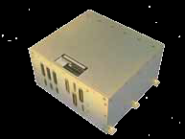
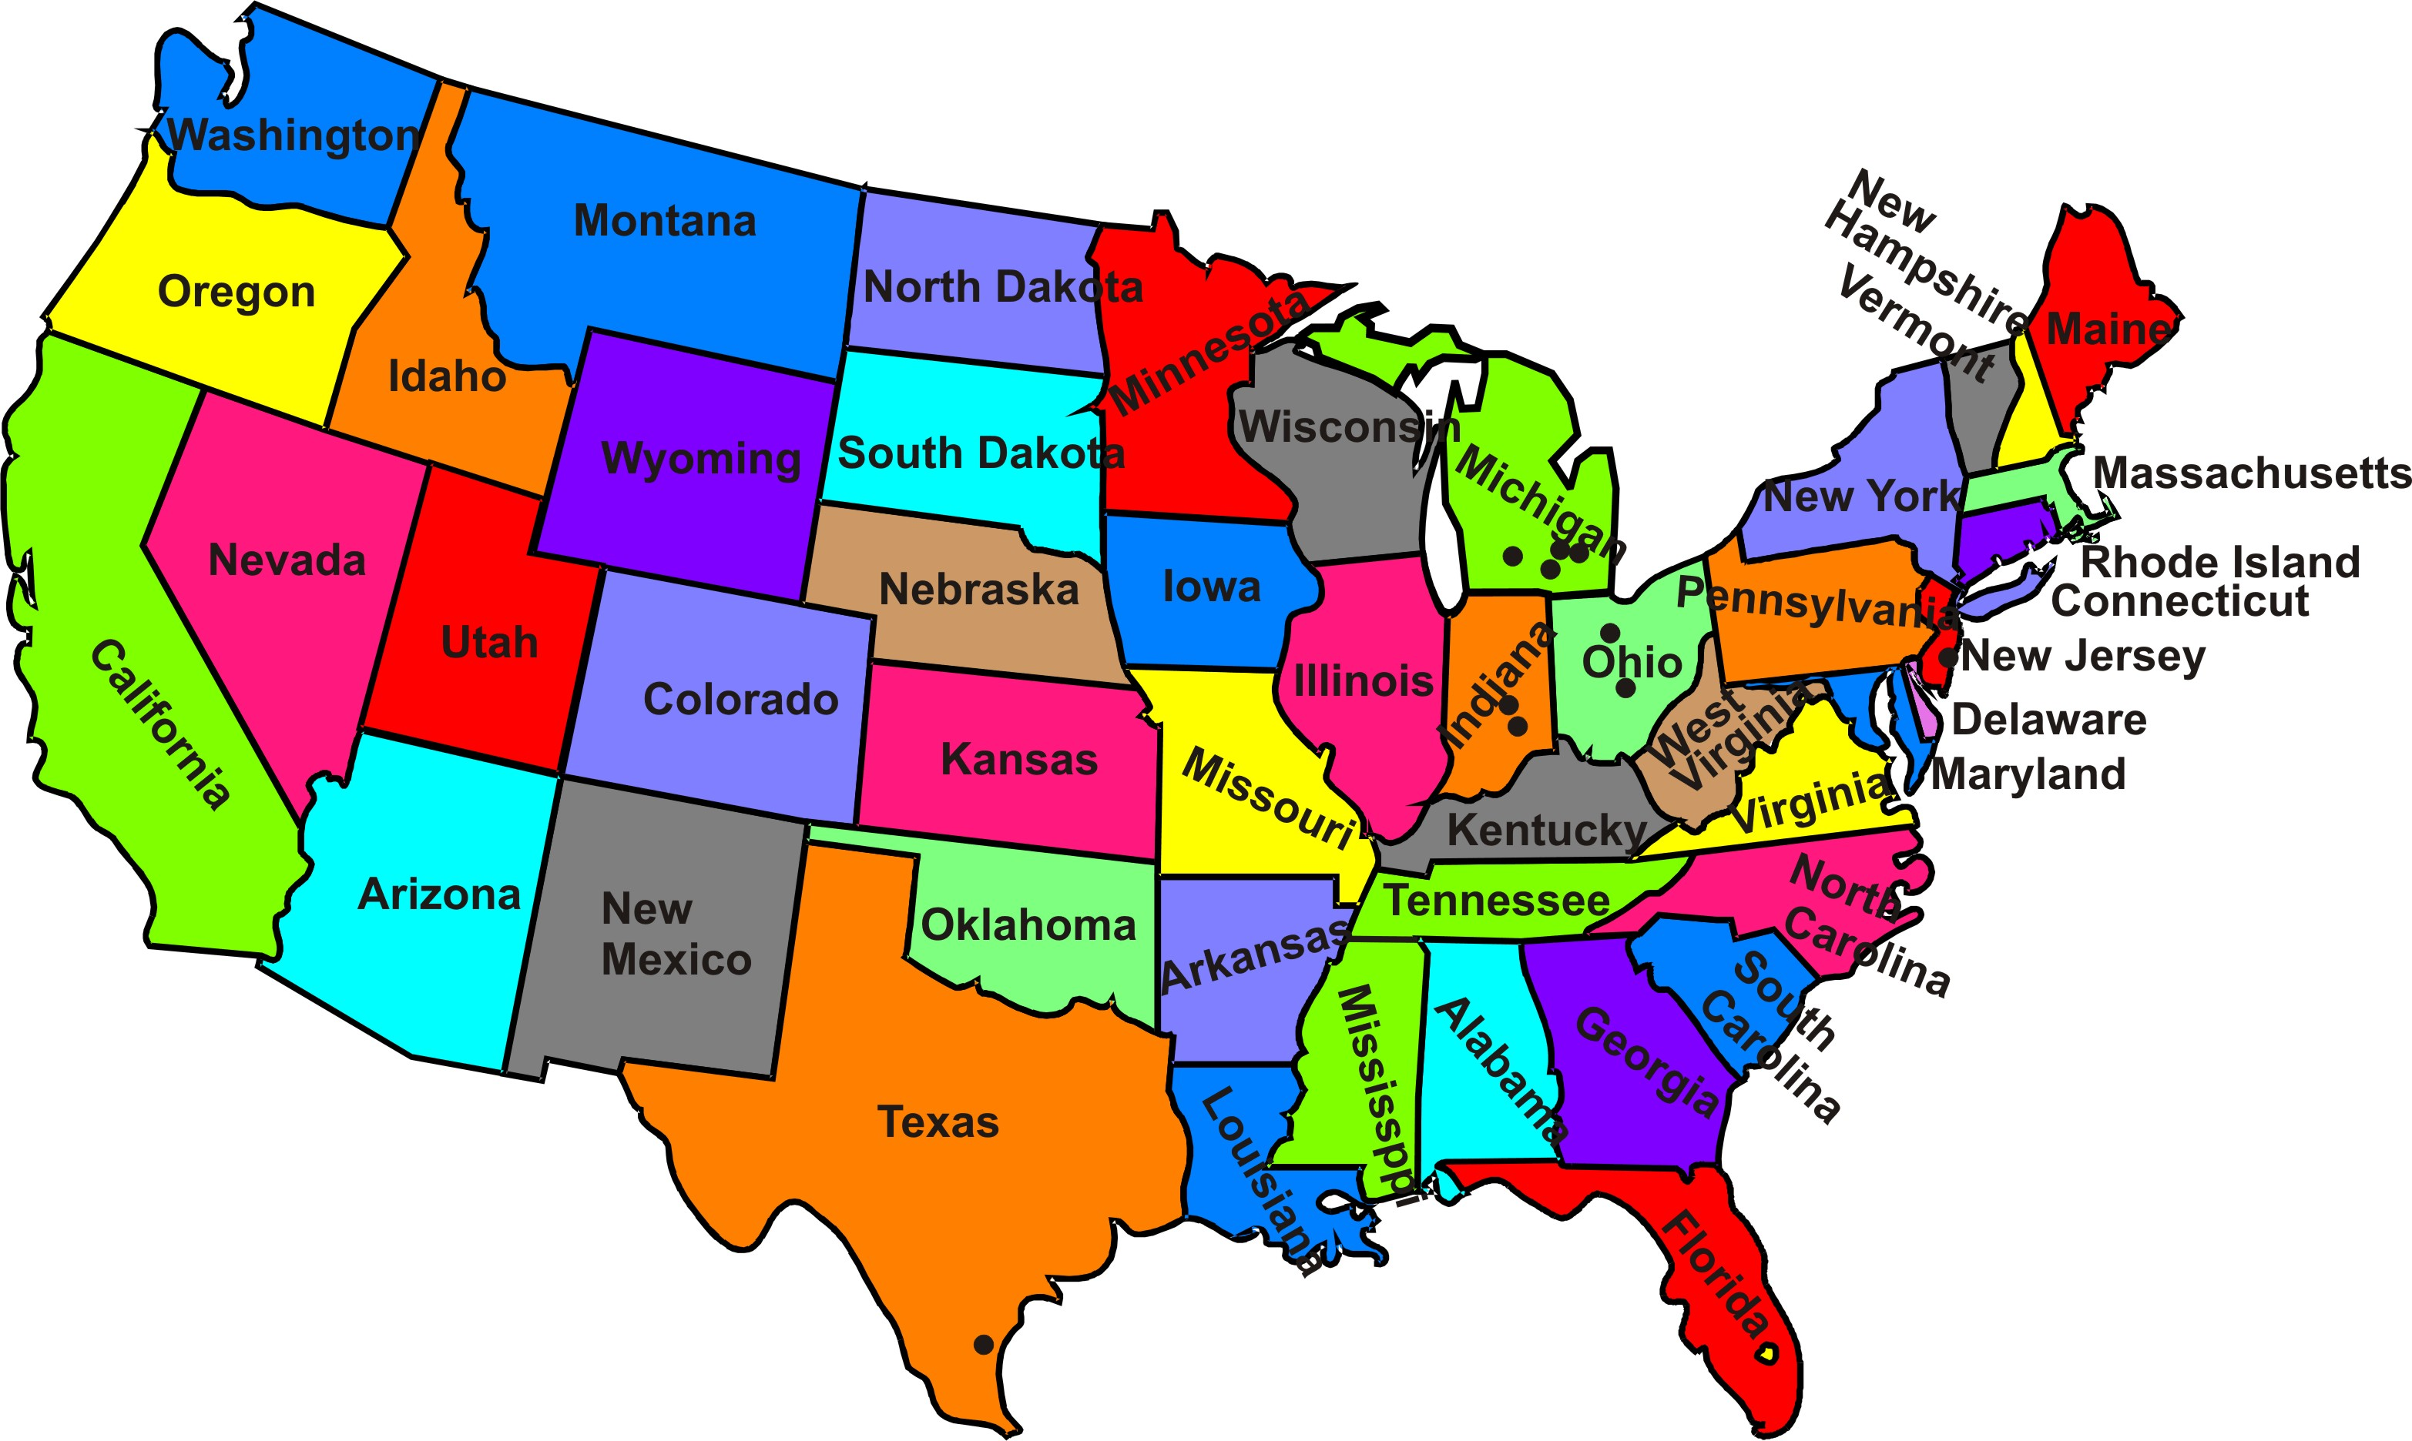
LADEE Travelling Road Show (TRS)
Early EDU Integration
At Payload Sites
Before ICDs finalized
Ensure H/W S/W compatibility
Lend EDU/SDU’s
To Payload Teams
Remote S/W Updates

Slide 7
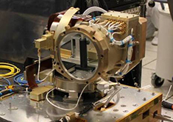
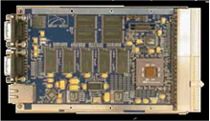
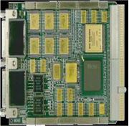
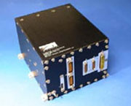
LADEE LLST H/W I/F
LVDH High Speed FSW Telemetry
LADEE
Avionics Interface Board
(FPGA Programmable)
cPCI
Optical Module
Cmds
&
Tlm
Optical Link
LADEE CPU Rad750
RS422 CE I/F
Lasercom Control Electronics (CE)

Slide 8
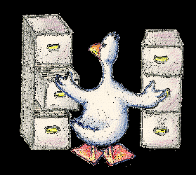
LLST Control Electronics (CE) I/F
CCSDS cFE-compatible packets
Over serial interface (RS422)
Commands Passed directly to CE
from cFE Software Bus
Telemetry from CE
Published directly to FSW cFE Software Bus
1/Sec Attitude / Time Message
State Estimator S/W Bus Message
Adapted and sent to LLST CE
Files transfers
Between FSW and CE via CFDP
Goddard-provided CFDP engine
Common code used in LADEE FSW and LLCD CE
cFE wrapper in LADEE FSW
Custom wrapper in LLCD CE Software
Usage
Uplinked Ephemeris Files

Slide 9
HWIO Apps in FSW Architecture
OFSW
Command
& Mode
Processor
Actuator
Manager
State
Estimator
Safe Mode
Controller
Attitude
Control
System
Thermal
Control
System
Power
Control
System
Battery
Charge
System
Software Bus
HWIO APPS
RWIO, STIO, IMUIO, ADIO,
CMDIO (CI), TLMIO (TO)
Payloads:
LDEXIO, UVSIO, NMSIO, LLCDIO,
HLLCDIO
Device Drivers
KEY
Data to/from
Devices Over
Device Transports (i.e. RS422, LVDS, etc.)
FSW Internal
Simulink
Task
cFS
Task
Hand
Written
Task
FSW External

Slide 10
LLST LADEE FSW High-Speed Interface
40 Megabits / Second
192 byte frames
Hardware generated footer
Sequence Count and Checksum
4 wire physical interface
3 Transmit Wires
Clock, Data, FrameValidLine
1 Receive Wire
ReadyLine for Flow Control

Slide 11
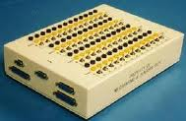
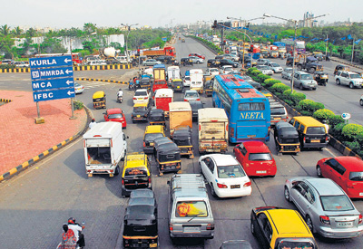
Filling the Bandwidth
Initial TRS Test with prototype FPGA
H/W protocol demonstrated
Discrepancies worked around with Break-out-Box (BOB)
All of CPU devoted to feeding lasercom tlm
cPCI Bottleneck between CPU and Interface Board
Full bandwidth barely achieved
FSW Design Constraints
Maximize FSW data fed to Lasercom I/F
Minimize real-time cPCI traffic
Minimize CPU utilization

Slide 12
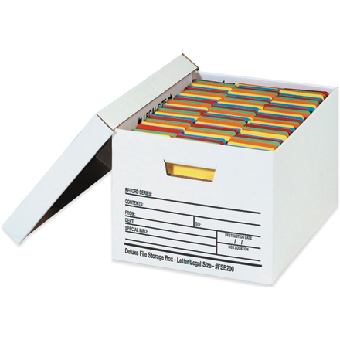
LADEE Telemetry Data Storage
cFE Data Storage Files
Downlink via R/F
cfdp type 2 (reliable: retransmits missed chunks)
1 GB of SDRAM Mass Storage
Formatted into DOS partitions
Accessible over cPCI bus by CPU
CFDP over FSW lasercom I/F?
No FSW lasercom uplink
Could only do cfdp type 1 (un-reliable: send and forget)
Requires multiple cPCI accesses
Retrieval of files for chunking
Transmitting chunks to lasercom I/F
Requires non-trivial CPU utilization

Slide 13
Final Lasercom I/F Design
FPGA transmits Memory Dump chunks
Takes Flash Mass Storage Start, Stop Addresses as input
Dumps all memory between Start and Stop Addresses
CPU interrupted when full Transmission completes
Lasercom Device Driver (on CPU)
Only cPCI access is writing Start/Stop addresses
Restarts transmission if looping flag set
Ground Commands
Set Start, Stop Addresses
Set/Unset looping flags
Workstation (linux) Post Processing
FPGA (H/W) headers processed and stripped
Binary data written to file
File mounted on workstation as a dos partition
All files and directories accessible

Slide 14
Operational Use
All Stored Telemetry Files downlinked in < 5 minutes
1 GB divided into 5 partitions
Test data Partition
13 megabytes allocated and filled
20 distinct files generated from small samples
FSW SOH Partition
Data useful for analyzing EDAC memory error
Science Partitions
LLCD Control Electronics Telemetry Useful
Other Science Data not fully populated
May run Lasercom again before mission end

Slide 15
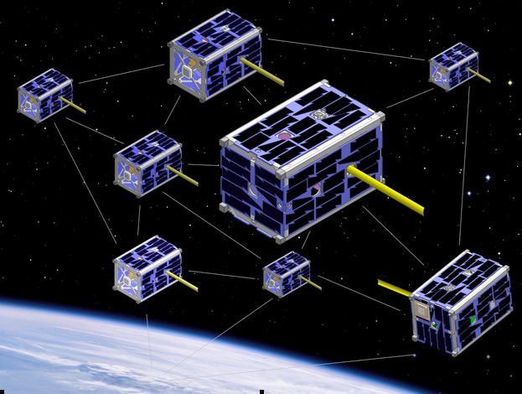
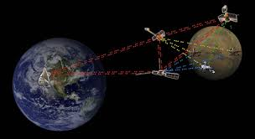
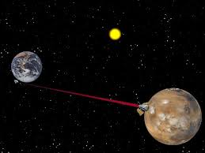
Future Implications
Satellite Swarm Telemetry
Simultaneous readings from many cubesats
Sent to Mass Storage Lasercom Relay Node
Lasercom Node organizes Swarm Data as file system
Entire swarm state downlinked instantly
Mounted as a directory of files on Ground
Delay-Tolerant Networking (DTN)
Store data on Lasercom Nodes
Forward data in massive blobs
Interplanetary Lasercom

