Slide 1
Next Generation of Spaceflight Processors: Low Power, High Performance, with Integrated SpaceWire Router and Protocol Engines
Steve Parkes, Chris McClements,
STAR-Dundee Ltd, UK
Guy Mantelet, Nicolas Ganry
Atmel Aerospace, France

Slide 2
Overview
SpaceWire
STAR-Dundee
Castor Overview
Castor Capabilities
Castor Applications

Slide 3
SpaceWire
Computer network technology for spacecraft
SpaceWire
Connects together data-handling elements onboard a spacecraft:
Instruments
Processors
Mass memory
Telemetry and Telecommand
Standard interface
Simple
Implementation requires few logic gates
High performance
Flexible architecture
Notes:
SpaceWire is a data-handling network technology specifically designed or use onboard spacecraft.
It connects together instruments, processors, mass memory and the telemetry/telecommand subsystem.
SpaceWire provides a standard interface between all these elements, which simplifies integration and testing of the onboard data-handling system.
Instruments and other units designed with SpaceWire interfaces are easy to reuse on other spacecraft,
The SpaceWire standard was written by the University of Dundee with input from spacecraft engineers from across Europe.

Slide 4
SpaceWire
SpaceWire standard
Written by University of Dundee
With inputs from international spacecraft engineers
SpaceWire missions
Being used or designed into over 100 spacecraft
Over $15 billion worth of spacecraft rely on it
Scientific, Exploration, Earth observation, Commercial
Dundee SpaceWire technology designed into
USA, European, Japanese and other spacecraft

Slide 6
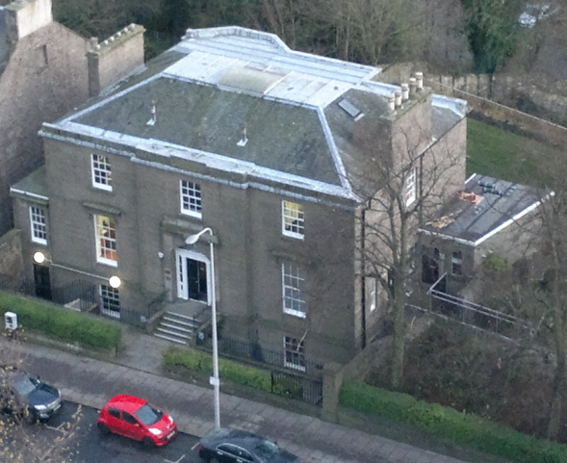
STAR-Dundee
Established Space Technology Company
Incorporated 2002
Supplier to NASA, ESA, JAXA and the global space industry
Based in Dundee, Scotland, UK
Management majority owned
SpaceWire
Leading SpaceWire experts
Developing standards
Highly Technical Staff
50% staff PhD qualified
80% technical R&D
Capabilities
Chip design, electronics, software, SpaceWire networks
All production outsourced to accredited manufacturers
Notes:
Originally a spin-out of Dundeee University.
Self funding.
Profitable form the outset and continue to be every year.
Growing organically.

Slide 7
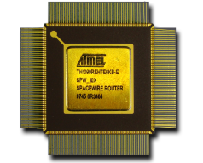
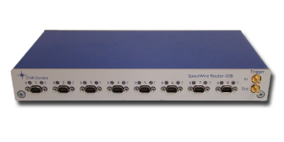
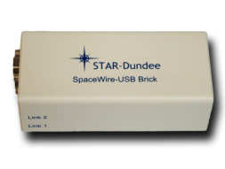
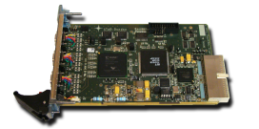
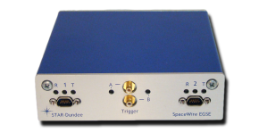
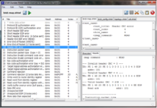
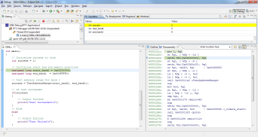
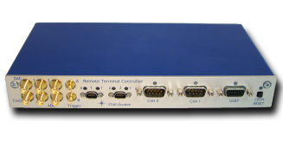
STAR-Dundee Products
IP Cores: VHDL & Flight Ready
CODEC, Router, RMAP Initiator, RMAP Target
Interface & router devices
USB-Brick, Router-USB Mk2
PCI, cPCI, PCIe
Analysis Tools
Link Analyser Mk2, Conformance Tester, IP Tunnel
Real-time Instrument Emulator / EGSE
Real-time instrument emulation in a day!
Software
Comprehensive software for all devices
LabVIEW Drivers
Flight Chip Development Kits
Router Development Kit (AT7910E)
RTC Development Kit (SPARCv8 based AT7913E)
Notes:
IP cores and cover everything needed to design, develop, integrate and test SpaceWire sub-systems

Slide 8
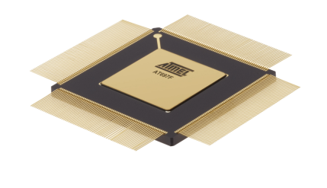
Castor Overview
Complete system on chip for spaceflight
Powerful processor core
IEEE 754 Floating-Point Unit
Memory Management Unit
Substantial on-chip memory
Interfaces to external memory
SpaceWire router
SpaceWire protocol engines
MILSTD 1553 interface
CAN and many more peripheral interfaces
Atmel AT6981 Castor
90 nm technology
Low-power, high-performance
Radiation tolerant

Slide 9
AT6981 Castor Architecture
Debug Port
Switch
Matrix
Debug SpW
SPARC V8
SpW
Router
SpW Engine
SpaceWire
I-Cache
D-Cache
SpW Engine
SpW Engine
Internal RAM 1
Internal RAM 2
Configuration Registers
RMAP/PnP Bus
Internal RAM 3
APB Bridge
Internal RAM 4
CAN
CAN
Mil Std 1553
Mil Std 1553
External Memory Interface:
PROM, SRAM, SDRAM, DDRx
Ethernet
Ethernet
Peripheral
Peripheral
Interfaces

Slide 10
AT6981 Castor Processor
Debug Port
Switch
Matrix
Debug SpW
SPARC V8
SpW
Router
SpW Engine
SpaceWire
I-Cache
D-Cache
SpW Engine
SpW Engine
Internal RAM 1
Internal RAM 2
Configuration Registers
RMAP/PnP Bus
Internal RAM 3
APB Bridge
Internal RAM 4
CAN
CAN
Mil Std 1553
Mil Std 1553
External Memory Interface:
PROM, SRAM, SDRAM, DDRx
Ethernet
Ethernet
Peripheral
Peripheral
Interfaces

Slide 11
Processor
SPARC® V8, LEON-FT Core
32-bit architecture
5 stage pipeline
8 register windows
Tightly coupled instruction and data cache
32 kbyte multi-set instruction cache
32 kbyte multi-set data cache
Integrated MMU with 32 table entries
Integrated IEEE 754 Floating-Point Unit
32-bit single and 64-bit double precision
High processing power:
>150 MIPS Dhrystone 2.1
> 40 MFLOPS Whetstone
Advanced High-performance Bus (AHB)

Slide 12
AT6981 Castor H-Matrix
Debug Port
Switch
Matrix
Debug SpW
SPARC V8
SpW
Router
SpW Engine
SpaceWire
I-Cache
D-Cache
SpW Engine
SpW Engine
Internal RAM 1
Internal RAM 2
Configuration Registers
RMAP/PnP Bus
Internal RAM 3
APB Bridge
Internal RAM 4
CAN
CAN
Mil Std 1553
Mil Std 1553
External Memory Interface:
PROM, SRAM, SDRAM, DDRx
Ethernet
Ethernet
Peripheral
Peripheral
Interfaces

Slide 13
Interconnection Switch Matrix
Multiple AHB master and slave interfaces
Dynamically connects masters to slaves
Concurrently
Provided that no two masters access the same slave
Prevented by arbitration mechanism
Masters
Processors
DMA controllers
Slaves
Memory
IO

Slide 14
AT6981 Castor Memory
Debug Port
Switch
Matrix
Debug SpW
SPARC V8
SpW
Router
SpW Engine
SpaceWire
I-Cache
D-Cache
SpW Engine
SpW Engine
Internal RAM 1
Internal RAM 2
Configuration Registers
RMAP/PnP Bus
Internal RAM 3
APB Bridge
Internal RAM 4
CAN
CAN
Mil Std 1553
Mil Std 1553
External Memory Interface:
PROM, SRAM, SDRAM, DDRx
Ethernet
Ethernet
Peripheral
Peripheral
Interfaces

Slide 15
Memory
Internal Memory
Several banks
Each separate slave on Interconnection Switch Matrix
Total internal memory 1 Mbyte (TBC)
EDAC protected
External Memory Interface
PROM
SRAM
SDRAM
DDRx
EDAC protection for external memories if required

Slide 16
AT6981 Castor SpaceWire
Debug Port
Switch
Matrix
Debug SpW
SPARC V8
SpW
Router
SpW Engine
SpaceWire
I-Cache
D-Cache
SpW Engine
SpW Engine
Internal RAM 1
Internal RAM 2
Configuration Registers
RMAP/PnP Bus
Internal RAM 3
APB Bridge
Internal RAM 4
CAN
CAN
Mil Std 1553
Mil Std 1553
External Memory Interface:
PROM, SRAM, SDRAM, DDRx
Ethernet
Ethernet
Peripheral
Peripheral
Interfaces

Slide 17
SpaceWire Engines
Offloads processor from SpW comms
SpaceWire Remote Memory Access (RMAP)
RMAP Target
Memory region or software based authorisation
RMAP Initiator
Automatic initiation of multiple commands
DMA
3x TX and 3x RX channels
Protocol Multiplexer
Detects SpaceWire or user protocol
Multiplexes received data accordingly
Time-Code Controller
Regular and custom time-codes plus signalling codes

Slide 18
Write Command
First byte transmitted
Destination Logical Address
Protocol Identifier
Packet Type, Command
Destination Key
Source Logical Address
Transaction Identifier
Transaction Identifier
Extended Write Address
Write Address (MS)
Write Address
Write Address
Write Address (LS)
Data Length (MS)
Data Length
Data Length (LS)
Header CRC
Data
Data
Data
Data
Data
Data
Data
Data
Data
Data CRC
EOP
Last byte transmitted
Above format is when using SpaceWire Logical Addressing

Slide 19
Write Operation
RMAP
Source
RMAP
Destination
Write Request
Write
Command
Write Data
Request
USER
APPLICATION
USER
APPLICATION
Write Data
Authorisation
Write Data
Write
Reply
Write Data
Indication
Write Complete
Confirmation
SpaceWire
Network

Slide 20
Write Reply
First byte transmitted
Source Logical Address
Protocol Identifier
Packet Type, Command
Status
Destination Logical Address
Transaction Identifier
Transaction Identifier
Reply CRC
EOP
Last byte transmitted
Above format is when using SpaceWire Logical Addressing

Slide 21
SpaceWire Engines
Offloads processor from SpW comms
SpaceWire Remote Memory Access (RMAP)
RMAP Target
Memory region or software based authorisation
RMAP Initiator
Automatic initiation of multiple commands
DMA
3x TX and 3x RX channels
Protocol Multiplexer
Detects SpaceWire or user protocol
Multiplexes received data accordingly
Time-Code Controller
Regular and custom time-codes plus signalling codes

Slide 22
AT6981 Castor SpaceWire
SpW
Router
SpaceWire Engine 3
SpaceWire Engine 2
Protocol
Multiplexer
RMAP Target
AHB
Interface
SpaceWire
RMAP Initiator
AHB
DMA Channel (x3)
DMA Channel (x3)
DMA Channel (x3)
SpaceWire Engine 1

Slide 23
AT6981 Castor Peripherals
Debug Port
Switch
Matrix
Debug SpW
SPARC V8
SpW
Router
SpW Engine
SpaceWire
I-Cache
D-Cache
SpW Engine
SpW Engine
Internal RAM 1
Internal RAM 2
Configuration Registers
RMAP/PnP Bus
Internal RAM 3
APB Bridge
Internal RAM 4
CAN
CAN
Mil Std 1553
Mil Std 1553
External Memory Interface:
PROM, SRAM, SDRAM, DDRx
Ethernet
Ethernet
Peripheral
Peripheral
Interfaces

Slide 24
Peripherals
Redundant pair of MILSTD 1553 interfaces
Bus controller
Or Remote Terminal
DMA controller
Redundant pair of CAN Bus interfaces v2.0
15 channels
DMA controller
Ethernet
Lower speed peripherals
SPI Serial Peripheral interface
TWI Two wire interface (also called I2C)
UART
ADC & DAC interfaces
Pulse width modulation
GPIO

Slide 25
Peripherals
AHB Interconnection Switch Matrix
Peripheral Bridge
APB
DMA
Timer
Watchdog
DMA
SPI
ADC
System Control
PMC
INT
PIO
RESET
DMA
DMA
TWI
DAC
DMA
UART
PWM

Slide 26
AT6981 Castor Debug
Debug Port
Switch
Matrix
Debug SpW
SPARC V8
SpW
Router
SpW Engine
SpaceWire
I-Cache
D-Cache
SpW Engine
SpW Engine
Internal RAM 1
Internal RAM 2
Configuration Registers
RMAP/PnP Bus
Internal RAM 3
APB Bridge
Internal RAM 4
CAN
CAN
Mil Std 1553
Mil Std 1553
External Memory Interface:
PROM, SRAM, SDRAM, DDRx
Ethernet
Ethernet
Peripheral
Peripheral
Interfaces

Slide 27
Debug and Test
Comprehensive debug support
Debug support unit
Breakpoints
Single stepping
Register and memory access
Trace memory
Hardware watch-points
Accessible via
JTAG
Debug UART
Debug SpaceWire (high-speed debug)

Slide 28
AT6981 Castor Characteristics
Operating Temperature Range
-55ºC to +125ºC (Tj max 145ºC)
Radiation Tolerance
Total dose 300 Krads (Si)
SEU error rate < 10⁻⁵ errors/device/day
No SE latch-up below LET threshold of 70 MeV.cm²/mg
Low Power Consumption
Dedicated mechanisms for adapting power consumption
To level of processing performance
Programmable clock for each major function
Dedicate reset for each major function
Estimated core power
Core operating current target 5mA/MHz

Slide 29
Software Development Environment
SDE from STAR-Dundee
Code Rocket
Code Visulation, Design & Documentation
Eclipse Development Platform
C / C++ Language Module (CDT)
SSDE
Plugins
GNU Compiler Collection (GCC)
STARGate
Target Development Hardware

Slide 30
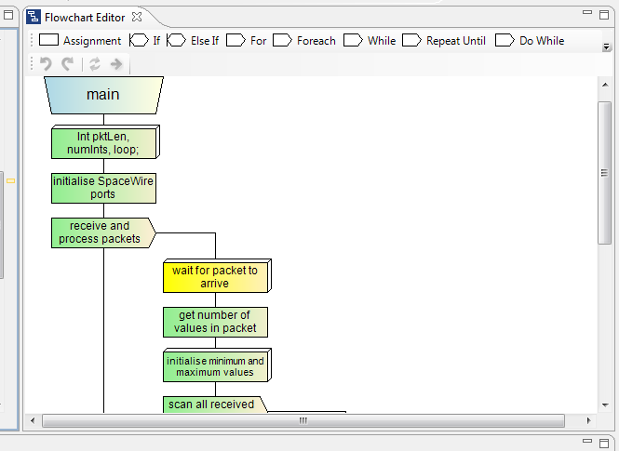
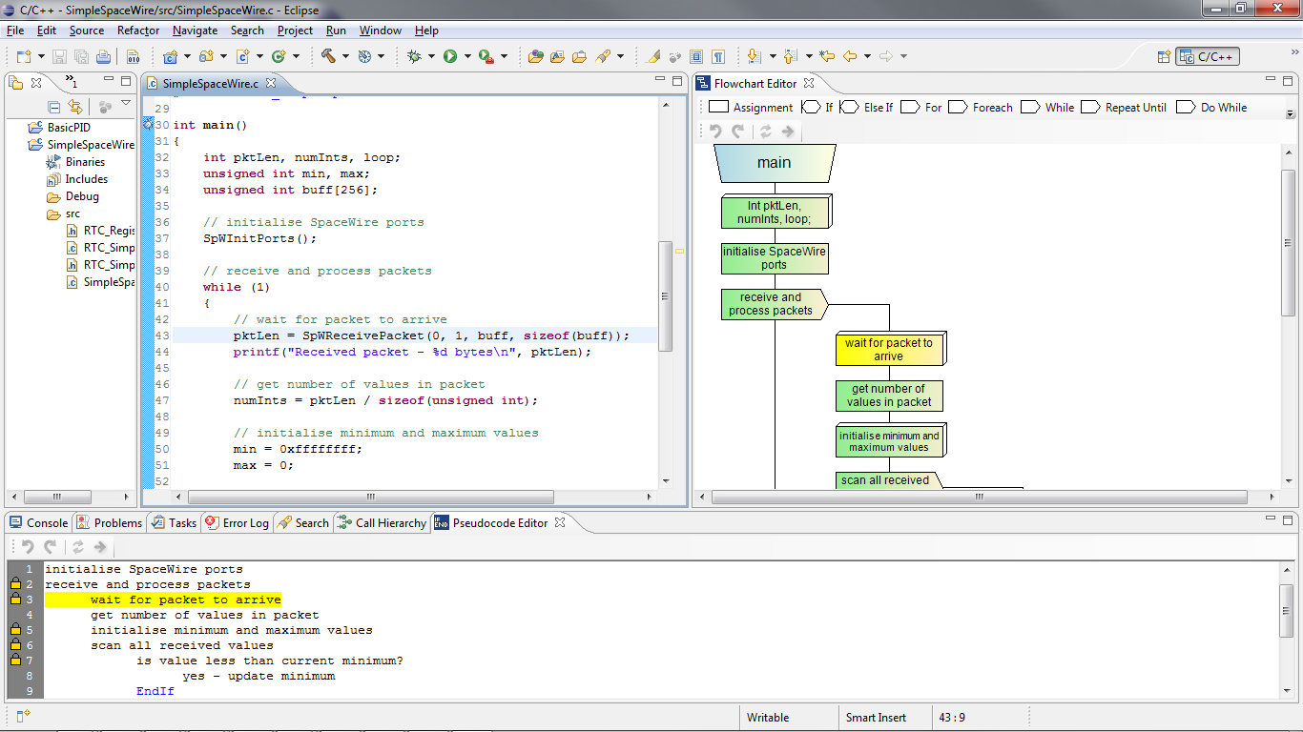
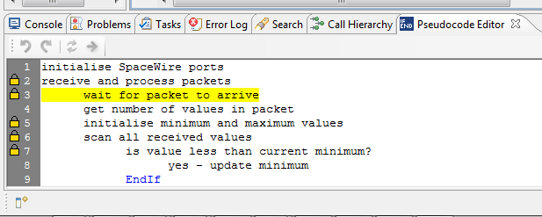
Code Rocket

Slide 31
Code Rocket Design Views
Changes made to design reflected in code

Slide 32
Code Rocket Design Views
Changes made to code reflected in design

Slide 33
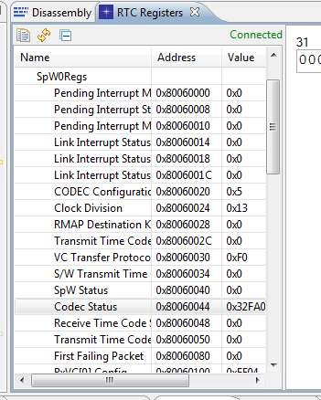
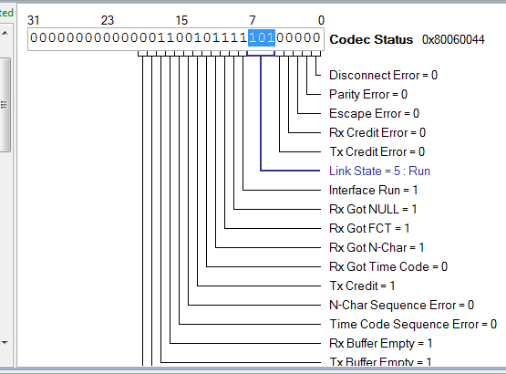
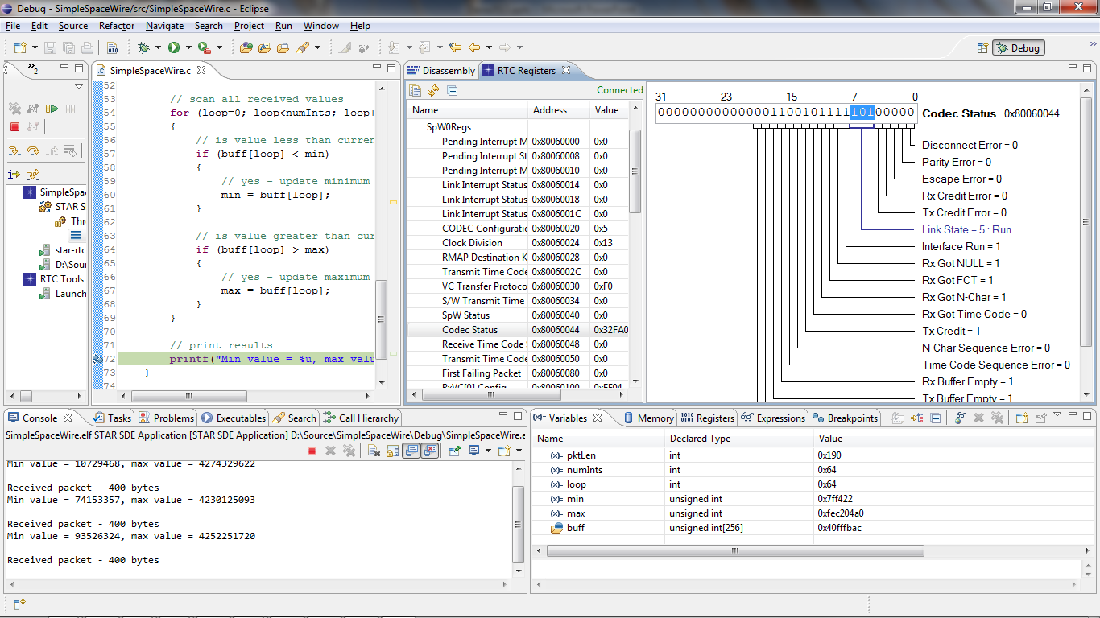
Target-Specific Debug Views
Device registers (showing AT7913 registers)

Slide 34
Spaceflight Applications
Data Compression
High processing power
>150 MIPS
>40 MFLOPS
On-chip memory
Interfaces to Spacecraft networks.
Instrument
Instrument
Processing
Low power consumption
Plenty of processing capability
On-chip memory
On-chip peripherals
ADC & DAC interfaces
Interfaces to Spacecraft networks
SpaceWire RMAP Target
SpaceWire & MILSTD 1553 I/F
On-chip memory for command buffering
On-chip SpaceWire router
SpaceWire engines with DMA to off-load processor from command distribution
Instrument
Mass Memory
Instrument
Payload Telemetry
Encoding
Housekeeping
Processing
SpaceWire RMAP Initiator
Able to send repeated commands and gather replies without processor intervention
Perfect for gathering housekeeping data over SpaceWire network
HK Telemetry
Encoding
Communications
Payload Control
Processing
Telecommand
Decoding
Single and double precision floating-point
Interfaces suitable for most AOCS sensors
Pulse Width Modulation
AOCS
Sensors
AOCS
Processing
AOCS
Actuators

Slide 35
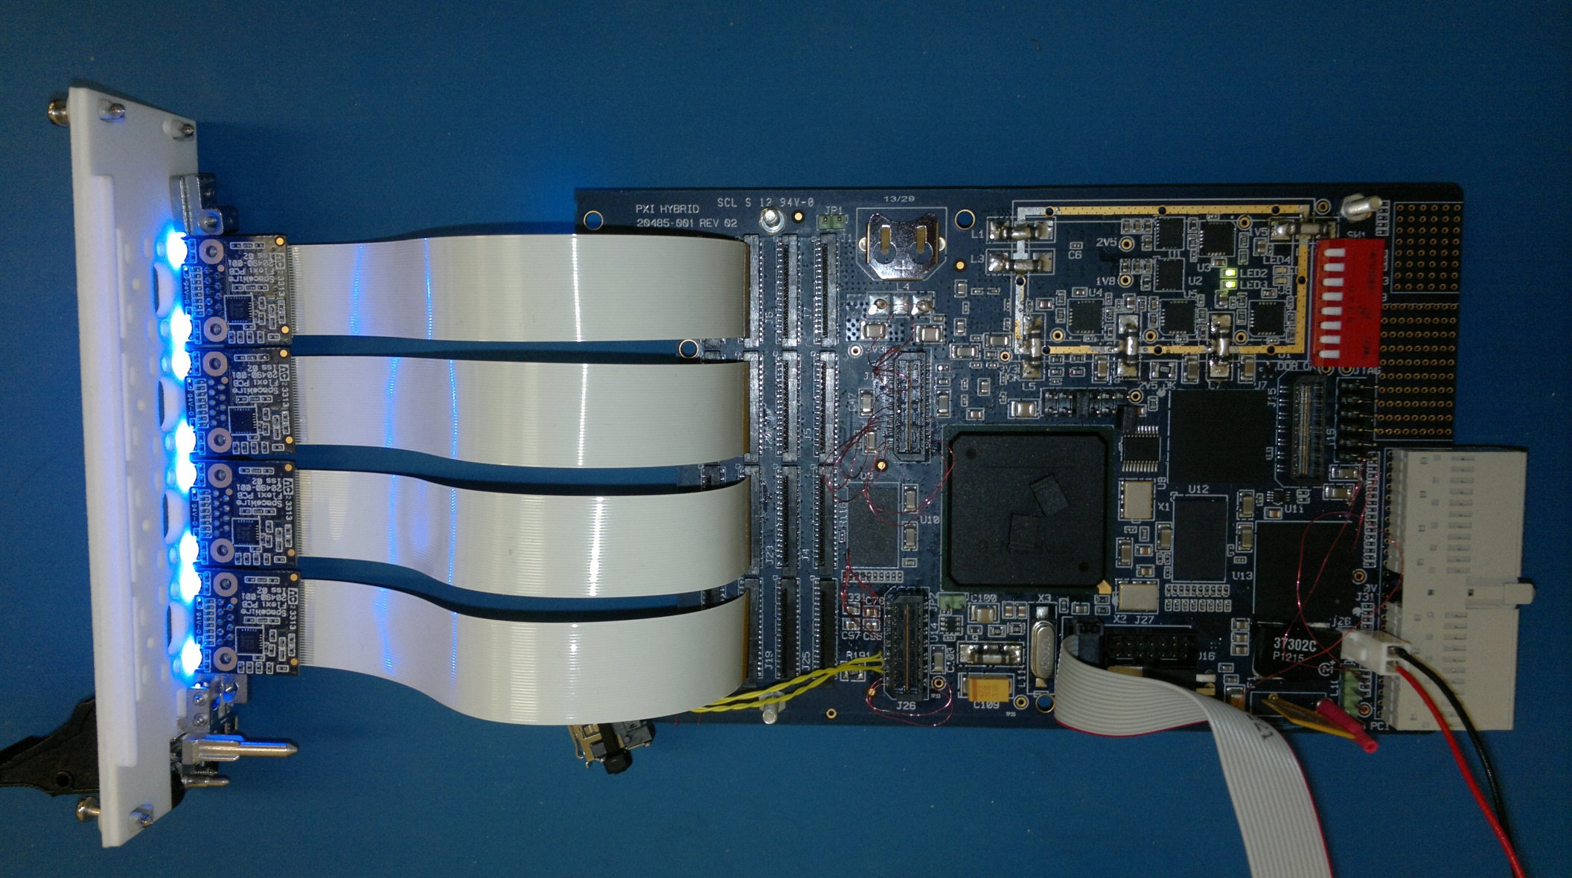
AT6981 Castor Prototype
Photo of PXI Board

Slide 36
Conclusions
Atmel AT6981 Castor
Highly capable processing system on-chip
Low power
High performance
Substantial on-chip memory
Extensive set of on-chip peripherals
SpaceWire router and protocol engines
Designed for spaceflight applications
Current status
Design frozen, functional validation ongoing
Evaluation kit available 1Q14
SDE from STAR incorporating Code Rocket technology

