Slide 1
SpaceWire EGSE: Real-Time Simulation of SpaceWire Instruments in a Day
Stephen Mudie, Steve Parkes, Martin Dunstan
Notes:
Introduce yourself and the EGSE.

Slide 2
SpaceWire EGSE
What is SpaceWire EGSE:
SpaceWire test and development unit developed by STAR-Dundee
Purpose:
Rapidly emulate instruments or other SpaceWire equipment
In real-time for test and integration
Generates user defined packets
In pre-defined sequences at specific times and data rates
E.g. packet 1 followed 10ms later by packet 2 at 100Mbps
Notes:
EGSE description. Expand on purpose.

Slide 3
SpaceWire EGSE
SpW
Mass
Memory
Camera
Notes:
EGSE description. Expand on purpose.

Slide 4
SpaceWire EGSE
EGSE
(simulating camera)
SpW
Mass
Memory
Notes:
EGSE description. Expand on purpose.

Slide 5
SpaceWire EGSE
How it works:
User defines instrument behaviour in a script
Software used to compile script and load resulting configuration file into EGSE unit
Hardware functions independent of software resulting in real-time performance
Benefits:
Reduce time and costs associated with traditional EGSE development
All real-time behaviour is handled by hardware
Notes:
An alternative to traditional EGSE development requiring a SpW interface card, software engineer, real-time operation system and significant development time. Reduce time and costs associated with traditional EGSE development

Slide 6
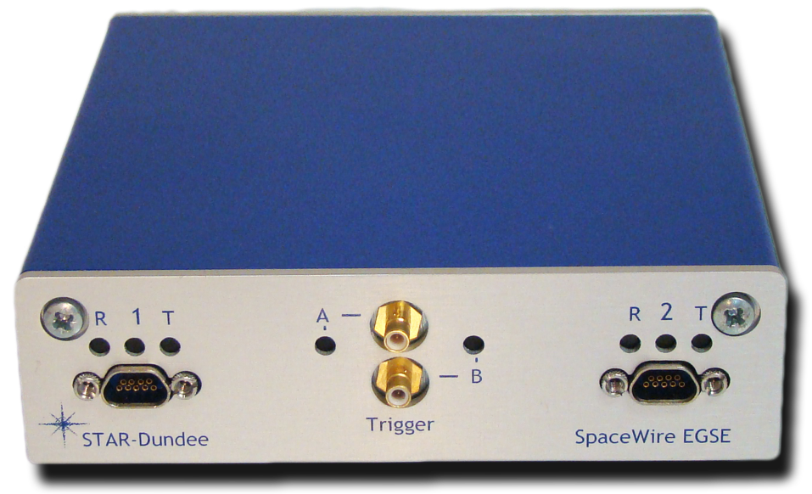
SpaceWire EGSE Hardware
2 SpaceWire interfaces
4 external triggers (3 IN, 1 OUT)
128MB memory
2 Mictor logic analyser connectors
USB connection to host PC
Indicator LEDs
Notes:
Hardware description.
2 SpW interfaces: tx and rx SpW traffic
4 ext triggers: interfacing with ext equipment
128MB memory: stores packet definitions
2 mictors: show device state
Indicator LEDs: status of SpW interfaces, ext triggers and USB port

Slide 7
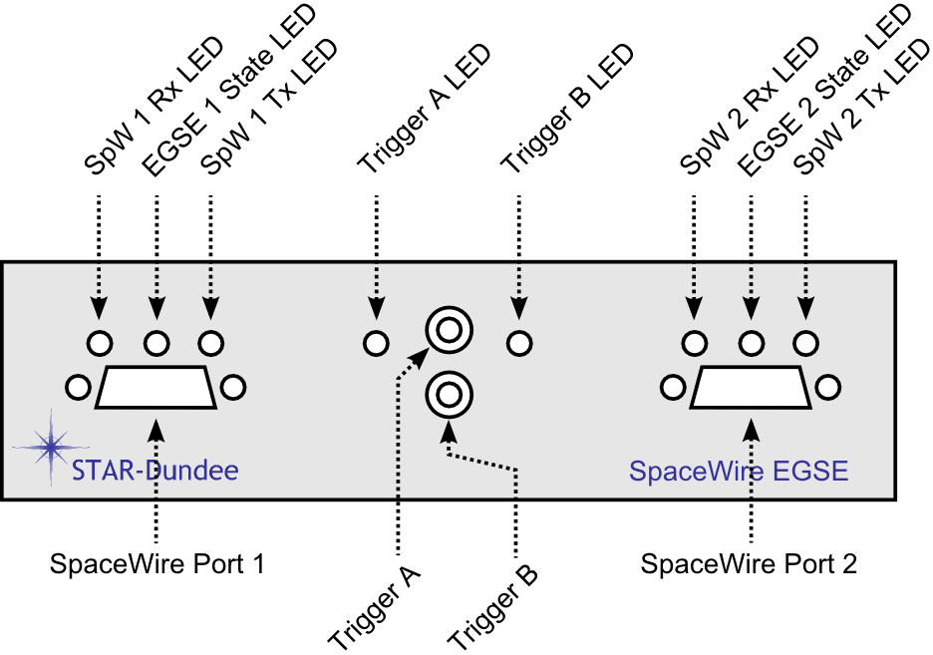
SpaceWire EGSE Front Panel

Slide 8
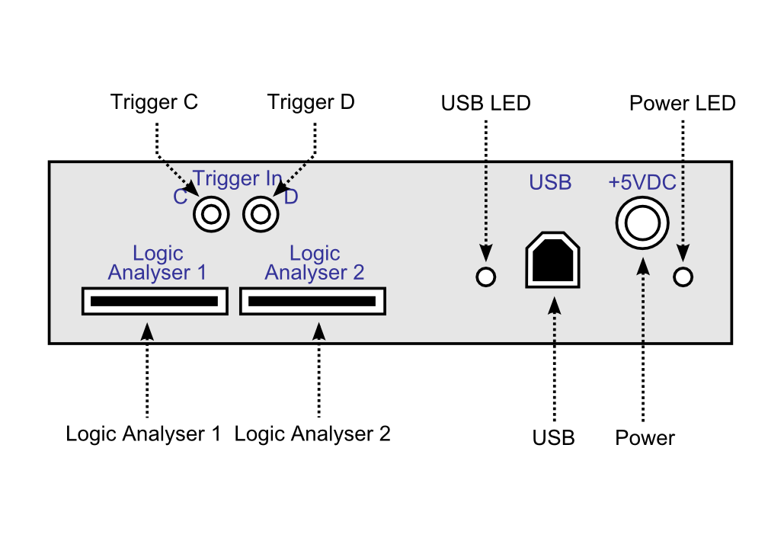
SpaceWire EGSE Rear Panel

Slide 9
SpaceWire EGSE Software
Compiler
Compiles scripts into EGSE configuration files
Loader
Loads EGSE configuration files onto hardware
Software API
Create custom applications to control and interact with the EGSE
GUI
Combines a text editor with most of the functions provided by the compiler, loader and API
Notes:
Software description.

Slide 10
SpaceWire EGSE Software GUI
Notes:
Text editor
Compile + load toolbar buttons
Generate software events
View EGSE notifications
Time-code management

Slide 11
SpaceWire EGSE Scripting Language
Packet Definitions
Variables
Used to define packets with dynamic data
Packet Generation Schedules
State Machines
Control current packet generation schedule
Events
State machine reacts to events, controlling the packet generation schedule
Notes:
Mainly consists of:

Slide 12
SpaceWire EGSE: Simple Script
config
spw_tx_rate(1, 200Mbps)
spw_tx_rate(2, 200Mbps)
end config
packet pkt1
dec(1 2 3 4)
eop
end packet
schedule schedule1 @ 100Mbps
500ms send pkt1
end schedule
statemachine 1
initial state state1
do schedule1 repeatedly
end state
end statemachine
Set line rates to 200Mbit/s

Slide 13
SpaceWire EGSE: Simple Script
config
spw_tx_rate(1, 200Mbps)
spw_tx_rate(2, 200Mbps)
end config
packet pkt1
dec(1 2 3 4)
eop
end packet
schedule schedule1 @ 100Mbps
500ms send pkt1
end schedule
statemachine 1
initial state state1
do schedule1 repeatedly
end state
end statemachine
Define packet named “pkt1” with 4 decimal bytes followed by EOP

Slide 14
SpaceWire EGSE: Simple Script
config
spw_tx_rate(1, 200Mbps)
spw_tx_rate(2, 200Mbps)
end config
packet pkt1
dec(1 2 3 4)
eop
end packet
schedule schedule1 @ 100Mbps
500ms send pkt1
end schedule
statemachine 1
initial state state1
do schedule1 repeatedly
end state
end statemachine
Define schedule named “schedule1” that sends “pkt1” after 500ms at 100Mbit/s

Slide 15
SpaceWire EGSE: Simple Script
config
spw_tx_rate(1, 200Mbps)
spw_tx_rate(2, 200Mbps)
end config
packet pkt1
dec(1 2 3 4)
eop
end packet
schedule schedule1 @ 100Mbps
500ms send pkt1
end schedule
statemachine 1
initial state state1
do schedule1 repeatedly
end state
end statemachine
SpW link 1 state machine has a single state that executes “schedule1” repeatedly

Slide 16
SpaceWire EGSE: Simple Script
Notes:
Data is 1,2,3,4
Link speed is 200Mbits/s
500ms between the transmission of each packet

Slide 17
SpaceWire EGSE: Simple Script
Notes:
Data is 1,2,3,4
Link speed is 200Mbits/s
500ms between the transmission of each packet

Slide 18
SpaceWire EGSE: Simple Script
500ms
500ms
500ms
Notes:
Data is 1,2,3,4
Link speed is 200Mbits/s
500ms between the transmission of each packet

Slide 19
SpaceWire EGSE: Variables Script
variables
random = rnd08()
header = int08(2)
id = inc08(0)
crc = crc08()
end variables
packet pkt1
start(crc)
header
id
random * 8
stop(crc)
crc
eop
end packet
schedule schedule1 @ 100Mbps
500ms send pkt1
end schedule
statemachine 1
initial state state1
do schedule1 repeatedly
end state
end statemachine
Declare random variable

Slide 20
SpaceWire EGSE: Variables Script
variables
random = rnd08()
header = int08(2)
id = inc08(0)
crc = crc08()
end variables
packet pkt1
start(crc)
header
id
random * 8
stop(crc)
crc
eop
end packet
schedule schedule1 @ 100Mbps
500ms send pkt1
end schedule
statemachine 1
initial state state1
do schedule1 repeatedly
end state
end statemachine
Declare constant variable value 2

Slide 21
SpaceWire EGSE: Variables Script
variables
random = rnd08()
header = int08(2)
id = inc08(0)
crc = crc08()
end variables
packet pkt1
start(crc)
header
id
random * 8
stop(crc)
crc
eop
end packet
schedule schedule1 @ 100Mbps
500ms send pkt1
end schedule
statemachine 1
initial state state1
do schedule1 repeatedly
end state
end statemachine
Declare incrementing variable value 0

Slide 22
SpaceWire EGSE: Variables Script
variables
random = rnd08()
header = int08(2)
id = inc08(0)
crc = crc08()
end variables
packet pkt1
start(crc)
header
id
random * 8
stop(crc)
crc
eop
end packet
schedule schedule1 @ 100Mbps
500ms send pkt1
end schedule
statemachine 1
initial state state1
do schedule1 repeatedly
end state
end statemachine
Declare CRC variable

Slide 23
SpaceWire EGSE: Variables Script
variables
random = rnd08()
header = int08(2)
id = inc08(0)
crc = crc08()
end variables
packet pkt1
start(crc)
header
id
random * 8
stop(crc)
crc
eop
end packet
schedule schedule1 @ 100Mbps
500ms send pkt1
end schedule
statemachine 1
initial state state1
do schedule1 repeatedly
end state
end statemachine
Define packet
named “pkt1”:
Constant header
Incrementing ID
8 random bytes
CRC calculation

Slide 24
SpaceWire EGSE: Variables Script

Slide 25
SpaceWire EGSE: Variables Script
Constant
header

Slide 26
SpaceWire EGSE: Variables Script
Incrementing
ID

Slide 27
SpaceWire EGSE: Variables Script
Random
bytes

Slide 28
SpaceWire EGSE: Variables Script
CRC

Slide 29
SpaceWire EGSE: Schedules Script
packet pkt1
hex(11 11 11 11)
eop
end packet
packet pkt2
hex(22 22 22 22)
eop
end packet
packet pkt3
hex(33 33 33 33)
eop
end packet
Define 3 packets named “pkt1”, “pkt2” and “pkt3” each with unique data.

Slide 30
SpaceWire EGSE: Schedules Script
“schedule1” sends “pkt1” 5 times, 1s after schedule starts
schedule schedule1
1s send pkt1 * 5
end schedule
schedule schedule2
500ms send pkt1
1000ms send pkt2
1500ms send pkt3
end schedule
schedule schedule3
0ms send pkt3
+1s send pkt2
+1s send pkt1
end schedule

Slide 31
SpaceWire EGSE: Schedules Script
schedule schedule1
1s send pkt1 * 5
end schedule
schedule schedule2
500ms send pkt1
1000ms send pkt2
1500ms send pkt3
end schedule
schedule schedule3
0ms send pkt3
+1s send pkt2
+1s send pkt1
end schedule
“schedule2” sends “pkt1” 500ms, “pkt2” 1000ms and “pkt3” 1500ms after schedule starts

Slide 32
SpaceWire EGSE: Schedules Script
schedule schedule1
1s send pkt1 * 5
end schedule
schedule schedule2
500ms send pkt1
1000ms send pkt2
1500ms send pkt3
end schedule
schedule schedule3
0ms send pkt3
+1s send pkt2
+1s send pkt1
end schedule
“schedule3” sends “pkt3” immediately, “pkt2” 1s after “pkt3” tx begins and “pkt1” 1s after “pkt2” tx begins

Slide 33
SpaceWire EGSE: Schedules Script
“state1” executes “schedule1”once then transitions to “state2”
statemachine 1
initial state state1
do schedule1
goto state2
end state
state state2
do schedule2
goto state3
end state
state state3
do schedule3
goto state1
end state
end statemachine
“state2” executes “schedule2”once then transitions to “state3”
“state3” executes “schedule3”once then transitions to “state1”

Slide 34
SpaceWire EGSE: Schedules Script

Slide 35
SpaceWire EGSE: Schedules Script
schedule1

Slide 36
SpaceWire EGSE: Schedules Script
schedule2

Slide 37
SpaceWire EGSE: Schedules Script
schedule3

Slide 38
SpaceWire EGSE: FSM and Events Script
events
swEvent0 = software_in(0)
end events
statemachine 1
initial state state1
do schedule1
on swEvent0 goto state2
end state
state state2
do schedule2
on swEvent0 goto state3
end state
state state3
do schedule3
on swEvent0 goto state1
end state
end statemachine
Declare software event named “swEvent0”

Slide 39
SpaceWire EGSE: FSM and Events Script
events
swEvent0 = software_in(0)
end events
statemachine 1
initial state state1
do schedule1
on swEvent0 goto state2
end state
state state2
do schedule2
on swEvent0 goto state3
end state
state state3
do schedule3
on swEvent0 goto state1
end state
end statemachine
Change state when “swEvent0” is detected.
Notes:
Mention other event types:
- software, state machine, ext trigger in, ext trigger out, time-code rx, time-code tx, received pattern matched, link error

Slide 40
Other Features
Software events
Triggering on SpaceWire received packets
Triggering on received time-codes

Slide 41
Solar Orbiter Simulation
Project Aims
STAR-Dundee SpaceWire-EGSE unit
Able to perform real-time instrument simulation in a day
Wanted to explore its
Capabilities
Limitations
With a view to enhancing its capabilities
Simulate a complete on-board data-handling system

Slide 42
Spacecraft selection
Evaluated missions for simulation
Requirement: Extensive SpW OBDH network
Selected: ESA Solar Orbiter
Routed SpaceWire Network
Standard CCSDS packets
Standard ECSS PUS services
Documents available through BepiColombo heritage
Image Credit: ESA

Slide 43
Solar Orbiter Mission Profile
ESA M-class mission
ESA’s Cosmic Vision 2015-2025
Contractor: Astrium UK Ltd.
Remote sensing
EUI,
METIS,
PHI,
SoloHI,
SPICE,
STIX
In situ
EPD,
MAG,
RPW,
SWA
Image Credit: ESA
Notes:
M-class mission: ESA classification for a medium-sized mission
In-situ: (“in position”) -- ON BOOM
- EPD: Electronic Particle Detector
- MAG: Magnetometer
- RPW: Radio and Plasma Waves
- SWA: Solar Wind Plasma Analyser
Remote sensing: -- BEHIND SHIELD
- EUI: Extreme UV Imager
- METIS: Coronagraph
- PHI: Polarimetric and Helioseismic Imager
- SoloHI: Heliospheric Imager
- SPICE: Spectral Imaging of the Coronal Environment
- STIX: X-ray Spectrometer / Telescope

Slide 44
Solar Orbiter SpaceWire Network
Image Credit: Paul Norridge, Astrium UK

Slide 45
Solar Orbiter Mass Memory

Slide 46
Solar Orbiter SSMM Simulation I

Slide 47
Solar Orbiter SSMM Simulation II

Slide 48
Solar Orbiter simulated OBDH network

Slide 49
Demonstration Network

Slide 50
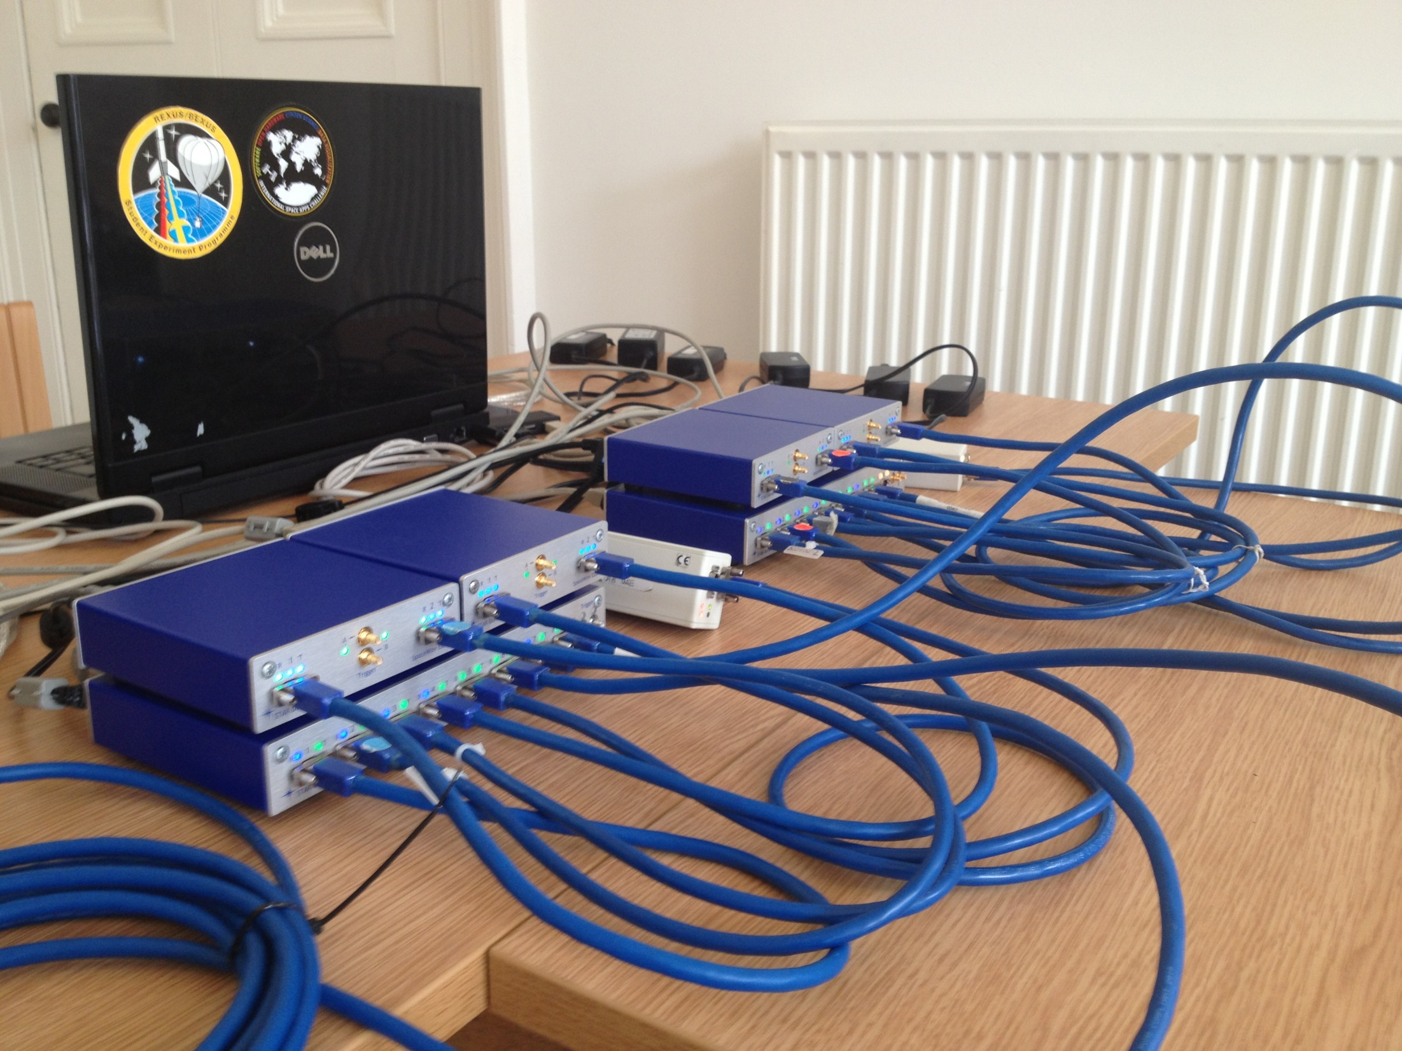

Slide 51
EGSE Summary
New concept for SpaceWire instrument real-time emulation
Minimal development time
A day or two for a instrument real-time emulation
Integrate with other test equipment via external triggers
Interacts with host software via
Software events from host to EGSE
Software events from EGSE to host
Received SpaceWire packets can be passed to the host software
Real-time simulation of the Solar Orbiter
Designed and developed by MSc Student
Using STAR-Dundee SpaceWire-EGSE unit
Some limitations on the simulation to make it realisable
Results being used to enhance the SpaceWire-EGSE functionality

