Slide 1
SpaceFibre A Multi-Gigabit/s Network for Spaceflight Applications
Steve Parkes¹, Chris McClements¹,
Albert Ferrer², Alberto Gonzalez²
¹Space Technology Centre, University of Dundee, UK
²STAR-Dundee Ltd, UK and Spain

Slide 2
Contents
SpaceFibre Need
SpaceFibre Standard
SpaceFibre Quality of Service
SpaceFibre Chips
SpaceFibre Test Equipment
SpaceFibre Validation
SpaceFibre Current and Planned Work

Slide 4
The Need for SpaceFibre
Need for very-high data-rates
Synthetic Aperture Radar (SAR)
High-resolution multi-spectral imaging
Need for integrated control and data network
Instrument data-handling
Equipment control
Housekeeping information
Time distribution
All over the same network
Saving mass and power
Need for determinism
To support AOCS and other control applications

Slide 5
The Need for SpaceFibre
Need for long distances
For launcher applications
Need for galvanic isolation and improved FDIR capabilities
To improve overall reliability and robustness
Need for integrated Quality of Service
To simplify software and system design
Need for backwards compatibility with existing data-handling technology
SpaceWire

Slide 6
SpaceFibre Key Features
SpaceFibre key features
High performance
2.5 Gbits/s current flight qualified technology
20 Gbits/s with multi-laning
Galvanic isolation
Electrical and fibre-optic cables
Low latency
Broadcast codes
Integrated QoS
Bandwidth reservation
Priority
Scheduling
Integrated FDIR support
Low implementation cost
Compatible with SpaceWire at packet level
SpaceFibre
Designed for Spaceflight
Applications

Slide 7
SpaceFibre Standard
Management
Interface
Packet Interface
Broadcast Message Interface
Network Layer
VC Interface
Broadcast Interface
Quality Layer
Management Layer
Multi-Lane Layer
Lane Layer
Physical Layer
Physical Interface

Slide 8
SpaceWire CODEC
Packet Interface
Time-Codes
Management
SpaceWire CODEC
Serial

Slide 9
SpaceFibre IP Core
Each VC like pair of SpW FIFOs.
Sends and Receives SpFi packets
Management interface configures VCs, BC, etc
Broadcasts short messages.
Time distribution, synchronisation, event signalling, error handling
Virtual Channel Interfaces
Broadcast
Management
…
SpaceFibre IP Core
SerDes

Slide 10
Network Layer
Packets
Packages information to be sent over link
Transfers packets over network
<Dest. Address><Cargo><EOP>
Same routing concepts as SpaceWire
Path and logical addressing
Broadcast Messages
Broadcasts short messages across network
Can carry time-codes, time messages, events
Network Layer
Quality Layer
Management Layer
Multi-Lane Layer
Lane Layer
Physical Layer

Slide 11
Management Layer
Network Layer
Configures, controls and monitors status
Quality Layer
Management Layer
Multi-Lane Layer
Lane Layer
Physical Layer

Slide 12
Quality Layer
QoS and FDIR
Virtual Channels:
Quality of service and flow control
Framing:
Frames information to be sent over link
Scrambles SpaceFibre packet data
Retry:
Recovers from transient errors
Can cope with bit error rate of 10⁻⁶
Network Layer
Quality Layer
Management Layer
Multi-Lane Layer
Lane Layer
Physical Layer

Slide 13
Multi-Lane Layer
Runs several SpaceFibre lanes in parallel
Provides higher data throughput
Provides redundancy with graceful degradation
Network Layer
Quality Layer
Management Layer
Multi-Lane Layer
Lane Layer
Physical Layer

Slide 14
Lane Layer
Network Layer
Lane control
Lane initialisation and error detection
Encoding/Decoding:
Encodes data into symbols for transmission
8B/10B encoding
DC balanced
Quality Layer
Management Layer
Multi-Lane Layer
Lane Layer
Physical Layer

Slide 15
Physical Layer
Network Layer
Serialisation:
Serialises SpaceFibre symbols
Includes oversampling clock-data recovery
Fibre optic or electrical medium
Quality Layer
Management Layer
Multi-Lane Layer
Lane Layer
Physical Layer

Slide 16
SpaceFibre Quality of Service
Integrated QoS scheme
Priority
VC with highest priority
Bandwidth reserved
VC with allocated bandwidth and recent low utilisation
Scheduled
Synchronised Time-slots
E.g. by broadcast messages
VCs allocated to specific time-slots
In allocated time-slot, VC allowed to send

Slide 17
SpaceFibre QoS
Integrated QoS scheme
Priority
VC with highest priority
Bandwidth reserved
VC with allocated bandwidth and recent low utilisation
Scheduled
Synchronised Time-slots
E.g. by broadcast messages
VCs allocated to specific time-slots
In allocated time-slot, VC allowed to send

Slide 18
Virtual Channels
VC1
VC1
VC2
MAC
DEMUX
VC2
VC3
VC3
VC sends when
Source VC buffer has data to send
Destination VC buffer has space in buffer
QoS for VC results in highest precedence
A SpW packet flowing through one VC does not block another packet flowing through another VC

Slide 19
QoS: Bandwidth Reserved
Precedence
Bandwidth Credit Counter
time

Slide 20
QoS: Bandwidth Reserved
Precedence
time

Slide 21
QoS Priority
Priority 1
Priority 2
time
Priority 3

Slide 22
Scheduled Precedence
Time-slot
1
2
3
4
5
6
7
8
VC 1
VC 2
VC 3
VC 4
VC 5
VC 6
VC 7
VC 8

Slide 23
Configured for Priority and BW Reserved Only
Time-slot
1
2
3
4
5
6
7
8
VC 1
VC 2
VC 3
VC 4
VC 5
VC 6
VC 7
VC 8

Slide 24
Mixed Deterministic and Priority/BW-Reserved
Time-slot
1
2
3
4
5
6
7
8
VC 1
VC 2
VC 3
VC 4
VC 5
VC 6
VC 7
VC 8

Slide 25
SpaceFibre FDIR
FDIR
Fault detection
Parity/disparity
Invalid 8B/10B codes
Enhanced Hamming distance
CRC
Over and under utilisation of expected bandwidth
Fault isolation
Galvanic isolation
Data framing – time containment
Virtual channels – bandwidth containment
Fault recovery
Link level retry
Graceful degradation on lane failure
Babbling idiot protection
Error reporting

Slide 26
SpaceFibre Chips
SpaceFibre interface design
University of Dundee and STAR-Dundee
Funded by ESA, EC, STAR-Dundee
Designed in tandem with SpaceFibre standard specification
Used to test and validate standard
Implemented as VHDL IP Core

Slide 27
SpaceFibre Chips
SpaceFibre VHDL IP Core
Compliant to current version of standard
Interfaces
Virtual channel interface
Broadcast channel interface
Management interface
QoS
Integrated priority and bandwidth reservation
Scheduling with 64 time-slots
Retry
Rapid retry
Single lane
Multi-lane support will be provided early 2014
Available from STAR-Dundee Ltd

Slide 28
VHiSSI Project
VHiSSI (Very High Speed Serial Interface) Chip
Radiation tolerant SpaceFibre device
Uses UoD/STAR SpaceFibre VHDL IP Core
EC Framework 7 research project
International project team:
University of Dundee
Astrium GmbH
STAR-Dundee Ltd
Ramon Chips
ACE-IC
IHP
Synergie CAD Instruments

Slide 29
SpaceFibre Chips
VHiSSI chip specification
Fully integrated SpaceFibre interface
2.5 Gbits/s
Including full QoS and FDIR capabilities
Including two SerDes: nominal and redundant
Versatile IO
SpaceWire to SpaceFibre Bridge
Parallel IO modes
Including FIFO, Memory, DMA, Transaction modes
Ideal for simple connection to FPGA
Small size, 20 x 14 mm
Radiation tolerant
Prototypes in 2014

Slide 30
VHiSSI Architecture
CNF[3:0]
IO
Switch
Matrix
SpaceWire
Bridge
VC0
SpaceFibre
Interface
VCA
SpaceFibre
Nominal
…
…
Mode
Switch
Matrix
SerDes
VCB
SpaceWire
& Digital IO
…
FIFO & DMT
Interface
VCJ
SpaceFibre
Redundant
SerDes
JTAG
JTAG
VHiSSI Chip

Slide 31
VHiSSI Applications
SpaceWire to SpaceFibre Bridge
SpaceWire
Instrument
SpaceWire
Equipment
SpaceWire
SpaceWire
VHiSSI
SpaceWire
To
SpaceFibre
Bridge
VHiSSI
SpaceWire
To
SpaceFibre
Bridge
SpaceWire
Instrument
SpaceWire
Equipment
SpaceFibre
SpaceWire
Instrument
SpaceWire
Equipment
SpaceWire
Instrument
SpaceWire
Equipment

Slide 32
VHiSSI Applications
Instrument interface
Mass memory interface
Instrument
Mass Memory Unit
Data
Output
Instrument
Data IO
Memory
Network
Instrument
Interface
FPGA
VHiSSI
SpaceFibre
VHiSSI
Mass Memory
Interface
SpW
Control/HK
SpW
Control/HK

Slide 33
SpaceFibre Applications
Local Instrument
Data Output
Instrument 1
Interface
Mass Memory Unit
Local Instrument
Mass Memory
Interface
Data Output
Instrument 2
Interface
Data Bus
To Memory
Local Instruments
Data Output
SpaceWire
To
SpaceFibre
Bridge
Data Output
SpaceWire
Instrument
SpaceWire
Instrument
SpaceWire
Instrument
SpaceWire
Instrument
Remote Instruments

Slide 34
SpaceFibre Applications
Control Processor
Local Instrument
Data Output
Instrument 1
Interface
Control
Processor
Interface
Data Input/Output
SpW Control/HK
SpW Control/HK
SpaceFibre
Router
Mass Memory Unit
Local Instrument
Data Output
Instrument 2
Interface
Mass Memory
Interface
SpW Control/HK
Data Bus
To Memory
Local Instruments
Data Output
SpaceWire
To
SpaceFibre
Bridge
SpW Control/HK
Data Output
Downlink Telemetry
SpW Control/HK
Downlink Telemetry
Interface
Data Output
SpW Control/HK
SpaceWire
Instrument
SpaceWire
Instrument
SpaceWire
Instrument
SpaceWire
Instrument
Remote Instruments

Slide 35
STAR Fire: SpaceFibre Test Equipment
USB
3
Router
5
SpaceFibre
Port 1
(8 Virtual Channels)
6
VC/BC
IF
SpF
SpW
1
Reg
SpW
2
Mictor
Analyser
7
SpaceFibre
Port 2
(8 Virtual Channels)
8
VC/BC
IF
SpF
4
Reg
Analyser
Mictor
Configuration Bus
RMAP Config
(RMAP Target)

Slide 36
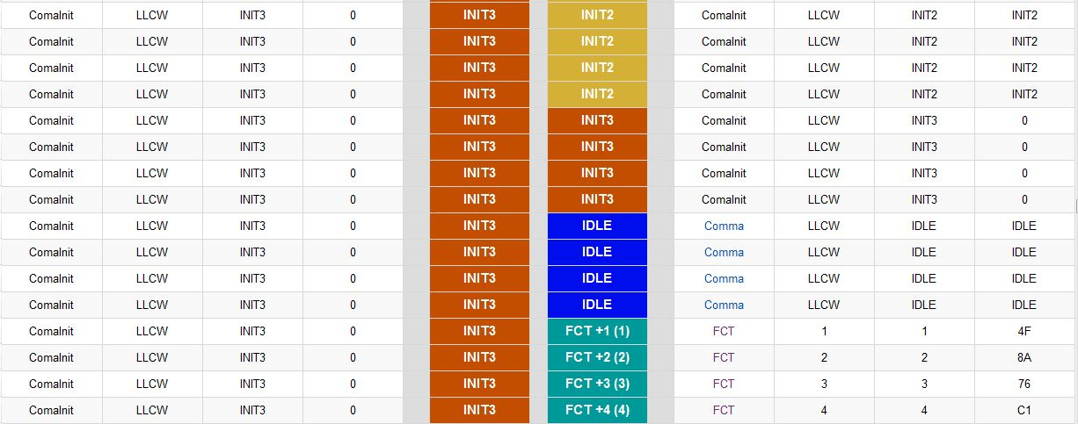
STAR Fire Word Viewer

Slide 37
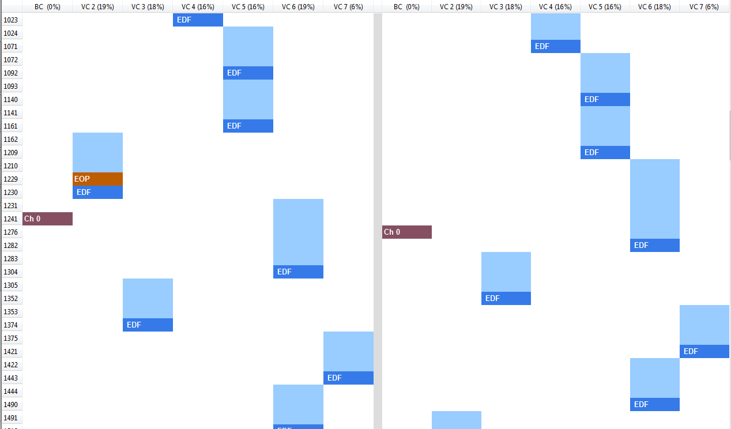
STAR Fire Frame Viewer

Slide 38
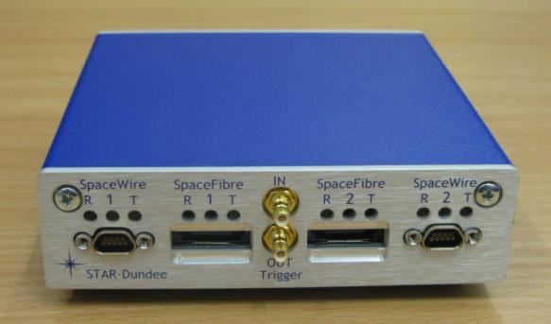
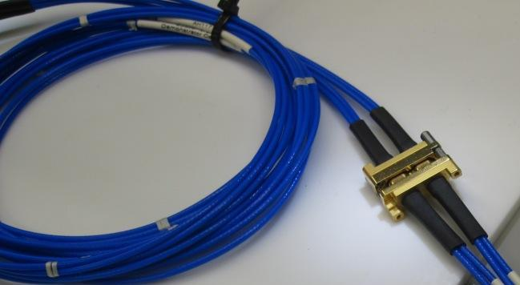
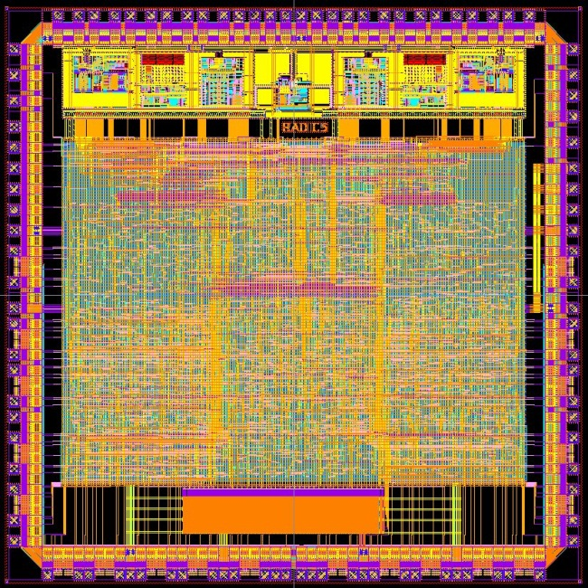
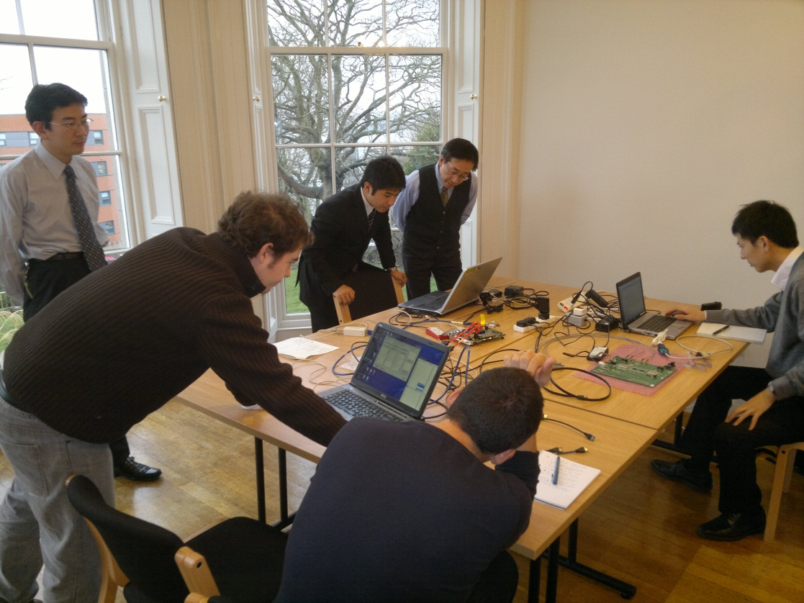
SpaceFibre Validation

Slide 39
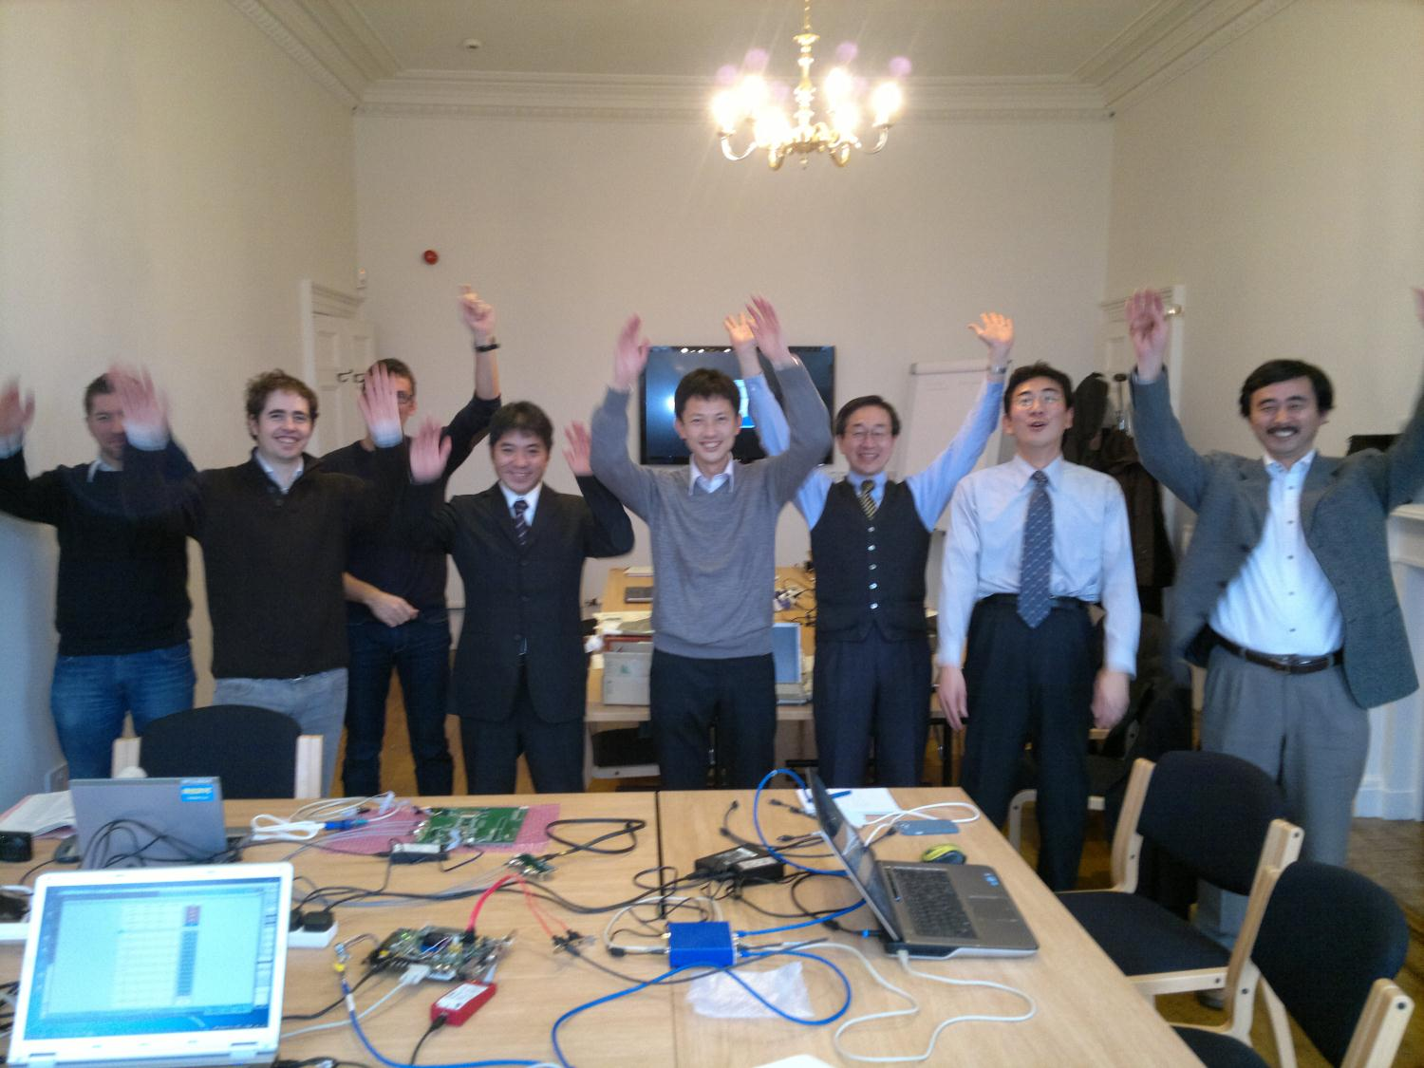
Interoperability testing Dec 2012

Slide 40
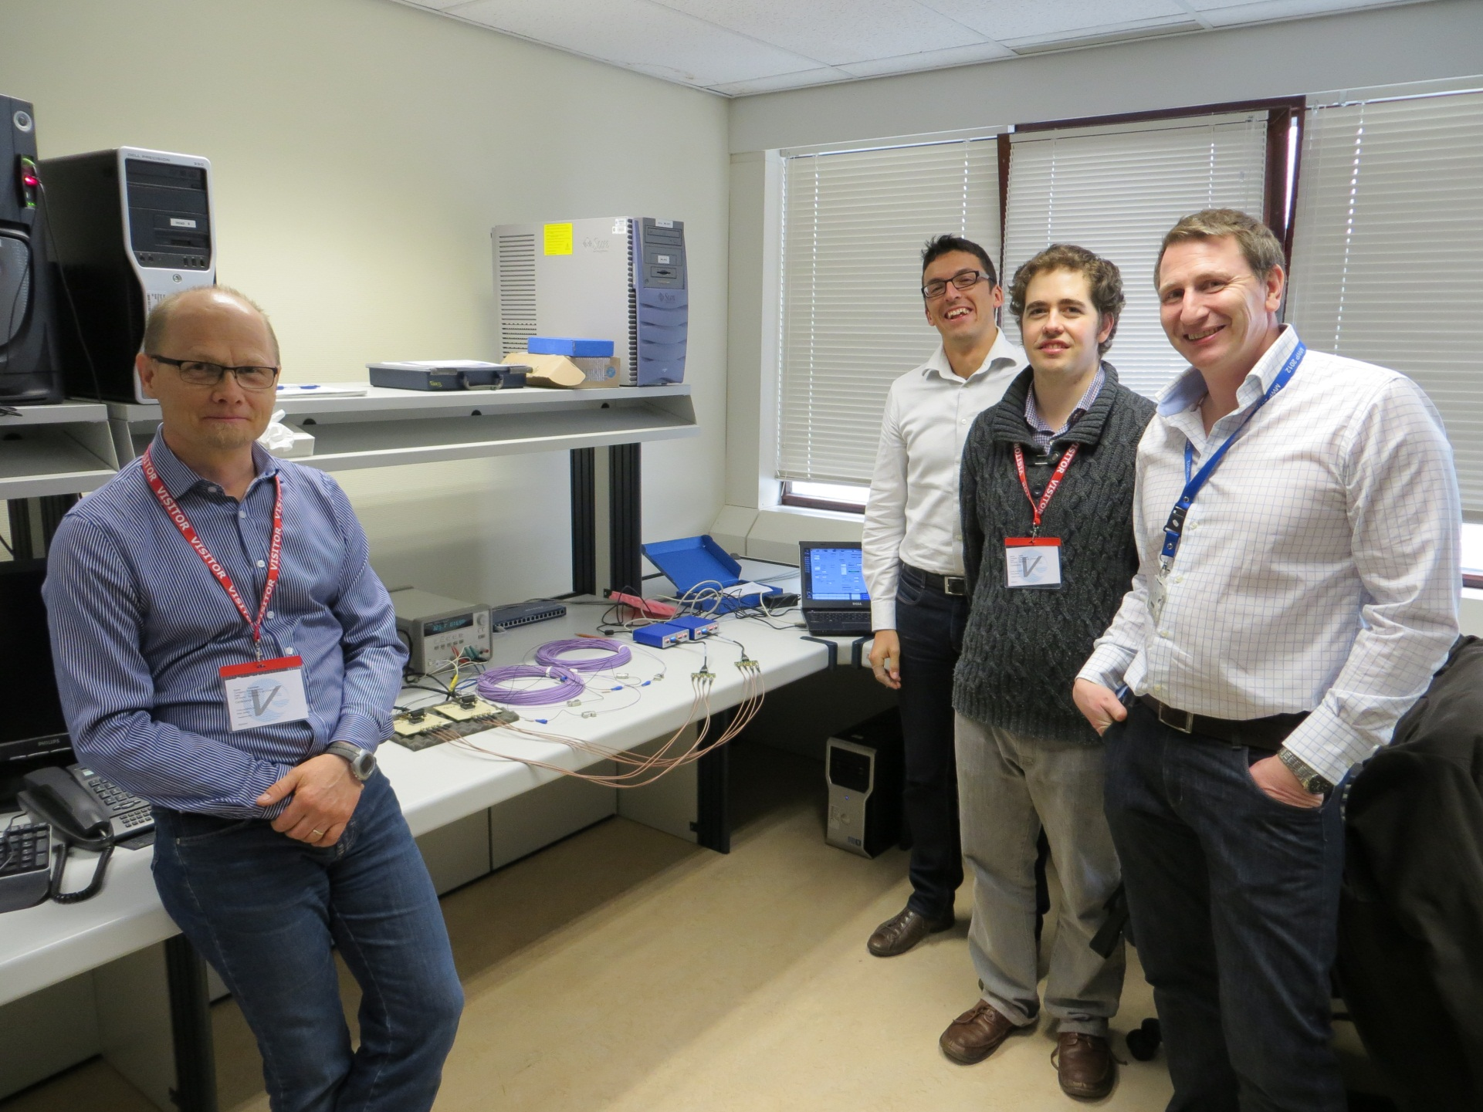
SpaceFibre running over 100m fibre

Slide 41
ESA SpaceFibre Beta Test Projects
Next Generation Mass Memory, Astrium (D), IDA (D)
High Processing Power DSP, Astrium (UK)
High Performance COTS Based Computer, Step 2 (Prototyping and Validation), Astrium (Fr), CGS (I)
FPGA Based Generic Module and Dynamic Reconfigurator, Bielefeld University (D)
Leon with Fast Fourier Transform Co-processor, SSBV (NL)

Slide 42
SpaceFibre Flight Engineering Model
SpaceFibre Demonstrator activities
Cables and Connectors
Demonstration Board and Testing
Simulation and Validation

Slide 43
Conclusions
SpaceFibre designed specifically for spaceflight applications
Multi-Gbit/s
Galvanic isolation
Integrated QoS
Integrated FDIR capabilities
Compatible with SpaceWire packet level
Efficient design
Several application demonstrators
Successful interoperability testing
Formal ECSS standardisation scheduled for 2014
Radiation tolerant chips currently under development
Test equipment and IP cores available now

Slide 44
Acknowledgements
The research leading to these results has received funding from
The European Space Agency under ESA contract numbers:
17938/03/NL/LvH - SpaceFibre
4000102641 - SpaceFibre Demonstrator
The European Union Seventh Framework Programme (FP7/2007-2013) under grant agreement numbers
263148 - SpaceWire-RT (SpaceFibre QoS)
284389 - SpaceFibre-HSSI (VHiSSI chip)
We would also like to thank
Martin Suess ESA project manager

Slide 45
Thank You Any questions?

