Slide 1
Overview of the SMAP Science Data Manager (SDM)
Ed Benowitz
SMAP FSW Developer
NASA/Jet Propulsion Laboratory
Caltech
Copyright 2013 California Institute of Technology. Government sponsorship acknowledged.

Slide 2
Introduction
SMAP Mission Overview
SMAP Science instruments
Science Data Management Design
Data Flow
Hardware View
Storage
Transmission
Implementation
Interactions
Flight Software Responsibilities
Lines of Code
Local Fault Protection

Slide 3
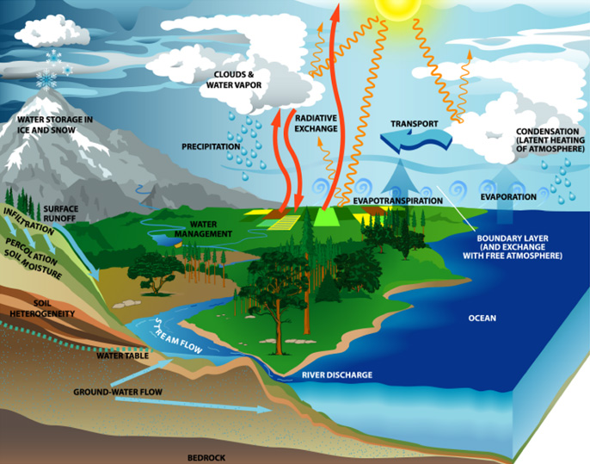
SMAP Mission Overview₁
SMAP
Soil Moisture Active Passive
Provides global measurements of soil moisture
These measurements assist with
Understanding of the water, energy, carbon cycles
Improved flood prediction
Drought monitoring
Weather models
Climate prediction models

Slide 4
SMAP Movie₁

Slide 5
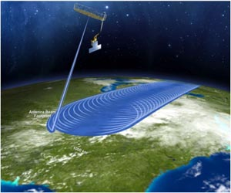
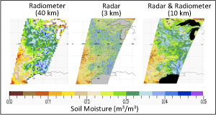
SMAP Instruments₁
Radar (SAR)
Higher spatial resolution but lower soil moisture accuracy
Radiometer (RAD)
Higher soil moisture accuracy, but coarse spatial resolution
Ground software will process data from the two instruments together
Soil moisture will be retrieved at a spatial resolution of 10 km, and freeze-thaw state at a spatial resolution of 3 km
Reflector
Spinning at 14.6 RPM

Slide 6
Overall Science Data Flow
Command and Data Handling (CDH)
Spacecraft
Ground
System
SAR
CDH
X-Band
Radio
RAD

Slide 7
Inside CDH, the Hardware View
CDH
NVM Storage Board
Non-volatile memory
RAM
Flight Computer
Board
DMA Engine
instrument interfaces
X-band
interfaces

Slide 8
Science Data Storage
NVM Storage Board
RAM
NVM
SAR instrument interface
SAR FIFO
DMA
SAR NVM
Region
RAD
instrument interface
RAD FIFO
RAD NVM
Region
DMA

Slide 9
Science Data Transmission
NVM Storage Board
NVM
RAM
SAR NVM
Region
DMA
Collector FIFO
X-band
interface
RAD NVM
Region

Slide 10
Science Data Interactions
Science data is never seen on the flight computer board.
The NVM board stores, buffers, and prepares science data for transmission
The flight software running on the flight computer board orchestrates this by commanding the NVM board
Input
An interrupt from the SAR/RAD input fifo indicates that data has arrived
In response to the interrupt, flight software asks hardware to DMA from the SAR/RAD input FIFO to NVM
Output
The ground commands a transmit
Flight software asks hardware to DMA from NVM to the collector FIFO
An interrupt from the collector FIFO indicates that it needs more data
In response to the interrupt, flight software asks hardware to DMA from NVM to the collector FIFO
Repeat until there is no more data to send for this comm pass

Slide 11
Flight Software Responsibilities
Manage simultaneous science data input and transmission
Share usage of limited hardware DMA engines
Manage and control DMAs
Flight software keeps track of read, write, and erase addresses within NVM
Software uses these addresses as part of a DMA request
Provide an abstraction for science data
Although it is implemented with DMAs, RAM FIFOs, and NVM storage
The entire storage appears as a giant fifo in NVM
Do not allow overwrites of old data
Keep SAR and RAD science data separate
Each type of science data (SAR/RAD) appears as an individual stream over the transmission
Control hardware registers and counters to identify these streams
Overlap transmitted data for ease of ground assembly
Provide commanding for transmission and retransmission of data
Prioritize science data (SAR vs RAD) for transmit
Provide telemetry
Provide fault monitoring and responses

Slide 12
Flash File Systems vs SDM₃
NVM storage has special usage. Flash file systems must deal with these issues as well.
 | Typical Flash File System | SMAP Science Data
Blocks must be erased before being written to | Yes | Yes
Bad blocks must be avoided | Yes | Yes
Random access | Yes | No. FIFO access only.
Wear leveling | Yes | Not explicitly needed, FIFO spreads out writes.

Slide 13
Software Stats and Info
Approximately 7K physical lines of code, 3 K logical lines of code, 3K lines of comments
SMAP’s statechart autocoder₂ was used for this module
Separate files within the module deal with
Science data input
Science data transmission
NVM addressing and abstraction
Inter-process communication

Slide 14
Local Fault Protection
Monitoring
DMA errors
Input FIFO errors
Collector FIFO errors
X-band radio is unexpectedly not functioning
Responses
Empty a fifo
Reset a hardware interface
Abort a transmit command

Slide 15
Conclusion
Keeping science data within the NVM board allows us to perform high-rate storage and transmission.
Flight software orchestrates the simultaneous hardware actions and provides an abstraction for the operations team.

Slide 16
References
[1] http://smap.jpl.nasa.gov
[2] Murray, A.; Jones, C.G.; Reder, L.; Shang-Wen Cheng, "The use of modeling for flight software engineering on SMAP," Aerospace Conference, 2011 IEEE , vol., no., pp.1,19, 5-12 March 2011
[3] http://en.wikipedia.org/wiki/Flash_file_system

