Slide 1
Interface-Implementation Contract Checking: A Case Study on NASA’s OSAL
Dharmalingam Ganesan, Mikael Lindvall
Fraunhofer Center for Experimental Software Engineering
College Park
Maryland

Slide 2
Agenda
Context: NASA OSAL
Static equivalence analysis
Static contract checking
Conclusion

Slide 3
Context: NASA OSAL
Operating System Abstraction Layer
Isolates flight software from real time operating systems and hardware.
Implementation for the real time systems RTEMS and vxWorks and posix compliant non-real time systems.
Provides “Write once, run everywhere (somewhere)” at compile level
Used for mission critical embedded systems
Provides support for file-system, tasks, queues, semaphores, interrupts, hardware abstraction, I/O ports and exception handling

Slide 4
NASA OSAL
Why is it important that OSAL is bug free?
flight software is mission critical and needs to be of very high quality
OSAL is the foundation of the CFE which CFS runs on top of
OSAL is used in many NASA missions, e.g. the Lunar Renaissance Orbit
If OSAL has issues, it might result in catastrophic failure

Slide 5
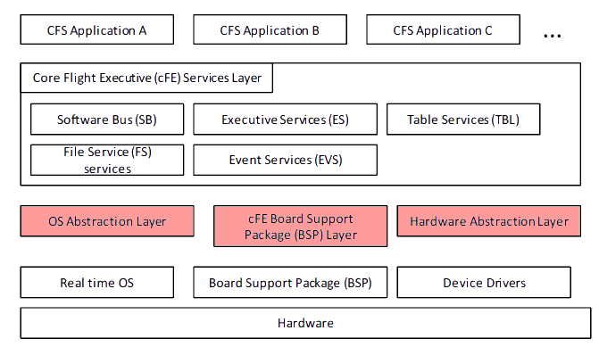
NASA OSAL in CFS

Slide 6
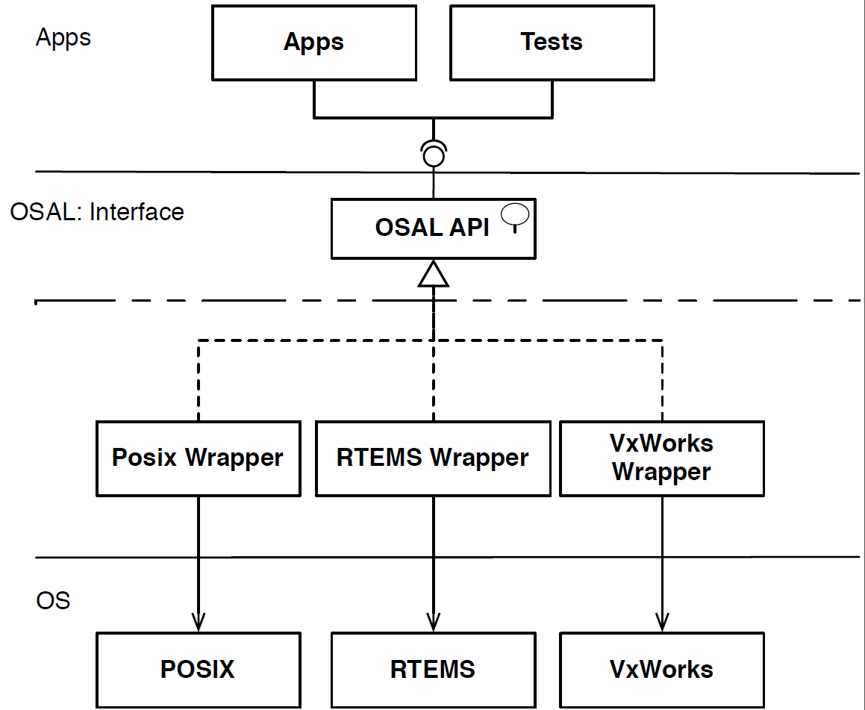
NASA OSAL – Architecture

Slide 7
Agenda
Context: NASA OSAL
Static equivalence analysis
Static contract checking
Conclusion

Slide 8
Static equivalence analysis
Currently OSAL has implementations for Rtems, vxWorks and Posix operating systems
All implementations should work the same
Perform same operation regardless of OS
Return same error-codes when errors occur

Slide 9
Static equivalence analysis
Used to find differences between implementations of OSAL
Posix, RTEMS, vxWorks
Extracts return codes from function bodies
Return codes of each implementation compared to find differences

Slide 10
Static equivalence analysis
Enables us to easily find otherwise subtle and hard to find errors
Posix implementation
Rtems implementation

Slide 11
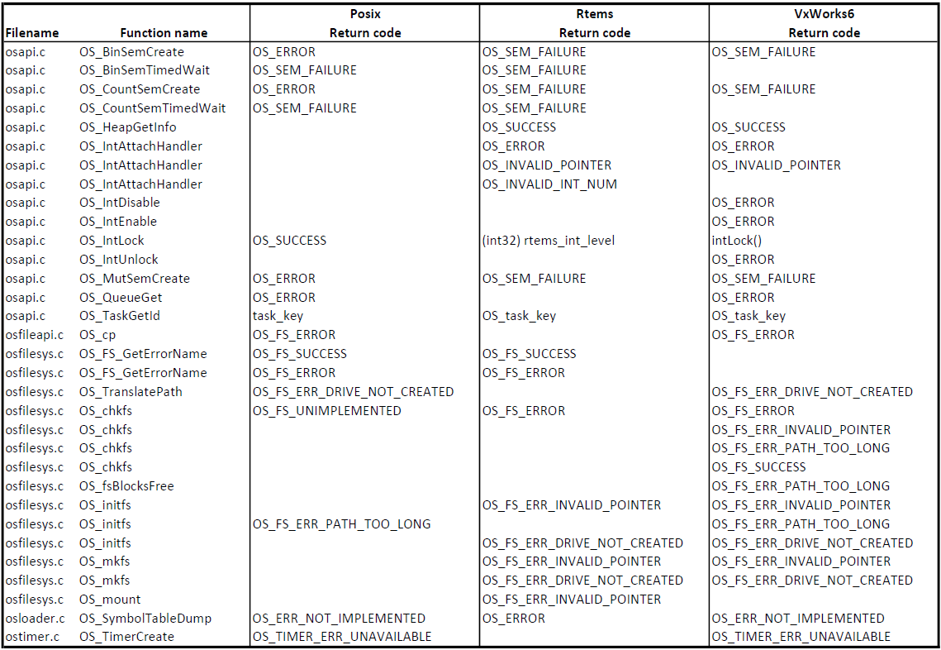
Static equivalence analysis - example

Slide 12
Which defects can be found in OSAL when analyzing function pairs for functional equivalence?
Runtime Issues | # Issues
Precondition Checking Diffs. | 13
Return Code Diffs. | 24
Global Variable Writing Diffs. | 15
Parameter Writing Diffs. | 3
Parameter Checking | 2
Σ | 57
Minor Issues | # Issues
Configuration Issues | 9*
Output Differences | 18*
Σ | 27
Acknowledged and/or Fixed
Notes:
More than one issue per function

Slide 13
Agenda
Context: NASA OSAL
Static equivalence analysis
Static contract checking
Conclusion

Slide 14
Static contract checking without a formal contract
API‘s are supposed to fulfill a “contract”
A contract is:
Specification of what each function does and
How it responds to errors and what the function should return
Programmers program to a API using the contract as a guide.
A function not written according to the contract can cause hard to find errors

Slide 15
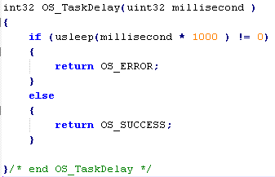
Static contract checking without a formal contract
Example of function fulfilling contract
Contract
Implementation

Slide 16
Static contract checking without a formal contract
Example of function fulfilling contract

Slide 17
Static contract checking without a formal contract
Example of function fulfilling contract

Slide 18
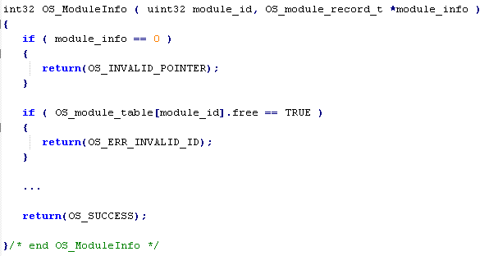
Static contract checking without a formal contract
Example of function not fulfilling contract

Slide 19
Static contract checking without a formal contract
Regular expressions to create simple and fast perl programs
Compatible with C and C++
Extracts return codes from function bodies and contract comments
Compares the return codes of contract comments and function bodies to find mismatches

Slide 20
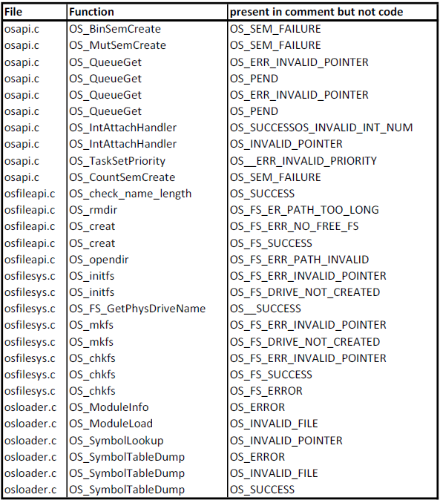
Static contract checking without a formal contract

Slide 21
Static contract checking without a formal contract
...and the other way around.
To find if functions implement more than the contracts implies
To identify an uncomplete contract that could result in implementation mismatches between wrappers
Extract return codes from the function bodies, instead of the contract comments
Compare the extracted returns to the contract comments to find undocumented behavior

Slide 22
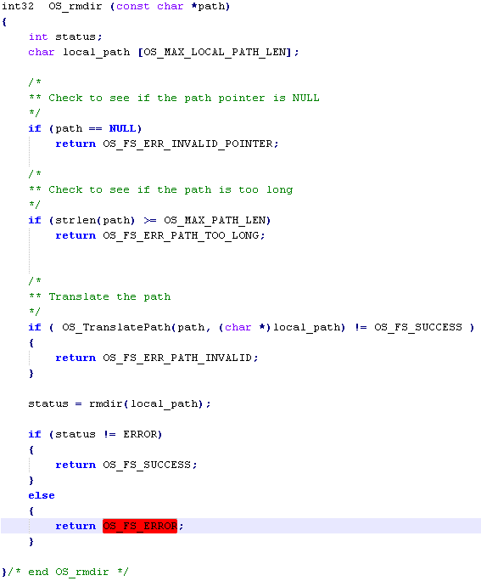
Static contract checking without a formal contract

Slide 23
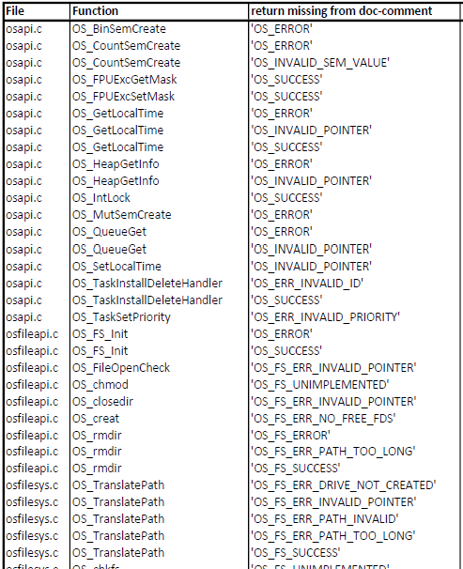
static contract checking without a formal contract
A part of the 61 issues found in the Posix implementation.
All issues reported and taken care now.

Slide 24
Summary
Static equivalence analysis:
A lightweight technique
powerful for detecting inconsistencies between wrappers
Found several inconsistencies (addressed in OSAL)
Static contract checking without a formal contract:
A lightweight technique
Found a lot of inconsistencies between documentation and code (addressed in OSAL)
Does not need any modeling or rigor
(but neither sound nor complete)

Slide 25
Thank you!
dganesan@fc-md.umd.edu
mlindvall@fc-md.umd.edu

Slide 26
Acknowledgement
Gunnar Cortes
Henning Femmer
Dave McComas
Alan Cudmore
Wesley Deadrick

