Slide 1
A Continuous Integration System for GSFC Core Flight Executive/Core Flight System (cFE/CFS)
Scott Zemerick
Scott.A.Zemerick@nasa.gov
December 16, 2014
Justin R Morris, JSTAR/ITC Lead
Justin.R.Morris@nasa.gov
304-367-8260
http://www.nasa.gov/centers/ivv/jstar/ITC.html

Slide 2
Agenda
Independent Test Capability (ITC) Team Introduction
Jon McBride Software Testing & Research Lab (JSTAR)
Infrastructure, Deployment, and Users
Technologies Developed
Introduction to Software-Only-Simulation
Process and approach for simulation and hardware modeling
cFE/CFS Continuous Integration System
Concepts / Features / Technologies

Slide 3
Introduction to the NASA Independent Verification & Validation (IV&V) Independent Test Capability (ITC)

Slide 4
IV&V Approach for Independent Testing
Create specialized group
Provide infrastructure to support efforts
ITC team formed in 2009
JSTAR Lab Built in 2010
ITC Charter
The NASA IV&V Program's Independent Test Capability (ITC) is responsible for acquiring, developing and maintaining adaptable test environments. These test environments enable the NASA's IV&V Program to perform dynamic analysis of software behaviors for multiple NASA missions.
The ITC team is the expert in software-only- simulation and the IV&V project teams are experts in the systems.
IV&V project teams utilize the solutions developed by the ITC team within the JSTAR laboratory.
Infuse into IV&V Projects
Independent Testing & Dynamic Analysis

Slide 5
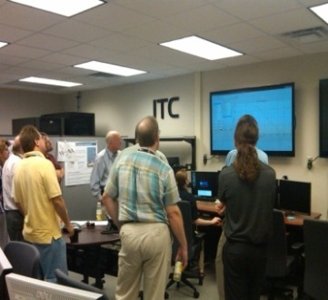
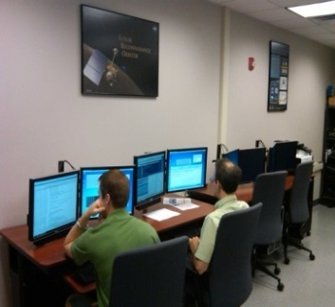
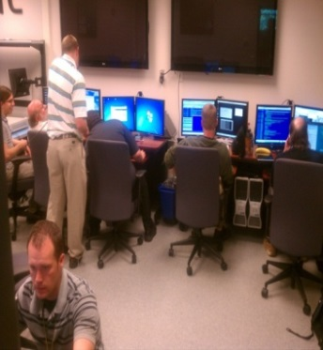
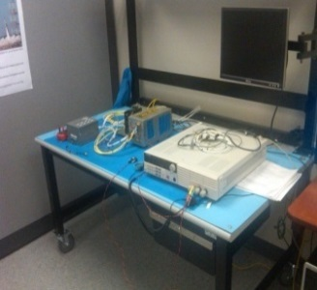
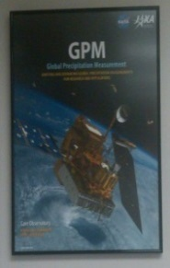
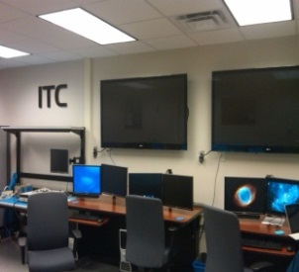
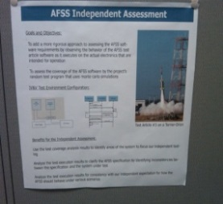
Jon McBride Software Testing & Research (JSTAR) Laboratory
Cloud-based infrastructure using server and desktop virtualization
Multiple strings of simulator deployments for onsite/offsite test teams
Integration of COTS and GOTS software tools to support V&V activities
Hardware-in-the-loop RAD750s, 1553, SpaceWire

Slide 6
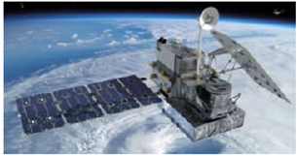
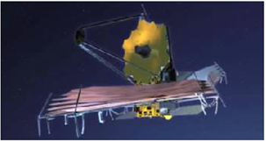
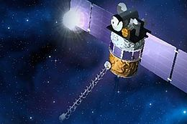
ITC Developed Spacecraft Simulators
Global Precipitation Measurement (GPM) Operational Simulator (GO-SIM)
Closed-loop simulator including unmodified operational ground system, unmodified flight software, environmental simulator, and science instrument simulators
James Webb Space Telescope (JWST) Integrated Simulation and Test (JIST)
Simulator that demonstrates reusable NASA Operational Simulator (NOS) technologies can be applied to other NASA missions
Deep Space Climate Observatory (DSCOVR)
ITC-developed simulator that also used NOS
technologies to model the spacecraft C&DH

Slide 7
Software-Only-Simulation

Slide 8
Software-Only-Simulation Introduction
Software-Only-Simulation is a complete software representation of modeled hardware components and software emulators
Together, the components form a complete spacecraft simulator
Software-Only-Simulator provides complete control of CPU, Time, Memory, and Peripheral Devices
Can stop all execution for debugging
Can peek/poke memory, perform fault injection
Spacecraft simulator used for:
Independent Testing (IV&V)
Operator Training
Augmenting project hardware testing

Slide 9
Software-Only-Simulation Introduction
Simulator Components
Modeled
Spacecraft Hardware
cPCI, SpaceWire, 1553, Ka-band, S-band, FPGAs
Instruction Set
Simulator
Simics / QEMU
PPC750, PPC401, LEON3
Unmodified Flight
Software Binary
Operational
Ground System
Spacecraft Scenarios
Halt Entire System
Memory Analysis
Fault Injection
What-if Scenarios
Independent Testing
Operator
Training

Slide 10
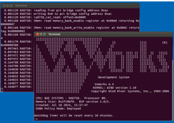
Software-Only-Simulation Introduction
QEMU was heavily used for this cFE continuous integration effort
QEMU is a generic, open-source machine emulator
QEMU already had support for many platforms
x86, Sparc, ARM, MIPS, ColdFire, Microblaze, PowerPC
ITC QEMU Modeling Experience
Since the RAD750 is based on the PowerPC 750, the ITC Team was able to use the PowerPC model as a starting point and develop a RAD750 QEMU model, capable of running RAD750 FSW
ITC also developed QEMU Ethernet and MIL-STD-1553 cPCI
card models
Some initial LEON3 work based upon QEMU patches provided by ESA

Slide 11
cFE/CFS Continuous Integration System

Slide 12
System Goals
Provide an automated means to exercise “build- system tests” of cFE/CFS
cFE chosen as pilot project due to size, usage, current manual build/test efforts, and dependence upon ground station software
ITC familiar with cFS/CFS and plans to utilize it in the future
“Build-System” tests are integration tests with ground station software as the test driver
Main focus of this effort
Limited focus on unit tests
Support multiple target platforms
Linux x86
VxWorks (QEMU RAD750 Model)
Create a regression test suite
Enable efficiencies in IV&V’s testing efforts
NASA IV&V Independent Test Capability

Slide 13
System Technologies Utilized
Technology/Product | Origin | Purpose | Integration Method
Atlassian Bamboo | COTS | Automated Build and Test Execution | Virtual Machine Installation on Linux
ASIST | GOTS/GSFC | Ground Station used by CFS for executing build/integration tests | Virtual Machine Installation on Linux
ASIST WRAPPER | ITC | ASIST Ground System Automation | Mostly new development for this task (Some parts leveraged from the ITC Framework)
Bamboo CFS Plugin | ITC | Plugin allowing for CFS to be built by the Bamboo build server | Integrated with Bamboo (Designed for reuse where possible)
Core Flight System (CFS) | GOTS/GSFC | Software Under Test | Source installed and built on Build Server Virtual Machine
QEMU RAD750 Model | ITC | Execution of the CFS under the RAD750 Target running VxWorks | QEMU RAD750 Model built and installed on Linux
QEMU DEC Ethernet Tulip Model | ITC | Ethernet connectivity to the RAD750/VxWorks kernel. Provides connection between VxWorks and ASIST | QEMU Tulip model integrated with the QEMU RAD750 Model
NASA IV&V Independent Test Capability

Slide 14
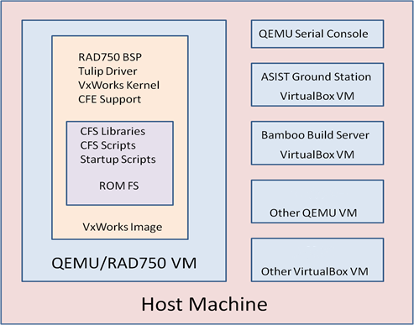
Continuous Integration System Architecture
Ground Station Software of Choice
Bamboo VM coordinates activity across all VMs
Other QEMU VMs for additional targets
NASA IV&V Independent Test Capability

Slide 15
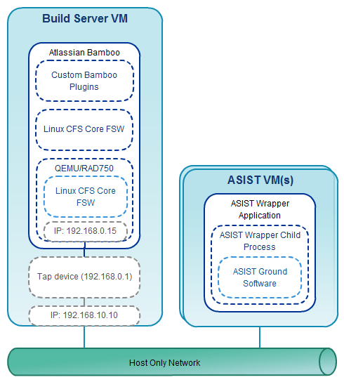
Bamboo and ASIST System Architecture
NASA IV&V Independent Test Capability

Slide 16
Continuous Integration Activity Flow
Source Code Checkout
Run CFS Core on QEMU/RAD750 emulator
Stop ASIST
Run CFS Core Executable
Configuration Changes
(RegEx Replace Task)
Start ASIST
Run pre-test cmds, ground test procs, and post-test cmds
Make Task
(build script, GNU make)
Linux?
NO
Stop CFS Core;
Stop ASIST
Build Task
(VxWorks / SB Unit)
YES
Log Test Results
Configure ASIST
(Generate needed files (.prc, .rdl))
NO
Failed Tasks or
Tests?
YES
Start ASIST
Build ASIST Procedures
Build Successful
Build Failed
NASA IV&V Independent Test Capability

Slide 17
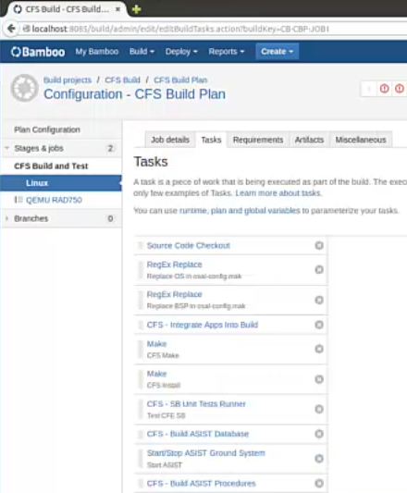
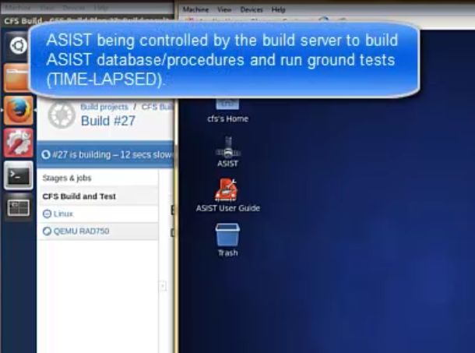
System Automated Build & Test

Slide 18
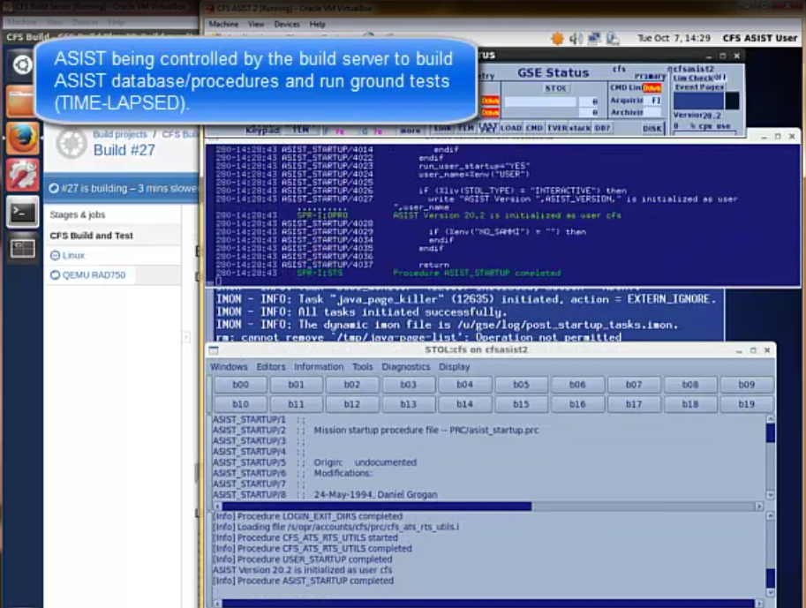
System Automated Build & Test

Slide 19
Benefits & Next Steps
Benefits
Quickly perform a checkout of cFE/CFS and execute integration/regression tests automatically
Supports multiple targets
x86/Linux and QEMU RAD750/VxWorks
Automation of Ground Station Software
Next Steps
Apply lessons learned and technology developed from this pilot project for another NASA mission, with increased focus on the IV&V lifecycle
Add automated static analysis to activity flow

Slide 20
Contact Information
Web Page
http://www.nasa.gov/centers/ivv/jstar/JSTAR.html
E-Mail
scott.a.zemerick@nasa.gov
justin.r.morris@nasa.gov
Contact us for…
Demonstrations of test beds
Middleware usage agreements
Simulator development
Hardware modeling
V&V Services, HWIL Testing, Performance Testing

Slide 21
Backup Slides &
ITC Technologies

Slide 22
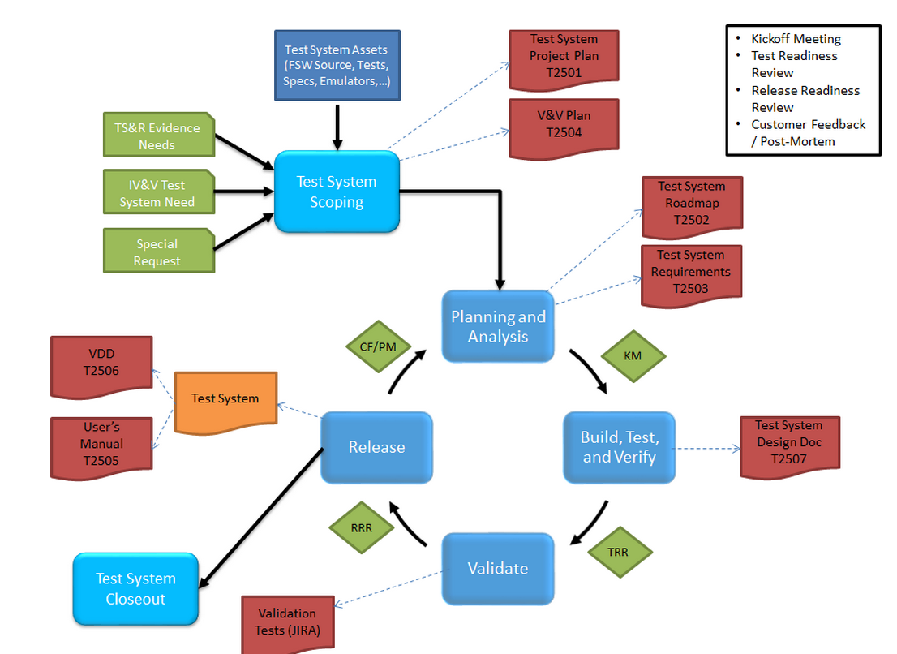
Software-Only-Simulation Introduction
Simulator Development Process

Slide 23
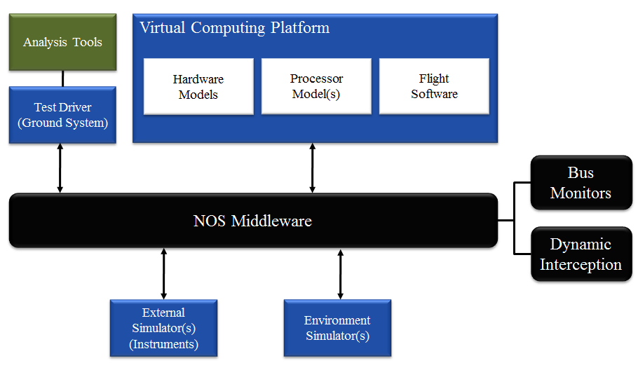
NASA Operational Simulator (NOS)
ITC Technologies
Software-only simulation architecture
Capable of executing unmodified flight software
Custom layered-architecture middleware
Dynamic interception capability
Reusable software modules and scripts
Virtual machine deployment
Typical NOS Architecture
(Space Domain)

Slide 24
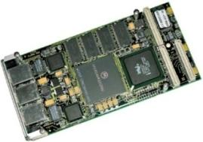
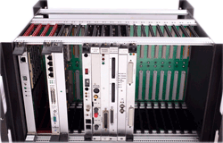
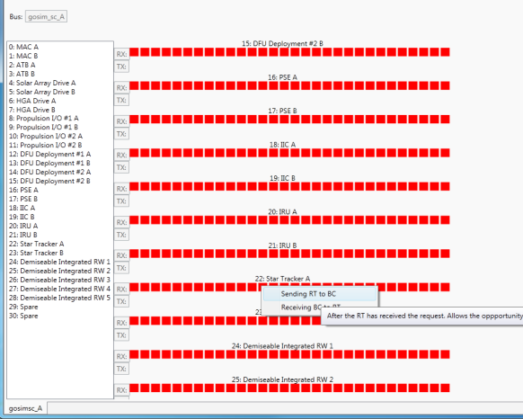
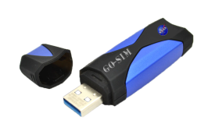
NOS Feature Set
Plug-and-Play Hardware Models
Use of Operational Ground Systems Software
Instrument Model Framework
Instrument1
Subaddress HandlerA → FunctionA
Subaddress HandlerB → FunctionB
…
Subaddress HandlerN → FunctionN
InstrumentX
Subaddress HandlerA → FunctionA
Subaddress HandlerB → FunctionB
…
Subaddress HandlerN → FunctionN
Processors,
Boards, Racks
Internal Bus Monitoring
NOS Middleware
Deployment & Maintenance
Specialized Layers
Base Layer Communications
Virtualization

Slide 25
NOS Middleware
Overview
Features
Offers re-usable communication mechanism
Ensures consistent and correct data passing
Provides synchronization between distributed applications
Flexible and extensible design
Can be extended to incorporate any communication protocol
Transport agnostic
Cross platform C++ implementation
Robust User API
Specialized User API Layers
MIL-STD-1553B
ESA SpaceWire
Discrete Signals
Time Synchronization
Interception allows for V&V analysis
No modification to software-under-test

Slide 26
NOS Middleware Architecture
System Under Test
MIL-STD-1553
SpaceWire
Discrete
Time
Synchronization
Additional Protocols as Needed
System
Monitoring
NOS Core Middleware with
Interception Capability
Bus Analyzer
I/O Interface Layer

Slide 27
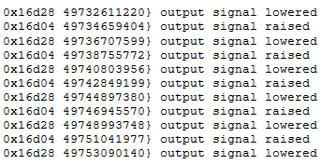
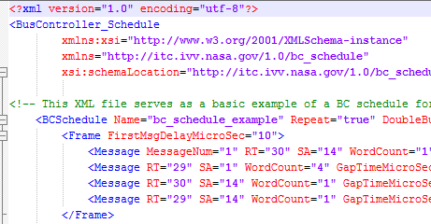
NOS Software Utilities
Virtual Oscilloscope
Virtual CompactPCI (cPCI) Analysis
Board-Level Signal Analysis
Virtual MIL-STD-1553 Bus
Bus Controller with XML Defined Schedules
Remote Terminal
Bus Monitor/Logger
PASS3200 Software Emulator
Virtual SpaceWire Router

Slide 28
NOS Dynamic Interception
Interceptor Blocking Data
Interceptor Modifying Data
Data Flow With Interceptor
Normal Data Flow
Node A
NOS
Node B
Block
Modify
Interceptor

