Slide 1
Implementing SpaceWire-D in RTEMS for the AT6981 Processor
David Gibson
David Paterson, Steve Parkes, Stuart Mills

Slide 2
Overview
Introduction to AT6981 – Castor
Supporting RTEMS on Castor
STAR SDE support
Porting RTEMS
Introduction to SpaceWire-D
SpaceWire-D on Castor

Slide 3
Introduction to Castor

Slide 4
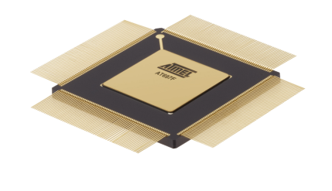
AT6981 – Castor
Complete system on chip for spaceflight
Powerful processor core
IEEE 754 Floating-Point Unit
Memory Management Unit
Substantial on-chip memory
Interfaces to external memory
SpaceWire router
SpaceWire protocol engines
MIL-STD-1553 interface
CAN and many more peripheral interfaces
Atmel AT6981 Castor
90 nm technology
Low-power, high-performance
Radiation tolerant

Slide 5
AT6981 Castor Architecture
Debug Port
Switch
Matrix
Debug SpW
SPARC V8
SpW
Router
SpW Engine
SpaceWire
I-Cache
D-Cache
SpW Engine
SpW Engine
Internal RAM 1
Internal RAM 2
Configuration Registers
RMAP/PnP Bus
Internal RAM 3
APB Bridge
Internal RAM 4
CAN
CAN
MIL-STD-1553
MIL-STD-1553
External Memory Interface:
PROM, SRAM, SDRAM, DDRx
Ethernet
Ethernet
Peripheral
Peripheral
Interfaces

Slide 6
SpaceWire Engines
Offloads processor from SpaceWire communications
SpaceWire Remote Memory Access (RMAP)
RMAP Target
Memory region or software based authorisation
RMAP Initiator
Automatic initiation of multiple commands
DMA
3x transmit and 3x receive channels
Protocol Multiplexer/Demultiplexer
Detects SpaceWire or user protocol
Multiplexes received data accordingly
Time-Code Controller
Regular & custom time-codes, signalling codes
SpaceWire Engine 3
SpaceWire Router
SpaceWire Engine 2
AHB
Interface
RMAP
Target
Protocol Multiplexer/ Demultiplexer
AHB
RMAP Initiator
DMA Channel (x3)
Time-Code Controller

Slide 7
Debug and Test
Comprehensive debug support
Debug support unit
Breakpoints
Single stepping
Register and memory access
Trace memory
Hardware watch-points
Accessible via
JTAG
Debug UART
Debug SpaceWire (high-speed debug)

Slide 8
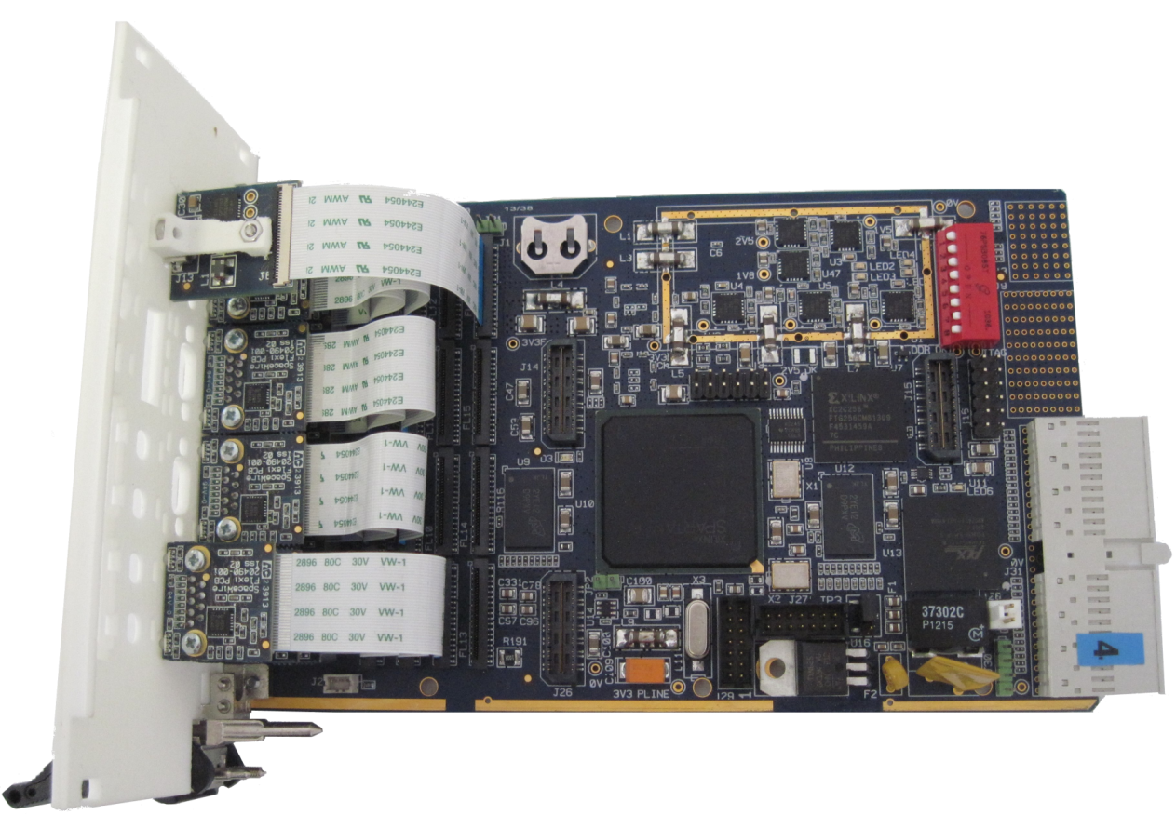
Castor Prototype Board
LEON2-FT core (40MHz)
128KB on-chip RAM
256MB DDR RAM
3 x SpaceWire engines
Router
Time-code controller
SpaceWire debug port
UART debug port

Slide 9
Supporting RTEMS on Castor

Slide 10
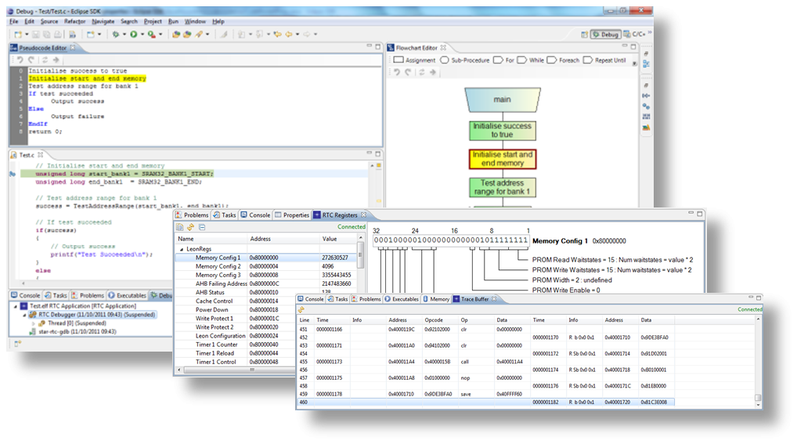
STAR SDE Overview
Supports development of software for flight processors
Based on Eclipse IDE, using GCC toolchain
Debug over UART or SpaceWire
Custom plug-ins provide access to processor-specific features, e.g.:
Device internal register view
Trace buffer view
Processor cache view
Currently supported devices:
Atmel AT697E/F
Atmel AT7913E (SpW-RTC)
Atmel ATF697FF

Slide 11
STAR SDE Castor Support
Added register address map and register information
E.g. bit field assignments for each register
Provided device-specific libraries and linker scripts for GCC toolchain

Slide 12
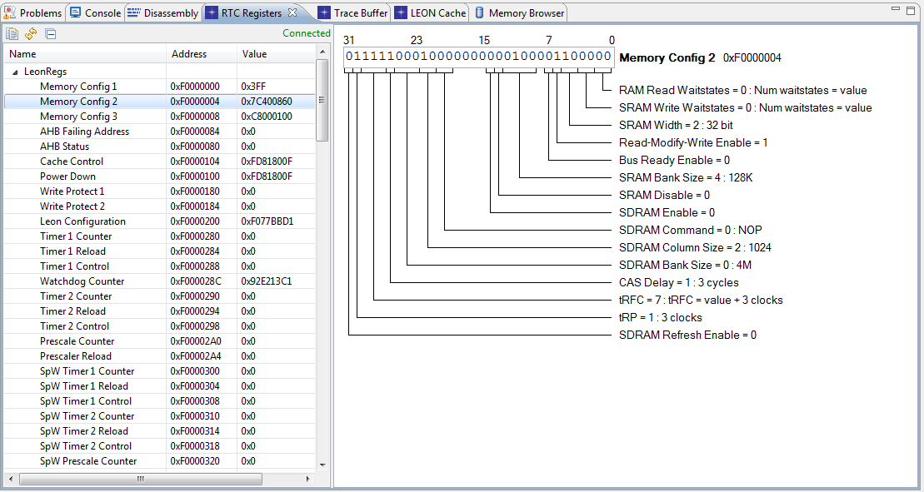
STAR SDE Castor Support
View and edit LEON2-FT register values

Slide 13
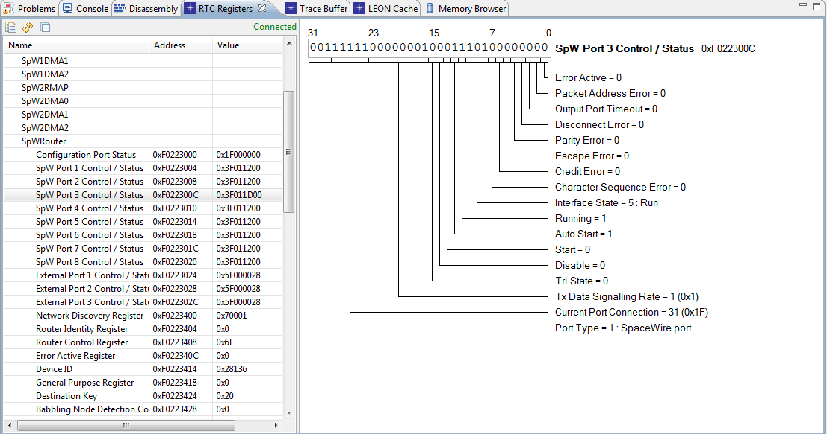
STAR SDE Castor Support
Control and debug all SpaceWire peripherals

Slide 14
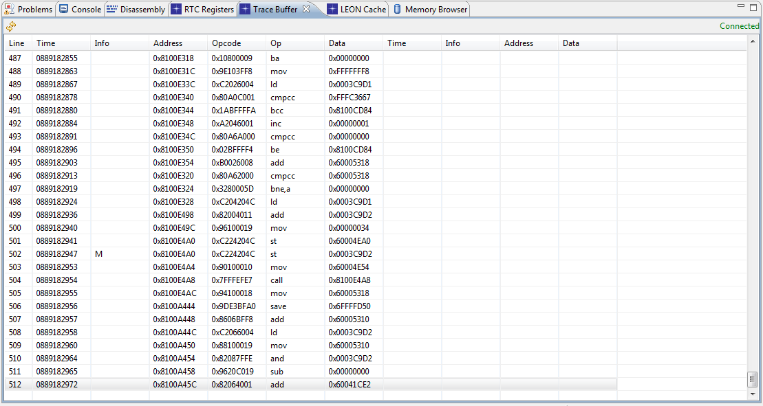
STAR SDE Castor Support
Trace Buffer

Slide 15
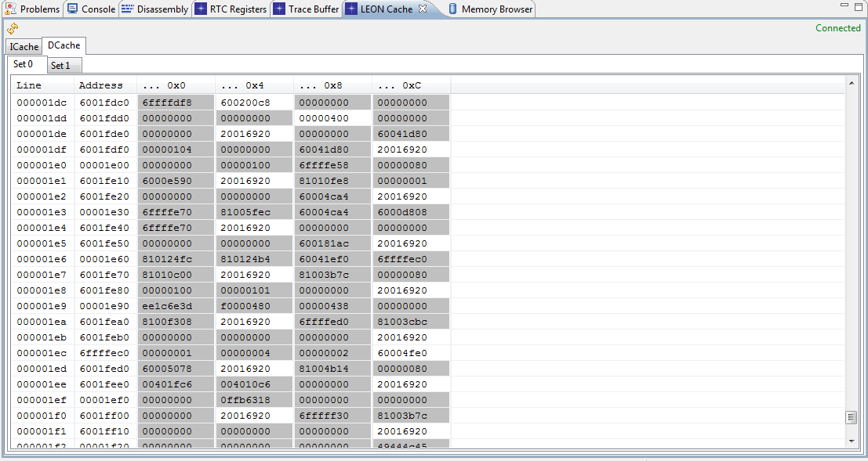
STAR SDE Castor Support
LEON Cache

Slide 16
Porting RTEMS to Castor
Creating a BSP
Does a BSP for this board exist?
Does a BSP for a similar board exist?
Is the board’s CPU supported?
Board initialisation
Device drivers
Clock
Console
Other devices

Slide 17
Features of The Castor Port
Based on existing LEON2 BSPs
Clock and console drivers
SpaceWire DMA channel driver
SpaceWire RMAP Target & Initiator driver
Other device drivers to follow…
Port to AT7913 (RTC) performed in parallel

Slide 18
Achievable Performance
Expected performance for a 200MHz clock:
150 MIPS, 40 MFLOPS
Low interrupt latency (~4µs)
SpaceWire transmit/receive up to maximum theoretical data rate (maximum link speed 200 Mbits/s)
Three engines operating in parallel, autonomously (assuming no port contention)

Slide 19
Introduction to SpaceWire-D

Slide 20
Deterministic SpaceWire
Want to use SpaceWire for control applications
Determinism is essential
Determinism means:
Predictable
Delivery within specified time constraints
A single SpaceWire link is deterministic
A larger network, with multiple masters, is not

Slide 21
Time-Slots for Managing Access
Time-Code 6
Time-Code 7
Time-Code 8
Time-Slot 6
Time-Slot 7
SpaceWire time-codes used to define time-slots
Time-slot has same number as time-code that starts the time-slot
64 time-slots

Slide 22
Determinism With Time-Slots
Time-slot in 1 to 15.625 ms range (typically)
Epoch of 64 time-slots around 0.1 to 1 second
Allows writing/reading between 20 and 300 KBytes per time-slot
For a 200 Mbits/s network
Sufficiently timely for avionics applications

Slide 23
Schedule
Schedule arranged to avoid conflicting use of network resources
In a single slot can have:
Parallel Initiators with non conflicting Targets or groups of Targets
Single Initiator that can send commands to any Target

Slide 24
SpaceWire-D Services
Static Bus
Deterministic
Transaction group
Dynamic Bus
Not deterministic
Transaction group
Asynchronous Bus
Not deterministic
Individual transactions with priority
Packet Bus
Not deterministic
Sends and receives SpaceWire packets using RMAP

Slide 25
Schedule
Time-Slot
Bus
Schedule allocates time-slots to buses
Each initiator has a copy of the schedule
Targets only respond so do not need to know the schedule
0
Static 0
1
Dynamic 1
2
Static 2
3
Async 3
4
Static 4
5
Async 5
6
Async 5
7
Dynamic 7
8
Empty
9
Dynamic 1
10
Dynamic 7
11
Packet 11
12
Packet 11
13
Packet 11
14
Packet 11
…
…
61
Static 61
62
Dynamic 7
63
Static 63

Slide 26
FDIR
Initiator can check that all transactions completed by time next time-code received
Can do this because RMAP transactions can provide acknowledgement
If an error is detected,
Can notify network manager
If it happens again can cease sending and notify network manager
Etc.
RMAP, time-code and schedule provide a means of detecting faults.

Slide 27
SpaceWire-D Summary
Provides deterministic data delivery
Using RMAP to provide basic communications
Operates over existing SpaceWire network
Using existing RMAP target devices
SpaceWire-D initiators can be implemented in software
Allows SpaceWire to be used for:
Time critical avionics applications (e.g. AOCS)
Concurrently with payload data handling
Draft specification under review
Written by University of Dundee under ESA contract
Based on requirements from industrial partners

Slide 28
SpaceWire-D Demo System
Being developed by the University of Dundee
Under SpaceWire-D protocol definition ESA contract
Multiple initiators
AT6981E Castor processors
Multiple targets
Hardware targets
Software targets
Castor
AT7913E RTC processors
Test all types of “virtual bus”
Explore effective scheduling algorithms

Slide 29
SpaceWire-D on Castor

Slide 30
SpaceWire-D on Castor
Networking software built with RTEMS 4.10.2 and the Castor BSP
Main components:
API for opening/loading/closing buses and setting initiator, target and system parameters
Bus controller for executing virtual buses
Virtual bus data structures
RMAP initiator driver
SpaceWire router driver

Slide 31
SpaceWire-D System Overview
Wait for a time-code to arrive
Execute an open bus or prepare an asynchronous bus queue (explained later)
Return bus
Schedule
Time-code IRQ
Router Driver
New time-slot
Bus Controller
Check for bus
Dispatch
Send RTEMS event
RMAP Driver
Async. Bus Queue

Slide 32
SpaceWire-D API
Provides the services described in the standard
For each type of bus:
Open bus
Load bus
Close bus
Helper functions for configuring initiator, target and system parameters and building data structures

Slide 33
Opening a Virtual Bus
Opening a bus takes 3 parameters
A requested slot for a static bus or a list of slots for a dynamic, asynchronous or packet bus
A slot size if the bus needs to execute large transactions across multiple time-slots
A list of targets that the bus is allowed to initiate with

Slide 34
Maintaining Determinism
In order to remain deterministic, an initiator should only open a bus that will not introduce the possibility of blocking
i.e. the paths between an initiator and the targets should not conflict with other initiator/target pairs already operating in the same time-slot
Research into scheduling algorithms is ongoing at the University of Dundee

Slide 35
Independent Virtual Buses
Two virtual buses with no shared links can operate in the same time-slot without blocking
TAR
INI
INI
RTR
TAR
RTR
INI
RTR
TAR
TAR
TAR

Slide 36
Independent Virtual Buses
Two virtual buses with no shared links can operate in the same time-slot without blocking
TAR
INI
INI
RTR
TAR
RTR
INI
RTR
TAR
TAR
TAR

Slide 37
Loading a Static or Dynamic Bus
Loading a bus differs depending on the type of bus
Static bus:
Takes a group of transactions and an execution mode
Single-shot mode executes a transaction group once
Repeating mode executes the transaction group in each time-slot until the bus is unloaded or closed
Dynamic bus:
Can load two transaction groups
Current group, executed in the next available time-slot
Next group, replaces the current group once it has been executed

Slide 38
Loading an Asynchronous Bus
Asynchronous bus:
Loaded with single RMAP transactions
Inserted into a priority queue, first ordered by priority (0-7) then by insertion time
In the time-slot preceding an asynchronous bus, the queue is prepared:
Extract a subset of transactions from the queue and sum their execution times until no more transactions will fit in a time-slot
To calculate execution time, initiator, target and system details are required such as target response time, link speeds and the number of routers in initiator/target paths

Slide 39
Asynchronous Queue Extraction
Example queue extraction
Asynchronous Queue
Extracted Transactions
Priority | Counter | Time (µs)
0 | 0 | 600
0 | 1 | 500
1 | 2 | 125
1 | 5 | 50
2 | 3 | 150
3 | 4 | 300
3 | 7 | 100
5 | 6 | 90
Priority | Counter | Time (µs)
0 | 0 | 600
1 | 2 | 125
1 | 5 | 50
2 | 3 | 150
 | Total | 925
Extract (1ms)
+ Overheads <= 1ms

Slide 40
Asynchronous Queue Implementation
Implemented as a min-heap
Higher priority transactions that won’t fit can be temporarily removed from the queue in favour of lower priority transactions that will fit
Ordering is based on a priority level and an insertion time so reinsertion maintains the original ordering
Preparation takes place in preceding slots to minimise initiator response time when a time-code is received

Slide 41
Closing a Virtual Bus
When the bus is no longer required it is closed
Frees any schedule slots associated with the bus

Slide 42
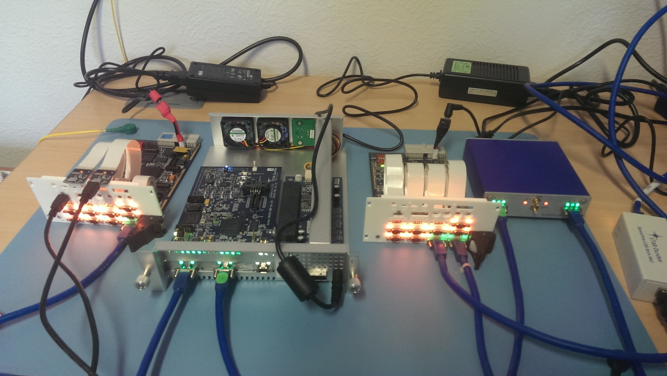
SpaceWire-D Demo System
Castor-cPCI
Castor-PCIe
Castor-cPCI
Link
Analyser Mk2
Brick
Mk2

Slide 43
Problems Encountered
Minimising initiator response time
First iteration used events to notify a dispatcher task when a time-code arrived
Dispatcher then used open/ioctl/close syscalls in the RMAP driver
This design was too slow so it was changed to
Remove syscalls and call driver functions directly
Remove events and initiate the first block of transactions from the router ISR (~10µs)
Reduced the initiator response time from ~380µs to ~25µs

Slide 44
Current Performance at 40MHz
Initiator response time measured from a time-code received until the first RMAP command leaves the router
~25µs
Castor RMAP target response time measured from when a command is fully received until a reply leaves the router
~2µs
Initiator post-processing time measured from a reply being received until the next RMAP command leaves the router
~7µs

Slide 45
Summary
Castor chips will be available next year
STAR SDE support is almost complete
RTEMS basic support is complete
Additional drivers will be added in future
SpaceWire-D draft specification is under review
Presented to the SpaceWire Working Group last week
SpaceWire-D implementation and testing on Castor ongoing
Any questions?

