Slide 1
Launch Into Intrafascicular Space
Design considerations for implanted medical devices
Douglas Kerns, Sigenics Inc.
Notes:
Intro: describe the general nature of Sigenics business, disclose ownership interest in Sigenics

Slide 2
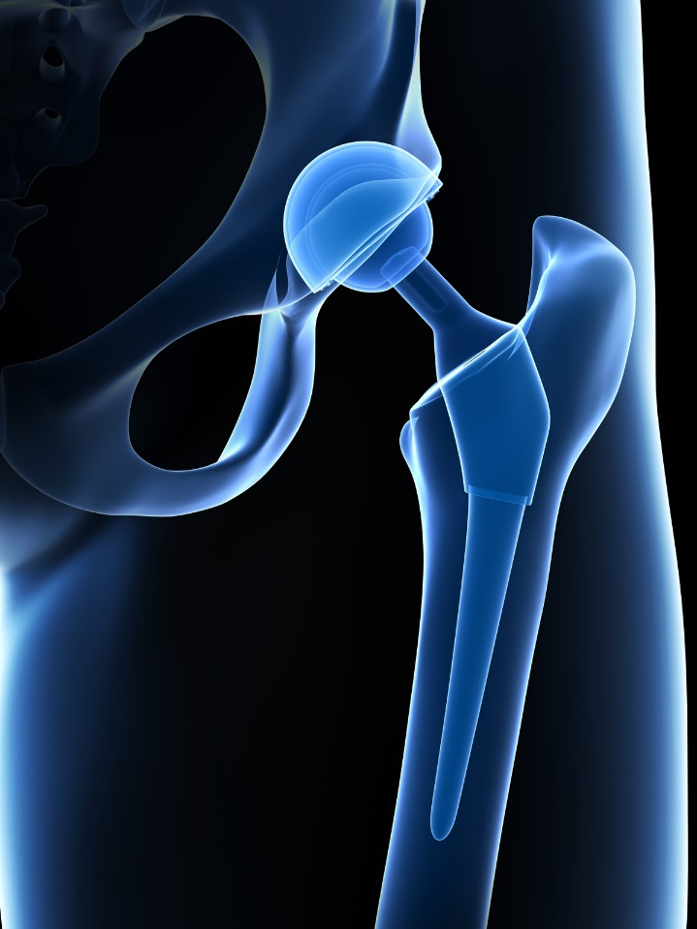
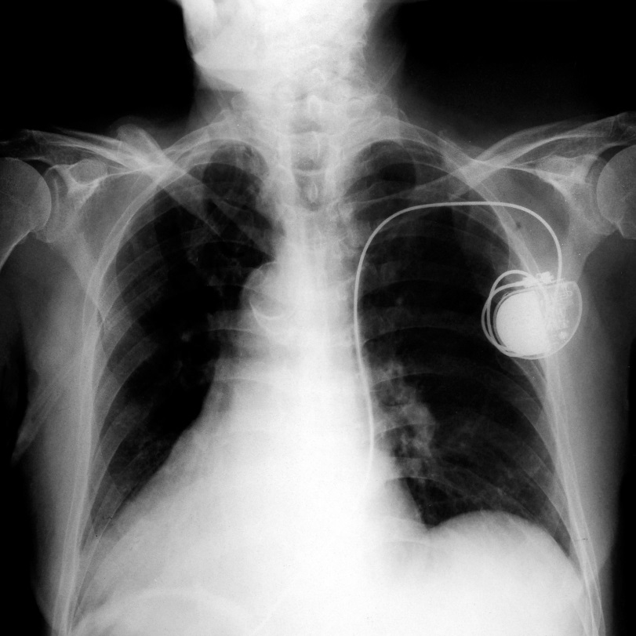
Implanted medical devices have a variety of functions
fixing broken hearts
fixing broken teeth
fixing broken bones
Notes:
Some familiar examples of implanted medical devices are things like dental fillings and crowns, hip and other joint replacements, and pacemakers. Sigenics is involved in designing electronics for newer medical devices, such as prosthetic limbs, and nervous system diagnostic and therapeutic devices.

Slide 3
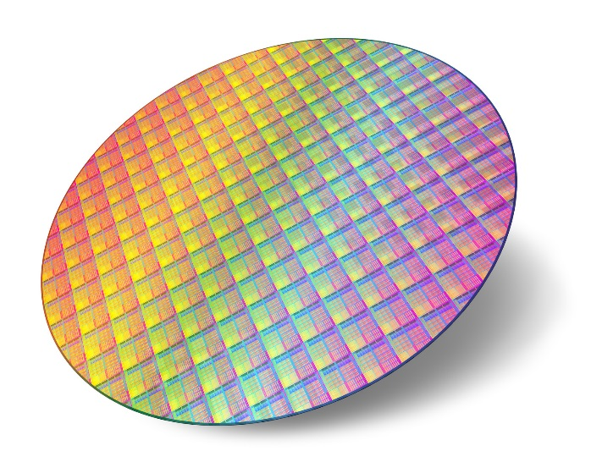
Sigenics makes integrated circuit microelectronics. What’s so great about integrated circuits?
Lithographic manufacturing (printing!) process make ICs a very inexpensive method for manufacturing huge quantities of electronic devices.
Microscopically small features make ICs a very effective method for reducing size, weight, and power of electronic devices.
This is a key item for implanted medical electronics!
Notes:
Sigenics primary business is integrated circuit microelectronics. Lithographic printing technology has developed into the preferred manufacturing method for most types active electronic devices.

Slide 4
The primary constraint on medical devices is SAFETY
Do no harm!
Notes:
Medical devices are required to be “safe,” that is, to not cause undue harm to the patient or the doctor throughout the entire course of usage.
Of course, nothing can be made perfectly safe.

Slide 5
The primary constraint on medical devices is SAFETY
Do no harm!
The primary requirement for medical devices is EFFICACY
Do some good!
Notes:
The idea is to find a reasonable compromise, so the device accomplishes significantly more good than harm.

Slide 6
In general, how are “safety” and “efficacy” rendered in an implanted medical electronic device?
SAFETY = minimize surgical invasiveness during and after implant
small implant size
biocompatible materials
minimize or eliminate secondary surgeries for repair or replacement

Slide 7
In general, how are “safety” and “efficacy” rendered in an implanted medical electronic device?
SAFETY = minimize surgical invasiveness during and after implant
SAFETY = choose operating and communication protocols to avoid unsafe conditions
As much as possible:
Limit the scope of autonomous machine actions
Limit the impact of autonomous machine actions
Use handshake protocols for control communications

Slide 8
In general, how are “safety” and “efficacy” rendered in an implanted medical electronic device?
SAFETY = minimize surgical invasiveness during and after implant
SAFETY = choose operating and communication protocols to avoid unsafe conditions
SAFETY = design safe failure modes for hardware, software, protocols
safe under any single-point failure
positive “good” diagnostic indicators wherever practical

Slide 9
In general, how are “safety” and “efficacy” rendered in an implanted medical electronic device?
SAFETY = minimize surgical invasiveness during and after implant
SAFETY = choose operating and communication protocols to avoid unsafe conditions
SAFETY = design safe failure modes for hardware, software, protocols
EFFICACY = whenever possible, design for continued function under partial failure
handshake-and-correct communication protocols
survive single-channel damage or failure
safe single-channel shutdown

Slide 10
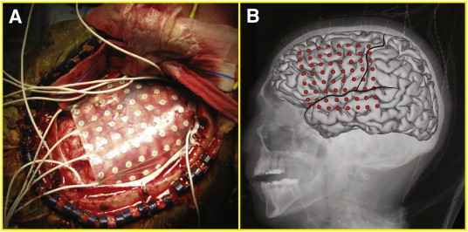
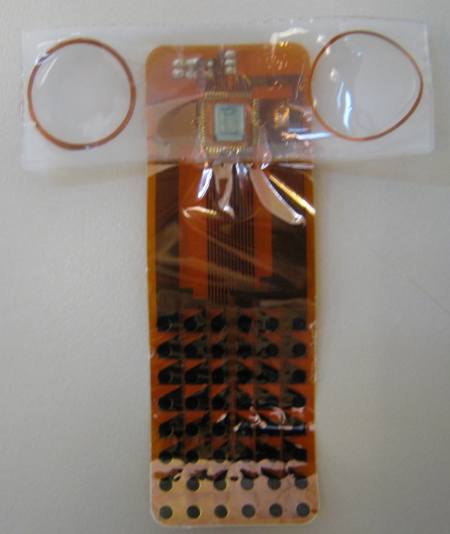
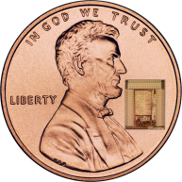
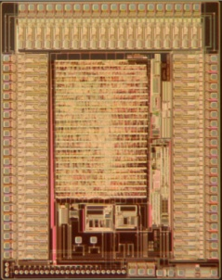
Example: epilepsy ElectroCorticoGram (ECOG) array
Current Method:
New Method
Wirelessly powered
Skull is closed during monitoring
64 recording and stimulation channels
Up to 1Mbps reverse telemetry rate
Iridium oxide electrodes deposited on flexible polyimide substrate
Silicone chip and coil encapsulation
Notes:
An example is a device currently under development, supported by an NIH research grant, for diagnosis of severe epilepsy.

Slide 11
We lose physical access to the device after it is implanted – it’s been “launched”
SAFETY: In the worst case, we want the implanted object to do no harm.
All exterior surfaces must be biocompatible
Worst-case electrical failure yields an inert mechanical object
EFFICACY: Observability and controllability of the implanted electronics
Status reporting for operational variables
per-channel diagnostic functions
per-channel shutdown
Notes:
An example is a device currently under development, supported by an NIH research grant, for diagnosis of severe epilepsy.

Slide 12
“Up link” to the implanted device
wireless power supply (look Ma, no batteries!)
small size (small tissue displacement when inserted)
small mass (small tissue disturbance during patient motion)
no need to replace the batteries (eliminate subsequent surgeries)
limited electrical energy delivery
Forward communication protocol
At most one stimulation pulse per command
Forward error control coding in packet wrapper
Handshake command protocol
By design, we avoid a variety of unsafe conditions
Notes:
An example is a device currently under development, supported by an NIH research grant, for diagnosis of severe epilepsy.

Slide 13
“Down link” from the implanted device
multiple communication bands
dodge external interference
compensate for marginal power supply conditions
flexible communication protocol
structured error control coding
detailed reporting of uplink errors
programmable packet framing and payload structures
By design, we can recover from a variety of partial failures
Notes:
An example is a device currently under development, supported by an NIH research grant, for diagnosis of severe epilepsy.

Slide 14
Operational features of the implanted device
Finite state machine controller
exhaustively verifiable
all states lead to INIT
“no action” response to garbled uplink command
Fail-safe hardware features
all i/o terminals passively clamped inside “water window”
no single-point failures can connect power directly to electrode
per-channel disable-and-disconnect
Notes:
An example is a device currently under development, supported by an NIH research grant, for diagnosis of severe epilepsy.

Slide 15
Graphics credits
This presentation used artwork obtained via CanStockPhoto from the following artists:
Krisdog, Roxanabalint p1
Khuruzero, Eraxion, Ingridat p2
Scanrail p3
Pixdesign123 p4
Pixdesign123 p5

