Slide 1
LADEE Simulation for Mission Operations
Nathaniel Benz
Millennium Integration and Engineering Co.

Slide 2
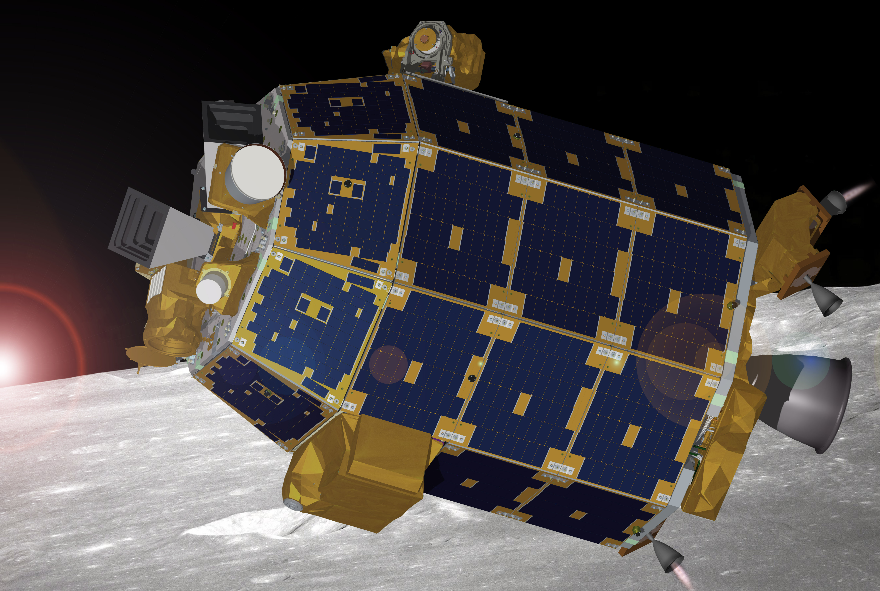
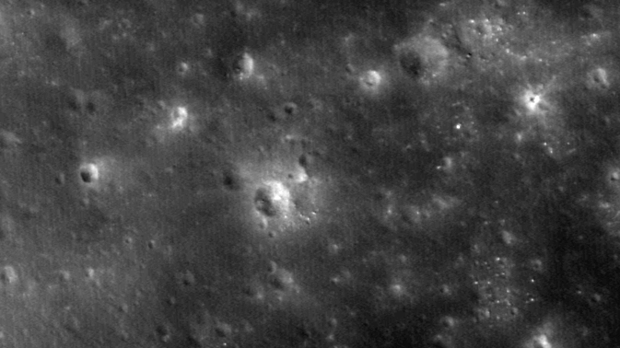
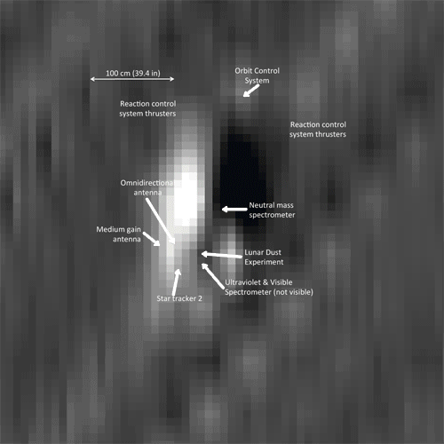
LADEE Mission Overview
Lunar Atmosphere and Dust Environment Explorer (LADEE) was a NASA mission that will orbited the Moon and its main objective is to characterize the atmosphere and lunar dust environment.
Low cost, minimal complexity and rapidly prototyped “common bus” design.
Model-Based Software Development
Determine the global density, composition, and time variability of the lunar atmosphere;
Laser Communications Demonstration: 622 Mbs Record download rate from the Moon!

Slide 3
Overview of simulators

Slide 4
LADEE Simulator Overview
Simulator | Platform | Description
WSIM Workstation Simulations | Simulink on Windows, Mac, or Linux computers | Models of GN&C, Prop, Power, & Thermal Used by FSW to generate and test algorithms. Provided to MOS for full sequence verification. Much faster than real time (~10-50x) depending on selected fidelity of models and platform.
PIL Processor-in-the-Loop | PPC750 Processor(s) in Standalone chassis | Includes all flight software functionality. Runs on 1 or 2 processors. Multiple copies maintained by FSW as inexpensive system for real time software & fault management development. Multiple copies provided to MOS for Training, GDS development, and Operations.
HIL Hardware-in-the-Loop | Avionics EDU with simulated vehicle hardware. | Highest fidelity simulator includes hardware interfaces. One copy maintained in FSW lab for software & fault management development and characterization. Inexpensive version (no power cards) provided to MOS and I&T. Runs in real time.
Notes:
As a review from Danilo’s presentation, there are three simulators built by the LADEE Flight Software Team. Worksatation Sim or WSIM, Processor in the Loop or PIL, and Hardware in the Loop or HIL.

Slide 5
WSIM
Model
Library
Simulation
Sim Cmd Products
Spacecraft
Model
Dyn
Eff
Sens
Flight
Software
FSW Cmd Products
Local Workstation
Simulink Only - No Autocoded or Handwritten Software (cFE/cFS, TO, CI…)
GN&C, Prop, Thermal, Power Models –Control and Plant
Reads & Interprets ATS Source and STOL Proc Scripts
Limited functionality (eg. No Limit Checker Cmds)
Outputs simulator data and fsw telemetry (not CCSDS packets) to file
for post processing and analysis
Notes:
WSIM runs on a local workstation and contains models of the Flight Software Apps as well as models of the spacecraft and its environment. It runs about 30 times faster than real time.

Slide 6
PIL
FSW Cmd Products
Sim Cmd Products
PIL Simulator
Sim
Processor
COTS “Flight”
Processor
Spacecraft
Model
Flight
Software
Command and
Telemetry Software
(ITOS)
Dyn
Commands & Telemetry
(CCSDS Frames over UDP)
Eff
Sens
Shared Mem
Shared Mem
cPCI Chassis
Models autocoded and running on RT processors with Handwritten Software
(cFE/cFS, TO, CI…). Includes all FSW functionality.
Inexpensive “flight-like” processor
Utilizes ITOS
FSW C&T Interface (full dictionary)
Simulator Interface
CCSDS Frames over UDP
Can be separate workstations: Flight Controller, Sim Controller
Notes:
What we define as the PIL, some sometimes referred to as the 2PIL, runs on 2 flight like processors. One processor runs the flight software the other runs the sim. The PIL includes the entire flight software including CFE apps such Limit Checker, Command Ingest, Memory Scrub, and others. The PIL uses the same telemetry interface as Operations, ITOS, and runs in real-time. Operations had 6 PIL simulators.

Slide 7
HIL
FSW Cmd Products
Sim Cmd Products
Test Interface Computer (TIC)
Avionics Box
Command and
Telemetry Software
(ITOS)
Commands and Telemetry
(CCSDS Frames over UDP)
SACI
Spacecraft
Model
PAPI
Analog Out
PAPI
Dyn
Analog In
Commands and Telemetry
(CCSDS Frames over UDP)
Eff
Sens
Discrete I/O
Flight
Software
RS422
Shared Memory or TCP/IP
C&DH
DMOAB
Models autocoded and running on RT processors with Handwritten Software
(cFE/cFS, TO, CI…). Includes all FSW functionality.
Utilizes IAU EDU with “flight-like” interfaces.
Utilizes ITOS
FSW C&T Interface (full dictionary)
Simulator Interface
CCSDS Frames over UDP
Can be separate workstations: Flight Controller, Sim Controller
Notes:
The HIL simulator utilizes the Integrated Avionics Unit to create “flight-like” hardware interfaces, it is the simulator used to test avionics hardware commands. The HIL also uses ITOS as user interface and runs in real-time.

Slide 8
Simulator Uses in Ops
Use | Description | Simulator
Tactical Cycle | Provide an accurate simulation for verification of maneuver plans during flight phase | WSIM: Verification of ACS aspects of command products. Spacecraft anomaly analysis. PIL: Verification of maneuver plans. HIL: Spacecraft anomaly troubleshooting.
Development | Pre-flight verification of command sequences and ground procedures, troubleshooting during both development and flight phases | PIL: Verification of spacecraft command sequence templates and ground procedures HIL: Verification of products that contain hardware-type commanding .
Training | Provide a realistic flight environment to support SIMs and ORTs | PIL: Thread tests of operations procedures. HIL: ORTs and Rehearsals.
Notes:
The simulators were developed by the Flight Software team primarily to design and test the onboard software. Knowing that Mission Operations would need a spacecraft simulator, requirements were also placed on the simulator so that it could be used seamlessly with Ops. There were 3 main categories at Ops where the Simulators were used. First in what is called the Tactical Cycle, which is phase were the spacecraft command sequences are generated. WSIM was used as a fast-time verification of the entire command sequence. The PIL was used if the command sequence contains a maneuver. And the HILL is used (along with other simulators) to debug anomalies when they happened. Before flight the simulators were used in the development phase. Operations used the PIL and HIL to test out command sequence templates, utility scripts and flight procedures. Finally, before flight the HIL was used as a training environment for the operations team during the Operational Readiness Testing campaign.

Slide 9
Development and Testing of Mission Ops Products

Slide 10
Ops Testing with Simulators
Product | Description | Simulator Use
Utility STOL Procedures | Scripts used in command plans executed by Operations Command Controller. Also used by systems team to process flight data. | Script unit tested and peer reviewed on PIL or HIL. Most script exercised in Sims or ORTs
Ops Utility RTS | Pre-defined relative time command sequence files can be used in ATS or command plans. Ops RTSs developed by S/C engineers. | Ops RTSs unit tested and peer reviewed on PIL or HIL.
ATS Templates | Common sequence of commands for repeated tasks such as maneuver sequence or Com profile. | Developed and tested on PIL or HIL Verified during SIMs and ORTs
Notes:
In the development cycle the PIL simulator was used by Ops for three types of products. The first, utility STOL proc scripts used by the command controller to execute space craft commands. For example uploading and downloading files. These also include procedures developed by the Flight Director such as procedures and contingencies for LOI. The second area is utility RTSs. RTS is a relative time sequence file, as opposed to ATS which is an Absolute Time Sequence File. A utility RTS execute repeated spacecraft tasks, for example the prop team had an RTS to run the prop heaters to thermally condition the prop tanks. The third type of product is an ATS template. An example of template would be during a maneuver there is a set of commands that are always exected in a certain order but some information like duration of the burn is a parameter that is entered into the template. These template files are tested before flight on the HIL and PIL and also during the SIMs and ORTs.

Slide 11
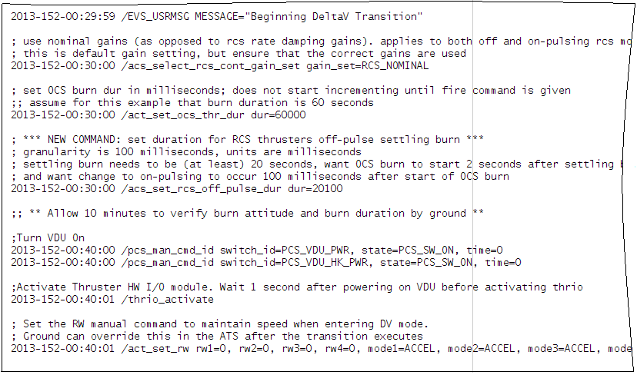
Example ATS/RTS
Absolute Time Sequence
Relative Time Sequence
Notes:
Here is an example of what an ATS and RTS look like. An ATS executes commands at a specific spacecraft time while the RTS executes a command at a relative time to the last command.

Slide 12
Mission Simulations

Slide 13
Mission Simulations
Train and certify operators during Operation Readiness Testing (ORTs)
HIL used to simulate nominal operations for
Launch and Activation
Phasing Loop Maneuvers
Lunar Orbit Insertion (LOI)
5 Day Science Orbit + Orbital Maintenance Maneuver
Spacecraft Anomalies injected to test operator response
Simulation runs 24 hours a day and events happen and same time of day as flight.
Notes:
Since the HIL use the same command and telemetry interface as used in flight, the HIL was used to train the operations team on console. This allowed the team to see see what the flight data would look like. There were several training events called “Sims” which were short in duration and contained only a subset of team. There were also 4 ORTs that simulated Launch and Activation, Phasing Loop Maneuvers, Lunar Orbit Insertion and a typical 5 Day Science week with a maintenance maneuver. The ORTs required all mission operators on staff during the mission and simulated events in real-time and at the time of day they would happen in flight. For example the LOI event started at 9PM on Friday with the critical burn around 2AM in the morning. During the ORTs there was a test conductor that had the capability to inject “faults” into the simulator to test the operators response. The method to inject faults is the same used by the Flight Software team to test flight software requirements such as fault management.

Slide 14
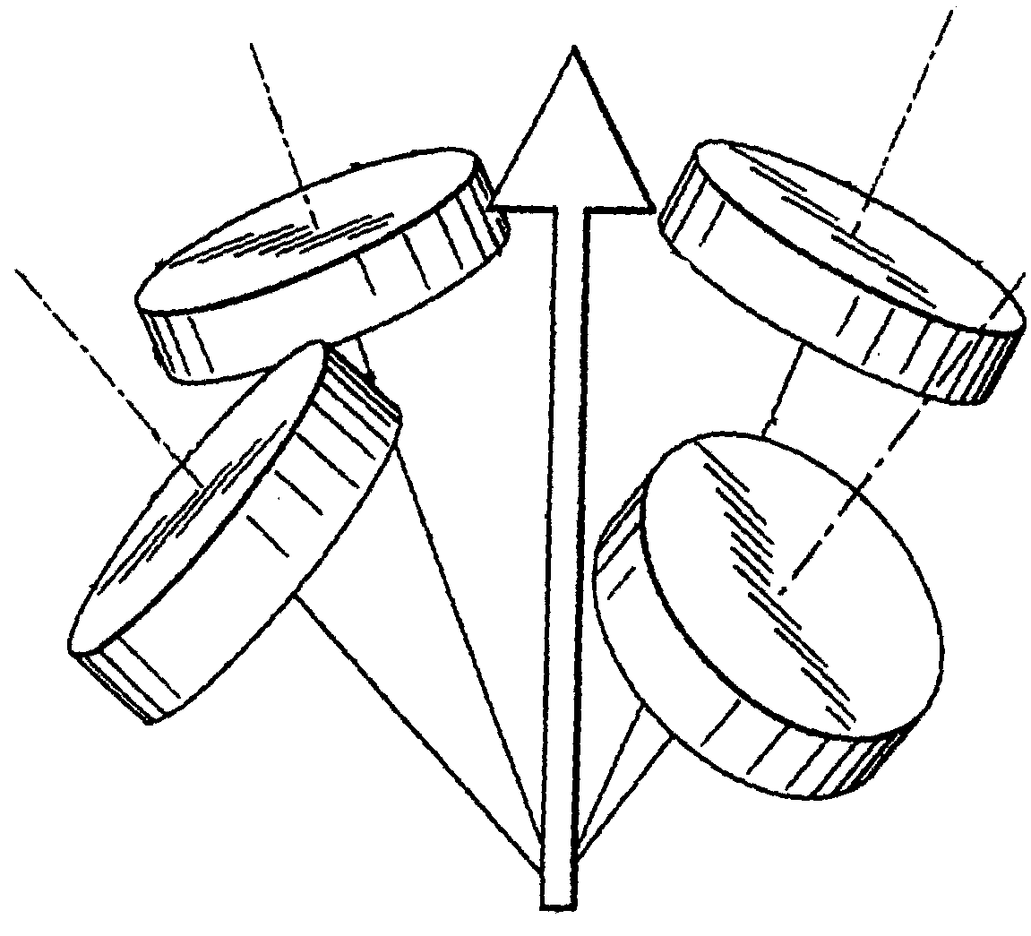
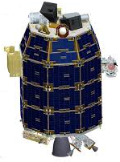
Example Fault Injection
Launch and Spacecraft Activation simulation
Polarity of 1 reaction wheel reversed during sim initialization.
Faulty wheel spun up to top speed causing 3 other wheels to try and counteract.
S/C unable to control attitude, one side “stuck” facing sun causing temps to increase
On Actual Launch Day
Reaction wheel fault detection treated nominal behavior as anomalous and turned off all RWs
S/C unable to control attitude, one side “stuck” facing sun causing temps to increase
Cause of anomaly was different, but resulted with similar issues for flight team.
Notes:
One example of an injected fault was during the Launch and Activation ORT. The polarity of one reaction wheel was reversed. Meaning when the flight software commanded the wheel to spin one direction it would spin the opposite way. This caused the “bad” wheel to spin up to the max speed in the wrong direction and consequently the other three wheels spun up to max speed to try and counteract the bad wheel. Ultimately the spacecraft could not control its attitude and was “stuck” with the sun facing one side when it was suppose to be slowly rotating in safe mode. This meant the temperatures slowly increased on one side which made the thermal team nervous and required the GNC and FSW team to come up with a plan to diagnose and fix the glitch. Interestingly, on the actual launch day there was a reaction wheel problem that caused all 4 reaction wheels to power off and left the spacecraft in a similar state as the Simulation where one side of the spacecraft was stuck facing the sun and began to heat up. The team was able to fix the problem, but many commented how the spacecraft was in a similar state as one of the simulations. Other faults injected during Mission simulations including increasing the lunar albedo and radiant intensity so temperature were hotter than expected, creating a “hot” burn on the main thruster during LOI so that a trajectory correction was required, software reboots, EDAC errors, heater failures, fuses blown, damaged solar arrays and several other which really demonstrated the extent to which the spacecraft and its environment were modeled. And importantly tested the team and all of the procedures of operations before flight.

Slide 15
uplink Verification

Slide 16
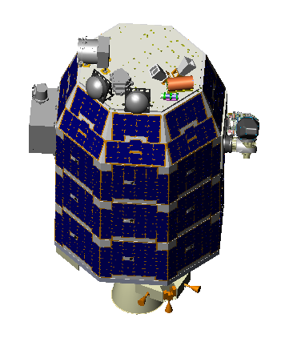
Science Phase Ops Overview
Instrument Activity Requests
Orbit Allocation
Science Analysis
Strategic Planning
Telemetry
Engineering
Activity Requests
Engineering Analysis
KEY
Engineering
Skeletal
Plan
Science Ops
Flight
Dynamics
Products
Maneuver
Planning
Orbit
Determination
Engineering Analysis
Flight Dynamics
Mission Planning
Attitude Planning
Maneuver
Verification
Tracking
Real-Time Ops
Tactical Planning
Command Sequencing
Command Verification
Commands
Notes:
For mission planning, inputs are provided by spacecraft engineering team, flight dynamics team, and science to the mission planning team. The last step before commands are uploaded to the spacecraft is command verification which uses WSIM and sometimes the PIL simulator.

Slide 17
Simulation Verification Workflow
Initial S/C state
from SET
Candidate ATS
WSIM
Propagated
State
Fix ATS
Previous ATS
Ephem File
From Tracking
WSIM
Sequence
Rejected
Attitude file
for STK
2PIL
Maneuver?
Propagated
State
Check Flight Rules
Check Flight Rules
Failed Any
Checks?
Pass All Checks?
Sequence Passes
Simulator
Pass All Checks?
Failed Any Checks?
Notes:
The chart shows the process flow of the Uplink Verification Engineer. Initial conditions are propagated to the start of the new ATS. The NEW ATS is simulated using WSIM and a report is automatically generated checking flight rules. A typical science phase ATS is 3 days long so that fact that WSIM runs 30 times faster than real time is crucial. If any flight rules fail the uplink verification engineer works with the mission planner, flight dynamics and/or the spacecraft engineering team to resolve the issue and generate a new ATS. If there is a maneuver in the ATS than the 2PIL is also used to verify that sequences.

Slide 18
Example FR Check by WSIM
FR-PL-LDEX-006 : LDEX Solar Pointing Constraint
LDEX’s Micro Channel Plate is sensitive to UV light, high voltage should be disabled when the sun is in the instrument FOV.
The Rule: LDEX instrument high voltage will be powered off at least 120 seconds before the sun is predicted to be within the instrument field of view (169 degree cone) and off for at least 120 seconds after the predicted time when the sun leaves the instrument field of view
Static Flight Rule Checker does not know where the sun is relative to the LDEX boresight
WSIM models sun position, sun in sight, S/C attitude, and instrument power cycles
Post processing script checks
Power on times for LDEX + buffer time
Is the sun in view at these times or is it blocked by the Moon?
Is the angle between the sun and LDEX boresight less than the half angle of the LDEX FOV at these times?
Notes:
Some flight rules can be checked by a static flight checker tool. But other flight rules can only be checked by WSIM. An example of a flight rule that is checked by WSIM is the LDEX Sun FOV flight rule. WSIM models position of the sun as well as the attitude of the Spacecraft.

Slide 19
Examples from flight

Slide 20
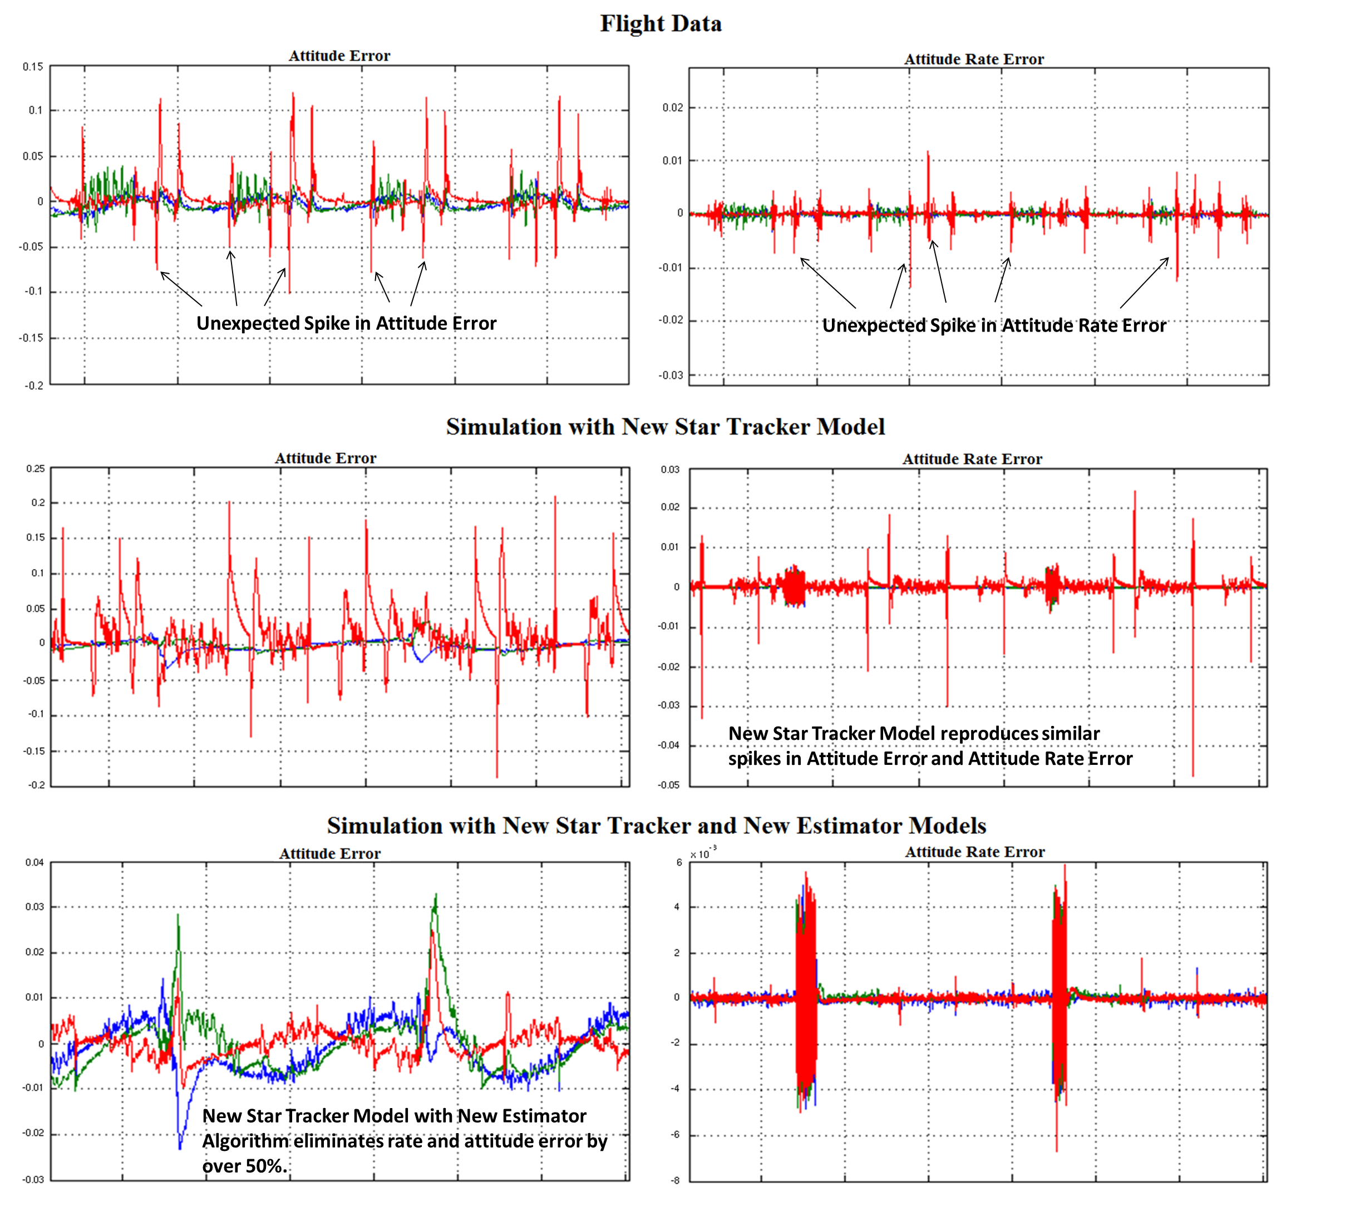
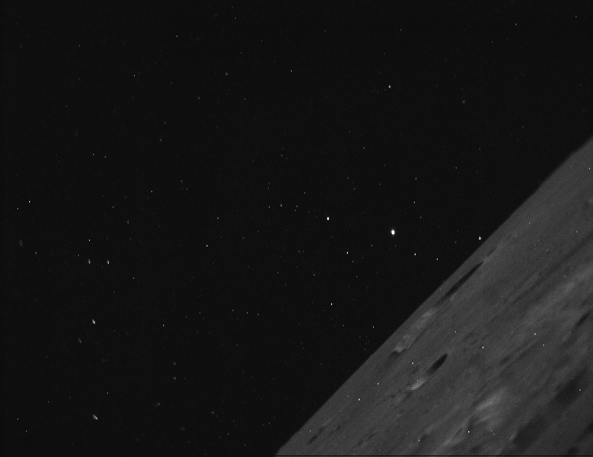
Debugging Star Tracker Anomaly
Notes:
One example from flight where WSIM was used to debug a spacecraft anomaly was when an issue with the star tracker arose. A few times during spacecraft checkout the fault management system transitioned the spacecraft into safe mode, due to an attitude error. The GNC team determined that the star tracker internal software had unexpected delayed measurement updates when a “Big Bright Object” such as the moon or earth entered the field of view. The GNC team used WSIM to update the star tracker model to reproduce the behavior which was seen in flight. Then the software team and GNC team developed a fix for the state estimator to compensate for irregular behavior. Results from WSIM were used to provide evidence to Operations Manager that the team understood the problem and that the proposed software change will fix the problem. Also while the team was developing the state estimator fix, the Uplink Verification team was able to use the updated star-tracker model to predict when future spacecraft commands might pose an issue.

Slide 21
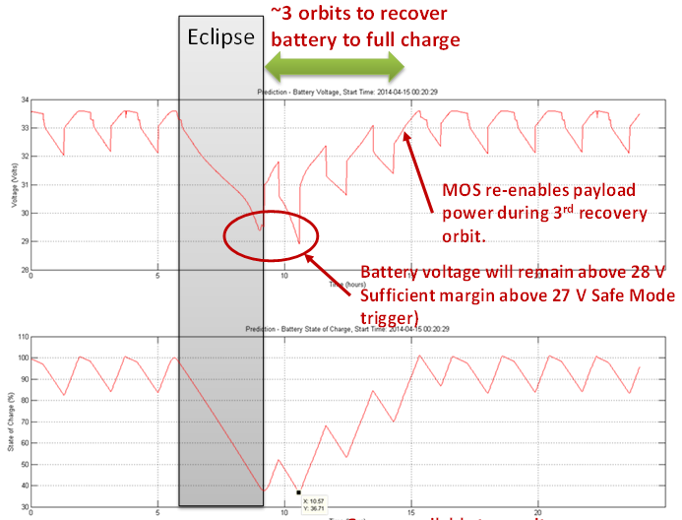
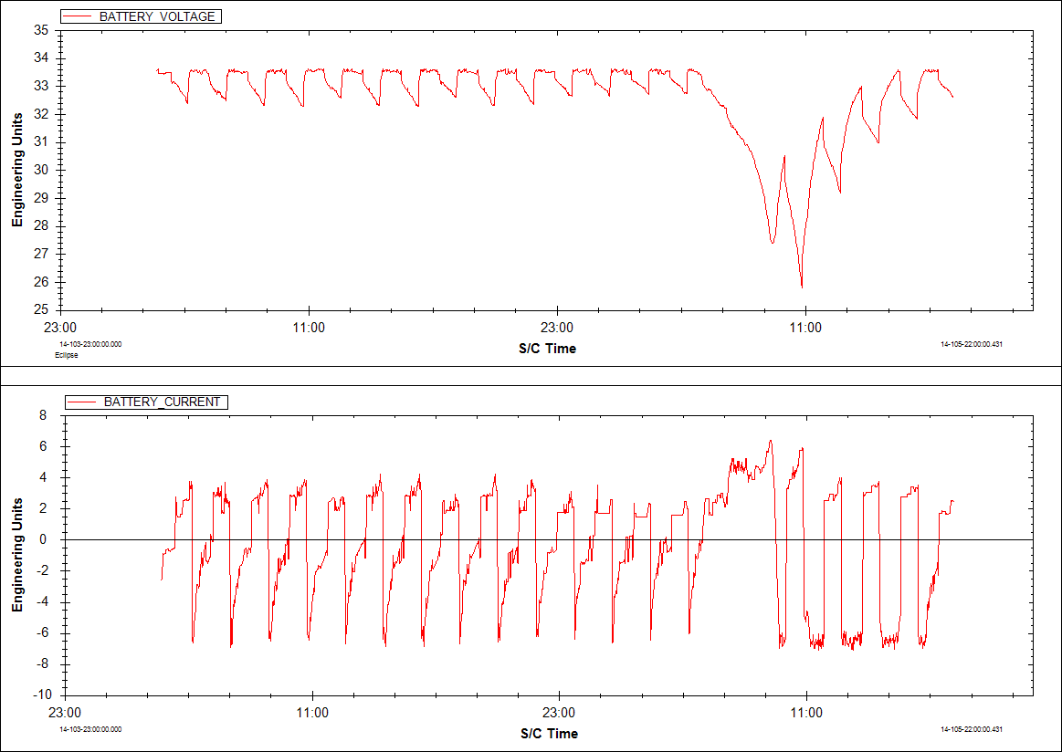
Power/Thermal During Eclipse
FLIGHT
Limit
PREDICT
Predicted Heater Power usage from thermal team model was 35W, actual was 93W
Discrepancy due to out of date heater set points and invalid assumption of constant battery voltage
WSIM model predicted safe mode due to low battery voltage to within 15 min of actual safe mode event.
Integrated multi-domain model can identify invalid assumptions and out of date parameters.
Notes:
Another example which is more of a lesson learned, was during the lunar eclipse. LADEE was never designed to survive an extended eclipse and the original plan was to impact the moon before the eclipse. However since LADEE still had reserve propellant, NASA Headquarters allowed an engineering test so spacecraft engineers can asses the Common Bus’s performance during an extended eclipse. The Power prediction was that the battery voltage would not drop below the voltage shed limit where the fault management would start shutting off instruments and heaters. The power prediction used inputs from the thermal team temperature model and thermal power load prediction. WSIM on the other predicted there would be voltage limit reached. In flight the spacecraft did reach the voltage shed limit within 15 minutes of the WSIM prediction. Post-eclipse analysis showed the main reason why the predicted battery voltage was off was because the thermal power load from heaters was more than twice the prediction. This was because heater set points used by the thermal model did not match the values of the flight software. The thermal model also made an assumption of constant battery voltage. While the thermal model’s prediction of temperatures were accurate the WSIM model correctly predicted the safe mode event because it is an integrated multi-domain model. WSIM has the actual models of the flight software, thus it had the correct heater set points. It also had a model of the power system so there was no assumption of constant battery voltage.

Slide 22
Conclusions

Slide 23
Conclusions
Design & Analysis environment is merged with the FSW Development & Verification environment means updates are immediately available.
PIL and HIL simulators from auto-code create higher fidelity simulations for full onboard software and a tool for testing MOS products
Using the same telemetry interface as Operations and I&T allows simulator reuse and early testing
Ability to test software by injecting ”faults” provides a natural interface for the Operations Test Conductor to train mission operators.
WSIM can be used as a fast-time tool to debug flight anomalies and verify flight commands prior to upload.

Slide 24
Future Work
Rigorous comparison flight data and simulator performance
Adapt simulator for future missions and generalize if necessary for reusability
Take advantage of improvements and new features of Simulink

