Slide 1
Space Exploration Sector Overview for the
Flight Software Workshop
Michael Ryschkewitsch
JHUAPL
Michael.Ryschkewitsch@jhuapl.edu

Slide 2
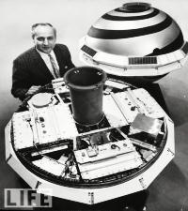
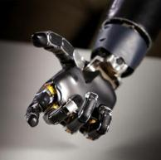
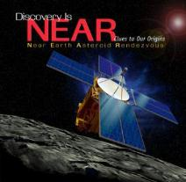
APL – Vision and Purpose
The Johns Hopkins University Applied Physics Laboratory was founded in 1942
  APL was initially founded for WWII research, specifically the proximity fuse.
  Johns Hopkins was the first research university in the US.
APL is designated as a DOD University Affiliated Research Center (UARC)
Notable technological successes at APL include satellite navigation, NEAR, Burnt Frost, human prosthetic work, MESSENGER

Slide 3
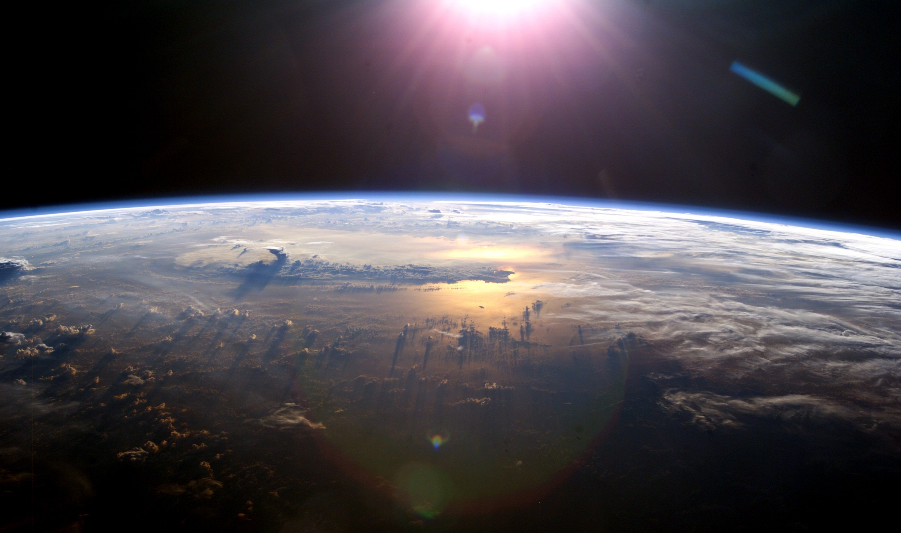
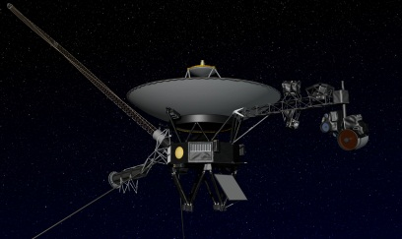
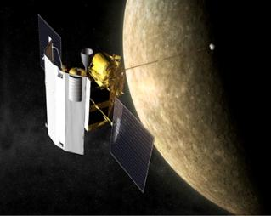
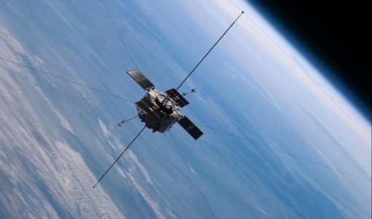
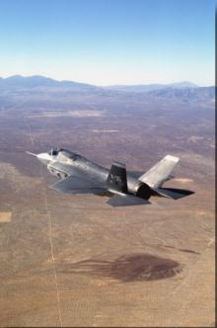
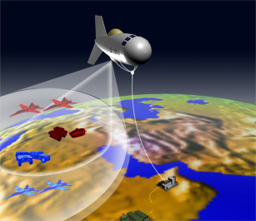
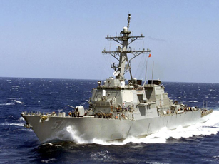
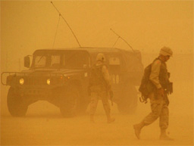
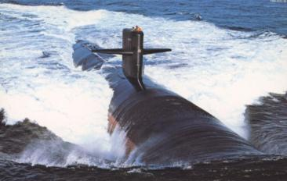
Breadth of APL Programs
Interstellar
Interplanetary
Earth Orbit
Air
Near-Space
Sea
Land
Undersea
Contributions Across Human and Robotic Domains

Slide 4
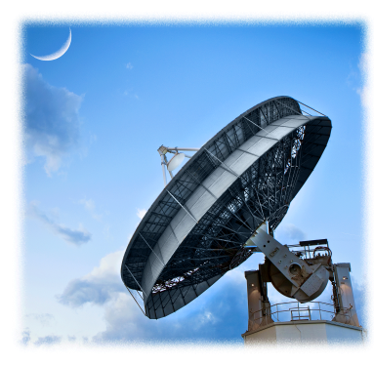
Space Exploration Sector
Founded in 1959 with a rich history of innovation and exploration spanning five decades
Full lifecycle systems engineering approach to mission implementation
  Design, build, test, operate and
  conduct both spacecraft and instruments for various science investigations.
Varied customer base enables
leveraging of technologies across
defense and civil applications
  Successful examples include: GUVI/SUSSI, MESSENGER antenna, communications technologies

Slide 5
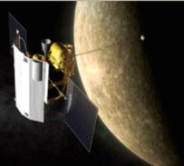
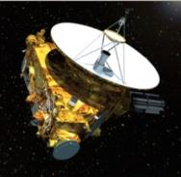
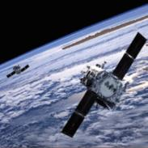

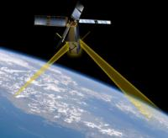
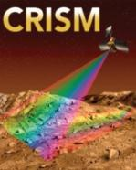
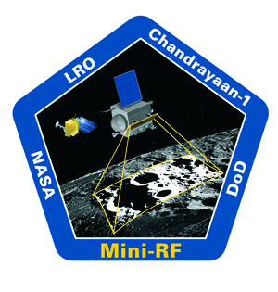
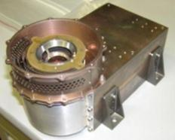
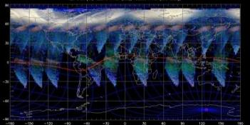
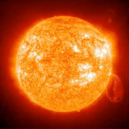
Space Exploration Sector Programs
Civil Space
National Security Space
Missions
Missions
SSUSI SEM-N
RB-SPICE
Instruments
Instruments
Planetary Heliophysics Earth
SBI/MGUE acquisition/GPS user equipment
Science Grants & Studies
Studies
ALHAT ASRG Connect
UDF for SSA/RF sensing/
Dynamic sensor tasking
Technology Development
NOAA Decadal Survey Planetary
Technology Development
SMC SMDC
Trusted Partner/Systems Engineering
Trusted Partner/Systems Engineering

Slide 6
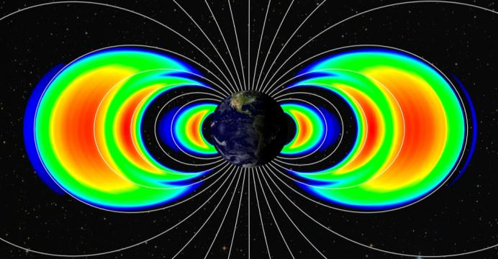
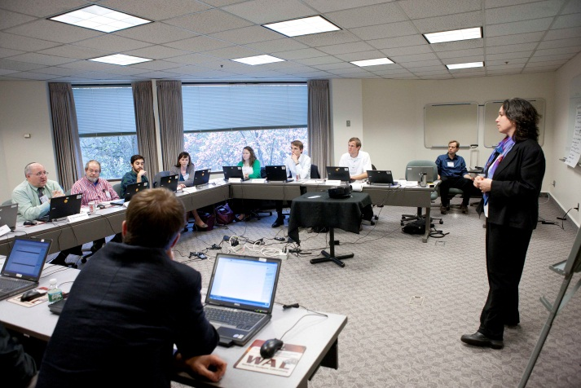
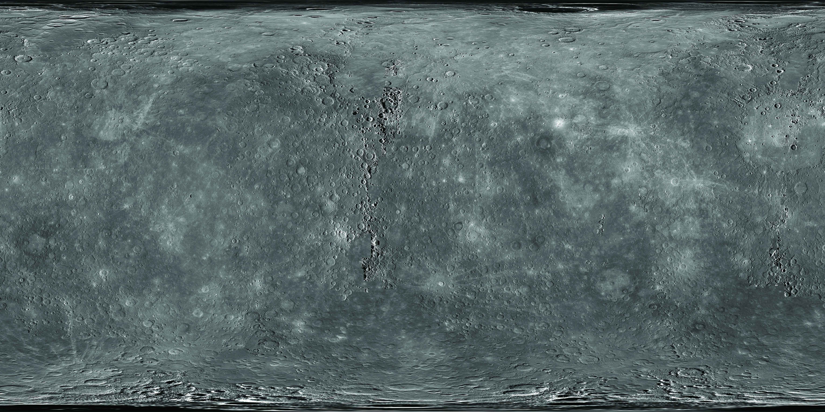
Civil Space Focus Areas
Heliophysics
Earth Science
Trusted Advisor
Planetary
Notes:
For staff, this chart is less important than the next one – effort should be made to present in a basic way: do NOT try to explain what SDP, SSA, SSS, ETO are, simply bumper sticker then as the next chart will describe them in more detail.
Key: Foundation of trusted agent: it is the same thing we do throughout the lab and that is best value for the sponsor. The lab executes end to end missions and systems if required. Some programs may only engage the front end concept development and analysis, some may execute through development and operations when needed. In either case, we are a trusted agent: if it exists sufficiently, we acquire and integrate it, if not we will develop it with partners and subcontractors.
The strategy is focused in four NSS core areas with a focused set of sponsors to engage, but then move to the next chart with the more detailed focus area decomposition (Why? Because the next one gets at the actual efforts that need to be pursued. It is a step closer to a functional context in which technical staff can think about their ideas and line management can consider priorities in terms to hiring and resource allocation).
Core sponsor focus for ETO: should be verbally indicated that US Army/SMDC is a critical focus as the Army is the largest consumer of space-generated products and SMDC has the mission to enhance and leverage that for the US Army.
--------------------Archive Notes Below ------------------------------
Trusted agent foundation in the same way that we execute across the laboratory and indeed in CS: we are driven to provide technical advice and solutions to the sponsor in a manner that is unbiased and founded in physics. Our capability that we bring to bear is end-to-end from concept, through development, through analysis and data products. Our programs may use all or part of that capability but in those situation in which development is necessary, we do so with the philosophy that if enabling technology exists, we obtain and integrate it, if it does not we invent it.

Slide 7
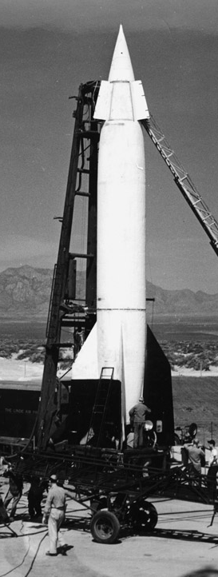
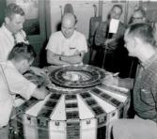
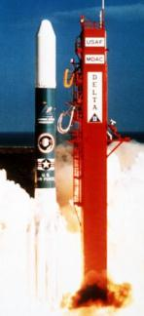
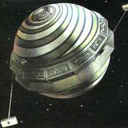
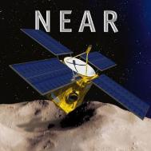
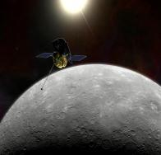
Historical Successes
Missions
  V2 Rockets
  Transit
  Delta 180 Series
  NEAR
  MESSENGER
  STEREO
Sponsor base has shifted between national security and civil agencies over the last 55 years.

Slide 8
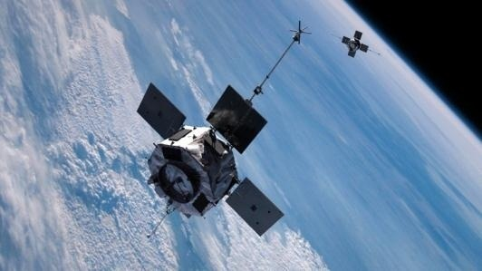
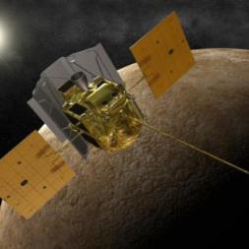
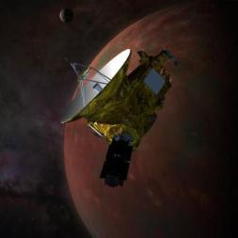
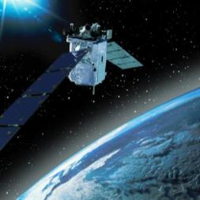
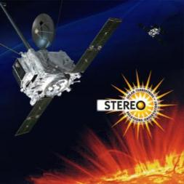
Operational Program Portfolio
Operating five missions for NASA:
  MESSENGER
  New Horizons
  TIMED
  STEREO
  Van Allen Probes
Significant engineering or science role on all these missions

Slide 9
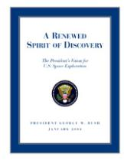
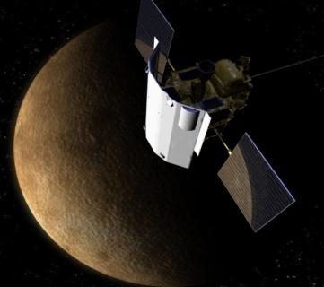
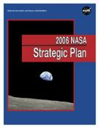
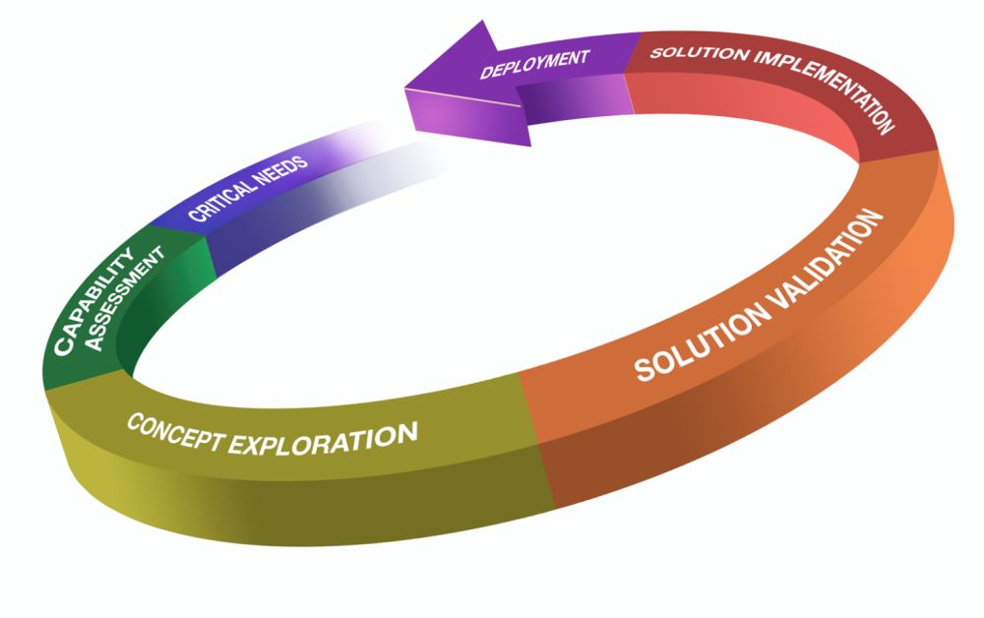
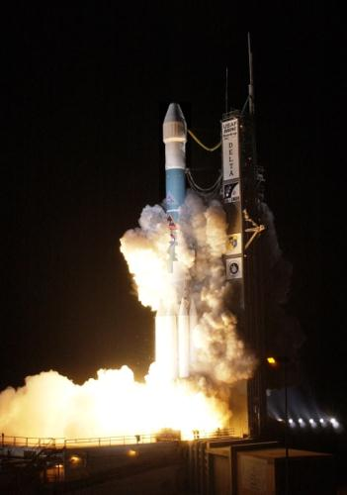
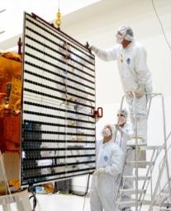
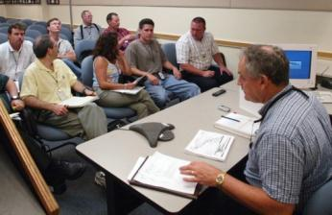
End-To-End Capability
Work with NRC & NASA to define roadmaps for future
Phase E: Operations & Sustainment
Data Acquisition and Analysis
Publication of results
Revised investigations
Pre Phase A:
Mission Concept Studies
Technology Development
Mission Proposals
Launch and checkout
Science operations
Phase B —Definition
Preliminary Design
Phase C (detailed design)
Phase D (fabrication, assembly, integration & test)
Hardware Implementation

Slide 10
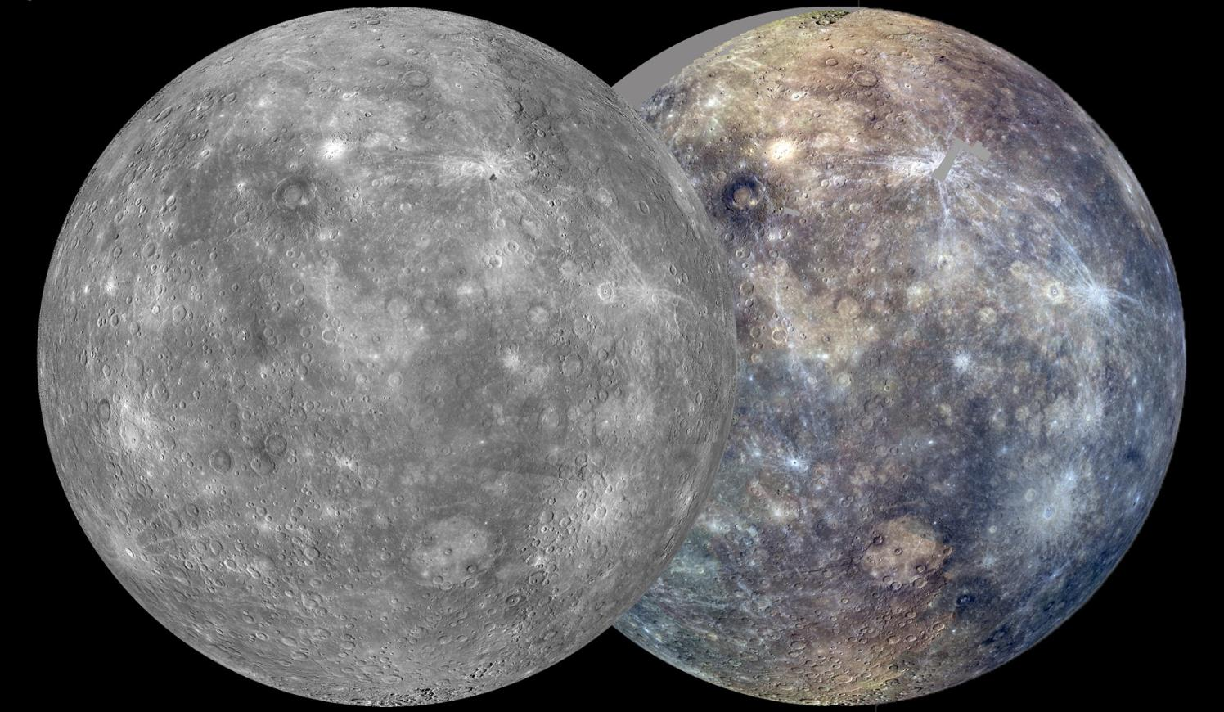
Operational Instruments
Particle – Energetic Neutral Atoms
  Cassini/MIMI
Particle – Charged
  Voyager/LECP
  ACE/EPAM
  Van Allen Probes/RBSPICE
  JUNO/JEDI
  New Horizons/PEPPSI
  MESSENGER/EPS
  ACE/ULEIS
Optical – Interferometers
  GIFS
Optical – Imaging Spectrometers
  MRO/CRISM
  DMSP/SUSSI
  TIMED/GUVI
Optical – Imagers
  UV: TIMED/GUVI
  Visible: New Horizons/LORRI
  MESSENGER/MDIS
RF-SAR
  Mini-RF
Coherent Scatter (CS) Radar
  SuperDARN
Magnetometers (Space & Ground)
  AMPERE/SuperMAG
  MESSENGER/MAG
Spectrometers
  MESSENGER/XRS (X-Ray)
  MESSENGER/GRNS (Gamma-Ray and Neutron)

Slide 11
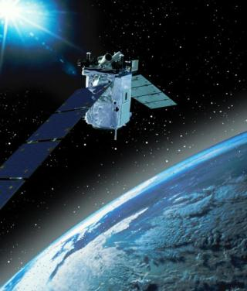
TIMED
Launched December 7, 2001
First mission in NASA’s Solar Terrestrial Probes Program
Highly productive view of the ionosphere, thermosphere and mesosphere science for an entire solar cycle
Completed over 5000 orbits
“TIMED is the first mission to simultaneously measure all critical parameters so that we can better understand the processes that control changes in the upper atmosphere.”
Sam Yee, TIMED project scientist

Slide 12
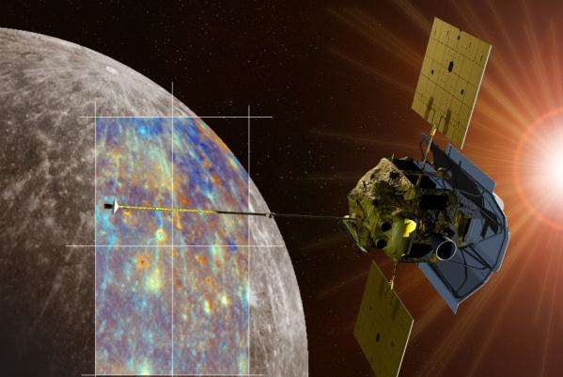
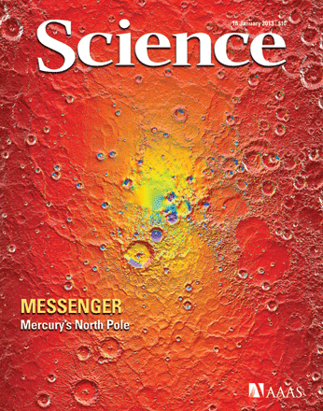
MESSENGER (2004-2015)
First spacecraft to orbit Mercury (18 March 2011)
Provided the first full maps of the last of the terrestrial planets.
Revealed Mercury’s geochemistry – it’s not the Moon!
Revealed planetary geology features
known of nowhere else
in the solar system:
  Complex magnetosphere
  Planetary contraction
  Historical volcanism
  Magnetic field
  Exosphere
  Water ice
  Hollows

Slide 13
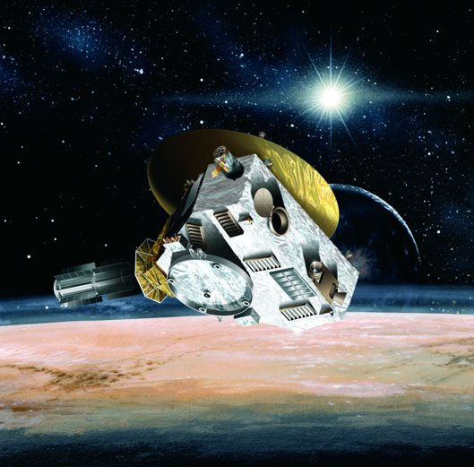
New Horizons
NASA’s First Mission to Pluto
  Launched January 19, 2006
  APL designed architecture to survive a long journey with limited resources
  Closest approach on July 14, 2015
    Begin science ops January 2015
    End science ops December 2015
  First NASA mission to employ hibernation as nominal operations concept
  New Horizons team has located a Kuiper Belt object that is pursuable; extension dependent on NASA funding

Slide 14
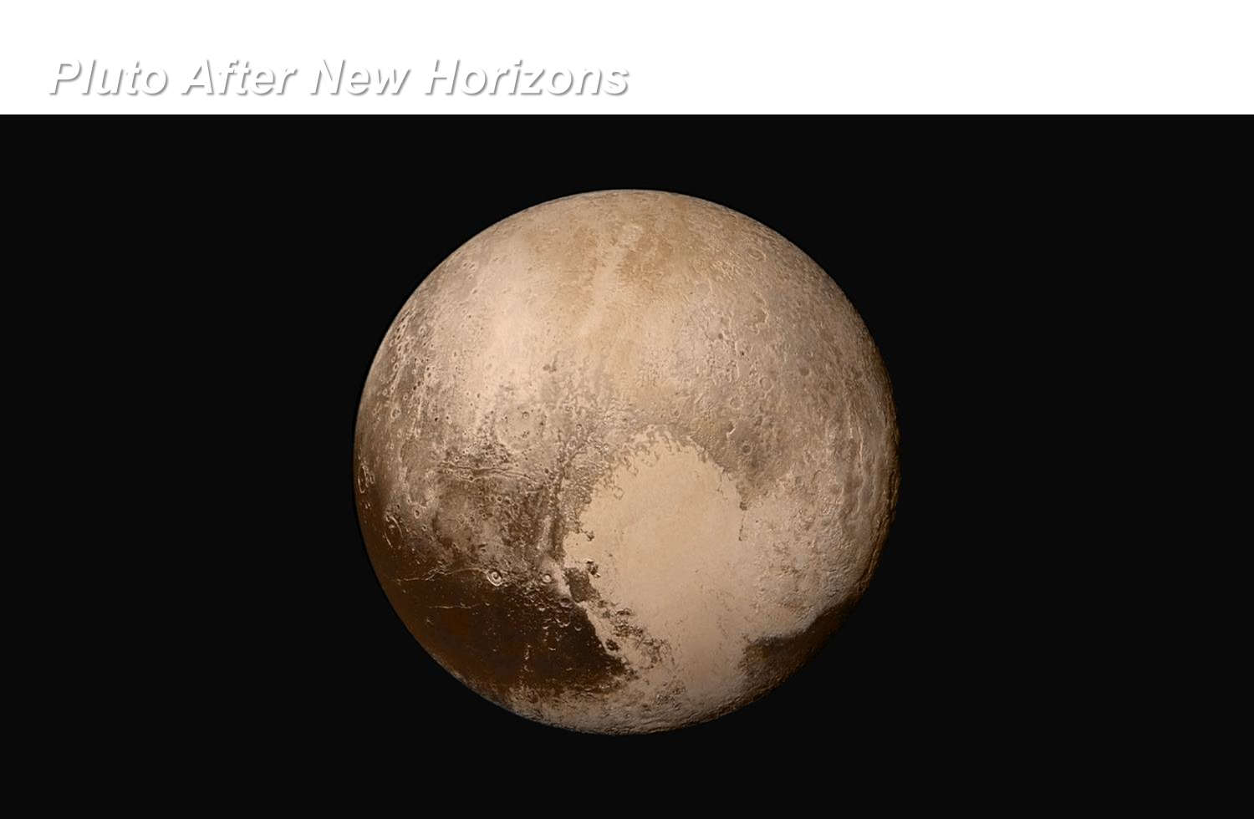
Notes:
Hubble is the best optical telescope ever built, but it’s tough to take high resolution pictures of objects 3 billion miles away! NH will transform Pluto and Charon from pixelated blobs into real worlds with complexity and diversity.

Slide 15
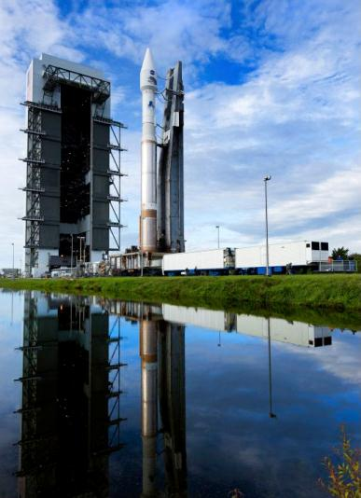

Van Allen Probes
Launched August 30, 2012
Part of NASA’s Living With a Star program, Van Allen objectives include:
  Discover which processes accelerate and transport radiation belt electrons and ions
  Understand the balance between competing acceleration and loss processes
  Understand how the radiation belts change
Science observations include a third radiation belt, rotationally driven ‘zebra stripes’ in Earth’s inner radiation belt

Slide 16



Programs in Development
Missions and Studies
  Next CubeSat build to increase manufacturability
  RAVAN Sensor aboard 3U CubeSat
  Balloon borne observatories
  Solar Probe Plus: Mission to fly into the Sun’s corona
  Defense programs

Slide 17


CubeSat
(Three Unit, or 3U)
First pair launched November 19, 2013
3U CubeSat offers
  Orbit flexibility
  Robust thermal management
  High performance command and data handling
  Electromagnetic interference
  controlled environment
  Mobile antenna ground station
3U Cubesat initiative has grown:
  Manufacturing improvements
  RAVAN sensor to measure Earth’s radiation imbalance

Slide 18


Solar Probe Plus
NASA’s first mission to touch the Sun
  Significant APL technology developments are mission critical to survive thermal environment of the Sun’s corona
Launch projected for 2018
Two key science questions:
  Why is the Sun’s outer atmosphere hotter than the sun's visible surface?
  What propels the solar wind that affects Earth and our solar system?

Slide 19
Laboratory Staff Capabilities
Technical Professionals
Degree Level
17% | Doctorate
51% | Master’s Degree
24% | Bachelor’s Degree
6% | None
Technical Professionals
Degree Field
55% | Engineering
28% | Math, Computer Science
17% | Physics, Chemistry, Other
8% | None

Slide 20

Resident Expertise – Software
Flight Software
  Spacecraft – Command and Data Handling (C&DH),
  Guidance and Control (G&C)
  Autonomy & Fault Protection
  Instrument Software
Ground Software
  Mission Operation Center
Science Application Software
  Science / Payload Operations Center
  Analysis and Planning Software
Testbed Software

Slide 21


Resident Expertise – Engineering
APL develop, builds and tests concepts, missions, systems, subsystems, and components
  Engineering analysis and concept development
  Mission design, development, and implementation
  Integration and test
  Launch, mission operations, and satellite communications
  Rapid Projects Office
AS9100 Certified quality management system
Staff breadth and depth to solve mission challenges

Slide 22



Science Expertise
Over 150 researchers on staff, covering a variety of research focus areas
  Geospace and Earth Science
  Planetary Exploration
  Space Physics
  Applied Research
  Space Science Instrumentation
Breadth of expertise creates a research culture, and staff collaborate on cross disciplinary problems.

Slide 23





Recent Research Highlights
Plasma bubbles may have impeded communications for US troops during a critical rescue operation in Afghanistan (Kelly, et al, 2014 DOI: 10.1002/2014SW001081)
Evidence of Subduction on the ice shell of Europa, (Kattenhorn & Prockter doi:10.1038/ngeo2245 )
Rotationally driven ‘zebra stripes’ in Earth’s inner radiation belt, (Ukhorskiy doi:10.1038/nature13046)
Data from Voyager 1, more than 11 billion miles (18 billion kilometers) from the sun, suggest the spacecraft is becoming the first human-made object to reach interstellar space. (Krimigis, et al, 2013)
Detection of magmatic water on the surface of the Moon. First such remote detection of this type of lunar water was arrived at using data from NASA's Moon Mineralogy Mapper (M3) (Klima, et al, 2013).
Observations by Spitzer's Infrared Array Camera indicate carbon dioxide is slowly and steadily “fizzing” away from Comet ISON by Spitzer (Lisse, et al, 2013)
Observations by the MESSENGER spacecraft provide compelling support for the hypothesis that Mercury harbors abundant water ice and other frozen volatile materials in its permanently shadowed polar craters (Lawrence, et al, 2012).
Notes:
. Asymmetry of this halo of energetic neutral atom (ENA) emission results from the complex MHD interaction of the corotating plasma with Titan’s ionosphere.
The ENA imaging results from the IMAGE mission at Earth, and from the Cassini mission at Jupiter and Saturn. Both IMAGE and Cassini carry ENA cameras built at JHU/APL. The HENA imager on board the IMAGE mission provides global images of the ring current around the Earth and reveals the dynamics of the electrical coupling between the ring current and the ionosphere. The INCA imager on board Cassini returns ENA images from the enormous magnetosphere around Saturn, giving unprecedented insight into the dynamics of the hot plasma and its interaction with neutral gas and Saturn’s moons. The review ends with a brief description of ENA imaging of the heliospheric boundary and the future projects utilizing ENA instrumentation.

Slide 24



Facilities
Building 200 – offices for 500 and light laboratory space
Two Environmental Test Facilities
Satellite Communications and Mission Operations
Time and Frequency Facility
Mission Concept Development Laboratory
Collaborative workspaces and Makerspace

Slide 25

Heritage • Expertise • Innovation
Notes:
John’s Sign Off Slide.

