Slide 1
Verification and Test with Model-Based Design
Flight Software Workshop 2015
Jay Abraham

Slide 2
The software development process
Develop, iterate and specify requirements
Create high level and low level design components
Requirements
Design
Coding
Integration
Convert design to source code (C/C++ software)
Integrate software with complete system, commence system level tests

Slide 3
Phase where errors are found
40
30
20
10
0
Errors are typically found late in the process!
Relative number of errors detected
Latent errors may remain in the software!
Requirements phase
Design phase
Coding phase
Testing phase
Source: How good is the software: A review of defect prevention techniques; Brad Clark, David Zubrow, Carnegie Mellon Software Engineering Institute; Software Engineering Symposium 2001
Notes:
http://www.sei.cmu.edu/library/assets/defect-prediction-techniques.pdf

Slide 4
Model-Based Design
Requirements
Design
Coding
Integration
RESEARCH
DESIGN
IMPLEMENTATION (Coding)
Integration (Test)
Models that describe your design
Executable specification
Evaluate and test in simulation
Start finding problems early
Before getting to code
Before hardware is ready
Environmental Models
Mechanical
Electrical
C, C++
VHDL, Verilog
Structured Text
REQUIREMENTS
Control Algorithms
MCU
DSP
FPGA
ASIC
PLC, PAC
Supervisory Logic
Continuous Verification and Validation

Slide 5
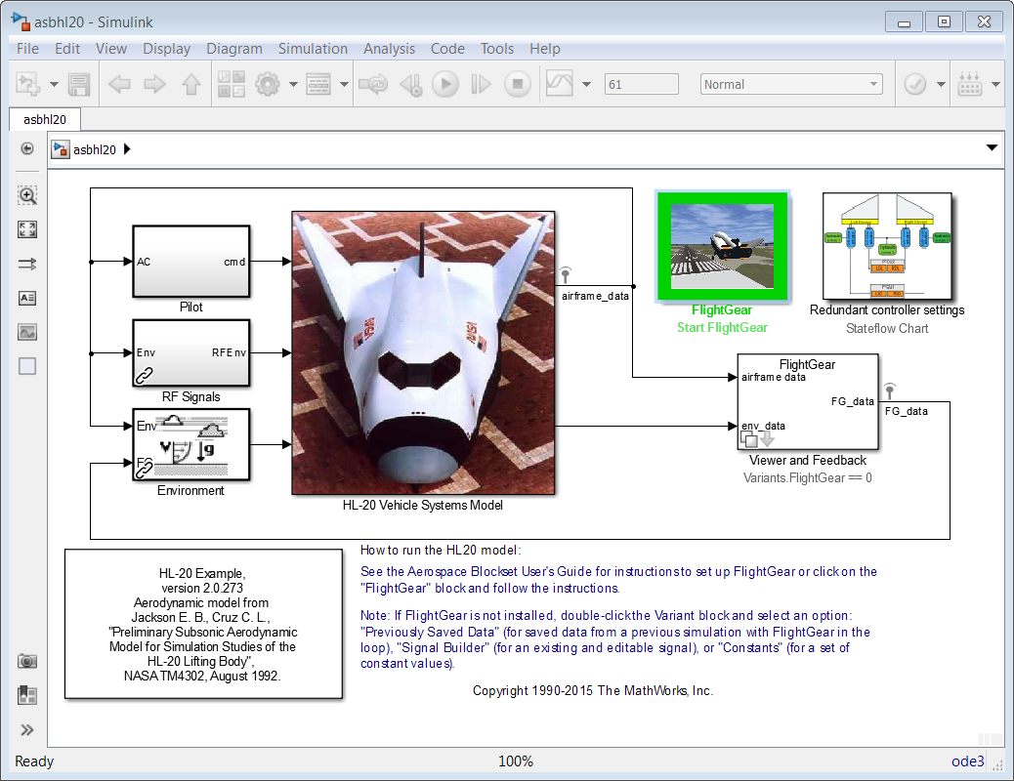
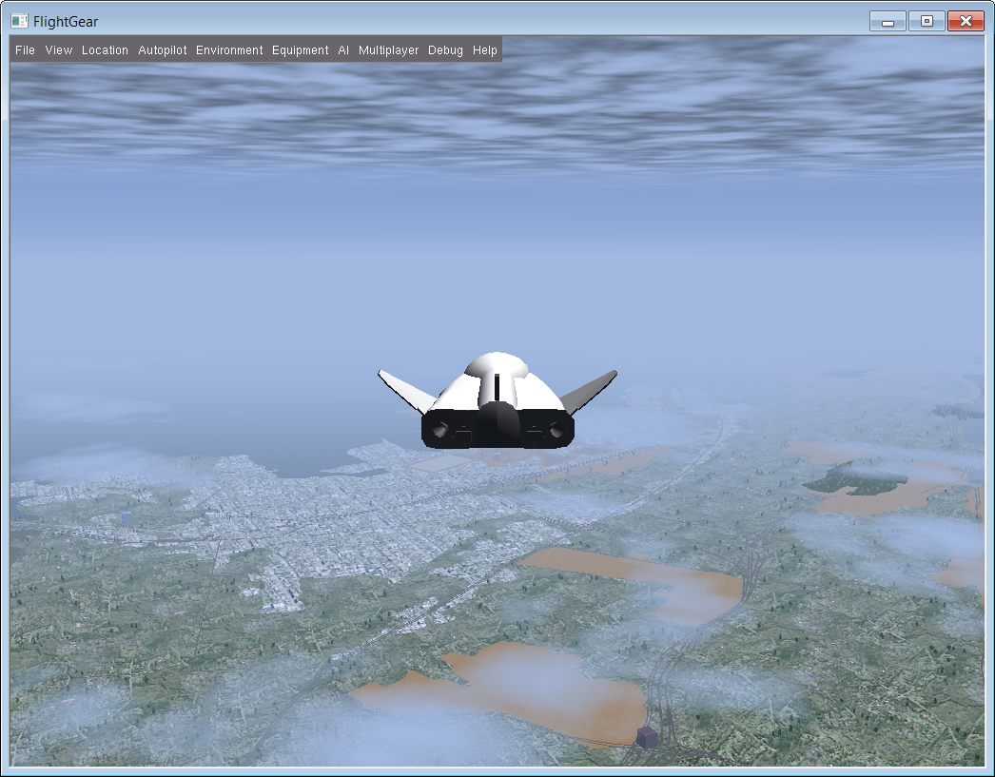
Modeling and simulation with Model-Based Design
Reference: http://www.flightgear.org/

Slide 6
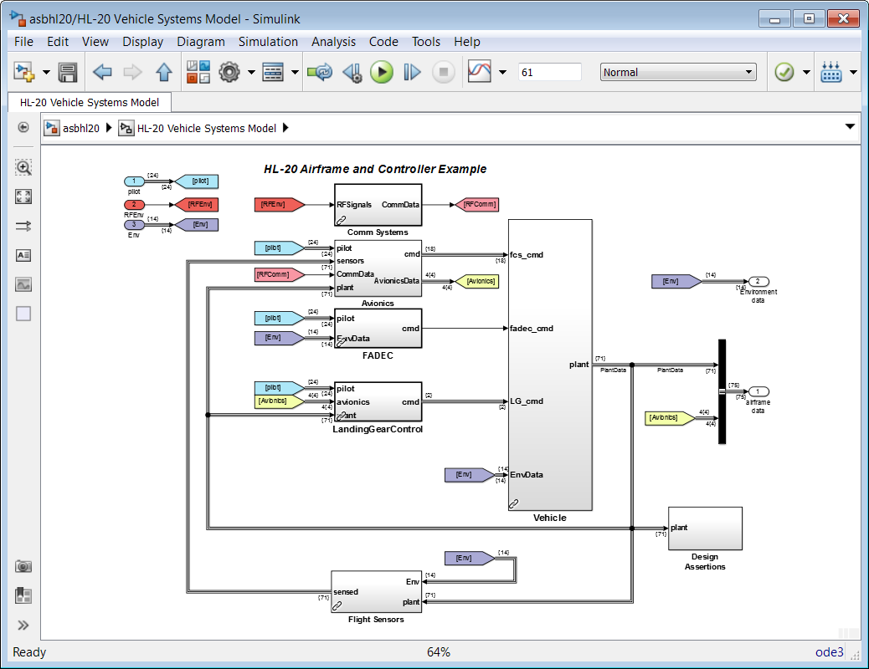
Modeling and simulation with Model-Based Design
Reference: http://www.flightgear.org/

Slide 7
Simulation and modeling with Model-Based Design
Now that you are done simulating, are you done?
Can you generate code for your controller and go directly to hardware?
Could there be other bugs in your design that could be detected earlier?
Could there be hidden bugs lurking in your design?

Slide 8
Requirement errors and their consequences
Requirements
Design
Coding
Integration
Missing or incomplete requirements
Design may not meet customer needs
Design lacks sufficient requirements
Design may not work as expected
Inconsistent requirements
Design may exhibit unintended behavior

Slide 9
Finding and fixing requirement errors early
Requirements
Design
Coding
Integration
Bi-directionally trace requirements
From requirements to design and visa-versa
Check that all requirements map to design components
Confirm expected behavior with simulation-based tests
Execute simulation-based tests that map to requirements
Identify unintended behavior or deviations
Complement testing with formal methods
Prove that design meets safety requirements
Use counter examples to debug design

Slide 10
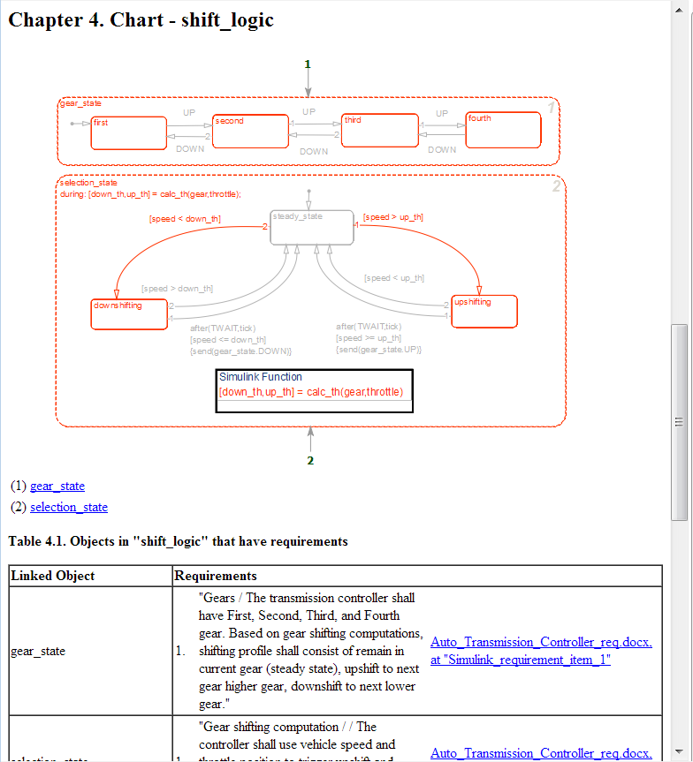
Confirm requirements map to design
Produce requirements trace reports
Identify missing requirements!
Design components that do not map to a requirement
Indicative of incorrect design, or misinterpreting requirements
Avoid finding unintended behaviors late in project phases
Tool: Simulink Verification and Validation

Slide 11
Finding and fixing requirement errors early
Requirements
Design
Coding
Integration
Bi-directionally trace requirements
From requirements to design and visa-versa
Check that all requirements map to design components
Confirm expected behavior with simulation-based tests
Execute simulation-based tests that map to requirements
Identify unintended behavior or deviations
Complement testing with formal methods
Prove that design meets safety requirements
Use counter examples to debug design

Slide 12
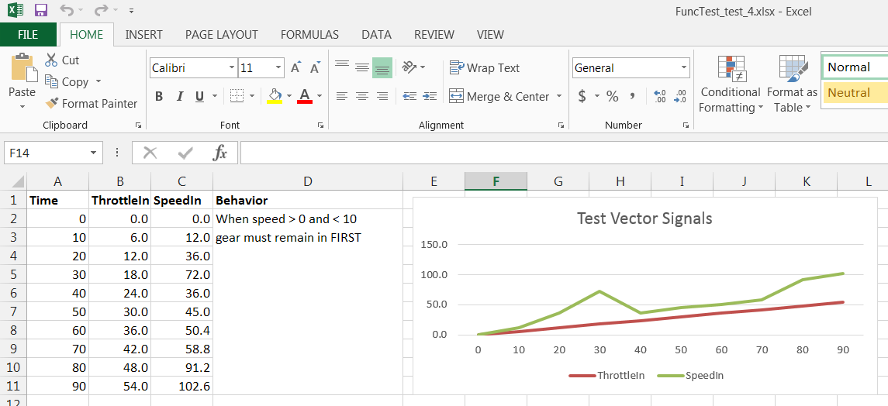
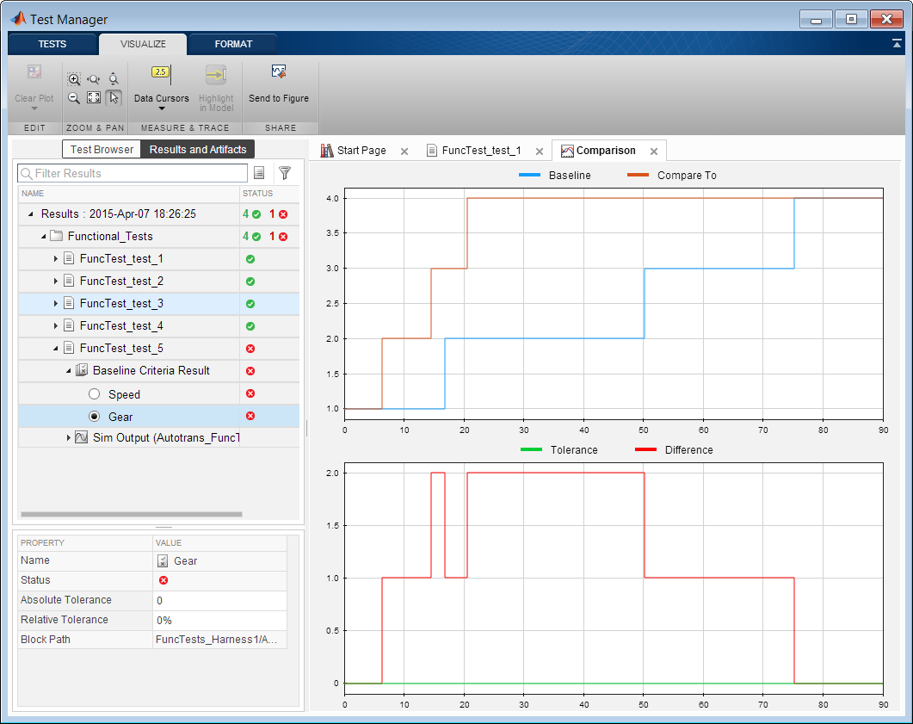
Execute functional tests in simulation
Time series test vectors
Define test vectors in Excel and other formats
Pass / fail results
Tool: Simulink Test

Slide 13
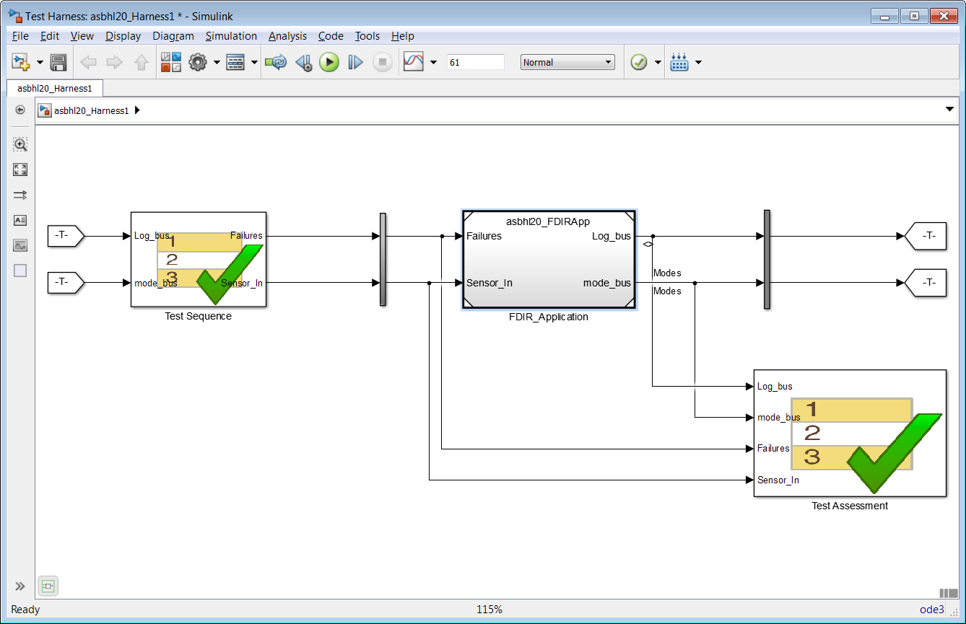
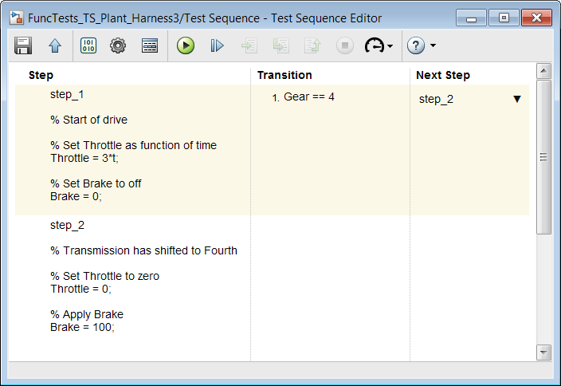
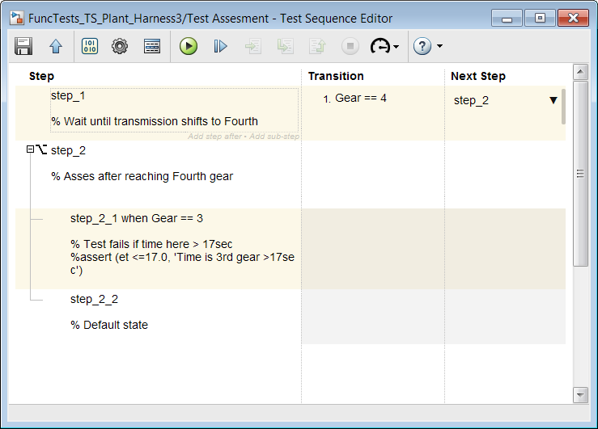
Execute functional tests in simulation
Sequence based tests and assessments
Requirement → In the event of an failure condition of the position sensor or low hydraulic pressure, the Fault Detection Isolation and Recovery (FDIR) application shall select the primary actuator to isolated mode
Tool: Simulink Test

Slide 14
Finding and fixing requirement errors early
Requirements
Design
Coding
Integration
Bi-directionally trace requirements
From requirements to design and visa-versa
Check that all requirements map to design components
Confirm expected behavior with simulation-based tests
Execute simulation-based tests that map to requirements
Identify unintended behavior or deviations
Complement testing with formal methods
Prove that design meets safety requirements
Use counter examples to debug design

Slide 15
Complement testing with formal methods
Graphical representation of safety requirements for thrust reverser
If average airspeed > 150knots, deploy cannot be true
If two WOW sensors are false, deploy cannot be true
If either wheelspeed sensor < 10 knots, deploy cannot be true
Tool: Simulink Design Verifier

Slide 16
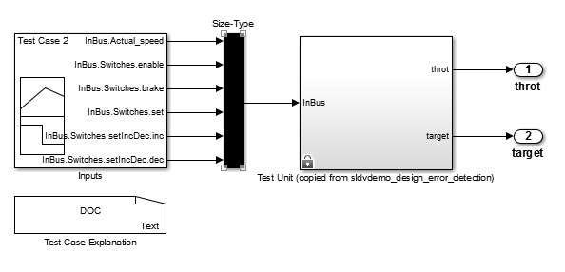
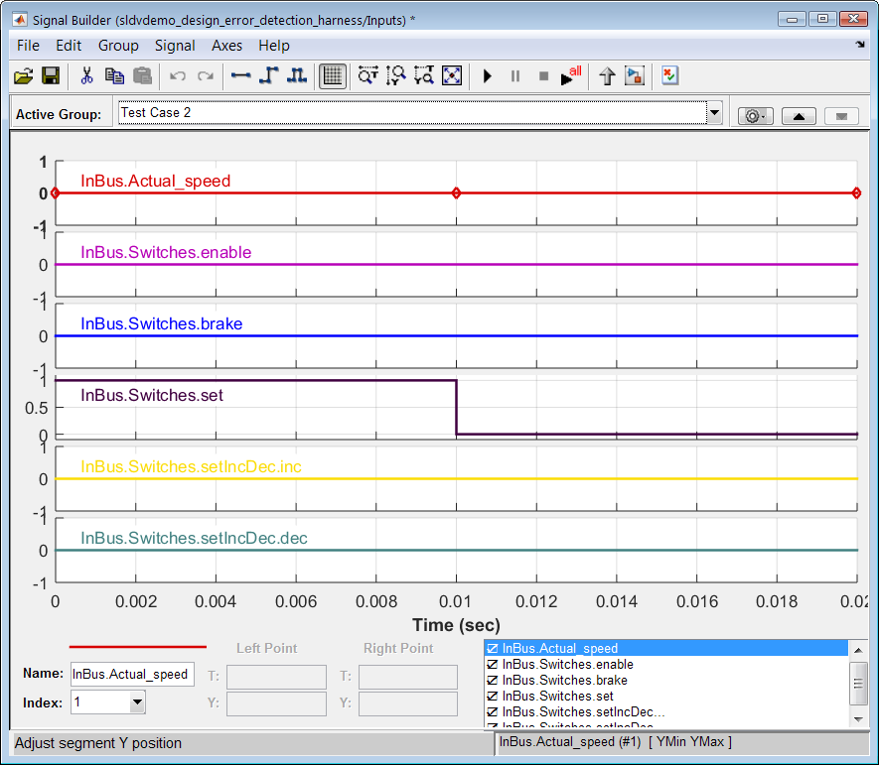
Counter example test generation
Tool: Simulink Design Verifier

Slide 17
Implementation errors and their consequences
Requirements
Design
Coding
Integration
Example implementation errors
Dead logic or unreachable states
Overflow, divide by zero, other mathematical errors
Consequences
Incorrect operation when presented with abnormal inputs
Design may fail catastrophically (design is not robust)

Slide 18
Finding and fixing implementation errors early
Requirements
Design
Coding
Integration
With formal methods, prove absence of
Dead logic or unreachable states (with model checking)
Overflow, divide by zero, out of bound arrays (with abstract interpretation)

Slide 19
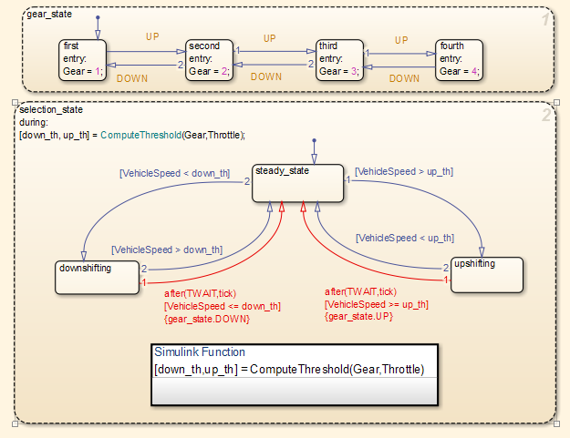
Confirm design is free of implementation errors
Prove absence of dead logic, unreachable states
Tool: Simulink Design Verifier

Slide 20
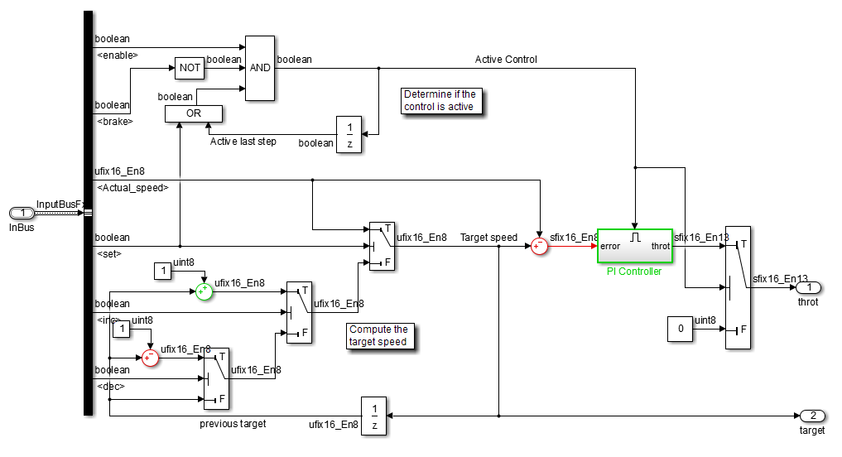
Confirm design is free of implementation errors
Prove absence of overflow, divide by zero, and other design errors
Overflow proven not to occur (colored GREEN)
Overflow and divide by zero proven not to occur (colored GREEN)
Overflow proven to occur (colored RED)
Tool: Simulink Design Verifier

Slide 21
Finding and fixing implementation errors early
Requirements
Design
Coding
Integration
Test completeness of design
Simulation-based tests to confirm design testability
All execution paths and conditions have been exercised
Use coverage metrics to confirm design has been fully tested
User defined
input vectors
System Under Test
Coverage Report

Slide 22
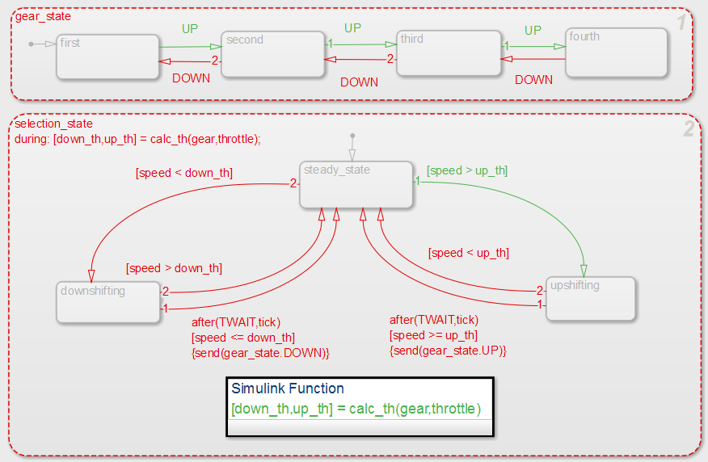
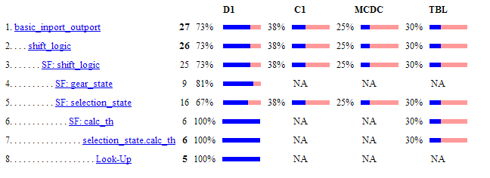
Confirm design is fully tested
Tool: Simulink Verification and Validation, Simulink Test

Slide 23
Generate additional tests with formal methods
Top off functional tests with generated tests
Use model checking to explore state space
Generate missing test-cases to execute all paths
Tests generated for decision, condition, MC/DC, table
User defined
input vectors
System Under Test
Generate input vectors
Cumulative Coverage Report
Tool: Simulink Design Verifier, Simulink Test

Slide 24
Consistency issues and their consequences
Requirements
Design
Coding
Integration
Design fails to meet standards compliance
Failure to certify development process and or software
Design model and code do not match
Functional behavior is different (e.g. timing, logic, etc.)
Differences between floating point simulation vs. fixed point

Slide 25
Addressing consistency issues
Requirements
Design
Coding
Integration
Check design compliance to standards
E.g. do input signals specify min/max?
Certification standard: ISO 26262, DO-178C
Industry standards: MISRA®, MAAB
Equivalence testing of model and code
Software In the Loop (SIL): test that code compiled on host computer matches simulation results
Processor In the Loop (PIL): test that code executing on target processor matches simulation results

Slide 26
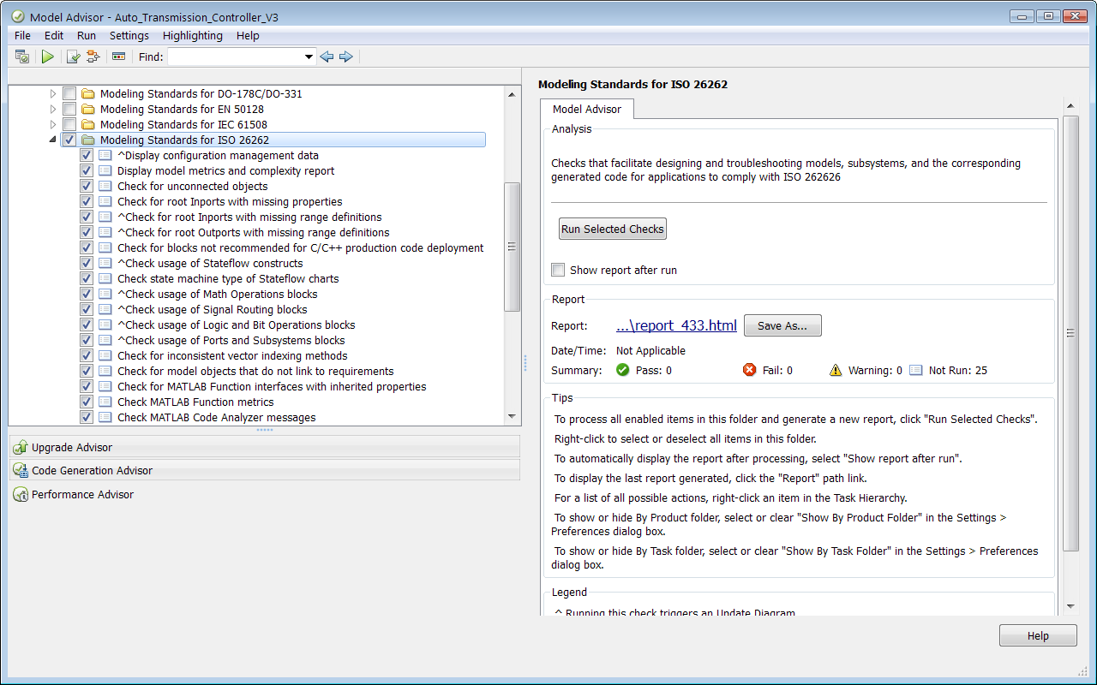
Check model complies with standards
Tool: Simulink Verification and Validation

Slide 27
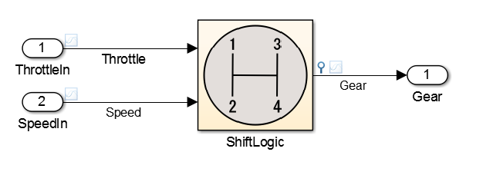
Confirm design and code consistency
Execute all tests to check equivalence of model to code
Normal mode simulation model
Test Vectors
Compare
Code generated from model, compiled on host
Tool: Simulink Test

Slide 28
Integrated code concerns
Requirements
Design
Coding
Integration
Code generation automates coding process
But generated code will be integrated with other code
Examples: driver code, RTOS services, etc.
Deployed code
Consists of handwritten and generated code
Important to consider the interfaces to avoid functional and robustness problems
Potential issues to consider
Runtime errors; non initialized variables, bad pointers, etc.

Slide 29
Finding runtime errors before production
Requirements
Design
Coding
Integration
Formal methods based static code analysis
Gain insight into the runtime behavior of the software
Verify code without executing the software or running tests
Confirm integrated code is robust
Prove software free of critical bugs (with abstract interpretation)
Find critical runtime errors

Slide 30
Verify robustness of integrated code
Requirements
Design
Coding
Integration
Formal methods with Abstract Interpretation can prove:
c = a + b; will never overflow
j = arr[i]; i will always be within array bounds
*ptr = 12; will never be an illegal dereference
w = x / (y + z); y never equal to -z or visa versa (divide by zero)
And many more …

Slide 31
Verify robustness of integrated code
Polyspace formal methods static analysis
static void pointer_arithmetic (void) {
int array[100];
int *p = array;
int i;
for (i = 0; i < 100; i++) {
*p = 0;
p++;
}
if (get_bus_status() > 0) {
if (get_oil_pressure() > 0) {
*p = 5;
} else {
i++;
}
}
i = get_bus_status();
if (i >= 0) {
*(p - i) = 10;
}
}
Green: reliable safe pointer access
Red: faulty out of bounds error
Gray: dead unreachable code
Orange: unproven may be unsafe for some conditions
Purple: violation code rules
Tool: Polyspace Code Prover

Slide 32
Summary of V&V with Model-Based Design
Confirm requirements map to design
Execute functional tests, perform formal verification, generate tests
Requirements
Design
Coding
Integration
With testing, confirm model and design are consistent
Verify robustness of integrated code

