Slide 1
Reduce Development and Testing Time on Embedded Space Programs With Auto- Generated Code
Matthew Conte
Software Engineer
Northrop Grumman Electronic Systems

Slide 2
Abstract
Embedded software for space systems is one of the most expensive types of software to produce, mainly because of the rigorous testing involved. However, developers on the Northrop Grumman Space Systems Software team have observed that infrastructure code such as class definitions for interface messages, configuration files, and telemetry points is often repetitive, with each class differing only in parameters and implementation of common functions. It became clear that rewriting this repetitive code for each program and, sometimes, within a single program was taking developers’ focus away from the true engineering problems.
To reduce time spent writing repetitive code, we have built up a suite of tools to parse human-readable documents such as Interface Control Documents (ICDs), configuration files, and telemetry definition spreadsheets and automatically generate C++ classes from these files. The use of these tools has improved code reuse and reduced the number of SLOCs that must be tested, resulting in cost and schedule benefits for our programs and freeing up developers’ time to concentrate on the unique technical challenges of each program. This presentation will explain how we designed our code generation tools and discuss the many benefits of these tools to our products.

Slide 3
Agenda
Who We Are
Why Auto-Generate Code?
Auto-Generation Tool Suite
Evaluation of Our Auto-Gen Efforts
Lessons Learned

Slide 4
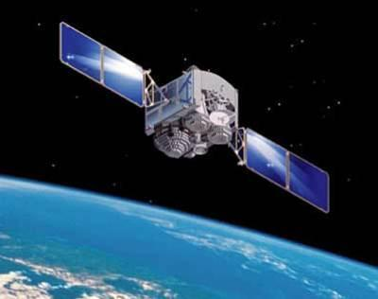
Who We Are
Northrop Grumman Space Systems Software (SSSW) group
Develop embedded FSW for space systems
Maintain a test software (TSW) suite to control our integration lab equipment and exercise functions of the system
Work with a variety of languages and tools
C++, Java, Tcl, Python
VxWorks Workbench

Slide 5
Program Background
Our system is highly configurable
Configuration files
Telemetry definition files
Calibration files
Need C++ code to read in these files at startup and provide the data to the relevant software components
Dozens of each type of file
Writing and maintaining C++ classes for each individual file would be a large effort
Settings change constantly during the testing phase of the program
If FSW group is bogged down in supporting test engineers, no time to continue development

Slide 6
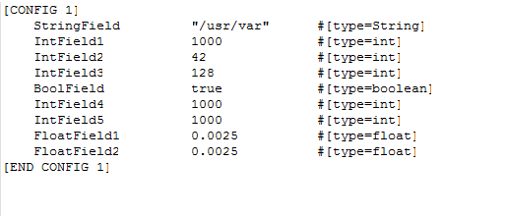
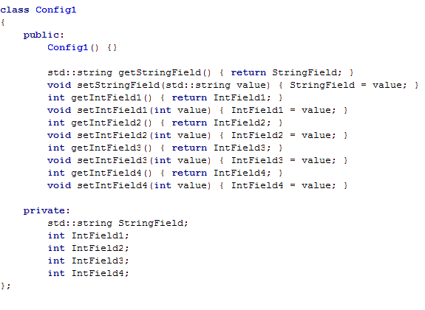
FSW Development Cycle
1.
Modify Config File
2.
4.
Red boxes indicate steps in the cycle where FSW is directly involved
FSW engineer required at every step
Update C++ classes to reflect config file changes
Provide new build to tester
3.
FSW
Make code changes to use new values/fields

Slide 7
Why Auto-Generate Code?
Engineers don’t want to do tedious work of maintaining dozens of configuration files
Especially not during Integration and Test (I&T) phase
Systems and test engineers update config files multiple times per day
Being bogged down with small updates distracts from critical development work
Program management wants a shorter schedule and lower cost
Test the auto-gen tool once instead of manually-edited code every time it changes
Time spent writing tool up-front saves developers’ time later
Tools can be repurposed for later programs, promoting reuse

Slide 8
Auto-Generation Tool Suite
Developed a suite of Java tools to generate code for several types of configuration files
Inputs:
Spreadsheets and text files created by Systems and Test Engineers
C++ class templates
Outputs:
C++ classes which are built into our flight code
Hold the data from the input files
Provide an interface for the rest of the system to access the data
Java Tools Core Library
Common features such as parsing text files and populating code templates
ConfigParser
Calibration
Parser
EventAndTelemParser

Slide 9
Configuration Parser
ConfigParser
Tool
Engineer feeds config.txt into the Java tool
Manually coding changes to program logic is unavoidable. But these are now the only changes which involve FSW engineer.
Test Engineer creates
config.txt
Tool outputs C++ classes
Software engineer makes required software changes and provides build to tester

Slide 10
Configuration Parser
Role of the software engineering team is minimized in the process of updating configuration files for testing
New classes are automatically generated by the tool
Tool is trusted so testing not required on updated classes
Quick turnaround compared to manually modifying and testing C++ code
Turn out build in minutes
Speed essential because of tight I&T schedule
Less burden placed on software group to support testing
More time to develop actual flight code

Slide 11
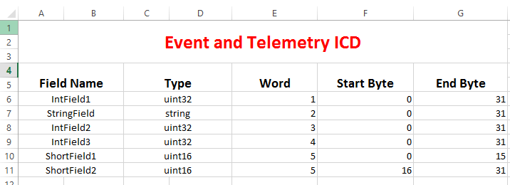
Event and Telemetry Parser
Feed spreadsheet into EventAndTelemParser
EventAndTelemParser
Tool
Telemetry ICD created in collaboration with customer
Outputs C++ classes and definition files for TSW suite

Slide 12
Event and Telemetry Parser
System events and telemetry points are more complex than config files
Definitions must be coordinated between FSW and TSW
TSW simulates sending/receiving telemetry from FSW
Cannot test unless both are in-sync
Tool generates the interface as well as the message-building classes for both TSW and FSW
TSW
UUT
Telemetry
FSW

Slide 13
FSW Development Cycle (with tool suite)
1.
Modify Config File
4.
Removes FSW engineers from steps 1. and 2.
Now only required for code changes in step 3.
2.
Provide new build to tester
Update C++ classes to reflect config file changes
3.
FSW
Make code changes to use new values/fields

Slide 14
How Has Auto-Generation Worked for Us?
Software engineers enjoy the auto-generation approach
Less tedious work
Reduced testing time for code changes
More time to work on the true engineering challenges
Still figuring out the development life-cycle for the tools
See Lessons Learned
Has been a tougher sell to management
Need to be convinced to spend money on non-delivered code

Slide 15
Lessons Learned
Rigorous testing of the tools should be performed well before I&T phase of the program
Time fixing bugs in tool is time that could be spent fixing integration issues
Sinking too much maintenance time into the tool defeats its purpose
Develop early and reuse
This was the SSSW group’s first foray into auto-generating config code
Developed tools from scratch side-by-side with FSW
Keep tools up-to-date
Make change to tool as soon as new formats released
Don’t let auto-gen files get “stale”; regenerate with new builds
Maximize use of code templates
Easier to swap out than if the text of the CPP file is hard-coded in the tool
Convince management of the value of investing time in auto-gen tools up-front

