Slide 1
Critical Testing Experts
cFS Workshop – Automated Test for NASA cFS
David C. McComas¹, Susanne L. Strege¹,
Paul B. Carpenter², Randy Hartman²
¹ NASA Goddard Space Flight Center
² EXB Solutions, Inc. (EXB)
Government
Aerospace
Medical
Certified ISO 9001
Service-Disabled Veteran-Owned Small Business (SDVOSB)

Slide 2
Objective of EXB Pilot Project
The objective of the pilot project is to apply EXB’s Requirements-Based Testing Methodology and associated TestCompass® toolset on a set of cFS applications designed for reuse with the following goals in mind:
Demonstrate EXB’s methodology and toolset to the cFS community while providing additional validation to the cFS applications themselves.
Evaluate EXB’s methodology and toolset with respect to the cFS configuration space verification challenge and to the cFS test maintainability challenge.
Evaluate EXB’s methodology and toolset as it is used on an application that is being matured for inclusion into the cFS app library.
Note: Apps that are originally designed for a single mission or under a technology effort need to undergo a maturation process before they are suitable for Class B missions and compliant with the cFS product line standards.

Slide 3
EXB Requirement-Based Testing Methodology
EXB’s methodology and TestCompass toolset automates five areas of requirements-based testing:
Requirements Analysis
Test Design
Test Case Development
Test Procedure Development
Test Execution
Rqts Analysis
Test Design
Test Case
Dev
Test Procedure Dev
Test Execution
Planning
Documents
Test Database,
Test Description
Documents
Test Procedure
Files
Test Results
Reports: Plan, Status, Cost & Schedule, Traceability

Slide 4
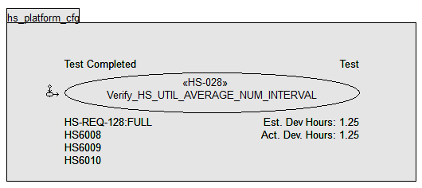
Requirements Analysis and Test Design
Requirements analysis provides:
Testable requirements
Initial project schedule and scope
Initial coverage analysis
Rapid impact of requirement changes
UML Use Cases capture:
Test name and Id
Requirements Trace
Status

Slide 5
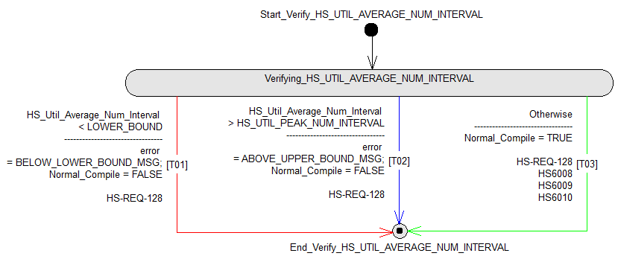
Tests Case Development - UML Activity Diagrams.
Test scenarios
Test behavior
Requirements traceability
Expected outputs

Slide 6
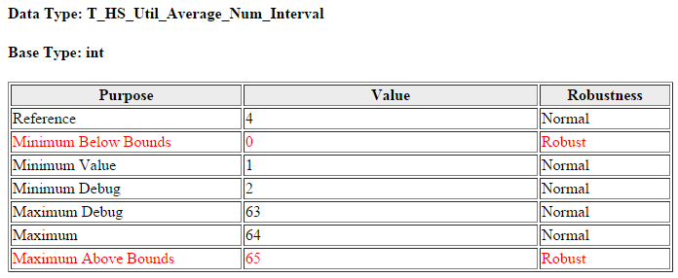
Test Case Development - Test Data Samples
Based on the criteria specified in the Test Database, TestCompass automatically generates Test Data Samples.
TestCompass combines the samples into Test Cases as shown on Slide 7.

Slide 7
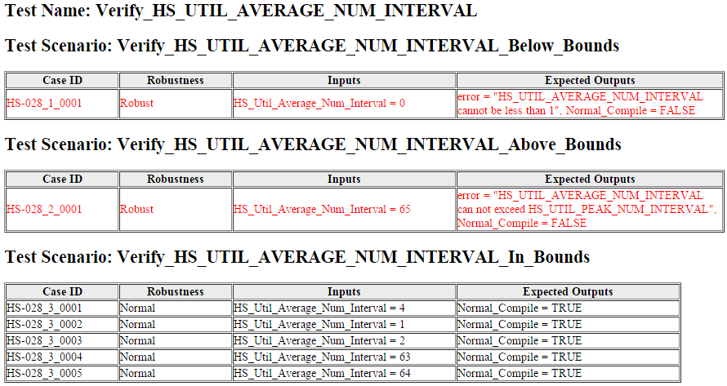
Test Case Development - Test Cases

Slide 8
Test Procedure Development
This is an automated process using TestCompass and project-specific software.
The project-specific software generates test procedures in client-specific software testing languages.
EXB develops the test procedure generator with guidance from the client.
When testing high-level software requirements, the test procedure generator creates test drivers, and library functions that are completed by the test engineers.
When testing software design requirements using a language such as C, the majority of the test procedures can be fully generated by the test procedure generator.
For the cFS project, EXB generated header files to replace the default configuration parameter files. In this project, the compile step is automated as part of the Test Procedure Development.
Slide 9 shows the result of executing Test Case HS-028_1_0001 from Slide 7.

Slide 9
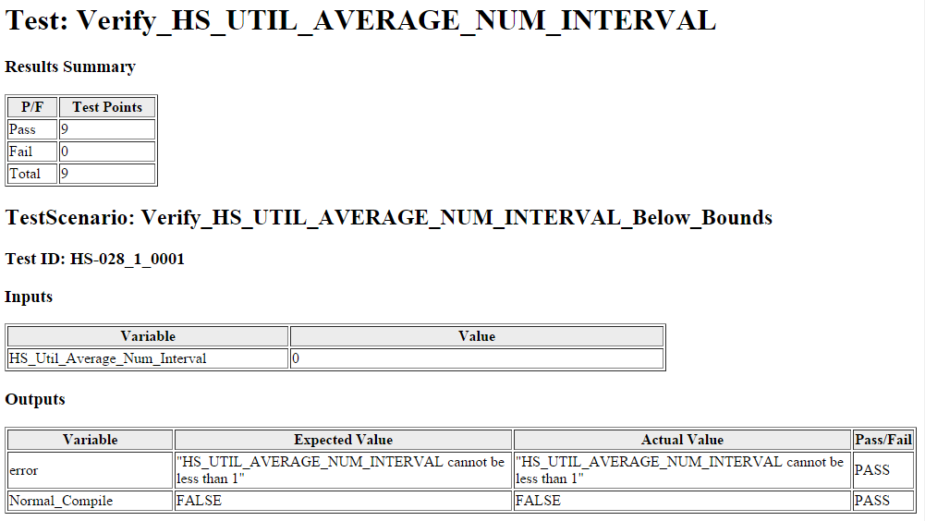
Test Execution - Test Results

Slide 10
Critical Testing Methodology and Automation Benefits
EXB’s verification methodology and toolset provide an automated and structured verification method.
Rapidly developed 157 cFS tests in 10 applications
Identified minor errors in the parameter definition that had previously been untested
On other programs EXB has developed thousands of tests that are easily modifies and rerun at minimal cost
Provides a visual test case design artifact that clarifies the understanding of the requirements
Adaptable to automate requirements based system level testing on virtual systems
Provides structural coverage for critical developments
Minimizes the cost and schedule of requirement and application updates
Documents the test development plan
Provide standardizes status and test artifacts
Enabling The Cost Benefit of Software Reuse

Slide 11
Conclusions
EXB’s methodology and toolset demonstrated a well-defined repeatable process with artifacts suitable for long term maintenance.
Future applications of cFS could easily reuse the automated testing of the verified applications
This approach could serve as a common cFS application verification method.
The next step is to apply EXB’s methodology and toolset to system level testing using the cFS virtual system and evolving cFS applications
Thanks for your time

