Slide 1
Future Products & Technology
The Johns Hopkins University Applied Physics Laboratory
Core Flight Software System Workshop
Jonathan Wilmot NASA/GSFC
October 26, 2015

Slide 2
Future Products & Technology
Increasing the message name space (App ID)
Software Bus Network
Multicore
Modeling/autocode
Real-time Linux
Partitioning
Electronic Data Sheets
OSAL/PSP layering
Checkpoint restart
Cmake build environment
Looking for early adopters

Slide 3
Increasing the Message Name Space
What’s the Problem
Allocation and management of APIDs during development
Early block assignments to subsystems
Ripple effects of APID changes to code, documentation, tests, ground systems…
Larger systems of systems may run out of APIDs
Example: Habitat and Orion docked
Formation flying, distributed, cluster satellites, small satellites
Includes multi-processor, multi-core, and partitioned systems
In CCSDS, the spacecraft ID is in the WAN frame and is stripped off as the packet goes up the protocol stack
Development timeline
Next 6 months
Mission adoption
Mission Gondola for High Altitude Planetary Science (GHAPS) balloon program

Slide 4
Increasing the APID Namespace
Change the cFS CFE_SB_MsgId_t from a uint16 to a uint64
Full change requires minor changes in SB implementation but no known API changes
Probably good for a “long time”
How it’s formatted in the CCSDS headers should not be an issue
Can be in non contiguous header fields
Change can be made backward compatible using tool chain and compilation options
Should not require changes to most cFS components (bubbles/lollipops)
Globally aware applications TO, DS, HK, SC and fault management would need changes
To keep SB efficient we will need a fast hash function to look up the linked-list of packet destinations.
Current SB has a reasonable 8KB table as APIDs are no more that 2¹²
2³⁷ would be a pretty large!

Slide 5
Proposed Updates to CCSDS SPP
CCSDS Space Packet Protocol 133.0-B.1c2
 | MSB |  |  |  |  |  |  |  |  |  |  |  |  |  |  | LSB
bit | 15 | 14 | 13 | 12 | 11 | 10 | 9 | 8 | 7 | 6 | 5 | 4 | 3 | 2 | 1 | 0
 | Version |  |  | Type ID | Sec Hdr | Application Id (APID) |  |  |  |  |  |  |  |  |  |  | Primary hdr
 | Segmentation Flags |  | Sequence Count
 | Length
 | Seconds MSW |  |  |  |  |  |  |  |  |  |  |  |  |  |  |  | Tlm sec hdr
 | Seconds LSW
 | Milliseconds
bit | 15 | 14 | 13 | 12 | 11 | 10 | 9 | 8 | 7 | 6 | 5 | 4 | 3 | 2 | 1 | 0
 | Version |  |  | Type ID | Sec Hdr | Application Id (APID) |  |  |  |  |  |  |  |  |  |  | Primary hdr
 | Segmentation Flags |  | Sequence Count
 | Length
 | res=0 | Function Code |  |  |  |  |  |  | Checksum |  |  |  |  |  |  |  | Cmd sec hdr
Proposed updates maintain 32bit alignment
 | (0x8000) | (0x4000) | (0x2000) | (0x1000) | (0x0800) | (0x0400) | (0x0200) | (0x0100) | (0x0080) | (0x0040) | (0x0020) | (0x0010) | (0x0008) | (0x0004) | (0x0002) | (0x0001)
 | MSB |  |  |  |  |  |  |  |  |  |  |  |  |  |  | LSB
bit | 15 | 14 | 13 | 12 | 11 | 10 | 9 | 8 | 7 | 6 | 5 | 4 | 3 | 2 | 1 | 0
 | Version |  |  | Type ID | Sec Hdr | Application Id (APID) |  |  |  |  |  |  |  |  |  |  | Primary HDR
 | Segmentation Flags |  | Sequence Count
 | Length
 | EDS Version (2⁵) |  |  |  |  | Endian | APID Qualifier (Subsystem ID 2¹⁰) |  |  |  |  |  |  |  |  |  | Tlm sec hdr
 | APID Qualifier (System ID)
 | Seconds MSW
 | Seconds LSW
 | Milliseconds
 | MSB |  |  |  |  |  |  |  |  |  |  |  |  |  |  | LSB
bit | 15 | 14 | 13 | 12 | 11 | 10 | 9 | 8 | 7 | 6 | 5 | 4 | 3 | 2 | 1 | 0
 | Version |  |  | Type ID | Sec Hdr | Application Id (APID) |  |  |  |  |  |  |  |  |  |  | Primary HDR
 | Segmentation Flags |  | Sequence Count
 | Length
 | EDS Version (2⁵) |  |  |  |  | Endian | APID Qualifier (Subsystem ID 2¹⁰) |  |  |  |  |  |  |  |  |  | Cmd sec hdr
 | APID Qualifier (System ID)
 | Function Code |  |  |  |  |  |  |  | Checksum

Slide 6
Software Bus Network
Updates to support interface plugins
Serial (422), SpaceWire, Ethernet, shared memory (dualport),
Wireless
Packet switching between interfaces
All interfaces treated as part of the same local area network
Update to support Quality of Service (QoS)
Reliability/Priority
Only implemented at serialization interfaces
Development timeline
Prototype complete
Slave to Time-Triggered networks (TTGbE, Deterministic SpaceWire,…)
ISS SpaceCube Experiment – Mini
Mission adoption
Who’s doing a distributed system?

Slide 7
Multicore Support
Muticore RTOS (VxWorks, Linux, RTEMS in work)
AMP for partitioning and fault containment
SMP
AMP/SMP partitioning mix
Vision processing gets 4 cores and C&DH get 1
OSAL support needed
Processor affinity support (Task, and interrupt)
Core dispatch service
Processing synchronization
Spinlocks
Near term target: dual core Leon
Development timeline
GSFC/APL IRAD completed over two years ago
Mission adoption

Slide 8
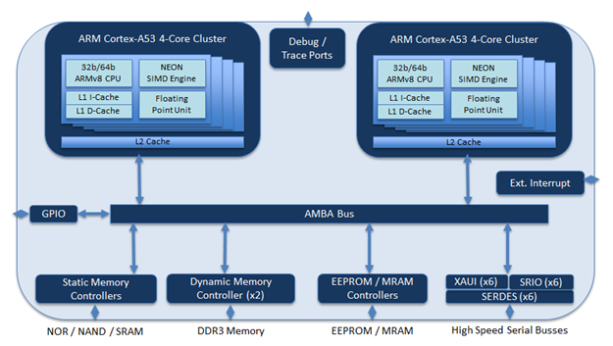
High Performance Space Computing (HPSC)
Joint NASA USAF effort to create game changing radiation hardened space processor
Architecture study was complete early 2015
8 core chiplet approach ARM A53 with internal NEON SIMD
Includes hardware support for partitions with fault containment
Updated baseline architecture RFP out early FY2016
FY16/17 funding for software middleware/framework development at NASA centers
Availability ~5 years

Slide 9
Modeling/autocode
ARC developed Simulink Interface Layer (SIL)
Autocodes Simulink models into template cFS compliant applications
GSFC integrating tool for NICER instrument application development
Development timeline
Developed for LADEE
Tools available with SUA
Open source release in work
Mission adoption
LADEE, NICER instrument

Slide 10
Real Time Linux
Xenomai
Draft OSAL developed by Matt Benson at JSC
Simple two partition approach
C&DH and control systems
Science processing
Development timeline
Next 6 months
Mission adoption
Mission Gondola for High Altitude Planetary Science (GHAPS) balloon program

Slide 11
Partitioning
Time and space partitioning between applications (Fault containment)
Time splice scheduler
Memory Management Unit (MMU) memory protection
SBN for inter-partition messaging
Simple two partition approach
C&DH and control systems
Science processing
Development timeline
First target OS - Xenomai Linux
HPSC hypervisior
Next 6 months
Mission adoption
Mission Gondola for High Altitude Planetary Science (GHAPS) balloon program

Slide 12
Electronic Data Sheets
XML definition of hardware and software components/applications
Many cFS users have independently developed similar approaches
CCSDS standards
XML Specification for Electronic Data Sheets for Onboard Devices 876.0-R-1
http://public.ccsds.org/sites/cwe/rids/Lists/CCSDS%208760R1/CCSDSAgency.aspx
Development timeline
GRC development of packet header files from EDS
ESA development of tool chain for SAVOIR architecture
JSC working on SysML tools to autogenerate interfaces
Next 6 months
Mission adoption
TBD

Slide 13
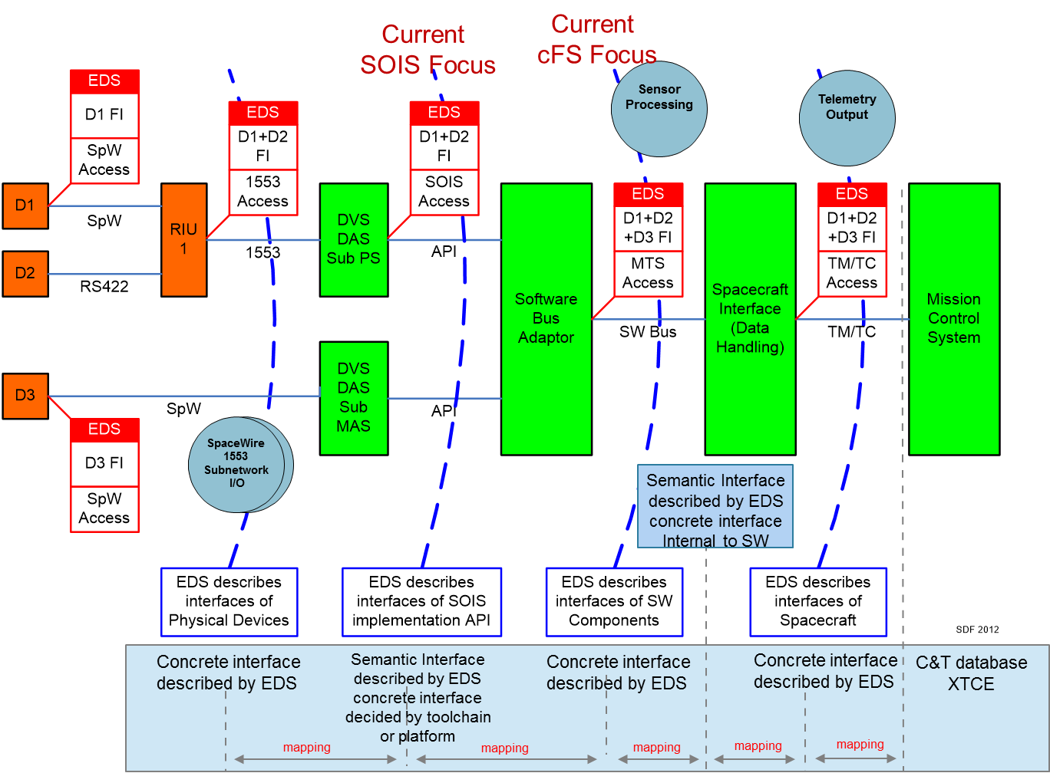
CCSDS Electronic Data Sheets

Slide 14
EDS Use Cases
Component EDS
Component EDS
Component EDS
Component EDS
Component
(software)
EDS
Device EDS
Designer and/or tools
Test/Simulation tool/consoles
Ground Systems
Page Displays
Models
Ground System Database(s)
Flight SW
components
Models
Flight SW
components
Models
Flight SW
components
Models
Models
Models
Models
Models
Models
Test procedures
Operations procedures
Simulators

Slide 15
OSAL/PSP layering
Build system changes to allow separate maintenance and release of OSAL implementations
Allows release of updated cFE with one PSP and OSAL
Others can developed and tested later as needed
Relayering of common OSAL code
Common parameter checking
Common API implementation
OS specific implementation abstracted out
Development timeline
Prototype code complete and on Babelfish
Mission adoption
GHAPS (TBR)
Similar concept for PSPs

Slide 16
Checkpoint Restart
Efficient Checkpointing service
DMA copy and memory pointer swap (TBD)
Executive service to shapshot key variables
Similar to Critical Data Store service
May be just extensions to that service
Use cases
Exchange with redundant systems to rejoin a running system
Shapshot state information to load
Development timeline
TBD
Mission adoption
TBD

Slide 17
Backup

Slide 18
How to use the extra bits?
Use the additional bits for EDS, endian, system and subsystem IDs
Similar to Orion/SLS Data Exchange Message (DEM) formats
Format is still defined by current APID only (2¹¹)
SB will fill in the System and subsystem IDs
CFE_SB_InitMsg(&packet, apps_MID, sizeof(packet), TRUE);
CFE_SB_SendMsg((CFE_SB_Msg_t *) &packet);
EDS version bits allows for checks that the EDS matches the packet format
System ID (2¹⁶) could be synonymous with the current CCSDS Spacecraft ID
Endian bit is set by sender/publisher, receiver implements any needed conversions
Subscriptions implement a full 37bit qualified APID (26new + 11old)
0 and all 1s in the System and/or Subsystem IDs can have special meanings
To keep the cFS API unchanged we would need to treat the 64bit topic as a combination of APID, System and Subsystem
Use the full 64bits as the command process or the telemetry topic
EDS and endian fields masked out
This would be globally unique for all potentially interacting systems

