Slide 1
DETERMINISTIC ETHERNET FOR SCALABLE MODULAR AVIONICS
Christian Fidi
Product Manager
13th December, 2016

Slide 2
Agenda
State of the Art
Deterministic Synchronous Ethernet
A Scalable Modular Architecture
Space Components and TRL
Conclusion

Slide 3
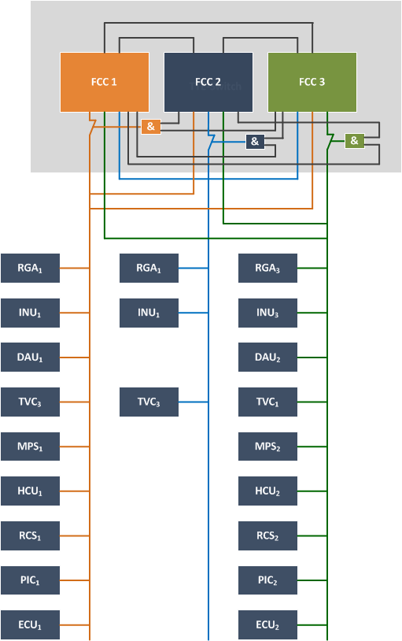
State of the Art Launcher Avionics Architectures
Voting with 2 out of 3 or 3 out of 4 FCCs
Redundant MIL1553 busses with the bus controller (BC) in one of the FCCs
Each FCC receives the data from all three MIL busses
An additional point to point communication is used to
exchange state information and
Synchronize the FCCs tightly
The fault isolation in case of a FCC disagreement is Performed by disconnecting the fault FCC from the MIL bus (as illustrated) or by
This architecture is therefore able to tolerate a single asymetric fault

Slide 4
Disadvantages
Multiple protocols needed:
Deterministic data with low latency and low jitter
Synchronization protocol for a tight synchronization
High speed data for voting data and state exchange in case of a recovery
➔ Additional wiring needed
➔ Software needs to take care of:
Precise synchronization
Redundancy management
Support of these different protocols
Fault masking
State exchange in case of reintegration
Testing effort and hardware to support these protocols (since this is application specific)
Physical separation and reintegration is quite challenging with a bus protocol

Slide 5
TTEthernet – Traffic Classes
Quality of Service
SAE AS6802
Time-Triggered
synchronous/periodic
very small jitter (< 1μs)
known latency
SAE AS6802
synchronous
jitter < 1 μs
known latency
ARINC664p7
AFDX
asynchronous
low jitter (< 500μs)
latency typical 1-10ms
IEEE802.3
Ethernet
best effort Ethernet
no performance guarantee

Slide 6
FT Synchronized Global Time
Fault-tolerant synchronization services are needed for establishing a robust global time base in the sub-microsecond area

Slide 7
Time-triggered Traffic Timing
Full control of timings in the system
Defined latency and sub-microsecond jitter
Minimum memory needs
Fault-containment regions
I’ll expect M between 11:05 and 11:15
I’ll accept M only between 10:40 and 10:50
I’ll accept M only between 10:55 and 11:05
M
M
M
I’ll forward M at 11:00
M
I’ll transmit M at 10:45
I’ll forward M at 11:10
Let’s see if I can receive M
…a switch
Notes:
…but sender and receiver still only do “I’ll transmit M at…” and “I’ll expect M at…” – the added complexity is in the network, not in the nodes

Slide 8
Fault-Containment Regions in TTEthernet
TTEthernet defines Switches and End Systems as two kinds of Fault-Containment Regions. Frame loss is mapped to the respective sender.
Depending on cost and reliability targets, switches and or end systems may be implemented with standard or high-integrity in order to be able to scale from single to dual fault tolerance.
Protocol mechanisms can be configured to handle Strictly Omissive Asymmetric switch faults (HI) and fully Transmissive Asymmetric end system faults (SI).

Slide 9
High-Integrity: Self-Checking Pair
High integrity design: Self checking pair
Two processor that execute same function in parallel
Comparator checks output of both processors.
If one processor fails (maliciously) and generates wrong data, second processors shuts down.
Self-checking pair ensures fail-silence !

Slide 10
Launcher Avionics Architectures based on TTEthernet – Sync
The architecture uses
4 synchronization masters (SM) and
2 compression masters (CM)
The SMs are providing their time information to the CMs
The CMs are performing a fault-tolerant average (FTA)
A single byzantine fault can be tolerated
The time information is distrbuted to the whole network
SM
SM
SM
SM
CM
CM

Slide 11
Launcher Avionics Architectures based on TTEthernet – Data
The 3 FCCs are connected to the two switches via two channels each
synchronized via the network
receive the same data via the two redundant channels
Each FCC is performing the same computation of this data
The actuators receive the commands from all three FCCs and perfore a 2 out of 3 voting
This architecture is tolerant against any single asymetric fault

Slide 12
Network Building Blocks
Switch and End System
Embedded Software (Drivers, Firmware)
Physical Layer
Cable and Connectors
Configuration and Verification Tools
Development, Testing and Monitoring Equipment

Slide 13
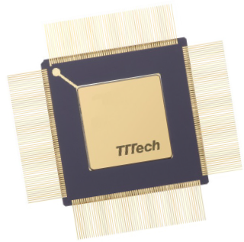
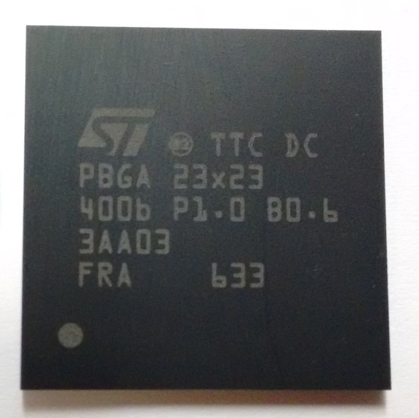
TTE-Controller Space
TTE-End System Controller
Space grade ceramic package (CQFP 256)
HiRel plastic package (PBGA 400)
TTE-Switch Controller
Space grade ceramic package (CQFP 256)
HiRel plastic package (PBGA 400)

Slide 14
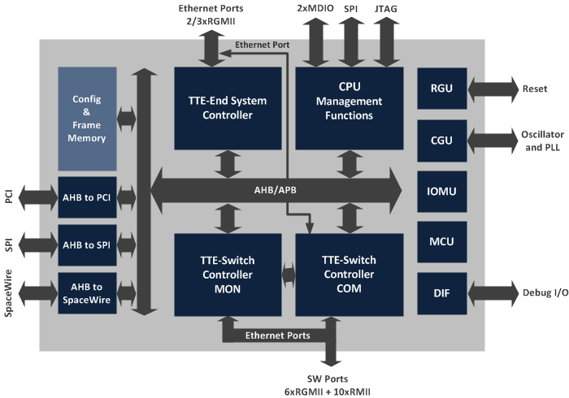
TTE-Controller
❶ Switch Controller COM
❷ Switch Controller MON
❸ End System
For the connection of the CPU to the switch controller
❹ CPU
Management &
Diagnostics

Slide 15
TTC - Communication
Interfaces Layers:
UDP-COM (TT & RC)
IP-COM (TT & RC)
MAC-COM (TT, RC & BE)
MAC-RAW (TT, RC & BE)
Via:
Sampling or
Queuing ports

Slide 16
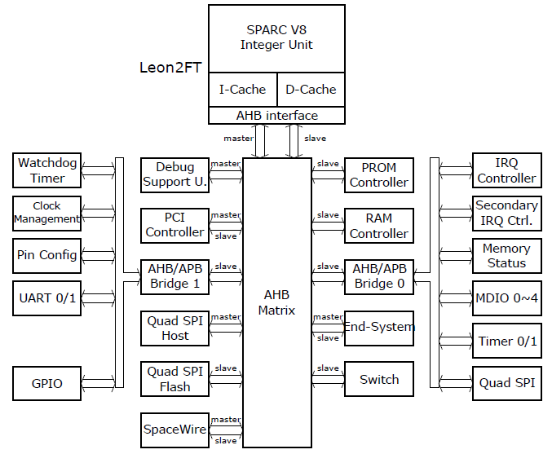
TTE-Controller – Architecture

Slide 17
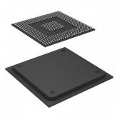
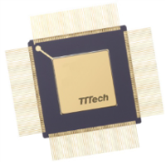
Chip Product Roadmap
TTE-Controller
TTE-End System Controller HiRel
Rad-hard ASIC
2/3x 10/100/1000Mbps
PT
SR
TTE-Switch Controller HiRel
Rad-hard ASIC
19x 10/100Mbps + 6x 10/100/1000Mbps
PT
SR
TTE-End System Controller Space
Rad-hard ASIC
2/3x 10/100/1000Mbps
PT
SR
TTE-Switch Controller Space
Rad-hard ASIC
12x 10/100Mbps + 6x 10/100/1000Mbps
PT
SR
2015 2016 2017 2018
Time
AVAILABLE
UNDER DEVELOPMENT
ENVISAGED
PT
Prototype
PS
Preseries
SR
Series
EOL
End of Life

Slide 18
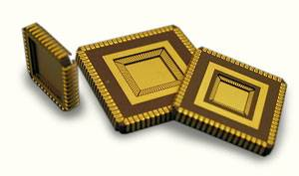
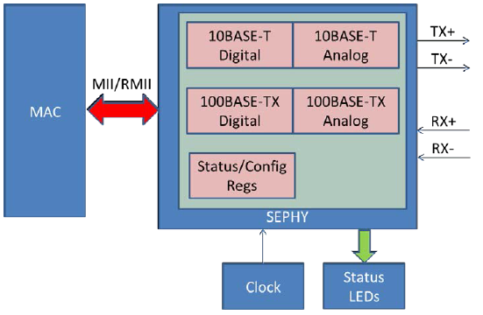
Ethernet PHY for Space
Ethernet PHY (www.sephy.eu)
1st step 10/100Mbit/s
150nm SOI mixed signal process
Experienced project partners
First samples in Q2/2017
QML Product Q4/2017
2nd step 10/100/1000Mbit/s

Slide 19
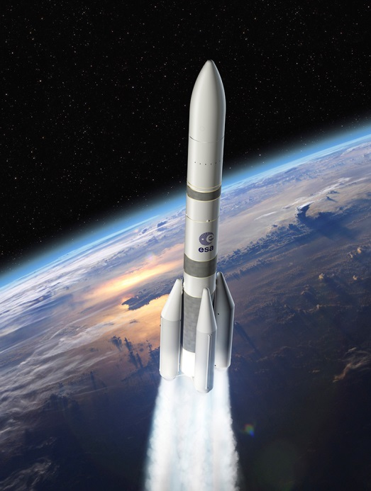
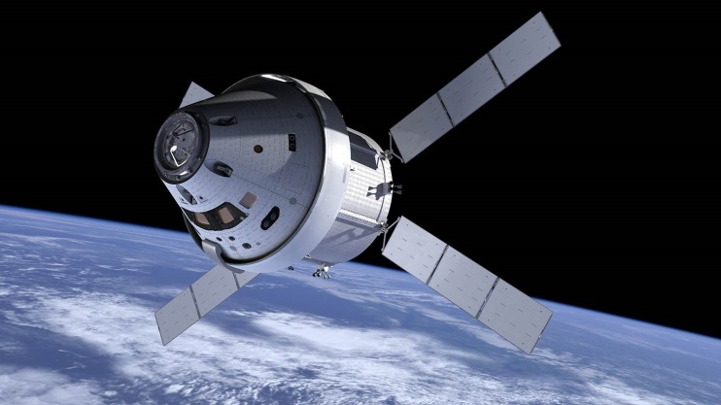
Conclusion
Support highly deterministic avionic control and payload data on the same physical media via partitioning
Provides built-in fault-tolerance based on a global a time-base (clock synchronization)
Integrates redundancy management and therefore allows to build up voting architectures more efficiently
Provides a robust physical layer with very low bit-error rate over long distances
Seamlessly integrates with standard Ethernet

