Slide 1
Challenges in the Verification and Validation of Mission-Critical Software Developed within an Agile Framework
James B. Dabney, UHCL
James D Arthur, Va Tech
13 December 2016

Slide 2
Overview
Conventional mission-critical software lifecycle
Conventional V&V process
Agile software development
Hybrid Agile variants
Adjusting V&V to hybrid Agile
Conclusions

Slide 3
Conventional Mission-Critical Software Lifecycle
Traditional lifecycle based on waterfall model
Sequence of milestone reviews
Preliminary design review (PDR)
Critical design review (CDR)
Test readiness review (TRR)
Design certification review (DCR)
Larger projects incremental model
Planned series of waterfall lifecycles
Certification mandated by regulations (e.g. FDA, UL)

Slide 4
Example Traditional Waterfall Lifecycle

Slide 5
Example Incremental Lifecycle
Increments can be developmental or operational
Plan several increments ahead

Slide 6
Conventional V&V Process
Reduce program risk by analyzing key artifacts
Strive to find issues in-phase by mirroring development
Verify during each lifecycle phase that the product satisfies requirements defined in previous phase
Requirements meet user needs, complete
No unintended functionality specified
Design satisfies requirements and no more
Testing fully covers design and requirements

Slide 7
Understanding Agile
The fundamental reason for a “new” paradigm
Need to respond to constant changes
Defines the set of most important beliefs of what is truly important
Agile Values
Defines a set ways to meet the values
Agile Principles
Defines in detail how this is implemented in practice
Agile Practices
Material adapted from "All about Agile", Ahmed Sidky, Presentation for CS 5704, Va Tech Fall 2006

Slide 8
Agile Manifesto [AM01]
Individuals and interactions | Over | Process and tools
Working software | Over | Comprehensive documentation
Customer collaboration | Over | Contract negotiation
Responding to change | Over | Following a plan
Valued More
Valued

Slide 9
Agile Principles
Customer satisfaction by rapid, continuous delivery of useful software
Working software is delivered frequently (weeks rather than months)
Working software is the principal measure of progress
Even late changes in requirements are welcomed
Close, daily cooperation between customer & developer
Fact-to-face conversations is the best form of communication
Projects are built around motivated individuals, who should be trusted
Continuous attention to technical excellence and good design
Simplicity
Self-organizing teams
Regular adaption to changing circumstances

Slide 10
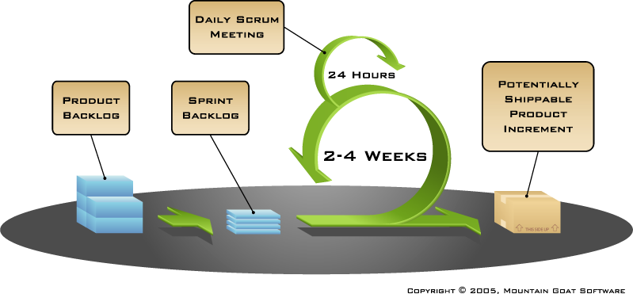
Agile Planning: The Scrum Process

Slide 11
Agile Planning: Release and Iteration Planning
Product
Backlog
Release A
Feature 1
Feature 2
Feature 3
Feature 4
Feature 5
Feature 6
Feature 7
Feature …
Feature 1, Feature 2, Feature 3a
Release Backlog
Iteration 1
Iteration 2
Iteration 3
Story A
Story B
Story C
Story D
Story …
Story A
Story B
Story C
Story D
Story E
Story F
Story G
Material adapted from "All about Agile", Ahmed Sidky, Presentation for CS 5704, Va Tech Fall 2006

Slide 12
Adapting Agile to Large Projects
Alistair Cockburn (one of the original agile proponents): “small projects, web projects, exploratory projects, agile is fabulous; it beats the pants off of everything else, but for NASA, no” [AM13]
“Embedded systems have specific product requirements, e.g. safety, which are not obviously addressed by agile practices such as XP or Scrum” [EOS14]
Key assumptions of Agile (e.g.co-located teams) are difficult to realize on large projects [TFR02]

Slide 13
Variants of Agile for Large Projects
Scaled Agile Framework (SAFe) [DL14]
Intended for high-assurance environments (medical)
Designed to comply with regulatory requirements (FDA)
Gaining acceptance
Incremental Commitment Model (ICM) [BL07]
Merges concepts of classic V-verification, concurrent engineering, Agile
Intended for large mission-critical and net-centric systems

Slide 14
Hybrid Projects
Similar to SAFe methodology
Early lifecycle activities follow standard process
Requirements, design, test follow Agile process
Sequence of releases composed of multiple sprints
Work down project backlog
Certification follows standard process

Slide 15
Mapping Traditional V&V to Agile
Assessed applicability of standard V&V methods to hybrid Agile
For each method specified for project elements, assessed
Inputs
Timing in lifecycle
Feasibility of executing method given the timing and available information
Methods fall into three classes
Early lifecycle methods generally compatible
Methods involving tracing need to be tailored
Methods involving completeness need to be replaced

Slide 16
Early Lifecycle V&V Methods
Concept documentation
Reuse analysis
Tracing high-level requirements, architecture elements
Feasibility study review
Security framework & threat identification
Safety requirements
No significant adjustments needed for hybrid Agile

Slide 17
Tracing-Oriented Methods
Bi-directional requirements traces
High level requirements available
Detailed requirements elaborated as part of sprints
Tracing design back to requirements
Trace fault trees and FMEA
Test plan & procedures
Typically developed incrementally
Coverage and completeness incrementally
Generally straightforward to tailor for hybrid Agile

Slide 18
Completeness-Oriented Methods
Interface requirements & design analysis
Internal interfaces defined as needed in sprints
Key source of integration problems
Scenario analysis
Very valuable V&V techniques
Scenario details and supporting requirements developed in sprints
Flow diagrams to discover missing, conflicting, unnecessary behavior
Requires extensive modification/rewrite to accommodate hybrid Agile

Slide 19
Adjusting V&V to Hybrid Agile
Project interfaces
Developing techniques to build assurance for completeness and emergent properties without linear progress of waterfall

Slide 20
Conclusions & Future Work
Pure Agile not appropriate for mission-critical or safety-critical projects
Hybrid Agile gaining acceptance
Hybrids of traditional and Agile methodologies
Retain early lifecycle activities
Agile techniques used in implementation phase
Agile projects may benefit from revised set of deliverables
V&V methodology must adapt to hybrid Agile

Slide 21
References
[AM01] K.Beck, M.Beedle, A. van Bennekum, A. Cockburn, W. Cunningham, M. Fowler, J. Grenning, J. Highsmith, A. Hunt, R. Jeffries, J. Kern, B. Marick, R. C. Martin, S. Mellor, K. Schwaber, J. Sutherland, D. Thomas “Agile Manifesto,” http://agilemanifesto.org/, 2001
[AM13] A. Minkiewicz, “Applying Agile practices to space-based software systems,” PowerPoint presentation, PRICE Systems, LLC, 2013
[EOS14] U. Eklund, H. H. Olsson, and N. J. Strom, "Industrial challenges of scaling Agile in mass-produced embedded systems," XP 2014 Workshops, Rome, Italy, 2014
[TFR02] D. Turk, R. France, B Rumpe, "Limitations of agile software processes," Proceedings of the Third International Conference on eXtreme Programming and Agile Processes in Software Engineering, Alghero, Sardinia, Italy, 2002.
[DL14] D. Leffingwell, “Agile software development with verification and validation in high assurance and regulated environments,” Leffingwell, LLC and Rally Software Development Corporation, 2014
[BL07] B. Boehm and J. A. Lane, "Using the incremental commitment model to integrate system acquisition, systems engineering, and software engineering," Cross Talk: The Journal of Defense Software Engineering, October, 2007

