Slide 1
Concepts for the Mars 2020 Rover Onboard Scheduler
Eddie Benowitz
© 2016 California Institute of Technology. Government sponsorship acknowledged.

Slide 2
Agenda & Thanks
Background/Introduction
Plan
Activity Types
Activity Attributes
More Features
Thanks to
Stephen Kuhn
Gregg Rabideau
Elyse Fosse
Glenn Reeves
Steve Chien
Steve Scandore
Marcel Schoppers
Corey Harmon
Planner Team
Gregg/Eddie

Slide 3
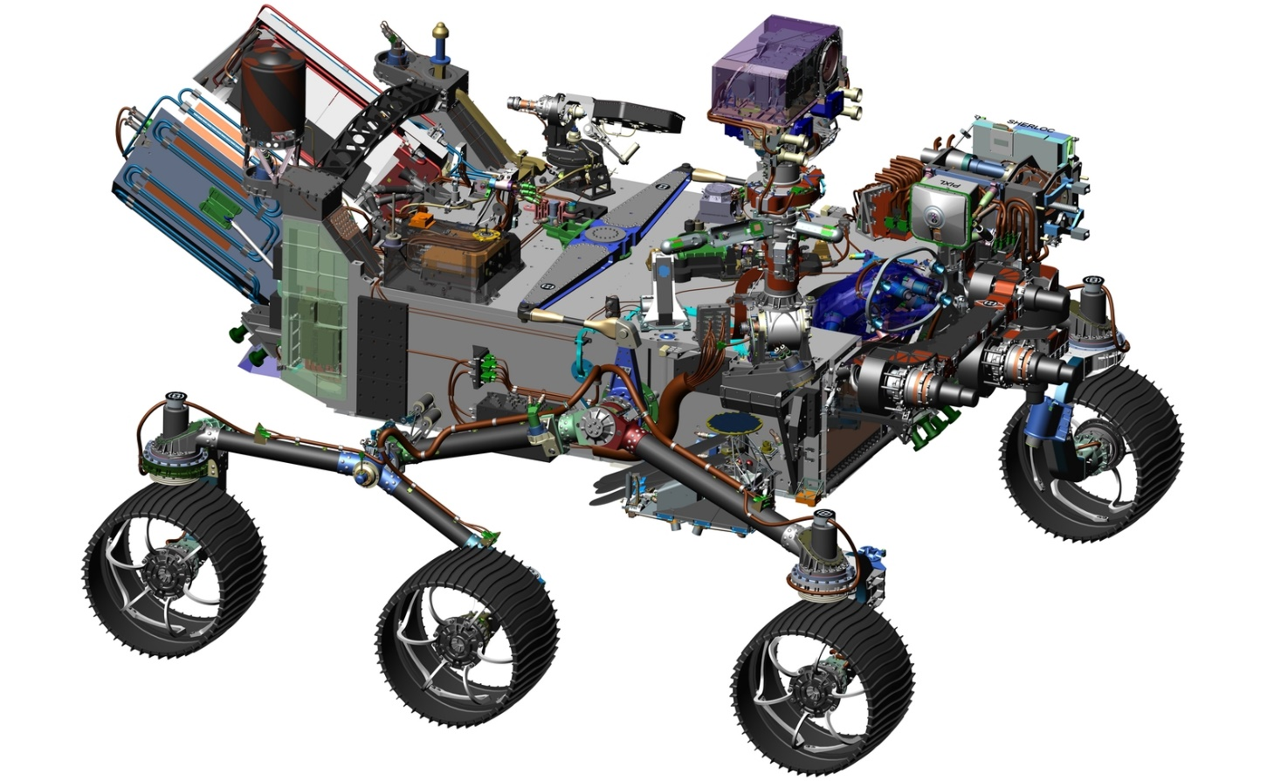
Background
Mars 2020 Rover
Leverages heritage from Curiosity
Will collect core samples of rocks and soils and set them aside in a "cache" on Mars.
http://mars.nasa.gov/mars2020/
(Above picture is from this web site)

Slide 4
Terminology
Sequence
A file containing a list of time-ordered commands
Sleep
At night, we shutdown the rover to recharge
Preheating
Heating up an actuator so that it is warm enough to safely use
Parameter
A saved value this is only changeable by ground command.

Slide 5
Prior Process on the Curiosity Rover
Any action taken by the rover is directed by a series of sequences
The process of creating sequences can take over 9 hours
Due to uncertainty, the operations team had to insert margin for duration estimates
Resulting in wasted time and energy onboard
Can’t take advantage of onboard knowledge of available power and time
If a sequence finishes early or fails, time is usually wasted
The operations team has to manage sleep activities and preheat activities

Slide 6
Onboard Planner Overview
Goals
Improve Operations Efficiency
Run more activities onboard
Less wasted resources (time, energy)
Allow the ground to generate uplink products within 5 hours from receiving spacecraft data
Vision
The onboard planner autonomously
Runs more activities when more power is available
Starts the next activity sooner, if the current activity finishes early
Decides when the rover goes to sleep
We are just starting to prototype
Today, we’ll share some thoughts on planner features appropriate for a Mars rover.
Notes:
This is not a planner in the AI sense. It is more of a scheduler.

Slide 7
Onboard Planner Overview
Planner is responsible for scheduling all onboard execution on the surface
Using the existing sequence engine underneath
What the planner does
Reads a plan file
Determines resource values in the future
Checks for conflicts
Decides when activities can run
gets
uplinked
creates
Onboard Planner
Ops Team
Plan File
predicts
schedules
1:00 | 2:00 | 3:00 | 4:00
 |  |  | Activity5
Activity1 |  | Activity3
 | Activity2 |  | Activity6
 |  | Activity4
constrains
Predicted power,
Predicted data volume
A schedule of when activities can run

Slide 8
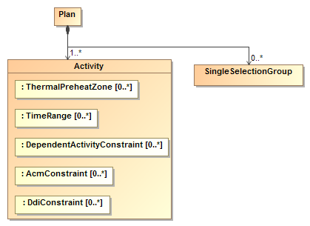
Plan - Definition
Plan file: What is uplinked from the ground to the spacecraft
A plan consists of activities
A plan also contains
Handover time
Handover minimum state of charge
Next plan filename
End time
Maximum delta data volume

Slide 9
Activity Types

Slide 10
Activity
Activity definition: The item that is scheduled
Activity Attributes
Type
Unique activity id
Sequence
Priority
Priority range is divided into mandatory and optional ranges

Slide 11
Activity Types
Generic Activity
Most common type of activity
Runs a sequence
Has a fixed duration
Expanding Activity
Has a variable duration
Recall generic activities have a fixed duration
The minimum duration is specified by the ground
Typical use case is a drive
Planner determines when the activity can end based on available resources and constraints

Slide 12
Activity Types
Single Selection Groups
A group of activities
At most one of the activities in the group is allowed to be scheduled
Purpose: If the most resource intensive activity in a group does not fit, run a less intensive activity instead.
Stay Awake Activity
Prevents the planner from automatically shutting down the computer during this time period
A ground-created activity

Slide 13
Activity Types: Shutdown Related Activities
Categories of shutdown-related activities
Planner
Automatically generated by the planner
Manual
Included in the plan file by the ground
Each category has 3 phases
Shutdown
Sleep
Wakeup
Planner Shutdown Activity | Planner Sleep Activity | Planner Wakeup Activity

Slide 14
Communication Window Activities
Communication (Comm) windows are created by heritage commands.
The planner queries the communication behavior manager to become aware of, and plan around comm windows.

Slide 15
Activity Attributes

Slide 16
Modeled Activity Attributes
Modeled by the ground team
Uplinked from the ground as part of the plan file for each activity
Activity Attributes
Duration
Marginal energy usage
Peak Power usage
Delta data volume
Max number of sequence engines used

Slide 17
Activity Time Ranges
An activity has multiple tuples containing
Start time range
Cutoff time
In other words, an activity has multiple start time ranges
For example:
Activity A can only start between
10:00 -11:00 or 1:00 - 2:00

Slide 18
Activity dependencies
An activity can have dependencies on prior activities
Example: B can only start after A has successfully completed
The dependency has the following attributes
Prior activity’s id
Prior activity’s status (COMPLETED, SUCCEEDED, FAILED, ABORTED, …)
An activity cannot be scheduled unless the dependency is satisfied
A
SUCCEEDED
dependency
B
Notes:
Meets = continuity

Slide 19
Constraining Parallelism
Sometimes we want to constrain activities so that they do not run in parallel.
For example, we don’t want to drive while we move the mast (rsm)
Activities the have the same resource usage bit set cannot be scheduled to run in parallel
Resource usage bits will be specified for each activity by a future ground tool
Many (~100) extra resource usage bits are available for ground-defined meaning
Ground can prevent arbitrary sets of activities from running in parallel.
These activities cannot be scheduled in parallel because they have the same resource bit set
time
1:00 | 2:00 | 3:00 | 4:00
Notes:
Idea:
Schedule activities onboard in advance such that arb would not encounter a conflict.

Slide 20
Preheat and Thermal zones
Preheat definition: Heating up an actuator so that it is warm enough to safely use
Each activity can contain
A list of the thermal zones the activity uses
The planner must autonomously generate preheat activities for a given activity that specifies thermal zones
Preheat activities are not uplinked as part of the plan
Planner must not dispatch the activity unless zone is ok to use
Preheat
Primary Activity

Slide 21
ACM and DDIs
An activity may contain multiple ACM and DDI constraints
ACM: A saved onboard variable typically allowing or precluding some action
DDI: An unsaved onboard variable
Because ACM and DDI values can change, they are only evaluated when assessing whether an activity can be immediately dispatched
ACM/DDI constraints are not evaluated for scheduling future activities

Slide 22
More Features and Definitions

Slide 23
Limiting Data Storage Usage
Project the modeled delta data volume generated by each activity into the future
Use actual delta data volume for all activities in the past
Do not schedule optional activities that would push us over the plan-specified maximum delta data volume.
Mandatory activities are allowed to push us over
The planner is not involved with tracking data stored on instruments

Slide 24
Predicting Future State of Charge
Knowns
For each uplinked activity, the plan file tells us
Activity’s marginal average power (W)
The activity’s duration (sec)
Planner-generated activities get marginal avg pwr (W) and duration (sec) from parameters and tables
Base marginal average power (W) when no activities are running is known from parameters
Present state of charge estimation gives us
The present estimate of the charge in the battery (W-hours)
The estimate of the total battery capacity (W-hours)
Consumption (W-hours) is
$(avg_power_W ∗ duration_hours\text{)}$ = consumption (W-hours)
$predicted state of charge= \frac{present charge estimate− base consumption− \sum{activity consumption}}{estimate of total battery capacity}$

Slide 25
Peak Power Check
Each activity has an attribute giving its peak power usage
Activities cannot be scheduled in parallel if the total peak power usage is above a threshold (W).
The threshold is a parameter.

Slide 26
Uses of State of Charge in Scheduling
Soft min state of charge parameter
Optional and mandatory activities are not scheduled if they would cause a violation
Mandatory are allowed to execute past if already dispatched
Hard min state of charge parameter
Any currently running activities that violate are aborted
Handover state of charge plan constraint
Optional activities are not scheduled if they would cause a violation
Mandatory are allowed to be scheduled if they would cause a violation

Slide 27
Planner Initiated Shutdown
Criteria
Minimum sleep duration (parameter)
Minimum awake duration (parameter)
No activities could be scheduled during the proposed sleep
Without violating the minimum state of charge (parameter)
No optional activities could be scheduled during the proposed sleep
Without violating the handover state of charge plan constraint
To improve long-term battery health
Do not sleep past maximum_state_of_charge (parameter)

Slide 28
Cleanup Activity
A generic activity with a dependency that a prior activity finished with failure (aborted or completed with failure)
Contains a sequence from the ground
Establishes a known state
For most activities, execution of a cleanup is off-nominal

Slide 29
Abort
The planner aborts an activity when
Activity has not finished by its absolute cutoff time
Activity is running when we hit the hard state of charge limit (parameter)
An optional activity is running past the soft state of charge limit
An optional activity is running past its duration
The effects of an abort
The activity’s state changes to ABORTED
This allows the planner to schedule a cleanup activity if present

Slide 30
Conclusion
Showed features needed to do onboard scheduling for a Mars rover
In particular, power estimation, sleeping, and pre-heating
Discussed some relevant constraints that will be evaluated onboard
Showed an enabling set of knowledge that needs to be uplinked from the ground
We hope the planner improves the Mars 2020 mission by
Enabling more activities to run onboard
Better utilizing onboard resources, such as time and energy
Reducing the workload of the ops team with autonomous sleeps and preheats
Future work: Planner prototyping effort
Determine RAM and CPU usage

