Slide 1
Benefits of a Virtual SIL
Spacecraft FSW 16
December 13-15, 2016
Brian Engelkemier, Chris Mason
This presentation does not contain ITAR restricted information

Slide 2
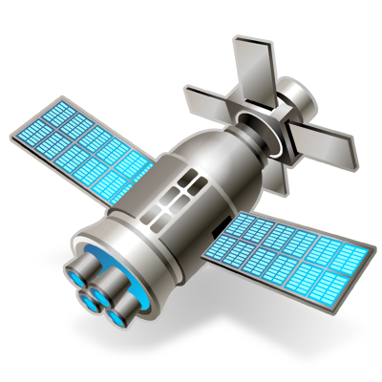
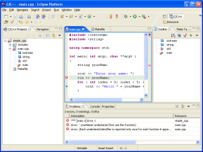
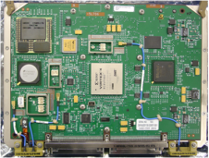
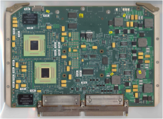
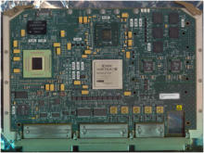
Why Invest In The Virtual Systems Integration Lab (VSIL)
System Test Benches With Real Hardware Expensive And Limited
Demand For Access To Test Benches From Many Groups
Hardware Verification Teams, Software Teams, Integration & Test Teams
Schedule Continually Pushed To The Right
Hardware Taken Away At Various Points In Lifecycle
Bench May Not Have All Hardware Of Real System
FSW and Test Environment Must Handle This
Payload
Single Board Computer | External Interface | Processor Board
Virtual Platform
Embedded Software

Slide 3
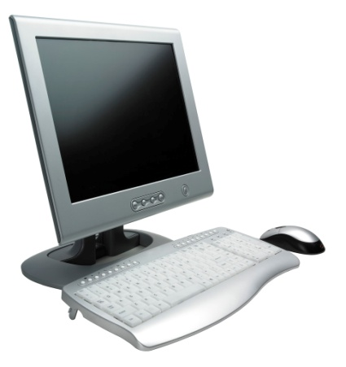
What Is The VSIL?
Hardware Simulation Using Wind River Simics
Runs Unmodified Software Binaries
Simulates Hardware From Software Viewpoint
Provides Each User Their Own Platform On Their Desktop PC
Flight Software, Test Software, I&T, Hardware Verification Team
About 4 FTEs For 6 Months To Get Basic VSIL Running For FSW Team
Payload
Single Board Computer | External Interface | Processor Board
Virtual Payload
Single Board Computer | External Interface | Processor Board
Virtual Platform
Embedded Software
Virtual Platform
Simics Model
Simics Model
Simics Model

Slide 4
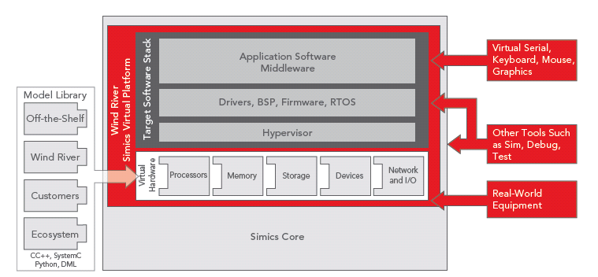
Simics: The technology which enables the VSIL
Model Library
Virtual Platform
Full System Simulation Tool For Software Development
Models All Boards In System
Simics Core Runs On Desktop Windows PC
No Custom compile Switches Necessary!

Slide 5
VSIL Provides Better FSW Development Environment
Kernel, BSP, Device Driver and FSW Development Environment
Simics Models Target CPU
Accurate Hardware Environment
Model Runs All Software Without Modification
Allows Debugging By Stopping The Entire System
All Threads Stop Running
Hardware Stops Running -- Interrupts Stop
Examine State of Software AND Hardware
Reverse Execution Of System
Within 2 Hours Determined Root Cause For Random Crash Plaguing Team For 6 Months
Virtual Payload
Single Board Computer | External Interface | Processor Board
Virtual Platform
Simics Model
Simics Model
Simics Model

Slide 6
VSIL Provides Environment For Fault Detection And Insertion
Add Extra Checking In Board Models
Board Interactions Controlled By FSW
Timeline Verification
Insertion Of Faults From Hardware Boards
Insertion Of Flash Memory Faults Without Destroying Real Flash
Able To Insert Block Level Recoverable And Non-Recoverable Errors
Exhaustively Test Detection Of Errors, Fail Over, And Recovery Process
Virtual Payload
Single Board Computer | External Interface | Processor Board
Virtual Platform
Simics Model
Simics Model
Simics Model

Slide 7
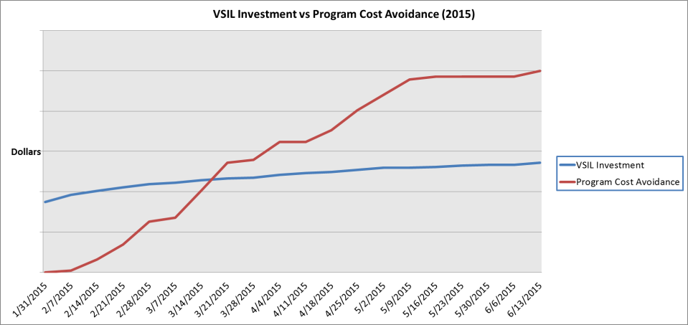
Moving Schedule To Left
Primary Selling Point For Investment Was Need To Gain Schedule
Tracked By Cost Avoidance
Compared Hardware Availability And Use To Real VSIL Usage
Hardware Shared Among Teams And Team Members
VSIL Actual Hours Then Projected Onto Hardware Availability
Number Of Additional Weeks Required For Same Work
Per Week Cost Of Team For Additional Work
ROI + 100% Within 6 Months

Slide 8
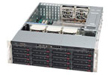
Northrop Grumman ATLA²S Testing Framework
ATLA²S Is A Reusable Framework For Testing
Performance Testing
Functional Testing
Calibration
Used For Software, Hardware And System Verification
ATLA²S Provides
Control Of Specialized Test Equipment (STE)
Control Of Unit Under Test (UUT)
“One Touch” Control For All Activities
Automated Pass/Fail
Captures And Archives
STE Telemetry
UUT Telemetry
UUT Output
Results Of All Activities
ATLA²S
Operator
STE
Data
Mgmt
UUT

Slide 9
Why Use ATLA²S With VSIL?
Provides A Resource For Many Other Engineering Disciplines
System and FSW Test Script Development
Capture Output Of All Tests To Track Problems
Hundreds Of Existing Testing Scenarios
Functional And Performance Tests
ATLA²S
Operator
STE
Data
Mgmt
UUT

Slide 10
Integrating ATLA²S With The VSIL
Remove STE From ATLA²S Configuration
Already Handles Missing STE
Replace UUT With VSIL
Change Bus Emulator for Missing 1553 Hardware In Test Set
Messages Sent Into VSIL Model To Place in 1553 Hardware
ATLA²S
Operator
STE
Data
Mgmt
UUT

Slide 11
Why Use ATLA²S With VSIL? (The Real Reason)
Release Rhythm (For FSW And TSW Teams)
Weekly or Fortnightly Engineering Build and Regression Tests
Engineer Coming In At 2 am To Run Tests Because Of Test Bench Availability
Monthly Release Build And Full Regression Testing
Replace With Nightly Automated Testing
No Concern About Damaging Limited, Expensive Hardware
Change ATLA²S For Headless Operation
Command Line Parameters
Operator Replaced By Jenkins (https://jenkins.io/)
ATLA²S
Operator
STE
Data
Mgmt
UUT
Jenkins Logo Courtesy of https://jenkins.io/

Slide 12
Implementing Automated Testing
Part Of Nightly Build Processing
Runs On Multiple Baselines
Created Spreadsheet Interface To Add Tests
Subset Run Nightly
Full Set Run Every Weekend
Developers Emailed Results Every Morning
Check In Code
Build
Deploy
Test
Report
ATLA²S
STE
Data
Mgmt
UUT
Jenkins Logo Courtesy of https://jenkins.io/)

Slide 13
Other Benefits
Earlier Integration With HW
New Programs Starting To Have FPGA Designers, Model Developers and FSW Team Define Model Behavior
Hardware Engineers Developing Acceptance Tests Earlier
FSW Running On Hardware Before Hardware Available
Virtual Payload
Single Board Computer | External Interface | Processor Board
Simics Model
Simics Model
Simics Model

Slide 14
Summary of Benefits
Better Development Environment
Accurate Hardware Environment
Reduce Cost and Schedule
Reduce Hours Needed On Limited and Expensive Hardware
Increase Reliability
Automated Unit, Regression, And Functional Tests
Kernel, BSP, Device Driver and FSW Development
Fault Insertion Not Previously Possible
Stop Entire System For Debugging
Reverse Executions
Useful for FSW, TSW (FSW Scripts), Integration & Test, Hardware Acceptance Test Development
Start FSW Development Before Hardware Available
More “Test Like You Fly” Testing
Full Payload Always Available
Fault Insertion

Slide 15
Lessons Learned
Start Small In Model First
Start With Just What FSW Requires
Increase To Include Data Payload Processes
Still Doesn’t Replace Full Payload
First Access To Full Payload Resulted In Minor Number Of Problem Reports
VSIL Introduces Second Source Of Bugs
Problem Seen On Real Hardware -- Why Wasn’t Problem Seen In VSIL?
Iterate On Timing Of Model
Board Models Need Provide Consistent Timing To Match Real Hardware

