Slide 1
SpaceFibre Flight Software Workshop 2016
Steve Parkes, University of Dundee
Albert Ferrer Florit, Alberto Gonzalez Villafranca, Chris McClements
STAR-Dundee Ltd.
David McLaren, University of Dundee

Slide 2
Contents
Next Generation SpaceWire
Links, Lanes, Packets and Virtual Channels
Quality of Service
Multi-Lane Operation
Virtual Networks
SUNRISE SpaceFibre Routing Switch
RC64 Core DSP Processor
Conclusions

Slide 3
SpaceFibre Next Generation SpaceWire

Slide 4
Driving Applications for SpaceFibre
High data-rates for SAR and high-resolution multi-spectral imagers require:
10s Gbits/s data rates
High performance mass memory units require:
Multi-Gbit/s network interconnecting memory modules
Integrated control and payload data handling requires:
Deterministic data delivery for AOCS/GNC
Concurrent with asynchronous payload data delivery
Simple configuration
Galvanic isolation
Space transportation and human space flight requires:
Long distance (100m)
Deterministic data delivery – safety critical
Carry video traffic without interfering with deterministic traffic
Backwards compatible with SpaceWire

Slide 5
SpaceFibre
SpaceFibre is
A spacecraft on-board data link and network
SpaceFibre runs over
Electrical and fibre optic cables
A substantial improvement on SpaceWire
Performance x10 to x100 (multi-lane)
Power per bit x0.2
Lower mass x0.75 electrical, x0.5 fibre per cable
Robustness: galvanic isolation, FDIR
Capabilities: virtual links, virtual networks, time distribution, event signalling, deterministic data delivery
Small footprint
Through efficient protocol design
E.g. 3-6% RTG4 FPGA (2-8 VCs)

Slide 6
SpaceFibre Key Features
High performance
2.5 Gbits/s current flight qualified technology
3.125 Gbits/s Microsemi RTG4 FPGA (6.25 Gbits/s coming)
Multi-laning of up to 16 lanes (40 Gbits/s)
Integrated QoS
Priority
Bandwidth reservation
Scheduling
Integrated FDIR support
Transparent recovery from transient errors
Error containment in virtual channels and frames
“Babbling Node” protection
Low latency
Broadcast messages
Compatible with SpaceWire at network level
SpaceFibre
Designed for Spaceflight
Applications

Slide 7
Links, Lanes, Packets and Virtual Channels

Slide 8
Links and Lanes
A SpaceFibre link is made up of one or more lanes
Lanes carry information from one end of link to other end
SpaceFibre lanes can run over
Electrical physical layer
Fibre optic physical layer
A multi-lane link
Can have some unidirectional lanes
Provided that at least one lane is bi-directional
Link provides
Quality of Service
Error recovery

Slide 9
SpaceFibre Packets
Destination
Cargo
EOP
Destination
Represents either
path to destination node e.g. 1,3,7,2
identity of destination node e.g. 67
Cargo
Data or message to be transferred from source to destination
End of Packet Marker
Indicates end of packet

Slide 10
Virtual Channels
Links carry packets through virtual channels
Maximum of 32 virtual channels
Numbered consecutively from 0
Traffic entering VCn at one end of link comes out of VCn at other end
Each virtual channel is independent
Is given:
Priority
Bandwidth allocation
Schedule
These three QoS parameters work together to
Determine the precedence of one virtual channel over another

Slide 11
Links, Lanes and Virtual Channels
VC 0
Link
Near End
Link
Far End
VC 0
Lane 0
Lane 0
VC 1
VC 1
Packets
Lane 1
Lane 1
Packets
…
…
Lane 2
Lane 2
VC N
VC N
Physical
Lane/Multi-Lane
Data Link
Network

Slide 12
Quality of Service

Slide 13
Virtual Channels
VC1
VC1
VC2
MAC
DEMUX
VC2
VC3
VC3
VC sends when
Source VC buffer has data to send
Destination VC buffer has space in buffer
QoS for VC results in highest precedence
A SpW packet flowing through one VC does not block another packet flowing through another VC

Slide 14
QoS: Bandwidth Reserved
Precedence
Bandwidth Credit Counter
time

Slide 15
QoS: Bandwidth Reserved
Precedence
time

Slide 16
QoS Priority
Priority 1
Priority 2
time
Priority 3

Slide 17
QoS Babbling Node Protection
Priority 1
Priority 2
time
Priority 3

Slide 18
Multi-Lane Operation

Slide 19
Multi-Lane Operation
Multi-lane layer provides
Data rate increase x number of Lanes
Any number of lanes 1 to 16
Can change number of lanes dynamically
Saving power in system mode where lower data rate acceptable
Graceful degradation when a lane fails
Without loss of critical (high-priority) information
Including deterministic traffic
Asymmetric operation
Small footprint design

Slide 20
Multi-lane capabilities
Asymmetric links
High data rate instruments pass data mainly in one direction
Allow lanes to be unidirectional
Provided there is at least one bi-directional lane
Lane 1
Bi-directional lane
Lane 1
Lane 2
Bi-directional lane
Lane 2
Lane 3
Unidirectional lane
Lane 3
TxOnly
RxOnly
Lane 4
Unidirectional lane
Lane 4
TxOnly
RxOnly
Lane 5
Unidirectional lane
TxOnly
Lane 5
RxOnly
Lane 6
Inactive unidirectional lane
Lane 6
RxOnly
TxOnly

Slide 21
Graceful Degradation
AOCS/GNC
Lane 0
Lane 0
AOCS/GNC
Control
Control
Lane 1
Lane 1
Essential Data
Essential Data
Lane 2
Lane 2
Important Data
Important Data
Lane 3
Lane 3
Other Data
Other Data
AOCS/GNC
Top Priority, Scheduled
Control
High Priority
Essential Data
High Priority
Important Data
Middle Priority
Other Data
Low Priority

Slide 22
Graceful Degradation
AOCS/GNC
Lane 0
Lane 0
AOCS/GNC
Control
Control
Lane 1
Lane 1
Essential Data
Essential Data
Lane 2
Lane 2
Important Data
Important Data
Lane 3
Lane 3
Other Data
Other Data
AOCS/GNC
Top Priority, Scheduled
Control
High Priority
Essential Data
High Priority
Important Data
Middle Priority
Other Data
Low Priority

Slide 23
Graceful Degradation
AOCS/GNC
Lane 0
Lane 0
AOCS/GNC
Control
Control
Lane 1
Lane 1
Essential Data
Essential Data
Lane 2
Lane 2
Important Data
Important Data
Lane 3
Lane 3
Other Data
Other Data
AOCS/GNC
Top Priority, Scheduled
Control
High Priority
Essential Data
High Priority
Important Data
Middle Priority
Other Data
Low Priority

Slide 24
Graceful Degradation
AOCS/GNC
Lane 0
Lane 0
AOCS/GNC
Control
Lane 1
Lane 1
Control
Essential Data
Essential Data
Important Data
Important Data
Lane 3
Lane 3
Other Data
Other Data
Lane 4
Lane 4
AOCS/GNC
Top Priority, Scheduled
Control
High Priority
Essential Data
High Priority
Important Data
Middle Priority
Other Data
Low Priority

Slide 25
Graceful degradation
When a lane fails in a multi-lane link
Automatically reconfigured
To run with remaining lanes
Takes a couple of µs
Using QoS
Deterministic and high priority traffic gets through
Less important, low priority, traffic is held up
If another, redundant lane, is available
It can be enabled
Full service then resumed
In the meantime, critical traffic is maintained
This capability is integrated in the SpaceFibre hardware

Slide 26
Virtual Networks

Slide 27
SpaceFibre Virtual Network
SpFi
Port 2
VC 0
SpaceFibre
Routing
Switch
VC 0
SpFi
Port 3
Control
Processor
Instrument 1
SpFi
I/F
VC 1
VC1
SpFi
I/F
VC 0
VC 0
VC 2
VC 2
VC 1
VC 1
VC 3
VC 3
VC 2
VC 4
VC 4
SpFi
Port 1
VC 0
VC 0
SpFi
Port 4
Instrument 2
VC 0
SpFi
I/F
VC 1
VC 1
SpFi
I/F
VC 0
Mass
Memory
Unit
VC 1
VC 2
VC 2
VC 1
VC 3
VC 3
VC 2
VC 4
VC 4
Over a link, VCX at one end is connected to VCX at the other end
Virtual networks are mapped on to virtual channels

Slide 28
SpaceFibre Virtual Network
SpFi
Port 2
VN 0
SpaceFibre
Routing
Switch
VN 0
SpFi
Port 3
Control
Processor
Instrument 1
SpFi
I/F
VC 1
VC1
SpFi
I/F
VN 0
VN 0
VC 2
VC 2
VC 1
VC 1
VC 3
VC 3
VC 2
VC 4
VC 4
SpFi
Port 1
VN 0
VN 0
SpFi
Port 4
Instrument 2
VN 0
SpFi
I/F
VC 1
VC 1
SpFi
I/F
VN 0
Mass
Memory
Unit
VC 1
VC 2
VC 2
VC 1
VC 3
VC 3
VC 2
VC 4
VC 4
Virtual channels are configured to support specific virtual networks
VC0 set of virtual channels is always mapped to VN 0, the Configuration Virtual Network

Slide 29
SpaceFibre Virtual Network
SpFi
Port 2
VC 0
SpaceFibre
Routing
Switch
VC 0
SpFi
Port 3
Control
Processor
Instrument 1
SpFi
I/F
VN 1
VC1
SpFi
I/F
VC 0
VC 0
VN 1
VC 2
VC 2
VC 1
VC 3
VC 3
VC 2
VC 4
VC 4
SpFi
Port 1
VC 0
VC 0
SpFi
Port 4
Instrument 2
VC 0
SpFi
I/F
VC 1
VN 1
SpFi
I/F
VC 0
Mass
Memory
Unit
VC 1
VC 2
VC 2
VN 1
VC 3
VC 3
VC 2
VC 4
VC 4

Slide 30
SpaceFibre Virtual Network
SpFi
Port 2
VN 0
SpaceFibre
Routing
Switch
VN 0
SpFi
Port 3
Control
Processor
Instrument 1
SpFi
I/F
VN 1
VC1
SpFi
I/F
VN 0
VN 0
VC 2
VC 2
VN 1
VC 1
VC 3
VC 3
VC 2
VC 4
VC 4
SpFi
Port 1
VC 0
VC 0
SpFi
Port 4
Instrument 2
VC 0
SpFi
I/F
VN 2
VN 1
SpFi
I/F
VC 0
Mass
Memory
Unit
VN 2
VC 2
VN 2
VN 1
VC 3
VC 3
VN 2
VC 4
VC 4

Slide 31
SpaceFibre Virtual Network
SpFi
Port 2
VN 0
SpaceFibre
Routing
Switch
VN 0
SpFi
Port 3
Control
Processor
Instrument 1
SpFi
I/F
VN 1
VC1
SpFi
I/F
VN 0
VN 0
VC 2
VN 1
VC 2
VC 1
VC 3
VC 3
VC 2
VC 4
VC 4
SpFi
Port 1
VC 0
VC 0
SpFi
Port 4
Instrument 2
VC 0
SpFi
I/F
VN 2
VN 1
SpFi
I/F
VC 0
Mass
Memory
Unit
VN 2
VC 2
VN 2
VN 1
VC 3
VC 3
VN 2
VC 4
VC 4

Slide 32
SUNRISE SpaceFibre Routing Switch

Slide 33
SUNRISE: Capabilities
SUNRISE Router capabilities
8-port Router
8 SpaceFibre ports
2.5 Gbits/s on each port
QoS with four virtual channels on each port
Path and logical addressing
4 SpaceWire ports
Connected to one port of SpaceFibre router
200 Mbits/s on each port
Virtual networks
SpaceWire to SpaceFibre bridge
Group adaptive routing

Slide 34
SUNRISE Router Architecture
SpFi
Port 4
VC 0
SpaceFibre
Routing
Switch
VC 0
SpFi
Port 5
VC 1
Port 4
Port 5
VC 1
VC 2
VC 2
VC 3
VC 3
SpFi
Port 3
VC 0
VC 0
SpFi
Port 6
VC 1
Port 3
Port 6
VC 1
VC 2
VC 2
VC 3
VC 3
SpFi
Port 2
VC 0
VC 0
SpFi
Port 7
VC 1
Port 2
Port 7
VC 1
VC 2
VC 2
VC 3
VC 3
SpFi
Port 1
VC 0
VC 0
SpFi
Port 8
VC 1
Port 1
Port 8
VC 1
VC 2
VC 2
VC 3
VC 3
Config
Reg.
&
Routing
Table
VC 0
VC 0
SpW1
Port 0
Port 9
VC 1
SpW2
VC 2
SpW3
VC 3
SpW4

Slide 35
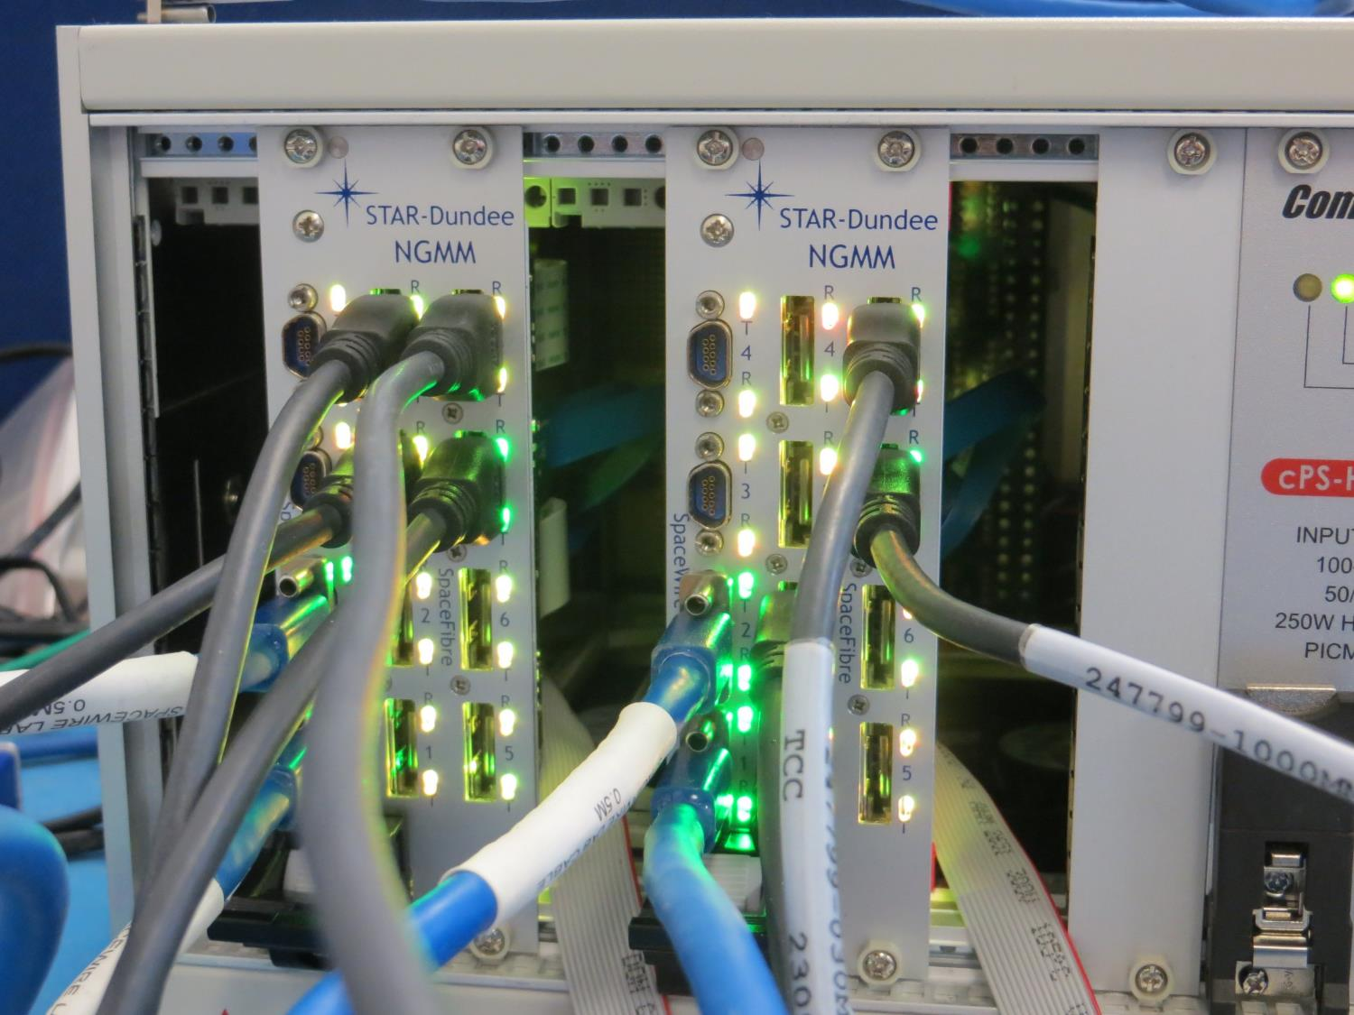
SpaceFibre Router

Slide 36
PXIe-RTG4 Board
JTAG
Microsemi
RT4G150
FPGA
Buffers
Flexi
Flexi
Flexi
Flexi
B1
B2
B4
B5
B6
B1
B2
B7
B8
SpFi 1
Triggers
SpFi 2
Flexi
Flexi
Flexi
Flexi
SpFi 3
SerDes
B0
PXIe
CML Switch
SpFi Conn.
SerDes
B1
SpFi 4
SerDes
B5
SpFi
SpFi 5
CML Switch
SpFi Conn.
SerDes
B2
B0
B9
DDR
DDR
SpFi 6
DDR
PXI P1/J1
SpFi 7
Flexi
Flexi
Flexi
Flexi
B4
B5
B6
B7
B8
SerDes
1 & 2
refclk
Program.
Clocks
SpFi 8
Flexi
Flexi
Flexi
SerDes0
refclk
Clocks
Power Supplies
Flexi
5V
sysclk

Slide 37
DDR Memory Bank 1
PXIe Interface
Flexi
Connectors
SpaceFibre
FPGA
Microsemi
RTG4
DDR Memory Bank 2
Power Supply

Slide 38
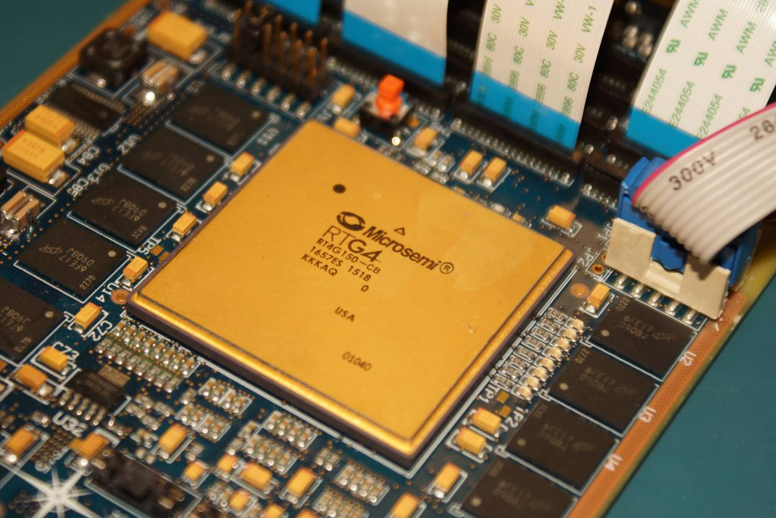
PXIe-RTG4 Under Test

Slide 39
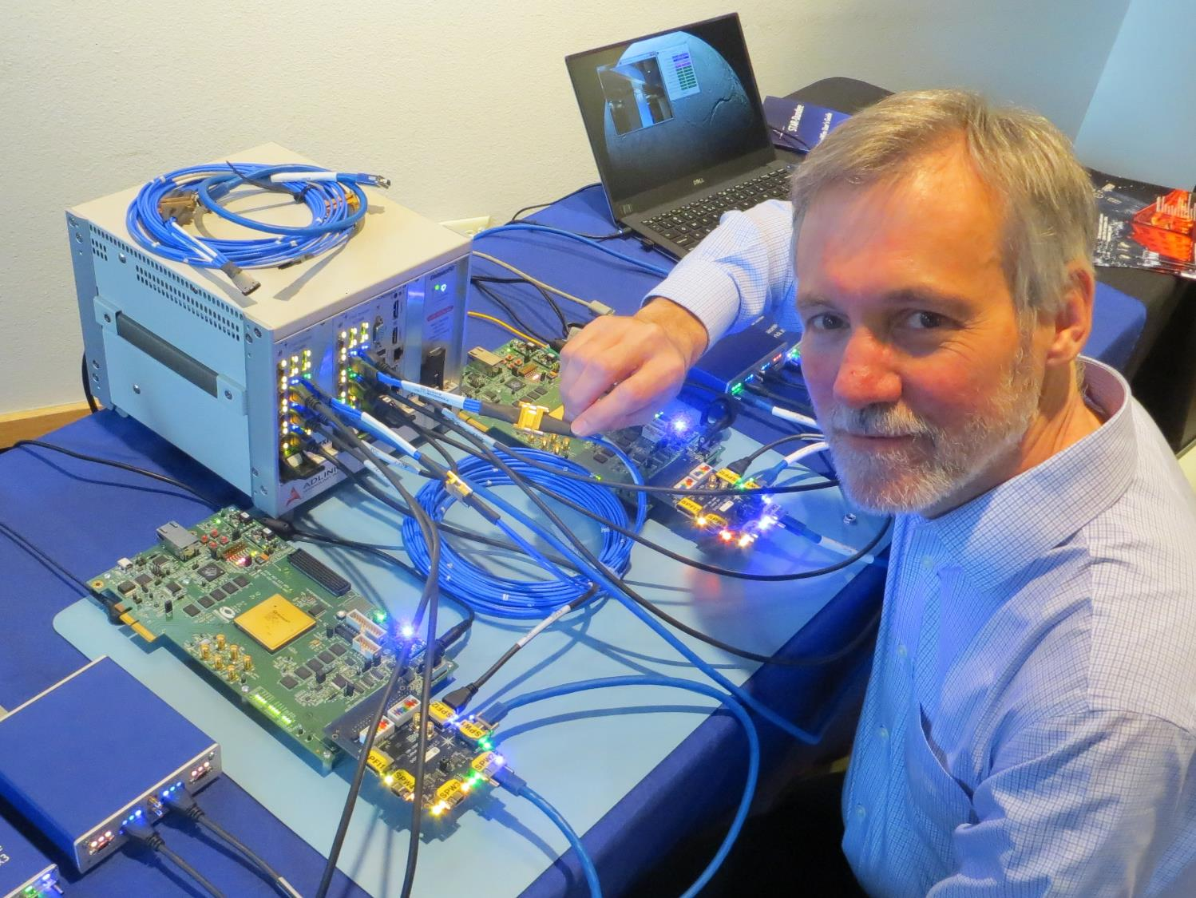

Slide 40
RC64 Many Core DSP Processor

Slide 41
RC64
scheduler
64 CEVA X1643 DSP cores
300 MHz
38 GFLOPS, 150 GOPS
HW scheduler
Modem HW accelerators
LDPC and Turbo codecs
4 Mbyte shared memory
Fast I/O
12 SpFi 6.25 Gb/s
4 SpFi ports double as sRIO
48bit DDR3 800 Mw/s
48 LVDS-DDR 800 Mw/s
96bit NAND Flash 200 Mw/s
2 SpW control ports 200 Mb/s
4 SpW instrument ports 400 Mb/s
Rad-Hard, FDIR
Advanced technology
65nm LP TSMC
10 Watt
PBGA624 & CCGA624
Modular
Payloads employ many RC64
Reprogrammable in space
DSP
DSP
DSP
DSP
DSP
DSP
DSP
DSP
FEC
$
$
$
$
$
$
$
$
M
M
M
M
M
M
M
M
M
M
M
M
M
M
M
M
M
M
M
M
M
M
M
M
Shared Memory
DMA
SpFi/sRIO
DDR2/3
AD/DA
SpW
NVM

Slide 42
Conclusions

Slide 43
Conclusions: SpaceFibre Benefits
Supports high data-rate instruments (e.g. SAR)
Very high data rates
Reduces cost, schedule and risk
Easy to integrate with existing SpaceWire equipment
Reduction of harness mass
Simplification of redundancy
Increase in reliability
Very small footprint due to efficient protocol design
Supports integrated AOCS/GNC and payload network
Quality of service
Deterministic data delivery
Supports space transportation and human space flight
Long distance
Galvanic isolation
Small footprint design (3-5% RTG4 FPGA)

Slide 44
Conclusions
Multi-lane layer provides
Data rate increase x number of Lanes
Any number of lanes 1 to 16
Can change number of lanes dynamically
Saving power in system mode where lower data rate acceptable
Graceful degradation when a lane fails
Without loss of critical (high-priority) information
Including deterministic traffic
Asymmetric operation
Small footprint design

Slide 45
Conclusions
SpaceFibre Network layer
Builds on SpaceWire network layer concepts
Backwards compatible with existing SpaceWire equipment
Virtual Networks
Like several independent, parallel SpaceWire networks
Separates different classes of traffic
Avoids packet blocking problem
STAR-Dundee SUNRISE router
Used to demonstrate and validate concepts
Being ported to Microsemi RTG4 FPGA

Slide 46
Acknowledgements
The research leading to these results has received funding from
The CEOI-ST under University of Leicester contract numbers:
RP10G0348A02
RP10G0348B206
RP10G0348A207
The European Space Agency under ESA contract numbers:
17938/03/NL/LvH - SpaceFibre
4000102641 - SpaceFibre Demonstrator
The European Union Seventh Framework Programme (FP7/2007-2013) under grant agreement numbers
263148 - SpaceWire-RT (SpaceFibre QoS)
284389 - SpaceFibre-HSSI (VHiSSI chip)

Slide 47
Thank You Any questions?
Demonstration Outside
www.star-dundee.com

