Slide 1
QGen Qualification
2016-12-13
TQL-1 Qualification of a
Model-Based Code Generator
Stephen Baird
Senior Software Engineer
FSW 2016, Pasadena, CA

Slide 2
Model-driven Development of Critical Software
An Automatic Code Generator (ACG) produces the source code from a model-based specification
To avoid verifying the generated code the ACG must be "Qualified" (i.e. Trusted) (or “Qualifiable”)
Qualification requires a rigorous and thorough verification of the ACG
  Extensive testing of the ACG with high exhaustiveness
Testing is a major cost in ACG qualification
Automatic Code Generator
Model
Source Code

Slide 3
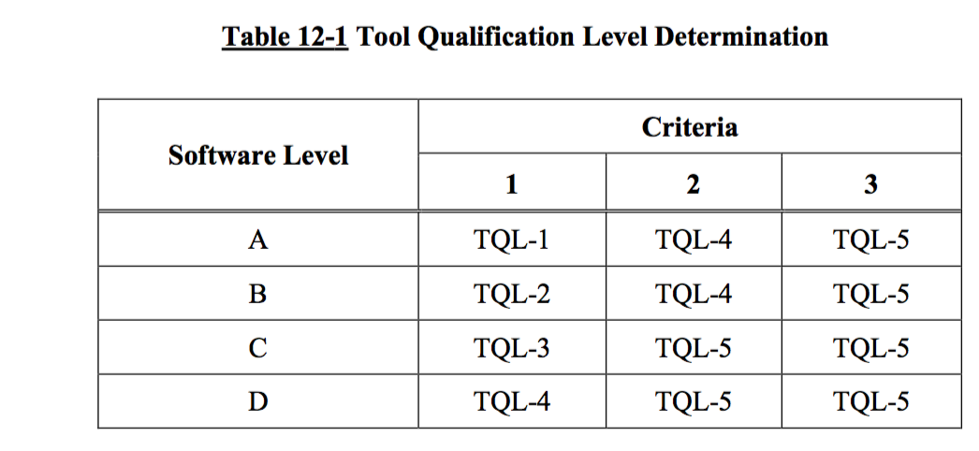
DO-178C, Tool Qualification Levels
Failure Condition is …
Level A: Catastrophic
Level B: Hazardous
Level C: Major
Level D: Minor
Criteria 1: A tool whose output is part of the airborne software and thus could insert an error.
Criteria 2: A tool that automates verification process(es) and thus could fail to detect an error, and whose output is used to justify the elimination or reduction of:
      Verification process(es) other than that automated by the tool, or
      Development process(es) that could have an impact on the airborne software.
Criteria 3: A tool that, within the scope of its intended use, could fail to detect an error.

Slide 4
Advantages of TQL-1 tool with respect to TQL-4/5 verification tools
TQL-1 is about correctness by construction
TQL-4/5 implies a posteriori checks
  DO-178C/331 Table A-5 (verification of the source code)
    After the final model is verified it can find source code is not traceable/compliant
  DO-178C/331 Table A-6 (testing)
    After the final model is verified it can find executable is not robust/compliant
  DO-178C/331 Table A-7 (coverage)
    After the final model is verified it can find uncovered source code
A Posteriori verifications may require changes late in the project
  User may need to modify (after source code generation)
    The generated source code
    The model
    The tests
    The requirements
  Forced to change them not because of deficient design, but because of problems with the code generation tools

Slide 5
Sidebar: What are DO-178C, DO-330, DO-331, DO-332, DO-333?
DO-178C Software Considerations in Airborne Systems
  primary document by which the certification authorities such as FAA, EASA and Transport Canada approve all commercial software-based aerospace systems.
Supplements to DO-178C:
DO-330 Software Tool Qualification Considerations
  addressing qualification of tools for use in airborne software, both from a tool developer’s and a tool user’s perspective
DO-331 Model-Based Development and Verification
  addressing Model-Based Development (MBD) and verification and the ability to use modeling techniques to improve development and verification while avoiding pitfalls inherent in some modeling methods
DO-332 Object-Oriented Technology and Related Techniques
  addressing object-oriented software and the conditions under which it may be used
DO-333 Formal Methods
  addressing formal methods to complement (but not replace) testing

Slide 6




TQL-1 Qualification and DO-178C Objectives
TQL-1 ensures that …
  Tool Operational Requirements define all translation rules from model to the Source Code
  Generated source code is
    Compliant to a defined coding standard
    Verifiable and Traceable
    No unintended function or structure
DO-178C Objectives and TQL-1 qualification
  Remove some review/analysis objectives of generated code (A-5)
  Automate or remove some low-level testing (A-6)
  Automate or remove some structural coverage analysis on source (A-7)
  SAVE MONEY

Slide 7
Source Code Verification Objectives: Shared Responsibility with User
Tool Vendor: TQL-1 Tool verification ensures correctness of the translation
  Tool Operational Requirements analysis and reviews
  Code generated from models corresponds to that defined in TORs
    Verify syntax and semantics of generated code comply with models
    Equivalence between TORs and Simulink/Stateflow semantics is validated by the tool developer through simulation test cases
  Source Code complies with coding standard defined in TORs
Tool User: TQL-1 Validation for project (DO-330, 6.2.1)
  Qualifiable vs. Qualified
  “Tool Operational Requirements are sufficient and correct to eliminate, reduce, or automate the process(es) identified in the PSAC”
  “The tool meets the needs of the software life cycle process in the tool operational environment”
Notes:
Generic DO-330

Slide 8
1994
T
TQL-1 Code Generator Architecture Overview

Slide 9
Qualifiable Code Generator architecture

Slide 10
Detailed Code Generator architecture
Overall Size:
50K SLOC Handwritten
50K SLOC Generated from Metamodel
I.e. BIG for highest level of assurance (think $50/SLOC)
MDL/SLX Importer
Preprocessor
Code Model Generator (CMG)
Optimiser
Expander
Decoration file Importer
Sequencer
Matlab Decoration File Exporter
Geneauto Metamodel API
(Automatically Generated)
Core MOF API
(Manually Written)
Notes:
Not sure if this slide is needed

Slide 11

TQL1 Qualification: Requirements-Based Testing Model for Tools
Tool Operational Requirements (TORs)
verified by
Test Cases
implemented by
implemented by
implemented by
allocated on
Tool
Requirements (TRs)
Tool Architecture
Test Procedures
implemented by
implemented by
Source Code

Slide 12
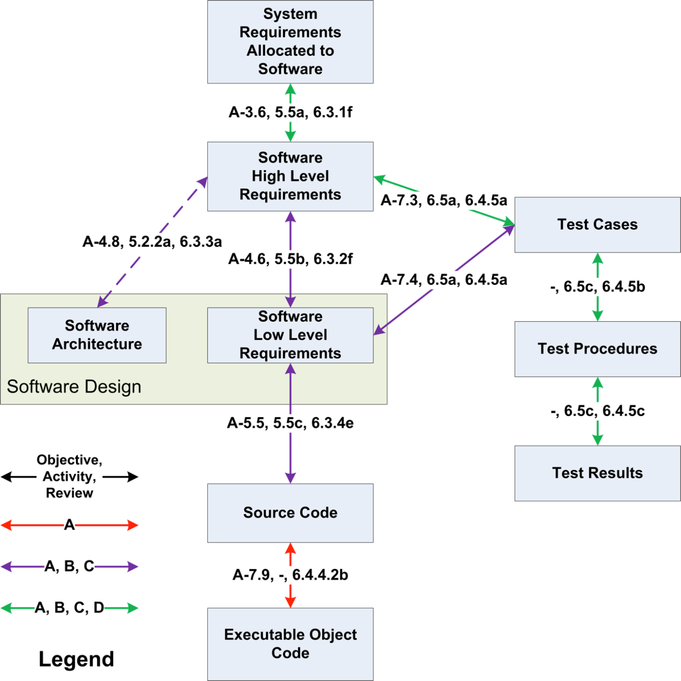
DO-178C Requirements-Based Testing Model for Airborne System
TQL-1 testing model is essentially identical, where:
TOR = HLR and TR = LLR
By Steven H. VanderLeest - Own work, CC BY-SA 3.0, https://commons.wikimedia.org/w/index.php?curid=27610716

Slide 13
Approach for defining Tool Operational Requirements (TORs = HLRs)
TORs define transformations between input model and target language in steps
  TORs define the transformation between input model and intermediate language
    Generic functionality
    Generic parameters
    Accepted combinations (types, dimensions, block parameters)
  TORs to define transformations within the intermediate language
    Optimizations
      Removal of intermediate variables,…
    Expansions
      Typing, loops according to dimensions,…
  TORs to define the representation in the target language (C or Ada)
    Relation between generic and concrete patterns
    Language-specific transformations
      For example, use of specific ++ operator in C
TORs defining the transformation between the input model and the target language in a single step are too complex
TORs are self-contained
  Defined semantics
  Do not refer to Simulink/Stateflow documentation
    Although obviously based on it
    Tests verify that behavior of the generated source code is equivalent to the simulation
TOR-Type-1
TOR-Type-2
TOR-Type-3

Slide 14
Intermediate P language
Goal
  Used to define abstract patterns of code
    High-level language that abstracts aspects of dimensionality and concrete typing
Why
  Define clear semantics
    Do not refer to Simulink/Stateflow documentation
  Compact
  Simplifies writing and understanding requirements
    Remove details
  Reduce combinatorial explosion
    Pattern applies to every type (uint8, int8,…) and every dimension (scalar, vector, matrix)
      And their combinations
  Reuse among target languages
    C, Ada,...

Slide 15
Tool Operational Requirements using intermediate P language
Transformation between input model and intermediate P language
  Expected generic pattern of code
  Generic parameters
    Types of ports, types of parameters, values of parameters
  Set of supported cases (combination of parameters)
Transformations within the intermediate P language
  Source pattern → target pattern
  We no longer have genericity on dimensions: scalar/vector/matrix have separate TORs
  We still have genericity on operators and base types
  No language-specific expansions
Transformations between intermediate P language and target language (C or Ada)
  Regular printing rules
  We are allowed to do intermediate expansion to account for language specific rules:
    P language a++;
    Ada-specific P language a := a + 1;
Exceptional blocks specified in natural language
  Virtual Subsystems that shall be inlined
  Goto/From blocks
TOR-Type-1
TOR-Type-2
TOR-Type-3

Slide 16
Example of TORs: Functional for Saturation (supported configuration)
TOR-Type-1
A legal Saturation block shall have 1 input, 1 output and the "UpperLimit" and "LowerLimit" parameter. The base types of input port and output port shall coincide. If the input and output are scalar then "UpperLimit" and "LowerLimit” shall be scalars. If the input and output are vectors or matrices then "UpperLimit" and "LowerLimit” shall be either scalars or have the same dimensions as the block’s output. "UpperLimit” shall be greater than or equal to "LowerLimit”.
TOR.1
Notes:
We would expect to see this structured in VeroTrace. I.e. one parent requirement and 5 child requirements, otherwise test and traceability becomes very difficult.

Slide 17
Example of TORs: Functional for Saturation (scalar case)
TOR-Type-1
The Saturation block imposes upper and lower limits on an input signal. The block output is equal to the input value when the input value is within the range specified by the “LowerLimit” and “UpperLimit” parameters, “LowerLimit” when the input value is lower than “LowerLimit”, and “UpperLimit” when the input value is greater than “UpperLimit”. if the block’s output is scalar then the generated code model shall be: if in < Params.LowerLimit out = Params.LowerLimit else if in > Params.UpperLimit out = Params.UpperLimit else out = in
TOR.2

Slide 18
Example of TORs: Functional for Saturation (non scalar case)
TOR-Type-1
The Saturation block imposes upper and lower limits on an input signal. The block output is equal to the input value when the input value is within the range specified by the “LowerLimit” and “UpperLimit” parameters, “LowerLimit” when the input value is lower than “LowerLimit”, and “UpperLimit” when the input value is greater than “UpperLimit”. if the block’s output is a vector or a matrix and LowerLimit and UpperLimit are of the same dimension then the generated code model shall follow the pattern specified in TOR.4 where: Code_Fragment is: if in < Params.LowerLimit out = Params.LowerLimit else if in > Params.UpperLimit out = Params.UpperLimit else out = in Dims are the dimensions of output port Indexed_Expressions are: in, out, Params.LowerLimit, Params.UpperLimit
TOR.3

Slide 19
Example of TORs: Expansion
TOR-Type-2
The expansion of a code fragment for multidimensional data is parameterized by the following aspects: A code model fragment: Code_Fragment List of dimensions: Dims List of sub-expressions that are to be indexed in Code_Fragment: Indexed_Expressions The following transformation shall be performed: The code model fragment Code_Fragment shall be wrapped into N RangeIterationStatements, where N is the number of dimensions in Dims. N can only be 1 or 2. The iteration ranges are 0 .. Dims (K) - 1, where K = 1 .. N Each occurrence of an iterable expression in Indexed_Expressions shall be suffixed with M indices, where M is the dimensionality of the given Indexed_Expression and index values set to appropriate index variables A literal non-scalar expression in Indexed_Expressions (block parameters only) shall be copied to a new variable named <block_name>_<parameter_Name>. Then, each occurrence of the given expression in Indexed_Expressions shall be replaced by the appropriate indexed variable expression
TOR.4

Slide 20
Example of TOR: Optimization
TOR-Type-2
A variable that is assigned but never read shall be removed
TOR.N
A variable that is assigned once shall be removed if the following conditions are true: - It is assigned in a simple assignment - The assignment is not for a single element of a vector or a matrix - The assignment is not for a component in a structure - The variable is not the out argument of a subprogram call
TOR.N+1
Sum1_out1 = In1 + In2 Sum2_out1 = Sum1_out1 + In3 Out1 = Sum2_out1
TOR.N+1
Out1 = In1 + In2 + In3

Slide 21
Example of TOR: target code pattern
The C code generated for an if statement that contains an else alternative: if <condition> <if_statements> else <else_statements> shall have the following pattern: if (<condition>) { <if_statements> } else { <else_statements> } where: <condition> is the controlling boolean expression of the if statement <if_statements> is the sequence of statements if the condition evaluates to True <else_statements> is the sequence of statements if the condition evaluates to False
TOR-Type-3
TOR.M
If A > 100 Out1 = In1 else Out1 = In2
TOR.M
if (A > 100) { Out1 = In1; } else { Out1 = In2; }

Slide 22
Types of Tool Operational Requirements
TOR-Type-1
(functionality)
TOR-Type-2
(optimization and expansion)
TOR-Type-3
(code patterns)
MDL/SLX Importer
Preprocessor
Code Model Generator (CMG)
Optimizer
Expander
Printer
Sequencer
Contains
  Specification of transformations
How
  MDL/SLX Importer
    Natural language
  Preprocessor
    Natural language + Contracts
  Sequencer
    Natural language + Contracts
  Code Model Generator
    Natural language + pseudo-code in P language
  Optimizer
    Natural language
  Expander
    Natural language
  Printer
    Natural language

Slide 23
Example of Tool Requirements (TRs = LLRs): Configuration for “Saturate” block
TR.1.1 checks the configuration for two different Simulink blocks
  Saturation
  Saturation Dynamic
The supported configuration of a Saturate block shall have: Either 3 inputs and 1 output, or 1 input, 1 output and the "UpperLimit" and "LowerLimit" parameters The base types of all input ports and output port shall coincide In the Saturation Dynamic block, "Saturate On Integer Overflow" flag shall be turned off (MISRA constraint)
TR.1.1
If the input and output of a Saturation block are scalar then "UpperLimit" and "LowerLimit” shall be scalars.
TR.1.2
If the input and output of a Saturation block are vectors or matrices then "UpperLimit" and "LowerLimit” shall be either scalars or have the same dimensions as the block’s output.
TR.1.3
"UpperLimit” shall be greater than or equal to "LowerLimit”.
TR.1.4

Slide 24
Requirement-Based Testing
Types of tests
  TOR-based test cases -- High Level Requirements based testing
  TR-based test cases -- Low Level Requirements based testing
TOR-based test cases (DO-330, table T-6, obj. 1 & 2)
  Expected code from Simulink models
    Input: Simulink models
    Expected output: Check against expected code patterns and behavior
  Combination of test cases with reduced and large number of blocks
  One or more test cases per test procedure
  Requirement-based testing
TR-based test cases (DO-330, table T-6, obj. 3 & 4)
  Check behavior based on internal model representation (at intermediate steps)
  Expected behavior of subprogram
    Input: cannot express as Simulink model
    Output: cannot express as behavior of output code
  Requirement-based testing based on internal context

Slide 25
TOR-based (High-Level-Requirement-based) testing
Verify behavior of individual blocks
  Individual test cases for each block and each configuration
Verify optimization rules
Verify generated code
Verify composition of blocks
  Tester defines the expected result
  Simulation used as oracle

Slide 26
TR-based test cases: Difficulties in performing unit testing of low-level requirements
Input
  Cannot express as Simulink model
  Internal models are difficult to generate
Output
  Cannot express as behavior of output code
  Generated internal models are difficult to verify
Traceability
  How to ensure that a concrete test case is exercised by a concrete test procedure
Coverage
  How to ensure that all test cases have been exercised
Expressiveness
  Compare state before and after the subprogram execution
Notes:
Hide to users. Too much details not needed

Slide 27
Unit Testing vs. Integration Testing
Unit testing vs. Integration Testing
User Language
Ti−1
Mi
Ti
Mi+1
Ti+1
Source Code
Input
Unit Testing
Output
Input
Output
Integration Testing
Integration testing is widely preferred to unit testing
Objective
Achieve unit testing exhaustiveness using only integration tests
 | Unit Testing | Integration Testing
Test Data Editor/Viewer | Internal languages have no editors | User language has a good editor
Test Data Complexity | Intermediate languages are complex | User language is simpler, has higher abstraction
Test Exhaustiveness | Achievable thanks to isolation of units | Hard to achieve with no visibility on the internals of the tool

Slide 28
TR-based test cases: Approach to handling low-level requirements “unit” testing
We need to define:
  Equivalence class definition
    Characterization of the input relevant to the test case
  Oracle
    Output validity criteria
    The way to decide the pass/fail verdict
Test procedures can be:
  End-to-end (from Simulink to code) tests
    Covering a set of test cases at different phases
  Unit tests
    Covering a set of test cases for a given TR
Executable expression of test cases
  Instrument code of the tool, so at execution time we can
    Log the occurrence of test cases (traceability and coverage)
    Check (test oracle) the expected result of the test case
  Tool does not have instrumentation in production mode
  Equivalence between instrumented and non-instrumented version
    Execute the test procedures in both modes and check that generated code is exactly the same
Notes:
We use the test procedures for the HLR. We define test cases for the LLR. We run test procedures, we log test cases that have been exercised, and log the result of the test case verification

Slide 29

Instrumentation for Test Case Evaluation
control flow
Subprogram Under Test
Log which equivalence classes are covered by the input data
instrumentation
instrumentation
Evaluate the test oracles of the covered test cases
All instrumentation is marked as ghost code
Compiler produces ghost code only when assertions are enabled.

Slide 30
Instrumentation for Test Case Evaluation
control flow
for TC of Test_Cases loop
if TC.Equivalence_Class then
TC.Covered := True;
Log (TC.Id & “ Covered”);
end if;
end loop;
Subprogram Under Test
instrumentation
for TC of Test_Cases loop
if TC.Covered then
if not TC.Oracle then
Log (TC.Id & “ Failed”);
end if;
end if;
end loop;
instrumentation

Slide 31
Instrumentation for Test Case Evaluation
control flow
function Equivalence_Class (T : Process_Goto_From_TC1)
return Boolean is
-- Input model contains “Goto” blocks
Goto_Blocks_In_Model : Element_Sequence'Class :=
Model.Get_Blocks_Of_Type (“Goto”);
begin
if Goto_Blocks_In_Model.Length > 0 then
T.Goto_Blocks.Append (Goto_Blocks_In_Model);
return True;
else
return False;
end if;
end Equivalence_Class;
Preprocessor
instrumentation
function Oracle (T : Process_Goto_From_TC1)
return Boolean is
-- Check that all “Goto” blocks become null and are no longer
-- contained in the model
begin
return (for all B of T.Goto_Blocks =>
B.Is_Null and then
not Model.Contained_Elements.Contains (B));
end Oracle;
instrumentation

Slide 32
Instrumentation for Test Case Evaluation
control flow
function Equivalence_Class (T : TC1) return Boolean is
(B.Inports (1).Is_Vector and then B.UpperLimit.Is_Scalar);
function Equivalence_Class (T : TC2) return Boolean is
(B.Inports (1).Is_Vector and then B.UpperLimit.Is_Vector);
function Equivalence_Class (T : TC3) return Boolean is
(B.Inports (1).Is_Matrix and then B.UpperLimit.Is_Matrix
and then (for some V in B.UpperLimit =>
V.Is_Infinity));
...
Code Model Generator
instrumentation
instrumentation
Test Oracle does not have to be automatic. It might be:
- Printing the intermediate code model, validating it and setting it as a test baseline
- Validating the final generated code because it has a structure very similar to the code model, and setting it as a test baseline

Slide 33
TR-based test cases: Implementation
Test cases are expressed as:
  Executable form
    Test objective =>
      Evaluated at subprogram entry
    Test oracles =>
      Evaluated at subprogram exit
  Manual verifications
    If applying the previous are difficult
Traceability and coverage
  Logging occurrences of requires and ensures
  Requires
    Evidences of coverage of test cases
  Ensures
    Test case results
function Sqrt (X : Integer) return Integer with Test_Case => (Name => “TC1”, Mode => Nominal, Requires => X = 1, Ensures => Sqrt’Result = 1), Test_Case => (Name => “TC2”, Mode => Nominal, Requires => X > 1, Ensures => Sqrt’Result ** 2 <= X and then (Sqrt’Result + 1) ** 2 > X);
Trace for a test with Sqrt (5): Sqrt.TC1.Requires False Sqrt.TC2.Requires True Sqrt.TC1.Ensures Not Applicable Sqrt.TC2.Ensures True
Notes:
Hide to users. Too much details not needed

Slide 34
TR-based test cases: Implementation (II)
Some flexibility
  Instead of Test_Case we can use Contract_Case, Precondition, Postcondition
Expressiveness
  We can save and check state using a separate verification package
Use “Ghost” Code throughout
  Ghost code removed when compiled in no-assertions mode
Example using Executable Preconditions/Postconditions:
Procedure to eliminate GoTo blocks. Test case is: - Requires: There exists a GoTo block - Ensures: That GoTo block becomes null and is removed from the model
procedure Preprocess (SB : SystemBlock’Class) with Pre => Preprocess_Verif.Preprocess_Test_Cases_Requires (SB), Post => Preprocess_Verif.Preprocess_Test_Cases_Ensures (SB); -- Routines called in the pre- and post-conditions can store any required data within -- internal variables and check their status after execution of Preprocess
Notes:
Hide to users. Too much details not needed

Slide 35
Integrated Unit Testing
Integration Test Input
Ti−1
Mi
Ti
Mi+1
Ti+1
MN
Integration Test Execution
tri,j
tri,j
tri,j
toi,j
tri,j
tri,j
Unit Test Requirements
Unit Test Oracles
 | Unit Test Requirements
Integration Tests | tr0,0 | tr0,1 | tr0,2 | to0,0 | to0,1 | to0,2 | tr1,0 | tr1,1 | to1,0 | to1,1 | tr2,0 | tr2,1 | to2,0 | to2,1
Test0 | SAT | – | – | PASS | – | – | – | SAT | – | PASS | – | SAT | – | PASS
Test1 | – | – | SAT | – | – | PASS | – | SAT | – | PASS | – | SAT | – | PASS
Test2 | – | – | SAT | – | – | FAIL | SAT | – | PASS | – | – | SAT | – | PASS
Test3 | – | – | – | – | – | – | SAT | SAT | PASS | PASS | – | SAT | – | FAIL
Test4 | SAT | – | – | PASS | – | – | – | SAT | – | PASS | – | SAT | – | PASS
Non-covered Unit Test Case
Unit Test Failure
Non-covered Unit Test Case
Unit Test Failure

Slide 36
TQL-1 Qualification Approach – Building Trust in Code Generator
Structure of Tool (Operational) Requirements reflects Multi-Pass structure of Code Generator
  Input, Transformation(s), Optimization(s), Output
Conventional Unit Testing of Multi-Pass Code Generator is painful
  Difficult to create inputs and check outputs of individual passes
Integration Testing is generally easier
  can use normal Models as Input; generated Source Code as output
Instrument Code Generator with “ghost” code to use Integration Testing to accomplish Unit Testing
  Monitor inputs during Integration Testing to be sure all relevant Test Cases go through each pass
  Can check completeness and uniqueness of input classification, so each input gets exactly one classification
  Use Oracle to create expected output based on input classification and check for match
Coverage Testing now at Test Case level
  Verify that all interesting test cases were executed
Approach applicable to other multi-pass tools such as Compilers

