Slide 1
Parameter-Defined Testing as a Major Success Factor in Integrating and Testing Space Programs
Space FSW Conference 2016
Matthew Conte
Software Engineer
Northrop Grumman Mission Systems
Baltimore, MD

Slide 2
Agenda
I&T Environment
Traditional Test Script Development Approach
Knob-Driven Test Script Approach
Implementation Details

Slide 3
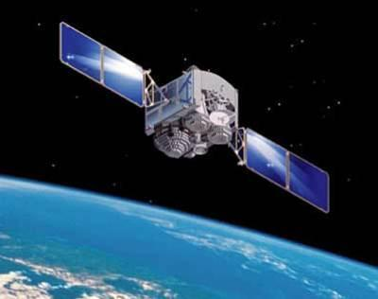
Who We Are
Northrop Grumman Space Systems Software (SSSW) group
Develop embedded FSW for space systems
Maintain a test software (TSW) suite to control our integration lab equipment and exercise functions of the system
Work with a variety of languages and tools
C++, Java, Tcl, Python
VxWorks Workbench

Slide 4
Integration and Test (I&T) Environment
Unit Under Test (UUT):
Flight, lab, or simulated hardware running FSW
Test Rack:
TSW consists of:
Test scripts (written in Tcl)
FSW command sets
STE control code
Test scripts specify how the STE should be set up for a specific test
Telemetry; Data Files
Test Rack
UUT
STE
TSW
FSW
Command Sets

Slide 5
Traditional Test Script Development
Software Engineers implement custom test scripts.
If requirements are not conveyed correctly, software and systems engineers must spend time debugging the test script together.
Systems Engineers
Design test cases
Provide test case requirements to software engineers
Non Working Test Script
After multiple iterations, software engineers finally complete working test scripts.
Working Test Script
Systems Engineers spend time debugging software.
Software engineers spend time on system mode specifics.
NOT EFFICIENT
Notes:
Diane

Slide 6
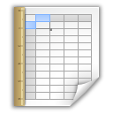
New Approach to Test Script Development
Test Case
Definition Format
Working Test Script
Software Engineers
Develop infrastructure that allows user friendly definition of test case parameters
Do not spend time developing mode-specific test cases
Are free to develop other infrastructure
Systems Engineers
Use software-defined infrastructure to define their test case parameters
Concentrate on the specifics of testing their mode
Are much more likely to develop the desired test setup since they are the SME’s
Systems Engineers spend time on mode testing.
Software engineers spend time developing software to optimize I&T.
EFFICIENT!
Notes:
Diane

Slide 7
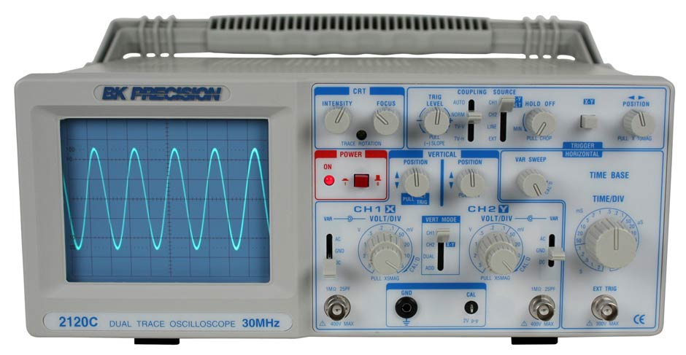
Test Configuration Spreadsheet
Composed of TSW “knobs”
Test equipment parameter
An option for how TSW should execute the test
Analysis tool to be run
TestScriptControls.xlsm spreadsheet defines a default value for every knob.
Each test has an individual knobs spreadsheet which defines specific knob values needed by the test.
If test-specific config spreadsheet does not define a knob value, the default is used.
Global array in TSW code populated with knob values, available to all modules which know when to apply the knob values.
Notes:
Matt

Slide 8
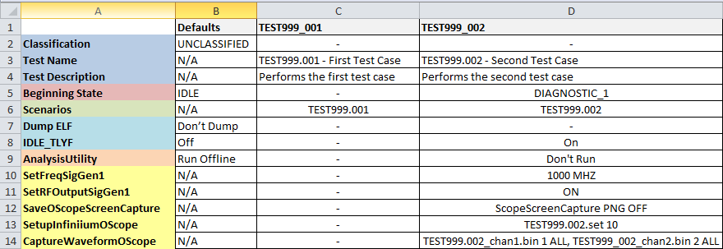
Test Configuration Spreadsheet Example
Test Execution Option
Run test in Test-Like-You-Fly mode
STE Control Set signal generator output freq. to 1000MHz
Post-Test Analysis
Do not run “AnalysisUtility” after this test
This single spreadsheet provides all the configuration parameters needed to set up, execute, and run analysis on a test case.

Slide 9
EAGE Knob Translation Table
Defines when to apply the knobs
Start of test
For multi-scenario tests, the start of each scenario
End of test
Defines the function call that corresponds to the knob

Slide 10
Parsing a Test Case Spreadsheet
TSW
Parse spreadsheet using table and map each STE knob to a TSW function
Test Case
Definition Spreadsheet
EAGE Knob Translation Table
TestEquipmentManager
SYSTEM_SETUP global array
Oscilloscope
Signal Generator
Discrete Controller
Analysis
Manager
TEM forwards these function calls to the individual STE control classes which, ultimately, command the devices to the desired settings
Analysis knobs are used to queue a list of tools to be run after the scenario completes

Slide 11
Simplified Test Script File
Most test cases follow the same basic format allowing for reuse of
a simple script file:
proc TEST999_002 {args} {
$::System preTestSequence
$::System queueRunScenario
$::System postTestSequence
}
Setup test equipment; start new database acquisition
Run a test scenario and acquire data
Post-process the data and record test results; close database acquisition
To create a test case:
TSW engineers copy and paste code
Systems engineers fill in knobs spreadsheet
MORE EFFICIENCY!

Slide 12
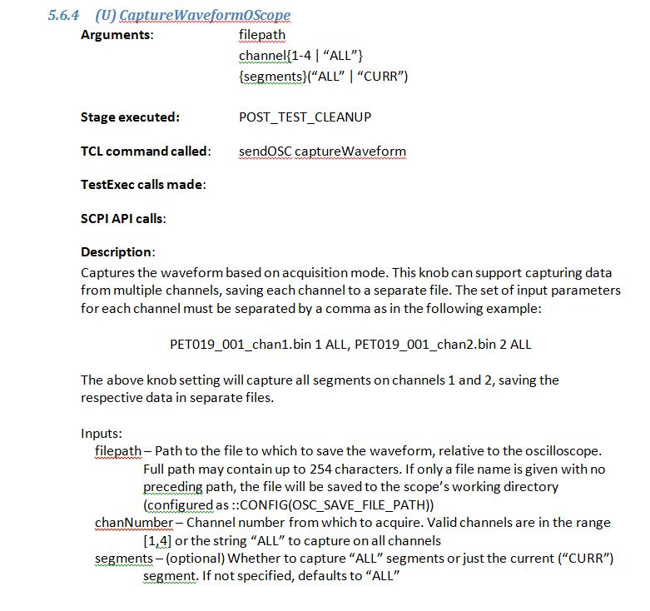
EAGE Knob Manual
Maintained a manual with every available EAGE knob and each of their parameters
Contains everything that a test or systems engineer would need in order to create a test definition spreadsheet

Slide 13
Results
Majority of mode test scripts were developed by systems engineers, not software engineers
Software engineers focused on test scripts that differed from standard data collects and required more customized code.
Only 255 out of 1456 total test cases were developed by software engineers, ~17%. The rest were mode test scripts developed by systems engineers.

