Slide 1
Orbital ATK Space Systems Group: Systems Engineering Fault Management and System Autonomy
Automated Testing and MBSE
2016

Slide 2
System Modeling Language (SysML)
Orbital ATK Technical Operations (East) Systems Engineering (SE) department has been sponsoring initial training and focused efforts to improve the use of Model Based Systems Engineering (MBSE), and in particular the introduction of System Modeling Language (SysML)
SysML is intended to enable improvements in the integrity and efficiency of SE process, methods, and tools and provide a means of integrating with existing Model Based Engineering (MBE) approaches
SysML is an extension of Unified Modeling Language (UML) familiar to software engineers
The initial deployment of SysML is being focused in two, related areas that
Do not have strong, existing methods of ensuring systematic methods are applied
Provide an opportunity for improving both the integrity and efficiency of SE efforts
Provide or improve upon a product that can be used by existing and new programs
Provide a potential for MBE/MBSE connectivity with existing products/efforts
Additional applications are being applied and examined to identify other areas of opportunity and future growth paths
The initial efforts are a proving ground of potential application and a means of developing and initial SysML understanding and skill set
Systematic application of these approaches requires
An initial, standard ontology and model structure for Orbital ATK systems
Selection and funding of a standard SysML toolset
Establishment of initial guidelines and work instructions for identified products
An initial user of SysML within the SE department is the Fault Management and System Autonomy (FM & SA) group
The concepts and approaches discussed and demonstrated represent initial efforts to identify specific
areas of systematic application that should be pursued, and the minimum effort to deploy them

Slide 3
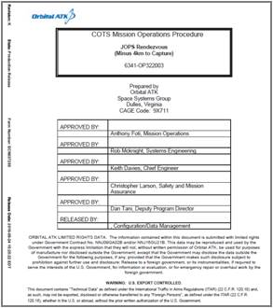
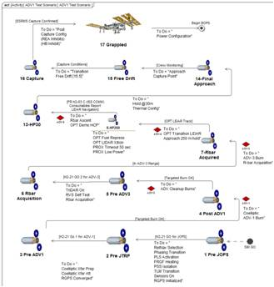
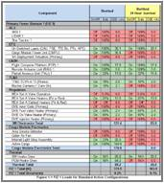
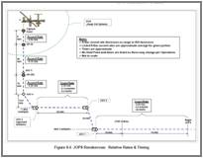
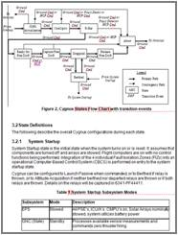
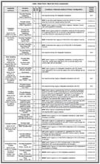
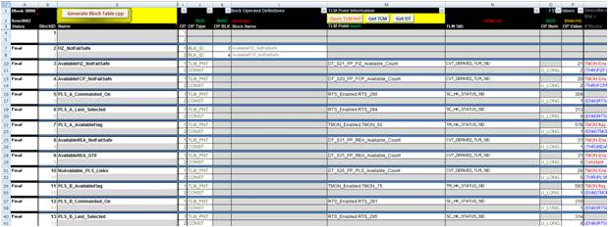
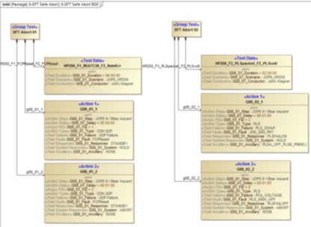
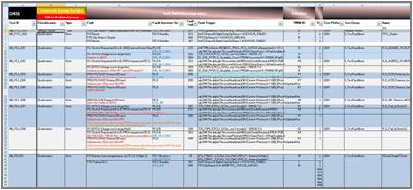
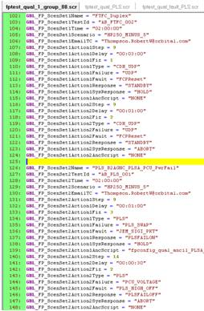
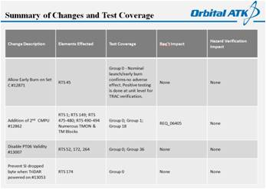
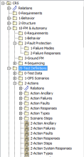
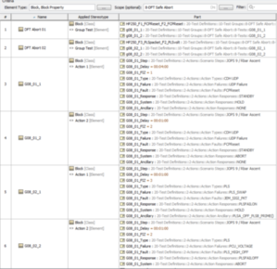
Initial SysML Deployment Exploration
Transition from non-standard definitions of ConOps (mission, system, vehicle, function, etc.)…
To a standard method within a SysML database
Enables systematic methods (reviewable, findable)
Reduces user errors (budgets, test, operations)
One tool/database allows consistency of identifying test cases from use cases, behavior, and requirements
Transition from multi-source, manual test definitions…
To structured, selectable test framework
Enables systematic methods (reviewable)
Reduces errors (clearly defined cases/options)

Slide 4
Initial SysML Deployment Paths
1
2
Initial integration with MBSE and system test tools
Expansion of behavior and sequencing diagrams to lower levels of system definition
Explore use of SysML for behavior diagrams and definition of:
System modes
Mode transitions
System states
State transitions
System activities
Activity constraints
3
Guidelines for standard use, integration of requirements tool sets, and report generation
4
ConOps
Dream Big
Explore use of SysML for test definitions:
Test scenario
Action timing
Action / Failure
Expected response
System response
Ancillary objectives
Guidelines for standard use, integration of test architecture and ConOps constructs
FM & SA
4
Guidelines for use in FM & SA design development and design integration with system objectives
Automated test generation
3
Use of SysML to capture FM & SA design artifacts
Behavior
Critical sequences
Failure categories
2
1

Slide 5
FM & SA Test Architecture
Scenarios based on Operational procedures (scripted) with pre-set steps
Tests defined by design and test team with selected scenario
Fault injection simulation scripted (if new) and group test definition is configured in Excel
Test approach is reviewed at Test Readiness Review
Test Definitions
Test Execution
Post Test Level 0 Processing
Review Level 1-2
Data Processing Tools
Test Definition
Platform Setup
Collect
Log Files
Fault Injection Simulation
Group Setup
Process
Log Files
Group Definition
Test Execution
Evaluate
Events
Requirements Closure
Group Summary
Evaluate
Telemetry
Group Script Generation
Generation Test Report
Log File Management
Update Status Sheet
Cradle
Automated
Manual
The FM & SA test architecture is highly automated in execution and data processing
Definition of test cases remains an area difficult to automate and review

Slide 6
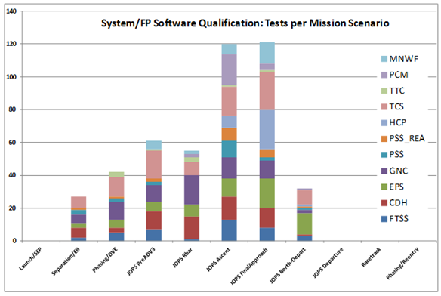
Test Definitions
Test definitions are currently specified in a large table construct in Excel
Values are transferred to a set of global parameters that define a test
Although globals define the scope of a test, the scenario context can be unclear
An important aspect of testing is the mission phases, activities, vehicle modes/states, or transitions selected for a given fault injection selected to assure flight like testing and expose potential emergent system behaviors
Some functions are fixed within mission phase or state based on applicability
Others may be shown to be independent based on their response (e.g. thermal zone reconfiguration) and may therefore be tested across test scenarios
Others may be selected as ‘worst case’ and tie to analysis supporting verification
Some test scenarios may be selected to show compliance of ‘capability’ – i.e. continue and complete mission activities in the presence of a failure, including retry
The test scenario selection may be reviewed and iterated to ensure coverage across mission phases, activities, vehicle modes/states, and transitions
The selection of scenarios is often based on the design and implementation
Selecting and communicating the sufficiency of scenario coverage can be difficult
Assuring proper coverage for stressing cases or identifying emergent behavior can be difficult
Scenario definitions used for operational rehearsals, interface tests, spacecraft tests, and systems analyses may not be well synchronized

Slide 7
Exploration of SysML for Test Definitions
The road map for this effort can be described in several phases
Replace spreadsheet based definition of test definition / test script generation
Evaluate options for representation of test definition parameters in SysML
Evaluate options for translating test parameters to current test script definition
Generate representation of tests in diagrams or reduced tables to support:
Test conductor situational awareness for expedited and effective execution and review
Test modifications for specific design changes
Test review by internal and external team members
Generation of expected test results (vehicle responses)
Generate representation of FM autonomous responses to support:
Population of expected test results (vehicle responses)
Identification and review of the scope of FM autonomy that should be tested
Updates to ConOps diagrams for valid FM responses (i.e. identify FM autonomous behavior within a phase, activity, sequence)
Generate representation of operational autonomy and automation to support:
Population of scenarios and scenario steps available for testing
Identification of sequencing options that should be tested
Updates to ConOps diagrams for autonomous control
Extraction of guidelines and patterns of ConOps and vehicle behavior definition that support operational and FM autonomy specification and test definitions
Evaluation of automated test result definition given a selected test case
Evaluation of automated test definition given a set of criteria and vehicle behaviors

Slide 8
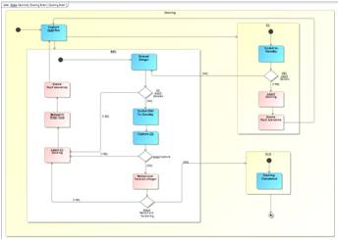
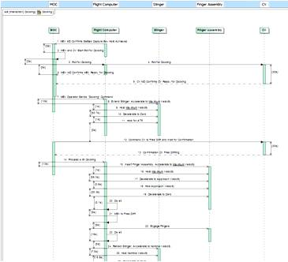
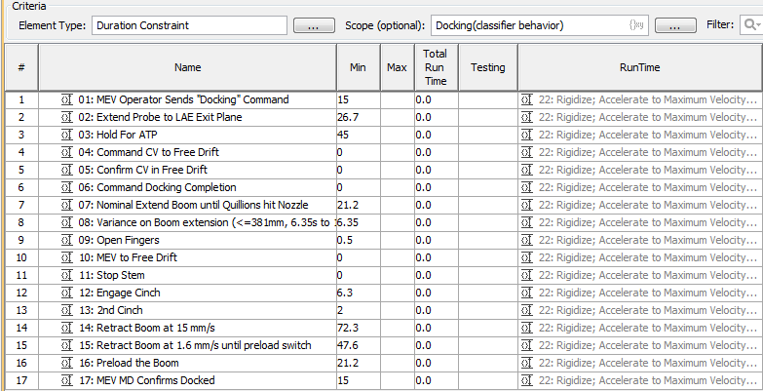
SysML Definition of FM & SA Test Scenarios
State diagrams represent transition criteria including anomaly responses from a given mode/state.
Systems state/mode nomenclature does not inherently agree with SysML diagram nomenclature.
Activity diagrams for a given scenario with steps indicating test initialization and transition points (startup or start activity timer or act) provide context for failure scenarios and tests.
A structure diagram (e.g. block / stereotyped) creates entities that can be enumerated or selected.
Sequence diagrams capture timing but are most applicable for single flow activities (i.e. once failure case is selected) or for identifying best and worst case timeliness ranges.
Automatic tables with embedded scripts can compute timeliness once the sequence is generated. Timeliness data is used for analysis and test definitions (timeouts).

Slide 9
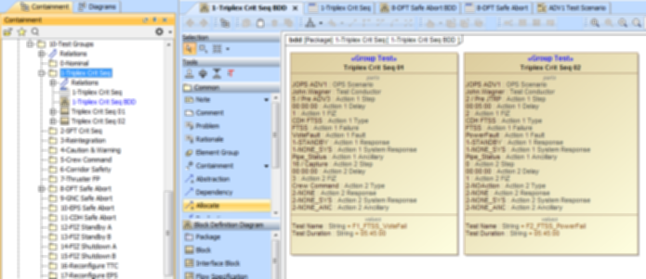
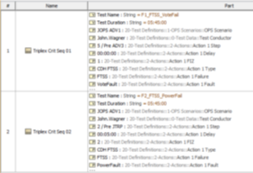
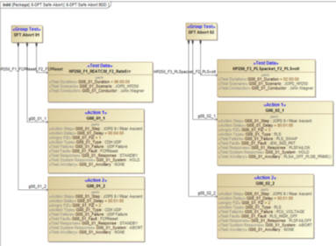
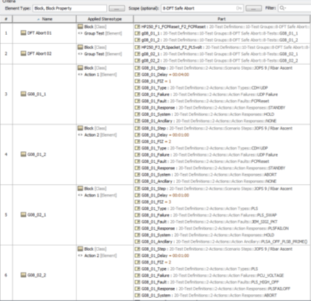
SysML Definition of FM & SA Test Definitions
A composite test definition (structure) identifies all parameters necessary for the test architecture to execute.
An automatically generated table is directly compatible with script generation tools.
A multi-layered composition definition (block structure) provides easier visibility into the test definition and an easier design pattern to copy and utilize.
Additional options are being evaluated for best connectivity to input (ConOps and FM/autonomy behavior for failure categories) and output (test flow visualization and results generation).
Automated test architecture supports 0-2 actions (failure or other) where each action may also call an ancillary action/function.

Slide 10
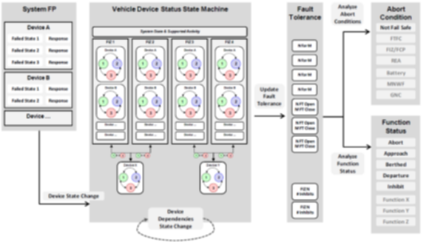
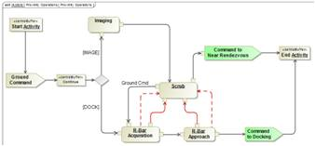
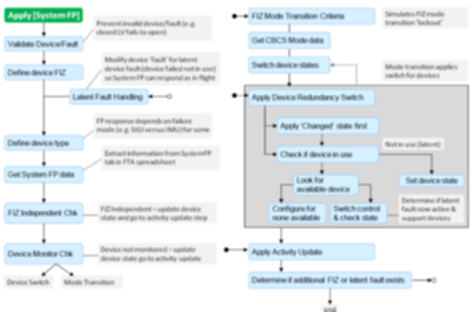
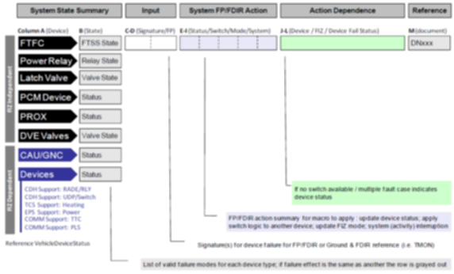
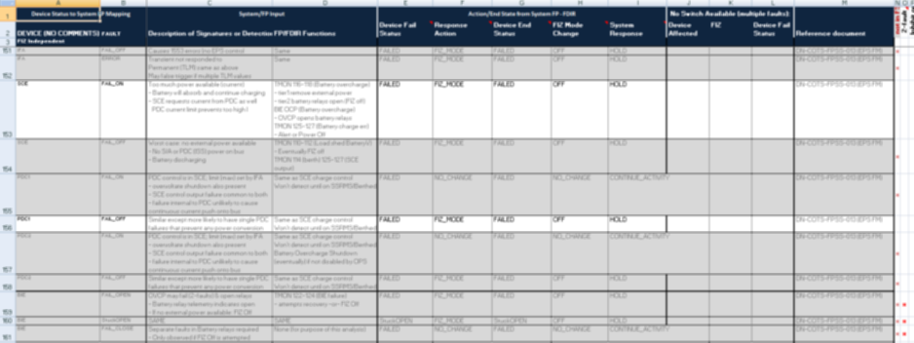
SysML Definition of FM & Autonomy Design
FM responses (ground and autonomy) will be structured to allow selection of valid combinations as done for the FTA.
The modeling of FM autonomy for a given set of failure types was developed on CRS to analyze the safe approach fault tolerance and ability to detect non-fail safe conditions. This methodology and use of abstracted design constructs fits nicely into a SysML construct and will be leveraged to provide fault/failure categories and expected system responses. This methodology also provided autonomous test combinations to assure every valid combination of failures was analyzed and provided a reviewable summary for FM analysis. These methods will be leveraged for the next phases of this effort.
Importing the FTA failure category and response listings will create a baseline FM behavior definition for the model.

Slide 11
Summary of Status and Findings
Behavior diagrams for system ConOps and FM/autonomy behavior
Modified use of activity, state, and sequence diagrams have been applied
There are limitations in the ability to designate general transitions in Safety, FM, and Autonomy capabilities or constraints within a phase, activity, or sequence
Looking into the best diagram methods for scenarios that are more detailed than a standard Use Case, but are not as detailed (or flow oriented) as a standard activity
Looking into the best object definitions of behavior descriptions that can be easily applied to test definition (i.e. transitions or intermediate points)
Block diagrams for test definitions
Several approaches for object specification that define a test case have been applied
Looking into improved methods of selecting test specifications (enumerations)
Looking into scripted or other connected definitions of test specification items (connecting diagram information to selectable test definitions)
Beginning scripting for test definition output (test architecture accepts a script defining a list of globals)
Diagrams for test definitions
Looking into the generation of test-specific diagrams (manual then automatic)
These fit more closely with standard behavior diagrams (sequence diagrams)
This effort is initiating what will be a SysML capability development cycle – with enough beginning pieces to generate products for existing capabilities, and following cycles to determine best practice and improvements for ConOps, behavior definitions, FM requirements, and V&V

Slide 12
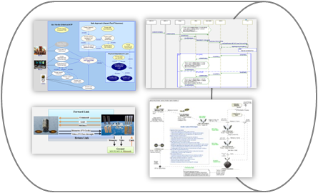
Dreaming Big(ish) For Near Term SysML Use
Power Balance
Power Budget
Array Sizing
Battery Sizing
Thermal Analysis
Heater Sizing
Thermal Balance
Blankets/Radiators
RF Link Analysis
Radio/Data Rate
Antenna/Location
FM/Autonomy
Qualification
OPS Validation
Stress Testing
Propellant Budget
Tank Sizing
Margin Allocation
Use of existing documentation varies and requires interpretation of Use Case/Scenarios. Sometimes references are made between users rather than to a central location.
CDH/FSW Modes
State Options
Function Options
Vehicle Testing
Day-In-Life Test
J0 Launch Setup
GSE Requirements
States and Modes
Equipment Lists
E-mail/Meetings
Procedures
Subsystem DN
ConOps DN
Mission Ops
Procedures
Staffing
Mission Planning
Rehearsals
GNC Analysis
Bounding Cases
for Monte Carlo
Filter Design
Sensor Placement
Many aspects of the system and mission depend on consistent Use Case definition; however, no formal, central mechanism exists to define or capture them. This leads to many re-interpretations of related documents (which are often OBE) and additional efforts to maintain consistency and correct inconsistencies late into a program, even into flight. This is inefficient, high risk, and has been a cause of mission failure.
SysML can provide a consistent, central location to define mission phases, activities, states, modes, and connect them to specific Use Cases (scenarios), providing unambiguous and common definitions for all users.

