Slide 1
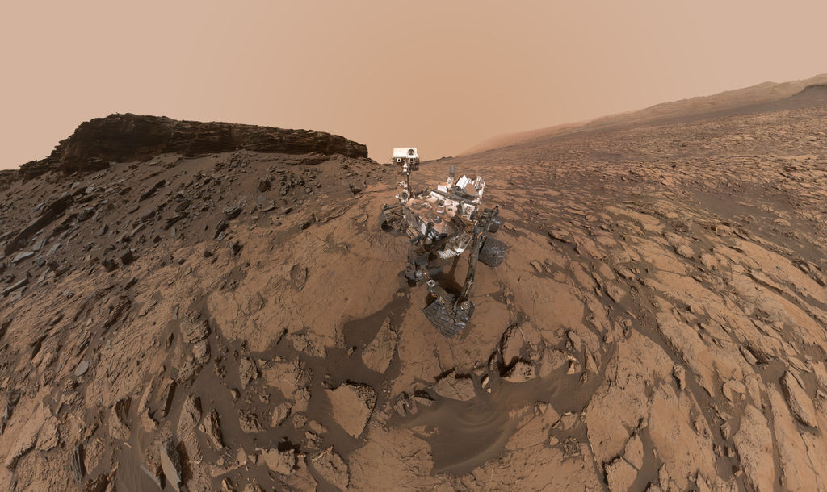
A Design for Self-Reliant Rovers to Increase Mission Productivity
Daniel Gaines
Jet Propulsion Laboratory,
California Institute of Technology
December 14, 2016
Copyright © 2016 California Institute of Technology. U.S. Government sponsorship acknowledged.

Slide 2

Overview of Project
Maintaining high levels of productivity for surface missions is a challenge
  Significant human effort required to develop command products
  Can take more sols than anticipated to accomplish objectives
Productivity challenge anticipated to become even larger liability in future
  Aging sun-synchronous relay orbiters being replaced with non-sun-synchronous orbiters
  Do not provide consistent “end-of-day” downlink pattern
Our goal:
  Identify changes to flight software and ground operations to address productivity challenges
  Implement and evaluate prototype to demonstrate ability to address challenges
Approach:
  Conduct case study of MSL operations to understand productivity challenges
  Identify design for flight software and ground operations to address challenges
  Implement prototype of approach and deploy on research rover
  Evaluate prototype on realistic, multi-sol scenarios

Slide 3
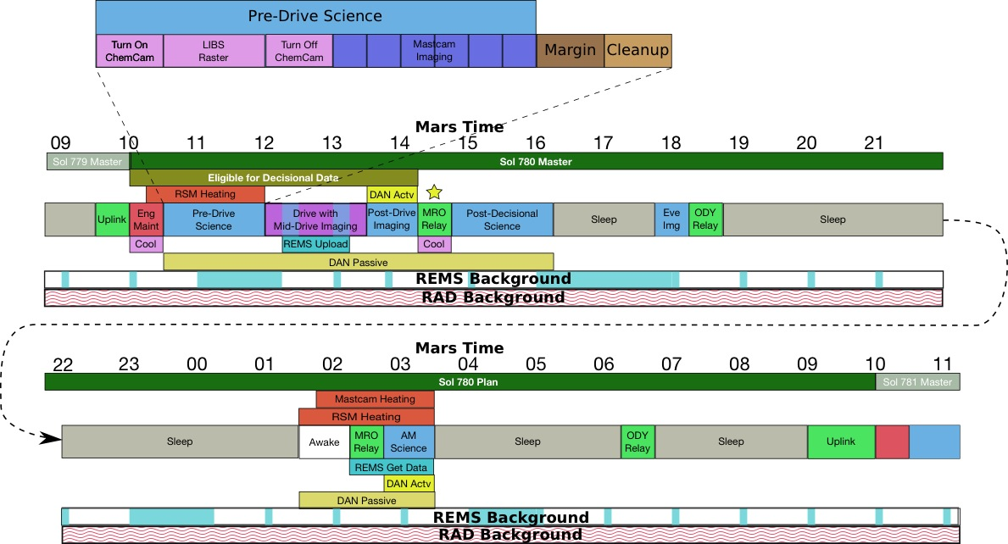
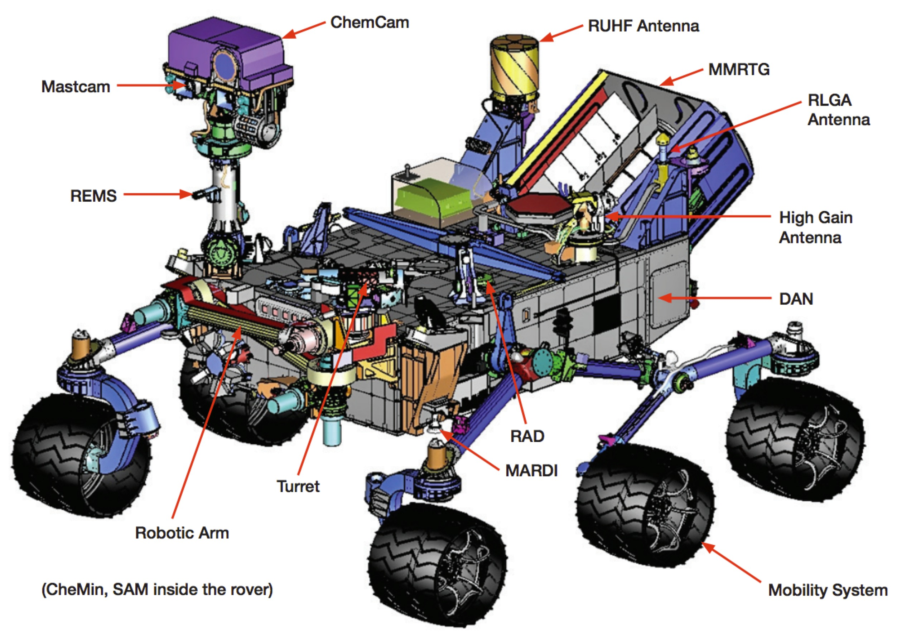
An Example Sol in the Life of the Rover
Typical drive sol
  Sol begins with morning uplink
  Data needed to inform next plan must be acquired before decisional pass
  Sol roughly organized into blocks of activity, includes margin and cleanup
  Rover sleeps to conserve energy, recharge batteries
    Some instruments can collect data while rover sleeps

Slide 4
Restricted Sols
Reception of rover end-of-day state “drifts” across Earth day over time
  Mars day ~40min longer than Earth day
  About ⅓ to ½ of the time, data arrives too late for team to create plan before rover’s next day (unless team works “Mars Time”)
Team creates multi-sol plans to cover time between ground-in-the-loop cycles
  Team restricted in what can be done second sol as data from this sol will not be available when next plan is developed

Slide 5
Case Study Overview
Case study questions
  Primary questions
    How does the operations team define productivity?
    What factors tended to increase productivity?
    What factors tended to decrease productivity?
  Secondary questions
    How did the team select activities to accomplish intent?
    What types of ground-in-the-loop decisions were made?
Approach
  Structured interviews with science and engineering operators
  Detailed study of selected MSL campaigns

Slide 6
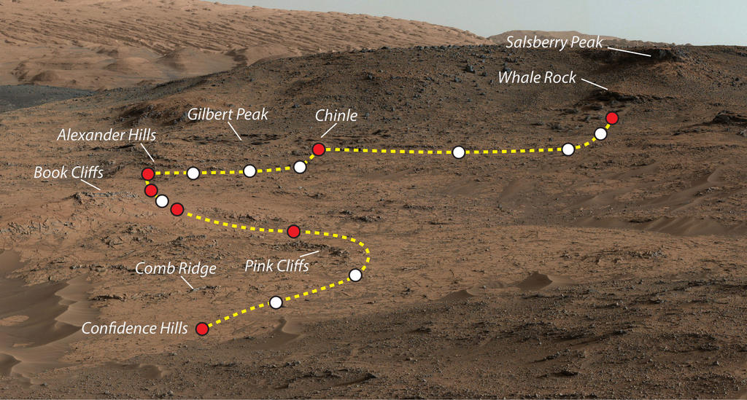
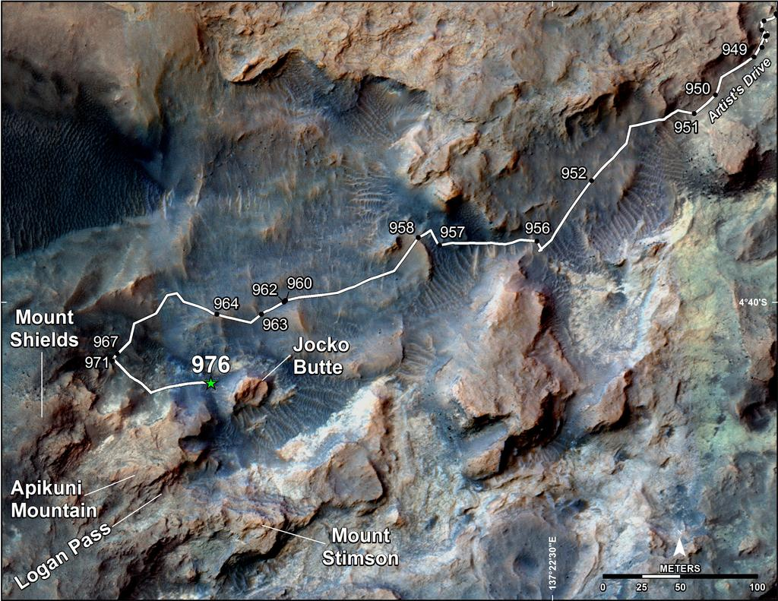
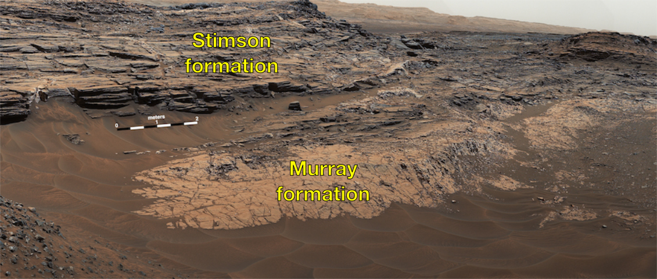
Selected MSL Science Campaigns
Selected campaigns provided mix of objectives, exploration strategies, mission contexts
Pahrump Hills Walkabout
  Characterize basal layer of Mt. Sharp
  Sols: 780 – 798 (19 sols)
  Season: Spring
  Drive dist: 152m
Artist’s Drive
  Reach higher level of Mt. Sharp
  Sols: 949 - 972 (24 sols)
  Season: Late Summer
  Drive dist: 567m
Marias Pass
  Characterize contact between two formations
  Sols: 991 – 997; 1027 – 1043 (24 sols)
  Season: Late Summer, Early Fall
  Drive dist: 130m
Mid-Drive Stops
End of Drive Stops
Pahrump Hills Walkabout
Artist’s Drive
Marias Pass

Slide 7
Summary of Campaign Activity by Sol
Pahrump Hills
Artist’s Drive
Marias Pass
Large percentage of sols not making significant contributions to campaign
Most significant factors in summary:
  Restricted sols
  Terrain conditions
Artist’s Drive and Marias Pass have similar breakdown
  Different objectives
  Similar terrain
  Similar pattern of restricted sols
  Indicates terrain and restricted sols more significant factors for these types of objectives
Sol Type | PH Sols | AD Sols | MP Sols
Campaign | 6 | 9 | 10
Campaign Multi-Sol | 2 | 4 | 4
Extra Drives | 2 | 6 | 5
Post-Drive Multi-Sol | 5 | 4 | 3
Deferred | 3 | 1 | 0
Runout | 1 | 0 | 2
Total Sols | 19 | 24 | 24

Slide 8
Resource Utilization Analysis
Conducted extensive set of resource usage analyses
  Duration, data volume, energy
Reduced resource utilization in multi-sol plans compared to single-sol plans
  2-sol plans: 12% reduction in CPU duration, 7% reduction in energy use
  3-sol plans: 15% reduction in CPU duration, 11% reduction in energy use
Significant reduction in campaign activity following drives in multi-sol plans
  Typical 0 to 30min of campaign activity on sol following drive
  Note: this will differ for different campaign types
Non-productive CPU duration
  Activities usually run shorter than predicted
  Margins and cleanups largely unused
  Constraints on type of activities allowed to follow decisional pass
Large discrepancies in predict vs. actual resource use
  Due to: uncertainties in activity duration, conservatism in models, inaccuracies in deriving and propagating state of charge value
  Potential to unnecessarily limit activities in plan
Estimates indicate there was significant extra duration available for additional campaign activities
  PH: 72 hrs, AD: 62 hrs, MP 70 hrs
  If productivity challenges can be overcome
Pahrump Hills CPU Duration Allocation
Pahrump Hills Estimate of Extra Available Duration

Slide 9
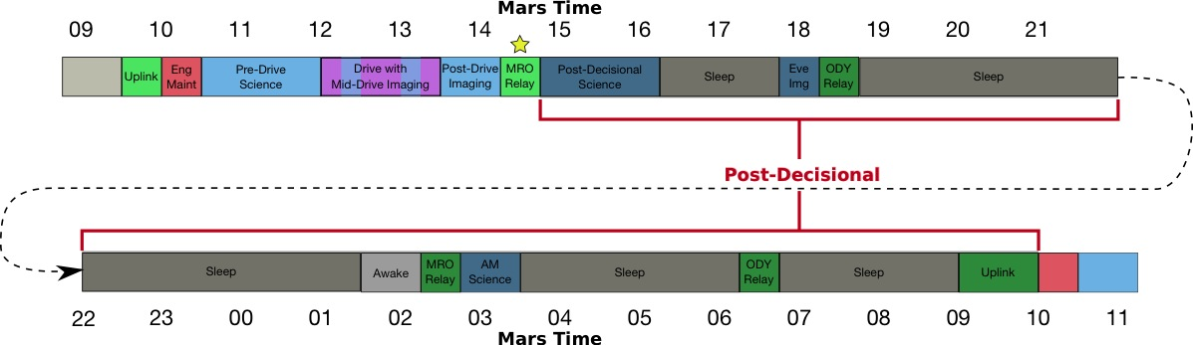
Major Productivity Challenges
Ground-in-the-loop requirements for target selection and effective drive planning
  Restrictions on when certain activities can be performed in plan (prior to decisional pass), resulting in non-productive time in plan
  Significant drop in productivity on sols following drive in multi-sol plan
Ground-in-the-loop requirements to respond to outcome of activity
  Drive faults, poor lighting in imaging, missed ChemCam targets, insufficient material under APXS
Capacity of tactical timeline to fill multi-sol plans
  Overhead in command product generation
  Overall drop in productivity across multi-sol plans
Managing tactical timeline complexity
  Ability to judge how much activity can be accomplished in timeline
  Difficulty in taking into account staffing variations
Use of margin and cleanup duration allocations
  Results in un-productive CPU duration
Predicting available vehicle resources
  May unnecessarily limit activity
Ability to exploit supratactical work
Communication among teams
Science team engagement
Time to analyze data, make decisions
Example drives in multi-sol plans

Slide 10
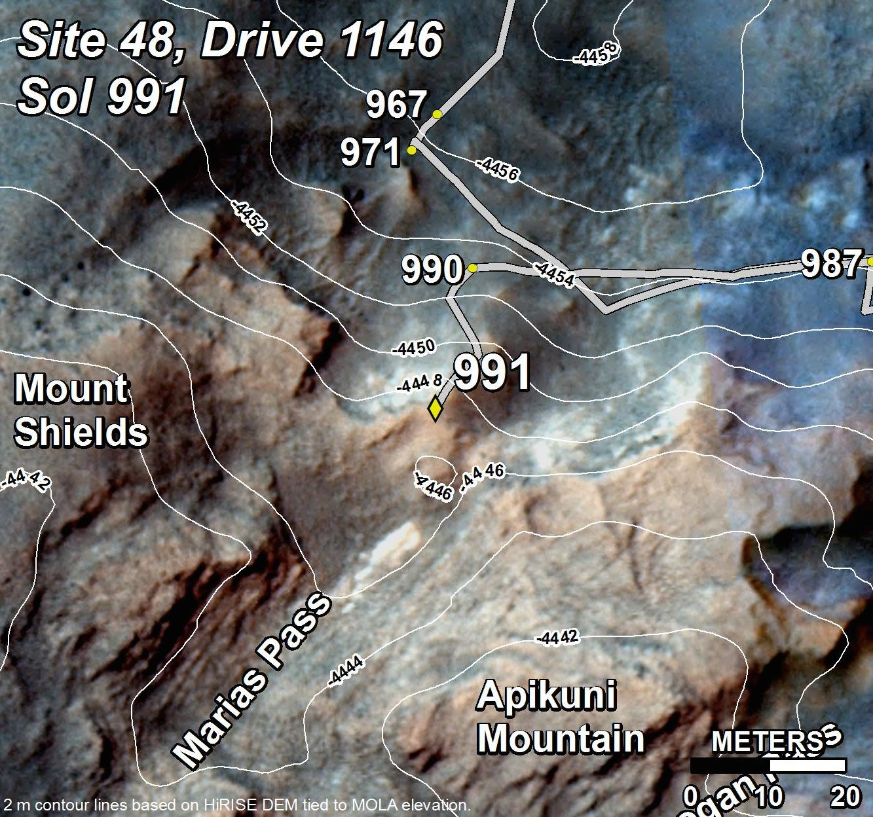
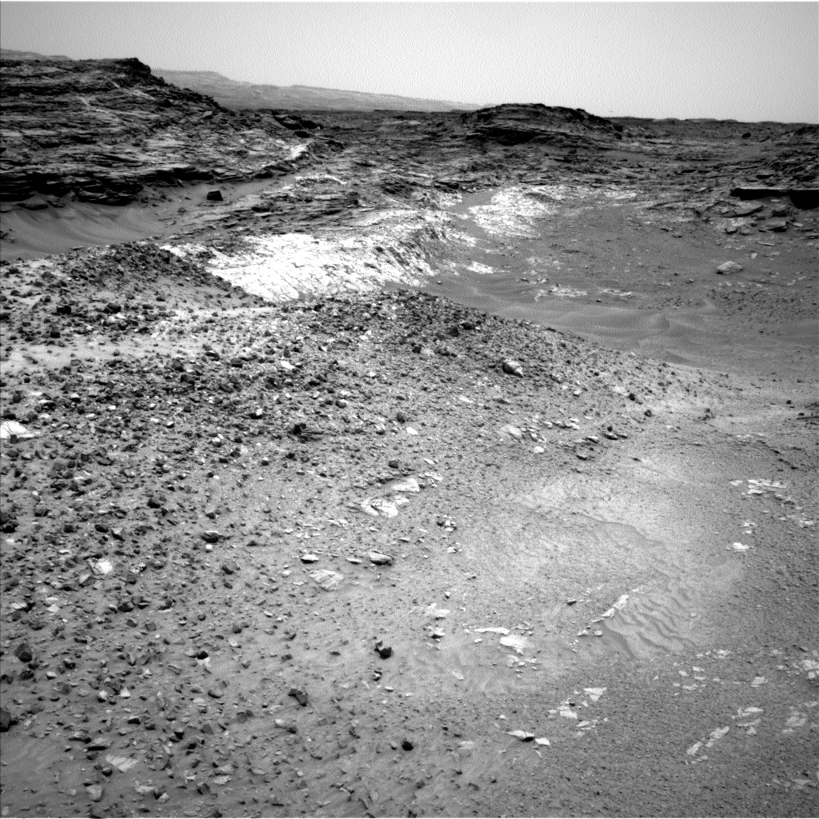
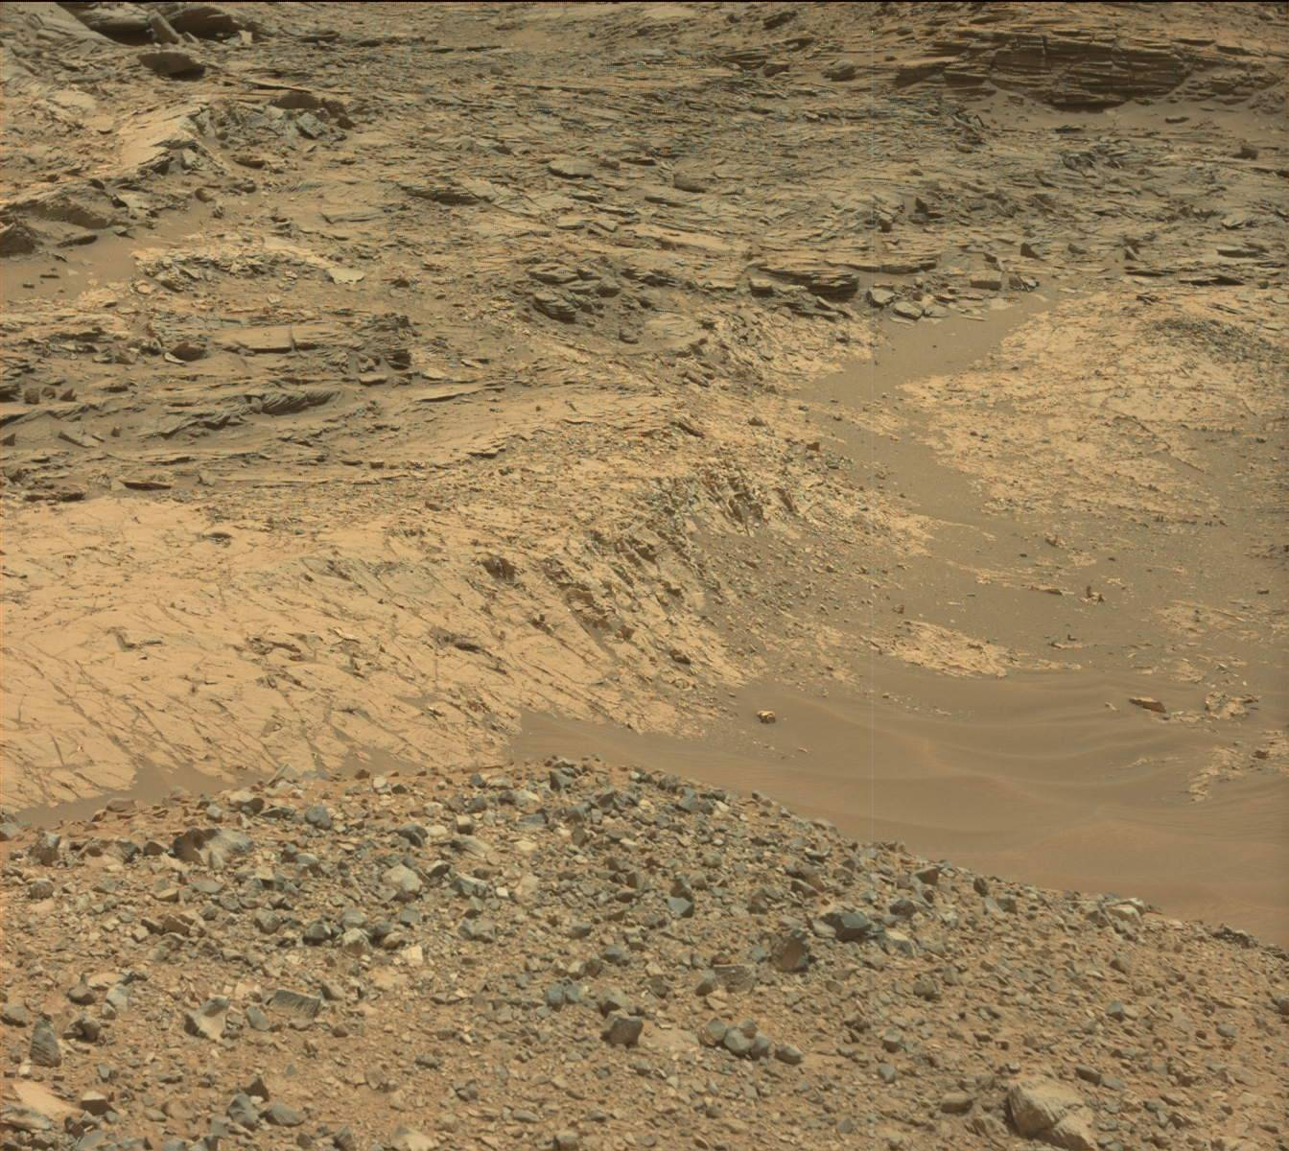
Major Types of Ground-in-the-Loop Decisions
Selecting science targets for ChemCam, Mastcam and contact science
  Use of high quality imaging from rover’s immediate surroundings to select science targets
  Requirement of high degree of accuracy in position of rover relative to targets for pointing small FOV instruments
Drive planning
  Selecting end drive location
  Selecting drive route (terrain conditions, hazards)
Stability assessment for contact science
Responding to problems in activity executions
  Re-planning failed drives
  Re-acquiring observations (or potentially losing opportunity if rover drove away)
Science discovery
  Changing strategic objectives (e.g. Logan’s Run in Artist’s Drive)
  Backtracking to prior locations (e.g. Marias Pass)
Orbital Imagery
Can identify location of contact, but insufficient detail to pick targets and plan actual drive
Contact
Location 2
Missoula
Location 1
First view of contact from rover. Can identify locations of interest but insufficient detail to pick out specific targets. Drive planning limited by occlusions blocking view to Location 1.
Example of target that would eventually be selected, but insufficient detail to select it from this distance (about 30m away)

Slide 11
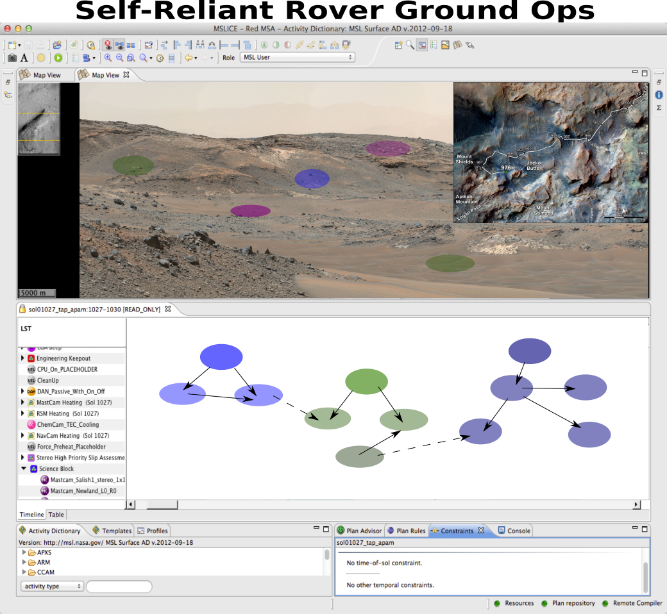
Self-Reliant Rover Approach
Goal Elaboration
  Reduce effort in interacting with vehicle
  Increase productivity through onboard resource management
Scientist-Guided Autonomous Science
  Increase science productivity with reduced reliance on ground-in-the-loop
  Increase expressivity of science intent
  Enable scientists to guide vehicle
State-Aware Health Assessment
  Improve onboard state tracking by incorporating health assessment into nominal vehicle operation
  Safely sustain productivity when problems occur
Robust, Multi-Sol Navigation
  Develop slip-aware navigation
  Safely respond to unexpected conditions for robust multi-sol navigation
Ground Operations
  Make it natural for team to interact with vehicle without knowing state vehicle will be in when command products are received

Slide 12
Guiding Scenario
Increased science during long-range driving campaigns
Reduced overhead for walkabout exploration

Slide 13
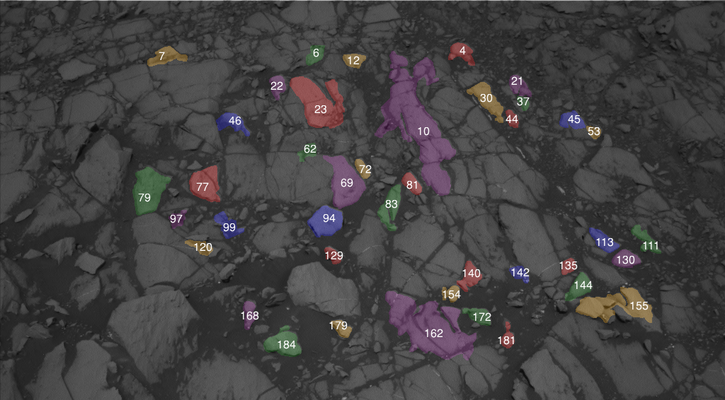
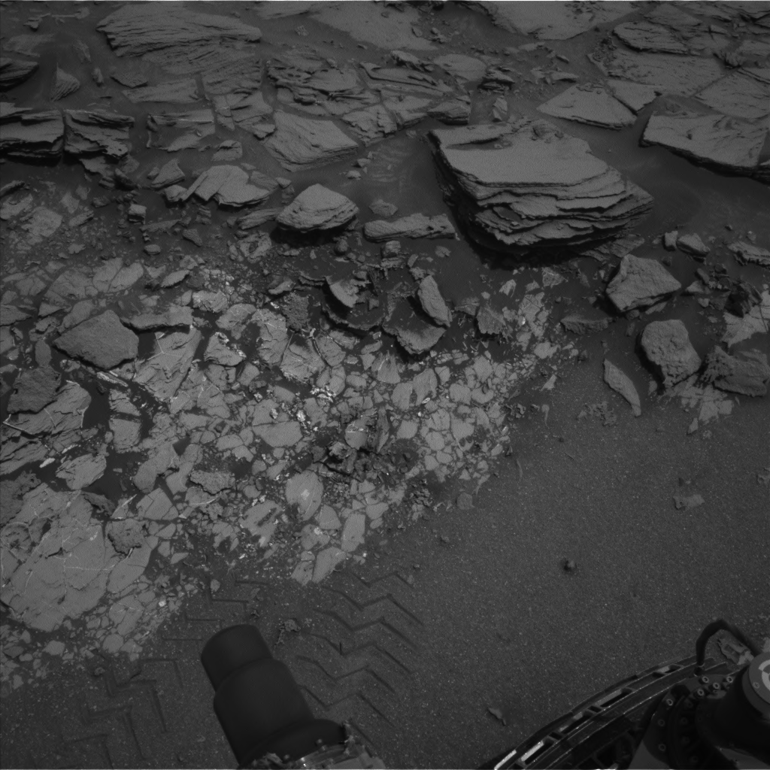
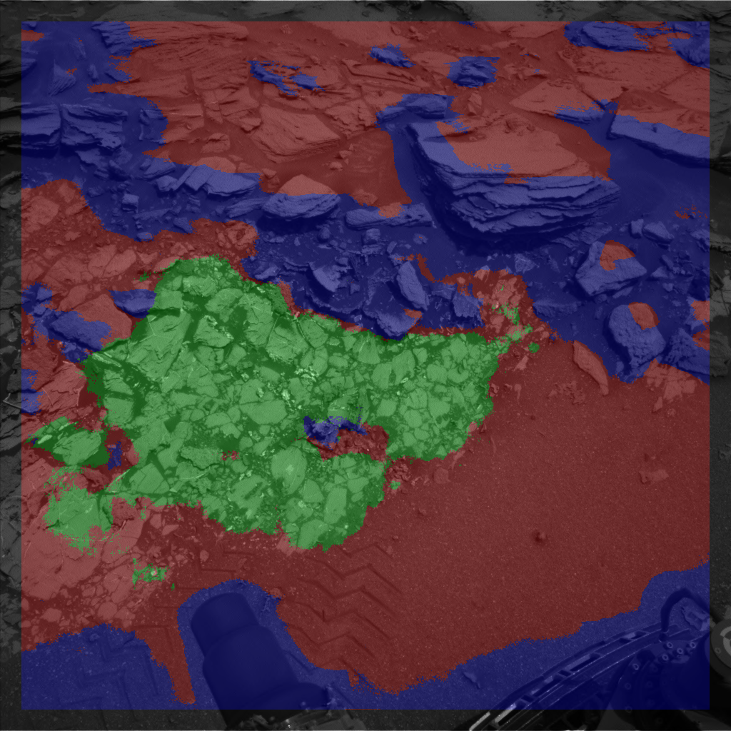
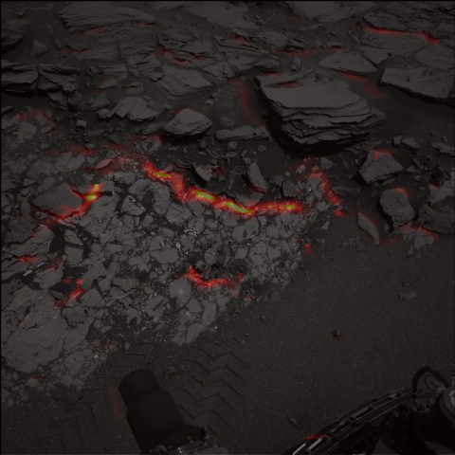
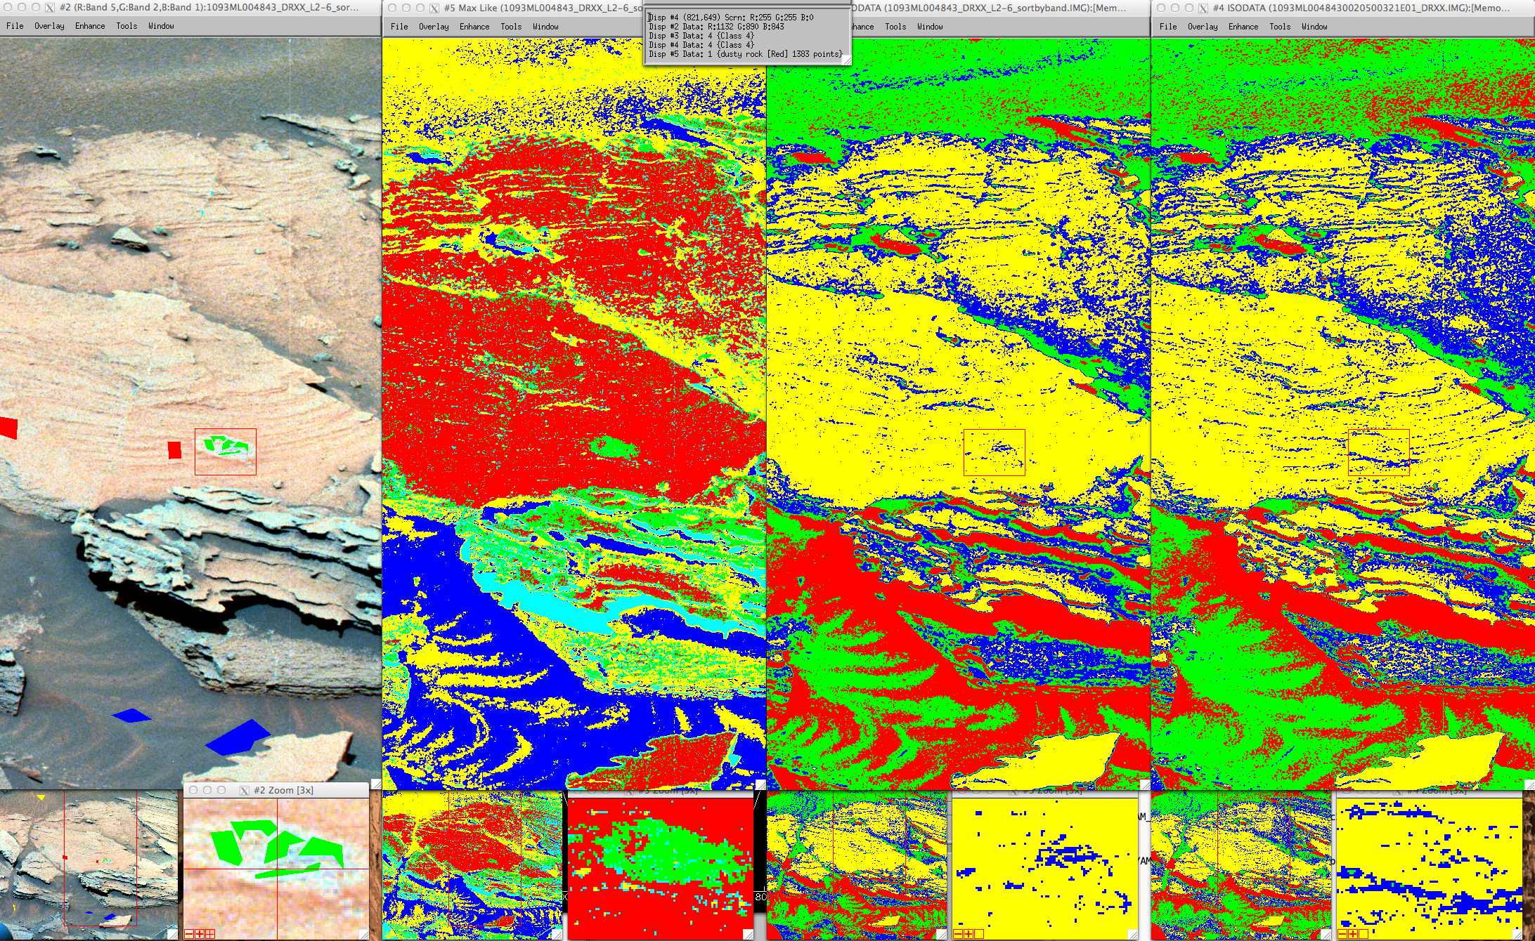
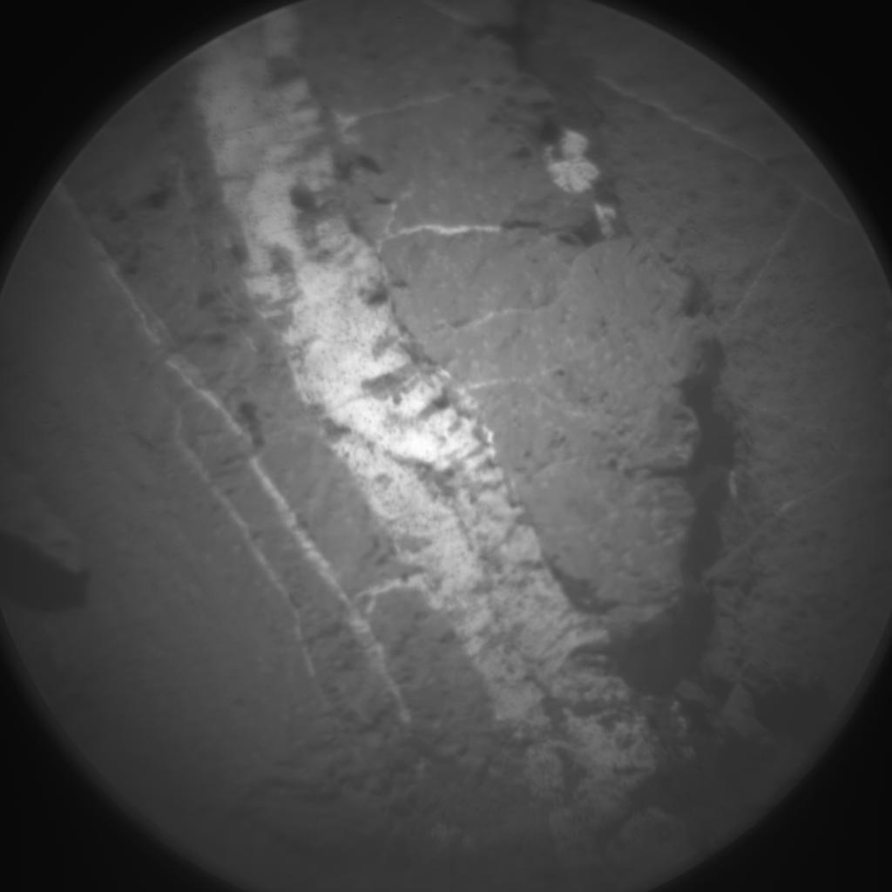

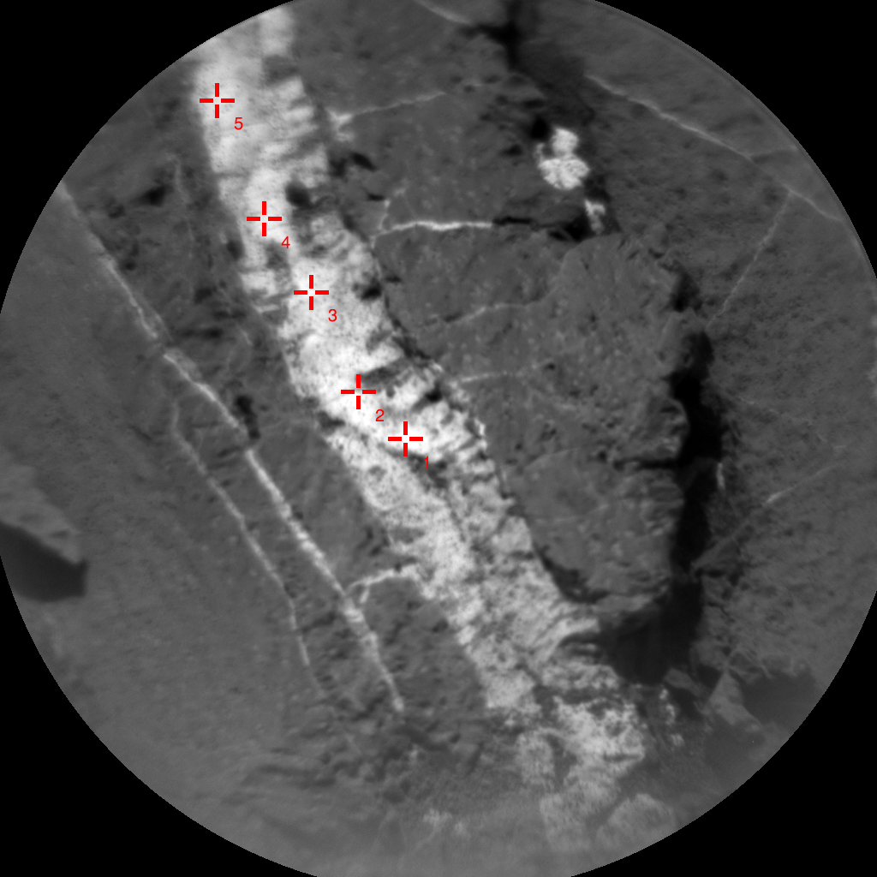
Scientist-Guided Autonomous Science
Target Detection
Contact Detection
Multispectral Analysis
Raster Designer
Developing an onboard characterization process
  Enables rover to assist scientists in characterizing an area or documenting traverse when ground-in-loop not available
  Includes collecting wide field-of-view contextual imagery along with high-quality, detailed observations
  Documents representative features and diversity of an area
  Provides means for scientists to guide process

Slide 14
Incorporating Health Assessment and Response into Nominal Operation
System forms expectations of activity performance / behavior
Monitors execution for expectations
  Detects faults if actual conditions deviate from expected
Combination of Fault Detection, Fault Isolation and Fault Classification used to identify “suspect” subsystems
  Suspect subsystems unusable until cleared for use
Fault resolution posted as goals for Planner to resolve
  May result in addition of diagnostic activities, recovery activities or shedding activities that are no longer allowed due to subsystem health status

Slide 15
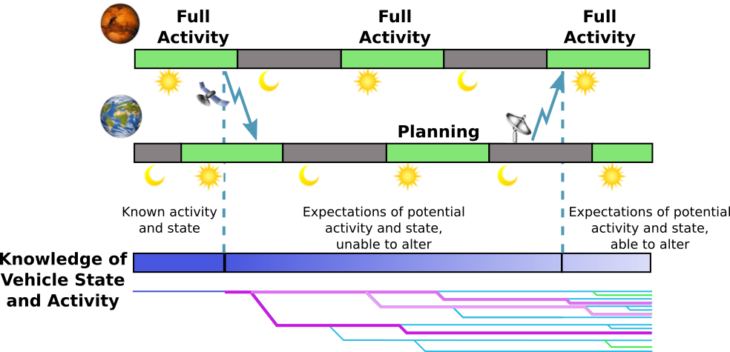
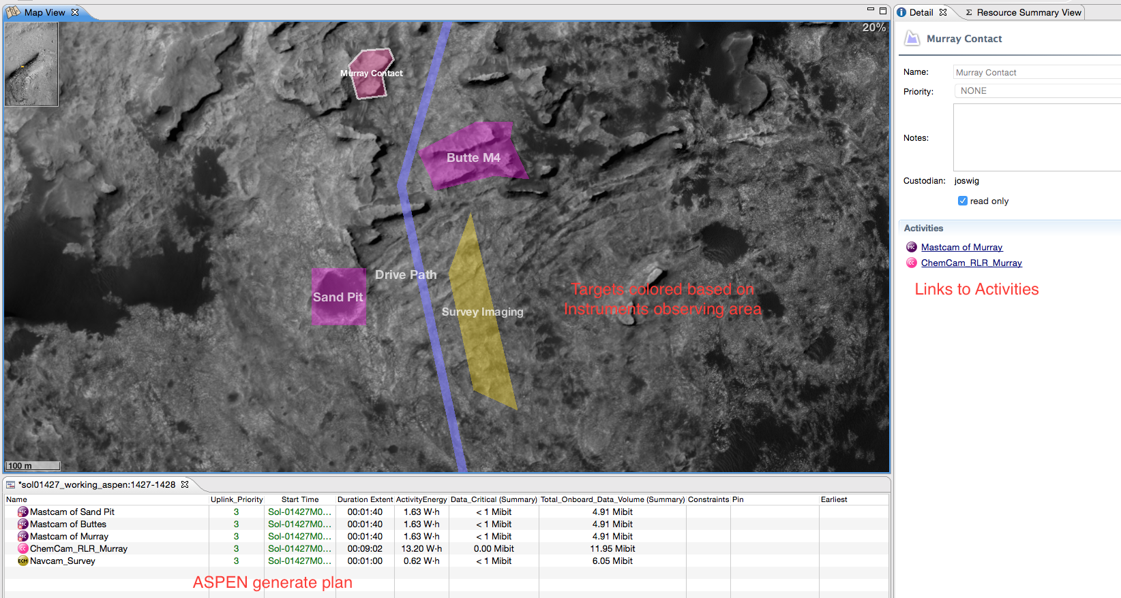
Interaction with Ground Operations
Developing concept of operations with “loose” ground-in-the-loop interaction
  Interaction with vehicle without requiring detailed information about vehicle state
  Provide expectations of potential vehicle state/activity given assumptions of conditions
  Updated when additional telemetry received
Developing new ground tools to express mission intent as goals and guidance
  Map view for specifying goals and visualizing actual and predicted plans
  Semantics for periodic goals to express campaign objectives

Slide 16
Flight Software Infrastructure Support
Target database
  Facilitates interaction among onboard autonomy
  Synchronized with ground DB
Onboard data product access
  Provide convenient access to onboard autonomy
  Identify new science opportunities
  Summarize data to maximize limited bandwidth
Onboard telemetry access
  Make telemetry available for onboard autonomy
  Supports onboard health assessment and resource management

Slide 17
Conclusions
Complete case study report available at:
  ai.jpl.nasa.gov → Publications → 2016
Case study has identified several challenges for maintaining high levels of surface mission productivity
Case study also identified opportunities for increasing productivity if these challenges can be overcome
We are leveraging study results to identify changes to flight system and ground practices to overcome these productivity challenges

Slide 18
Acknowledgements
Team:
  Daniel Gaines, Ali Agha, Robert Anderson, Oktay Arslan, Gary Doran, Chet Joswig, Heather Justice, Ryan Mackey, Gregg Rabideau, Umaa Rebbapragada, Jacek Sawoniewicz, Steve Schaffer, Eugenie Song, Ashwin Vasavada, Vincent Wong, Kathryn Yu
Thanks to the MSL mission for their support of this work!
This research was conducted at the Jet Propulsion Laboratory, California Institute of Technology, under a contract with the National Aeronautics and Space Administration. This work was funded by the Jet Propulsion Laboratory Research and Technology Development program.

