Slide 1
MEXEC: Autonomous science restart for the Planned Europa Mission
MEXEC Development Team: Vandi Verma, Dan Gaines, Gregg Rabideau, Rajeev Joshi
ASPEN Ground Tool: Steve Schaffer
Jet Propulsion Laboratory, California Institute of Technology
© 2016 California Institute of Technology. Government sponsorship acknowledged.
12/14/2016

Slide 2
Europa Flyby Restart Scenario
There are ~45 flybys that the Planned Europa Mission is base-lined to perform.
Each flyby would be ~10-20 hrs as part of an orbit of ~14 days.
Requirement is to accommodate 5 FSW resets during flyby segment.
Highest priority science would occur during the flyby. Requirement to recover science post reset.

Slide 3
SEQUENCING APPROACH
Notes:
Change shade of yellow

Slide 4
SEQUENCING APPROACH
Intent and Constraints
Notes:
Model resource constraints (start_time, duration, state/resource requirements/impacts using predicted state)
One/few possible plan path(s). For complicated sequences end product cannot easily be validated to meet intent and constraints. Eg. Relationship between Scan and WarmupUVS and GNC lost.

Slide 5
SEQUENCING APPROACH
Intent and Constraints
Notes:
Model resource constraints (start_time, duration, state/resource requirements/impacts using predicted state)
One/few possible plan path(s). For complicated sequences end product cannot easily be validated to meet intent and constraints. Eg. Relationship between Scan and WarmupUVS and GNC lost.

Slide 6
SEQUENCING APPROACH
Intent and Constraints
Notes:
Model resource constraints (start_time, duration, state/resource requirements/impacts using predicted state)
One/few possible plan path(s). For complicated sequences end product cannot easily be validated to meet intent and constraints. Eg. Relationship between Scan and WarmupUVS and GNC lost.

Slide 7
SEQUENCING APPROACH
Intent and Constraints
Model using predicted state

Slide 8
SEQUENCING APPROACH
Intent and Constraints
One (or few) possible plan paths.
Model using predicted state

Slide 9
SEQUENCING APPROACH
One (or few) possible plan paths.
Model using predicted state

Slide 10
SEQUENCING APPROACH
One (or few) possible plan paths.
Monitoring limited
to fault checking
Model using predicted state

Slide 11
MEXEC APPROACH

Slide 12
MEXEC APPROACH
Preserves
Intent and Constraints

Slide 13
MEXEC APPROACH
Performs on-board constraint checking
Preserves
Intent and Constraints
Monitors on-board state to robustly respond to actual conditions.
Notes:
Monitors on-board state during execution to check task constraints for currently executing activities for remaining plan.

Slide 14
MEXEC Overview
  Coordinates spacecraft activities based on on-board state and specified intent
  Monitors and projects spacecraft state to coordinate the execution of activities
    Currently executing activities
    Future activities in the plan
Key Benefits
  Robustly respond to actual state
    Performs on-board constraint checking for executing and remaining plan
    Enables fail operational capability (e.g. after FSW reset)
    Allows opportunistically taking advantage of surplus resources
  Simplifies uplink product creation and review
    Intent and constraints explicitly captured
    Reduces tactical overhead of command product generation
  Flexible choice between sequencing and commanding with higher level intent
    A task can represent a sequence
    Allows leveraging of existing sequencing capability
    Simplifies sequence creation by decoupling sub-system interactions from sequencing
    Sub-system interactions managed via constraints

Slide 15
EXAMPLE: NOMINAL INSTRUMENT SCENARIO
Notes:
Scale image

Slide 16
EXAMPLE: NOMINAL INSTRUMENT SCENARIO
Notes:
Scale image

Slide 17
EXAMPLE: NOMINAL INSTRUMENT SCENARIO
Notes:
Scale image

Slide 18
EXAMPLE: TASK CONstraints and IMPacts
Constraint: Requirement on state (resource) value at a specific time, or over a time interval
Impact: A change in state (resource) value at a specific time, or over a time interval: Value assignment, value increment, rate increment.
Resource: a value over time (e.g. time/duration, data volume, energy, claims, states, etc.
Notes:
Scale image

Slide 19
EXAMPLE: NOMINAL INSTRUMENT SCENARIO (PRE)
Constraint: Requirement on state (resource) value at a specific time, or over a time interval
Impact: A change in state (resource) value at a specific time, or over a time interval
Notes:
Scale image

Slide 20
EXAMPLE: NOMINAL INSTRUMENT SCENARIO (POST)
Constraint: Requirement on state (resource) value at a specific time, or over a time interval
Impact: A change in state (resource) value at a specific time, or over a time interval
Notes:
Scale image

Slide 21
EXAMPLE: NOMINAL INSTRUMENT SCENARIO (DURING)
Constraint: Requirement on state (resource) value at a specific time, or over a time interval
Impact: A change in state (resource) value at a specific time, or over a time interval
Notes:
Scale image

Slide 22
EXAMPLE: NOMINAL INSTRUMENT SCENARIO
Notes:
Scale image

Slide 23
EXAMPLE: NOMINAL INSTRUMENT SCENARIO
Notes:
Scale image

Slide 24
EXAMPLE: NOMINAL INSTRUMENT SCENARIO
Notes:
Scale image

Slide 25
EXAMPLE: NOMINAL INSTRUMENT SCENARIO
Notes:
Scale image

Slide 26
EXAMPLE: NOMINAL INSTRUMENT SCENARIO

Slide 27
EXAMPLE: PARTLY EXECUTED INSTRUMENT SCENARIO
CURRENT TIME

Slide 28
EXAMPLE: RESET

Slide 29
EXAMPLE: RESET

Slide 30
EXAMPLE: Response to EARLY RESET

Slide 31
EXAMPLE: Response to EARLY RESET

Slide 32
EXAMPLE: Response to EARLY RESET
Notes:
Highlight that it is using contingency repsonse to add flyby back and general repair to add attain nadir and degraded flyby

Slide 33
EXAMPLE: Response to EARLY RESET
Notes:
Highlight that it is using contingency repsonse to add flyby back and general repair to add attain nadir and degraded flyby

Slide 34
EXAMPLE: Response to EARLY RESET
Notes:
Highlight that it is using contingency repsonse to add flyby back and general repair to add attain nadir and degraded flyby

Slide 35
EXAMPLE: Response to EARLY RESET
Notes:
Highlight that it is using contingency repsonse to add flyby back and general repair to add attain nadir and degraded flyby

Slide 36
EXAMPLE: RESPONSE TO LATE RESET

Slide 37
EXAMPLE: RESPONSE TO LATE RESET

Slide 38
EXAMPLE: RESPONSE TO LATE RESET

Slide 39
EXAMPLE: RESPONSE TO LATE RESET

Slide 40
EXAMPLE: RESPONSE TO LATE RESET

Slide 41
SUMMER 2016 Prototype DEVELOPMENT Summary
Designed and implemented prototype version of MEXEC
  11289 lines of C code, excluding auto-code, scenario support files, unit tests, standard FSW infrastructure
  Designed for multi-mission use with few dependencies on Europa FSW or OS.
  Part of MEXEC code was inherited by the M2020 simple planner.
Multiple fail-operational scenarios for Europa flyby
  Reset at different times while GNC is maintaining NADIR pointing for FLYBY science
  Reset at different times while GNC is slewing for UVS Scan and UVS is Scanning
Demonstrated in Linux, WSTS and Europa flight system testbed
  Runs in WSTS and on testbed with space and time partitioning
  Takes less than 0.1 seconds to resolve plan problems after simulated reset in testbed
Demonstrated ability to dispatch and monitor execution of FSW commands
  Simulated GNC, Thermal, and instrument flight software
  Used Europa FSW Core command dispatch interface
  Demonstrated option to provide task parameters as arguments to FSW commands
  Used co-ordinated FSW State Buffer Store concept
Demonstrated end-to-end scenario with ground tool prototype
  Incorporated ground tool generated output as input to MEXEC

Slide 42
Task/Activity Dictionary
Used to define the default values for tasks: expected durations and constraints/requirements/relationships
  Task instance can override defaults, add/remove constraints
  Similar to existing flight operations activity dictionaries
Defined on the strategic timeline, referenced (by ground tools) on the tactical timeline
Uploaded in advance, for MEXEC to reference
Easy to change when necessary (without FSW upload)

Slide 43


Ground-based planning may be manual or mixed-initiative
PLAN
SIMULATION
WALKTHROUGH
ACTIVITY
DICT
AUTOMATED
PLANNER

Slide 44
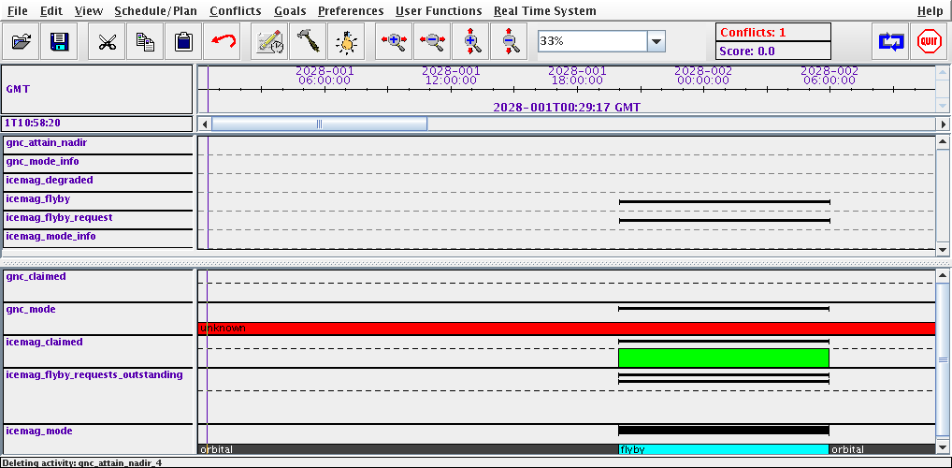
Example GROUND TOOL (ASPEN): INITIAL ACTIVITIES

Slide 45
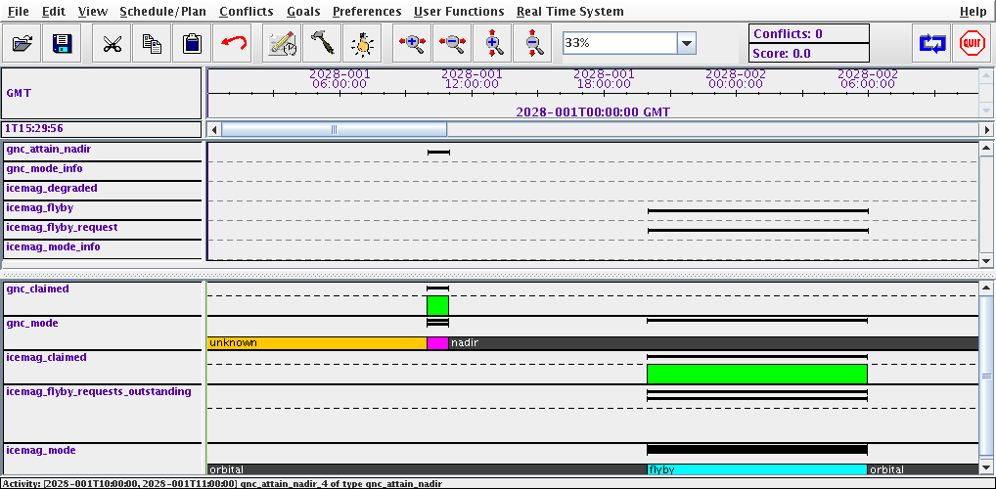
Example GROUND TOOL: PROPOSED PLAN UPDATE

Slide 46
CONCLUSIONS
Provides fail-operational capability
  Constraints checked on-board for executing and remaining plan
  Does not require special cases for FSW reset occurring at different times
Provides plan enhancement option
  MEXEC can add, move, and remove tasks if given permission
Provided preliminary feasibility assessment for flight and ground
  Integrated into Europa Flight Software. Parts ported to M2020 simple planner.
  Demonstrated capability with time and space partitioning on Europa system testbed
  Developed proof-of-concept ground tool to generate input to MEXEC using ASPEN planning and scheduling system
  Demonstrated MEXEC execution with output from ground tool
Lessons learned
  Need to demonstrate validation of MEXEC plans - a key concern for operators
  Need to develop user friendly interfaces to specify and manage MEXEC tasks

