Slide 1
Maximizing Data Return for the Europa Lander
Workshop on Spacecraft Flight Software
14 December 2016
William L. Van Besien
Embedded Applications Group, JHUAPL
William.Van.Besien@jhuapl.edu
Notes:
Introduction: Name, affiliation.
Recently completed Trade Study into the application of CCSDS protocols into the telecoms system for the Europa Lander.
Ultimately seek to answer how to maximize data return.

Slide 2
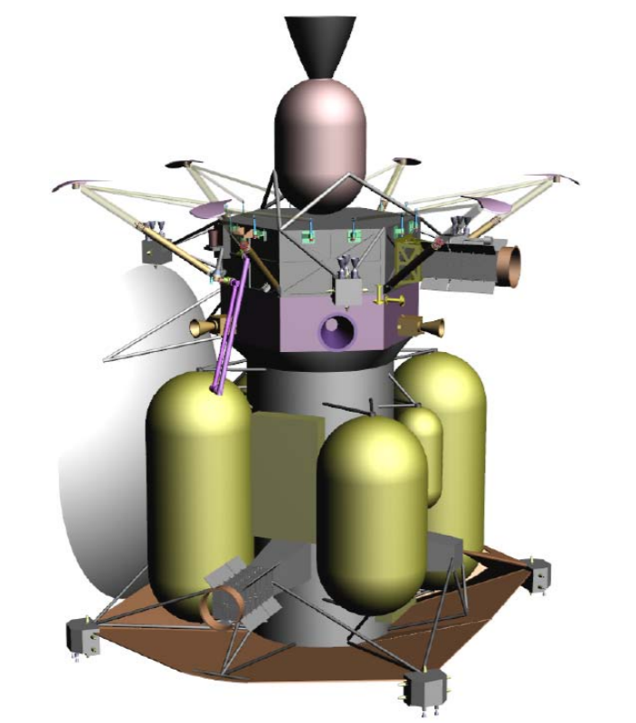
Europa Lander Mission Profile
Scientific Motivations
Europa is a prime candidate for having a habitable environment.
Water, energy sources, and favorable chemistry.
Lander enables surface chemical sampling, seismology, etc.
Mission Profile
Coupled Orbiter-Lander pair.
Orbiter to serve as primary data relay.
Follows launch of Europa Clipper.
Communications Challenges
Harsh radiation environment.
Multiple Earthbound routes, high-latency links, periodic communication windows.
Extremely limited energy budget.
Notes:
The Europa Orbiter/Lander is a pair of conjoined spacecraft launched from the same launch vehicle.
The mission is a JPL-APL collaboration, with APL taking the lead in Telecoms and other major subsystems.
In Europa orbit, the Lander will separate from the Orbiter to descend onto the surface of Europa, where it will statically operate a suite of imagers and instruments. The landing spot will have been identified earlier by the Europa Clipper, which already would have reconnoitered the surface.
On the surface, the Lander will use the Orbiter as the primary data relay to Earth.
The Lander can also use the Europa Clipper, which again is in eccentric Jupiter orbit, as an emergency data relay. However, its orbital characteristics present only opportunistic, relatively low-bandwidth, and at times high-latency communications.
The Lander will have to contend with a lot of tough environmental challenges. First and foremost is the harsh radiation environment around Jupiter, which interferes with communications and onboard electronics. Second, communication links to the data-relay spacecraft will be frequently interrupted Finally, all power is supplied with an integrated, non-rechargable battery, which gives the spacecraft only a limited time to operate on the surface.

Slide 3
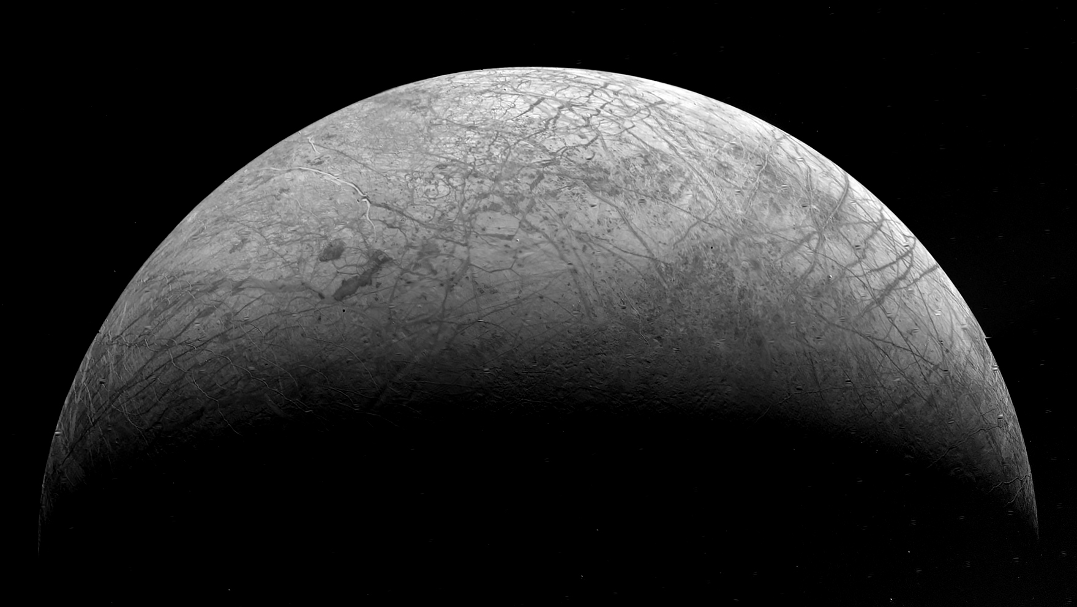
Motivating Question
Can we extend the lifetime of the surface Lander (or maximize science data return) by applying DTN protocols and tuning properties of the physical-layer RF link?
Given the challenging networking environment and limited energy budget….

Slide 4
Trade Study Methodology
Broad mandate of trade study; iterated several times.
First round: Develop intuition how Network- and Application-layer protocols affect link efficiency.
Header/trailer overhead, packet size, effect of bit errors on cost and frequency of retransmits.
Second round: Creating higher-fidelity models to characterize performance, investigating effects of Link-layer parameters.
Refine initial results, model encapsulation in Link-layer Prox-1 frames, identify optimal frame sizes for link conditions.
Third round: Understanding how physical layer RF properties and tradeoffs can be tuned and co-optimized with the higher layer protocols.

Slide 5
Phase 1: Network and Application Protocols
CFDP | FTP-like file transfer.
BP | Reactive fragmentation, route scheduling, and custody transfer over store-and-forward, high-latency networks.
LTP | TCP-like transmission control and reliability.
Selected three candidate networking stacks
CFDP-BP-LTP
CFDP-LTP
CFDP (Directly over link layer)
Objective: Understand effects of packet size on link efficiency under various error rates
Measure overhead, cost of retransmissions, etc.
Define efficiency as ratio of science data bits to cumulative count of bits transmitted (including headers, control packets, and retransmissions).
Objective: Quantify protocol stack’s cost-of-ownership for identified stakeholders
C&DH, Mission Ops, Telecoms, Ground Software, sometimes have competing interests.
Used a priori methods to model a science data file downlink

Slide 6
Phase 1: Selected Findings
BP and LTP add negligible overhead.
LTP helps maintain high efficiency in lossy settings.
“Raw” CFDP can achieve good efficiency on lossy links without LTP, but at a cost...

Slide 7
Phase 2: Link-Layer Effects (Selected Results)
Objective: Identify optimal CFDP packet size and Link-layer frame size pair for given bit error rates.
Prox-1: Recent CCSDS-defined Link-Layer protocol
Highest layer at which radio has awareness.
Used to negotiate bitrates, populate sync patterns, detect & correct bit errors, etc.
Contains extensions for session management, limited retransmits, etc.
Approach: Simulate CFDP file exchanges over Prox-1 Link-layer frames.
Developed higher-fidelity scripts to model repeated exchanges of sample science data files over lossy links (FER 10e-2 to 10e-5).
Varied Prox-1 and CFDP packet lengths.
Assumed no Link-level retransmission.

Slide 8
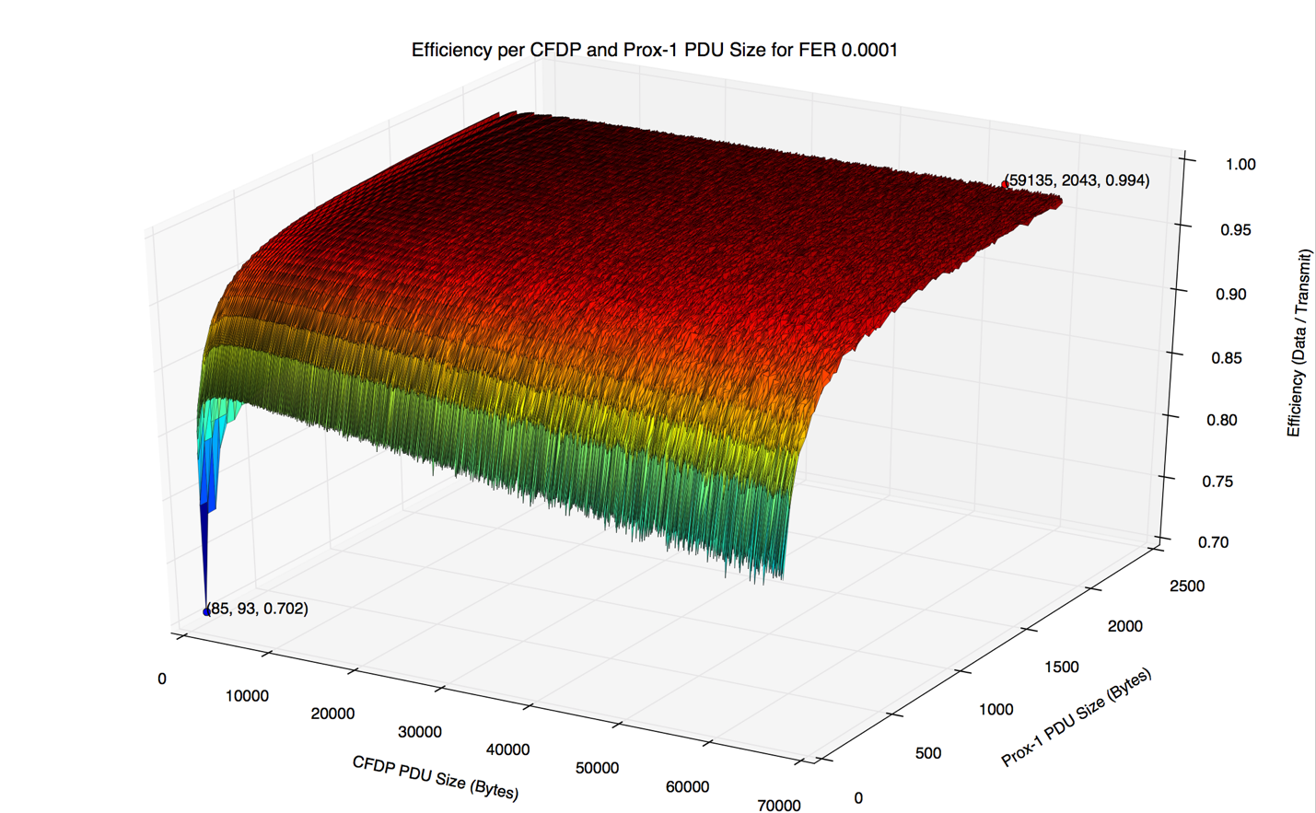
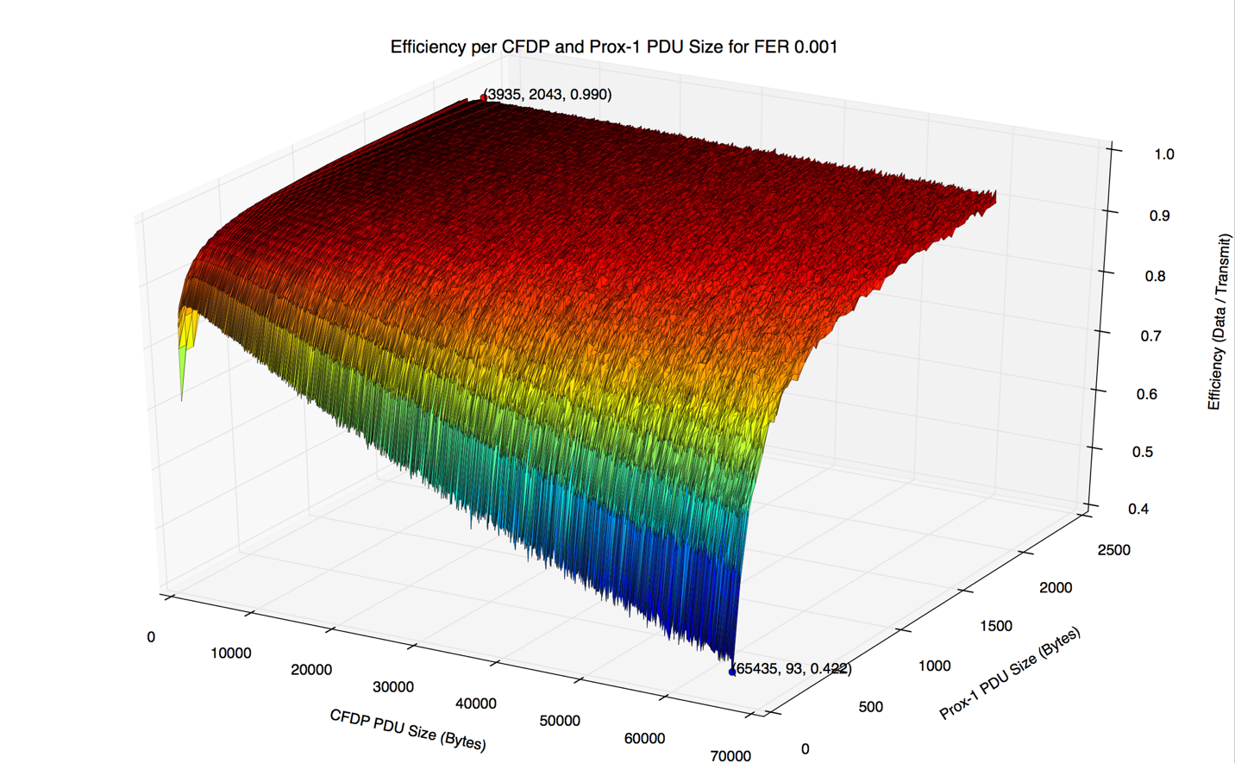
Phase 2: Selected Results
Maximally-sized Prox-1 frames of 2,048 bytes are optimal under all link conditions.
Choice of CFDP packet size still key metric of efficiency.
In general, smaller packets become more optimal as BER grows.
0.01% Frame error rate
0.1% Frame error rate
Increasing efficiency
Increasing efficiency
Increasing frame size
Increasing frame size
Increasing CFDP size
Increasing CFDP size

Slide 9
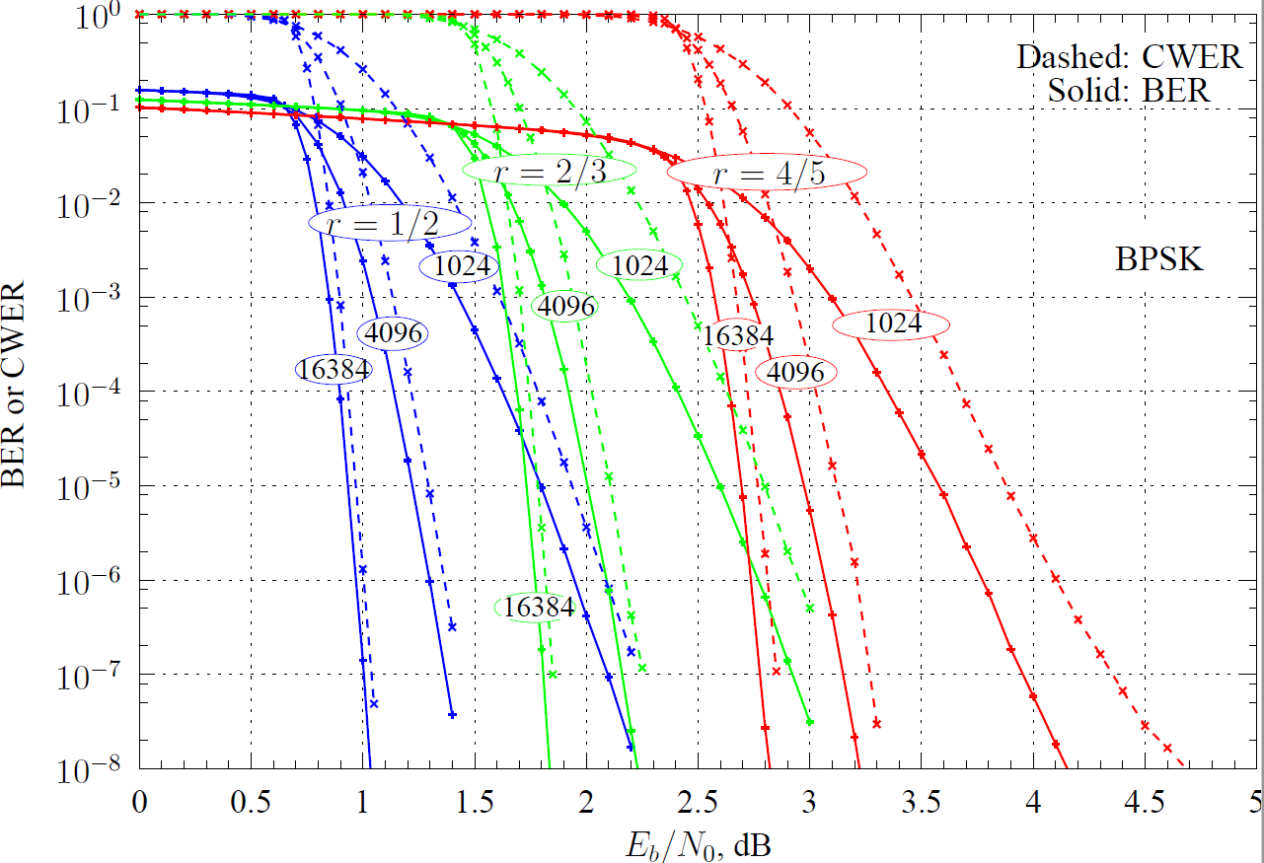
Phase 3: Physical Layer Tradeoffs
Decreasing error rate
We only need to consider this curve.
Increasing power, decreasing bitrate.
Contains the interrelationship between error rate, bitrate,
transmission power, and FEC codeword size on the RF channel.

Slide 10
Phase 3: Co-Optimizing R/F and Protocol Stack for Peak Efficiency
Objective: Explore the consequences of trading low error rates for faster bitrates and lower per-bit transmission energy.
For a fixed energy budget, how can we maximize the amount of science data retrieved off of the Lander?
Similarly, for a fixed data size, how can we most rapidly downlink it off of the Lander?
Can we identify any “sweet spots” on the Eb/N0 curve which can be further improved by optimized CFDP packet size?
Approach: Extend file exchange simulations to account for physical-layer properties (informed by Eb/N0 graph)
Run simulations over a range of sample points on the Eb/N0 curve.
Considering also range of CFDP packet sizes.

Slide 11
Phase 3: Selected Results
Cost of retransmissions can be cheaper than cost of maintaining perfect channel!
Energy efficiency does not improve with improving bit-error rates.
Tradeoff between optimal energy use and optimal downlink time.
Inflection point at FER between 10e-3 and 10e-4.

Slide 12
Protocol Trade Study Summary
Network and Application-layer protocol overhead does not significantly affect link efficiency.
LTP and BP can maintain high link efficiency in lossy environments, and reduce C&DH burden on CFDP.
Link-layer frames should be as large as possible.
Better link efficiency does not imply lower energy use.
Cost of retransmissions can be cheaper than cost of maintaining perfect channel.

Slide 13
Acknowledgements
Note: This talk covers only a portion of the overall trade study.
JHUAPL - Embedded Applications Group
Ed Birrane III, PhD.
Randy Ransier
Susan Ensor
Samantha Jacobs (SIG).
JHUAPL - R/F Engineering Group
Colin Sheldon (Orbiter/Lander Telecoms Lead)
Dipak Srinivasan (Clipper Telecoms Lead)
Norm Adams and Tom Magner.

