Slide 1
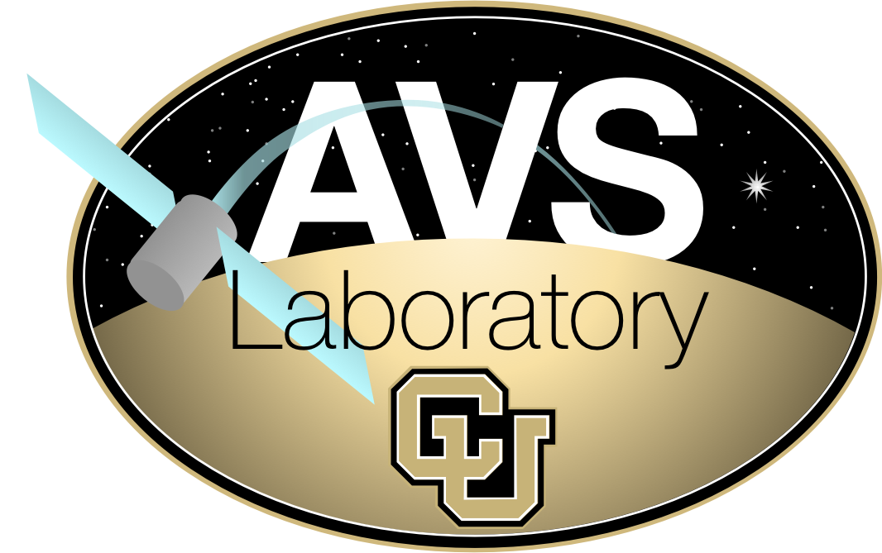
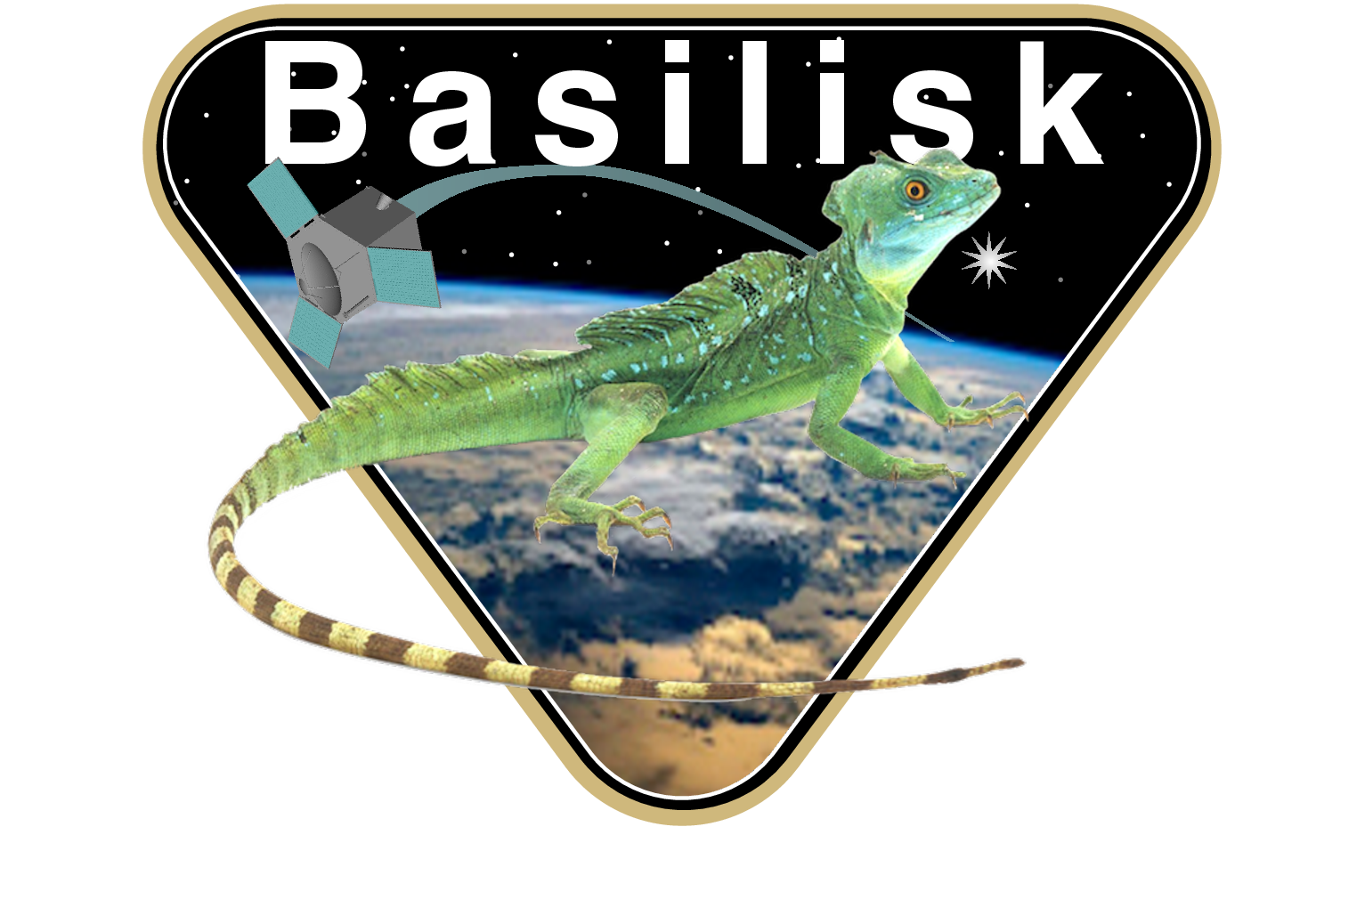
Flight Software Development Through Python
Scott Piggott, Maria Cols Margenet, John Alcorn,
P. Kenneally, and Hanspeter Schaub

Slide 2
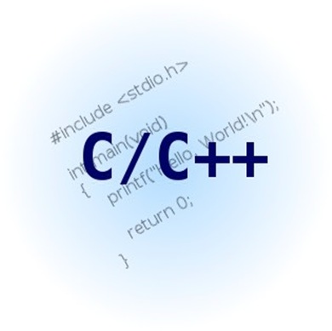



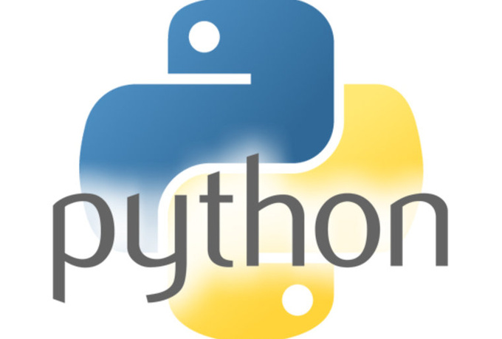
The Basilisk Development Environment
Collaboration between LASP and the Autonomous Vehicle Systems Laboratory at the University of Colorado
  Named for the South American Common Basilisk
Simulation internally runs in C/C++ objects
SWIG creates Python bindings that allow each module to be treated as Python objects
Cmake allows the whole package to be built cross-platform
  Windows, OSX, Linux

Slide 3
Relevant Basilisk Design Features
Diagram greatly simplified!
Algorithm interfaces are handled via message passing
  Pieces work like “Legos”
System abstraction allows user to sandbox messages
  Dynamics, FSW, analysis, etc.
Interface abstraction for multi-process
  Separate FSW
Granularity at the Python “brick” level
  Completely scalable up to full integrated model
Dynamics
Star Tracker
Reaction Wheels
Vehicle System
Inter-System MPI
Attitude Navigation
Vehicle Control
Pointing
FSW System

Slide 4
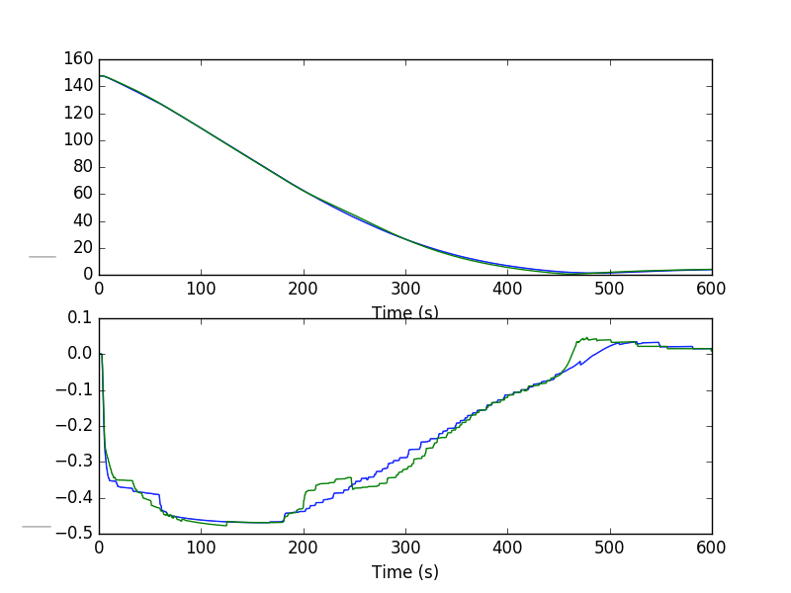
Transition to Target FSW
Overall design philosophy is to capture what was executed
  Python is very good at introspection
Configuration parameters are captured post-initialization
  Python can obtain all parameters from models
Messaging map is obtained from messaging singleton post-run
Task/Algorithm prioritization is reflected in code

Slide 5
Code Testing
Unit testing of algorithms performed via Python scripting
  Significantly easier test setup than with C test-stubs
  Inline test analysis easily performed with Python/numpy/matplotlib/etc
Integrated system-level tests can be based around a central test base-class
  Data display/analysis, remote communication configuration, scenario-macros
  Post-run products can be generated automatically
Automated testing can be easily integrated with continuous integration methodologies
  Basilisk utilizes pytest for system checkout
    Approximately 300 distinct tests running today
Complex analysis like code coverage can be performed against the test-suite
Mission-unique code can be separated from Basilisk and built/run/tested separately
  Basilisk compatible code can also be integrated directly

Slide 6
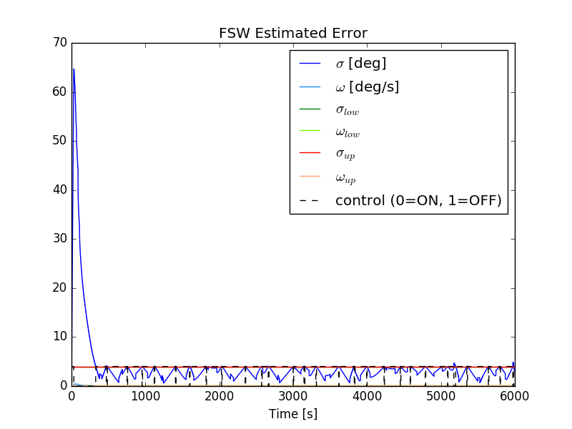
Test Execution Analysis
Basilisk is designed to facilitate analysis using Python-standard tools
  numpy/matplotlib/pytest/etc.
Any C/C++ variable accessible via SWIG/Python can be logged and interrogated
  Haven’t found a type yet that we can’t make work!
All system messages that are exchanged can be logged
  User-specified rate
All logs are returned as numpy arrays to simplify analysis

Slide 7
Autocoding a Basilisk Design
Each Basilisk task can have boilerplate architecture generated
  Queries itself to determine how to generate that data
All model parameters are specified in a single function
  Complex objects (arrays of structures for example) are totally usable with simple SWIG directives
Each task requested is then configured with top-level function calls
Separate rate-groups can be autocoded separately for multi-rate designs
Analogous to Simulink or Labview autocode

Slide 8
RTEMS/CFS/Basilisk
LASP is working on a project that is using CFS running on the RTEMS operating system
  Basilisk is being used for the ADCS application development
All algorithm functionality dispatched from a single application (multi-rate) using an internal blackboard messaging system
  CFS’ messaging is ill-suited to Basilisk’s messaging requirements
Inter-application messages are mirrored out to CFE software bus
Autocode is easily inserted into the main ADC app and called from CFS

Slide 9
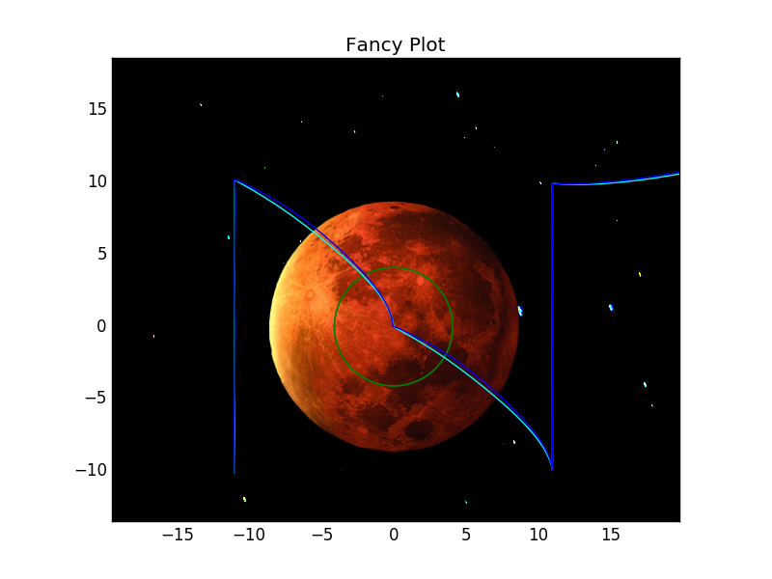
Have you Scanned your Planet Today?
Cyan line shows a distributed all-Basilisk simulation
Blue line shows that same simulation running distributed with CFS
Now we have easy reconfigurability
  Python is our main development testbed
Complex vehicle behaviors can be assembled from successive bricks
All internal code can be examined and analyzed by you

Slide 10
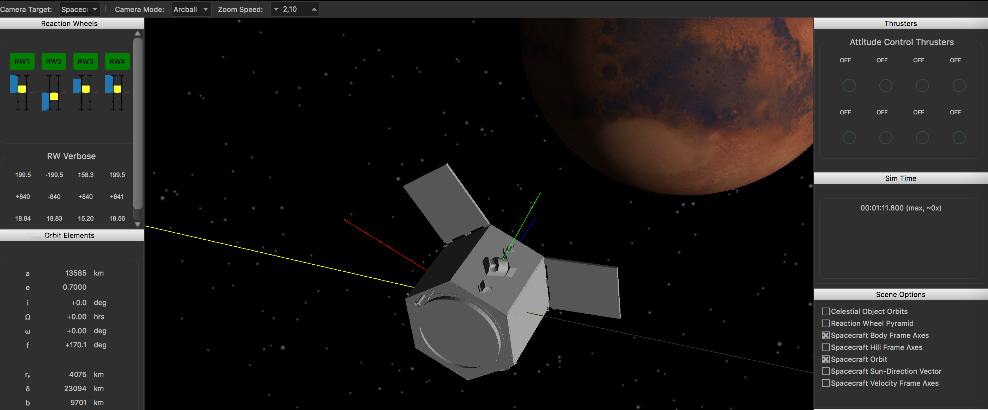
Basilisk Development Direction
Initial Alpha open-source release available January 15th
  Invitations readily available!
Anticipate a full open-source beta release sometime in 2017
Simulation model verification (unit-level) complete
Majority of software will be undergoing CDR review in 2017
Simulation will serve as flatsat driver for flight program
  Integration starting 2017
Algorithms should be on-orbit by late 2020

Slide 11
Conclusions
Basilisk is a free and open-source simulation and algorithm-development testbed
Entire package is designed from the ground up for the full spacecraft lifecycle on programs of arbitrary complexity
The entire Basilisk system can be run on most PC operating systems with the addition of some free and open-source products
  Tested daily on Windows, OSX, and Linux (Mint)
  Python, Cmake, SWIG, and your favorite compiler
The topics covered today are not even the coolest parts of the system!
  Full fidelity vehicle dynamics, vehicle visualization, etc.

Slide 12
Questions?

