Slide 1
Enhancement of ARINC 653 for Multi-core Hardware
Stephen Olsen VxWorks Product Line Manager
This presentation contains no export restricted information.

Slide 2
VxWorks
Safe & Secure RTOS Platform

Slide 3
Agenda
Industry Trends
What is ARINC 653?
Multicore issues
Overview of the VxWorks 653 Single and Multi-core Edition
Q&A

Slide 4
Main Aerospace & Defense Trends
Aerospace
Defense
More Functionality – smarter avionics, SWaP, more payload
Autonomous systems
Global procurement/partnerships
Safe and Secure
Pressure on development costs, schedule
Pressure on operational costs (personnel, training, spares)
More Functionality – more lethality/survivability, integrated battlefield, more arms and armor
Cyber warfare (more computer-based systems)
Coalitions/interoperation
Secure and Safe
Pressure on development cost, schedule
Pressure on operational costs (personnel, training, spares)

Slide 5
System Implications
More functions, “systems of systems,” more connectivity in less space, weight, and power (SWaP), reduced cabling
Hardware consolidation
(multiple applications on fewer processors)
Software “pressure”: larger volume of
Software comingled on fewer processors
New challenges to Safe and Secure

Slide 7
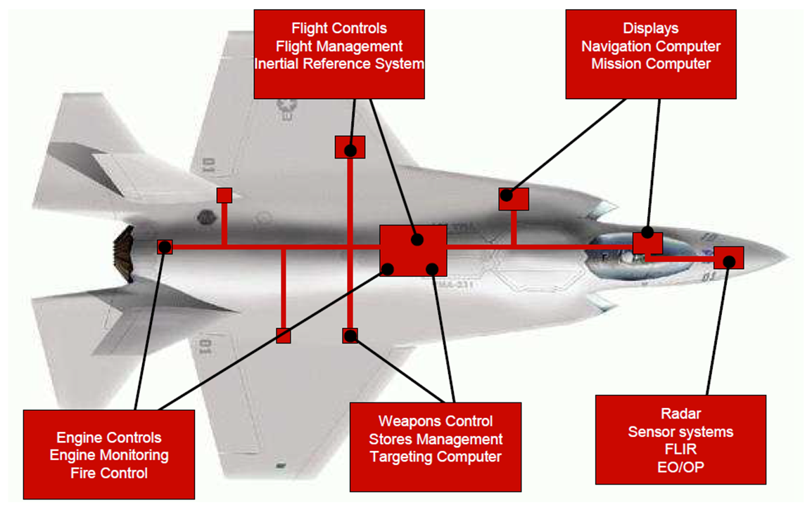

Slide 8
Federated versus IMA
Federated
IMA
PROs
Traditional methodology (Well Understood)
Relative “ease” of Design and certification
Supply chain geared for this
CONs
SWaP – Each function is separate LRU
Poor S/W Re-use
Poor portability
Poor modularity
Tier 1 at mercy of Primes ($$ for Tier 1)
PROs
SWaP (multiple functions on single LRU)
Excellent S/W re-use
Excellent portability
Excellent modularity
CONs
“Modern” methodology (777, A380, 787…)
Poorly understood
Complexity of design and certification
Supply chain not setup for IMA projects

Slide 9
aerospace
What is ARINC 653?

Slide 10
ARINC 653
ARINC 653
Avionics Application Standard Software interface
APEX (Application Executive) APIs
Space and Time partitioning
Safety of Real Time Operating System (RTOS)
Multiple applications with different safety requirements
Integrated Modular Avionics (IMA)
VxWorks 653 is specifically tuned to address the needs of ARINC 653
Notes:
Separate DO-297-based, role-based development for platform supplier, application suppliers, and system integrator
DAL: Design Assurance Levels

Slide 11
ARINC 653 APEX (APplication EXecutive)
The ARINC 653 specification defines a general purpose APEX (Application/Executive) interface between the OS and the application software
Partition management
Process management
Time management
Inter-partition communication
Intra-partition communication
Error Handling

Slide 12
VxWorks 653 Single/dual core
aerospace
7-themes.com

Slide 13
VxWorks 653 Single/Dual-core (up to 2.x)
Certifiable to RTCA DO-178C, Level A
Support certification of multiple design assurance levels(DAL) on multiple cores running concurrently
Fault isolation and containment: Health Monitors
The module operating system shall manage and enforce configuration of interconnect functions on the underlying architecture including IO, memory and caches
Static configuration and enforcement in accordance with ARINC 653
Role-based configuration per RTCA/DO-297

Slide 14
VxWorks 653 2.x IMA Architecture
Flight Control (FC)
Application
Level A
Radar
Application
Level B
Graphics
Generator
Application
Level C
Display
Application
Level D
Thread
Scheduling
Only
User
Mode
ARINC 653
Partition OS
POSIX
Partition OS
VxWorks Partition OS
Ada/Java
Partition OS
VxWorks 653
Application Executive
XML Configuration Data
Kernel
Mode
Partition
Scheduling
Only
Architecture Support
Package (ASP)
Board Support
Package (BSP)
Hardware
Notes:
IMA Integrated Modular Avionics

Slide 15
High-Performance, Two-Level Scheduling
Partition 1
Partition 2
T1
T1
T2
T2
T3
T3
T4
Partition OS
Partition OS
Partition 1 Time Slice
Partition 2 Time Slice
Execution
Idle
Execution
Idle
Time
Notes:
This slide shows the second level of scheduling in the two level scheduler.
This second level is application process scheduling which implements the ARINC 653 priority preemptive scheduling mechanism.
One item to note that with ARINC 653 scheduling, improperly designed application can result in wasted time within a partition minor frame time.
This is undesirable since this time could be used for other background type processing such as built in self test and other low priority processing.
This effect is common when initially migrating applications from a federated system into the IMA environment, and must be addressed in order to achieve the performance desired.

Slide 16
VxWorks 653 Multi-core Edition
aerospace

Slide 17
Multi-core System Issues
Contention makes it difficult to prove that timing constraints are met
Most SoC’s uses hardware that is shared between cores
Designs and effects of sharing are often unavailable
Sharing effects may change as SoC microcode is updated
Addressing these issues can involve additional cert effort
Performance and certification costs depend on matching the choice of strategies of the multicore hardware and the software application

Slide 18
Certification Authorities Software Team CAST-32A (Multi-Core Processors)
FAA-published guidance on usage of multi-core processors in aviation
Available free on FAA website
Topics Applicable to Multi-Core Processors (MCP) in Safety-Critical Applications
Sixteen objectives on MCP Determinism
Six objectives for MCP Software
Two objectives for MCP Error Handling
CAST paper addresses only 2 cores at this time, but is largely applicable to more than 2 cores
Wind River Verification Activities will support many objectives, but integrators will need to conduct additional activities to ensure compliance
Released November 2016
CAST-32A Appendix has mapping from CAST 32 to 32A

Slide 19
VxWorks 653 3 Multi-core Edition Requirements
Certifiable to RTCA DO-178C, Level A
Support certification of multiple design assurance levels(DAL) on multiple cores running concurrently
Fault isolation and containment: Health Monitors
The module operating system shall manage and enforce configuration of interconnect functions on the architecture
Static configuration and enforcement in accordance with ARINC 653
Role-based configuration per RTCA/DO-297
Notes:
Separate DO-297-based, role-based development for platform supplier, application suppliers, and system integrator
DAL: Design Assurance Levels

Slide 20
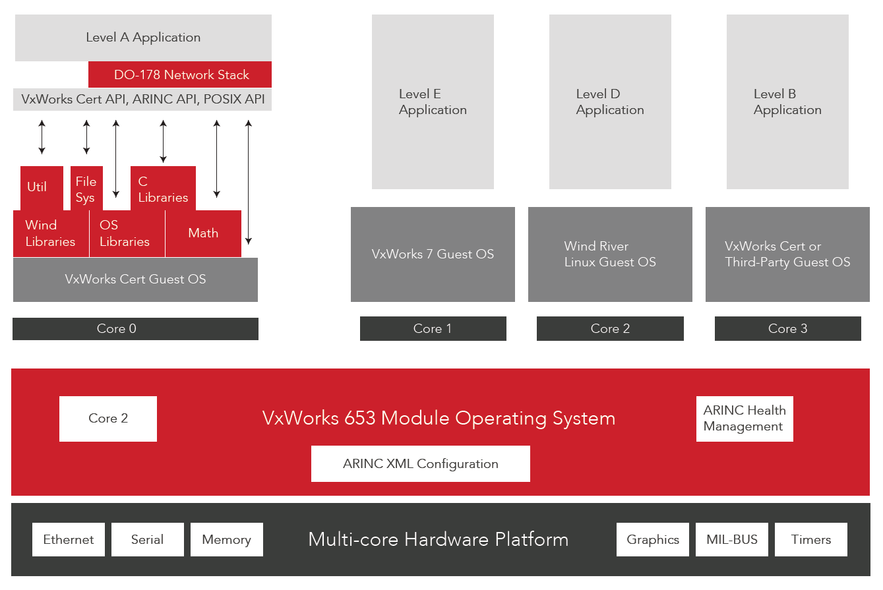
VxWorks 653 3.0 Multi-core Edition Safety Architecture
Available 2015
ARINC Ports

Slide 21
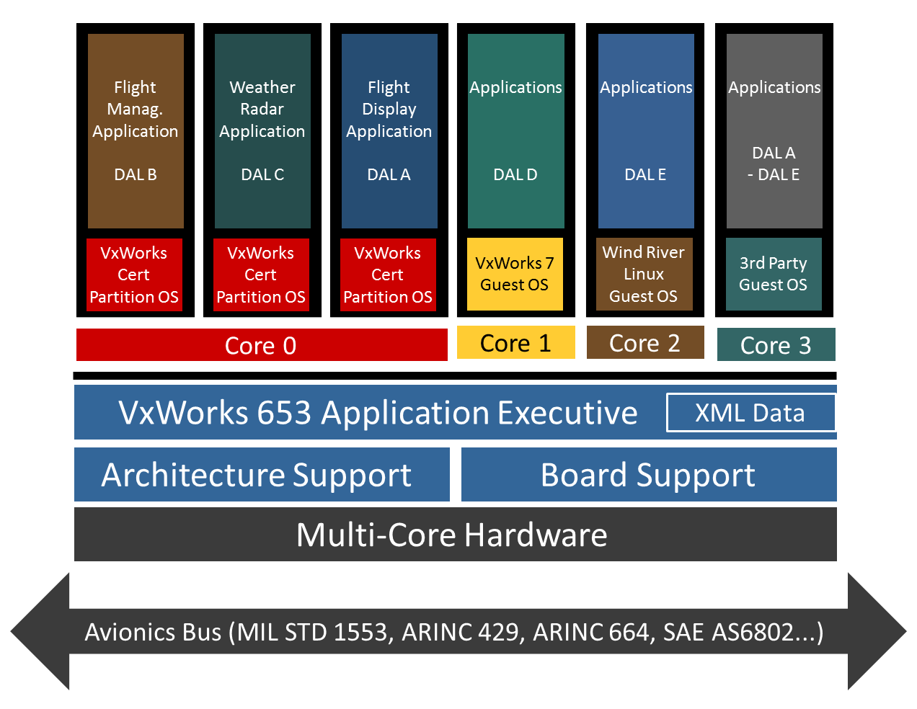
VxWorks 653 3.0 Multi-core Edition Time Scheduler
With the time partition scheduler, system integrators can schedule multiple guests in a specific time window to be scheduled on a core.

Slide 22
Roles of the MOS and POS in 3.0 Multi-core Edition
Partition OS (POS)
VxWorks Cert 6.6.7
Native kernel
BSP has Virtualization component
Device drivers are distributed to each Partition OS
APEX library
Application IBLL
Module OS (MOS)
Uses only devices required to enforce partitioning
Manages access to common architecture specific resources
Provides services for communication, health monitoring and emulation
System Fault Handling
Configuration management
Virtual Machine
Application
APEX
VxWorks Cert API
BSP
VxWorks Cert kernel
Drivers
ASP
VM API
Emulation
Core
VM HW Platform
VM Interface
Emulation
VM Interface
Module OS
Module OS Services
MOS Kernel
BSP
CV
Configuration Data
653 Platform Software
VM HW access interfaces
Notes:
Is there an equivalent to the MOS? Where do I put my kernel code?
How/where do I register device drivers? In 2.x, I add them to the MOS.
IBLL independent build link and load
APEX: Application Executive

Slide 23
VxWorks 653 MCE Use Case - Migration
Step 1
Re-host existing uni-core platform using a single core of a multicore
Minimizes risk but allows for characterization in the new environment to establish a baseline of performance and resolve any issues using existing techniques and understanding
Criteria for success easily established and bounded
Step 2
Redeploy platform by moving partition(s) to other core(s)
Re-distribute IO to allow for dedicated resources per partition
Perform characterization of new configuration against Step 1

Slide 24
Flight Mission Application
DAL B
Flight Display Application
DAL A
Weather Radar Application
DAL C
Step 1
Rehost
VxWorks Cert
Partition OS
VxWorks Cert
Partition OS
VxWorks Cert
Partition OS
Core 0
Core 1
Core 2
Core 3
VxWorks 653 Application Executive
XML Data
Architecture Support
Board Support
Multi-Core Hardware
Avionics Bus (MIL STD 1553, ARINC 429, ARINC 664, SAE AS6802...)

Slide 25
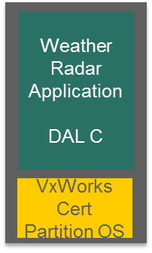
Flight Mission Application
DAL B
Flight Display Application
DAL A
Step 2
Redeploy
VxWorks Cert
Partition OS
VxWorks Cert
Partition OS
Core 0
Core 1
Core 2
Core 3
VxWorks 653 Application Executive
XML Data
Architecture Support
Board Support
Multi-Core Hardware
Avionics Bus (MIL STD 1553, ARINC 429, ARINC 664, SAE AS6802...)

Slide 26
Flight Critical Application
DAL A
Applications
DAL E
Application
DAL A
Federated Application and OS example with new content added
VxWorks Cert
Partition OS
Wind River Linux
Guest OS
3rd Party
Guest OS
Core 0
Core 1
Core 2
Core 3
VxWorks 653 Application Executive
XML Data
Architecture Support
Board Support
Multi-Core Hardware
Avionics Bus (MIL STD 1553, ARINC 429, ARINC 664, SAE AS6802...)

Slide 27
Flight Critical Application
DAL A
IMA platform with applications and OS example with new content added
Applications
DAL D
Applications
DAL E
Applications
DAL A – DAL E
VxWorks Cert
Partition OS
VxWorks 7
Guest OS
Wind River Linux
Guest OS
3rd Party
Guest OS
Core 0
Core 1
Core 2
Core 3
VxWorks 653 Application Executive
XML Data
Architecture Support
Board Support
Multi-Core Hardware
Avionics Bus (MIL STD 1553, ARINC 429, ARINC 664, SAE AS6802...)

Slide 28
Flight Mission Application
DAL B
Flight Display Application
DAL A
Weather Radar Application
DAL C
IO Server
DAL A
Applications
DAL E
Applications
DAL A
- DAL E
Redeploy
VxWorks Cert
Partition OS
VxWorks Cert
Partition OS
VxWorks Cert
Partition OS
VxWorks Cert
Partition OS
Linux
Guest OS
3rd Party
Guest OS
Core 0
Core 1
Core 2
Core 3
VxWorks 653 Application Executive
XML Data
Architecture Support
Board Support
Multi-Core Hardware
Avionics Bus (MIL STD 1553, ARINC 429, ARINC 664, SAE AS6802...)

Slide 29
DO-297 Role Separation
Application Suppliers
Display
Platform Supplier
System Integrator
XML Tables
FMS
XML Tables
XML Config File
XML Tables
XML Tables
Nav
XML Config File
XML Tables
XML Config File
XML Config File
XML Config File
XML Compiler/Checker DO-178B Qualified Development Tool
XML Business Rules
Binary Configuration Data
Multi-Core Hardware Platform
Notes:
29
29
DO –297, Integrated Modular Avionics (IMA) Development Guidance and Certification Considerations by the RTCA SC-200 described a number of stakeholders in the IMA design characteristics. Wind River has used this guidance and role definition to create a cohesive set of tools and processes to allow full realization of the DO-297 potential in any size project Through the extensive use of XML as described in ARINC 653 we allow separation of these roles to support dispersed development which has provided the ability to support such global programs such as the Boeing 787 Dreamliner.
By use of the DO-178B Qualified XML compiler/checker, the Wind River solution avoids costly and time consuming traceability steps that are required by other RTOS vendors without qualified development tools.

Slide 30
Conclusion
Important industry trends are leading to integrated systems.
ARINC 653 addresses these needs both for single and multi-core.
VxWorks 653 addresses ARINC 653
Remember: Safety and Security paramount

Slide 31
VxWorks MILS
aerospace

