Slide 1




Flight Software Workshop
John Warther – V.P. of Govt. Programs
Jeffrey Hall – Strategic Account Manager

Slide 2
FSW Guidelines
Technical Topics
  Flight software engineering and testing
  Autonomy
  Model based software development
  Navigation, fault management, and command sequence control
  On-board communication
  Space network protocols
  On-board data processing
  Software modeling, simulation and testbeds
  Spacecraft software architectures
  Multicore Challenges
  Agile software development
  Flight processors and operating systems
  Planning, tasking and execution
  Systems engineering
  Software Verification and Validation
  Testing Technologies
Business
  Core Competencies
  Past Performance
  Differentiators
  Company Data and Financials

Slide 3
Why should you listen to us?

Slide 4
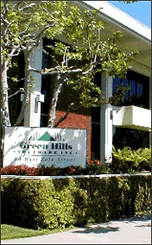
Green Hills Software – The Embedded Software Experts
Largest Independent Embedded Software Provider
  Worldwide support, headquartered in Santa Barbara, CA
  35 years in the embedded industry
  CMMI Level 3 certified development teams
  Diverse customer base including flight and space systems – satellites, spacecraft, aviation, and defense.
Successful, Proven and Stable Business
  Profitable every year since 1983
  Privately held and 100% self-funded
  Products are developed in the USA by US Citizens
Green Hills Software specializes in
supporting development and deployment of critical embedded applications
Notes:
Green Hills Software, Inc. is the technology leader in real-time operating systems and device software optimization for 32 and 64 bit embedded systems.
Since it’s founding in 1982 Green Hills has been the most successful embedded software company. All development is done in the US with core engineering taking place in California and Florida.
During our 27 year history as an embedded software vendor, there have been at least one hundred other embedded software vendors. Ten of them have gone public. None of them has ever paid a dime in dividends to their investors. None of them has earned enough money in its entire history to be able to repay the amount investors sunk into it.
In contrast, Green Hills Software has earned over $70,000,000 in net profits according to audited financial statements prepared in accordance with generally accepted accounting principles (not proforma earnings). We have been profitable in everyone of the last 26 years. Our profits have been so consistently high that we have been able to finance an average growth rate of 30% per year for 21years, without any additional capital beyond the $83,000 that was invested to start Green Hills Software in 1982. We are the second largest company in this industry and we have the fastest market share growth. Green Hills Software is also the most profitable RTOS company. We have made far more money than all other embedded software vendors combined!

Slide 5
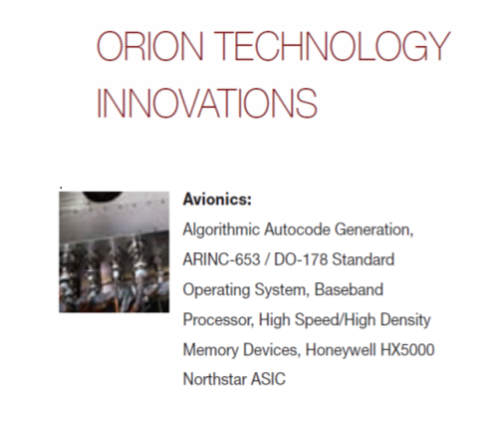
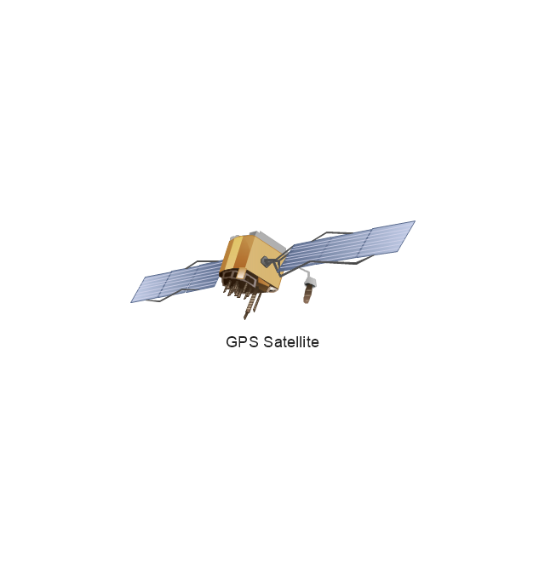
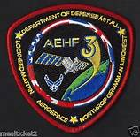

Past Performance - Green Hills Design in Space
  CEV – Orion Crew Exploration Vehicle
  GPS -III
  OCX
  AEHF
  FAB-T
  OMEGA-3
  Project Europa

Slide 6
Space Launch Systems and Crew Exploration Vehicle
Notes:
Our customers also build rockets and launch control systems. NASA is using INTEGRITY and our tools in their latest Crew Exploration Vehicle.

Slide 7
Spacecraft and aircraft
Notes:
Our customers also build rockets and launch control systems. NASA is using INTEGRITY and our tools in their latest Crew Exploration Vehicle.

Slide 8
What does flight software need?

Slide 9
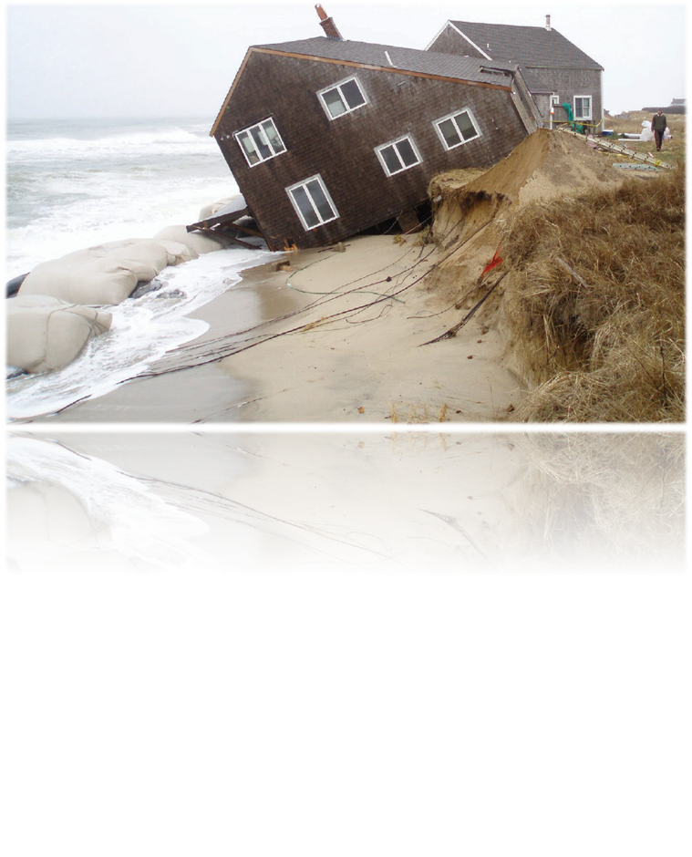
A secure and reliable foundation
“The threats posed by the modern computing environment cannot be addressed without support from secure operating systems. Any security effort which ignores this fact can only result in a fortress built upon sand.”
- National Security Agency, September 2005
Notes:
So… What are those multicore challenges?
To start with, the application may need to be refactored to run on the new architecture.
Multicore can also introduce indeterministic behaviors that didn’t exist in the separate processor system.
For instance, your application may have depended on task priority as a method of mutual exclusion where SMP could allow two tasks to run at the same time in a true concurrency.
Performance can be an issue as in the case of cache locality where the scheduling of a task on a different core causes cache misses.
Then there is debugging multiple cores and having system wide visibility. All tools must not only be multi-core aware, but they must also be able to handle thousands of cores in the extreme cases.
Finally, the application must take into account the complexities of shared resources including caches, local bus, main memory, I/O devices and secondary busses.

Slide 10
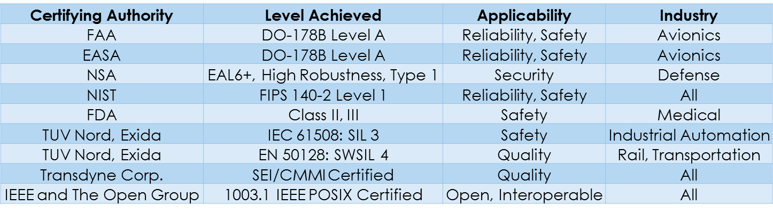
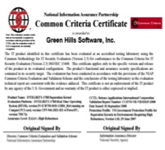
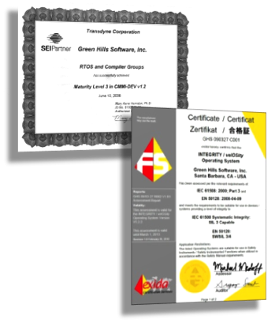
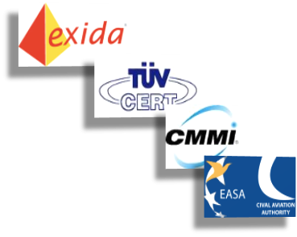

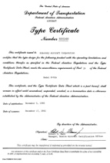

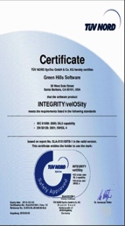


Proof of security and reliability
Your RTOS needs a variety of certifications across a range of industries to provide real assurance

Slide 11
Running flight software on multicore processors

Slide 12
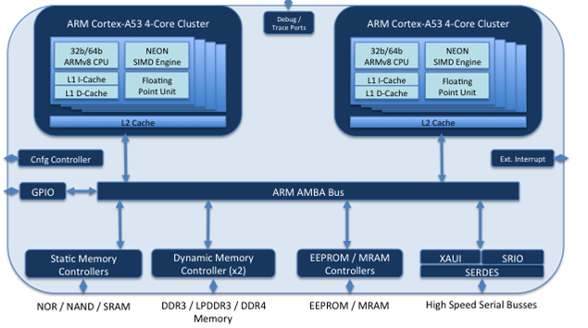
The future in flight is multicore
BAE Systems “Power” architecture
US Govt. Micro HPSC ARM architecture

Slide 13
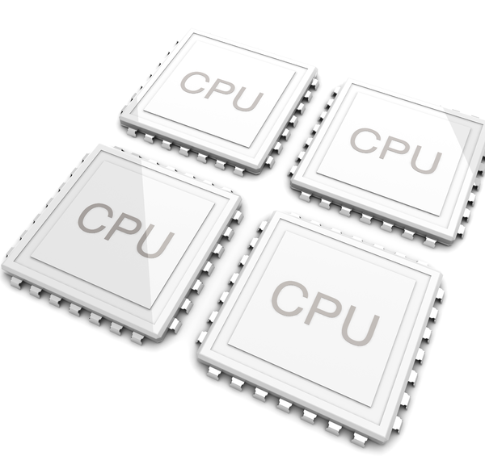
Multicore adds complexity
Developing software to run on multicore processors is a hard problem
  Code refactoring
  Determinism
Addressing True Concurrency
  Avoiding priority based mutual exclusion
  Protecting critical sections
Performance
  Tasks migrate from core to core
  Cache locality
Debugging and system visibility
  All tools must be multicore aware
  Stopping one core can cause the system to fail

Slide 14
Partitioning
Low Assurance
Not Mission Critical
High Assurance / Mission Critical
Science experiment #1
Science experiment #2
Navigation system
Engine control
Coms subsystem
POSIX Library
ARINC 653 Part 1 Required Services
Ada/C Language Support
Virtualized Linux
Socket Server
Virtualized Linux
File system
File system
Virtualization Hardware & Support
INTEGRITY Separation Kernel
Processor
Memory
Peripheral Hardware

Slide 15
System consolidation
Applications
Applications
Applications
Applications
AMP OS
AMP OS
AMP OS
AMP OS
Core
+ resources
Core
+ resources
Core 1
+ local resources
Core 2
+ local resources
system resources
system resources
shared system resources
Multiprocessing System
  Legacy system consists of multiple cards
  Hardware update required for obsolescence or SWaP
  Desire to run multiple systems independently
Multi-Core System
  Two or more independent CPU cores within a single integrated circuit

Slide 16
Heterogeneous Multiprocessing (HMP)
Separate, independent monolith images
Cores locked to specific subsystems
Each subsystem is one of traditional models (AMP/SMP)
No OS-enabled communication between subsystems
AMP AS
AMP AS
SMP AS
SMP AS
SMP AS
SMP AS
AMP OS
AMP OS
SMP OS
SMP OS
Core 1
Core 2
Core 3
Core 4
Core 5
Core 6
Core 7
Core 8
shared system resources

Slide 17
Unified Multiprocessing (UMP)
Single OS Load Image
Cores locked to subsystems
OS resource sharing
Blocking terms only exist when system architect “shares”
AMP AS
AMP AS
SMP AS
SMP AS
SMP AS
SMP AS
UMP OS
Core 1
Core 2
Core 3
Core 4
Core 5
Core 6
Core 7
Core 8
shared system resources

Slide 18
Space-specific requirements

Slide 19
Additional requirements for space systems
Constant radiation bombardment results in system degradation
Sectors of flash and RAM can become non-functional during the mission
  Space capable system must be able to work around bad blocks of RAM at boot/reboot
  This requires full virtual memory
Updating satellite/spacecraft during mission
  System can be launched with excess time/space capabilities
  New subsystems to be loaded/unloaded with an ARINC-653 partition scheduler

Slide 20
Using partitioning in flight systems
Empty at launch
Flight subsystem
Navigation system
Engine control
Science experiment #2
ARINC 653 Part 1 Required Services
Ada/C Language Support
POSIX Library
File system
File system
Virtualized Linux
Virtualization Hardware & Support
INTEGRITY Separation Kernel
Processor
Memory
Peripheral Hardware

Slide 21
Flight software development tools

Slide 22
There is no reset button in space
How can you develop totally reliable software?
  Leverage existing reliability standards, like MISRA
  Develop with an eye towards testability
    For example – partitioning allows you to ensure system haves the same before and after integration
  Use new debugging modalities (trace, for example)
Use simulation when possible
The importance of visualization tools can’t be overstated
Investment in the correct development tools environment is paramount to success

Slide 23
Develop a plan for the hardest bugs
Stack overflows
Race conditions
Buffer overflows
Memory leaks
Uninitialized variables
Memory corruption
Non-reproducible errors: “Heisenbugs”
How do you solve these today?
Is your process repeatable?
Notes:
And how do we do this? Well, we took a hard look at what causes undpredictability in software projects.
The answer is that for the hardest bugs, software engineers have no idea how to predict how long it will take them to fix these problems.
In fact, finding many of these things is a bit of a black art. It takes guesses, intuition, and often luck to get to the bottom of these problems.
These are the bugs that kill you, that cause schedule slips, reliability problems, and in some cases, they never get fixed. (brief pause)
When critical projects encounter these types of issues, we expect that all of you know how painful these things are. I’m sure many of you have spent nights and weekends instrumenting code and looking for bread crumbs so that you could get some kind of clue or at least form a theory of how the system could possibly be failing in that way.
I’d bet that everyone here has experienced stack overflows. We all know how painful they are to track down and fix. An error in one part of the program, causes a failure in another unrelated part of the program. They are typically very sporadic and intermittent and may not even show up in your regular testing.
Today, we will show you how to turn this art into an exact science – that is repeatable and that anyone can be taught how to do it.
All of these types of bugs become easy. You will usually fix them in minutes.
And soon you will be saying what Nikola says… “The moment I see a bug, I know I can fix it”

Slide 24
Multicore requires vastly more testing/validation
Example: INTEGRITY-178 kernel
  Lines of code
    Single-core – 15,000
    Multi-core – 19,000
  Lines of code to test
    Single-core – 460,000
    Multi-core – 4,600,000

Slide 25
Conclusion
Moving to multicore system introduces significant complexity
A reliable and secure OS is the bedrock of a reliable and secure system
Multiple third-party certifications are the only way to know if an OS is safe and secure
Operating systems can be run in a variety of ways on multicore hardware
Commercial quality tools are essential for developing and debugging multicore hardware

