Slide 1
cFS Workshop Introduction
core Flight System Workshop
Caltech
December 12, 2016
David McComas – NASA Goddard Space Flight Center

Slide 2
Introduction
Thanks to our hosts and sponsors
Jet Propulsion Laboratory, Aerospace Corporation, Johns Hopkins University Applied Physics Laboratory
Full day with no scheduled breaks except lunch
Lunch options
Workshop Session Chairs
Susie Strege, CCB Chair & Goddard cFS Lead
Jonathan Wilmot, Chief Architect
Alan Cudmore, Platform Abstraction

Slide 3
cFS Historical Context
< 2007: Birth of core Flight Executive (cFE)
GSFC assessment of FSW reuse to date, heritage analysis, architectural trades
Project independent funding kick started the effort
Operating System Abstraction Layer (OSAL) released as open source
2007: cFE goes to the Moon
Lunar Reconnaissance Orbiter (LRO) launched using OSAL & cFE
2008 – 2014: Birth of core Flight System (cFS)
Developed 12 cFS applications
Leveraged project funding
JSC certified Class A pedigree of cFS targeted to the ARINC-653

Slide 4
Historical Context (cont.)
2014: Birth of a Community
12 cFS applications released as open source
cFS Workshop (12/15 at GRC) established a NASA-wide repository managed by an inter-center Configuration Control Board (CCB)
2015: Community Youth
12 Goddard applications released as open source
CCB successfully released cFE 6.4.2
cFE Application Programmer Interface (API) is unchanged since LRO
First cFS Workshop
2016: Community Adolescence
CCB successfully released multiple components
Second cFS Workshop
Trying to find our identity

Slide 5
What is the cFS? Lifecycle Artifact Reuse
Project
Requirements
FSW Subsystem
Requirements
System Test
(Tester)
CFS
Repository
<p>
Detailed
Requirements
Build Test
(Tester)
<p>
CFS
Repository
<p>
<p>
Integration Test
(Developer)
<p>
Code
Unit
(Developer)

Slide 6
What is the cFS? Layered Architecture
cFE Apps (5)
cFE App 1
cFE App 1
cFE App 1
Open Source
Apps
cFE App 1
Mission
Apps
Application
Layer
Application Library
Mission
Library
cFE API
Executive Services
Layer
cFE Core
OS Abstraction API
Platform Support Package API
Platform Abstraction Layer
OS Abstractions
(Linux, RTEMS, VxWorks)
cFE Platform Support Packages
Open Source
Mission Specific

Slide 7
Workshop Goals
Gain an understanding of the current state of the community organization, products, and technologies
Gain an initial understanding of where we want to go
Get feedback from participants and users to understand their perspectives, needs, and goals
Challenge ourselves
Organize initial strategic paths for how to achieve our goals
Connect people with ideas
Have fun!

Slide 8
Workshop Strategy
Agenda contains Programmatic & Technical sessions
Sessions organized to achieve workshop goals
Where are we now?
Where do we want to be?
How can we get there?
Open dialogue and introspection
What’s working & what’s not working
What technologies are important

Slide 9
2015 Workshop Goal Evaluation
2015 Agenda
~2.5 hours of Community Organization, Product Management, and Technology Highlights
12 User Presentations
2015 Goals
Discuss current informal community charter/organization and create a roadmap for establishing a formal charter
Get feedback from user community to understand their perspectives, needs, and goals
Describe current product management, identify needs, and create a plan forward
Describe current communication mechanisms, shortcomings, and create a plan forward
Provide a path for how to engage and grow the community
Introduce virtual teams
Reduce risk of fragmentation!!

Slide 10
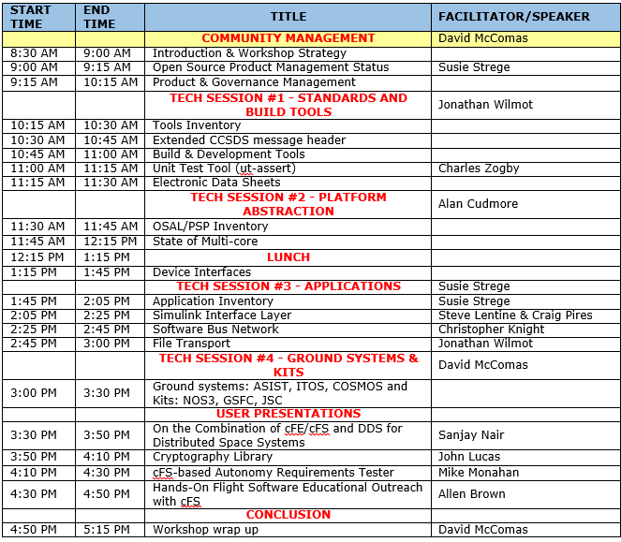
Workshop Agenda

Slide 11
Technological Session Strategy
Inventory
Communicate existing assets
Identify duplicate efforts
Identify missing needs
Highlight Key Technologies
Current maturity level and challenges
User presentations
Discuss potential strategic roadmap
Prioritization of efforts
Collaboration opportunities and future working groups
Discuss community organization & product management support needs

Slide 12
Example Technical Strategic Activity Relationships
Technology Focus: Kits
Ground-cFS
Ground-cFS-Simulator
Goals
Mission cFS Regression Test
Platform Certification
Device Certification
File Transport
Electronic
Datasheets
Device Plug-in Model
Related
Technologies
Direct dependency that drives
next activity
Indirect dependency. Receiving activity
can still occur without it.

Slide 13
Programmatic Session Strategy
Similar approach to technical sessions except along different parameters
Inventory where we are programmatically
What do users find difficult? Frustrating? Easy?
What is the scope of the assets controlled by NASA?
What is the scope and level of user contributions?
Is the business model sustainable?
Assess where we want to go
Answer the questions raised above
What products are controlled by whom
How do different user’s engage, collaborate, and participate
Present and discuss a draft organization and product management ideas in context of where we are and where we want t go
This workshop is not going to solve these problems but lay the groundwork for a working group that is tasked with creating a product management plan

Slide 14
cFS Public Website
Hosted by the University of Florida’s Center for High-Performance Reconfigurable Computing (CHREC, http://coreflightsystem.org)
Evolutionary approach
Discussion forums and document repositories
Support for member sponsored products and collaborative projects
Initial website launched 12/8/16 that provides
Q&A – Post specific questions and community answers
Forum – Users discuss and debate topics that interest them
Blogs – Newsworthy posts and exploration of focused topics.
Knowledge Base – Reference material in the form of articles and publications

Slide 15
Beginning With The End In Mind
Steve and I will organize the programmatic/technical information to help facilitate our final session of the workshop
Organize strategic themes and priorities
Look for collaborative opportunities
Website
How do we want to use the website?
What infrastructure will support our goals?
SmallSats and CubeSats are generating a lot of momentum for the cFS
Questions, suggestions, etc.

